Slide 1
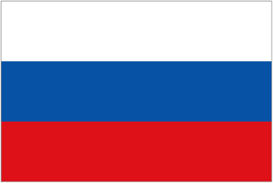
Let’s Learn About Russia
www.flags.net/RUSS.htm

Slide 2
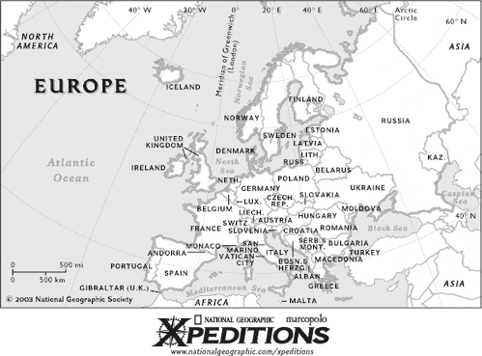
Where is Russia?

Slide 3
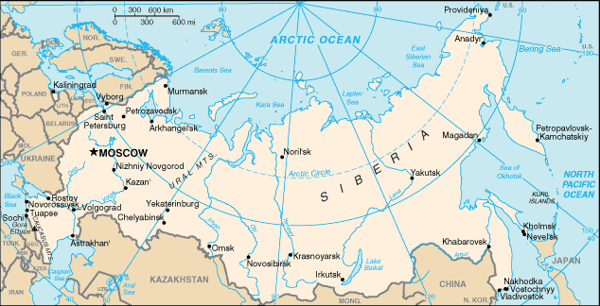
Map of Russia
www.flags.net/RUSS.htm

Slide 4
Facts About Russia
The capital of Russia is Moscow.
The population of Russia is 149,476,000.
The money used is the ruble.
The language spoken is Russian.

Slide 5
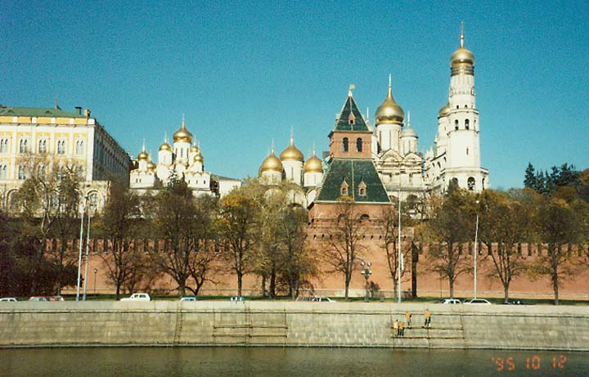
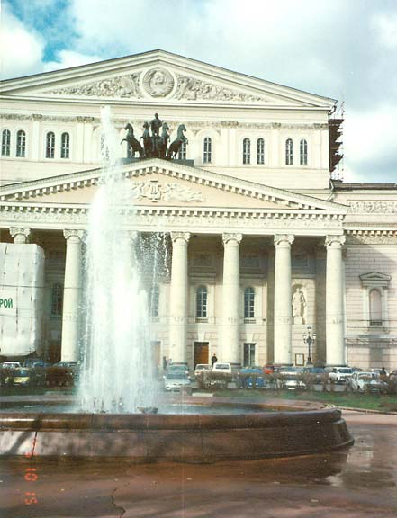
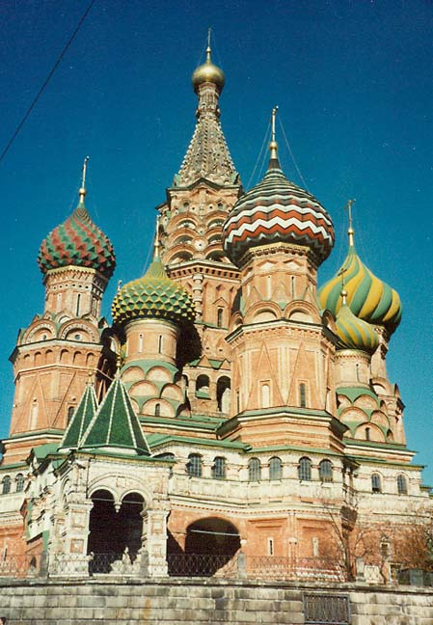
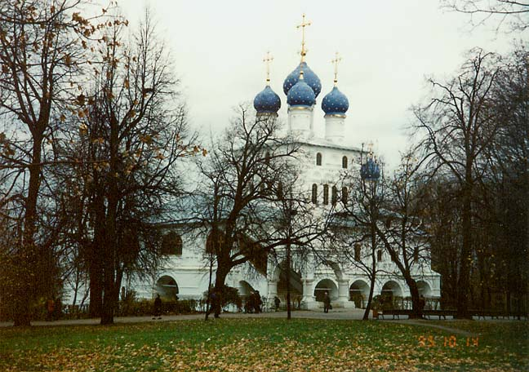
Let’s visit some important cities in Russia.
Moscow
www.galenfrysinger.com

Slide 6
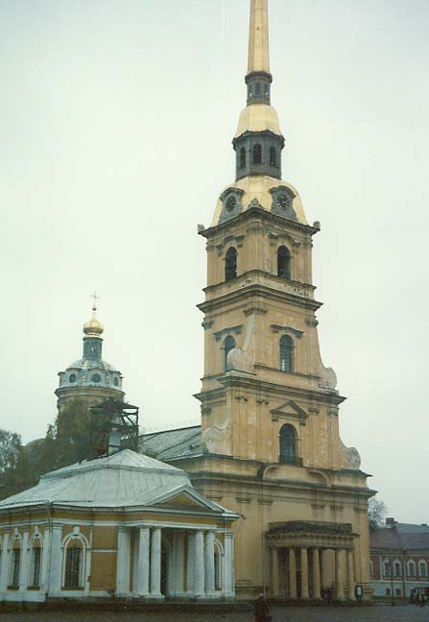
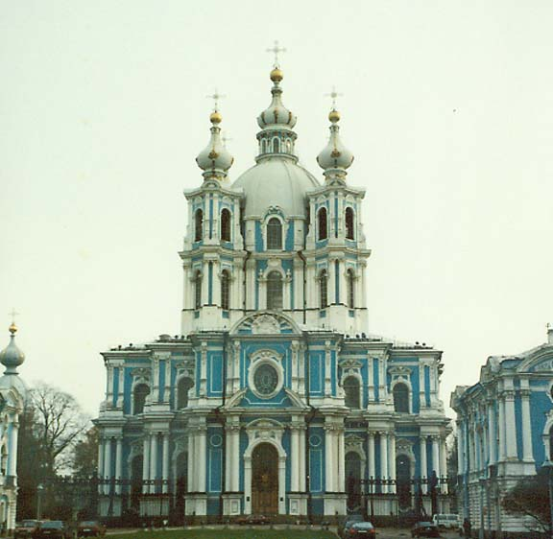
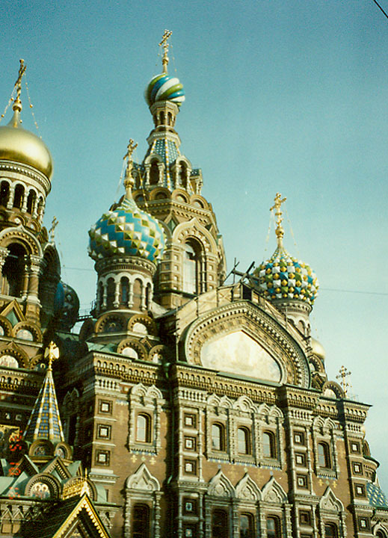
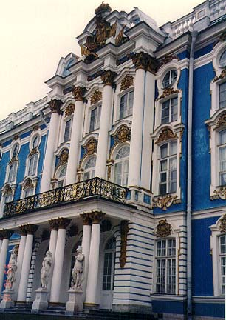
St. Petersburg
www.galenfrysinger.com

Slide 7
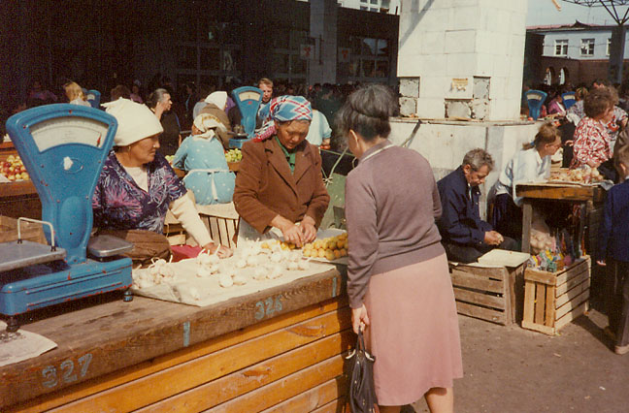
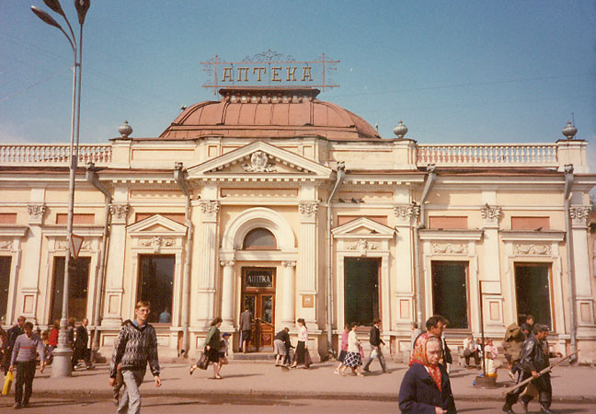
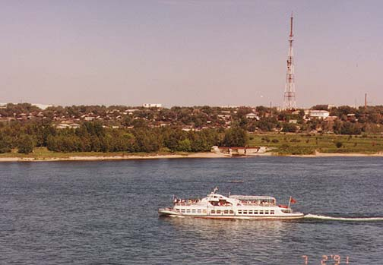
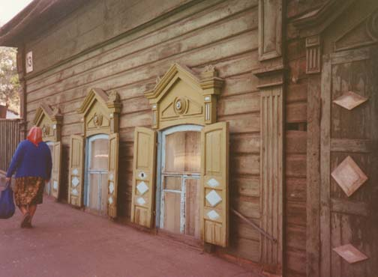
Irkutsk, in Siberia
www.galenfrysinger.com

Slide 8
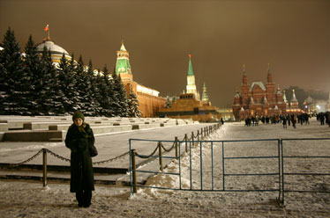
Famous Sights in Russia
The Hermitage Museum- (click on the name to see a virtual visit)
The Kremlin
The Peter and Paul Fortress (click on name to find out more.
www.russia.com/photos/

Slide 9
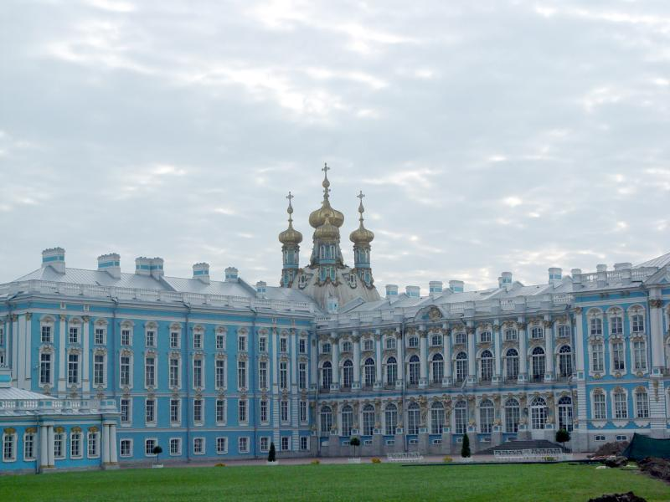
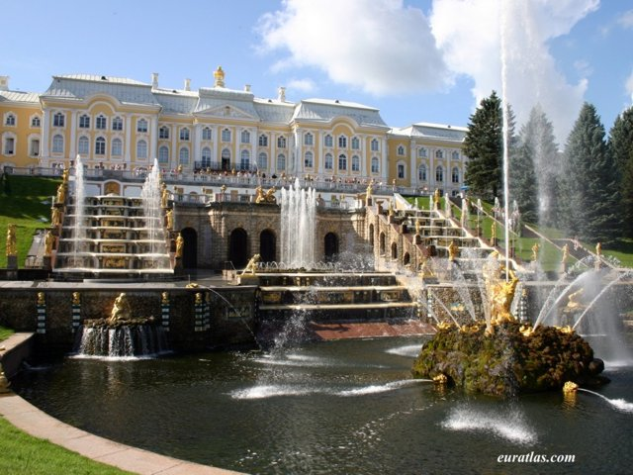
Famous Palaces
(click on the names to find out more)
Pushkin- Catherine’s Palace
Go to this website to see more photos - www.pbase.com/hiker_photograph/catherines_palac
Peterhof
Go to this website to see interactive panoramas of the entire palace- www.peterhof.org/english/pano/
www.pbase.com/hiker_photograph/image/48246979
www.euratlas.com/Atlas/ russia/peterhof_palace.jpg

Slide 10
Russia is famous for…
(Click on each name for more information.)
The Brown Bear
Russian Teacakes
Baba Yaga
Russian Nesting Dolls
Ballet
Ukrainian pysanky

Slide 11
What Russian Kids Do
Russian children love ice skating, sledding and playing ice hockey in the winter and swimming and boating in the summer.
Find out about schools in Russia at this website - www.kidsculturecenter.com/russia/russ_edu.htm
Find out about daily life in Russia at this site- http://library.thinkquest.org/CR0212302/russia.html

Slide 12
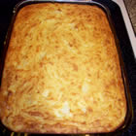
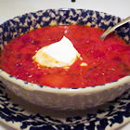
What Russians Like to Eat
http://allrecipes.com/Recipe/Kartoshnik-with-Cheese-and-Onions/Detail.aspx
http://allrecipes.com/Recipe/Borscht-I/Detail.aspx
Go to these websites for some Russian recipes:
www.world-recipes.info/russia-russian/
http://allrecipes.com/Search/Recipes.aspx?WithTerm=Russia

Slide 13
Some Famous Russians
Yuri Gagarin - first man in space
Mikhail Gorbachev - leader of the Soviet Union who made the country more free and democratic
Anna Pavlova - world-famous ballerina
Peter Tchaikovsky - a composer who wrote the music for The Nutcracker
Sergey Prokofiev - wrote the words and music for Peter and the Wolf

Slide 14
Learn More About Russia
Russia
www.kidskonnect.com/Russia/RussiaHome.html
Travel for Kids - Russia
www.travelforkids.com/Funtodo/Russia/russia.htm
Coloring Pages – Russia
http://edupics.com/coloring-pages-pictures-book-russia-237.htm
Kids Culture Center – Russia
http://www.kidsculturecenter.com/russia/russ_holiday.htm
Russia
http://www.oxfam.org.uk/coolplanet/kidsweb/wakeup/index.htm
Russia
http://library.thinkquest.org/TQ0312267/russia.htm
Russia
http://www.uen.org/utahlink/tours/tourFames.cgi?tour_id=8050

Slide 15
More Good Websites
Time for Kids – Russia
www.timeforkids.com/TFK/hh/goplaces/main/0,20344,595847,00.html
Kids from Russia
http://www.factmonster.com/ipka/A0930073.html
Peace Corps Kids World – Russia
www.peacecorps.gov/kids/world/europemed/russia.html

Slide 16
Books to Read
Discovering Cultures- Russia. Sarah DeCapua. Marshall Cavendish Corporation. 2004.
A Ticket to Russia. Tom Streissguth. Carolrhoda Books, Inc. 1997. Excellent for 3-5.
Russia: A Portrait of the Country Through Its Festivals and Traditions. Grolier. 1999.
Celebrating Birthdays in Russia. Cheryl L. Enderlein. Capstone Press. 1998.
Russia ABCs. Ann Berge. Picture Window Books. 2004.

