Slide 1
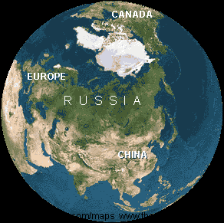
Russia and Central Asia

Slide 2
Statistics
Population: 140,041,247 (Jul. 09 est.)
Pop. Growth: -0.467% (2009 est.)
urban population: 73% of total (2008)
rate of urbanization: -0.5% annual rate of change (2005-10 es
Area total: 17,098,242 sq km
GDP - real growth rate:
  -8.5% (2009 est.)
  5.6% (2008 est.)
  8.1% (2007 est.)

Slide 3
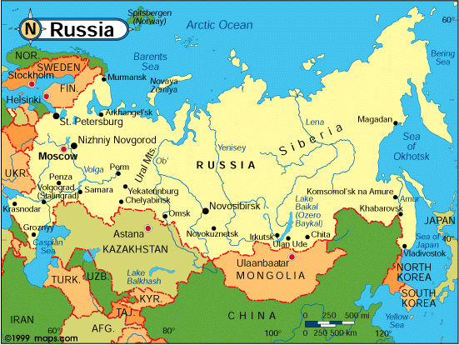

Slide 4
Leading countries
GDP-- Kazakhstan, Russia, Turkmenistan
Land Size--Russia, Kazakhstan, Turkmenistan
Population--Russia, Kazakhstan, Uzbekistan

Slide 5
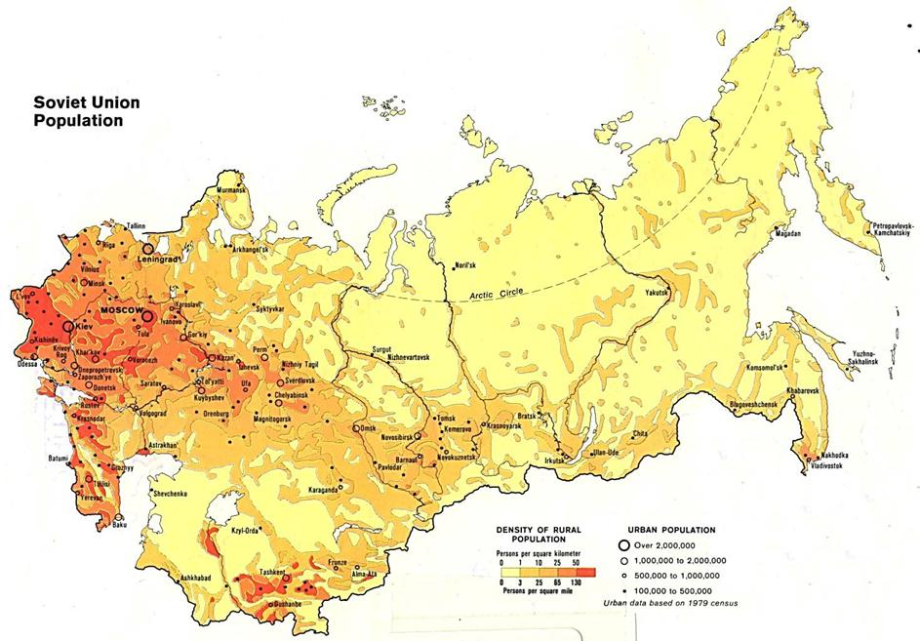

Slide 6
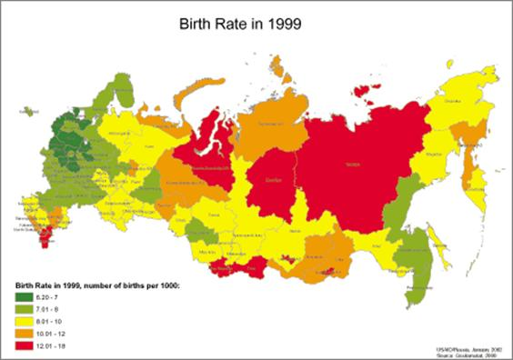

Slide 7
Physical Characteristics
Vast time zone--Spans two continents (Europe and Asia), covers 11 time zones
Vast area of tundra, taiga, permafrost, and steppe
varied climate regions
huge black earth belt (rich Chernozem soil)

Slide 8
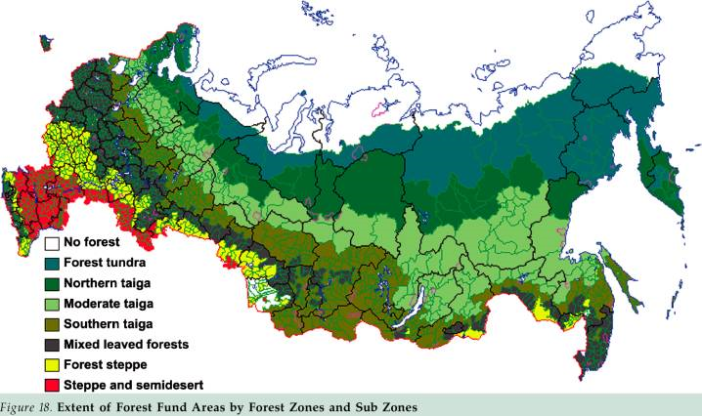
Natural Vegetation

Slide 9
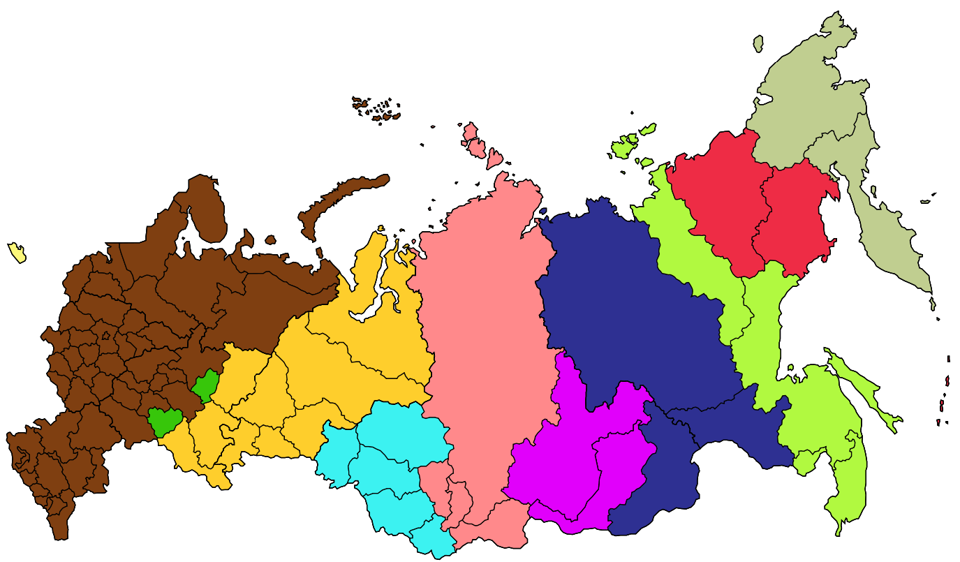
Difficulty of Size
Eleven Time Zones

Slide 10
Mountains
Caucasus
Ural Mountains (divide Europe from Asia)
Siberia (the sleeping land), located east of the Urals
Major oil, natural gas, and mineral resoures

Slide 11
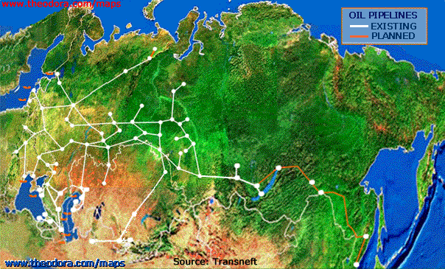
Rich in Oil

Slide 12
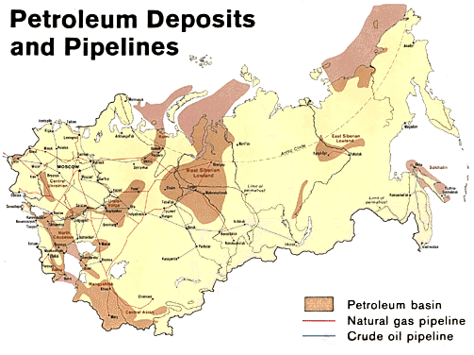

Slide 13
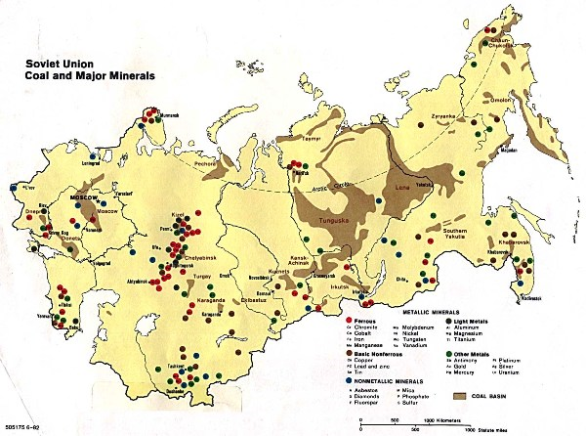

Slide 14
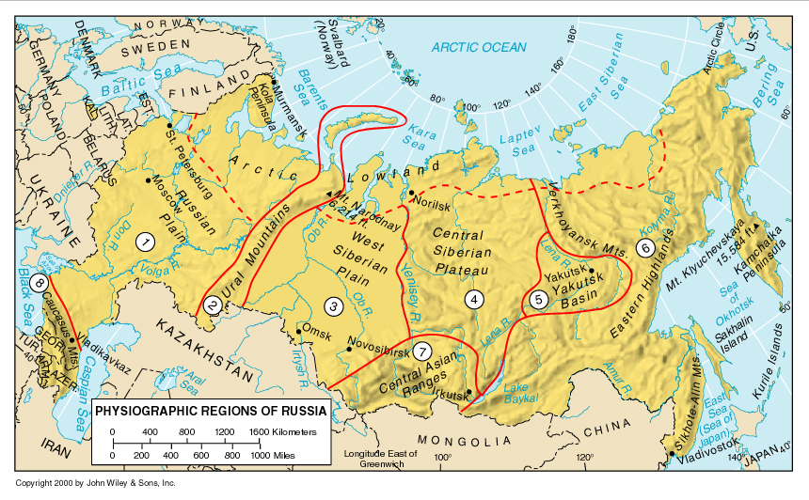

Slide 15
Many water features
  Volga River Ob River
  Amur River Lake Baikal
  Caspian Sea Aral Sea
  Bering Strait
  Pacific Ocean
  Arctic Ocean

Slide 16
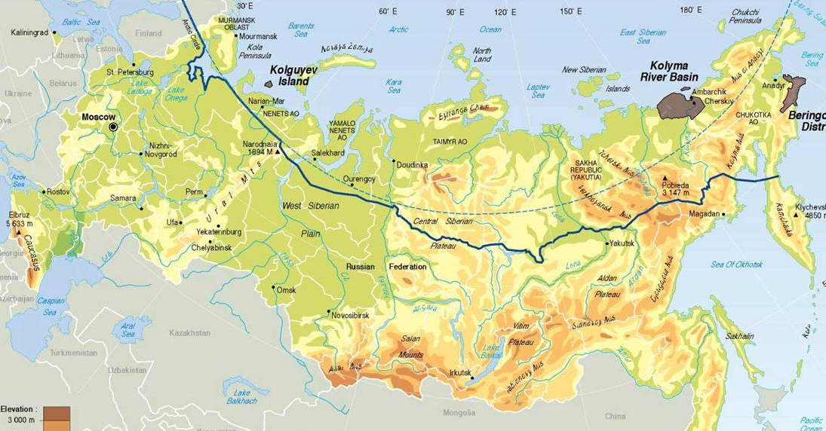
Physical Characteristic
Some rivers flow northward to the Arctic Ocean

Slide 17
Economic Characteristics
Transition from communist to free market economy hasn’t been easy
Farming and Industry concentrated in the Fertile Triangle region, home of rich Chernozem soils (wheat farming)

Slide 18
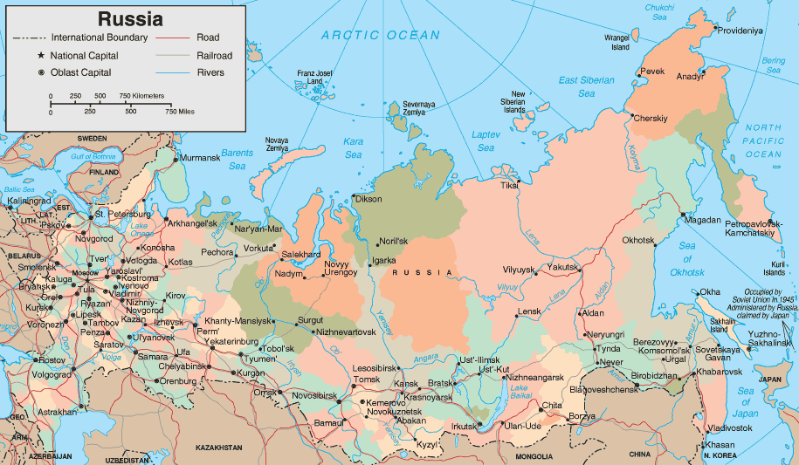
Fertile (developed) Triangle

Slide 19
Infrastructure--Trans Siberian Railroad plus systems of rivers, and canals and railroads
Energy resources--Hydroelectric power, oil and natural gas

Slide 20
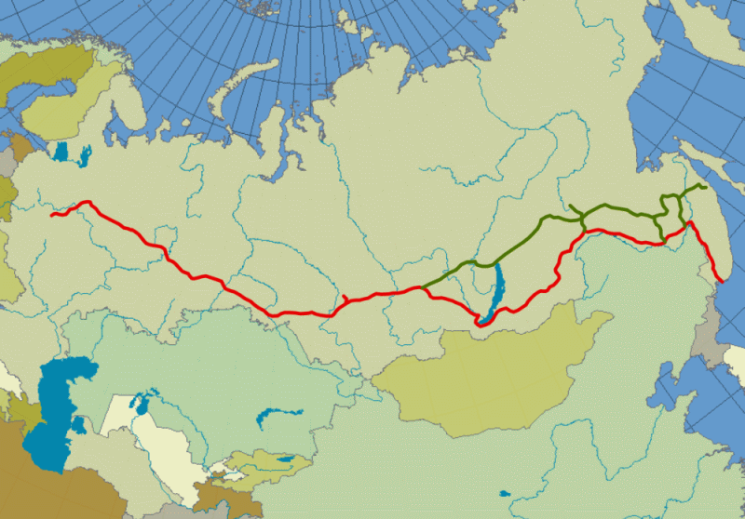
Trans-Siberian Railroad

Slide 21
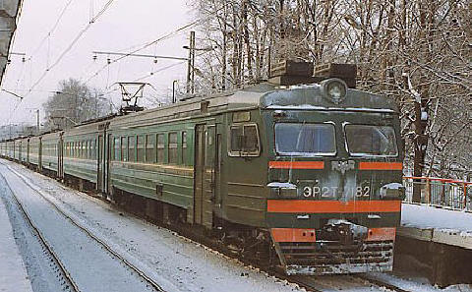
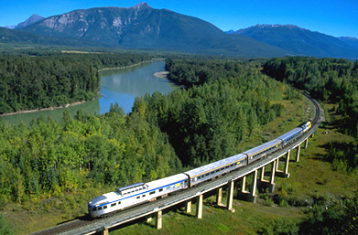

Slide 22
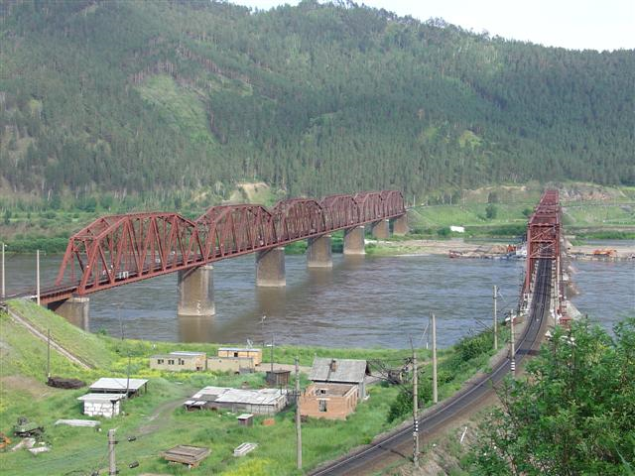

Slide 23
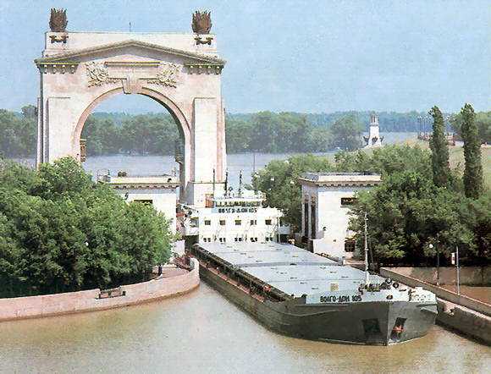
Volga-Don Canal

Slide 24
Economic characteristics cont.
Natural resources are not fully developed due to climate, limited transportation links, and vastness of the country
Foreign competition for investment in the region (oil pipeline)
widespread pollution

Slide 25
Shrinking of the Aral Sea due to the diverting of rivers feeding the sea (irrigation)
political and economic difficulties after the breakup of the Soviet Union
cotton production in Central Asia

Slide 26
Cultural Landscape
  -Russian Orthodox churches
  -St. Basil’s Church
  -Red Square
  -Kremlin
  -mosques, minarets
  -Siberian villages
  -Soviet style apartment blocks

Slide 27
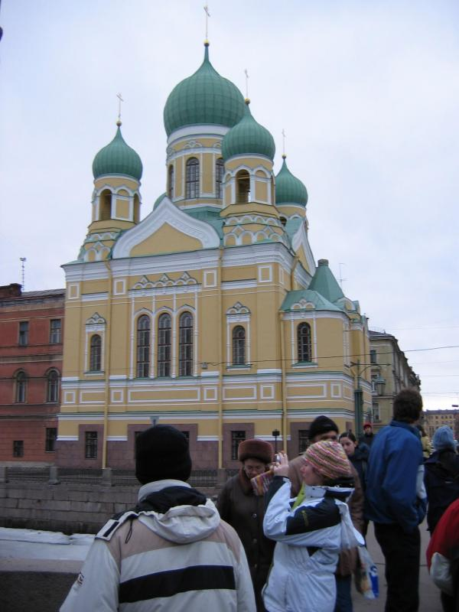
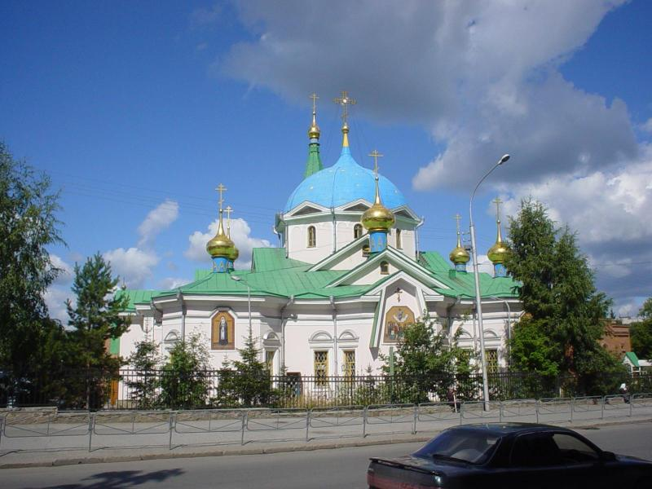
Russian Orthodox Churchs

Slide 28
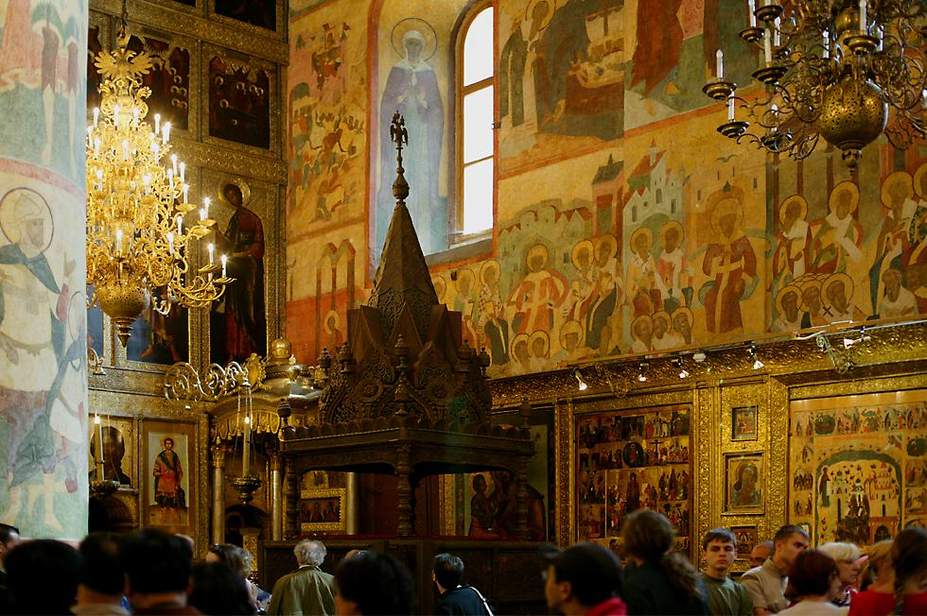
Church Interior

Slide 29
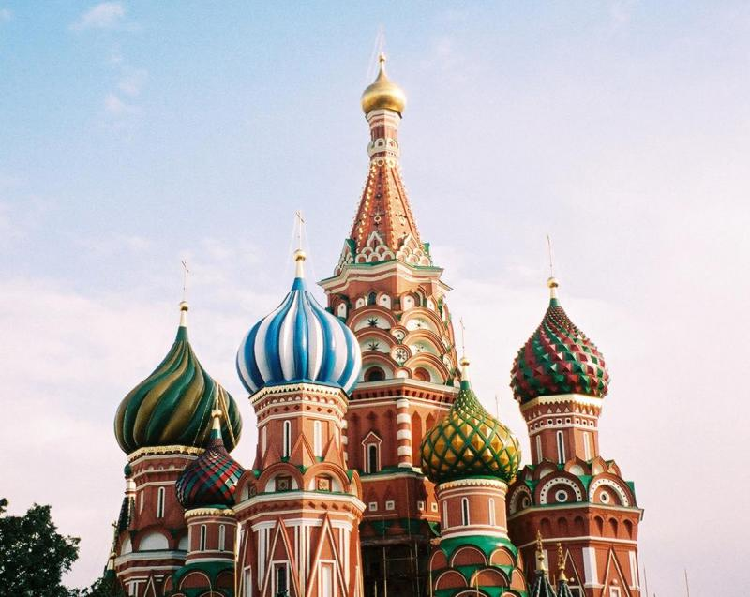
St. Basil’s Cathedral

Slide 30
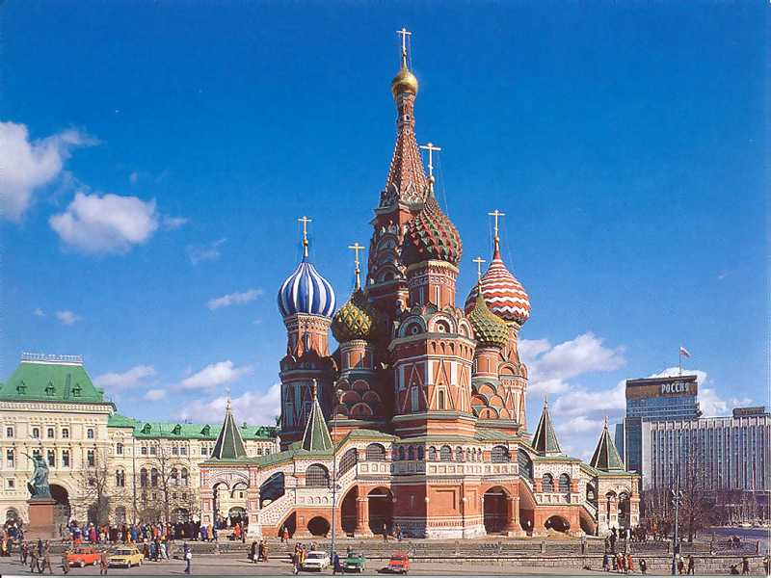

Slide 31
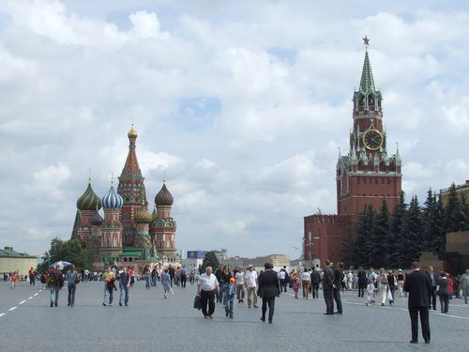
Red Square

Slide 32
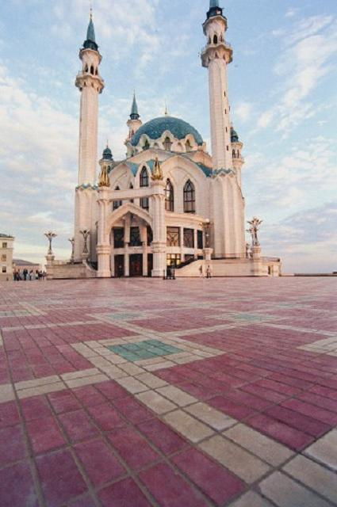
Russian Mosques & Minerets in Kazan, Tatarstan

Slide 33
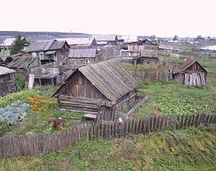
Siberian village

Slide 34
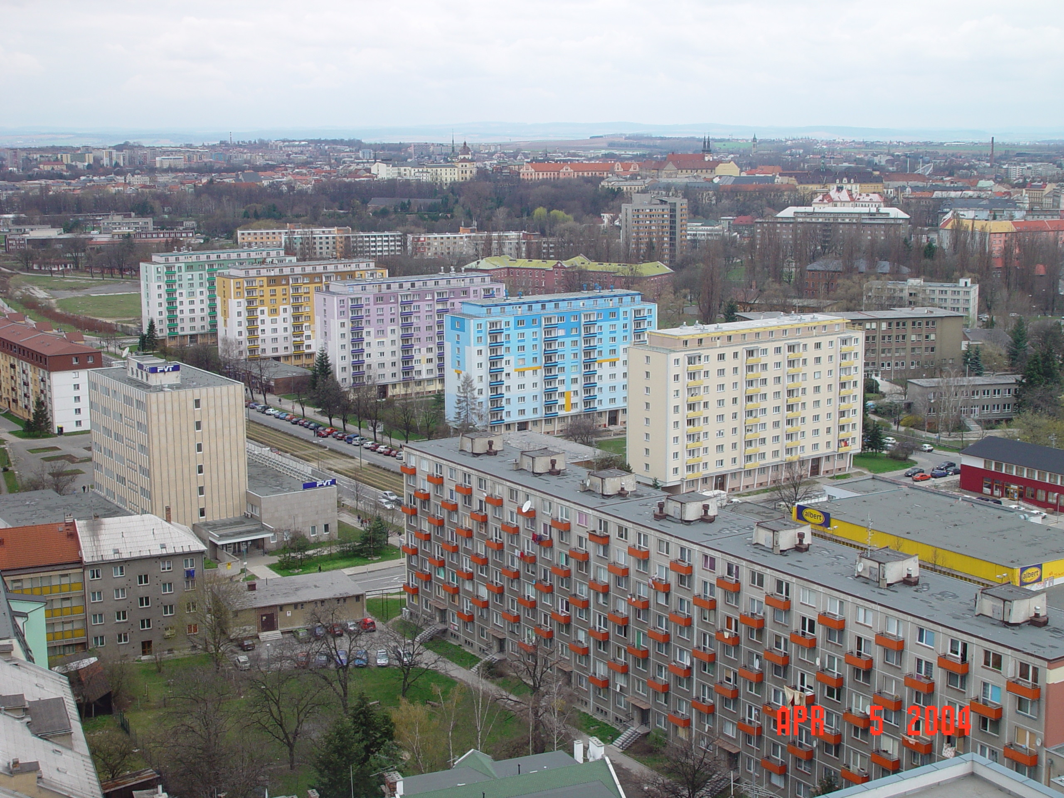
Soviet-Style Apartments

Slide 35
Cultural characteristics cont.
Cities as a center of culture and trade
  Moscow
  St. Petersburg
  Novosibirsk

Slide 36
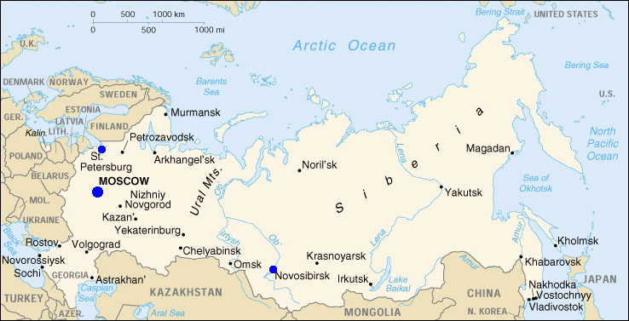
The Three cities Located

Slide 37
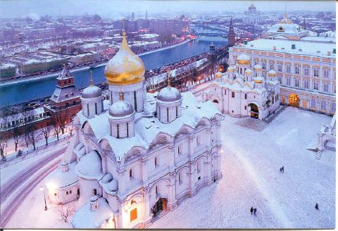
Moscow

Slide 38
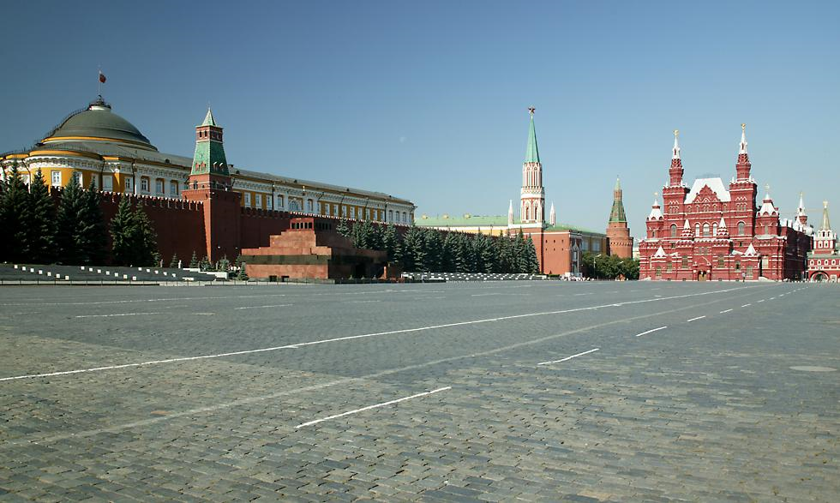

Slide 39
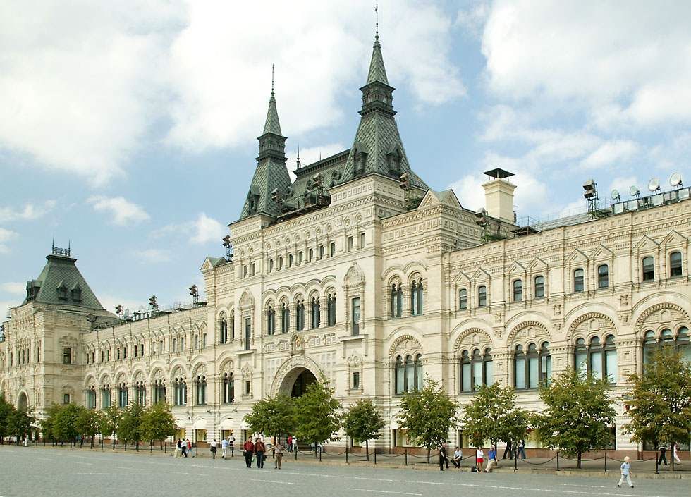

Slide 40
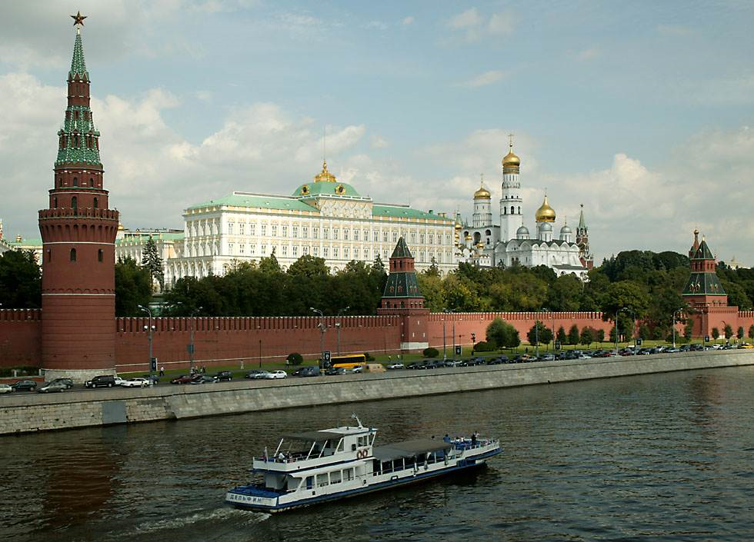

Slide 41
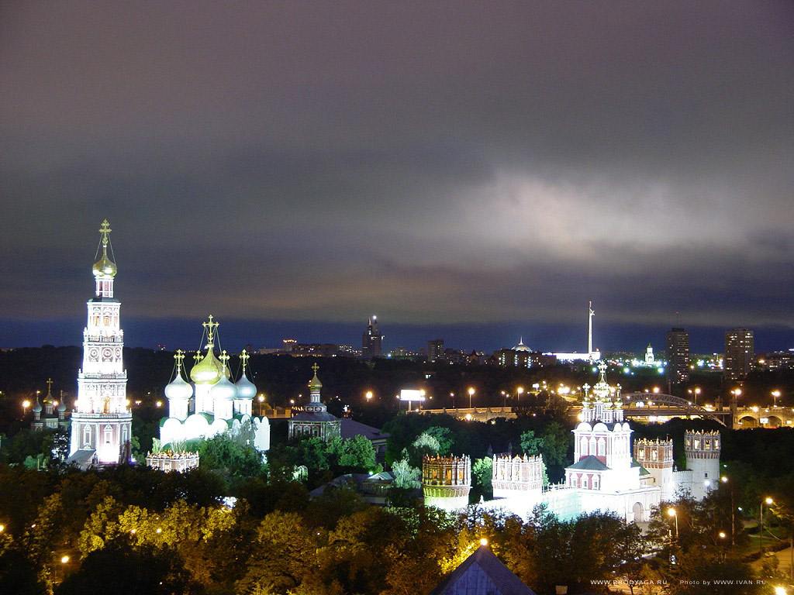

Slide 42
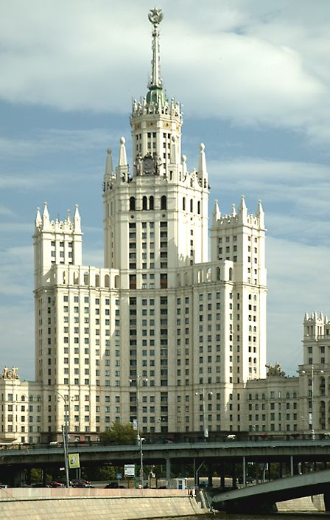
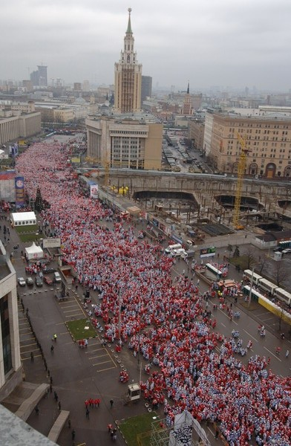

Slide 43
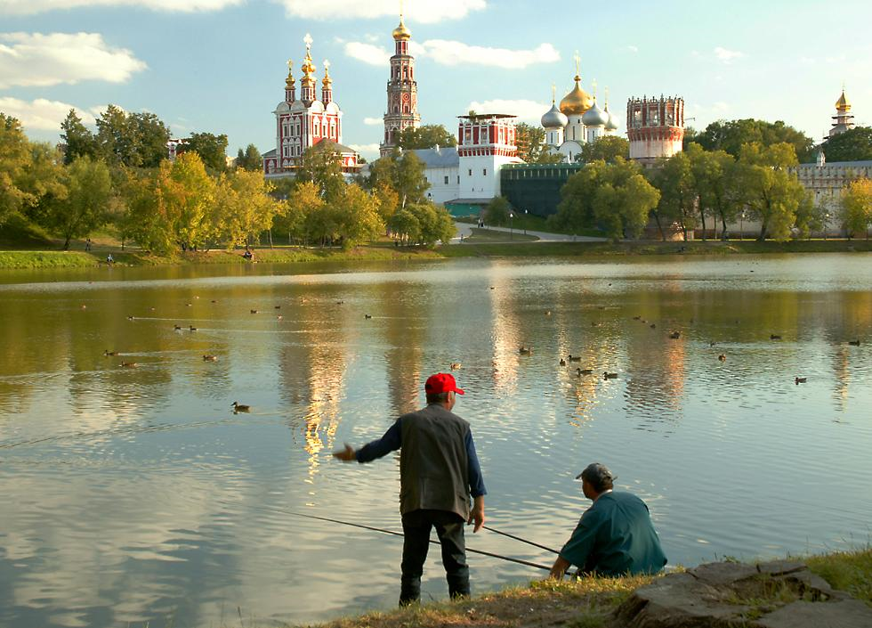

Slide 44
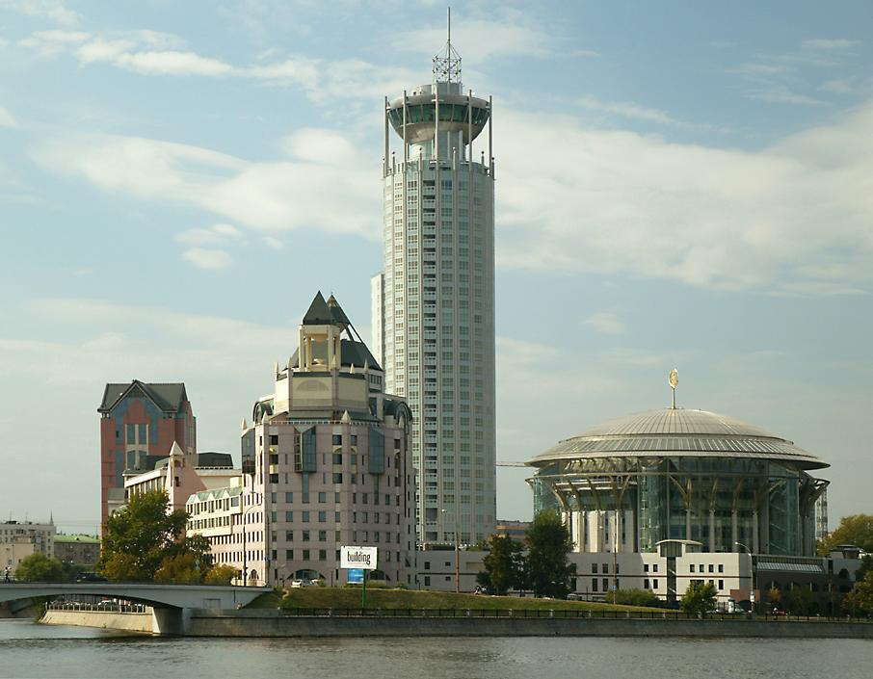

Slide 45
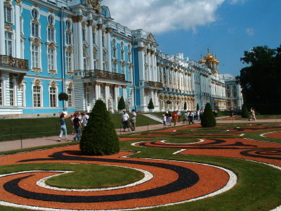
St. petersburg

Slide 46
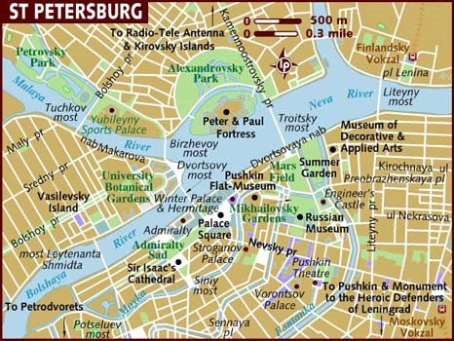

Slide 47
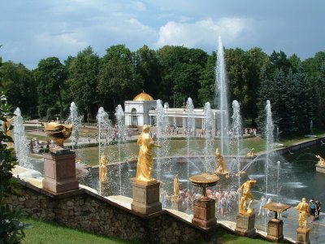

Slide 48
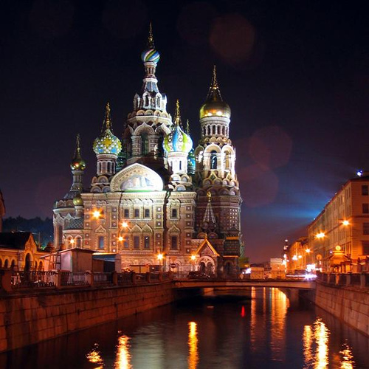

Slide 49
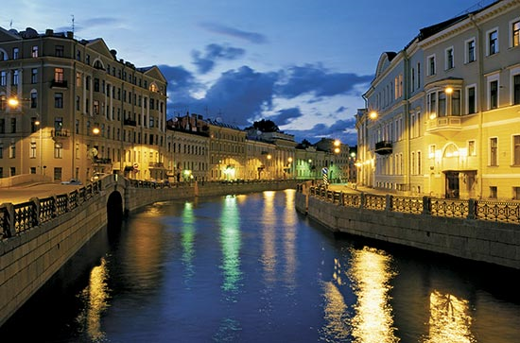

Slide 50
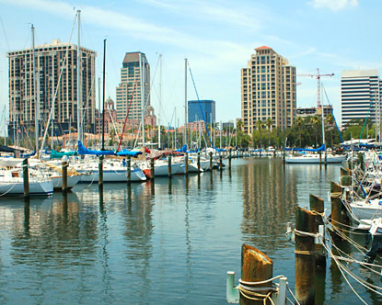

Slide 51
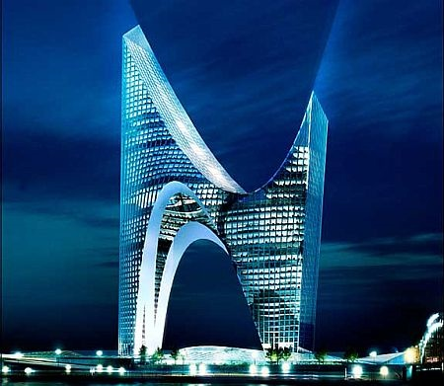
Due to be built in St. Petersburg

Slide 52
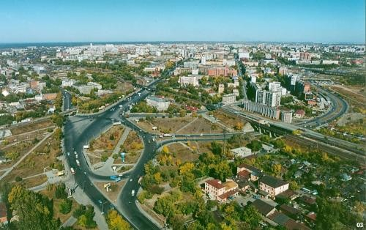
novosibirsk

Slide 53
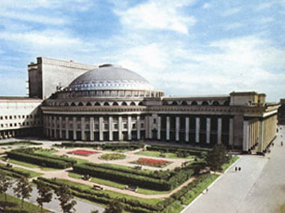

Slide 54
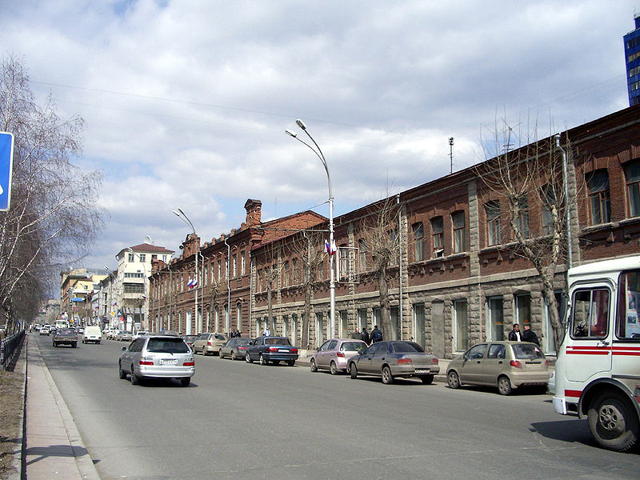

Slide 55
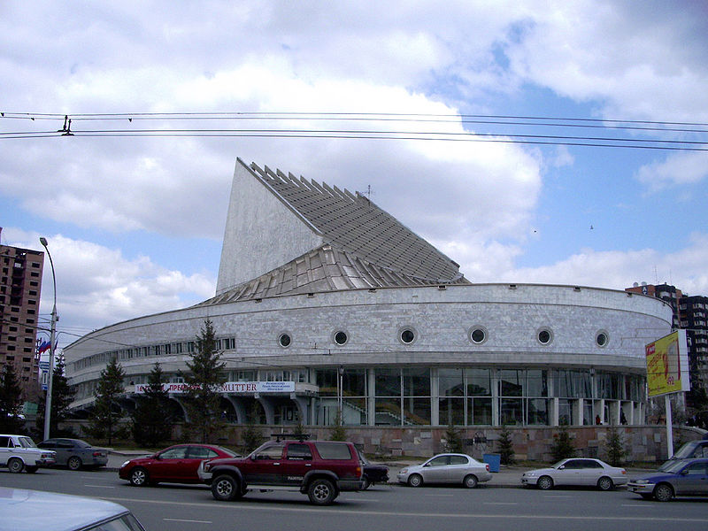

Slide 56
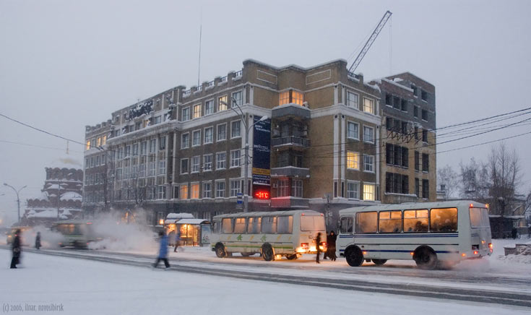

Slide 57
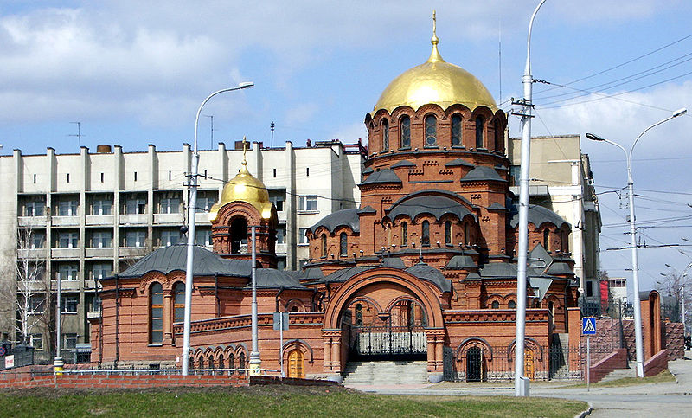

Slide 58
Cultural Characteristics
Diverse ethnic groups, customs, and traditions (many of Turkic and Mongol heritage)
Cultural Heritage
  Ballet Fabergé eggs
  Music Icons
  Matrioshka dolls
  Oriental carpets
  Samovars

Slide 59
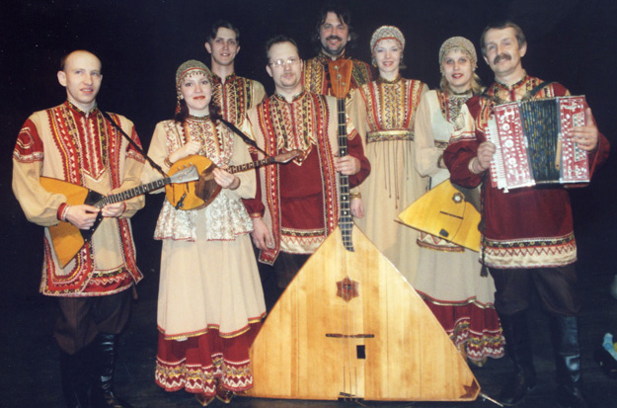
Russian Music

Slide 60

Russian State Ballet

Slide 61


Matrioshka dolls

Slide 62

Russian Carpets

Slide 63


Samovars

Slide 64


Faberge’ eggs

Slide 65


Russian Orthodox Icons

Slide 66


More Icons

Slide 67

Onion Domes Characteristic of Slavic Architecture

Slide 68


Slide 69

Typical Meal

