Slide 1
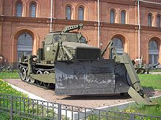
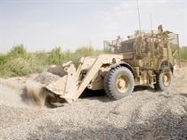
Russia – Recycling Military Vehicles

Slide 2
Some companies in Russia earn their living by buying cheap old Russian army vehicles and converting them to civil engineering and construction hardware that is then used at various construction sites in Russia.
One could be passing across a place where a new residential complex is being built, and a big military camouflaged tank equipped with a hoe instead of the gun can appear around a corner.
Also, it might be handy for exporting to third world countries where the construction areas are sometimes being combined with a battle front. Such construction machinery would be able to continue digging under the light to moderate range fire.

Slide 3
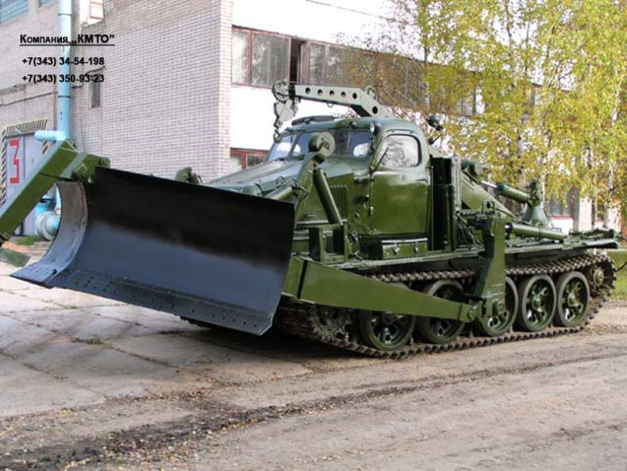

Slide 4
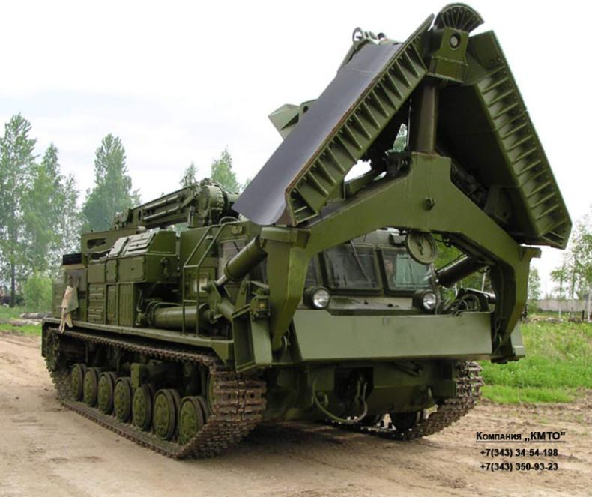

Slide 5
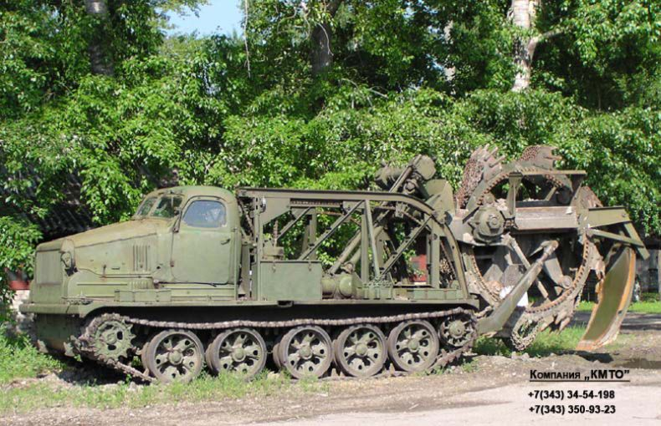

Slide 6
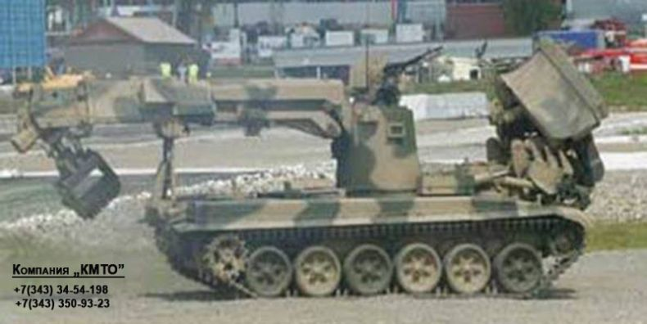

Slide 7
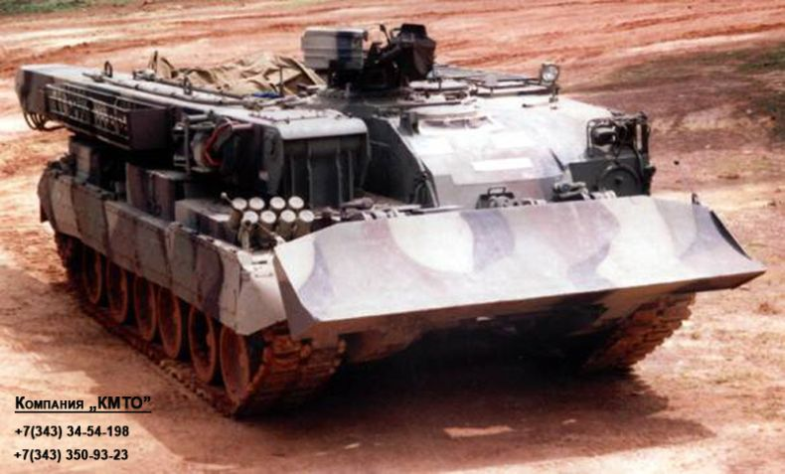

Slide 8
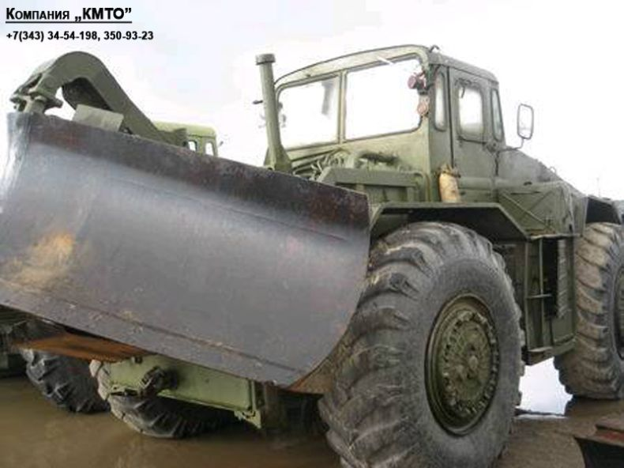

Slide 9
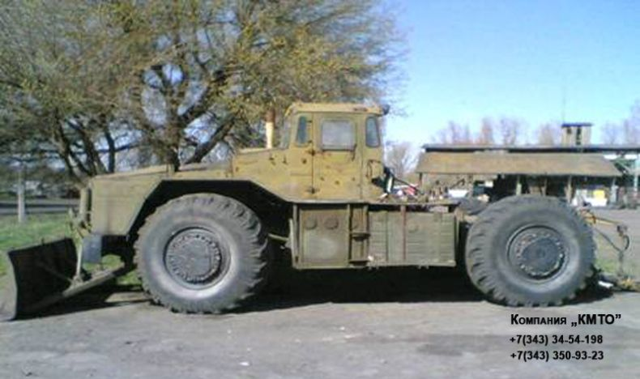

Slide 10
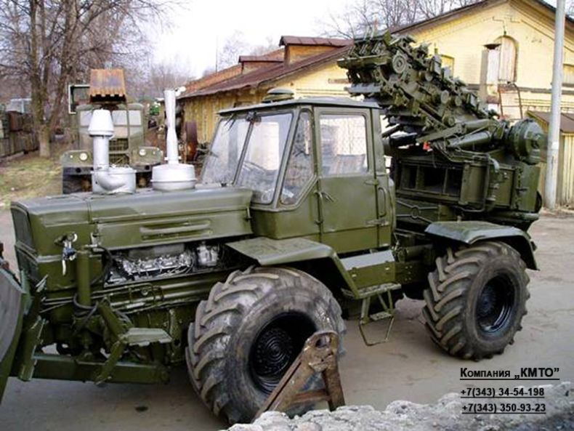

Slide 11
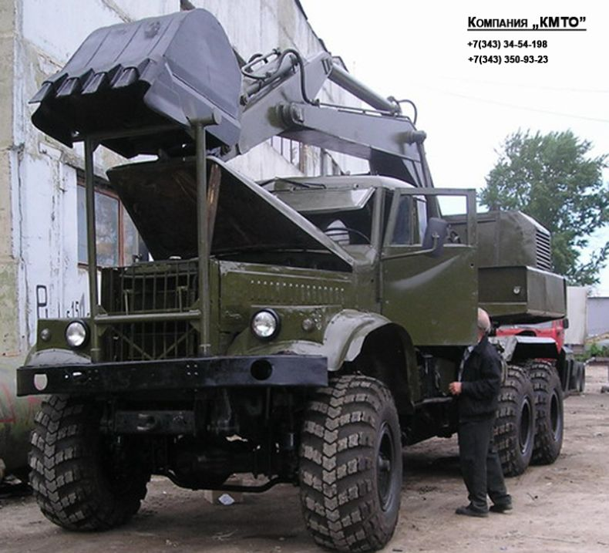

Slide 12
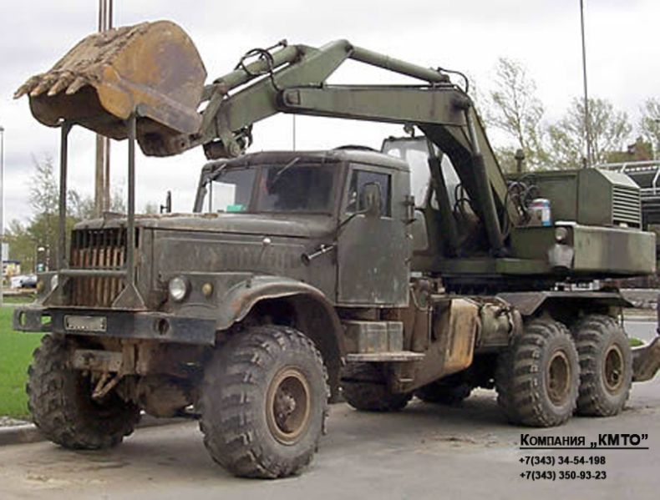

Slide 13
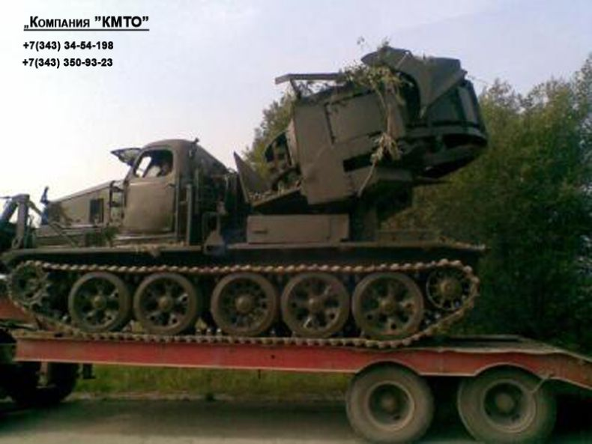

Slide 14
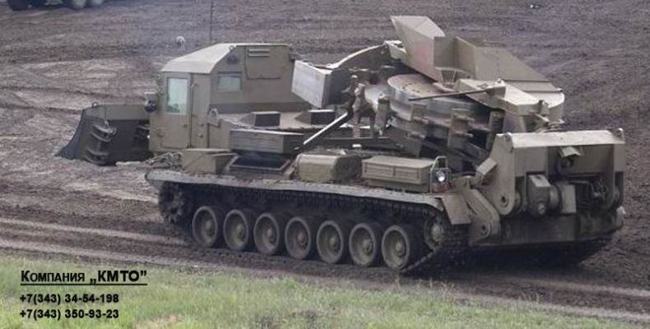

Slide 15
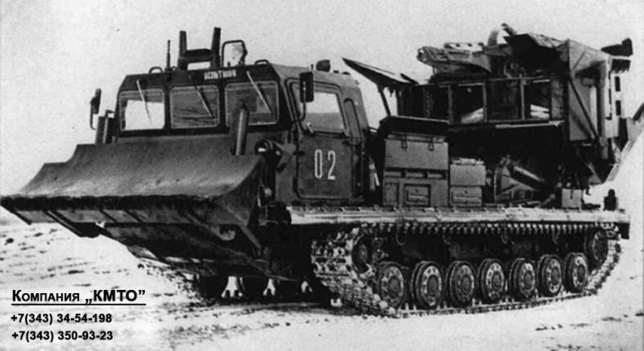

Slide 16
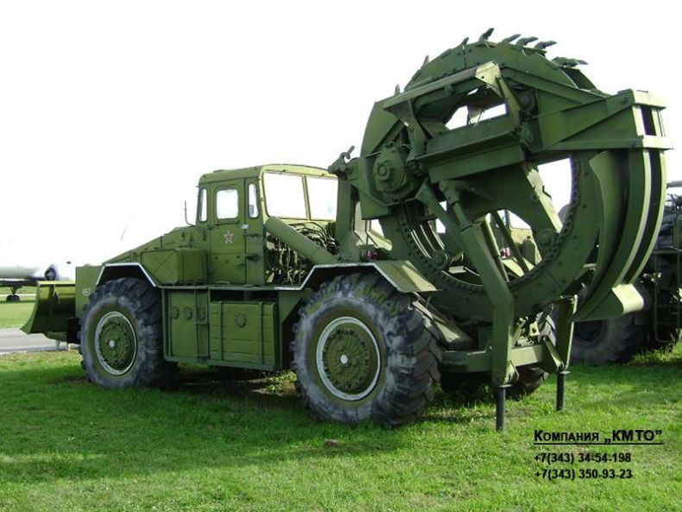

Slide 17
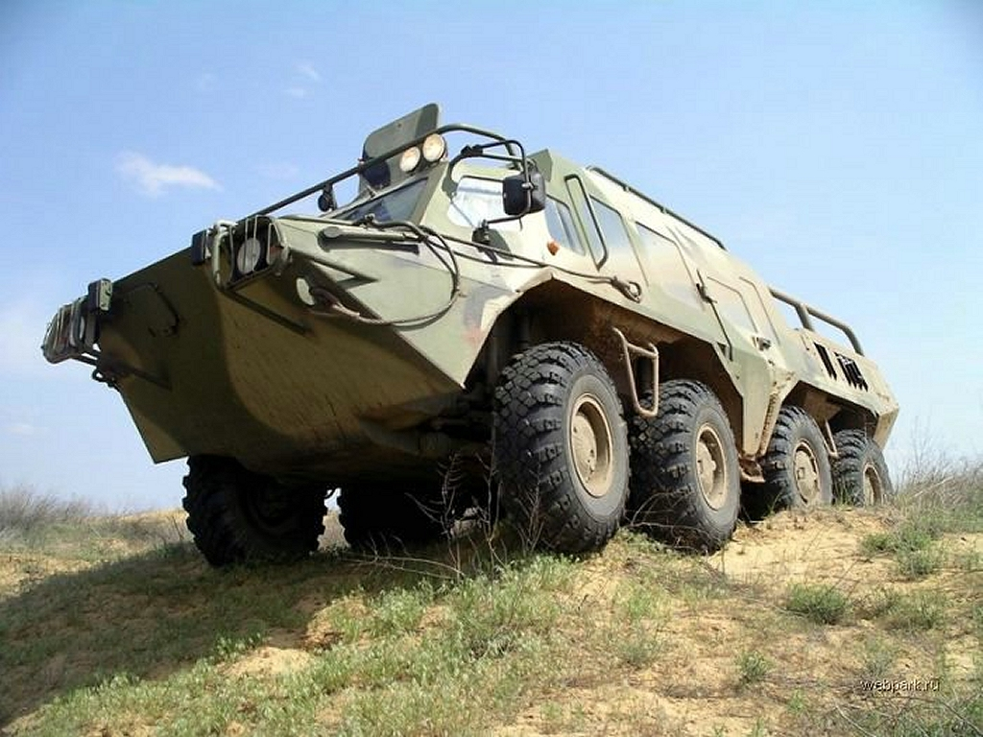
Some lucky home sport bought a used military APC and transformed it into the ultimate SUV!! Now that is awesome!

Slide 18
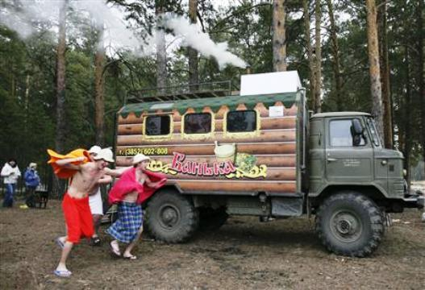
Russian Sauna on Wheels

Slide 19
