Slide 1
Lake Baikal, Siberia
&
Krugo Baikalskaya Railway
Beautiful . . .
Deepest in the world . . .
Greatest volume in the world. . .

Slide 2
Two First Places
Lake Baikal in southern Russia is the world's deepest lake. It is 5314 feet deep (1637 meters) and it's bottom is at 4215 feet (1285 meters) below sea level. This large lake is located in an active continental rift zone which is estimated to be widening at a rate of about 1 inch (2.5 centimeters) per year. Lake Baikal is the world's largest freshwater lake in terms of volume. It contains about 5521 cubic miles of water (23,000 cubic kilometers), or approximately 20% of Earth's fresh surface water. This is a volume of water approximately equivalent to all five of the North American Great Lakes combined.

Slide 3
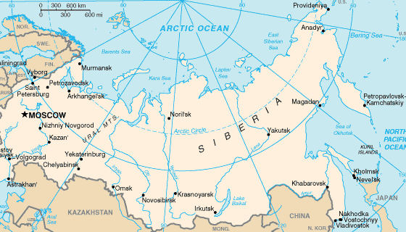

Slide 4
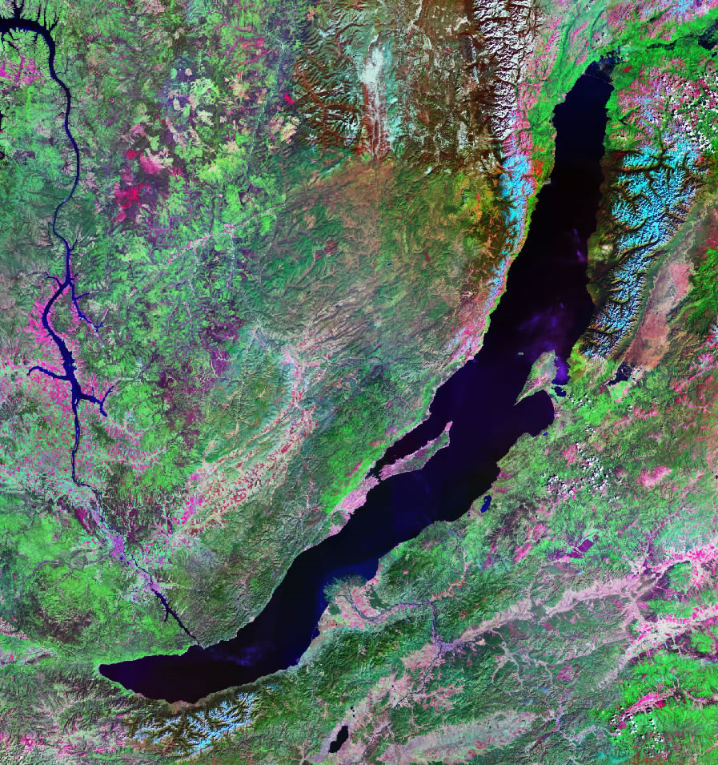

Slide 5
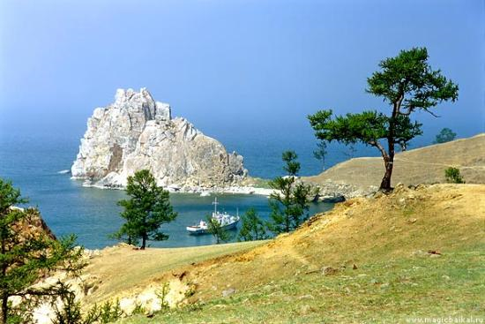

Slide 6
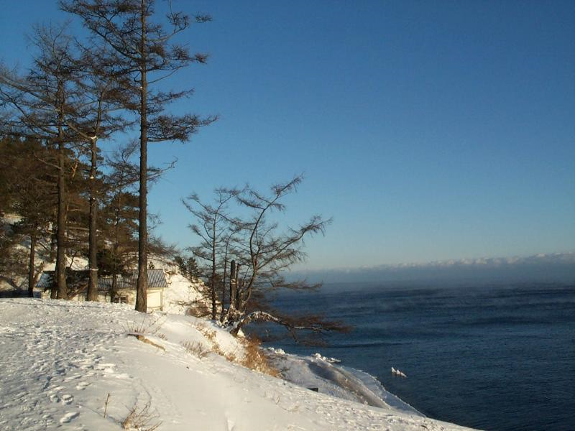

Slide 7
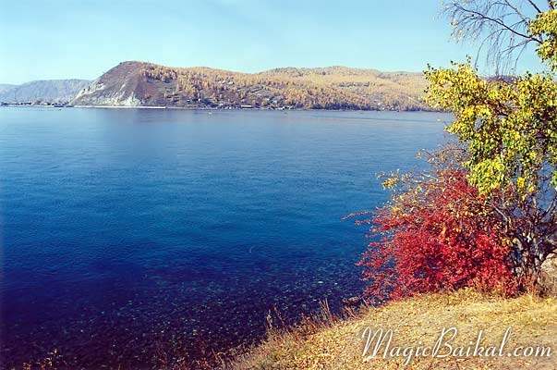

Slide 8
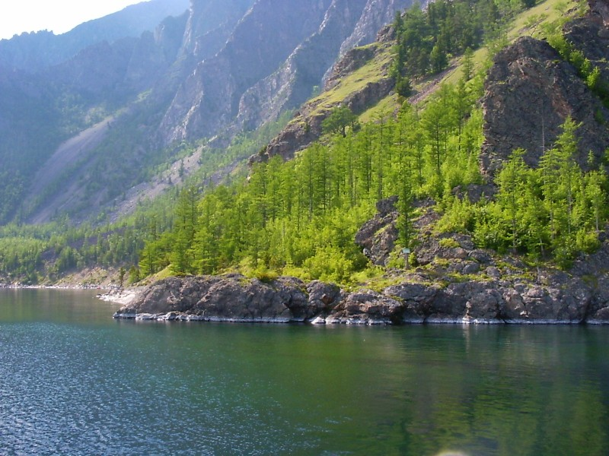

Slide 9
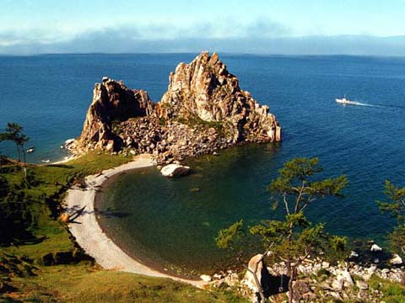

Slide 10
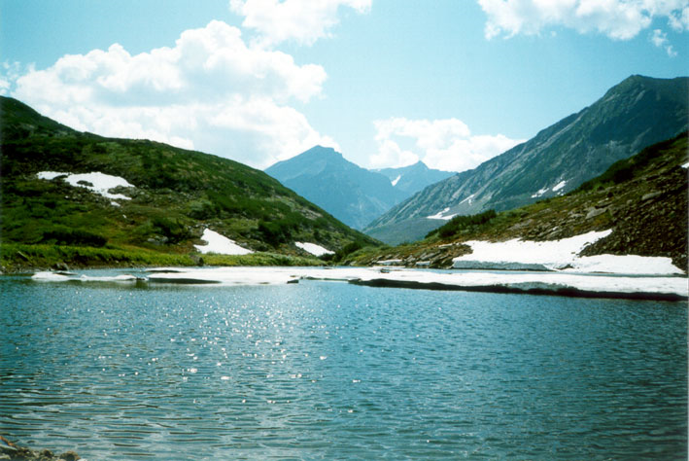

Slide 11
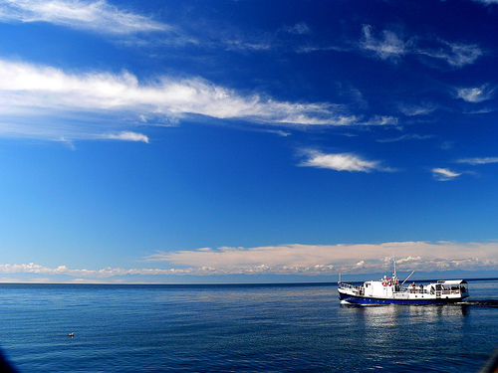

Slide 12
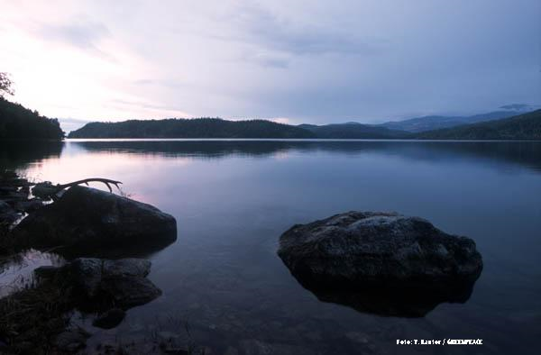

Slide 13
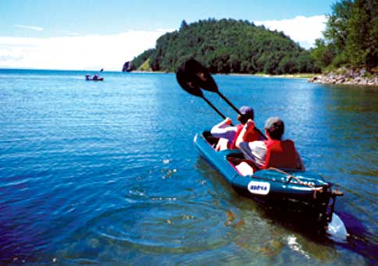

Slide 14
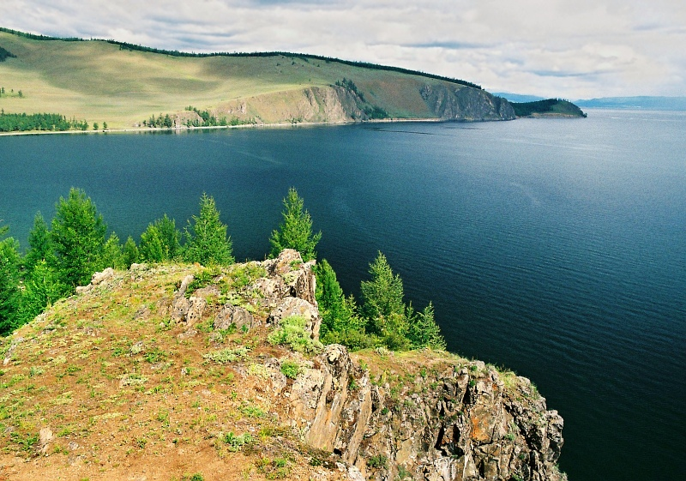

Slide 15
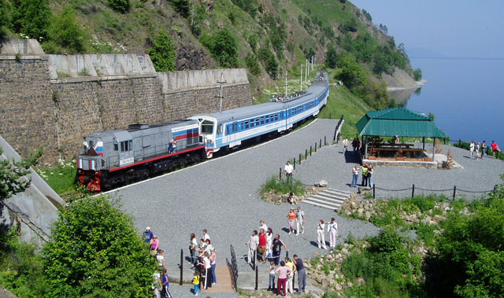
Krugo baikalskaya railway

Slide 16
Krugo-Baikalskaya Railway
Krugo-Baikalskaya railway is stretched along the southern coast of the lake Baikal for 260 km, from a source of the Angara river up to station Mysovaya. Its western site is especially unique. Circum-Baikal railway is 84 km of a rail way from the port Baikal up to the station Kultuk, 39 tunnels (the general long is 9 063 m), 16 stone galleries, about 400 bridges and viaducts, more than 200 retaining stone walls, tens kilometers of railway embankments.

Slide 17
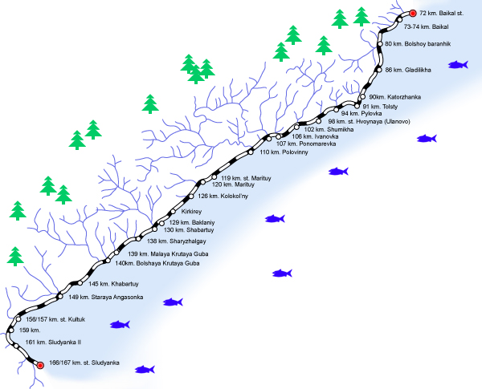

Slide 18
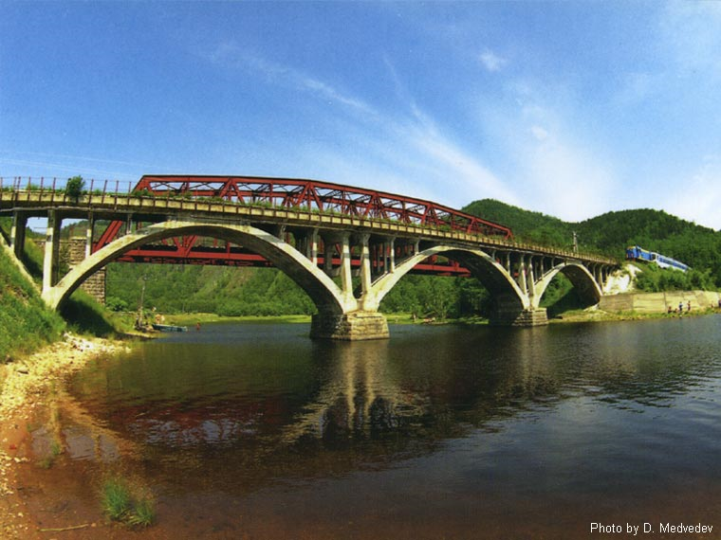

Slide 19
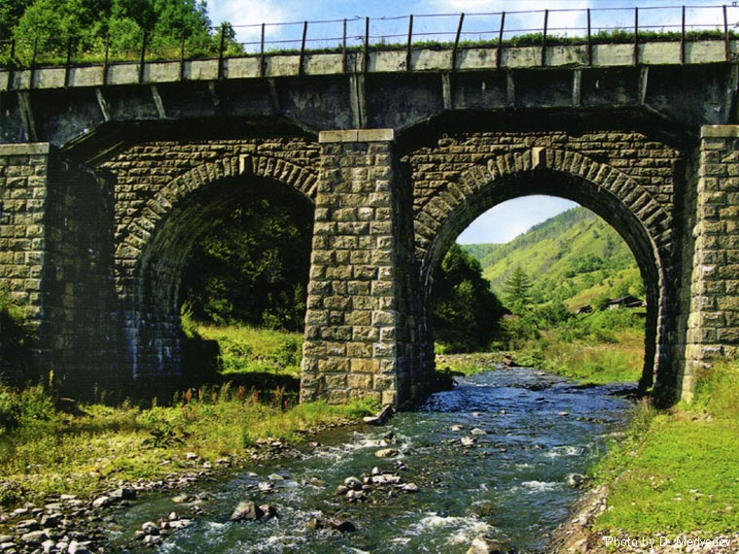

Slide 20
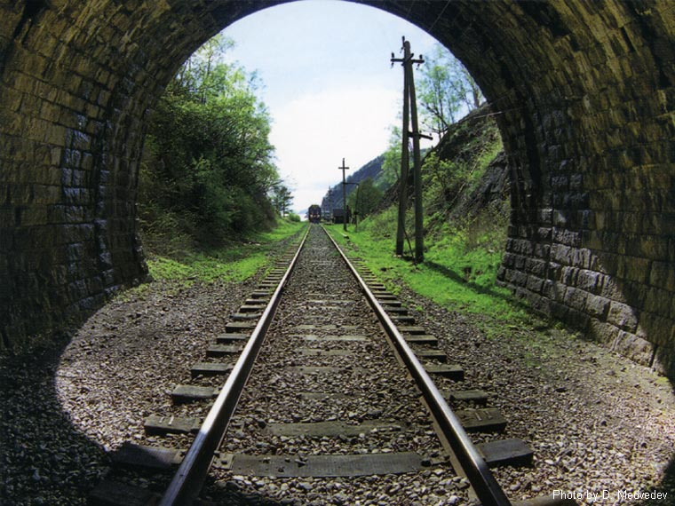

Slide 21
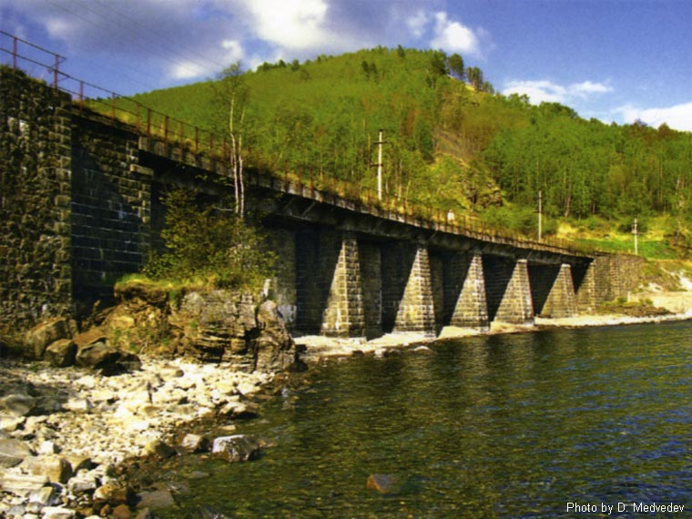

Slide 22
