Slide 1
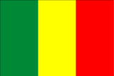
Mali

Slide 2
Mali
Region: Western Africa
Area total: 1,240,192 km2
Coast line: Landlocked country
Capital: Bamako
Population - 10,108,569 People
Life Expectancy - male -48 years female - 51 years 94 days

Slide 3
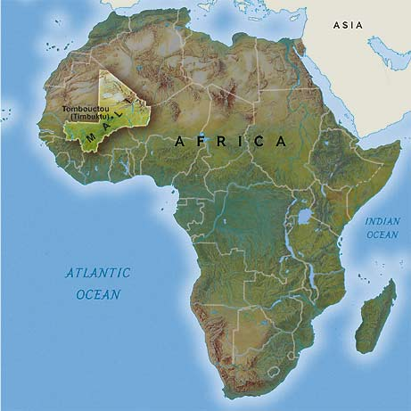

Slide 4
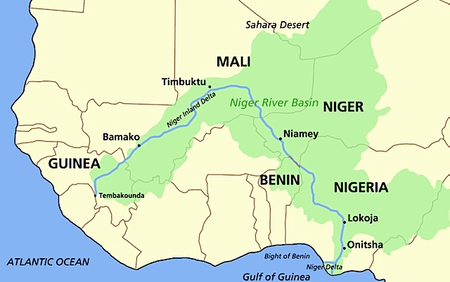
Niger River Basin

Slide 5
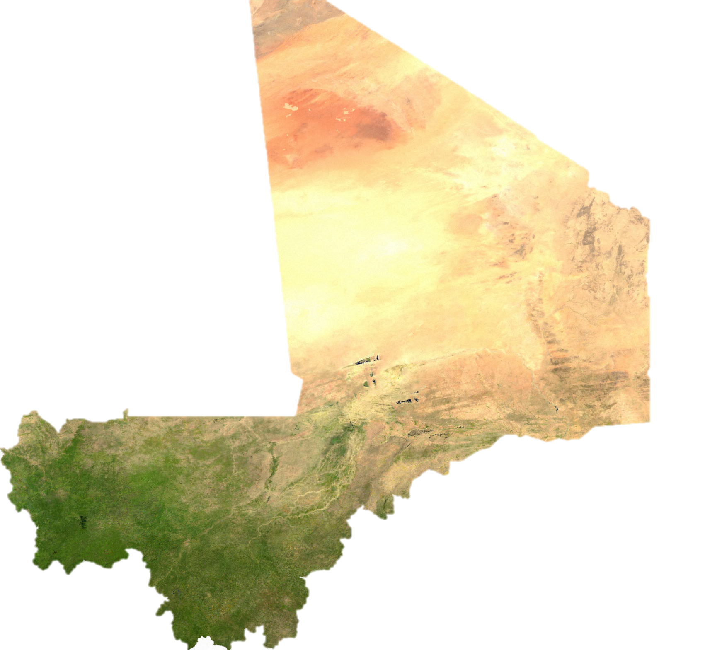
Satellite View

Slide 6
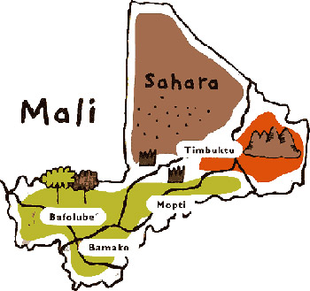

Slide 7
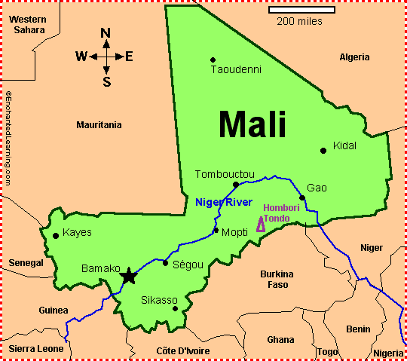

Slide 8
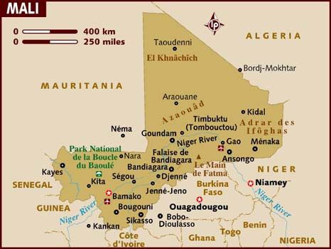

Slide 9
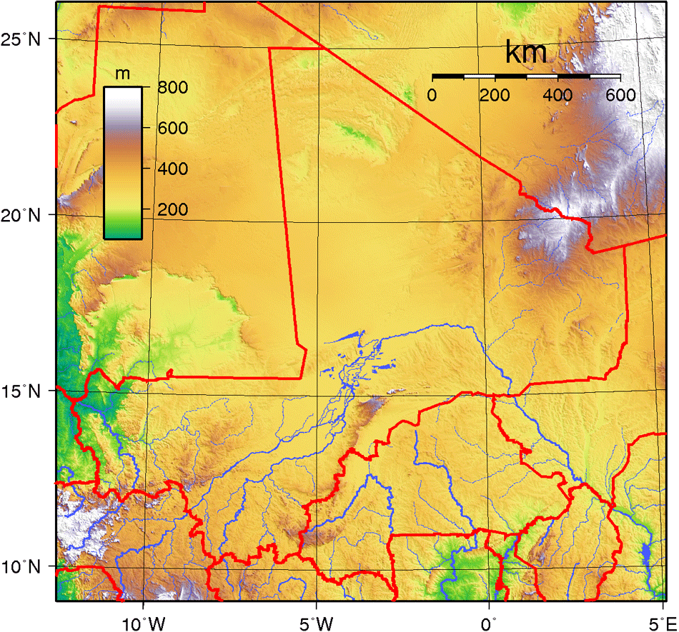
Topography

Slide 10
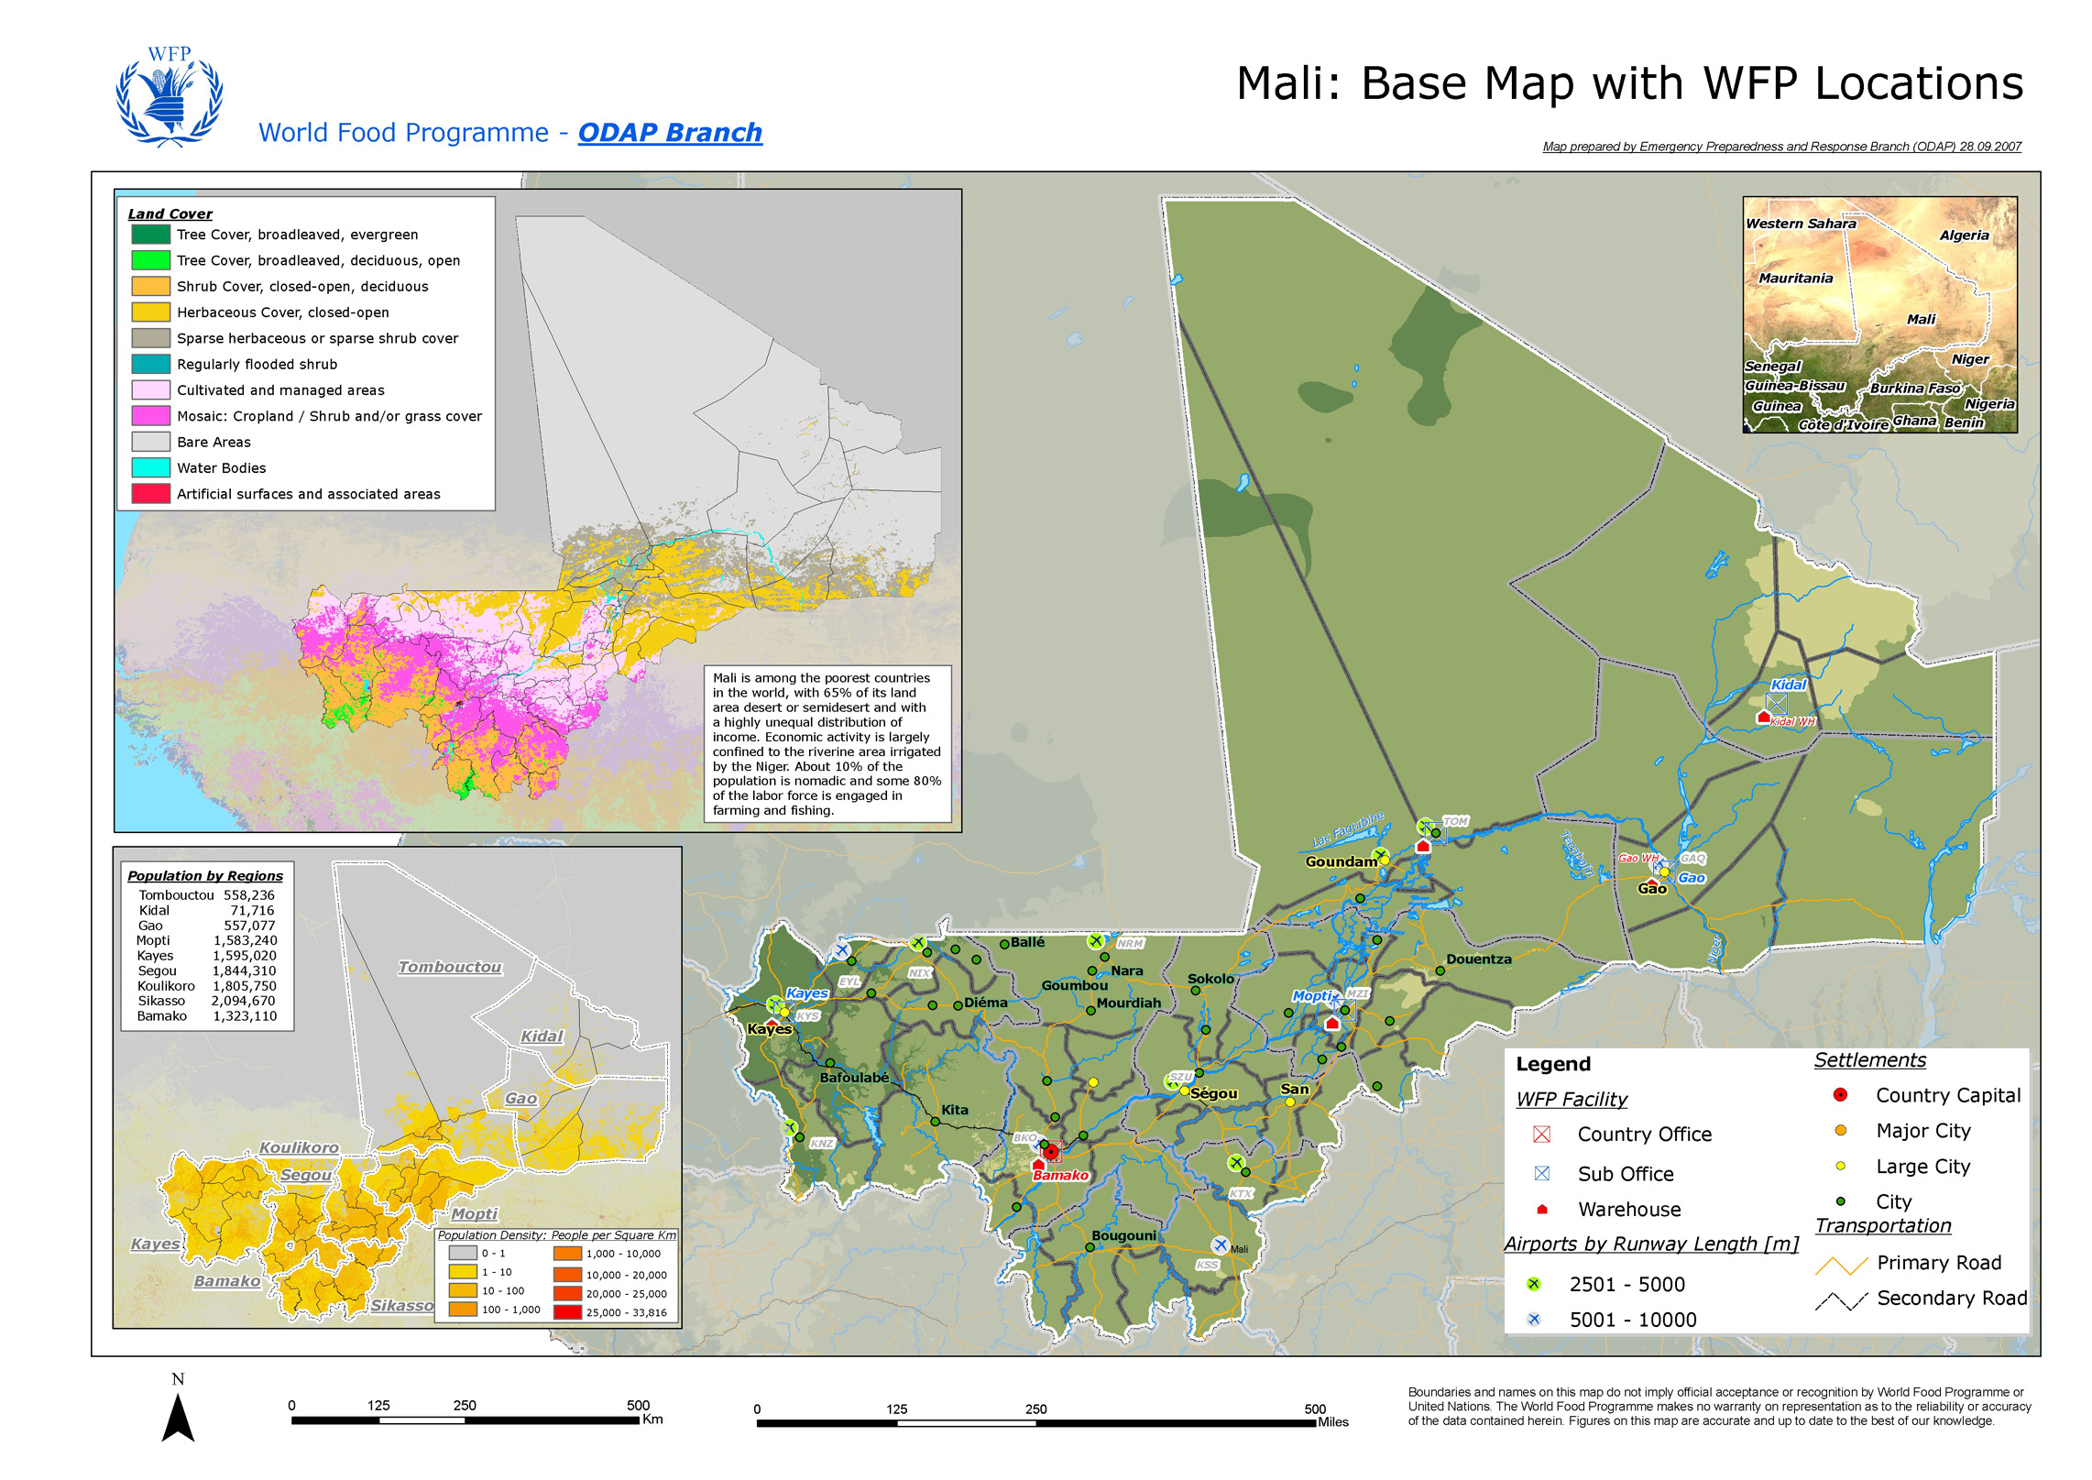

Slide 11
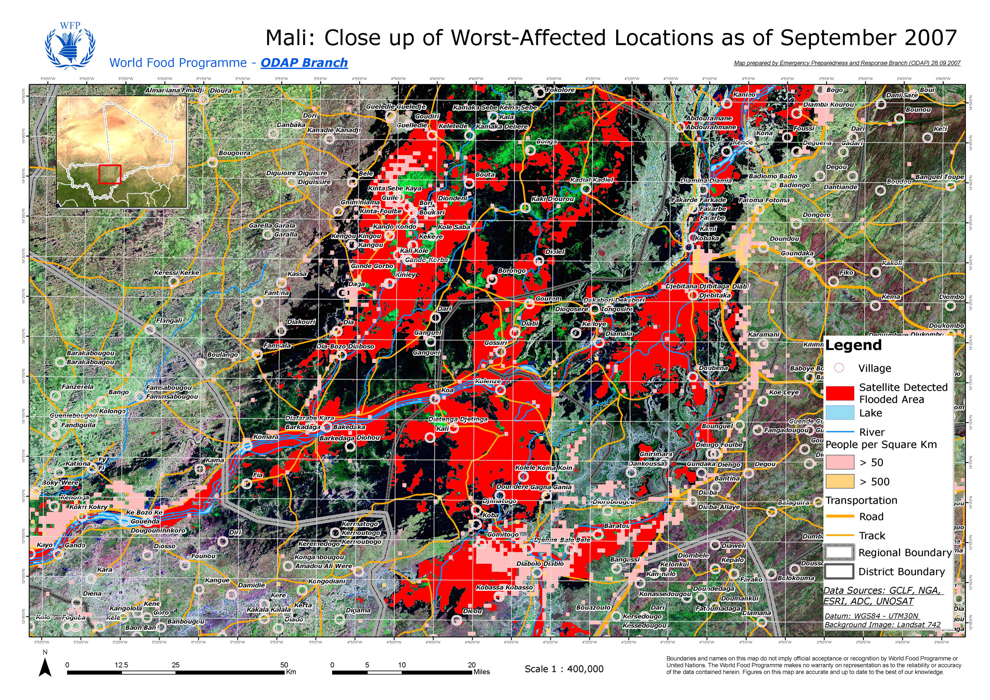

Slide 12
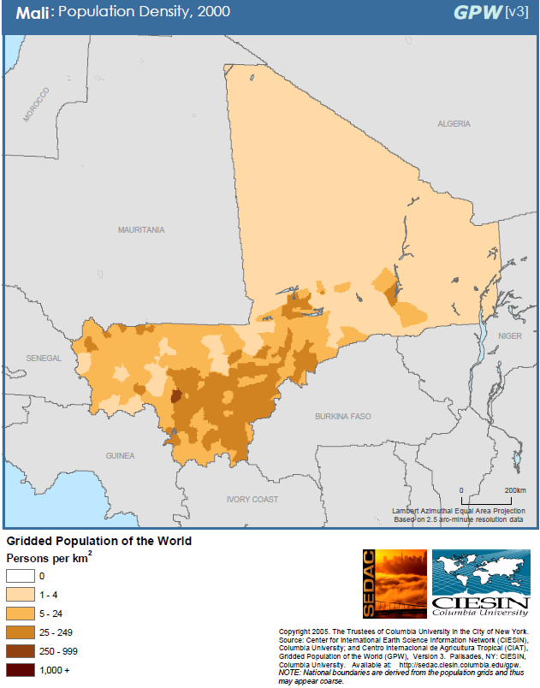

Slide 13
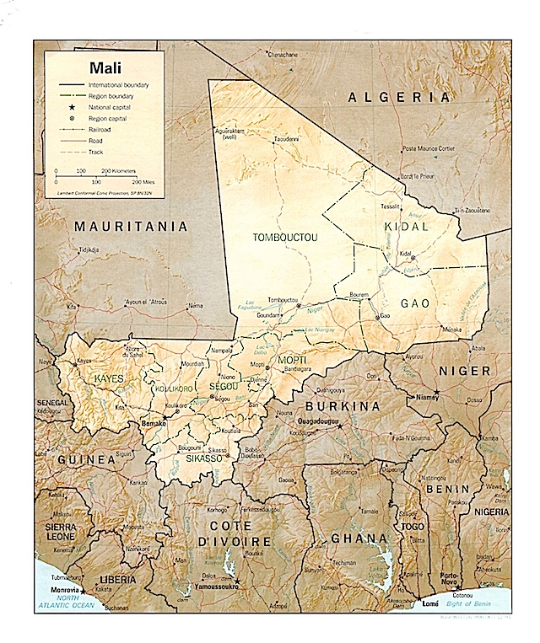

Slide 14
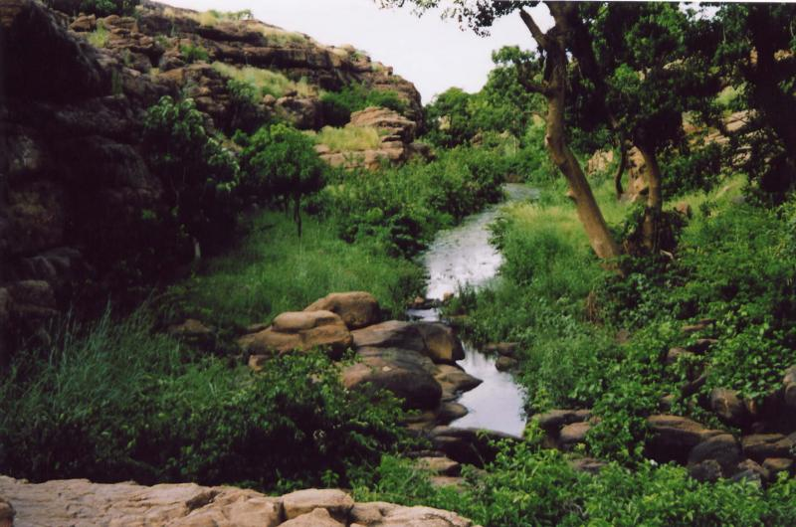
Physical geography scenes
The wetter south along a stream

Slide 15
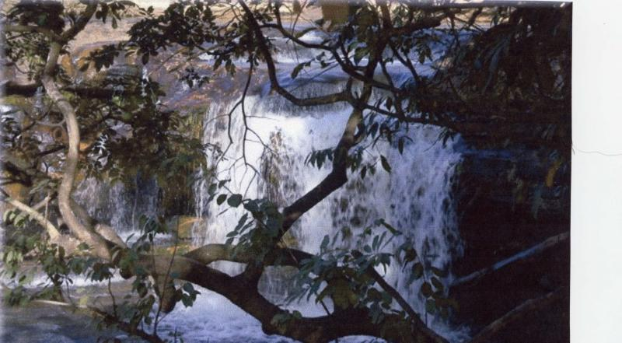

Slide 16
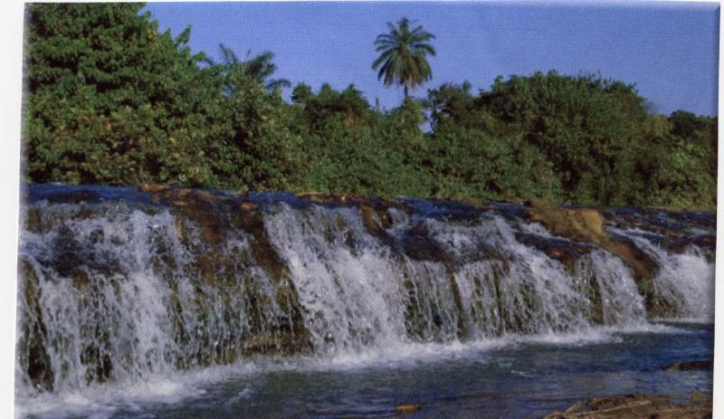

Slide 17
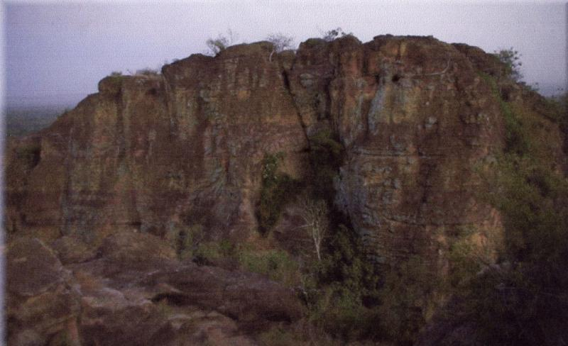
Plateau Escarpment

Slide 18
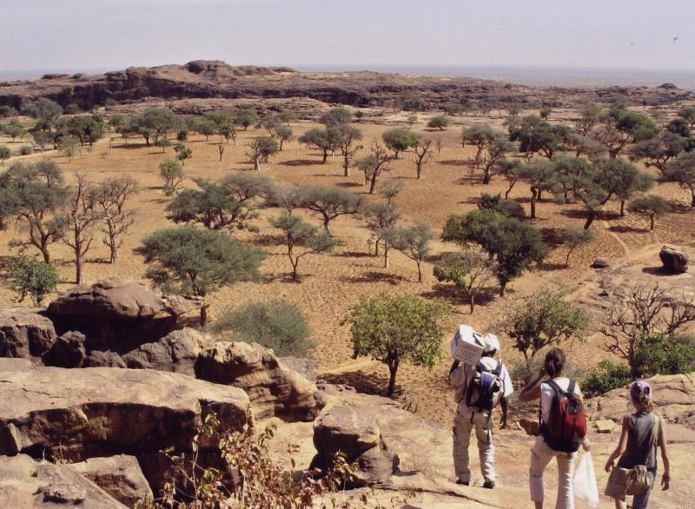
Savanna in the dry season

Slide 19
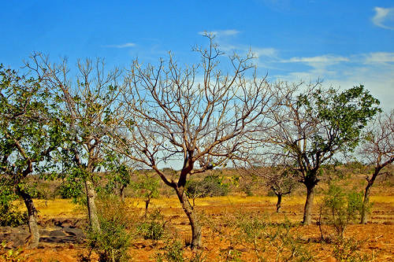
Savanna

Slide 20
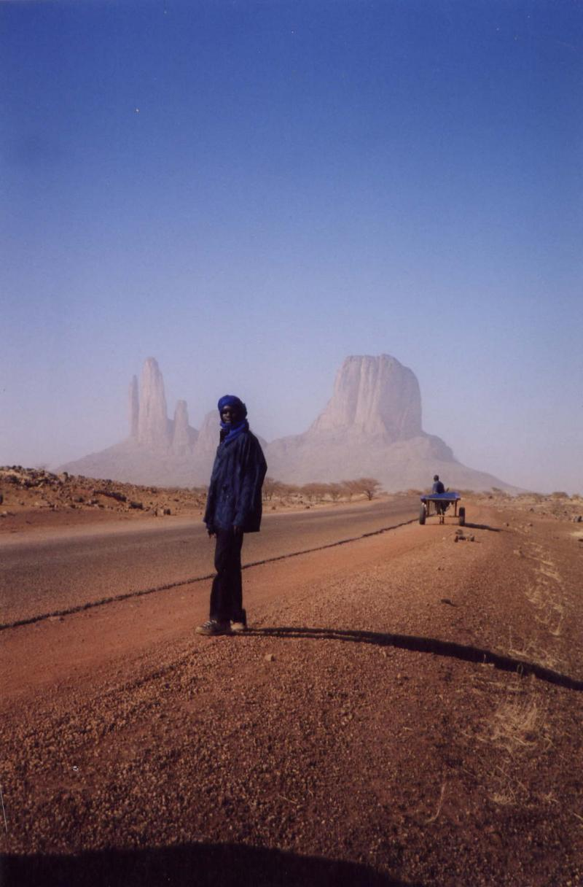
The northern desert (Sahara)

Slide 21
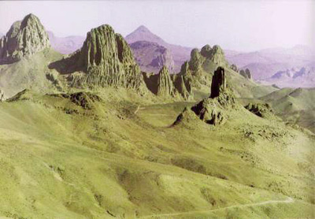
Sahara Desert mountain range of Tassili N'Ajjer

Slide 22
Urban Mali

Slide 23
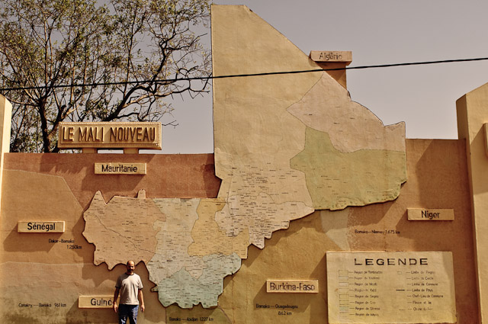

Slide 24
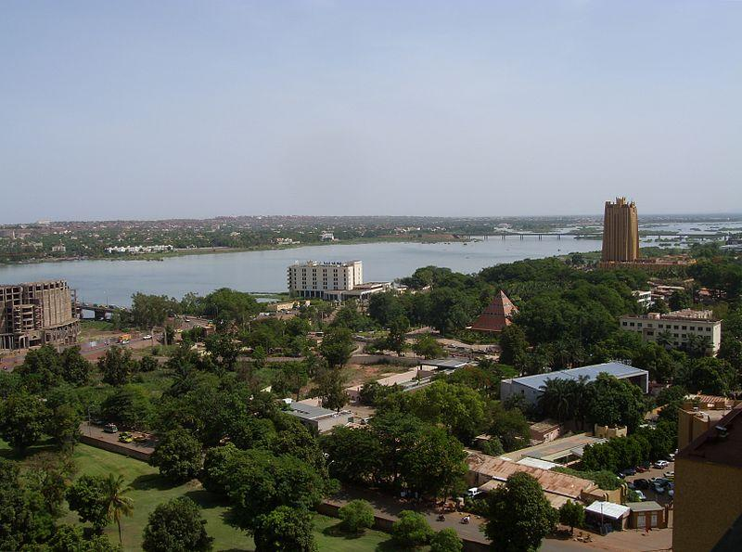
Bamako

Slide 25
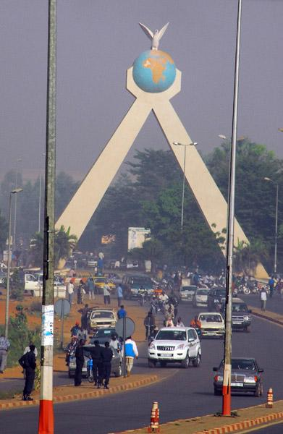
Martyrs Memorial

Slide 26
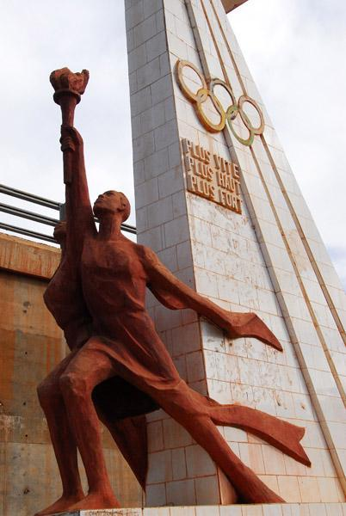
Mali Olympic Monument, Bamako

Slide 27
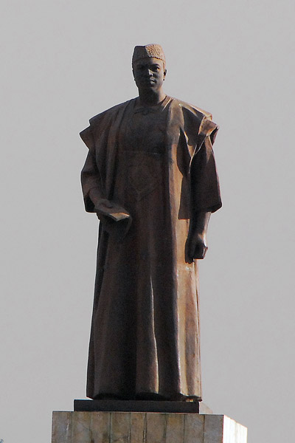
Memorial to Modibo Keita, Bamako, dedicated 1999
Modibo Keita (or Kéïta); (Bamako, 4 June 1915 - Bamako, 16 May 1977) was the first President of Mali (1960–1968) and the Prime Minister of the Mali Federation.
He espoused a form of African socialism.

Slide 28
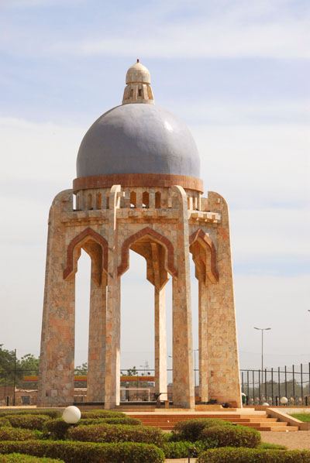
Monument, Avenue Al Qoods, Bamako

Slide 29
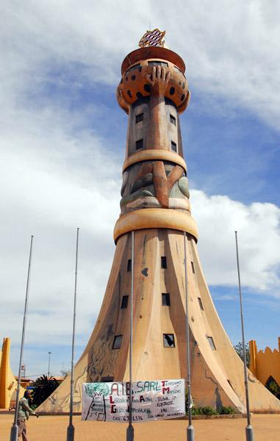
Africa Tower, Bamako

Slide 30
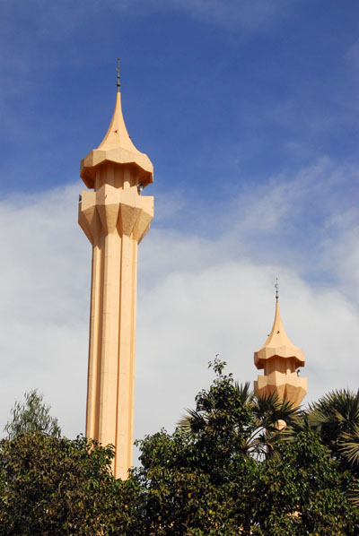
Grand Mosque-Bamako

Slide 31
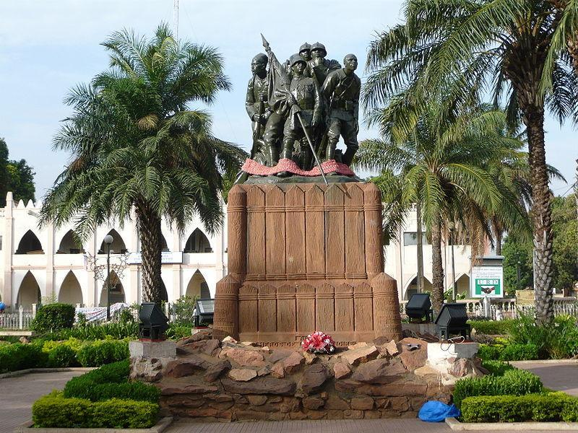
Statue of Liberty - Bamako

Slide 32
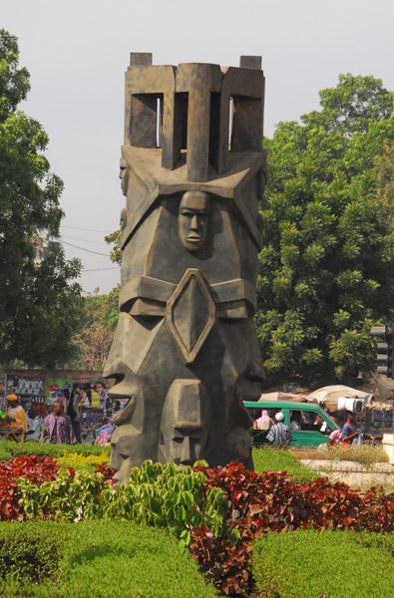
Statue resembling African masks, Bamako

Slide 33
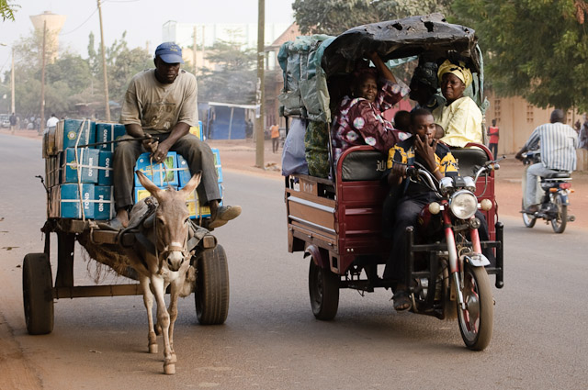

Slide 34
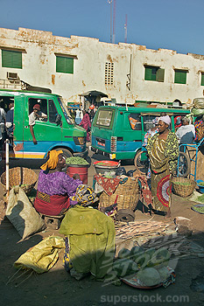

Slide 35
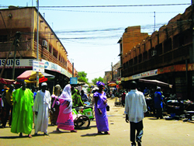
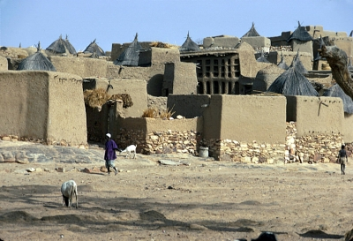
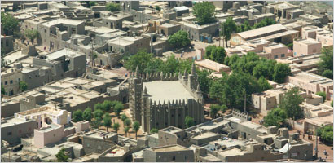

Slide 36
The mosque Djenné (picture on next slide)
The Great Mosque of Djenné is the largest mud brick or adobe building in the world and is considered by many architects to be the greatest achievement of the Sudano-Sahelian architectural style with definite Islamic influences.

Slide 37
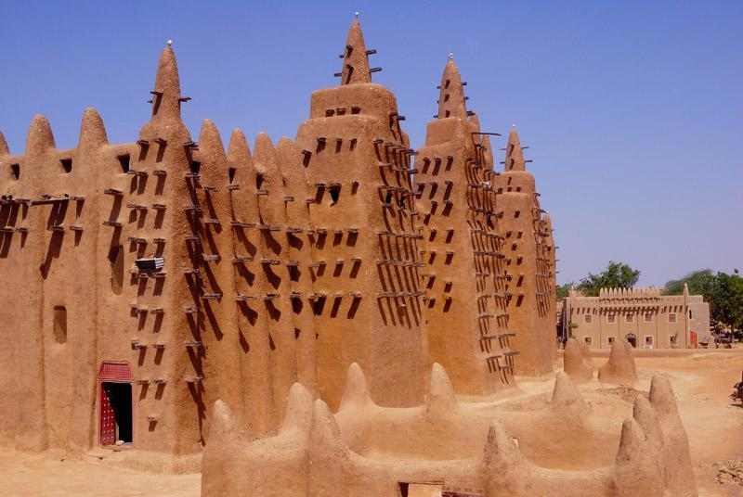

Slide 38
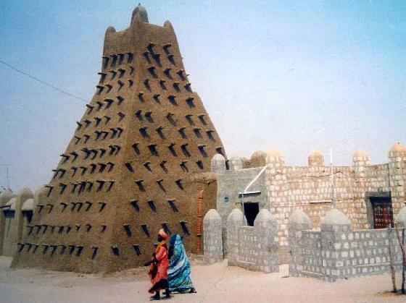

Slide 39
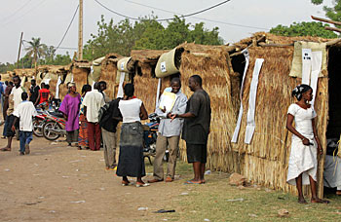
Voting Stations in Bamako

Slide 40
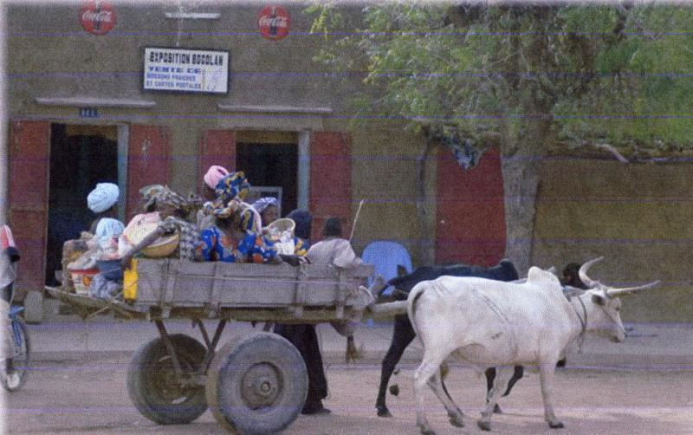
Town & Village Scenes

Slide 41
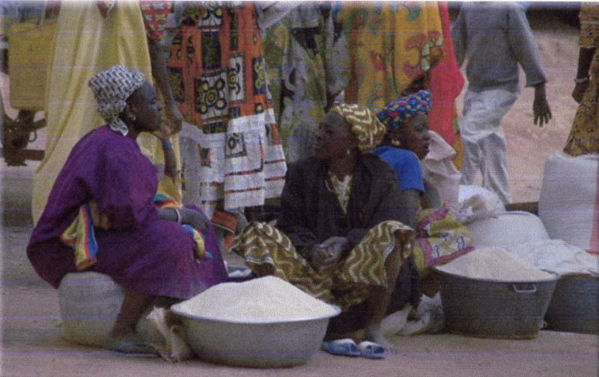

Slide 42
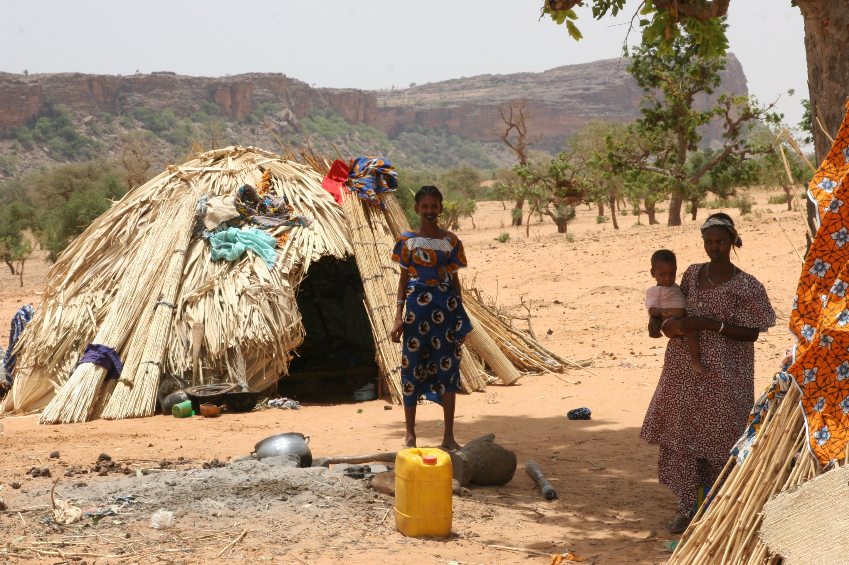
Fulani Village

Slide 43
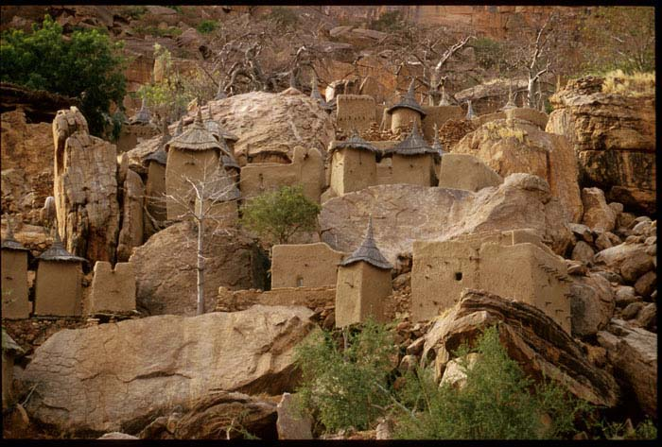
Dogon Village

Slide 44
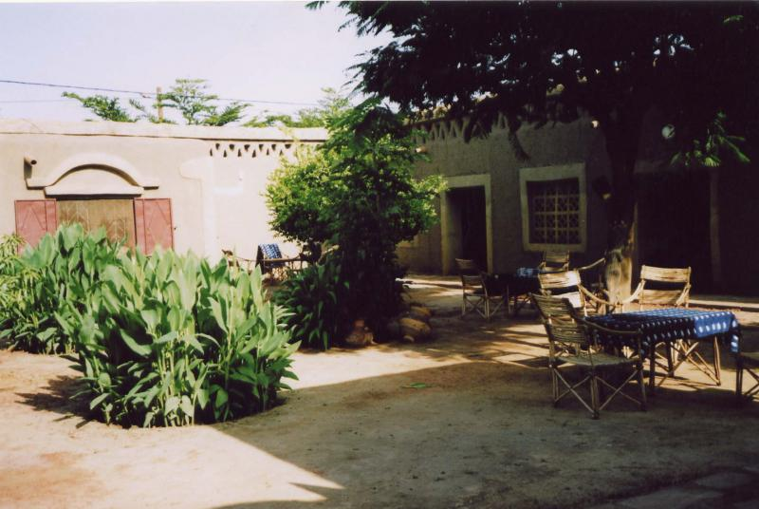

Slide 45
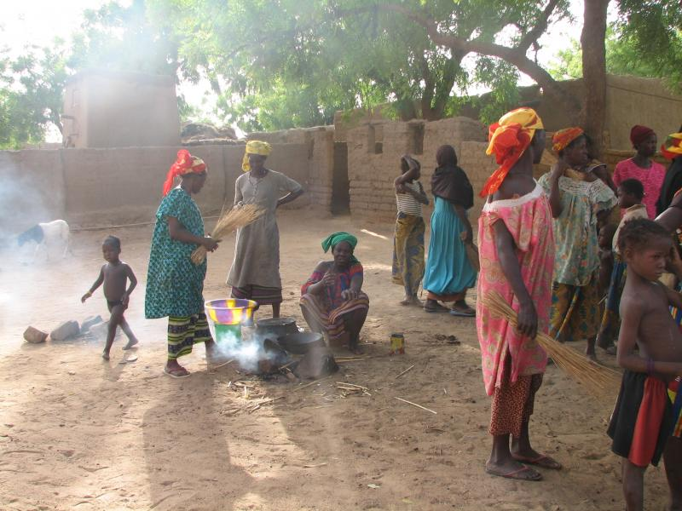

Slide 46
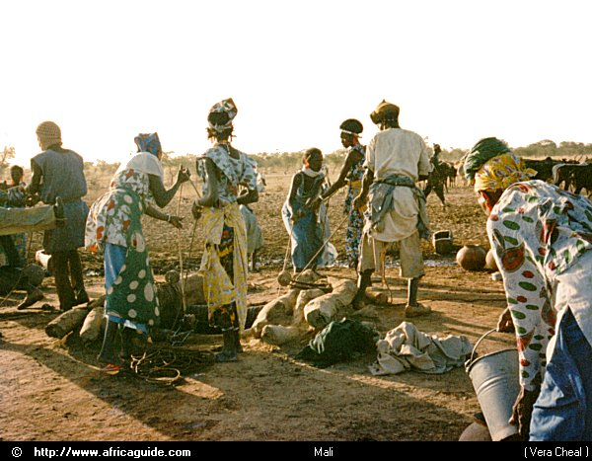

Slide 47
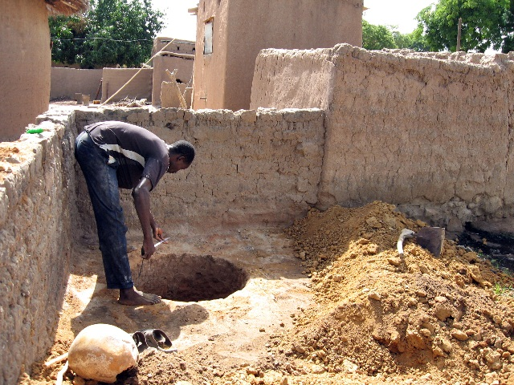
Building a Community Latrine

Slide 48
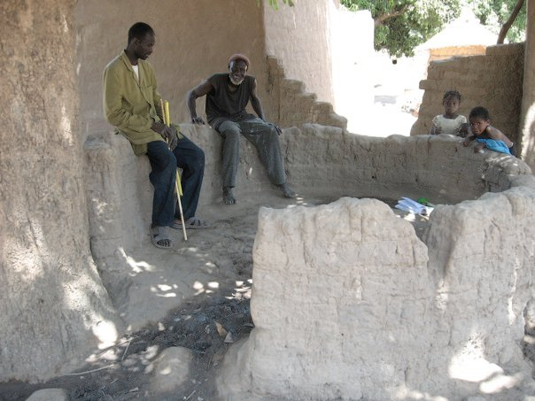
Well Improvement Project

Slide 49
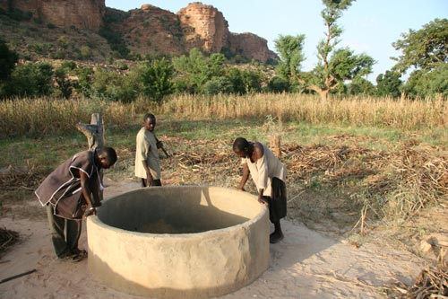

Slide 50
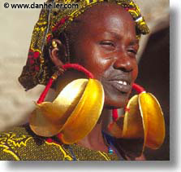
People of Mali – at home, at play, and at work

Slide 51
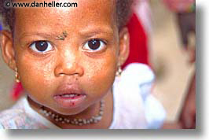









Slide 52







Slide 53


Slide 54


Slide 55


Slide 56


Slide 57


Slide 58


Slide 59


Slide 60


Slide 61


Slide 62


Slide 63


Slide 64


Slide 65


Slide 66

Maintaining cultural ties

Slide 67


Slide 68


Slide 69


Slide 70


Slide 71


Slide 72

Mopti and The Bani River in the life of Mali

Slide 73

Typical Fishing Boat

Slide 74

Sailing

Slide 75

River Crossing

Slide 76

Merchants at Port

Slide 77

River Traders

Slide 78

Waiting for Tourists

Slide 79

Car Ferry

Slide 80

Doing Laundry

Slide 81

Farming by the River

Slide 82

Selling salt

Slide 83

Mopti River and Mosque

Slide 84

Mopti Mosque

Slide 85

Mopti Streets

Slide 86

Distant Mosque

Slide 87

Art of mali

Slide 88


Slide 89


Slide 90



Slide 91


Slide 92



Slide 93






Slide 94


Foods of mali
Couscous Malian Fish Stew

Slide 95


Slide 96


Slide 97


Slide 98

Fried Bean Balls

Slide 99

Sweet Millet Fritters

Slide 100

Peanut Biscuits

