Slide 1

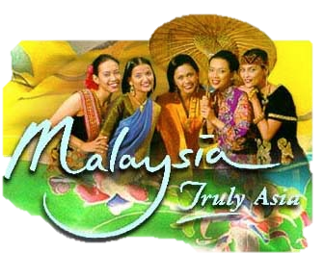
Malaysia

Slide 2
Region: Southeast Asia
Area total: 329,847 km2
Coast line: South China Sea
Capital: Kuala Lumpur

Slide 3
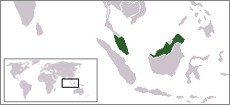
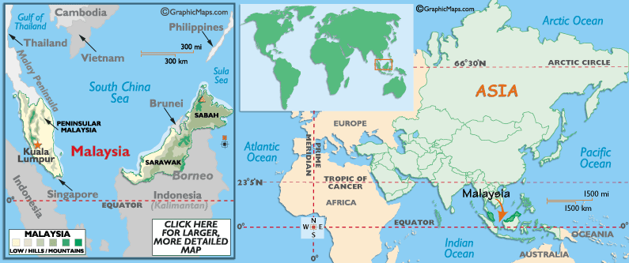

Slide 4
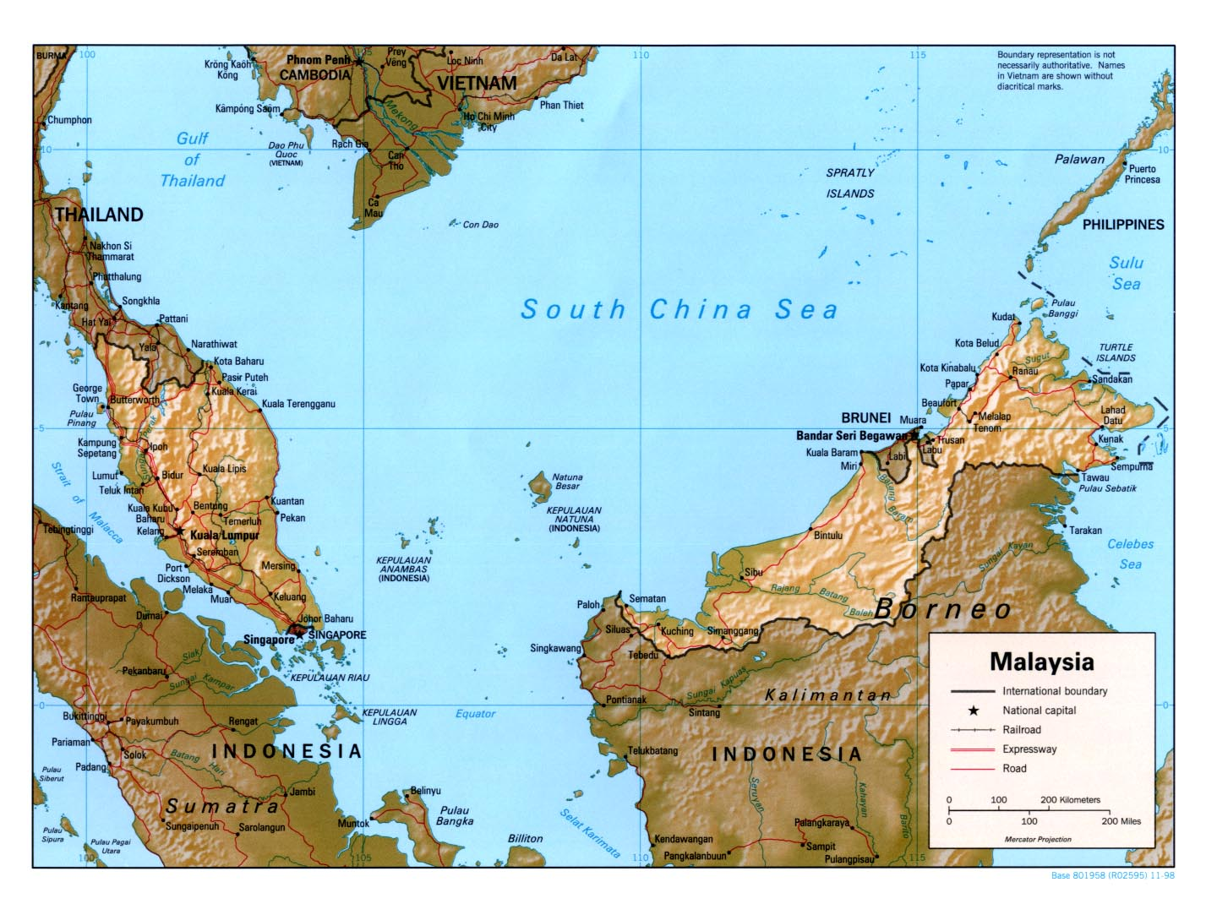

Slide 5
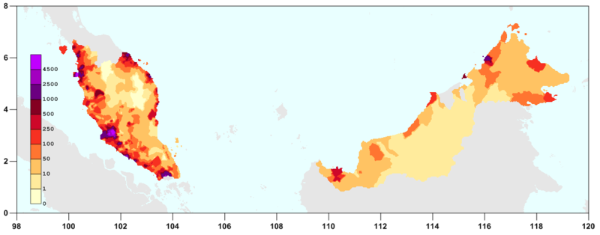
Population Density

Slide 6
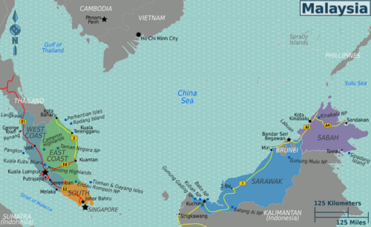

Slide 7
Peninsular Malaysia
West Coast: The more developed side of Peninsular Malaysia, with the states of Kedah, Malacca, Negeri Sembilan, Penang, Perak, Perlis and Selangor, as well as two Federal Territories; Malaysia's capital city Kuala Lumpur and the new administrative centre of Putrajaya, all located within this region. Majority of the chinese population live on the West side.
East Coast: More traditional and Muslim, the islands here are glittering tropical jewels. Made up of the states of Kelantan, Pahang and Terengganu.
South: Comprising just one state, Johor, two coastlines, and endless palm oil plantations.

Slide 8
East Malaysia
Some 800km to the east is East Malaysia (Malaysia Timur), which occupies the northern third of the island of Borneo, shared with Indonesia and tiny Brunei. Partly covered in impenetrable jungle where headhunters roam (on GSM networks if nothing else), East Malaysia is rich in natural resources but very much Malaysia's hinterland for industry and tourism.
Sabah: Superb scuba diving in Sipadan island plus muck diving at Mabul, , nature reserves, the federal enclave of Labuan, and mighty Mount Kinabalu.
Sarawak: Jungles, national parks, and traditional longhouses..

Slide 9
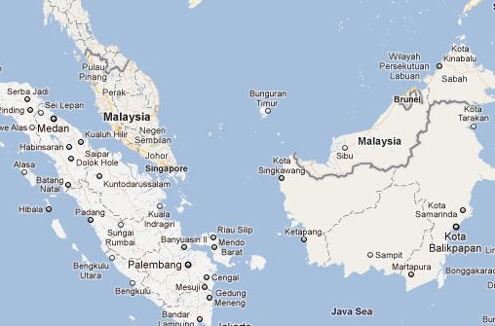

Slide 10
Cities
Kuala Lumpur — the multi-cultural capital, home of the Petronas Towers
George Town — the cultural and cuisine capital of Penang
Ipoh — capital of Perak with historic colonial old town
Johor Bahru — capital of Johor, and gateway to Singapore
Kuantan - capital of Pahang, and commercial centre of the east coast
Kota Kinabalu — capital of Sabah
Kuching — capital of Sarawak
Malacca (Melaka) — the historical city of Malaysia with colonial-style architecture
Miri — resort city of Sarawak and gateway to UNESCO World Heritage Site Gunung Mulu National Park

Slide 11
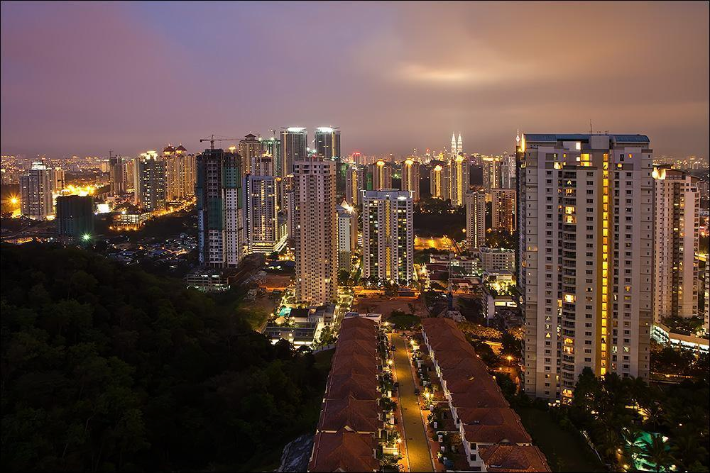
Kuala Lumpur

Slide 12
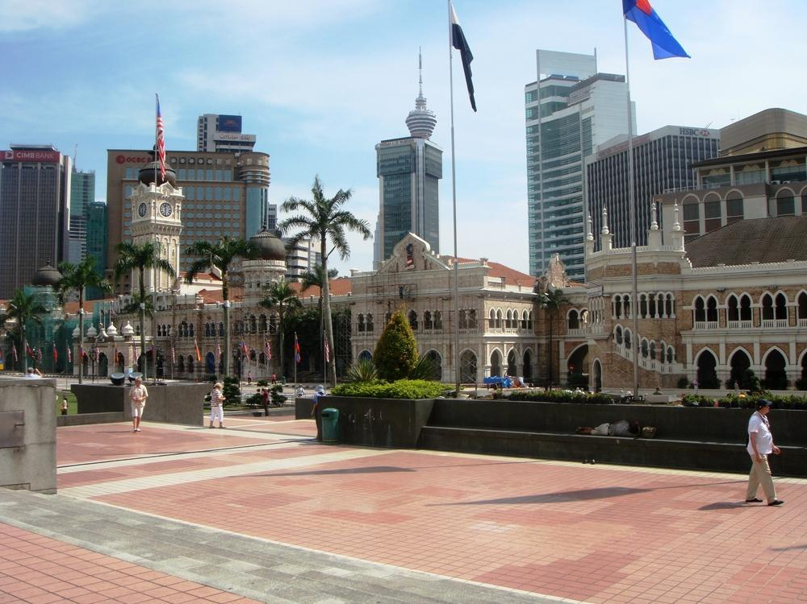

Slide 13
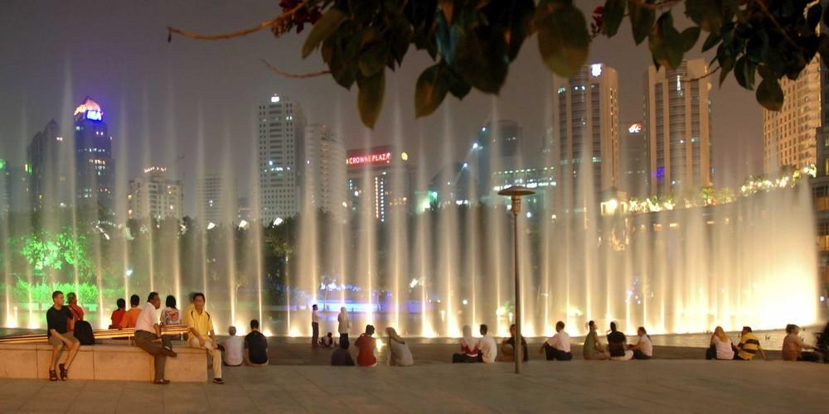

Slide 14
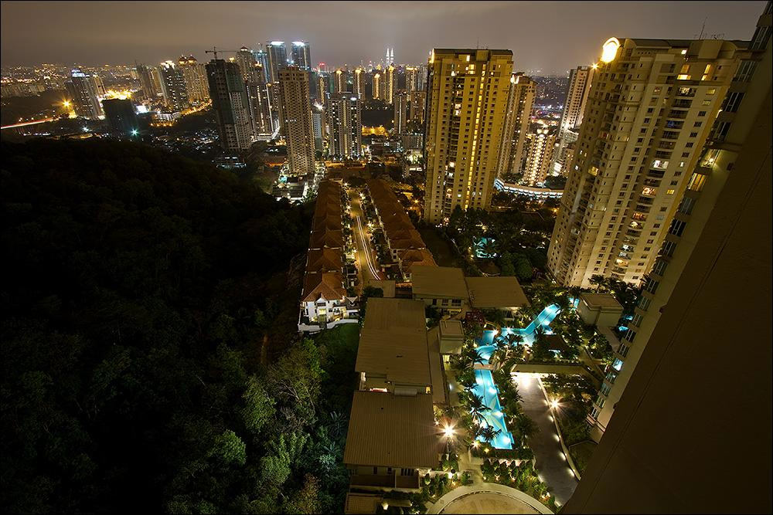

Slide 15
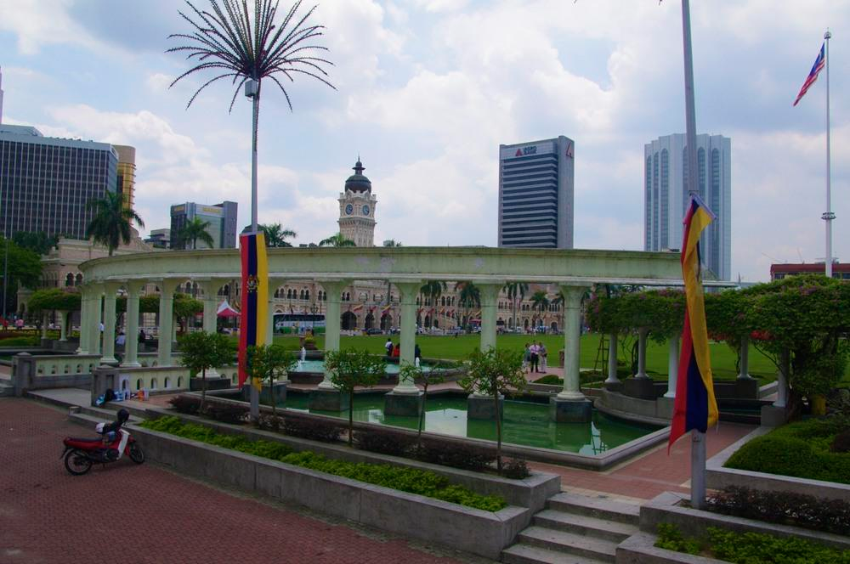
Independence Square

Slide 16
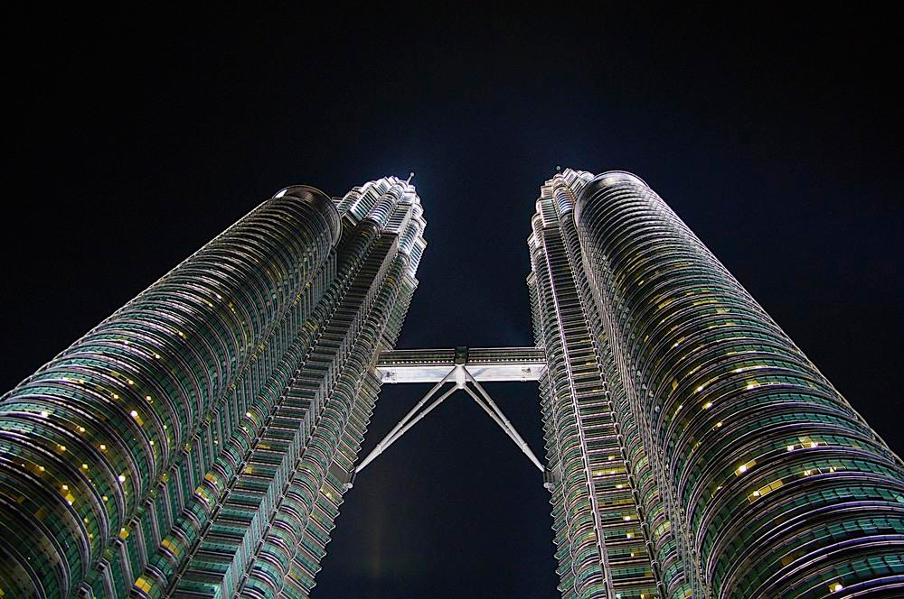
Petronas Towers – tallest buildings in the world for a short while

Slide 17
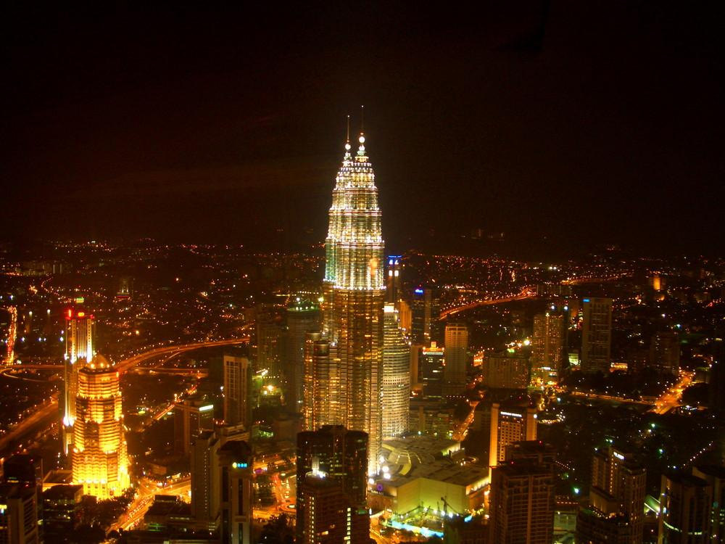

Slide 18
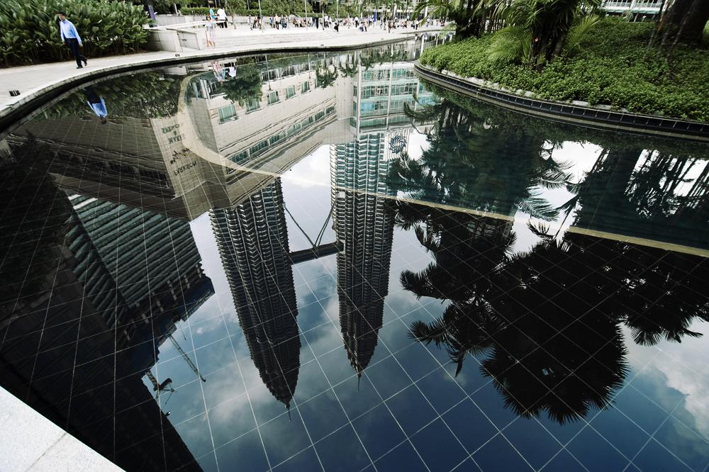

Slide 19
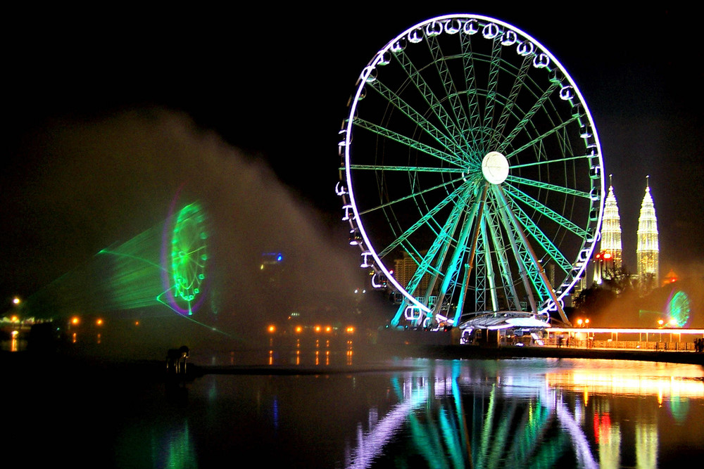
Eye of Kuala Lumpur - Malaysia

Slide 20
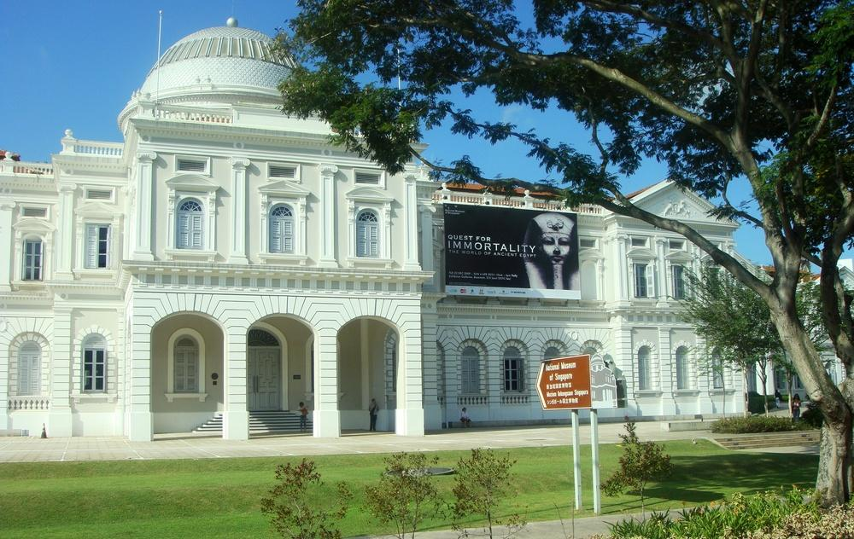
National Museum-Taman Tasik Perdana -Kuala Lumpur

Slide 21
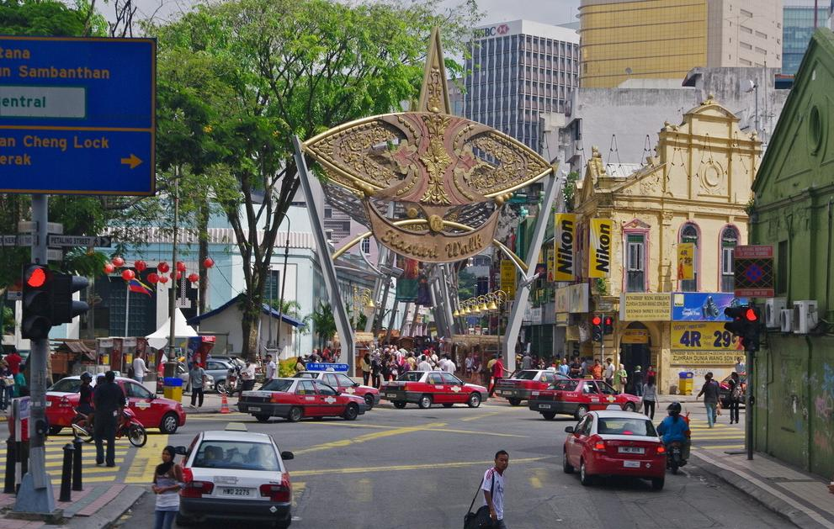
Chinatown – Kuala Lumpur

Slide 22
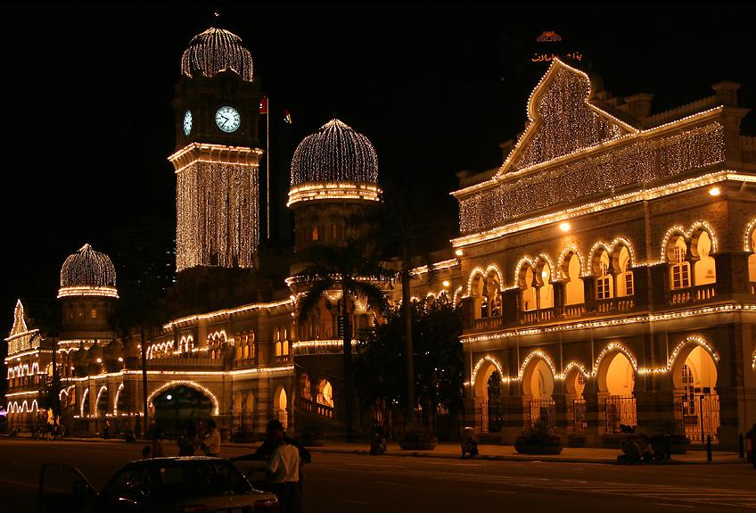
Sultan Abdul Samad Building by night, Kuala Lumpur

Slide 23
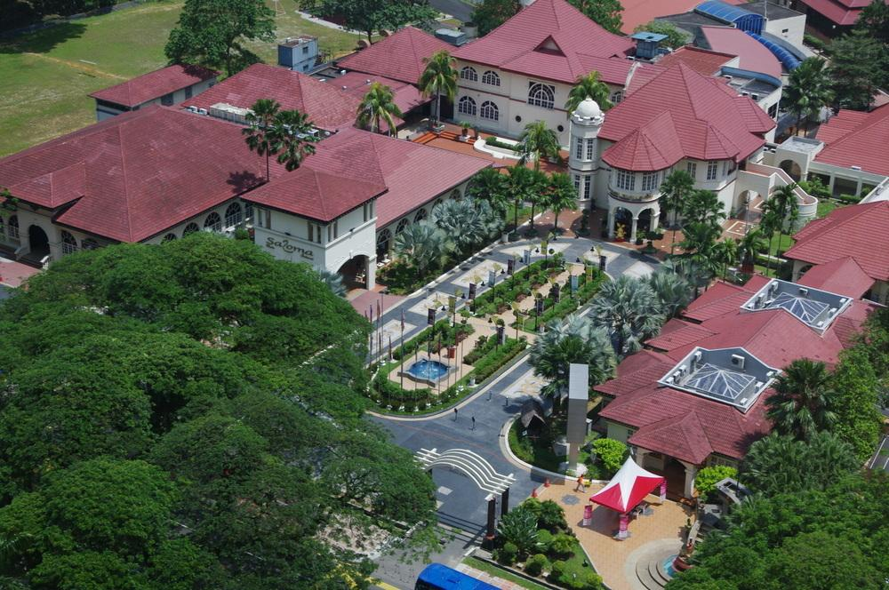
Tourist Information

Slide 24
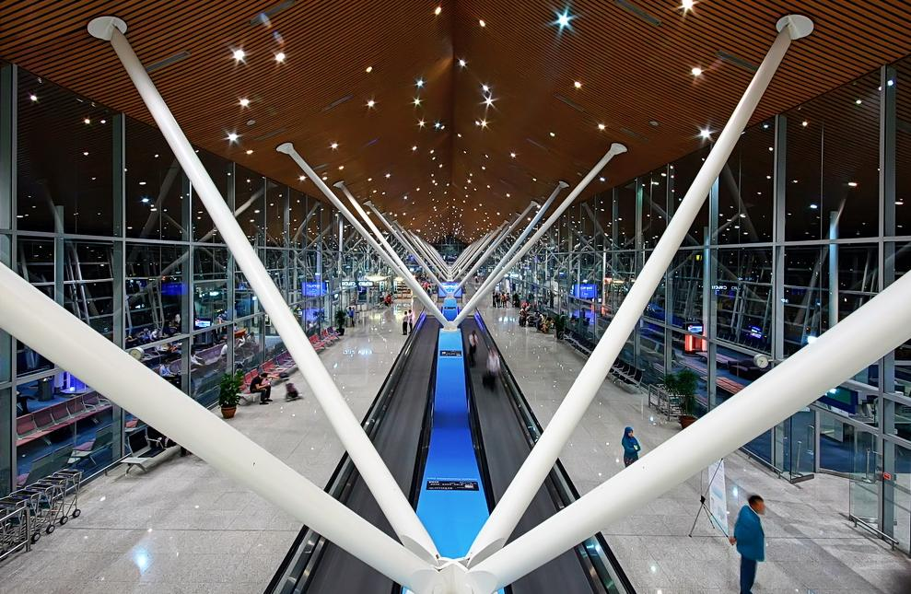
Kuala Lumpur Airport

Slide 25
Business, Commerce, & Employment

Slide 26
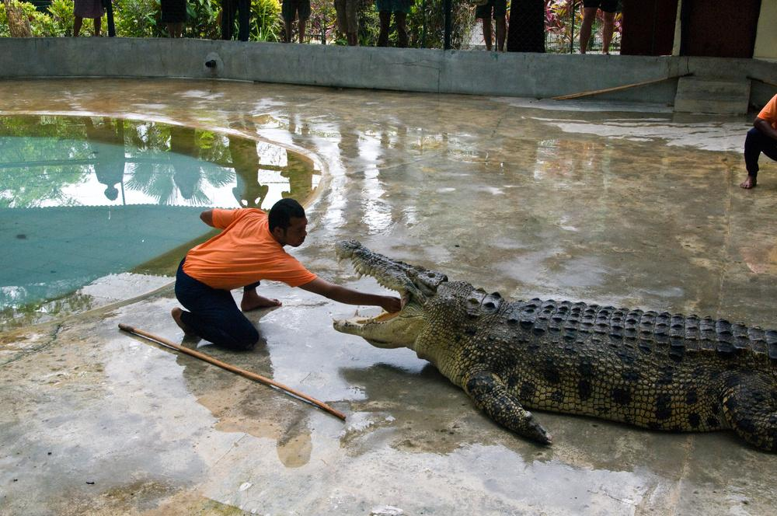

Slide 27
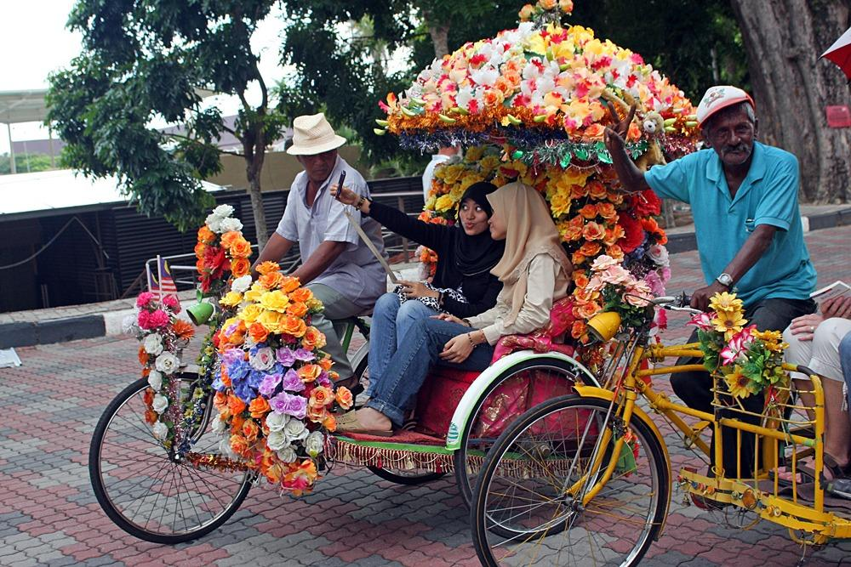

Slide 28
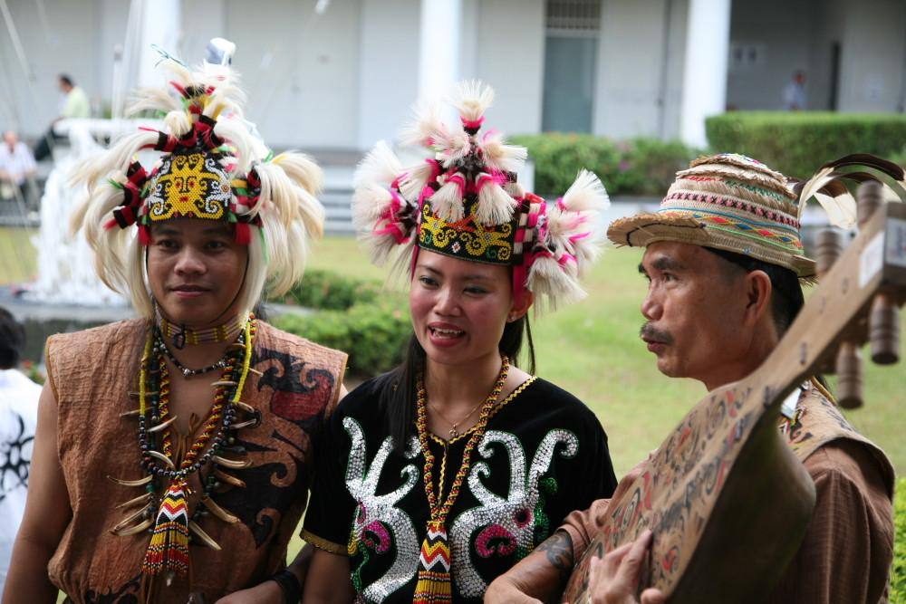

Slide 29
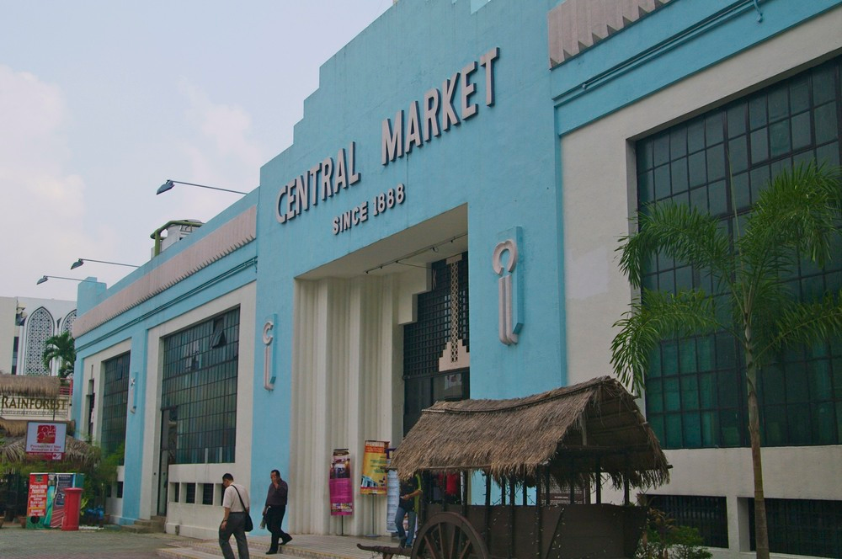

Slide 30
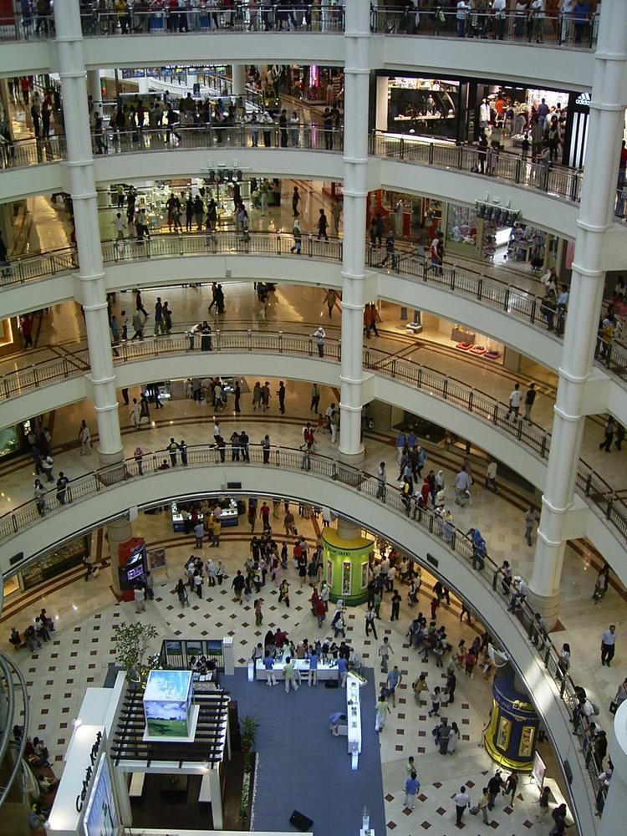

Slide 31
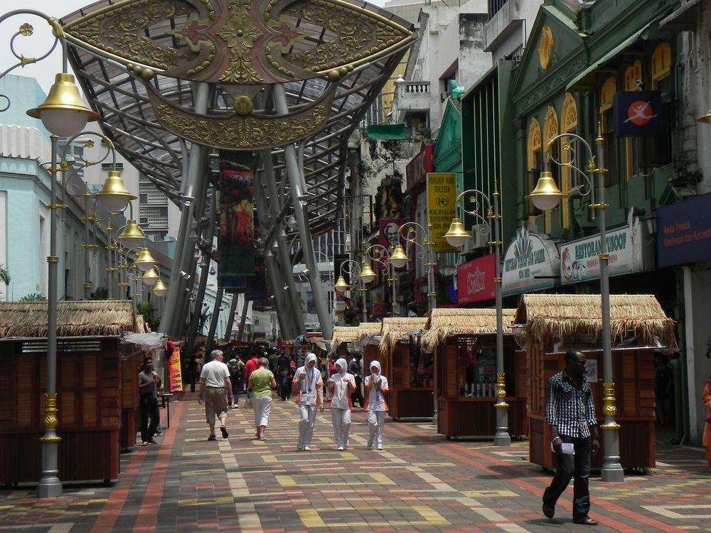

Slide 32
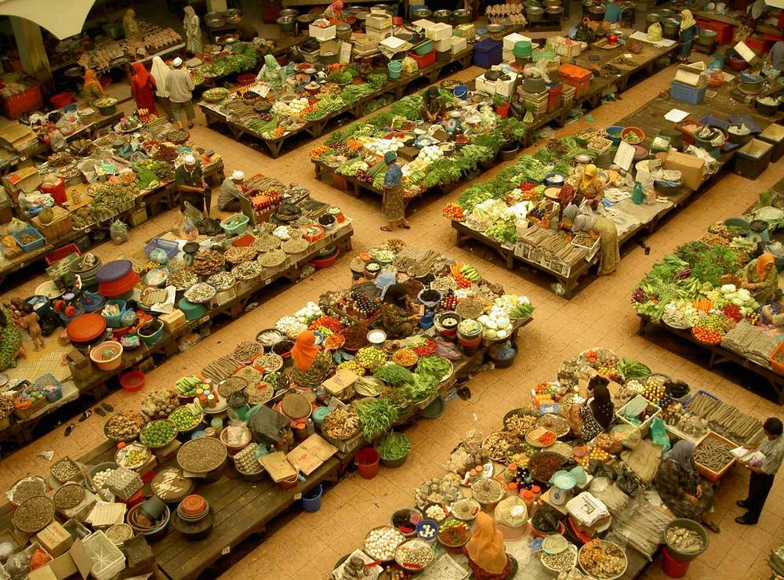

Slide 33
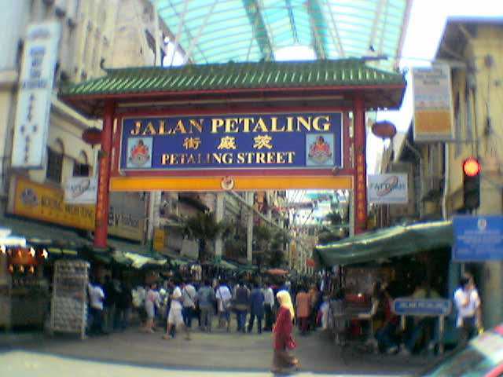

Slide 34
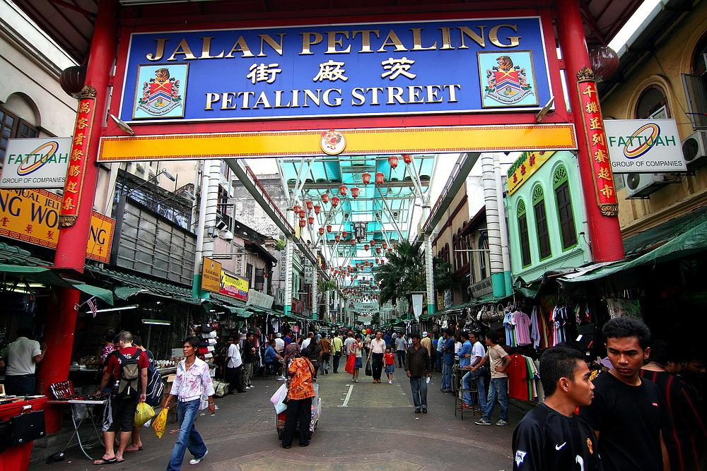

Slide 35
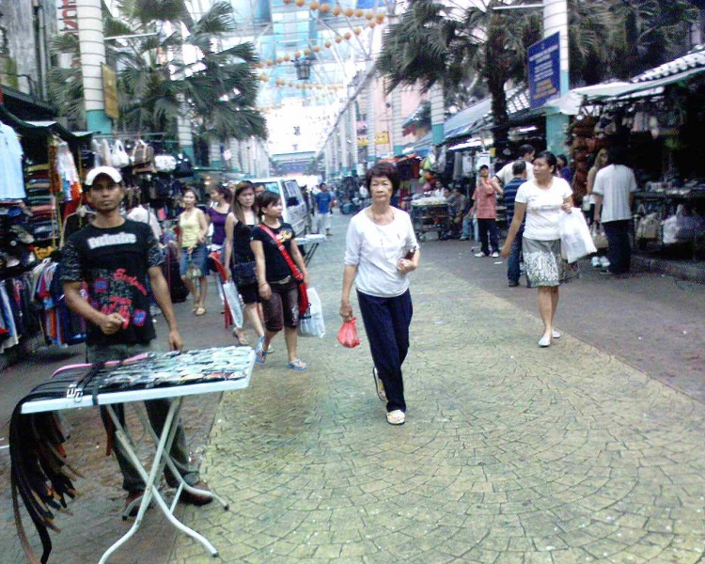
Petaling Street October 2006

Slide 36
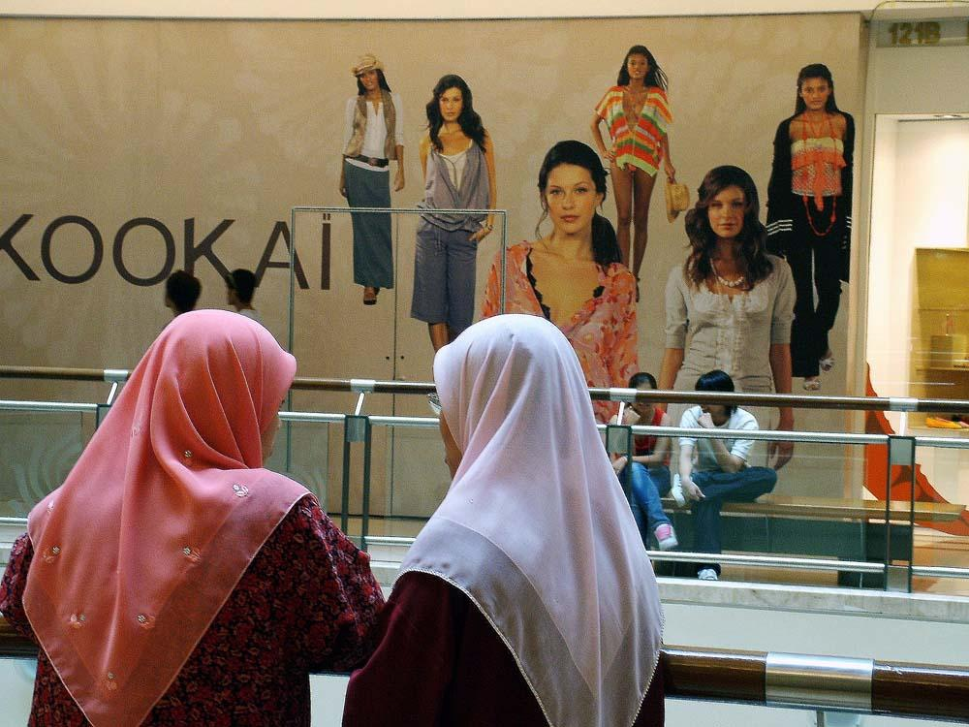

Slide 37
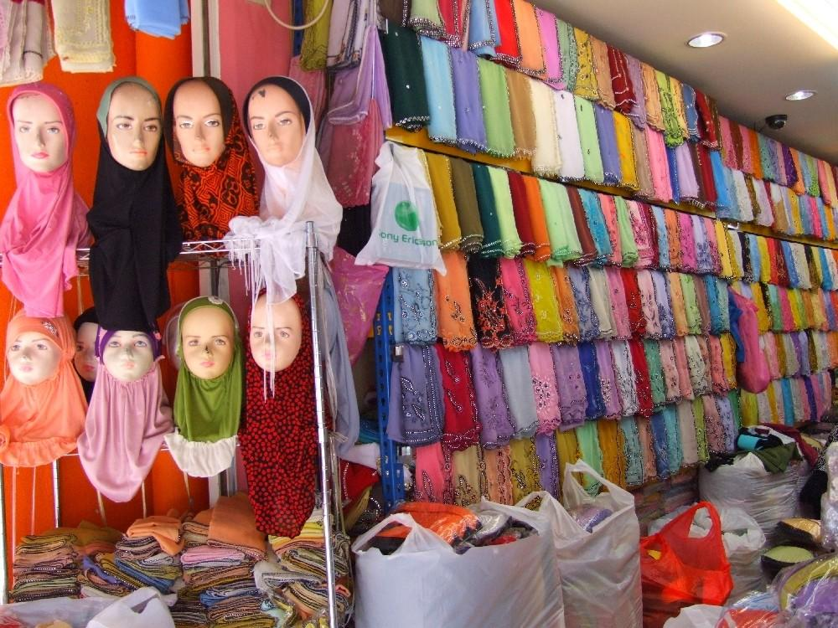

Slide 38
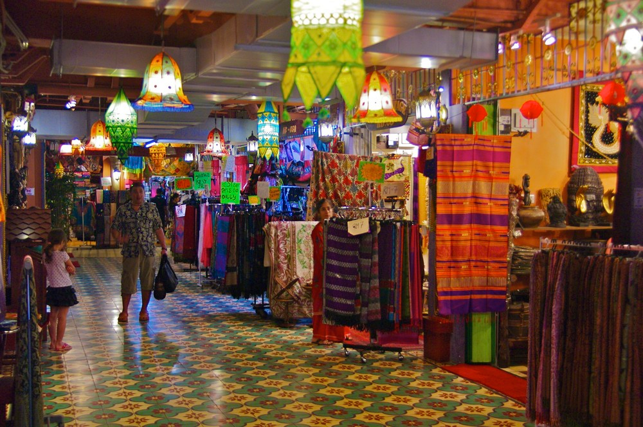

Slide 39
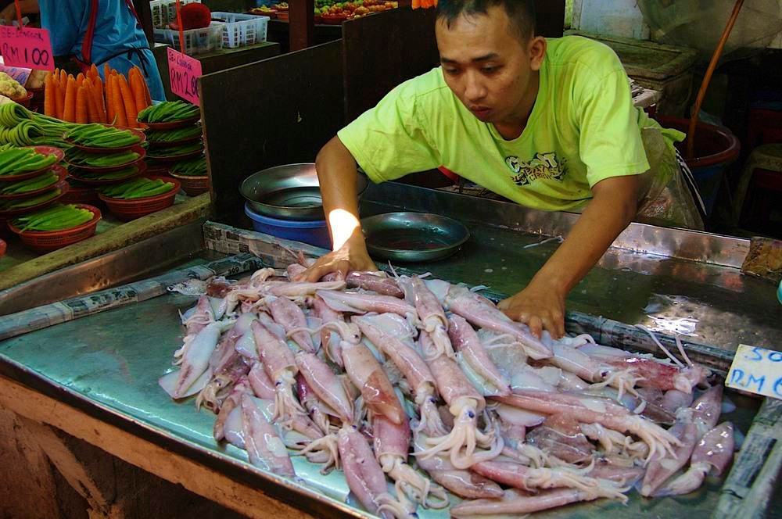

Slide 40
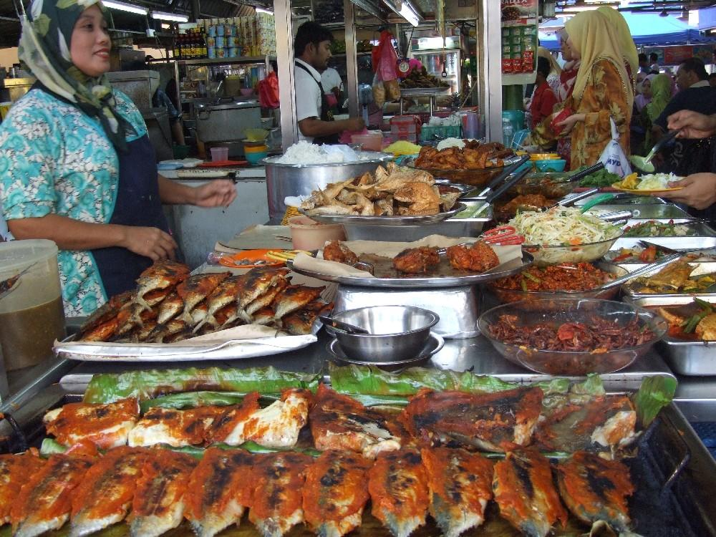

Slide 41
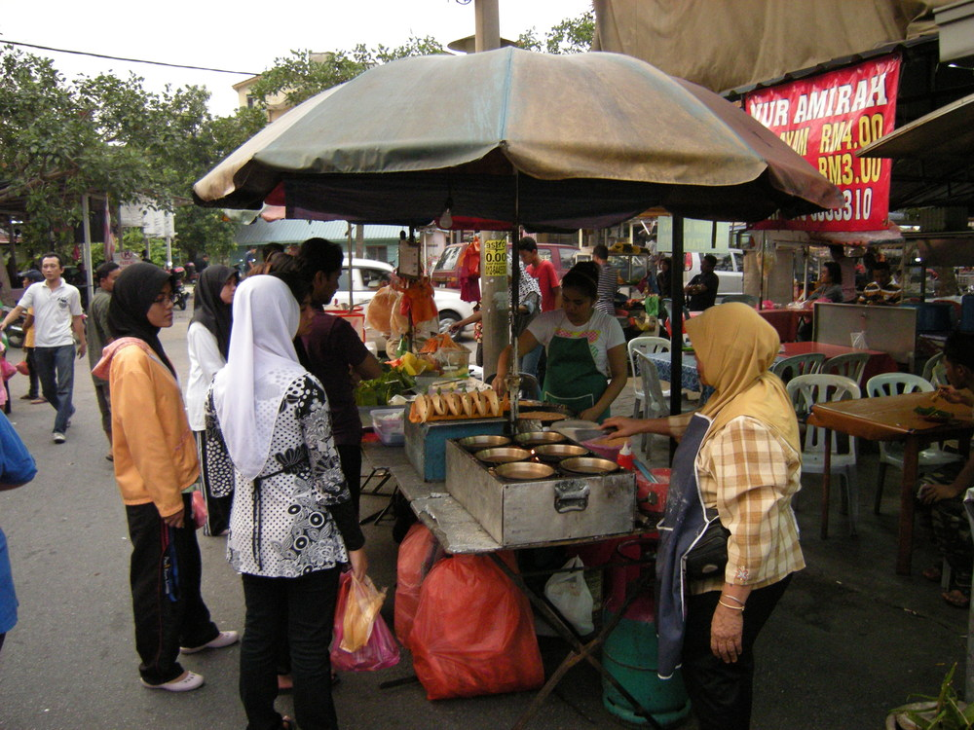

Slide 42
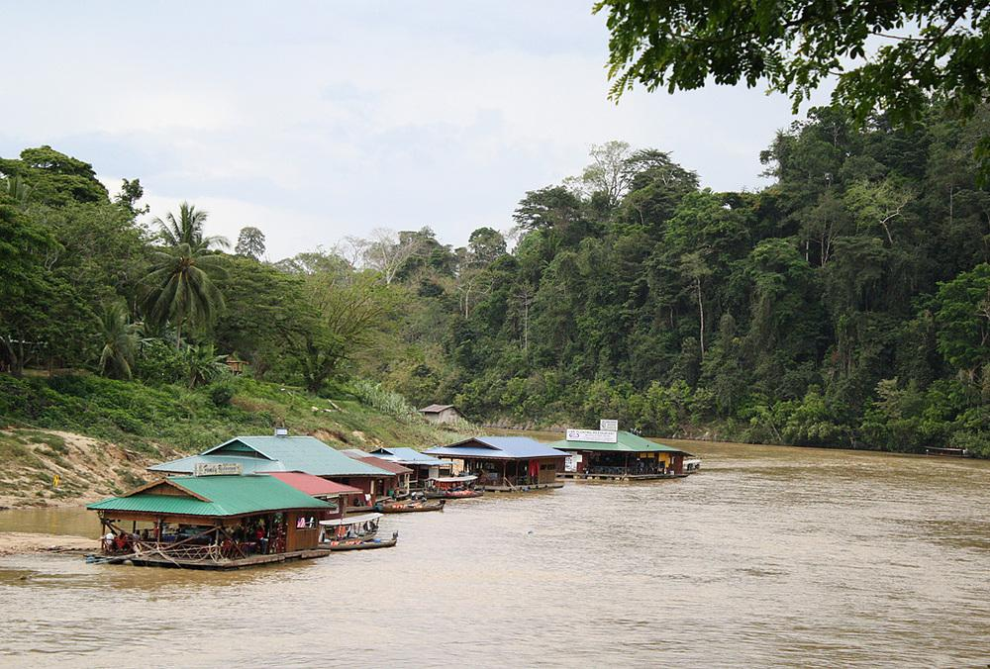
Taman Negara floating restaurants

Slide 43
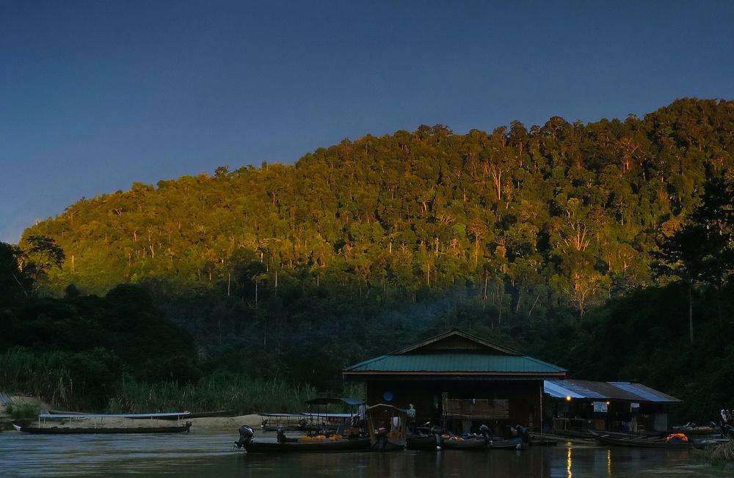
Taman Negara - Sungai -Tembeling

Slide 44
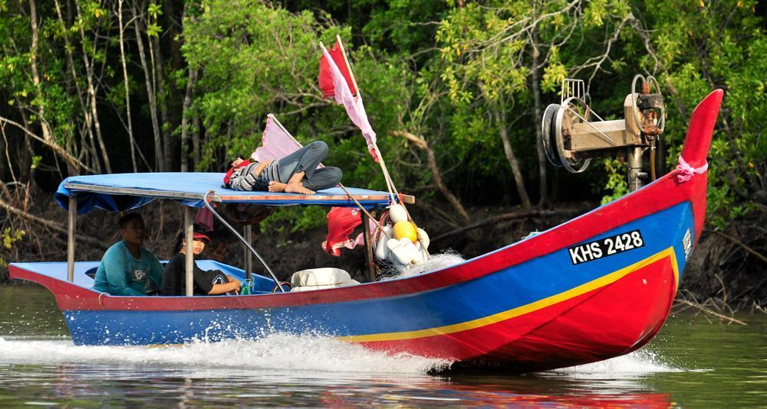

Slide 45
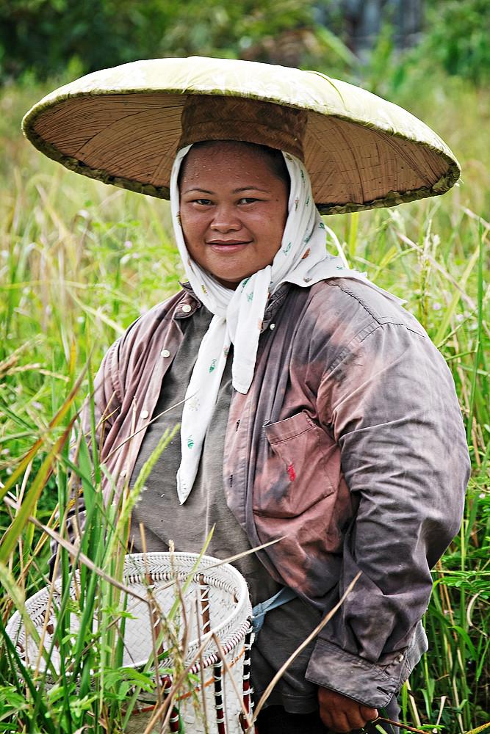

Slide 46
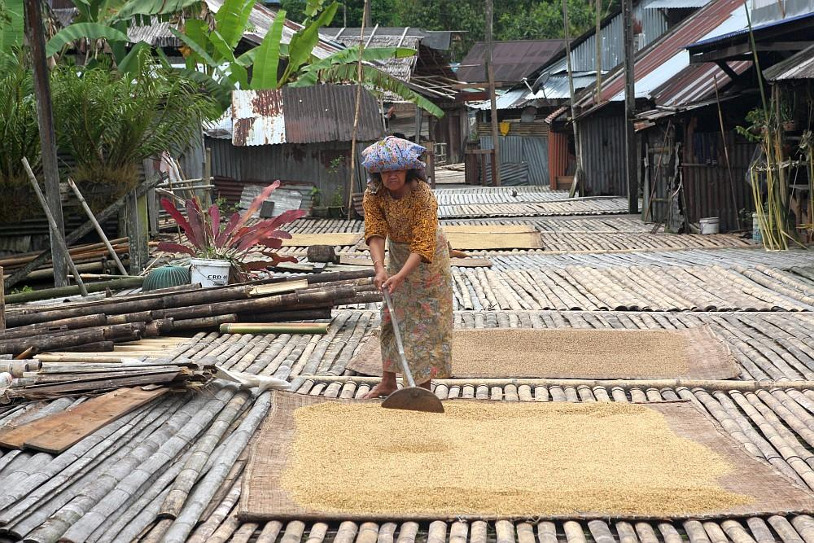

Slide 47
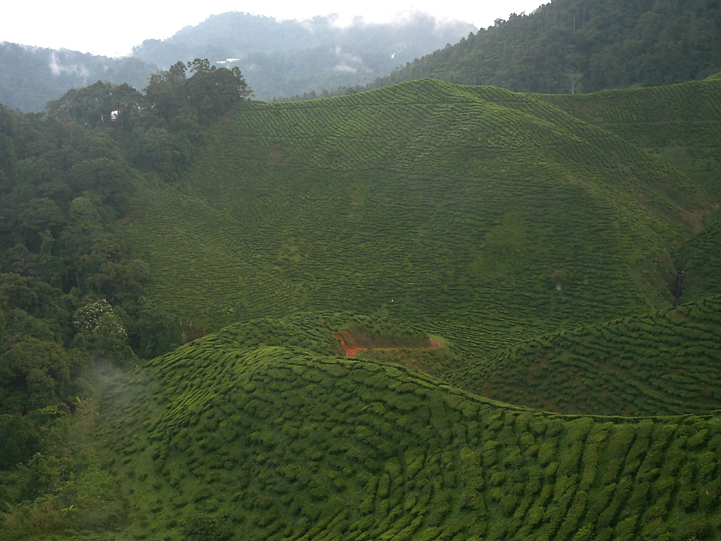
Tea Plantation

Slide 48
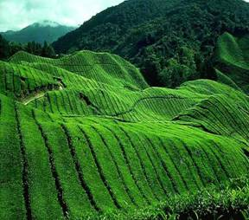

Slide 49
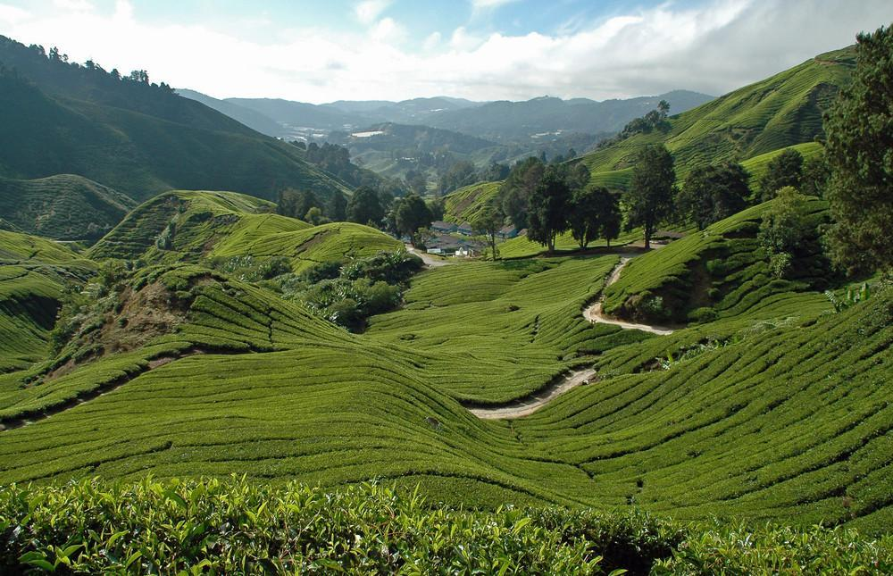
Valley of Tea Plantations

Slide 50
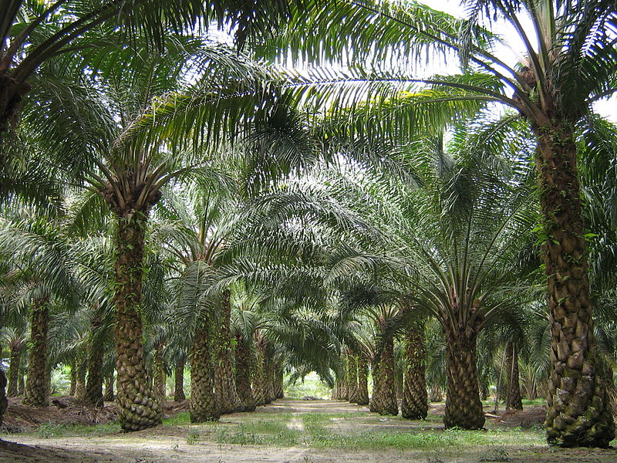
Oil Palm Plantation

Slide 51
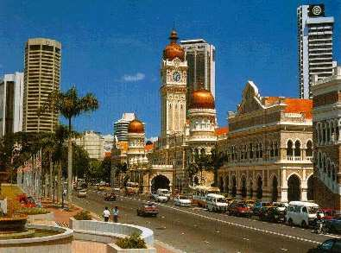

Slide 52
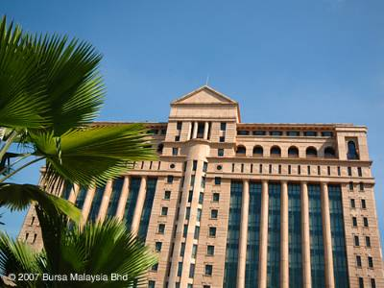
Bursa Malaysia - The Kuala Lumpur Stock Exchange -

Slide 53
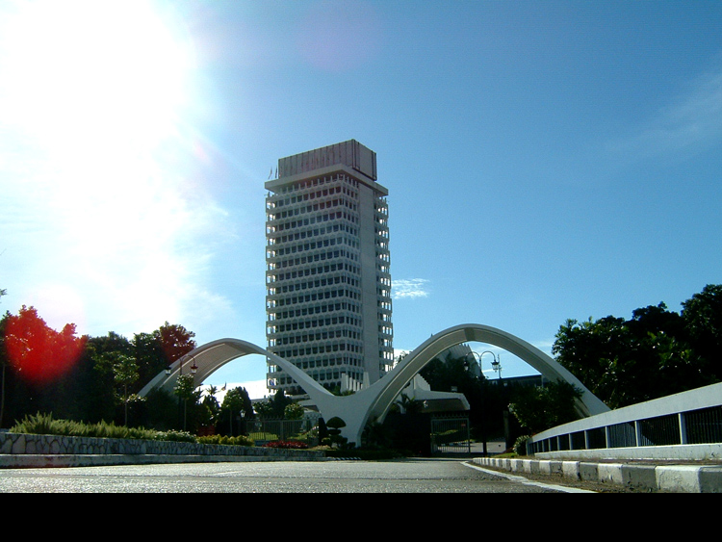
Malaysian Parliament

Slide 54
Places of Interest
Perhentian Islands (Pulau Perhentian) — glittering jewels off the East Coast still undiscovered by mass tourism
Redang (Pulau Redang) — popular island destination for scuba divers
Taman Negara National Park — a large area of rainforest spanning Kelantan, Pahang and Terengganu
Penang — formerly known as the "Pearl of the Orient", now bustling island with excellent cuisine which has retained more colonial heritage than anywhere else in the country
Cameron Highlands — famous for its tea plantations
Fraser's Hill — a time warp to the colonial era
Kinabalu National Park — home of Mount Kinabalu, the tallest mountain in South East Asia
Langkawi — an archipelago of 99 islands known for beaches, rainforest, mountains, mangrove estuaries and unique nature.
Tioman (Pulau Tioman) — once nominated one of the most beautiful islands in the world

Slide 55
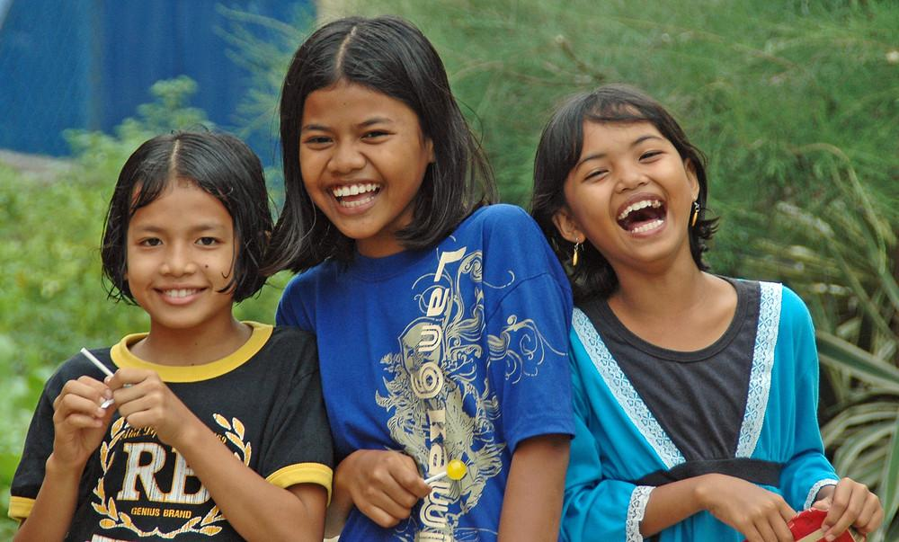

Slide 56


Slide 57

Malaysian House

Slide 58


Slide 59


Slide 60


Slide 61


Slide 62

Turtle Bay Pulau Perhentian

Slide 63

Langkawi

Slide 64

Langkawi Island Waterfall

Slide 65

Tanah Rata, Cameron Highlands

Slide 66

Terengganu

Slide 67

Penang Global City Center

Slide 68


Slide 69


Slide 70


Slide 71

Georgetown, Penang

Slide 72

Georgetown-Penang

Slide 73

Malacca

Slide 74

A Famosa-Malacca

Slide 75

Malacca house

Slide 76

Jalan Raja

Slide 77

Pulau Gaya Sabah

Slide 78

The Sultan Ibrahim Building in Johor Bahru is the government seat of the Johor state government.

Slide 79

The Perdana Putra is a building in Putrajaya, Malaysia which houses the office complex of the Prime Minister of Malaysia

Slide 80

Pulau Gaya Sabah

Slide 81


Slide 82


Slide 83


Slide 84


Slide 85


Slide 86

River Tembeling

Slide 87

Lankayan Island- diving resort

Slide 88

Langkawi Island

Slide 89

Langkawi Cable Car

Slide 90

Langkawi Cable Car top view

Slide 91

Langkawi swinging (sky bridge)

Slide 92


Slide 93

Langkawi Halong Bay

Slide 94

Langkawi - Tengah Beach

Slide 95

Langkawi-Tengah beach jelly fish sting awareness

Slide 96

Tioman Island - Salang Bay

Slide 97

Mount Kinnabalu - Borneo

Slide 98

Deer Cave - Borneo

