Slide 1
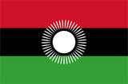
Malawi

Slide 2
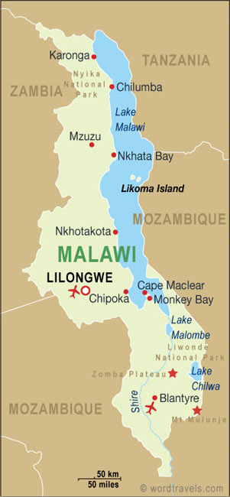
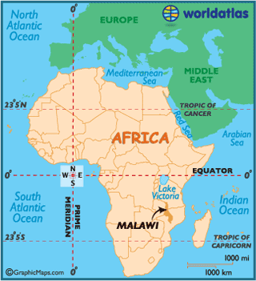
Region: Southeast Africa
Area total: 118,484 km²
Coast line: Landlocked country
Capital: Lilongwe

Slide 3
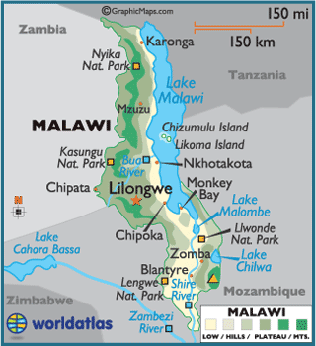
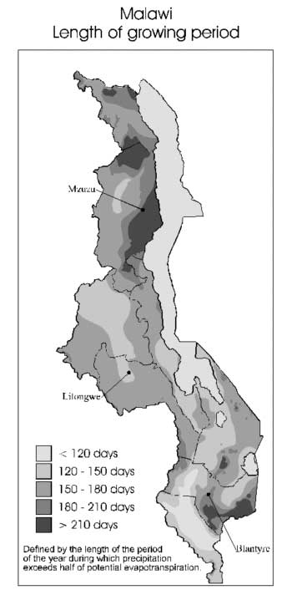
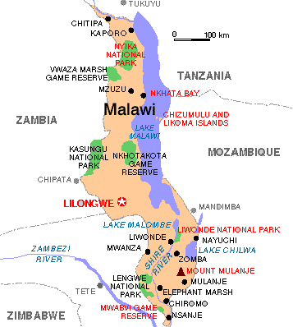

Slide 4
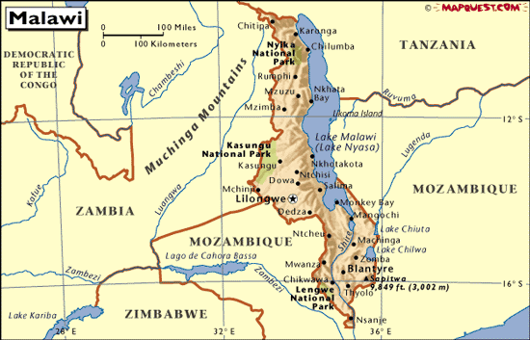

Slide 5
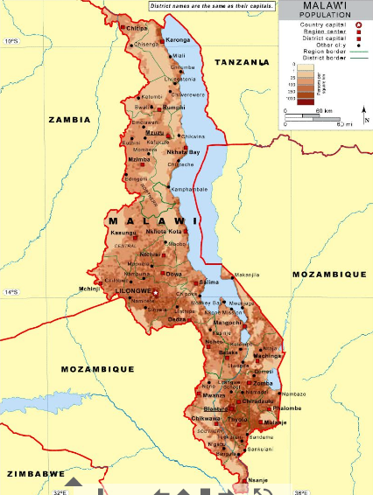
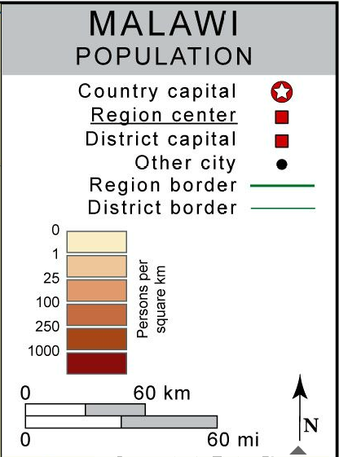

Slide 6
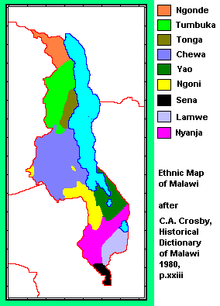
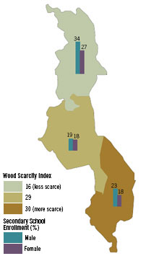

Slide 7
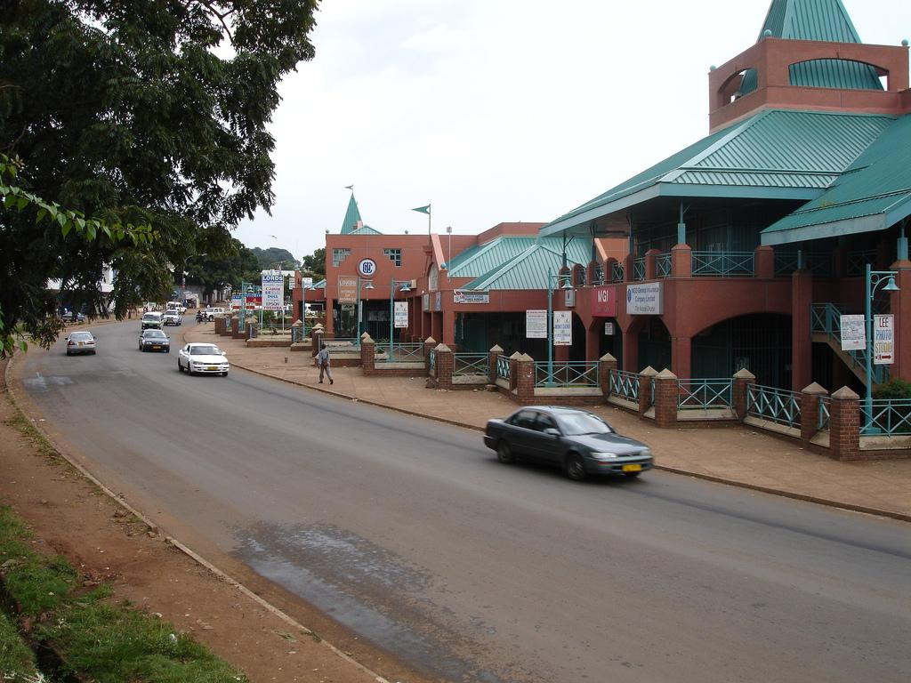
Lilongwe

Slide 8
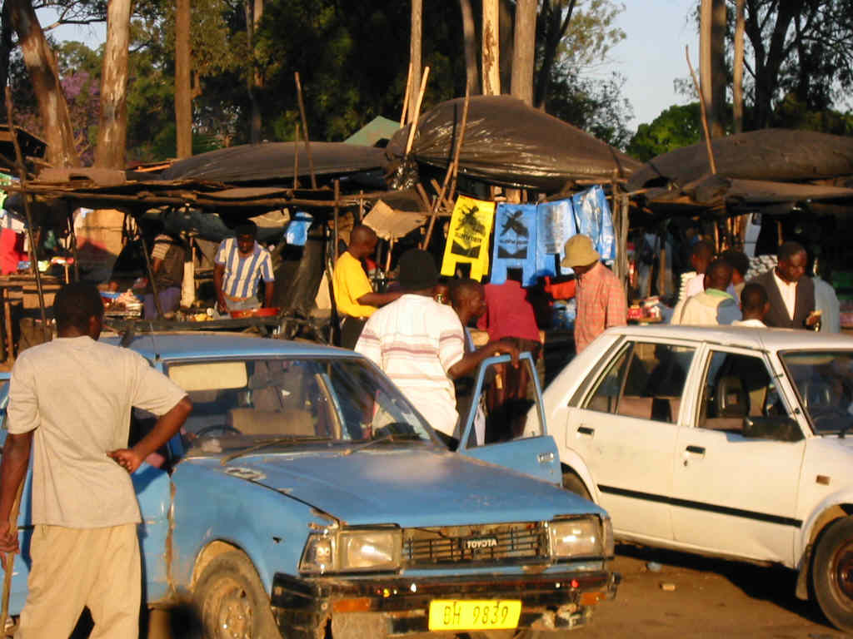

Slide 9
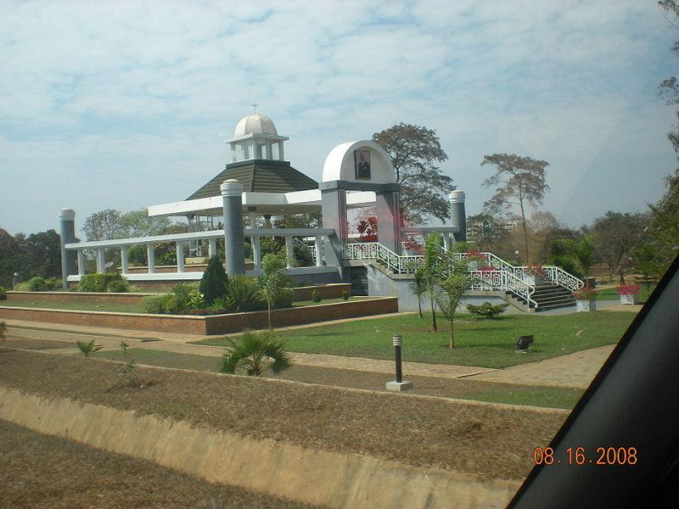
Kamuzu Mausoleum, Lilongwe, Malawi. This is the resting place for Malawi's first President, Dr. Hastings Kamuzu Banda

Slide 10
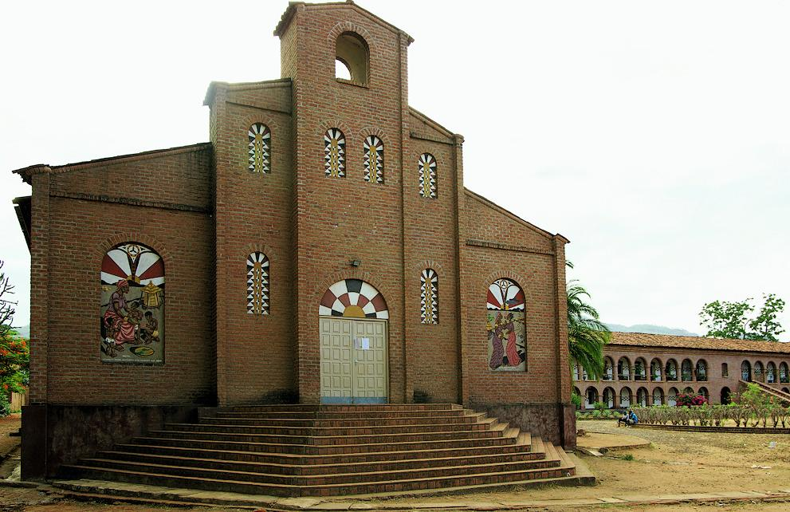
Church in Mua mission

Slide 11
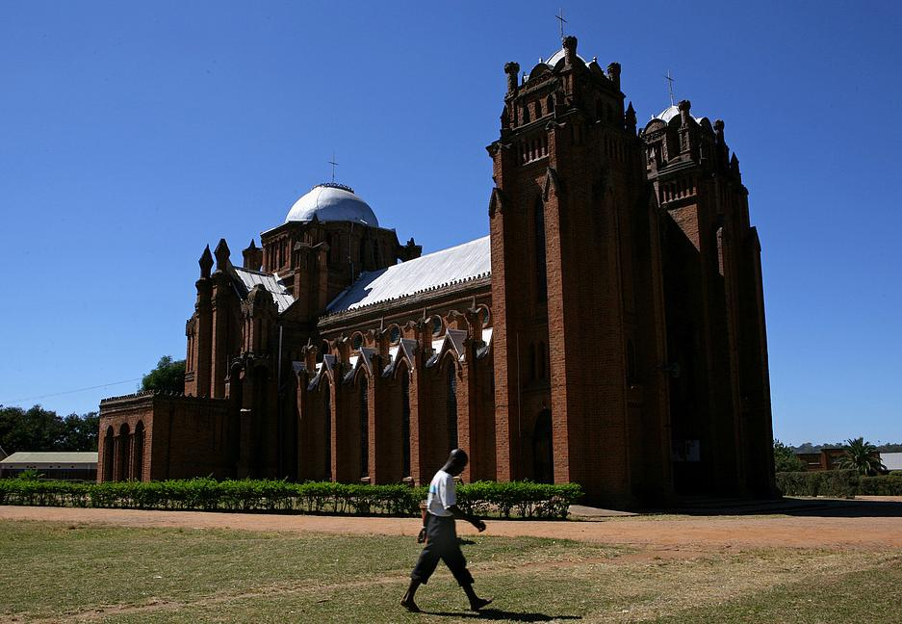
St. Michael's Presbyterian Church, Blantyre, Malawi

Slide 12
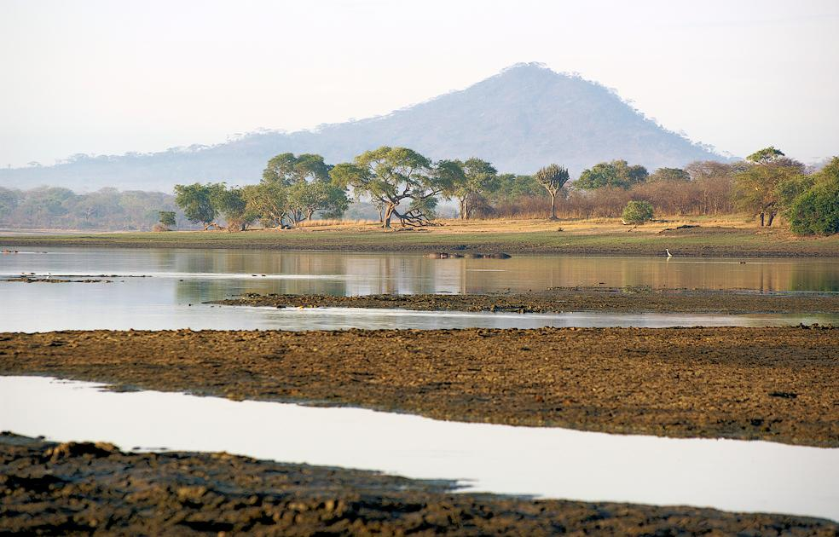
Lake Kazuni

Slide 13
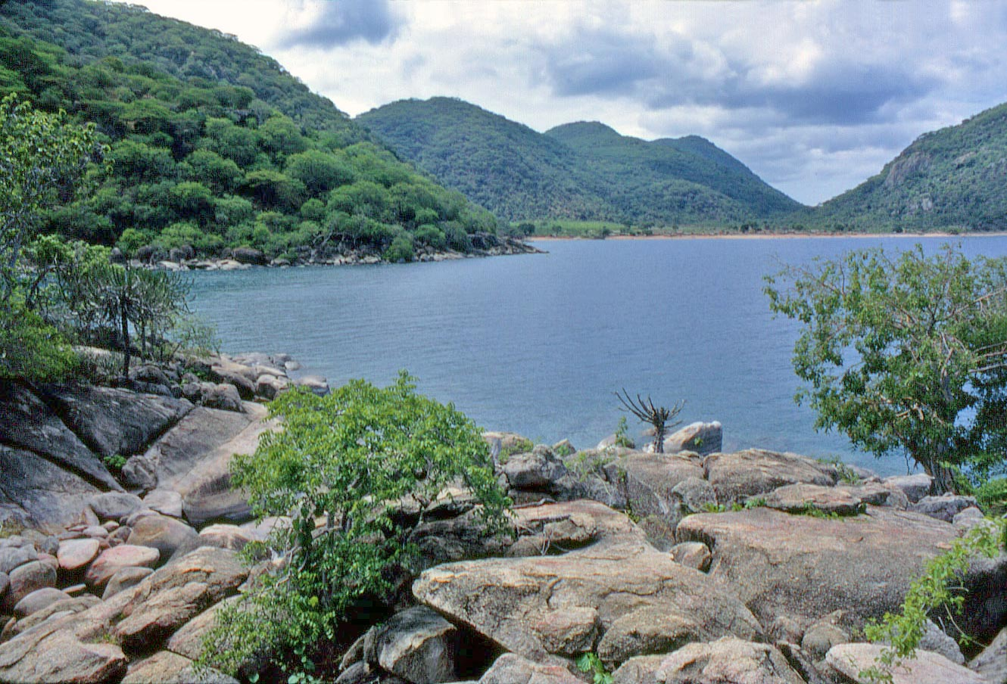
Lake Malawi

Slide 14
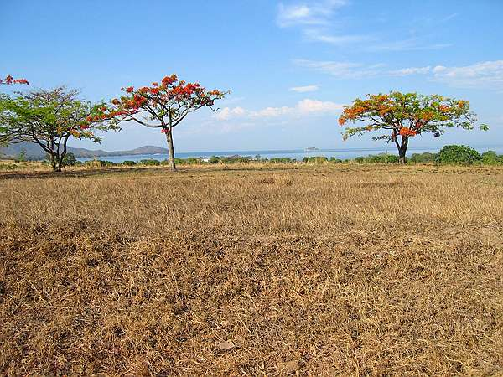
Savanna grassland

Slide 15
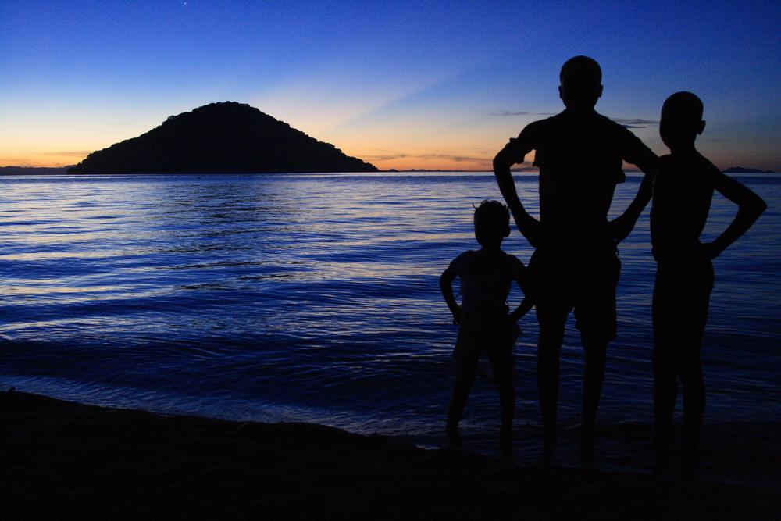
Lake Malawi

Slide 16
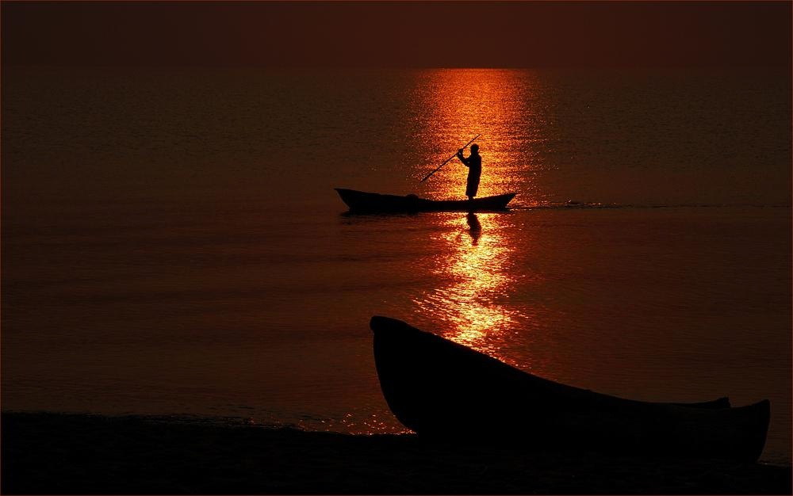
Lake Malawi

Slide 17
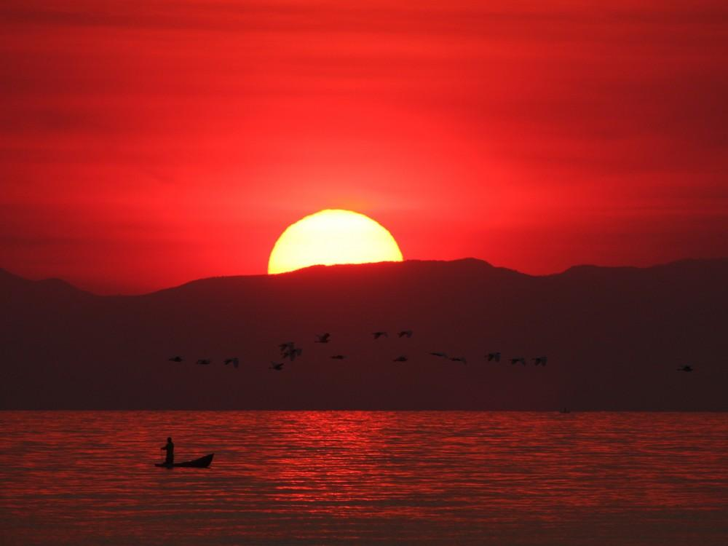
Lake Malawi

Slide 18
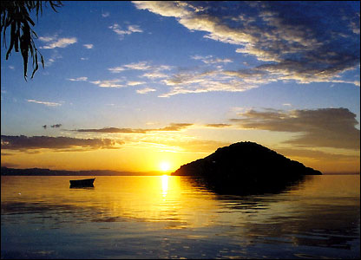

Slide 19
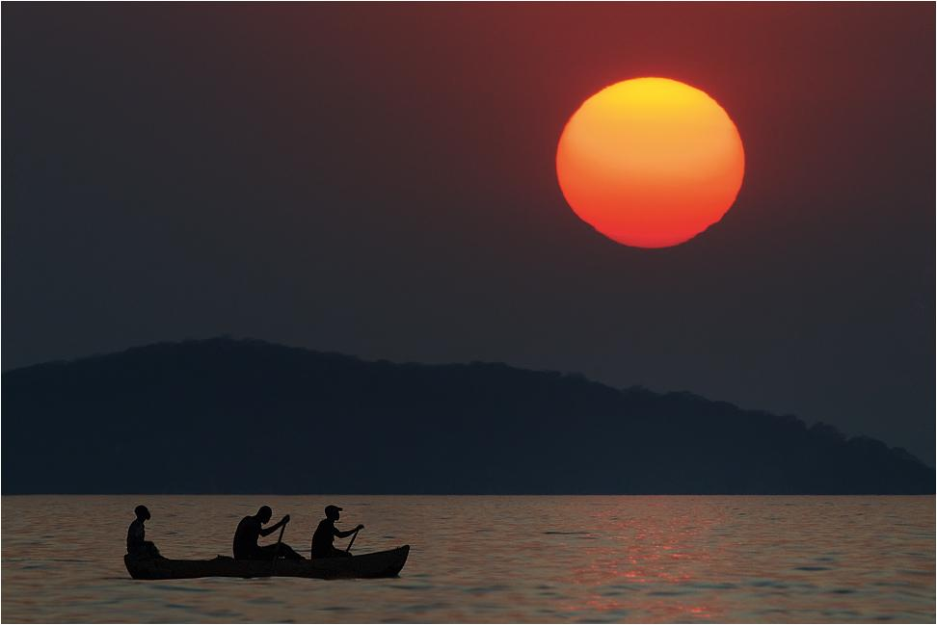
Canoe tour

Slide 20
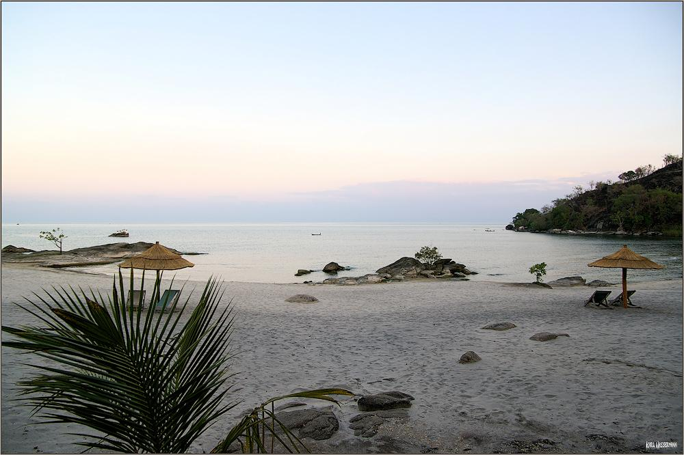
Makuzi Beach

Slide 21
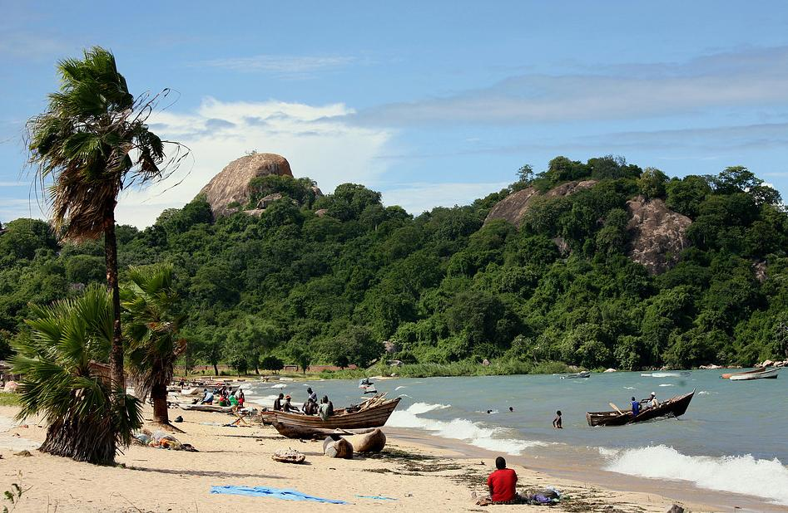
Monkey Bay

Slide 22
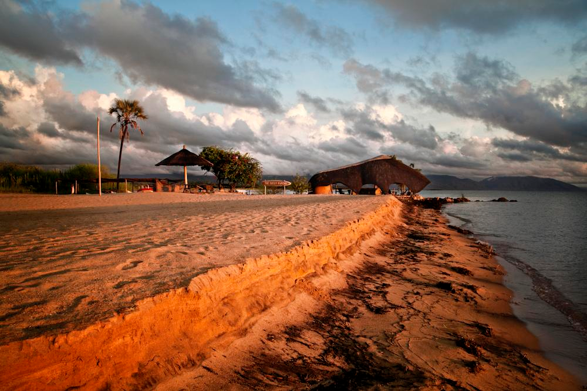
Ngala Beach

Slide 23
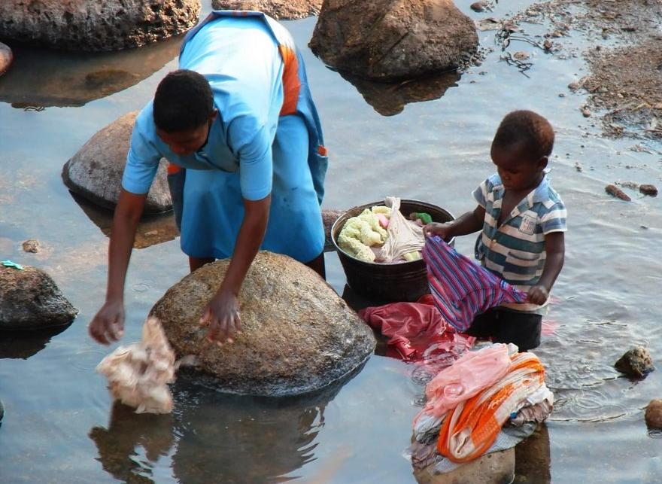

Slide 24
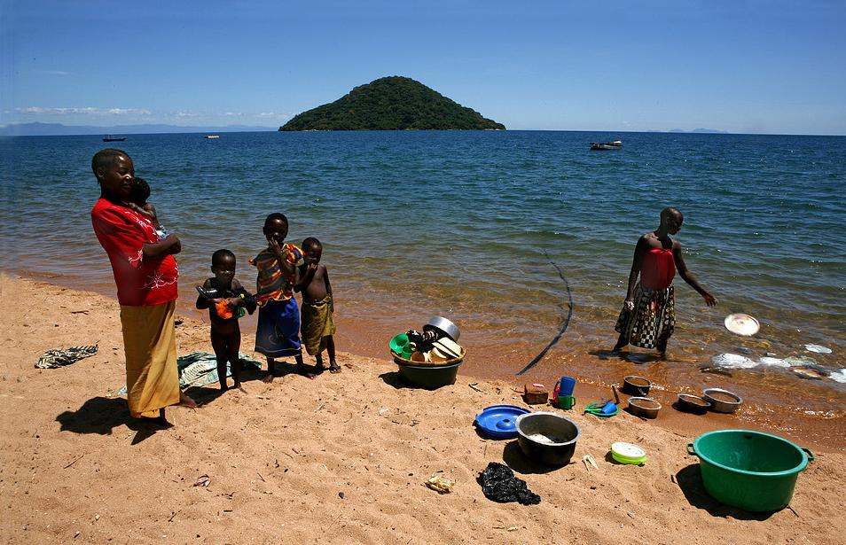

Slide 25
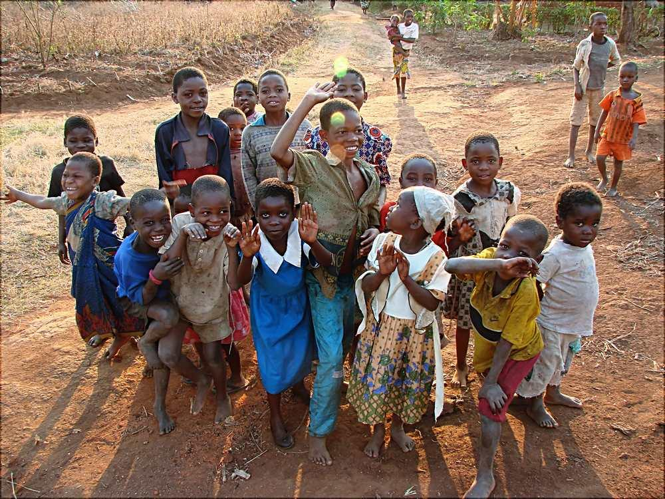

Slide 26
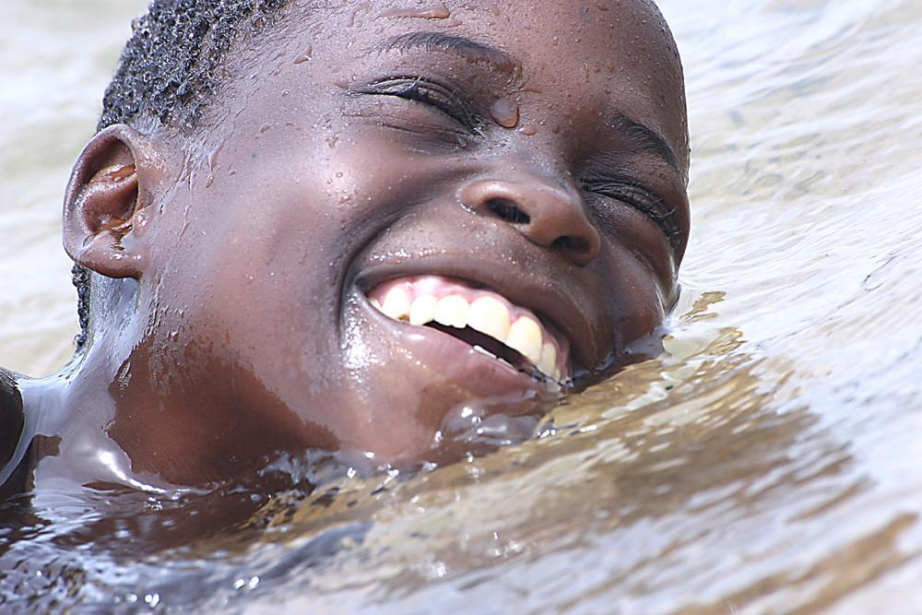

Slide 27
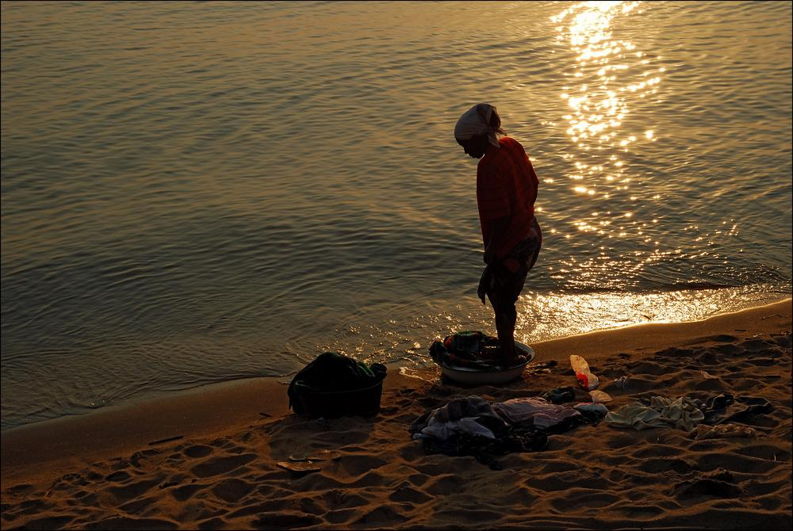

Slide 28
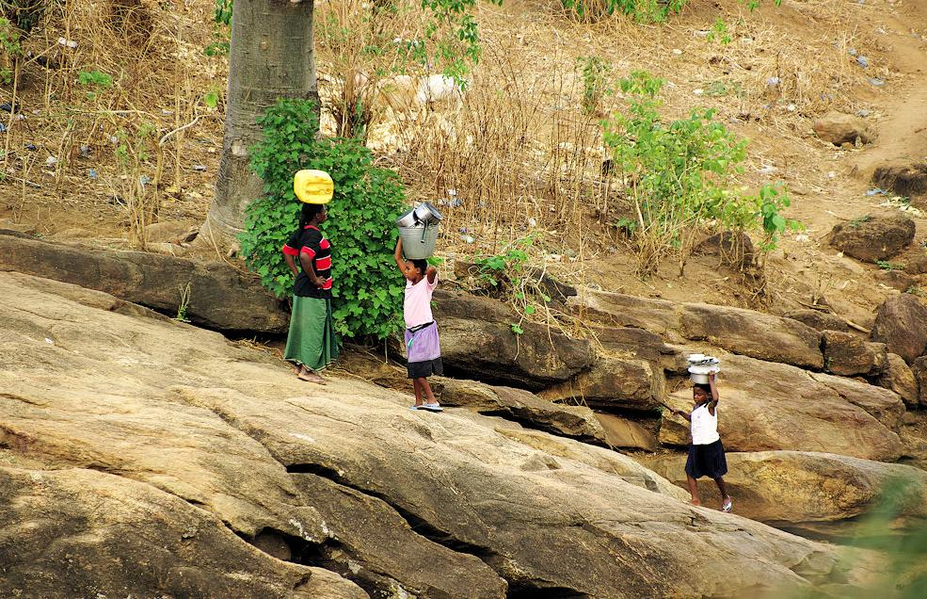

Slide 29
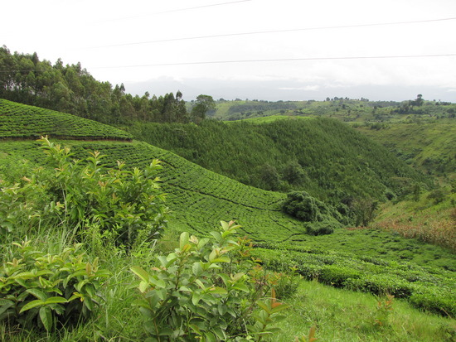
Tea Farms

Slide 30
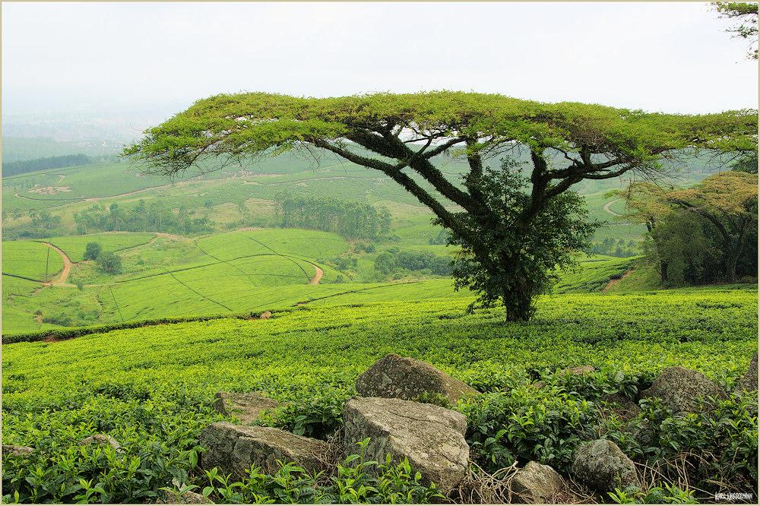
Satmawa Tea Estate

Slide 31
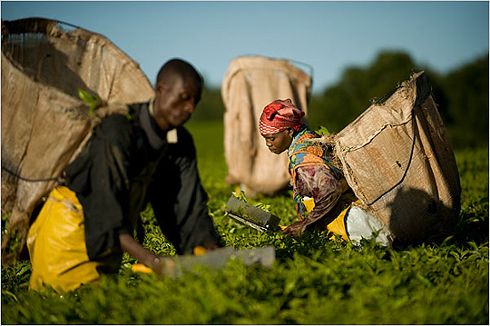
Harvesting tea leaves

Slide 32
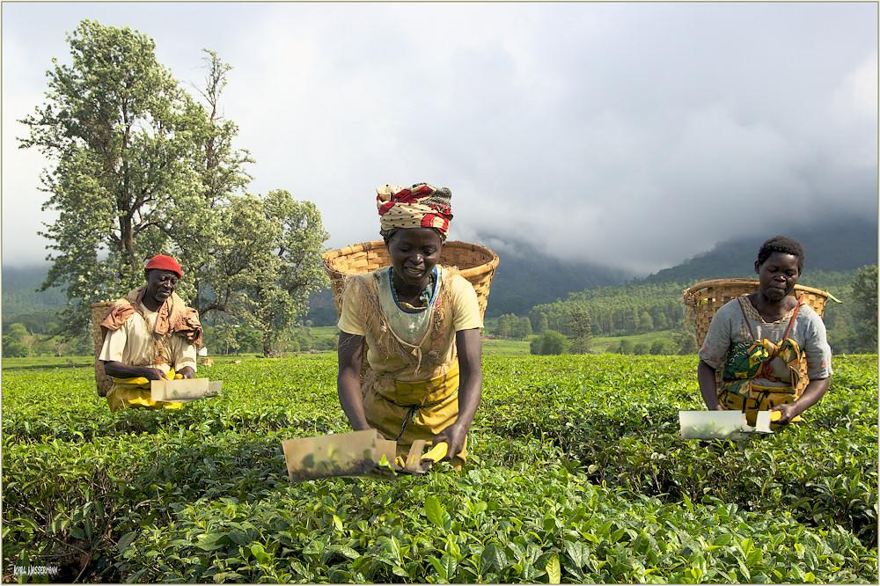

Slide 33
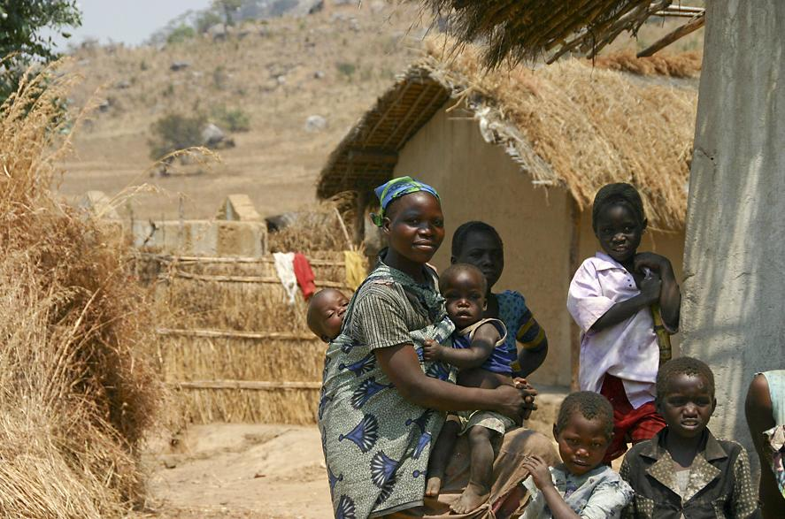

Slide 34
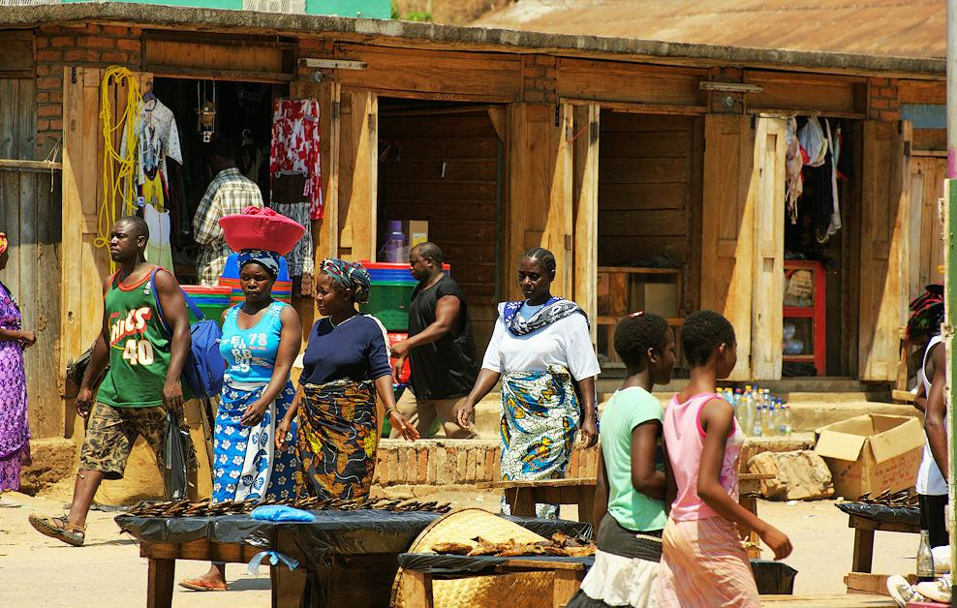

Slide 35
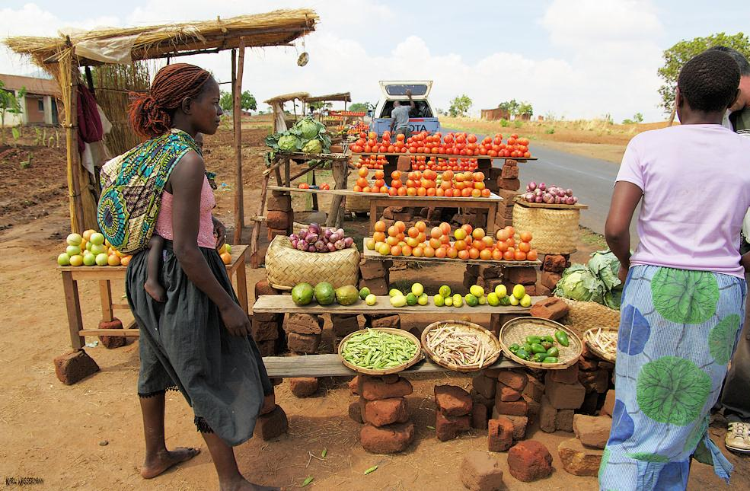

Slide 36
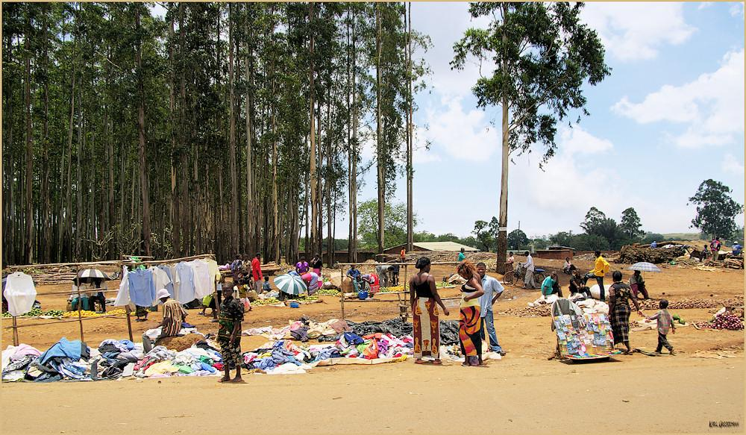

Slide 37
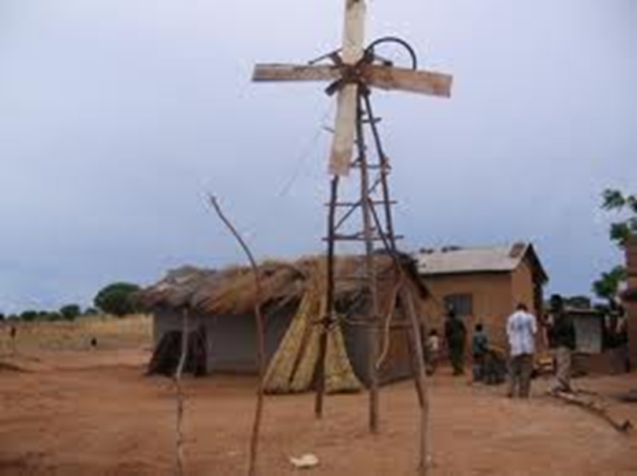
Homemade windmill
A young student in Malawi, East Africa, has made his own power windmill, supplying electricity to his home. He is using a bicycle mechanism to multiply the rotation speed and drive a car alternator charging a car battery.

Slide 38
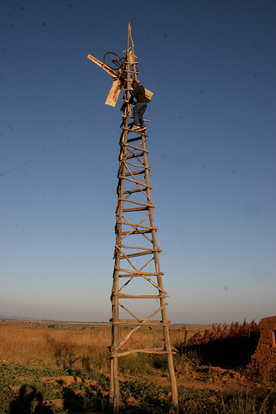
Ingenuity
A more advanced construction from the same person: A 12 meter high tower made of bamboo, for pumping water, serving the local school.

Slide 39
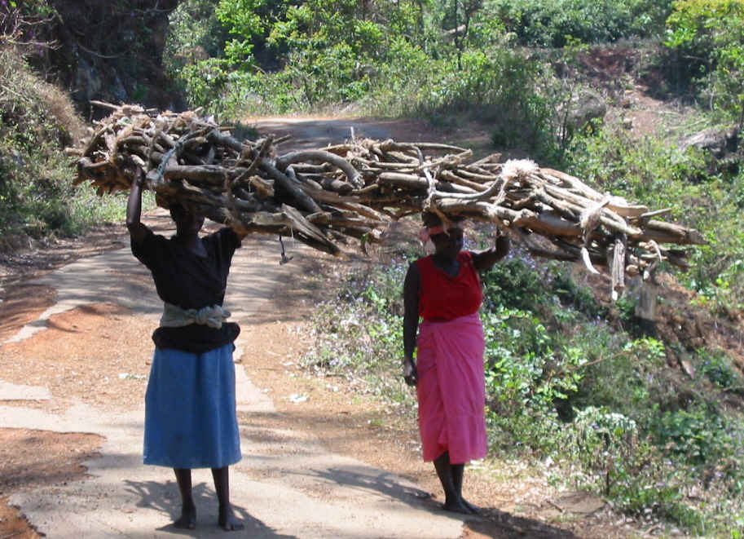

Slide 40
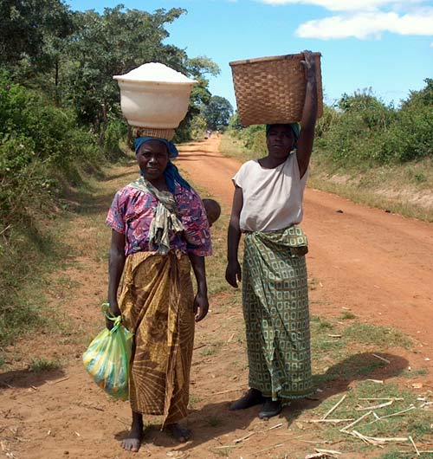

Slide 41
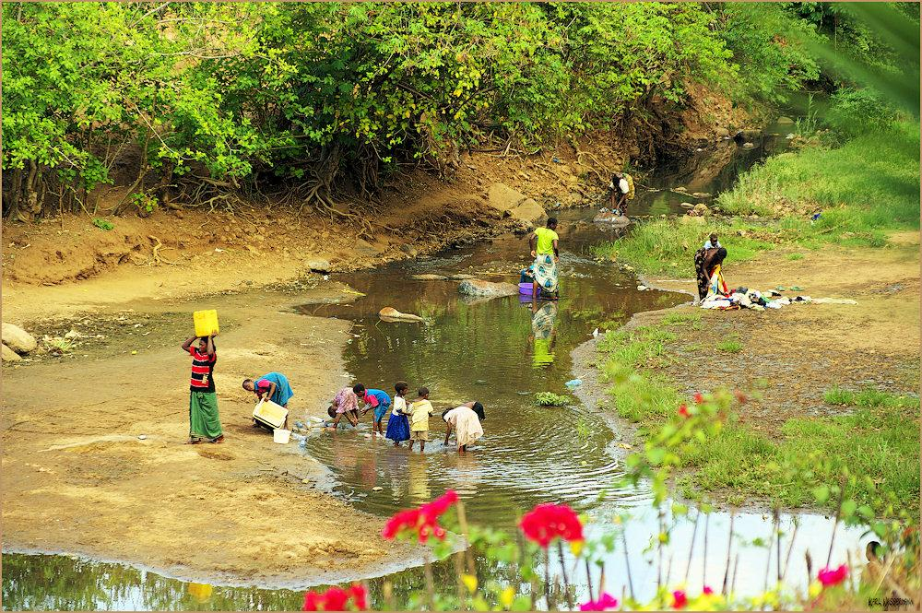

Slide 42
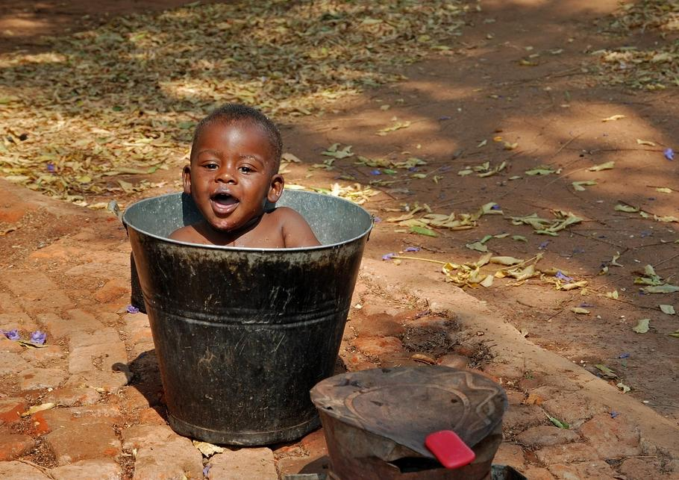

Slide 43
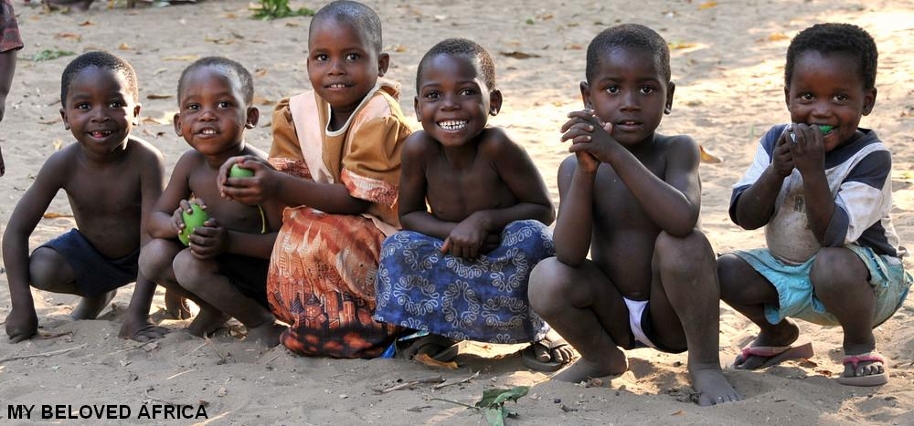

Slide 44
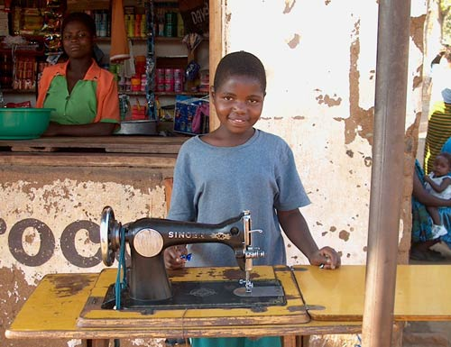

Slide 45

Part of family planning program

Slide 46
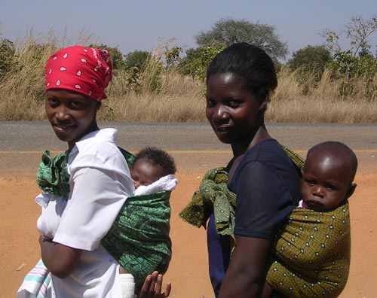

Slide 47


Slide 48


Slide 49


Slide 50

Work at Mulanje massif

Slide 51

Christian Church, Malawi (SE Africa), around 2000.

Slide 52


Slide 53


Slide 54


Slide 55


Slide 56

Globalization

Slide 57

fishing

Slide 58

Drying Fish

Slide 59

Near Chembe, Cape Maclear

Slide 60

Daily life - Cape Maclear

Slide 61

The gap-Cape-Maclear

Slide 62

Nkhata Bay

Slide 63


Slide 64

Mango time at Bwengu

Slide 65

Nuns in front of the bicycle shop, Kasungu, Malawi

Slide 66

Handicrafts

Slide 67


Slide 68

One of the many coffin shops that line the main road into Blantyre, Malawi’s largest city.

Slide 69


Slide 70


Deforestation causes problems

Slide 71

Building 300 Megawatts Coal Fired Power Plant

Slide 72


Slide 73


Slide 74


Slide 75


Slide 76


Slide 77


Slide 78


Slide 79


Slide 80


Slide 81


Slide 82


Slide 83
Mua Mission - The White Fathers
Mua Mission is a Catholic Mission and is one of the oldest in Malawi, It was established at the base of the Rift Valley Escarpment by the so-called "White Fathers" in 1902. White refering to the way they were dressed and not to the colour of their skin. On the 13th of September 1902 three White Fathers arrived at Mua after nightfall and pitched their tent under a boabab tree. This is where the Chamare Museum is today. Mua Mission is running a primary school, a secondary school, a school for deaf children, a training centre for woodcarving and the KuNgoni Arts Centre..

Slide 84


Slide 85


Slide 86


Slide 87


Slide 88


Slide 89




Slide 90


