Slide 1

Macedonia
From whence sprang Alexander the Great’s Empire

Slide 2
Region: Southeast Europe.
Formerly part of Yugoslavia
Area total: 25,713 km2
Coast line: Landlocked country
Capital: Skopje

Slide 3
Macedonia, officially the Republic of Macedonia, is a country located in the central Balkan peninsula in Southeast Europe. It is one of the successor states of the former Yugoslavia, from which it declared independence in 1991. It became a member of the United Nations in 1993 but, as a result of a dispute with Greece over its name, it was admitted under the provisional reference of the former Yugoslav Republic of Macedonia, sometimes abbreviated as FYROM. A landlocked country, the Republic of Macedonia is bordered by Kosovo to the northwest, Serbia to the north, Bulgaria to the east, Greece to the south and Albania to the west. The country's capital is Skopje, with 506,926 inhabitants according to a 2002 census. Other cities include Bitola, Kumanovo, Prilep, Tetovo, Ohrid, Veles, Štip, Kočani, Gostivar and Strumica. It has more than 50 lakes and sixteen mountains higher than 6,562 ft. Macedonia is a member of the UN and the Council of Europe. Since December 2005 it has also been a candidate for joining the European Union and has applied for NATO membership.

Slide 4
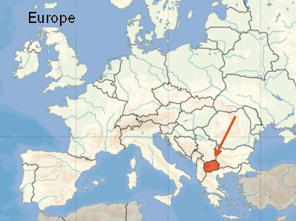

Slide 5
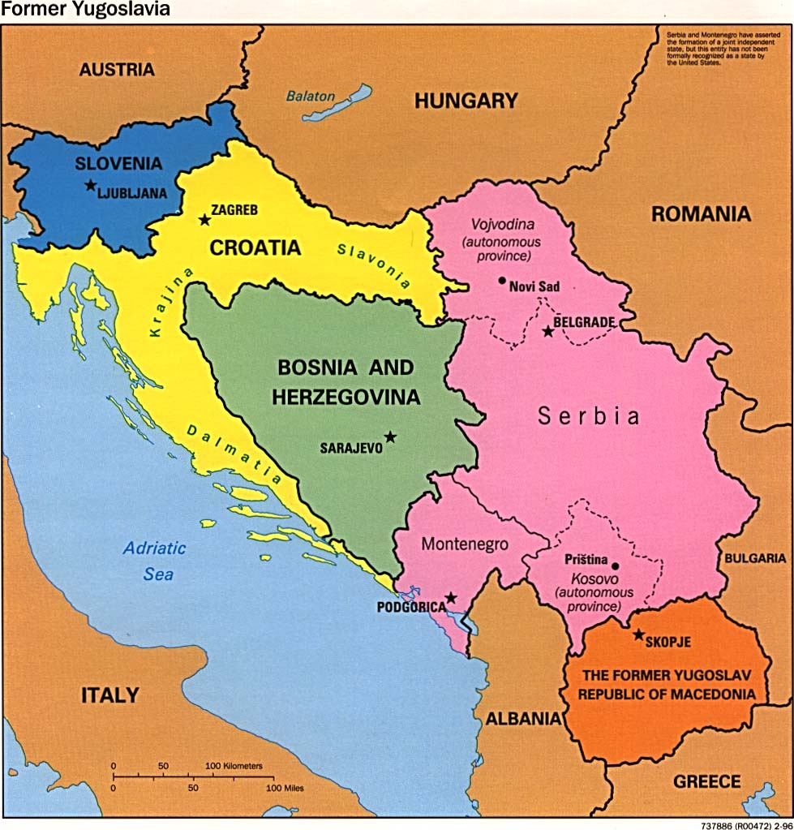

Slide 6
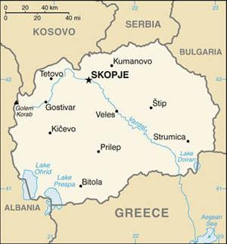

Slide 7
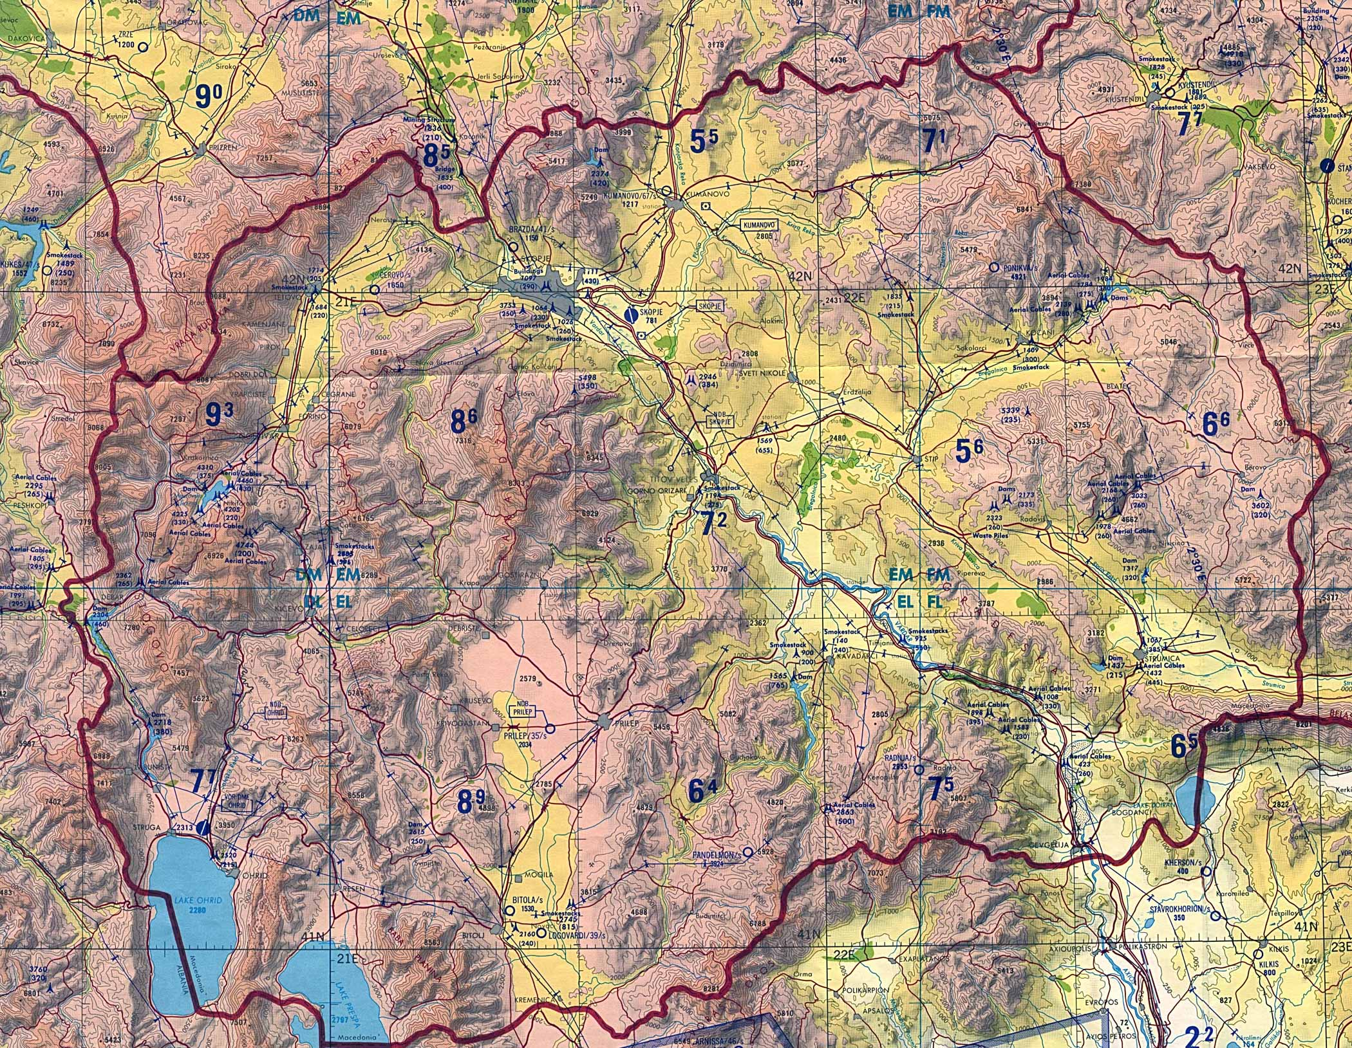

Slide 8
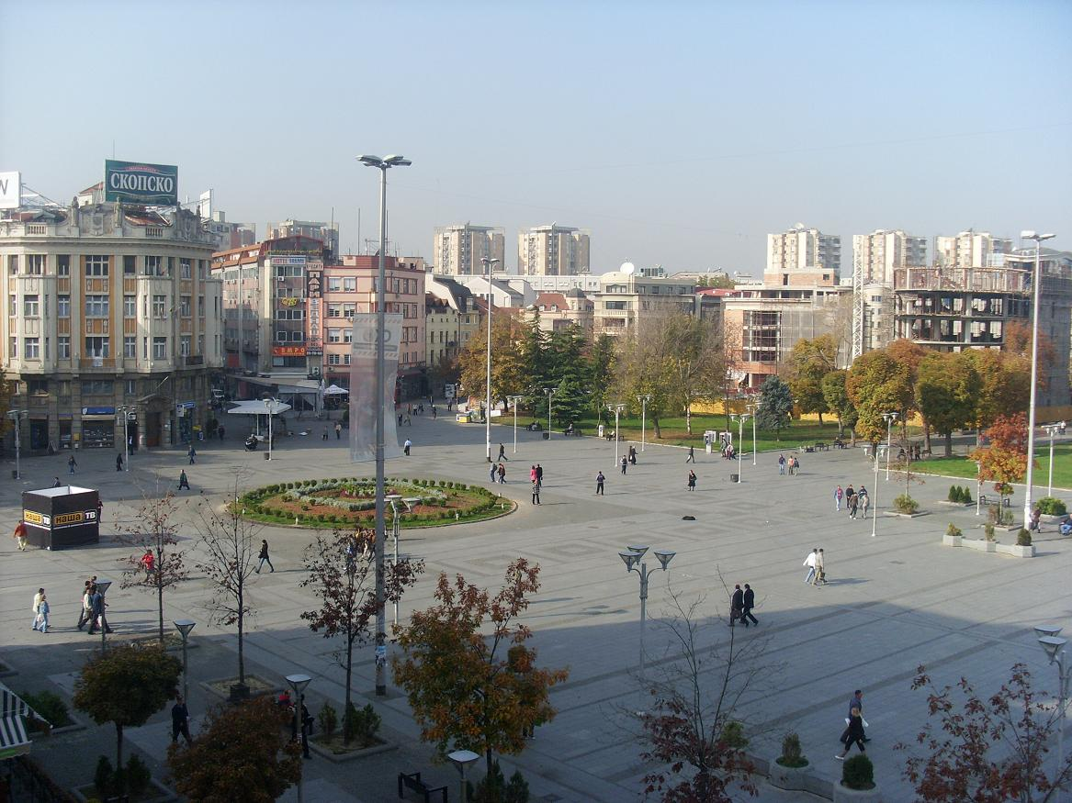
Skopje

Slide 9
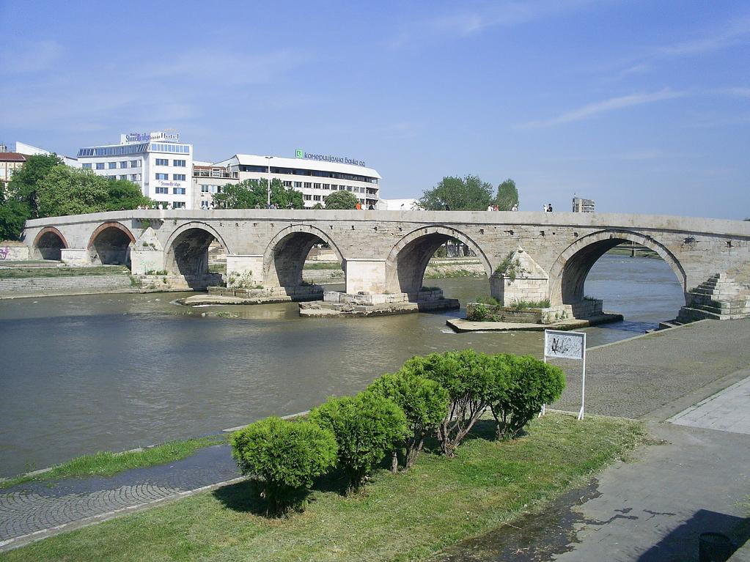
Stone bridge in Skopje

Slide 10
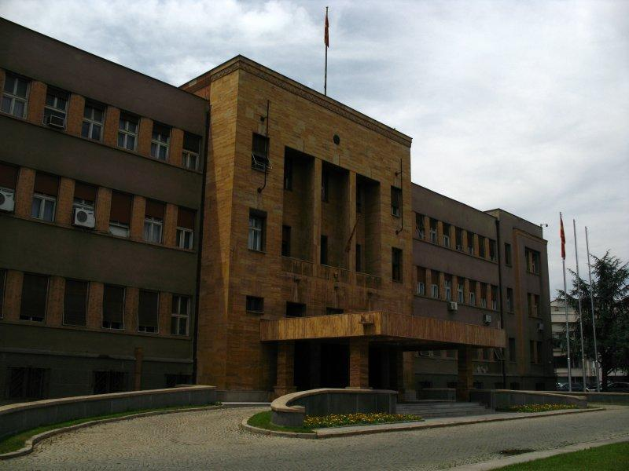
Parliament Building

Slide 11
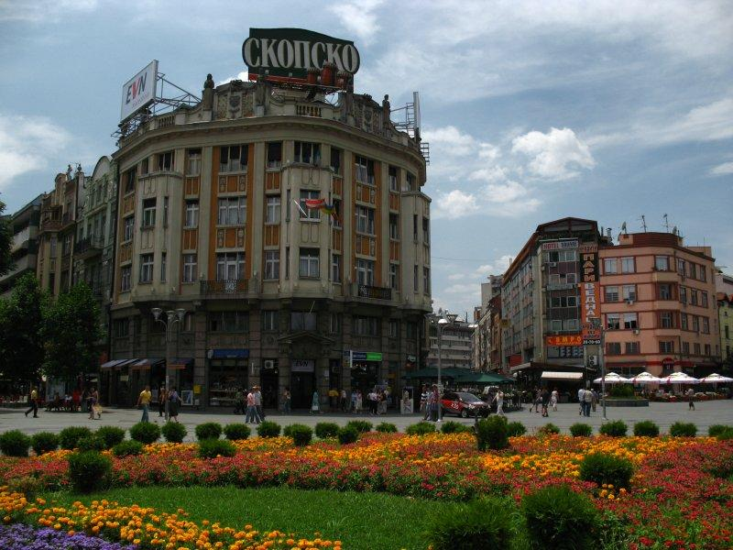
Ploštad square

Slide 12
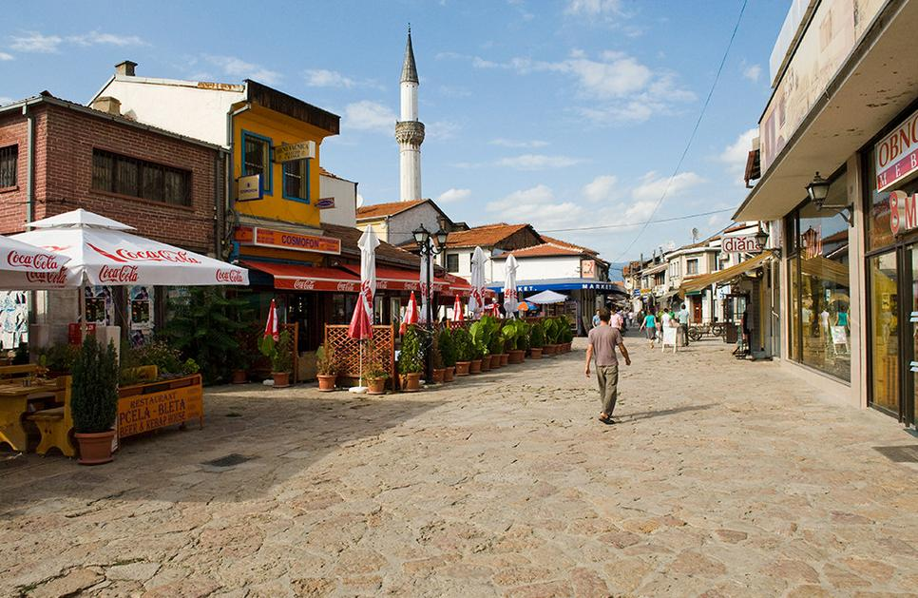
Stone-paved street

Slide 13
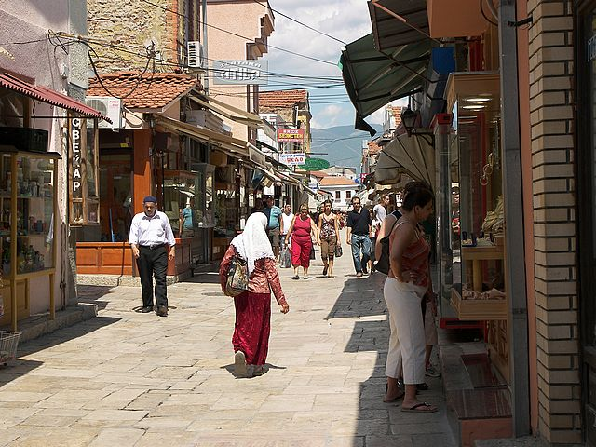
Skopje bazaar Muslim

Slide 14
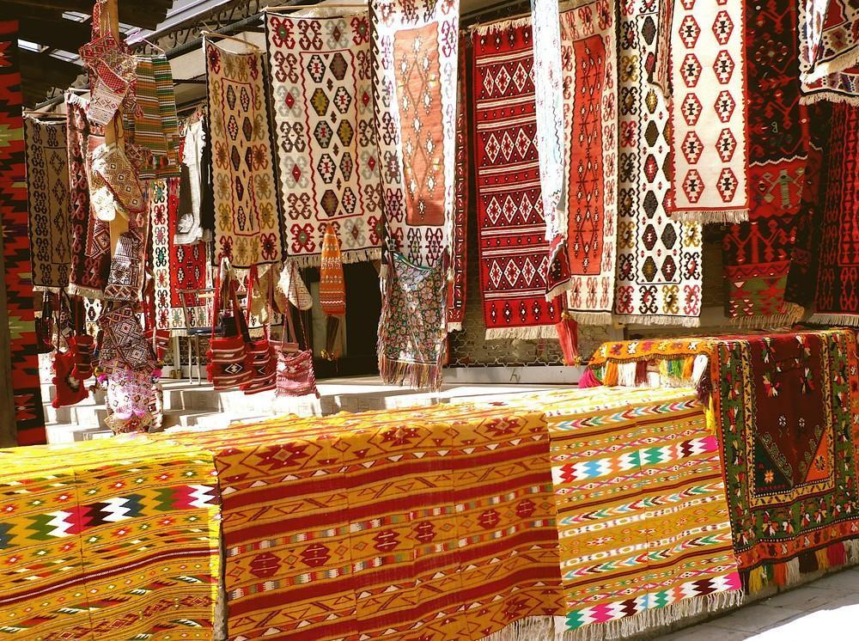
Carpets on sale at the Old Bazaar

Slide 15
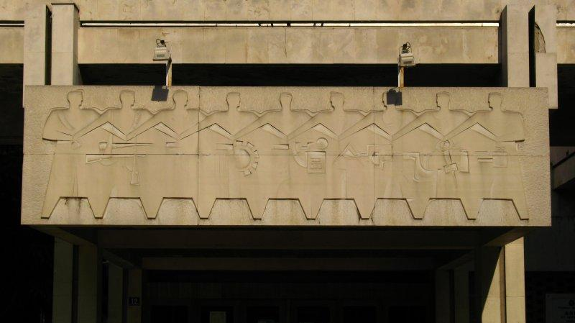
Socialist-realist details on Skopje's Concert Hall

Slide 16
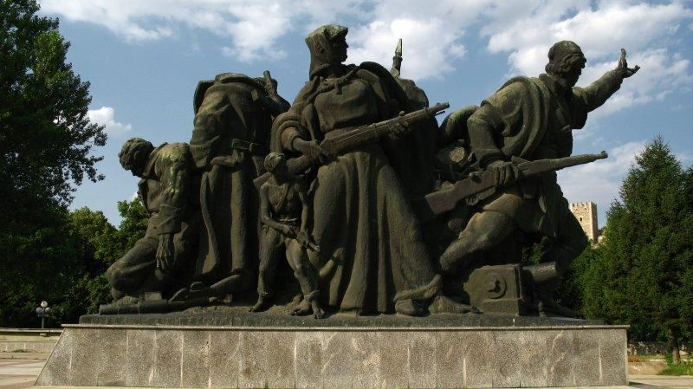
Monument to the Partisans of Skopje

Slide 17
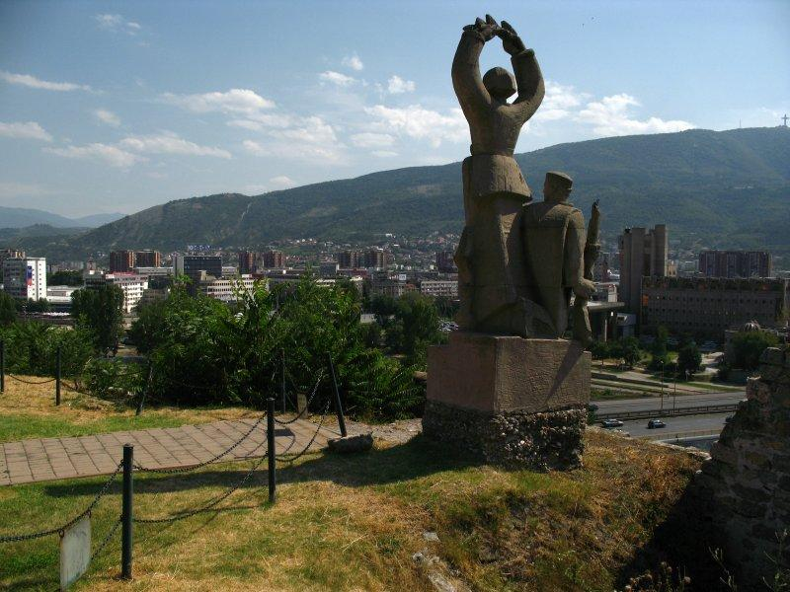
Trvdina Kale fortress

Slide 18
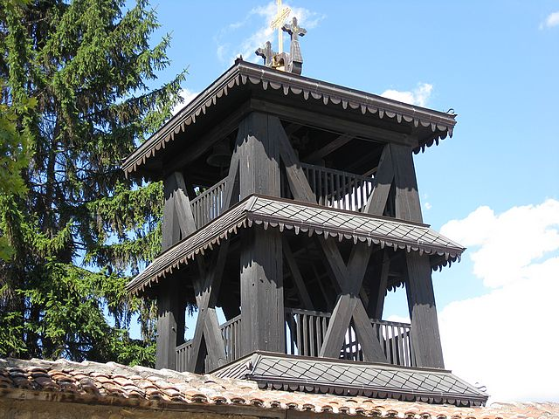
Skopje wood tower church

Slide 19
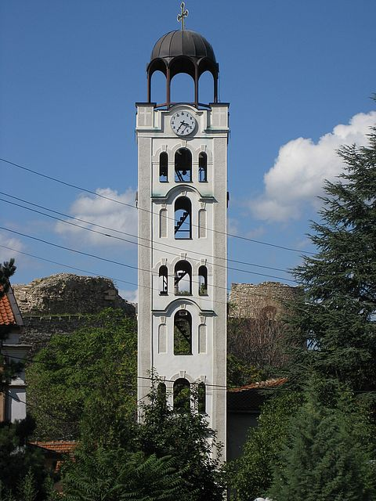
Skopje Dimitrija church

Slide 20
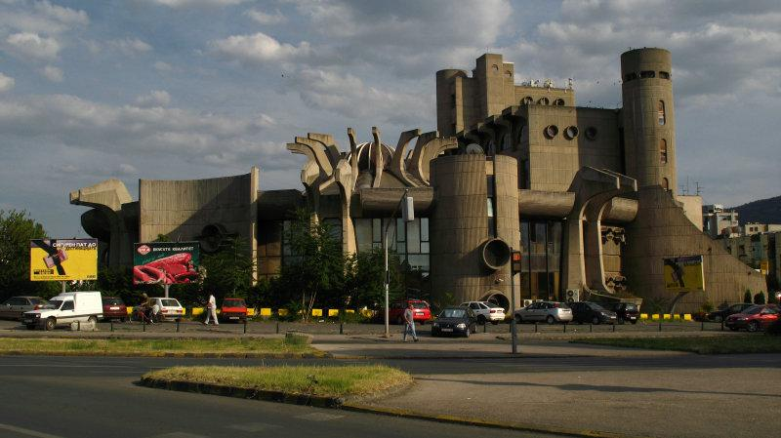
Central post office in Skopje

Slide 21
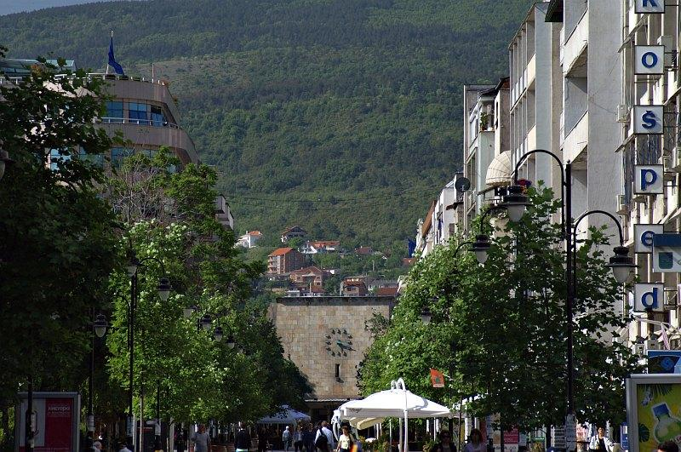
Marshal Tito Boulevard: At the end of the street is the Old Train Station, its clock stopped at the moment of the 1963 earthquake.

Slide 22
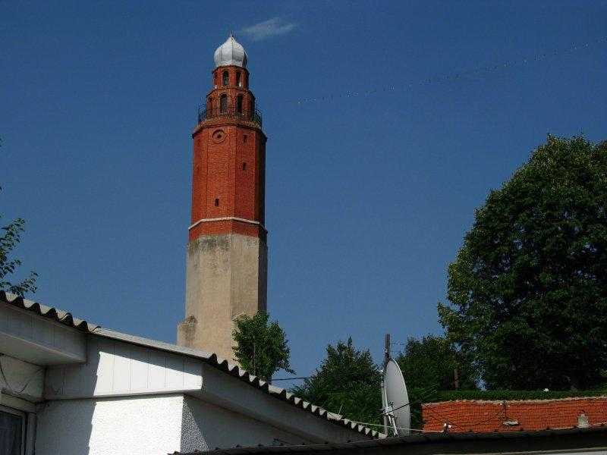
Sahat Kulla (Clock Tower) of Sultan Murat Mosque

Slide 23
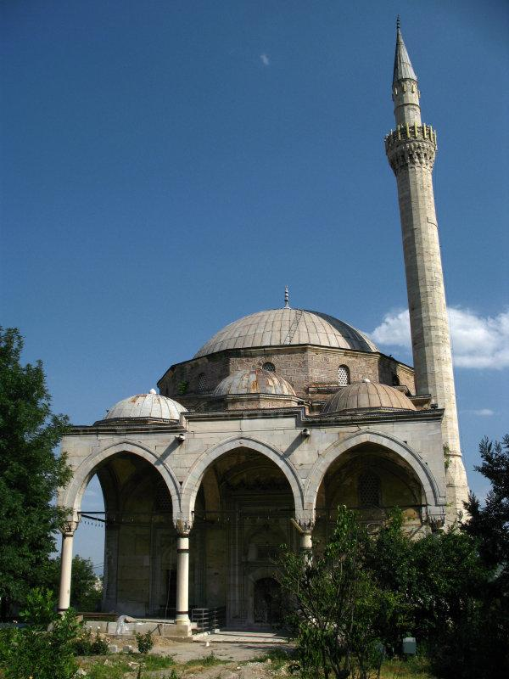
Mustafa Pasha Mosque

Slide 24
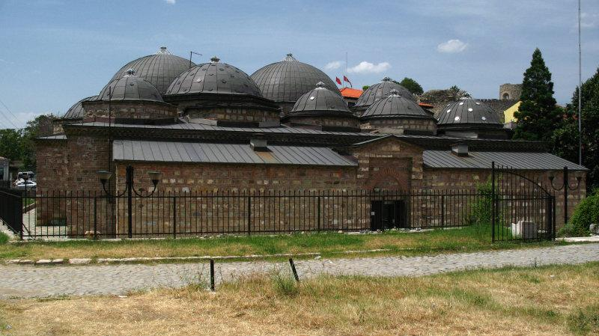
Daud Pasha Baths: Built in the 15th century as a bath house while Skopje was under Ottoman rule.

Slide 25
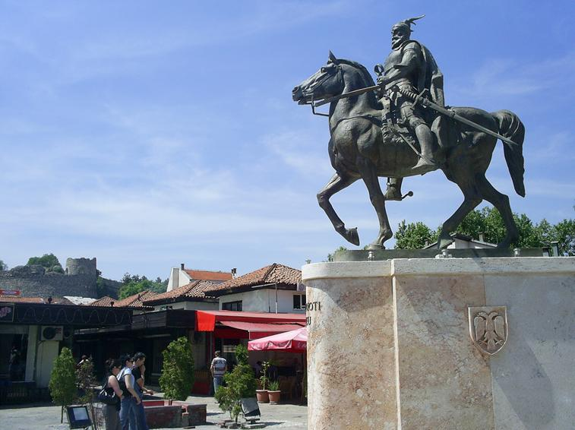
Monument of Skanderbeu in Skopje

Slide 26
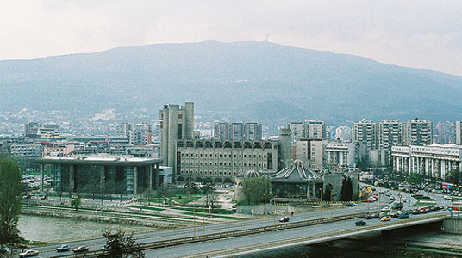
Skyline

Slide 27
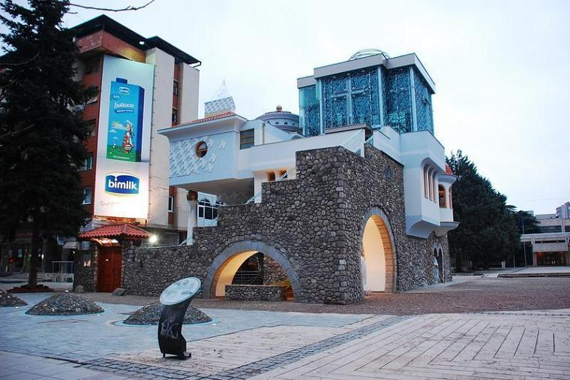
Memorial House of Mother Teresa in Skopje

Slide 28
Other towns & cities

Slide 29
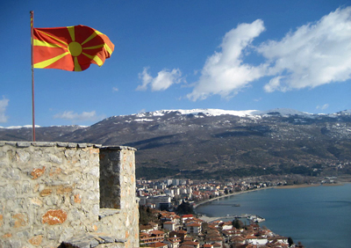
Flag flying over the town of Ohrid

Slide 30
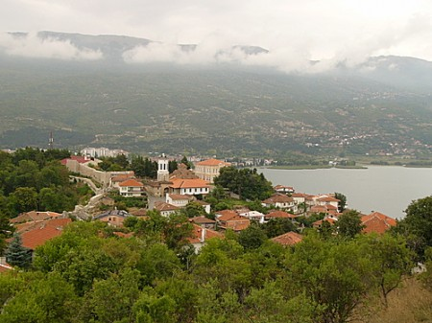
Ohrid

Slide 31
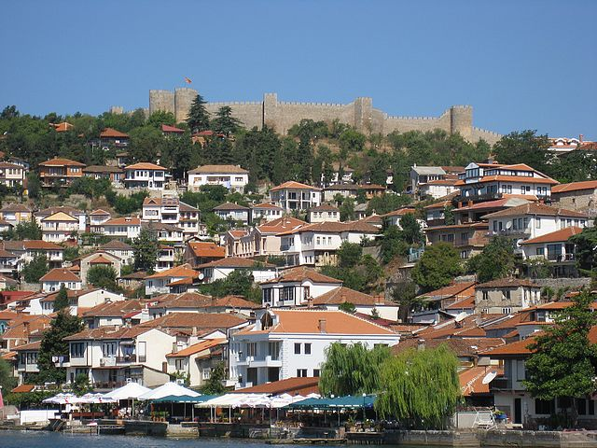
Ohrid citadel castle

Slide 32
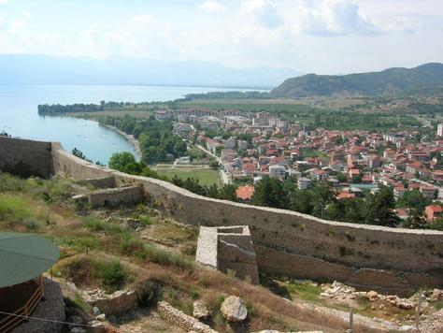
Ohrid Fort (Castle)

Slide 33
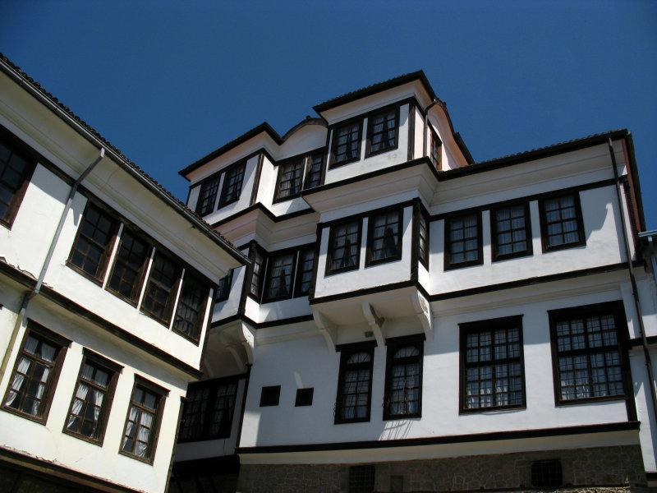
National Museum Ohrid

Slide 34
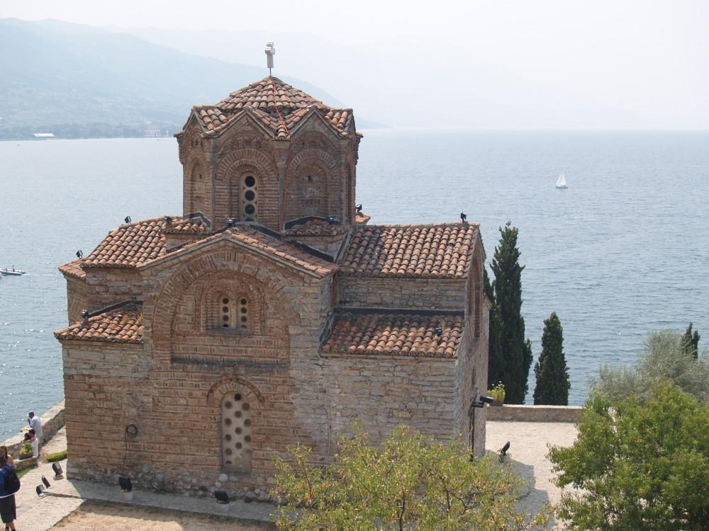
Eglise Saint Jean Kaneo - Ohrid

Slide 35
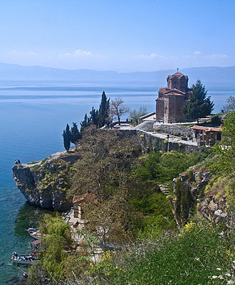
Lake Ohrid

Slide 36
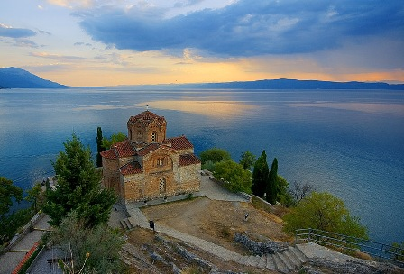

Slide 37
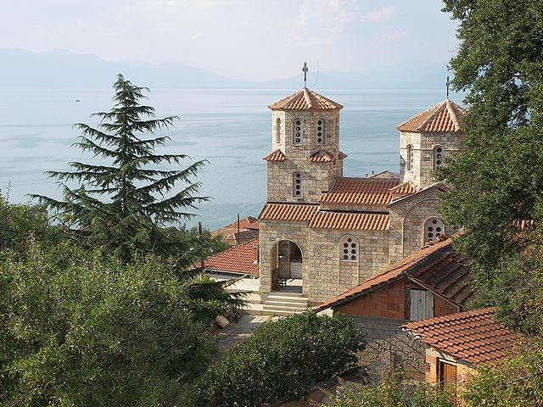
Ohrid Trpeizza church Orthodox

Slide 38
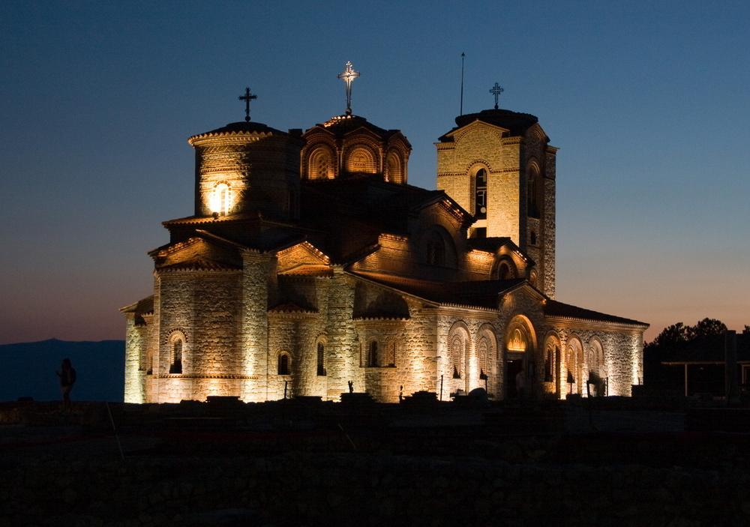
St. Pantelejmon Church - Ohrid

Slide 39
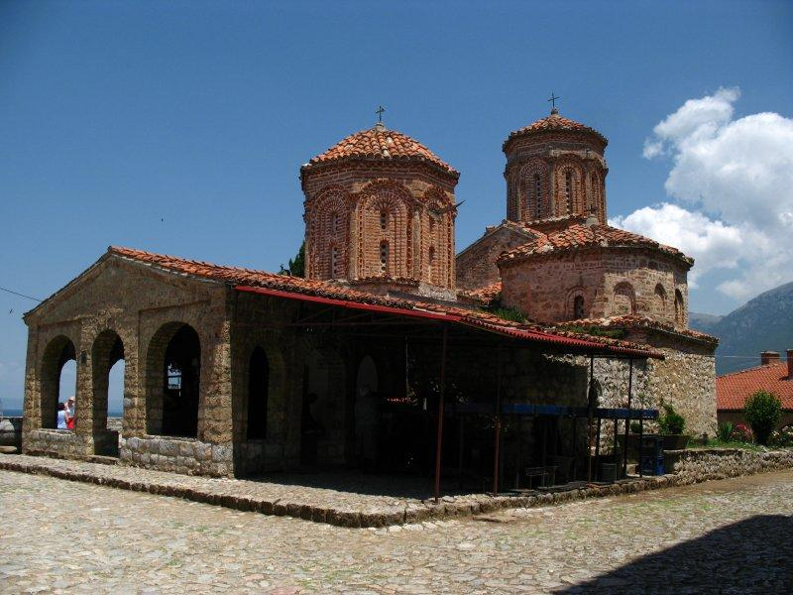
Monastery of Sveti Naum-Ohrid

Slide 40
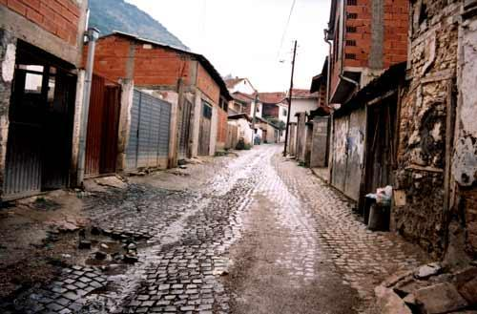
Old part of Tetovo

Slide 41
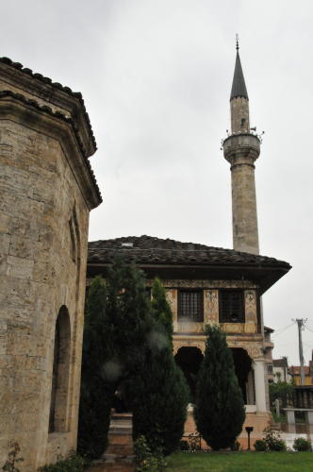
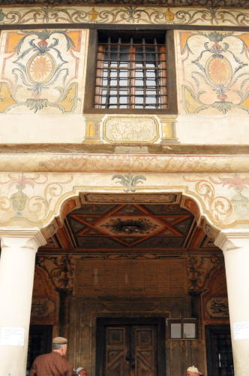
The Painted Mosque in Tetovo

Slide 42
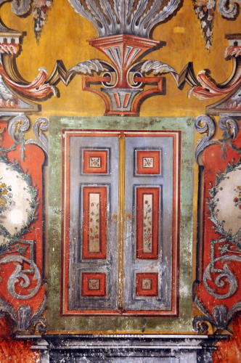
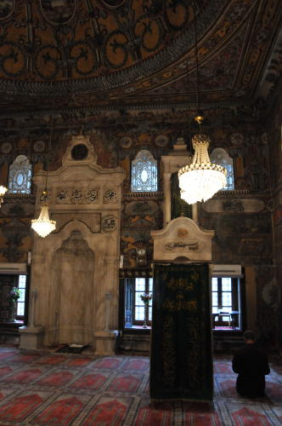
Inside the Painted Mosque

Slide 43
There has been tension and conflict between Sufi Muslims and Sunni Muslims in Tetovo

Slide 44
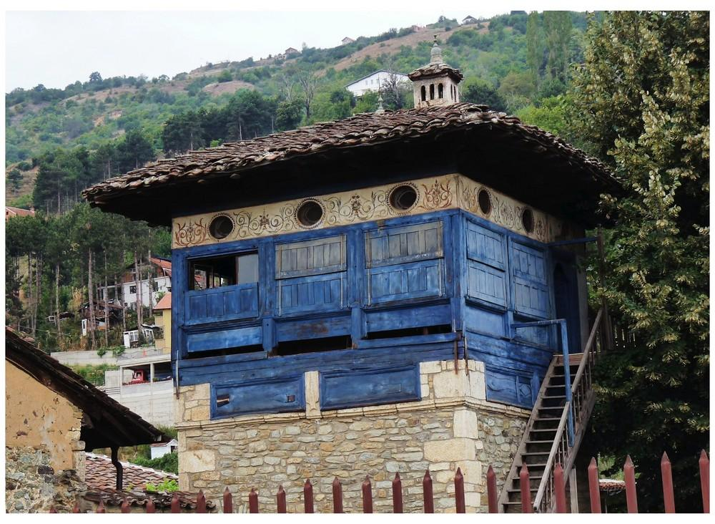
Dervish Arabati Baba Tekke in Tetovo

Slide 45
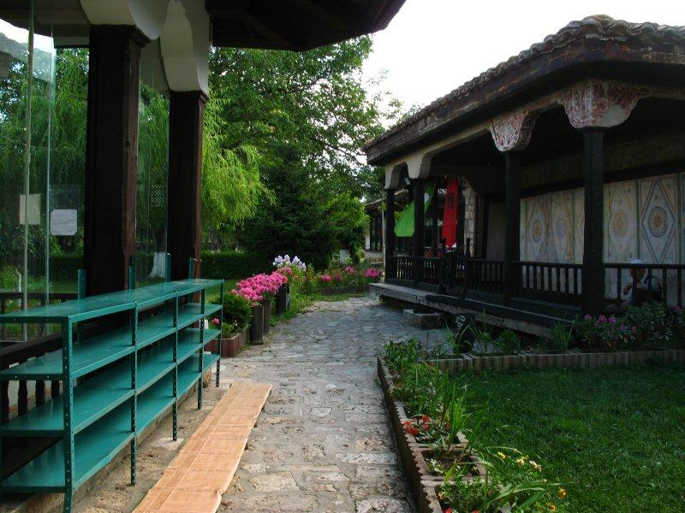
Dervish Arabati Baba Tekke

Slide 46
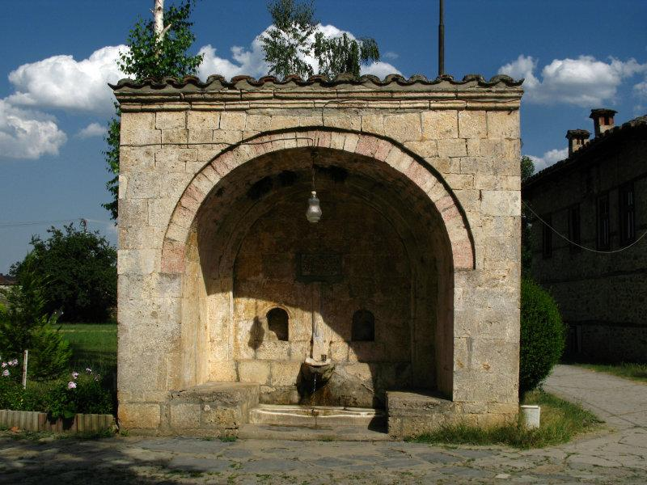
Ottoman era fountain- Dervish Arabati Baba Tekke

Slide 47
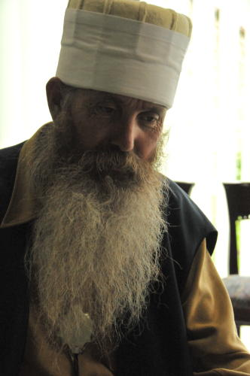
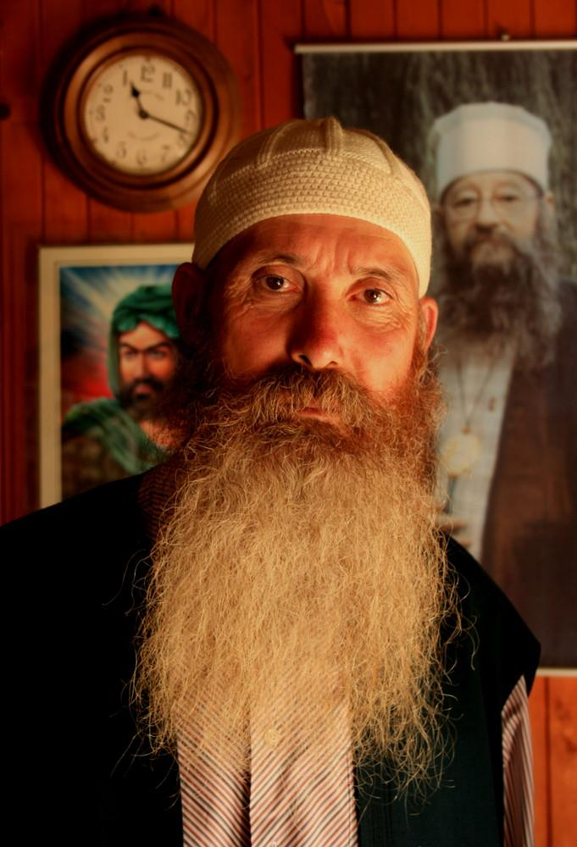
Dervishes

Slide 48
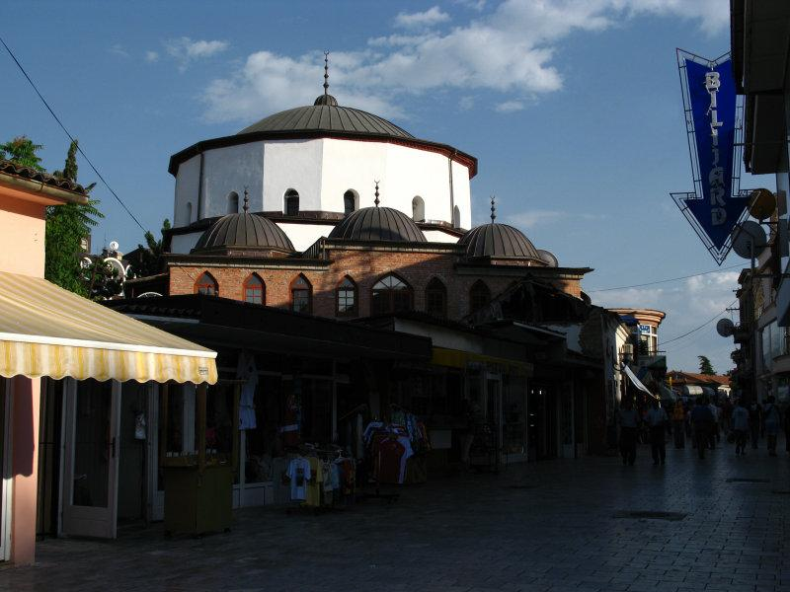
Historic hammam in the old town -Ohrid

Slide 49
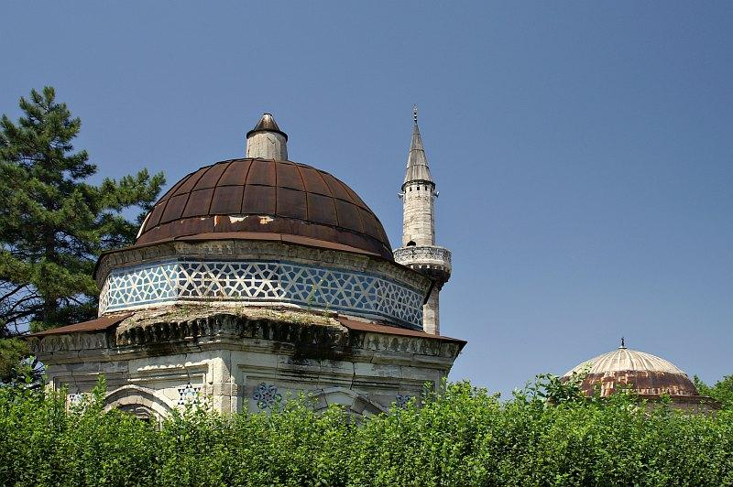
Ishak Beg Mosque

Slide 50
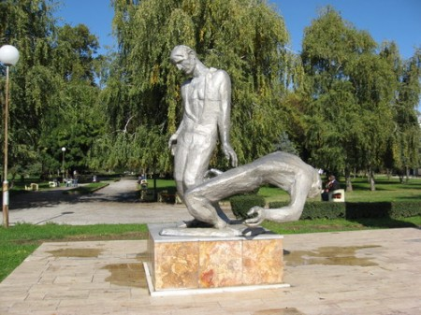
In the city of Strumica with a statue of two men suffering.

Slide 51
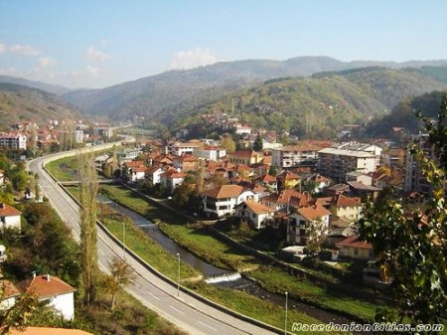
Town of Kriva Palanka

Slide 52
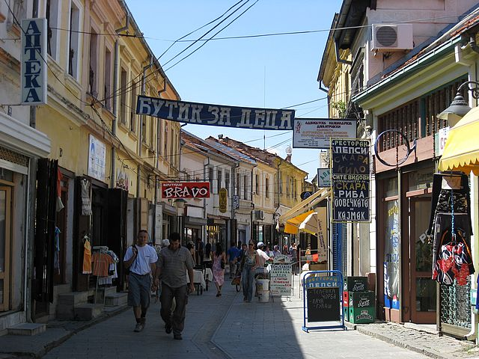
Bitola bazaar trading shops

Slide 53

Bitola open air restaurant

Slide 54

Treskavec monastery

Slide 55

Treskavec monastery fortress

Slide 56

Treskavec monastery entrance

Slide 57

Treskavec Court

Slide 58

Sveti Naum Monestery and Orthodox Church

Slide 59

Statue in Prilep commemorating Alexander the Great

Slide 60

Struga

Slide 61

The fresh market in Kavadarci

Slide 62
Landscape and features

Slide 63

Lake Ohrid

Slide 64

Lake Ohrid

Slide 65

Turbulent Lake Ohrid

Slide 66

the Millenium Cross in Macedonia

Slide 67


Slide 68

Agricultural fields

Slide 69


Slide 70

Galicia Natural Park

Slide 71

Galicia Park Lake

Slide 72

Lake Matka

Slide 73

Lake Prespa

Slide 74


Slide 75


Slide 76


Slide 77


Slide 78

Snowy Mountains

Slide 79

Statue of Mother Teresa

Slide 80
People, Culture, & life

Slide 81


Macedonian Pavements

Slide 82

Restored Ottoman-style House

Slide 83

Rugs outside a shop

Slide 84

Sidewalk Cafe

Slide 85

Albanian Muslim woman in Tetovo

Slide 86

Girls with Traditional Dress

Slide 87

Preparing for Winter Heating

