Slide 1
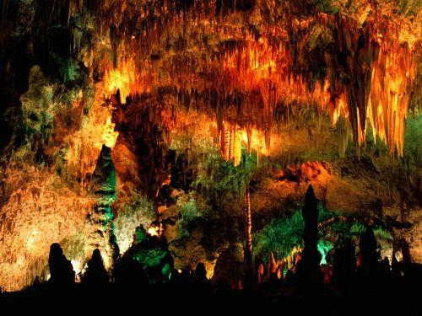
Iran: Chal Nakhjir Cave
Unusual formation process

Slide 2
Background
Chal Nakhjir is a rare geological phenomenon, discovered in 1989 and is located on the side of the road connecting Delijan to Naragh, Markazi province, Iran. The cave belongs to the Cenozoic period and has been formed as a result of tectonic factors and aerobic chemical reactions.

Slide 3
Chal Nakhjir is known for its exceptional white dolomite sediments, covering the floor of major corridors of the cave. The speleothems are exceptional too, looking like white popcorn. Even regular stalactites and stalagmites have this pure white cover of calcite and aragonite crystals.
The height of this cave in some places reaches over 20 m while having deep valleys in its divergent paths. A cave lake is located 140m inside the cave, 70m below the entrance.
The cave opened for public on March 2010.

Slide 4
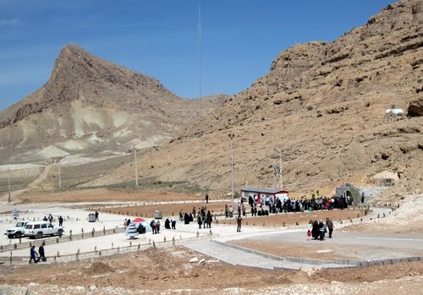

Slide 5
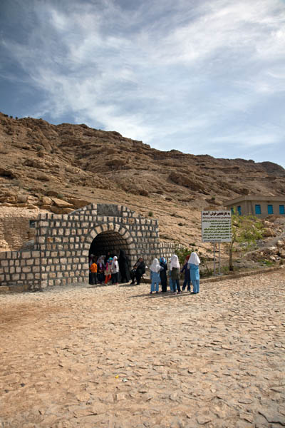
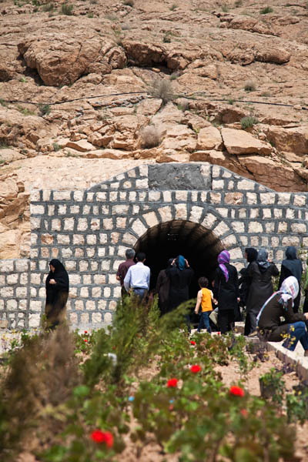

Slide 6
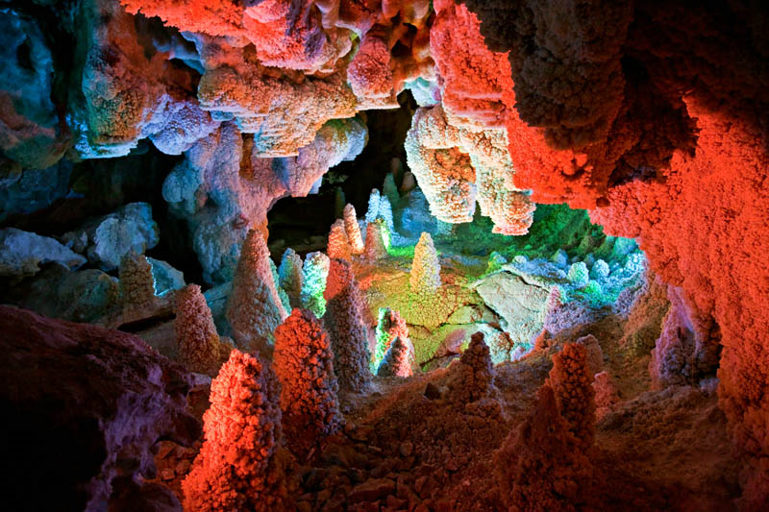

Slide 7
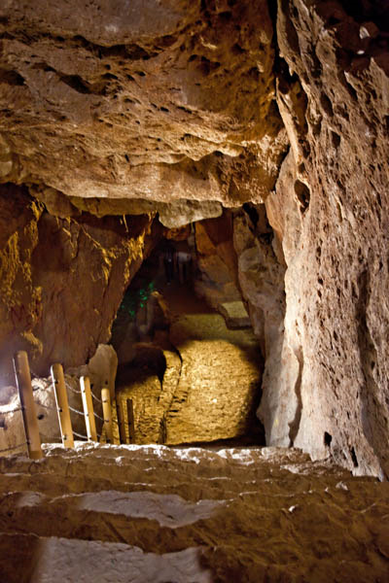
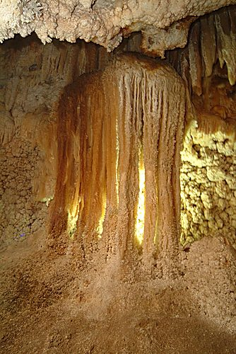

Slide 8
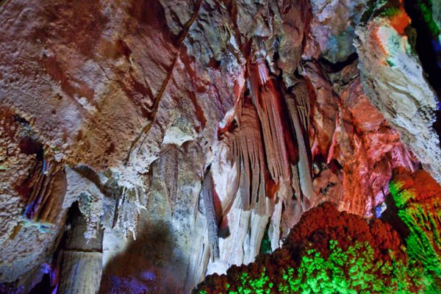

Slide 9
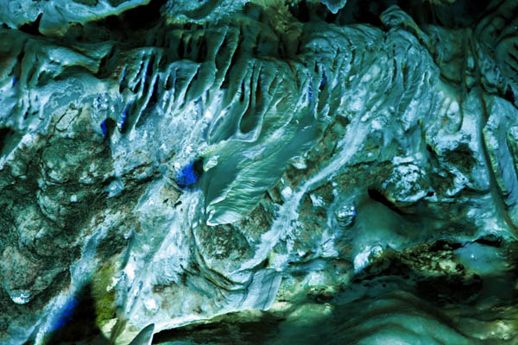

Slide 10
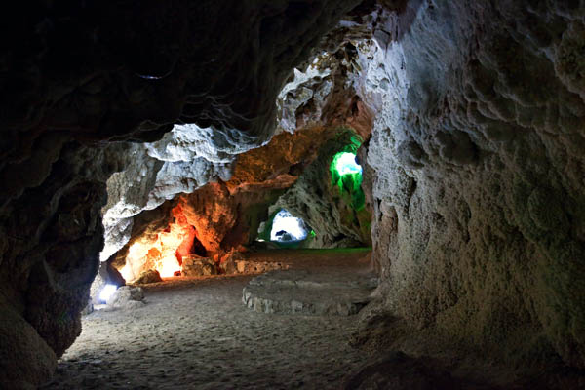

Slide 11
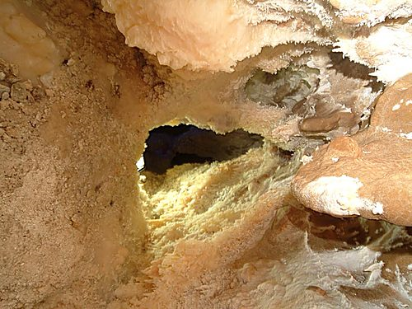

Slide 12
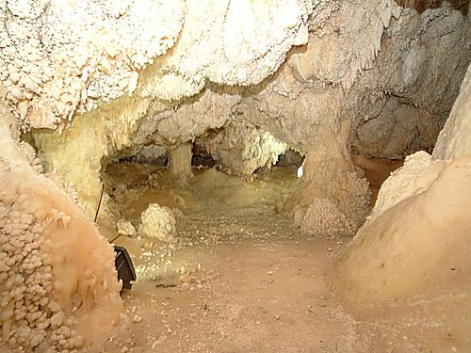

Slide 13
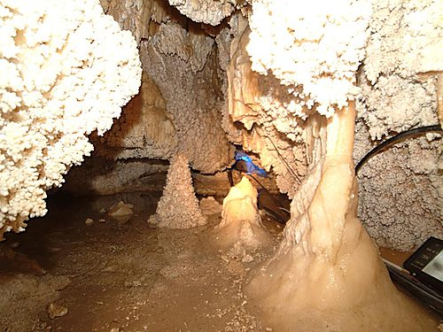

Slide 14
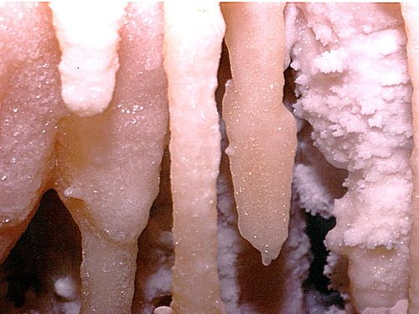

Slide 15
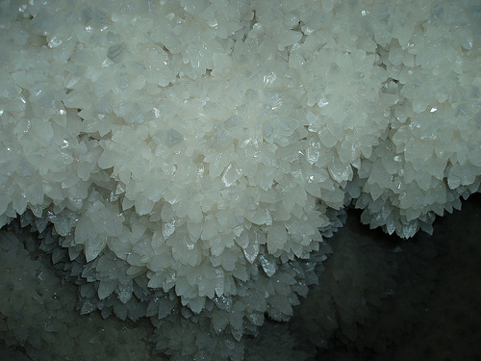

Slide 16
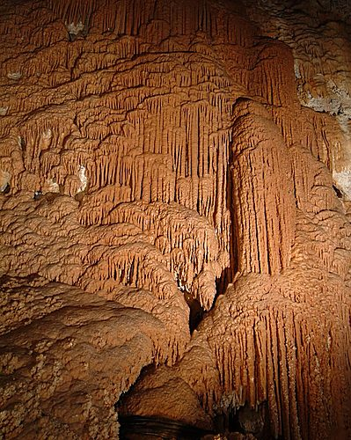

Slide 17
