Slide 1

Iceland
On the Mid-Atlantic Ridge

Slide 2
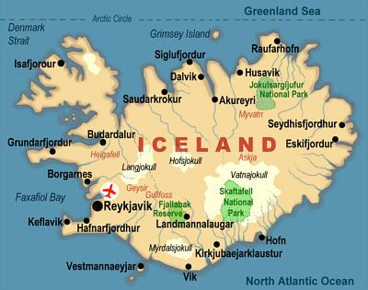

Slide 3
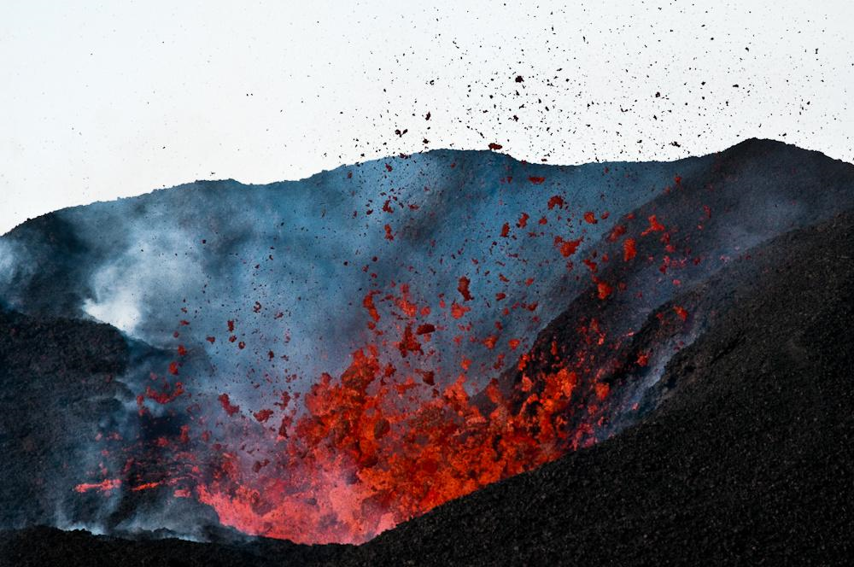
Located on the Mid-Atlantic Ridge
The Mid-Atlantic Ridge is a divergent tectonic plate boundary, and as such is subject to volcanic activity.
Iceland is the only portion of the Mid-Atlantic Ridge what is above sea level.

Slide 4
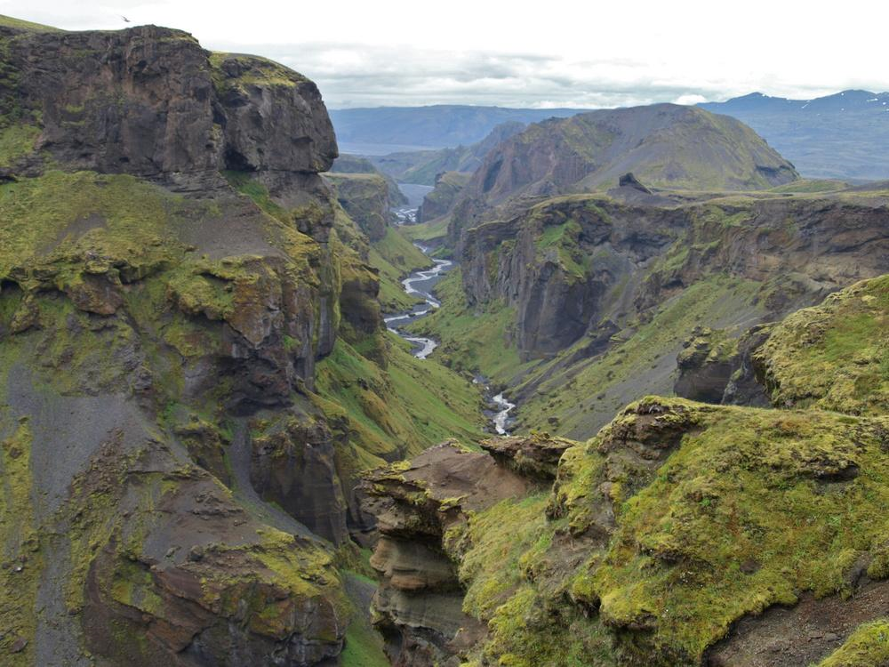
Divergent boundary exposed

Slide 5
Reykjavik

Slide 6
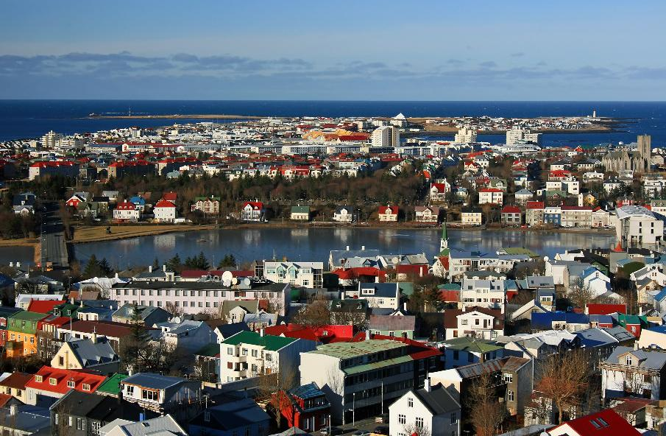

Slide 7
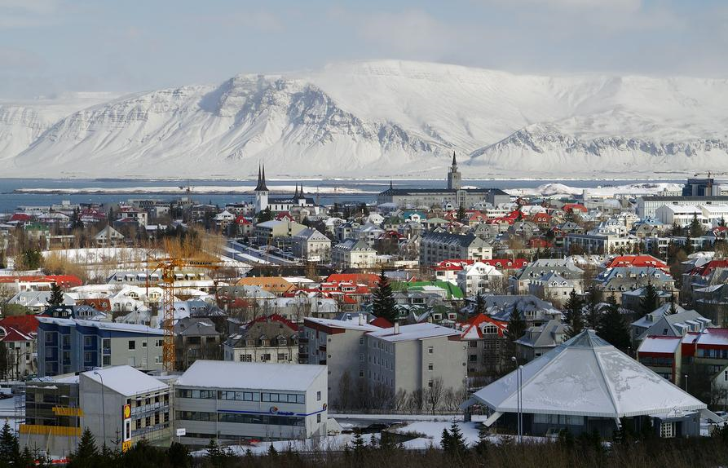

Slide 8
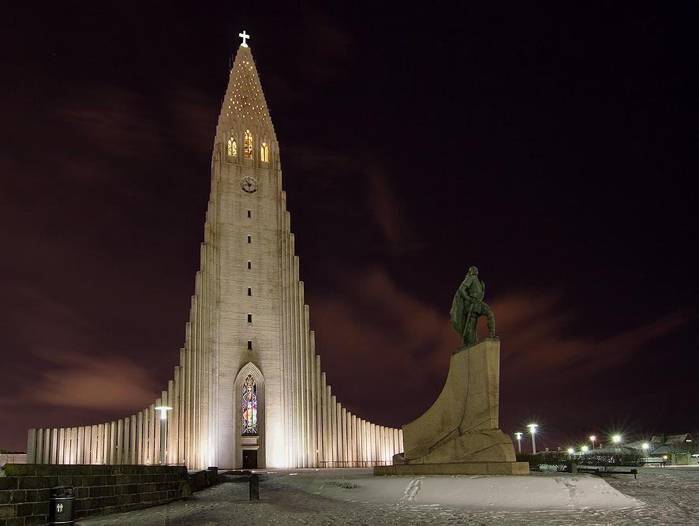
Hallgrimskirkja

Slide 9
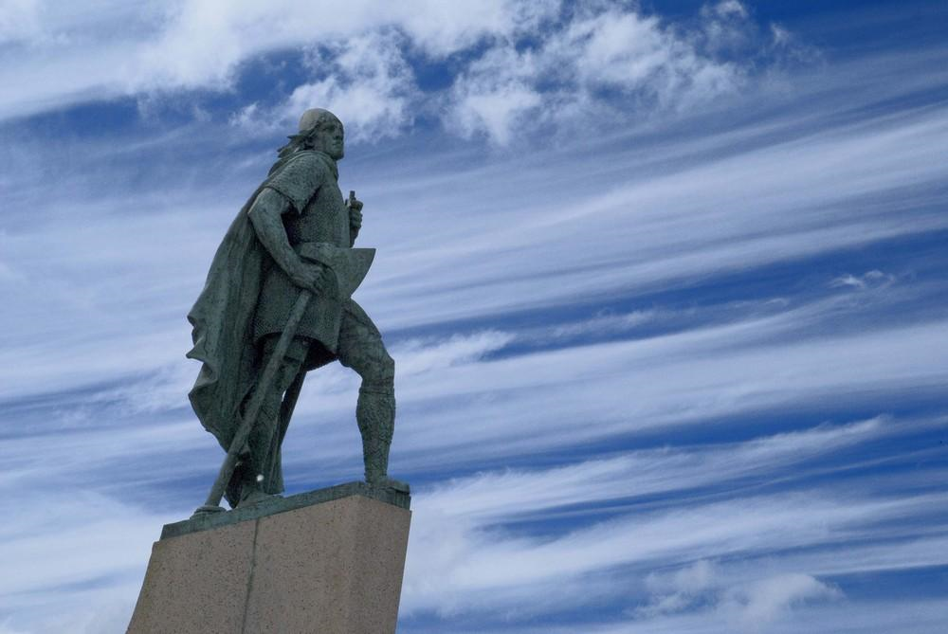
Statue of Leif Eriksson infront of Hallgrímskirche in Reykjavík

Slide 10
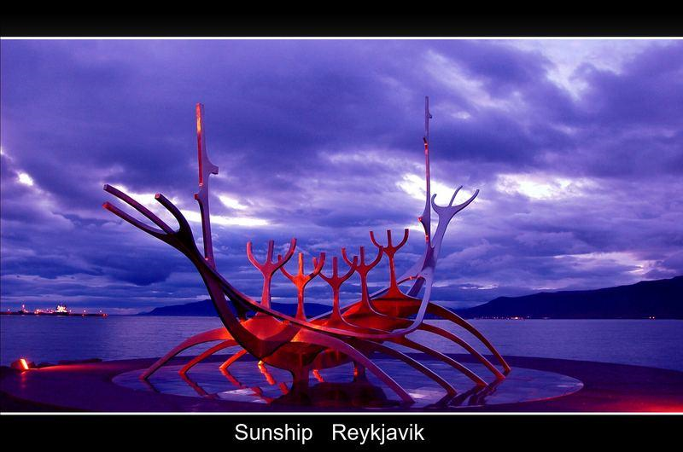

Slide 11
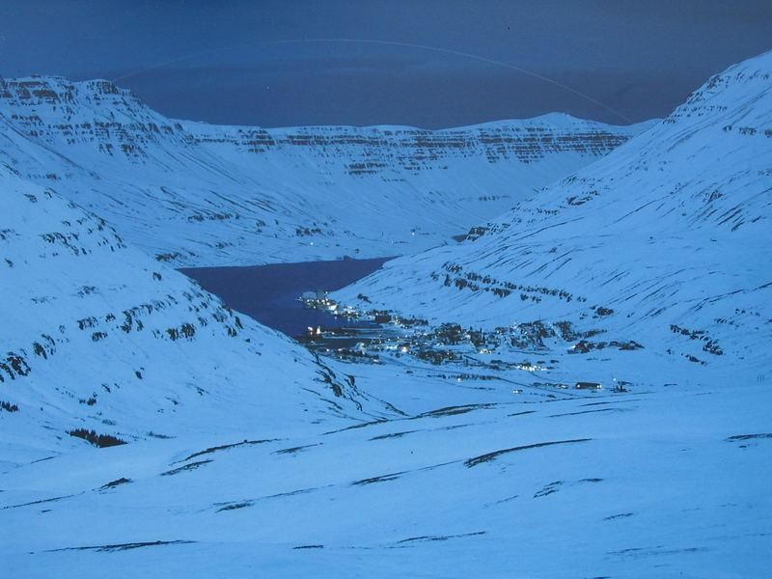

Slide 12
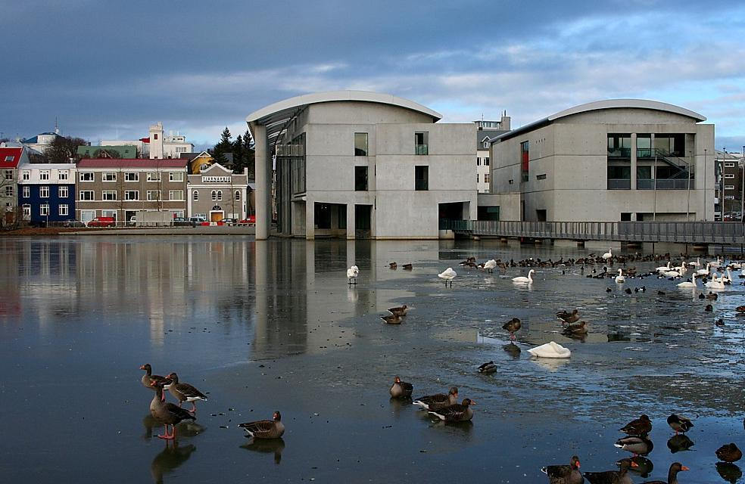
City Hall

Slide 13
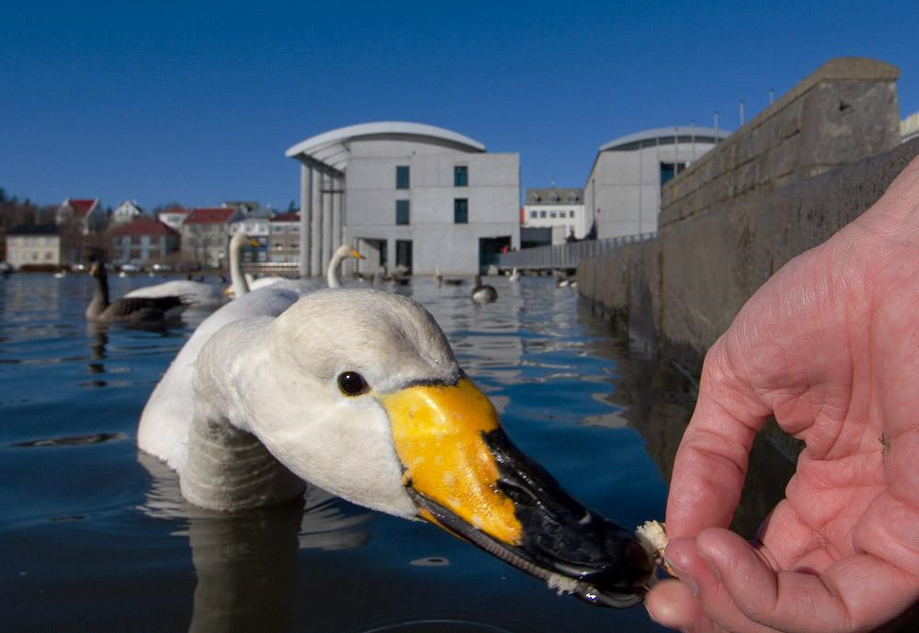

Slide 14
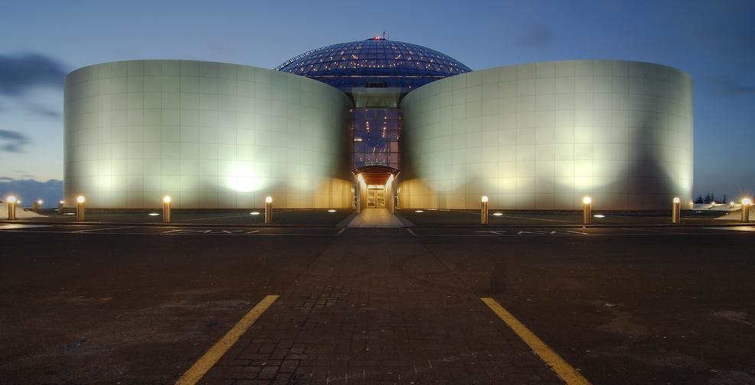
Perlan (Icelandic for the pearl) is a hot water tank in Iceland's capital Reykjavik

Slide 15
Reagan-Gorbatschow House
In October 1986, met U.S. President Ronald Reagan and Soviet General Secretary Mikhail Gorbachev, the Soviet Communist Party under the mediation of the former Icelandic President Vigdís Finnbogadóttir virtually in the middle between two states in Iceland.
Topic of the talks was a disarmament of both sides to reach agreement was not reached.
The meeting is nevertheless a milestone in the rapprochement between the two countries. The place of their meeting was the Hús Höfði in Reykjavik, which is now mostly just referred to as the "Reagan-Gorbachev house" and the Reykjavik often used under this name for driving directions.

Slide 16
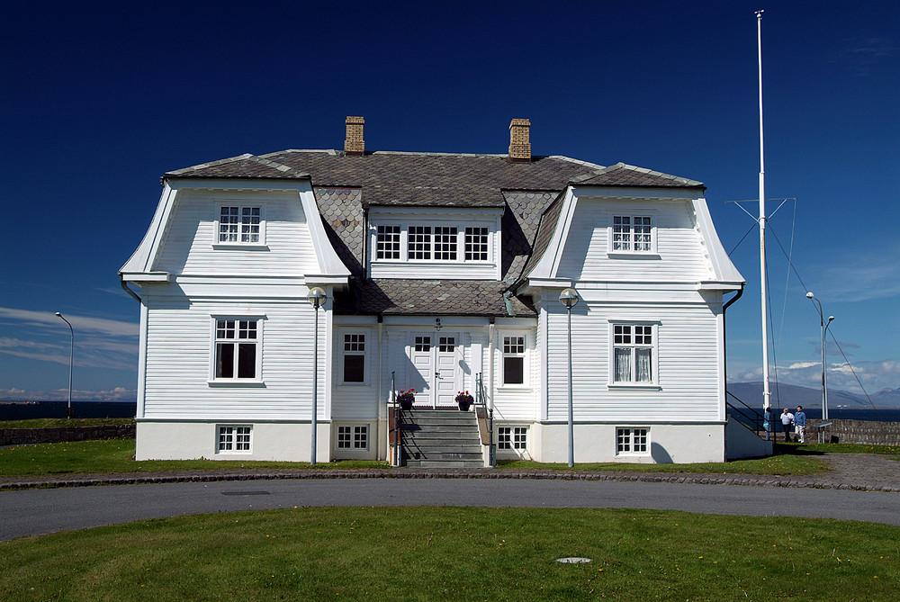

Slide 17
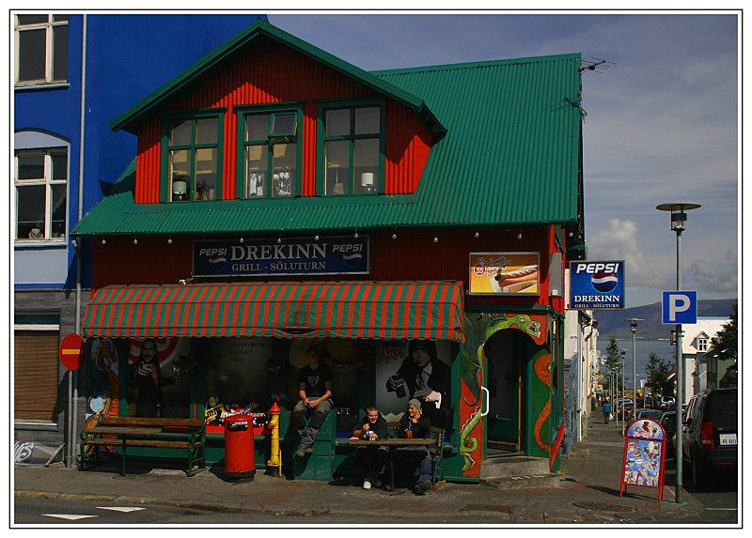

Slide 18
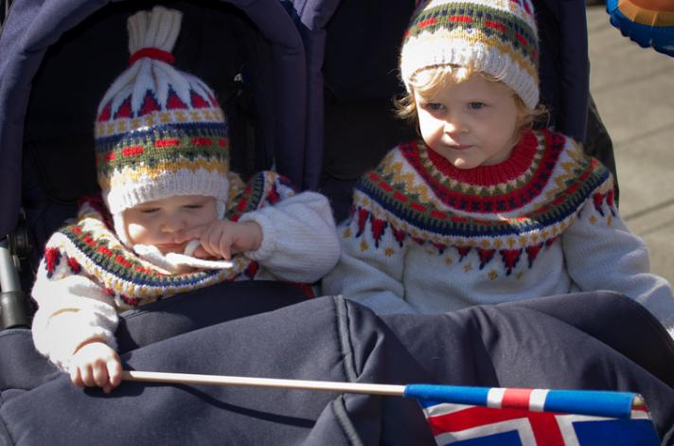

Slide 19
Husavik

Slide 20
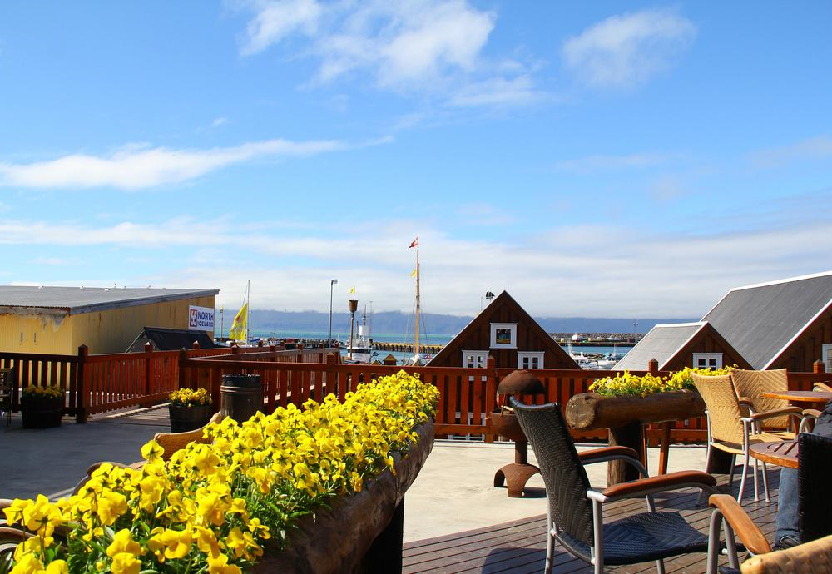

Slide 21
Grenivik

Slide 22
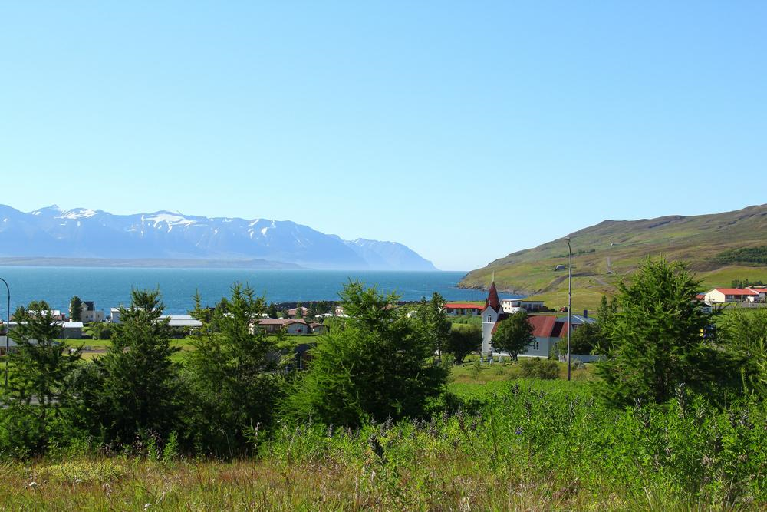

Slide 23
The Port of Stykkisholmur

Slide 24
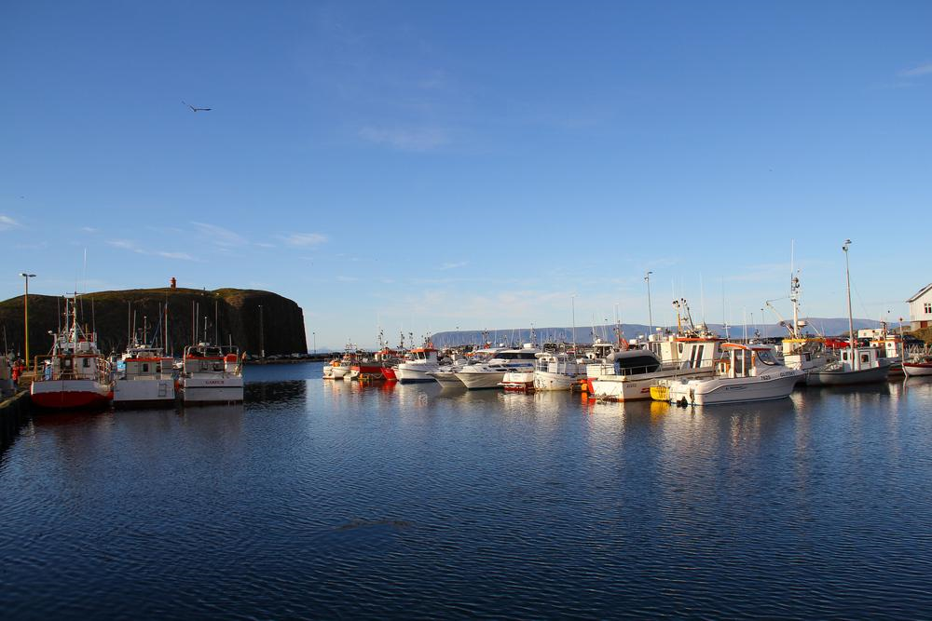

Slide 25
art

Slide 26
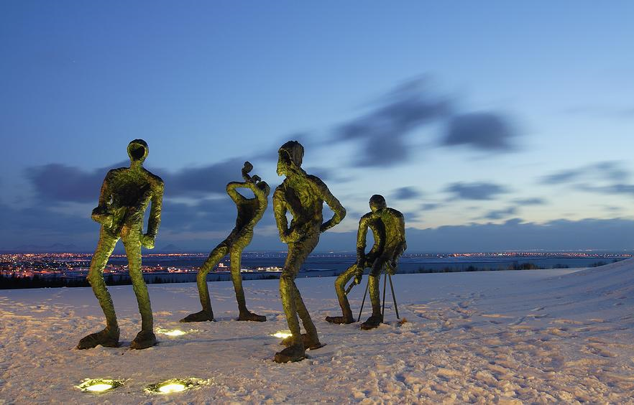

Slide 27
Environmentalism – The Greening of Iceland

Slide 28
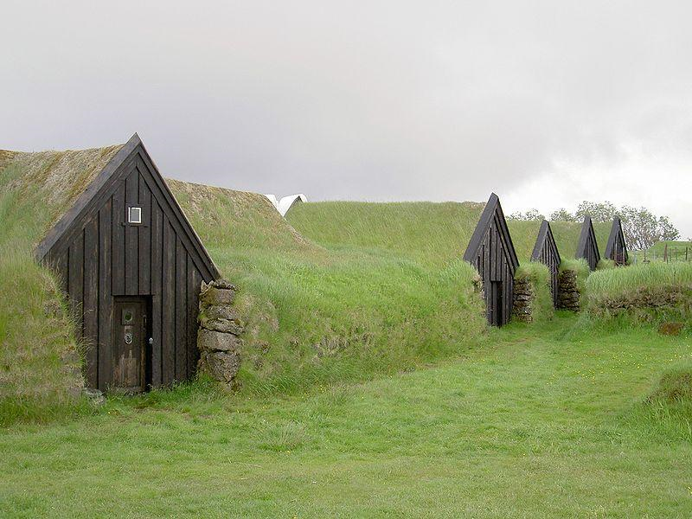

Slide 29
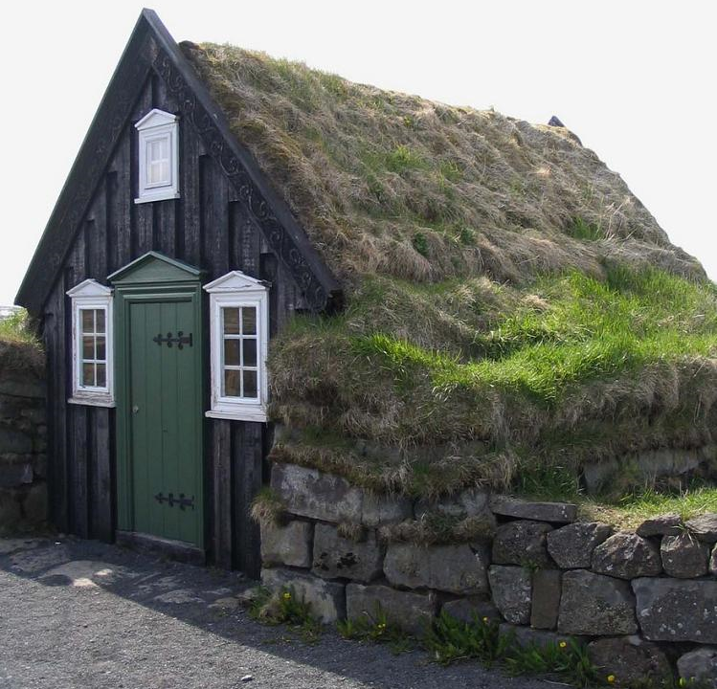

Slide 30
The Biotic component & Natural setting

Slide 31
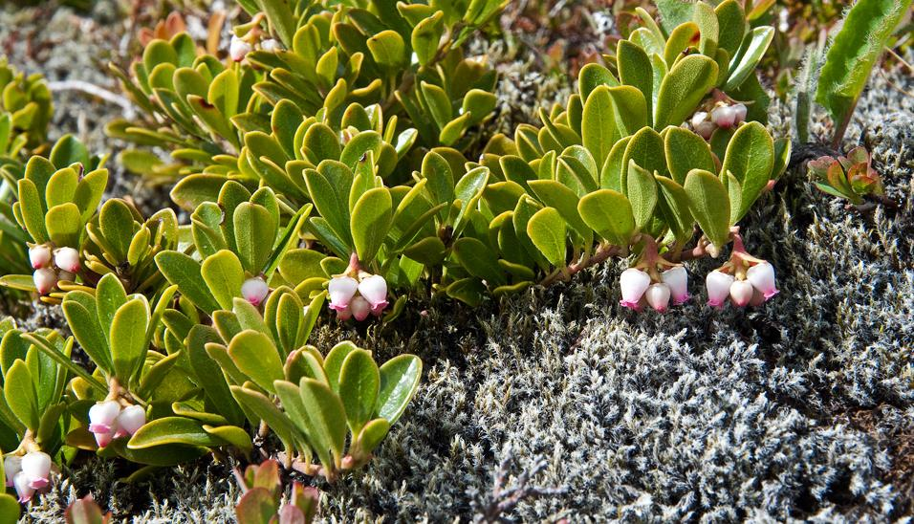

Slide 32
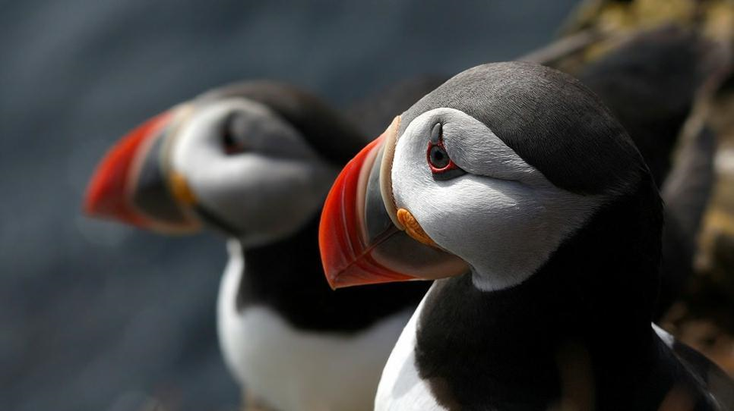

Slide 33
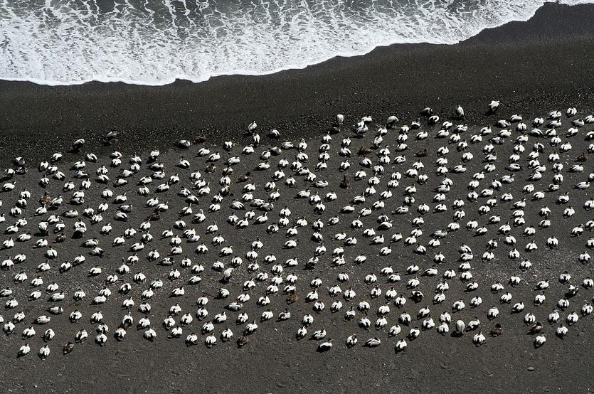

Slide 34
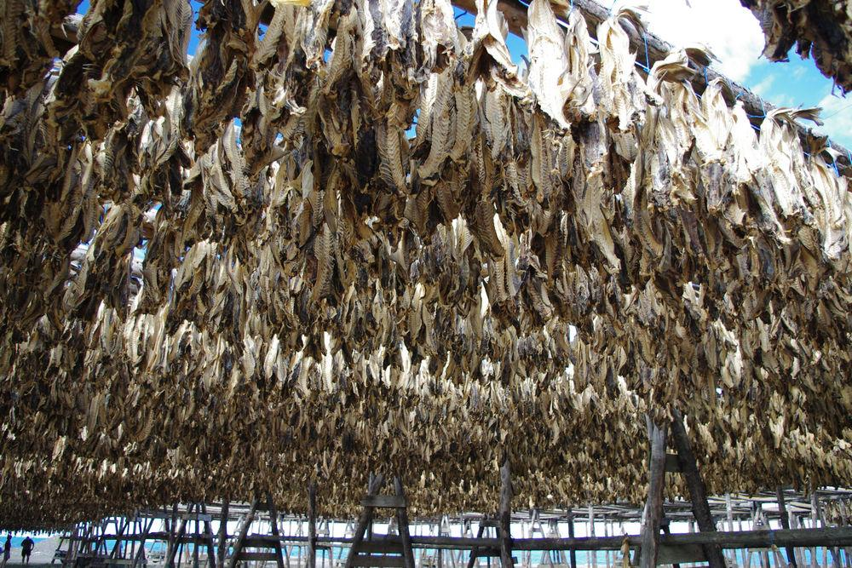

Slide 35
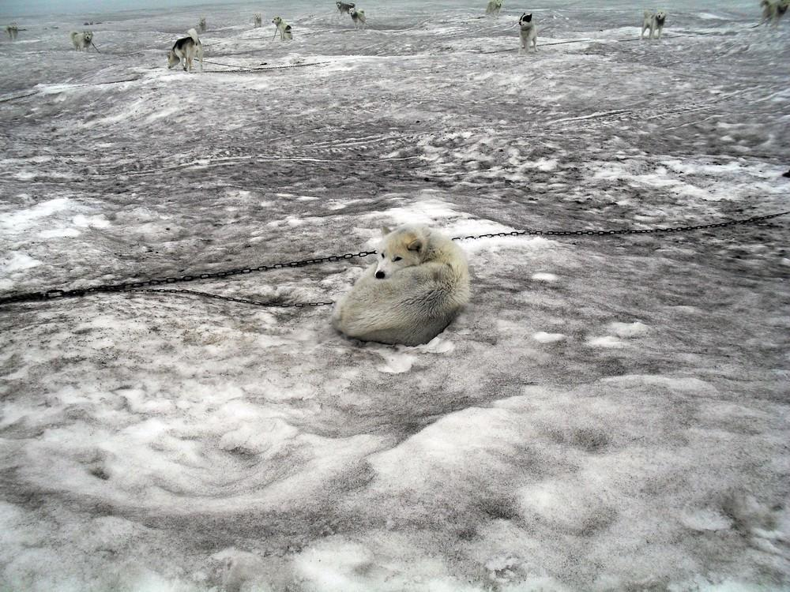
Huskey Dog

Slide 36
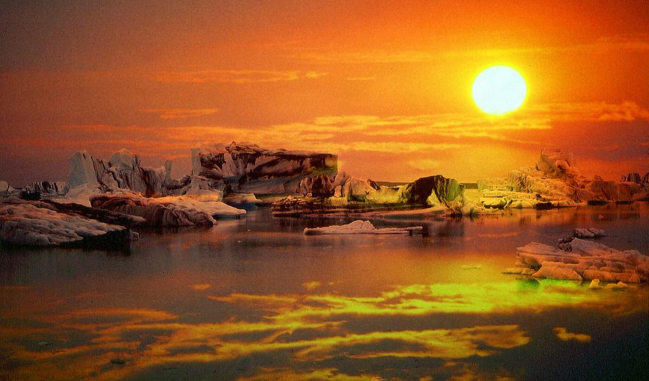

Slide 37
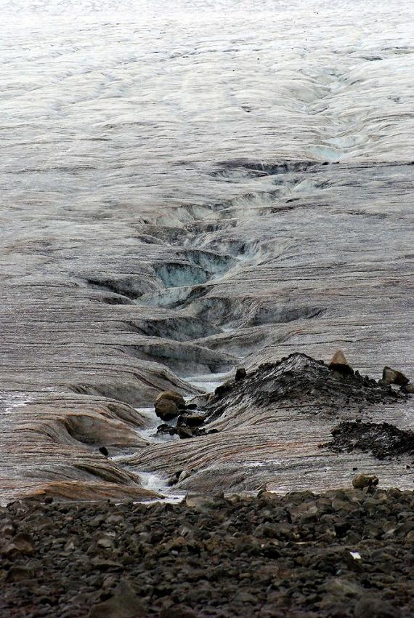
Glackier

Slide 38
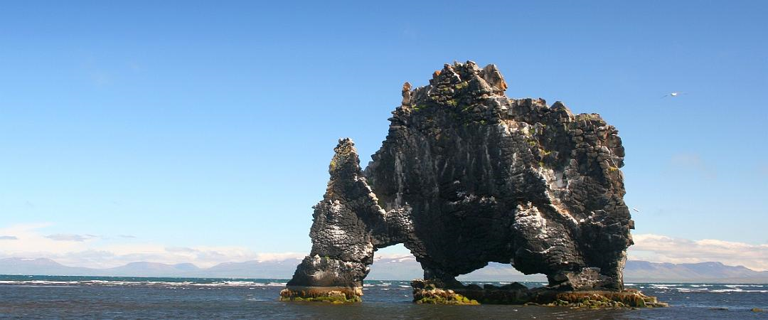
The name Hvitserkur means "white shirt" and is due to the deposits of bird droppings that stain the rock.

Slide 39
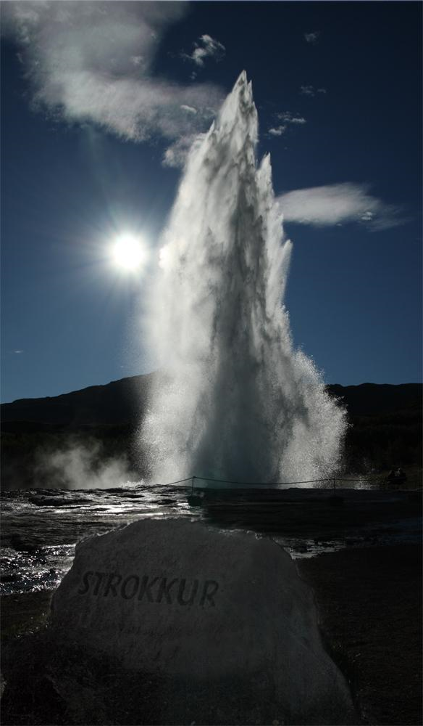
Strokkur
It is one of Iceland's most famous geysers, erupting regularly every 4-8 minutes generally.

Slide 40
