Slide 1

Guatemala

Slide 2
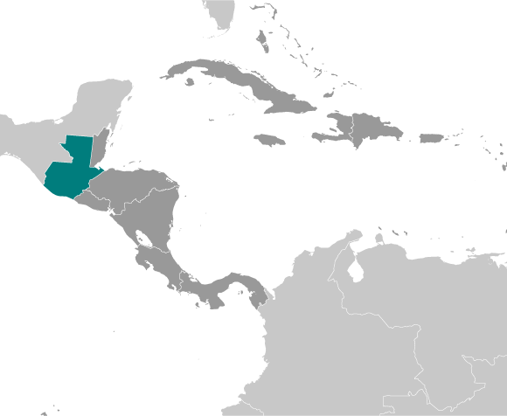
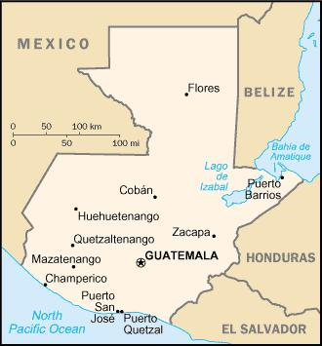

Slide 3
Basic Geographic Information
Location: Central America, bordering the North Pacific Ocean, between El Salvador and Mexico, and bordering the Gulf of Honduras (Caribbean Sea) between Honduras and Belize
Area: 108,889 sq km
Land boundaries: 1,687 km
Coastline: 400 km
Climate: tropical; hot, humid in lowlands; cooler in highlands
Terrain: mostly mountains with narrow coastal plains and rolling limestone plateau
Land use:
  arable land: 13.22%
  permanent crops: 5.6%
  other: 81.18% (2005)
Environment issues: deforestation of rainforest; soil erosion; water pollution

Slide 4
Demographics
Population: 13,550,440 (July 2010 est.)
Age structure: 0-14 years: 38.7%
Median age: 19.7 years
Population growth rate: 2.019% (2010 est.)
Urban population: 49%
Total fertility rate: 3.36
Infant mortality rate: 26.91 deaths/1,000 live births
Life expectancy at birth: 70.59 years
Literacy: age 15 & over can read and write: 69.1%
Ethnic groups: Mestizo and European 59.4%, K'iche 9.1%, Kaqchikel 8.4%, Mam 7.9%, Q'eqchi 6.3%, other Mayan 8.6%, indigenous non-Mayan 0.2%, other 0.1% (2001 census)
Religions: Roman Catholic, Protestant, Mayan beliefs

Slide 5
Economy
Population below poverty line: 56.2% (2004 est.)
Labor force - by occupation:
  agriculture: 50%
  industry: 15%
  services: 35% (1999 est.)
Household income or consumption by percent:
  lowest 10%: 1.3%
  highest 10%: 42.4% (2006
Public debt: 27.4% of GDP (2009 est.)
Agriculture - products: sugarcane, corn, bananas, coffee, beans, cardamom; cattle, sheep, pigs, chickens
Industries: sugar, textiles and clothing, furniture, chemicals, petroleum, metals, rubber, tourism
GDP - per capita (PPP): $5,200 (2009 est.)
GDP growth rate: -5% (2009 est.)
  4% (2008 est.)
  6.3% (2007 est.)
GDP by sector:
  agriculture: 13.5%
  industry: 24.4%
  services: 62% (2009 est.)
Unemployment rate: 3.2% (05)

Slide 6
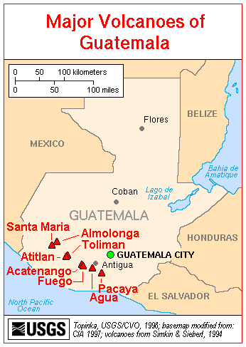
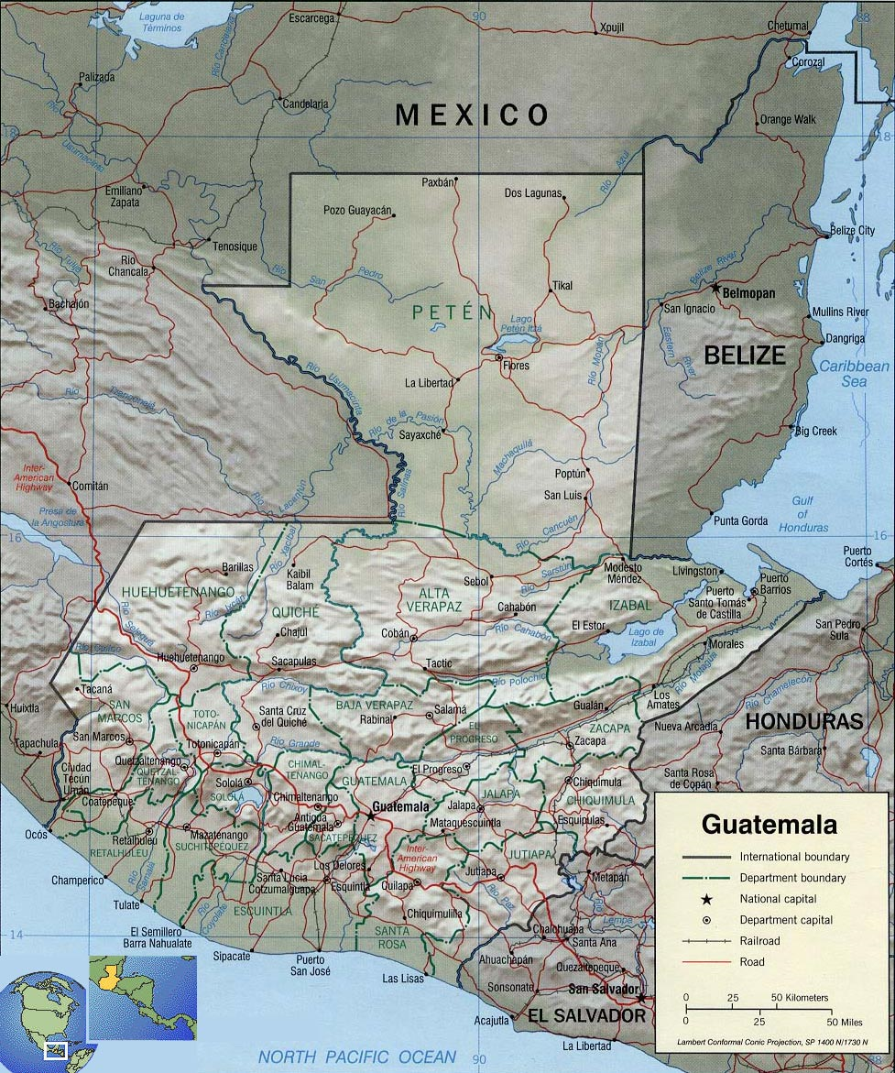

Slide 7
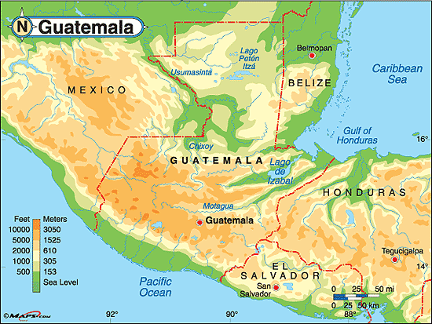

Slide 8
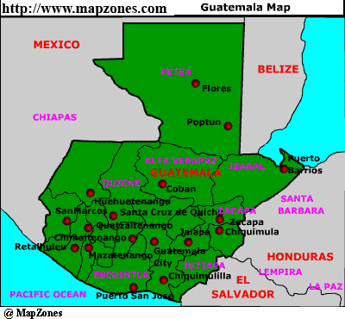

Slide 9
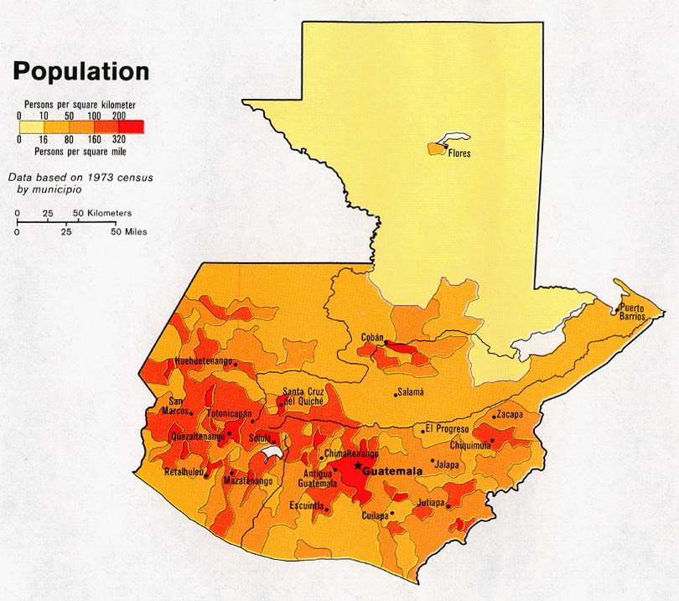

Slide 10
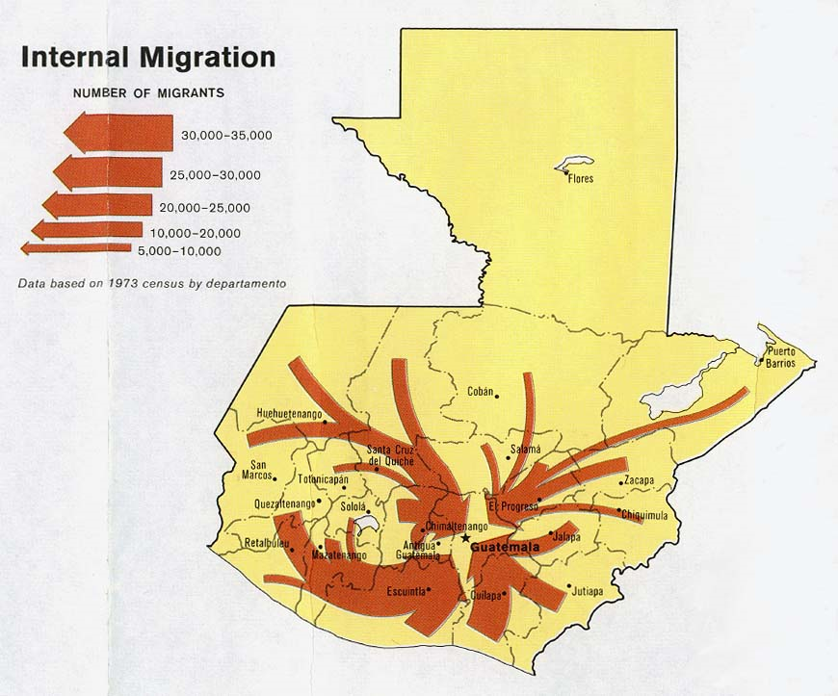

Slide 11
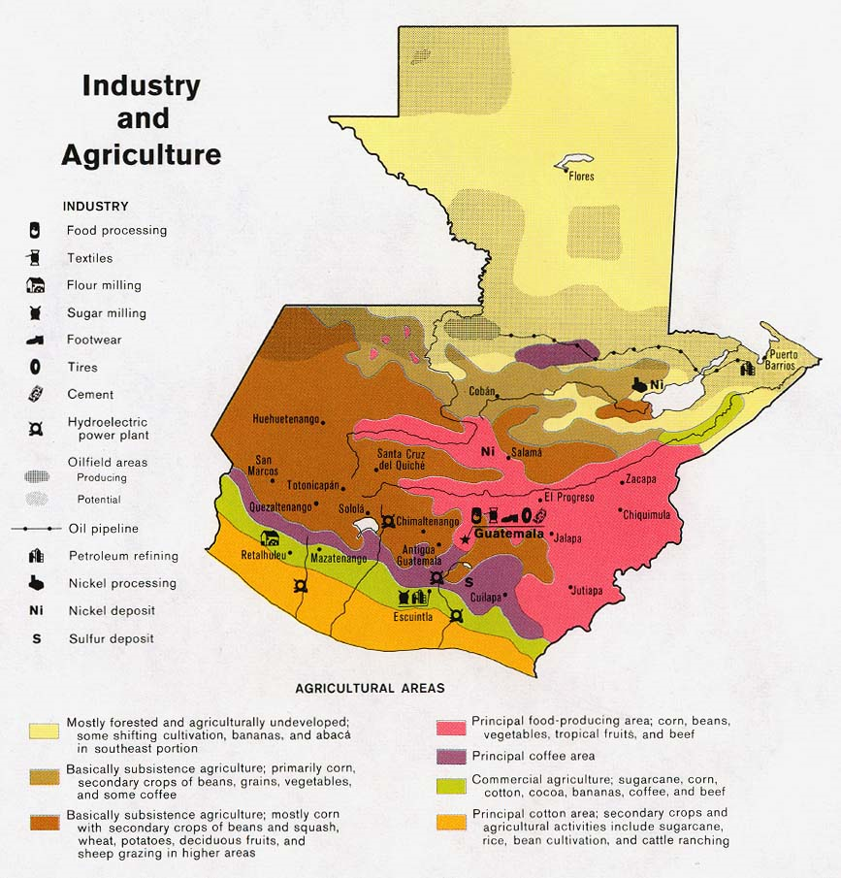

Slide 12
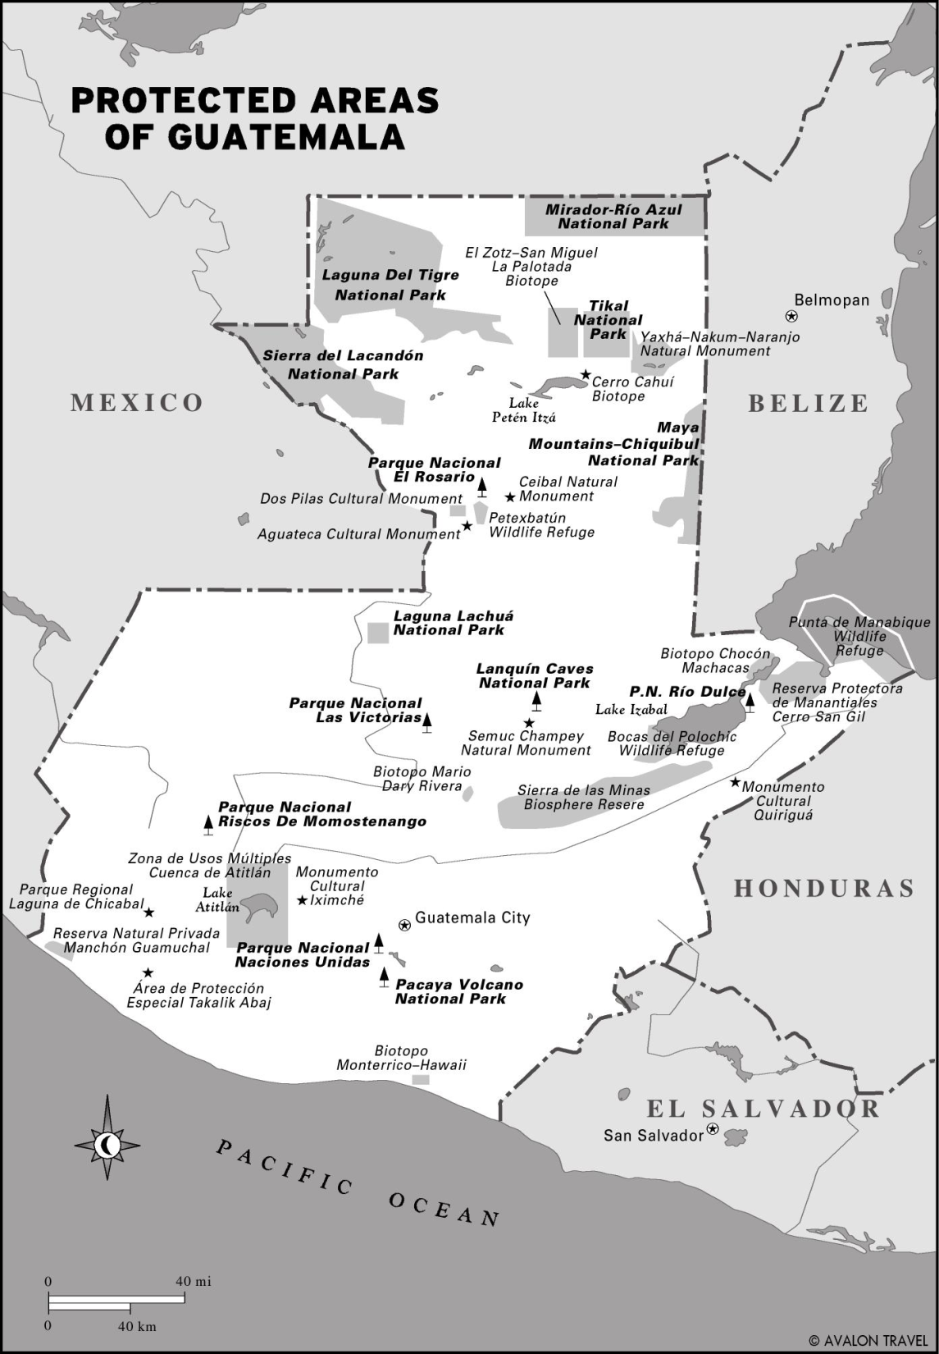
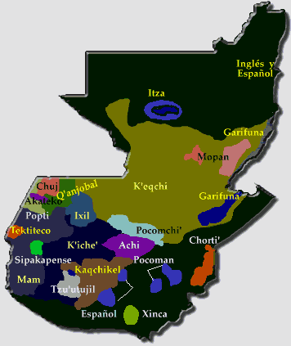
Native American Languages

Slide 13
Natural Landscape

Slide 14
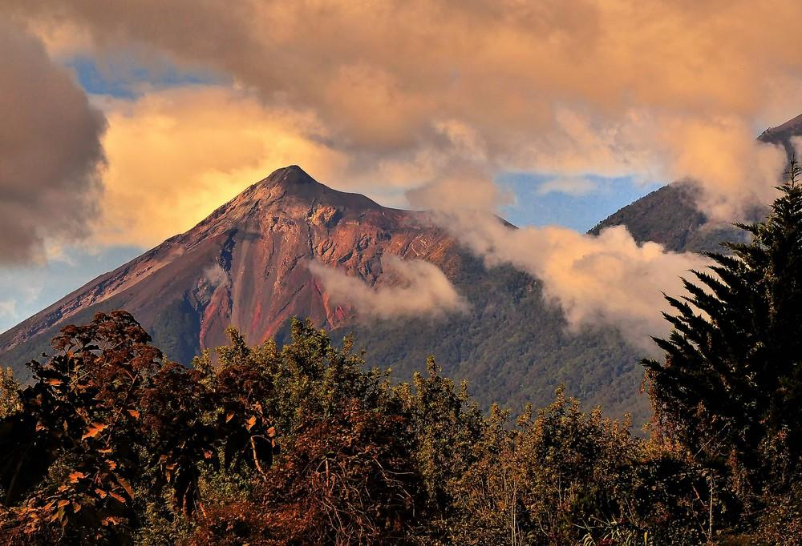
Fuego Volcano - Antigua

Slide 15
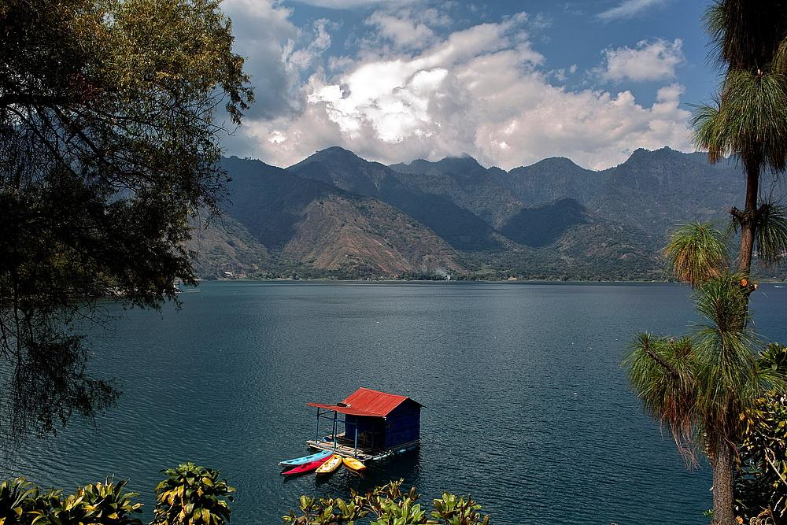
Lake Atitlan

Slide 16
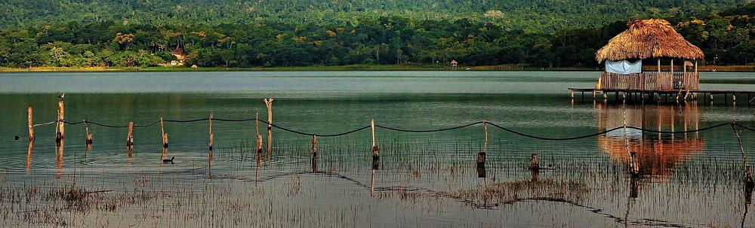
Lake Peten Itza

Slide 17
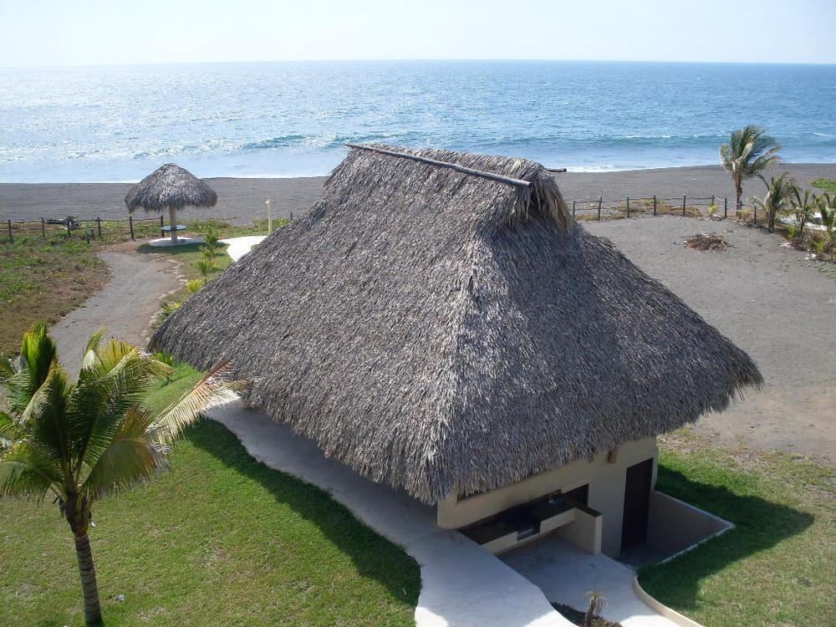

Slide 18
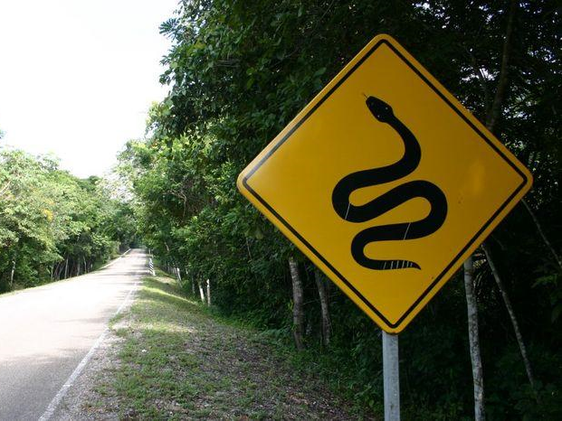

Slide 19
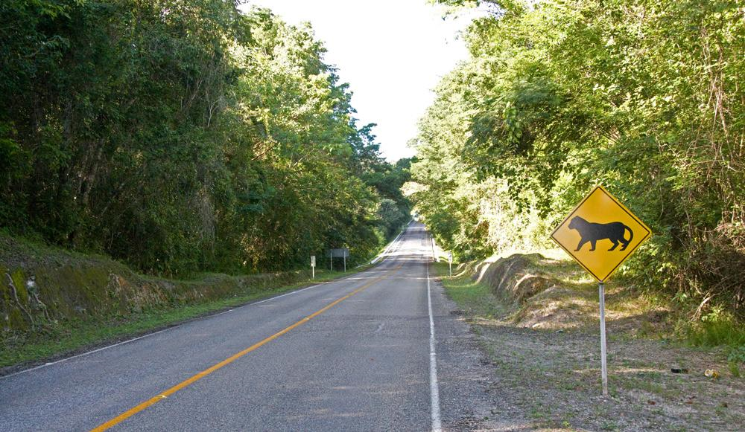
Jaguar crossing

Slide 20
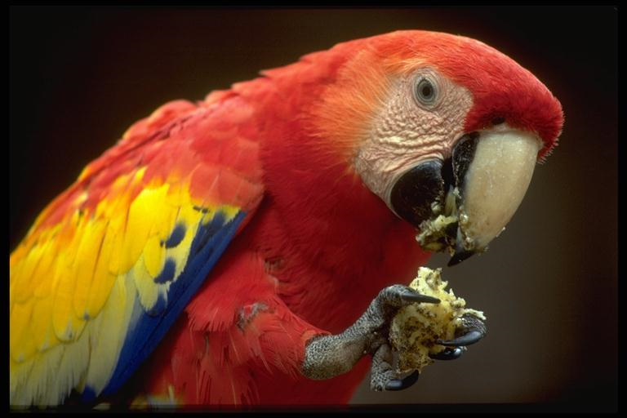

Slide 21
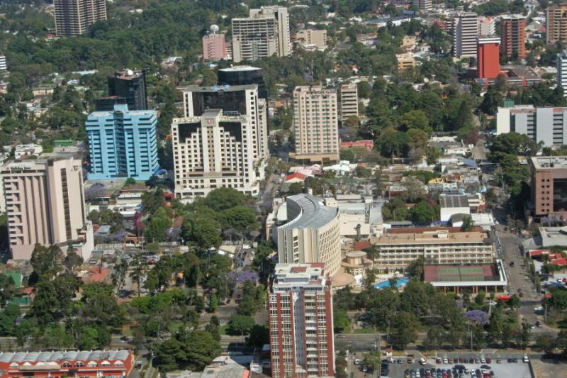
Guatemala City

Slide 22
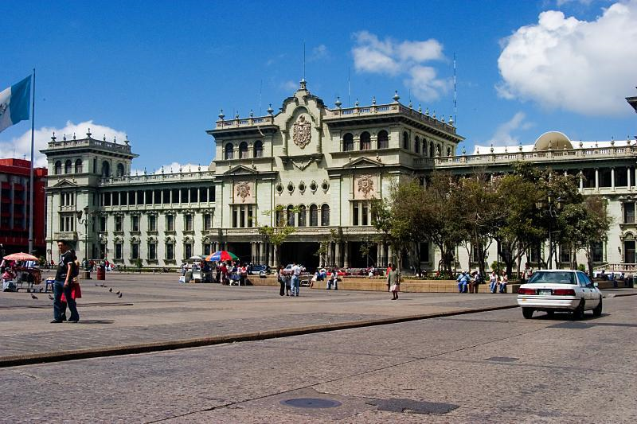
Presidential Palace

Slide 23
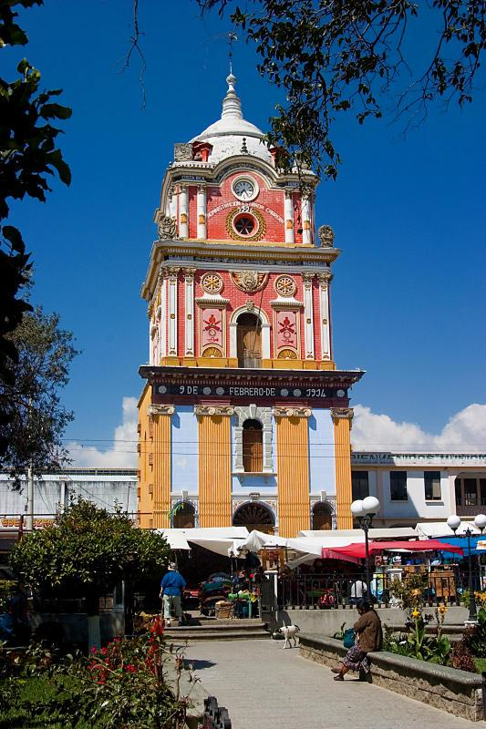
City Hall

Slide 24
Native American Background

Slide 25
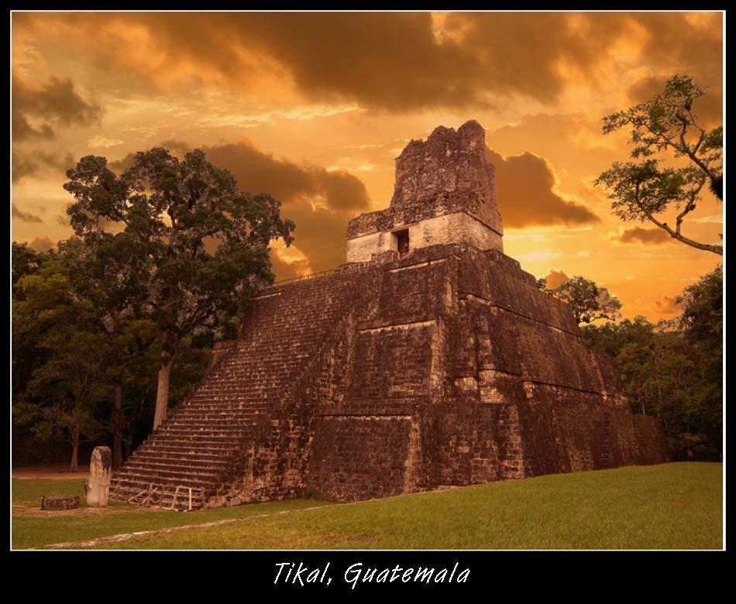

Slide 26
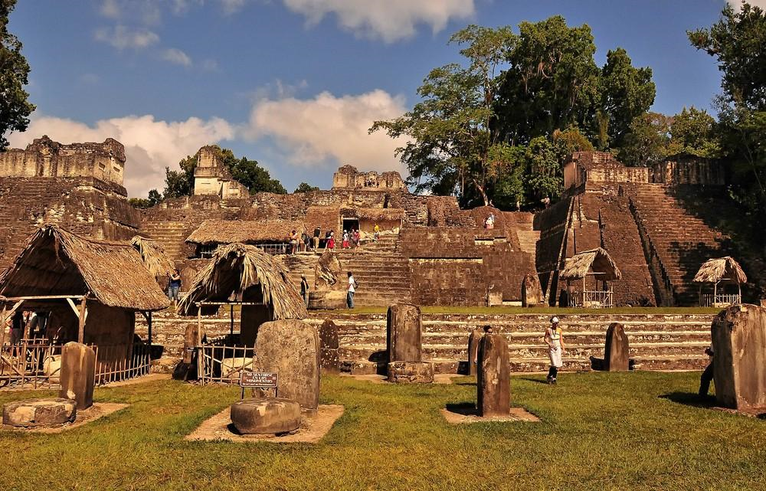
Plaza Mayor

Slide 27
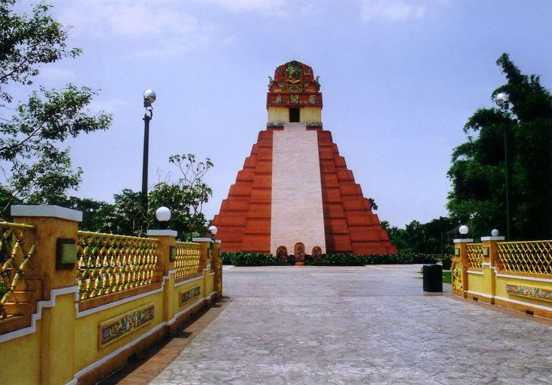
Xetulul theme park

Slide 28
Colonial architecture

Slide 29
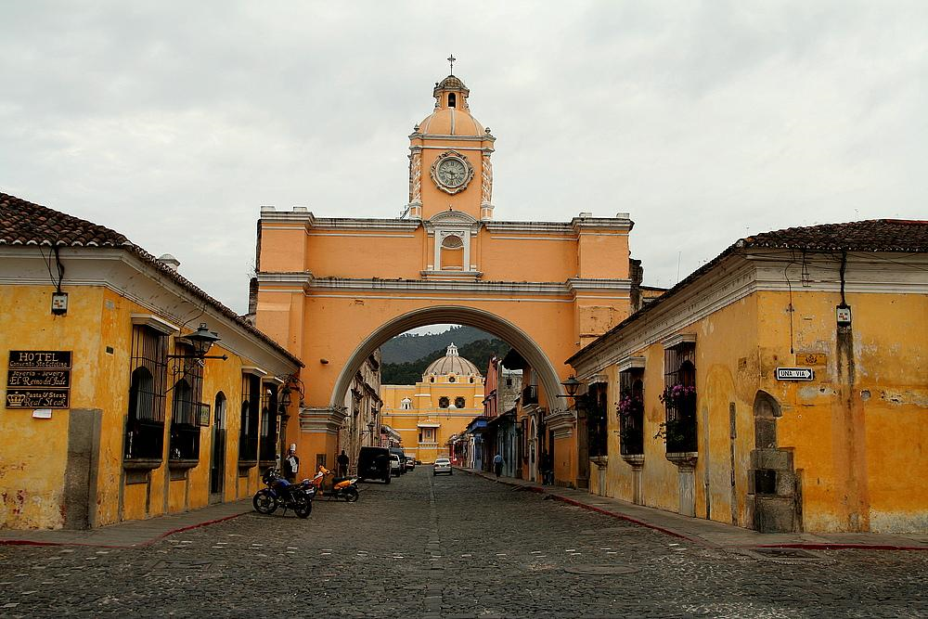
Arc of Santa Catalina-Antigua

Slide 30
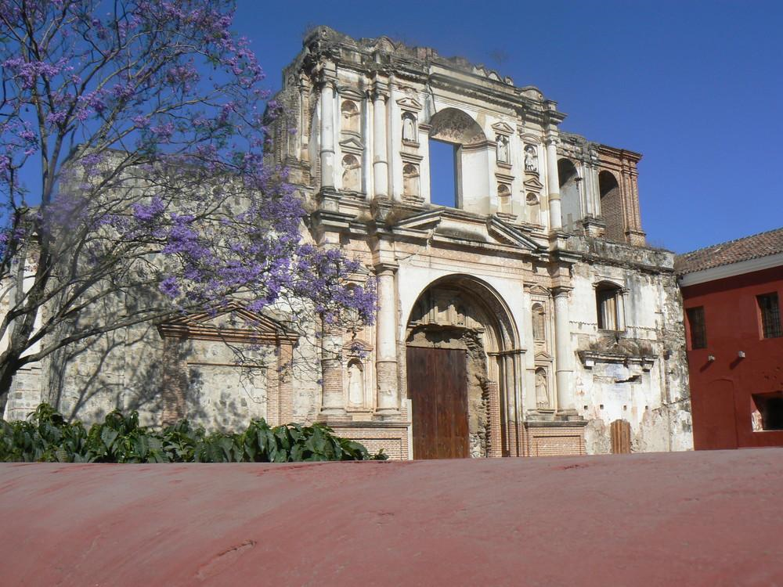
Antigua

Slide 31
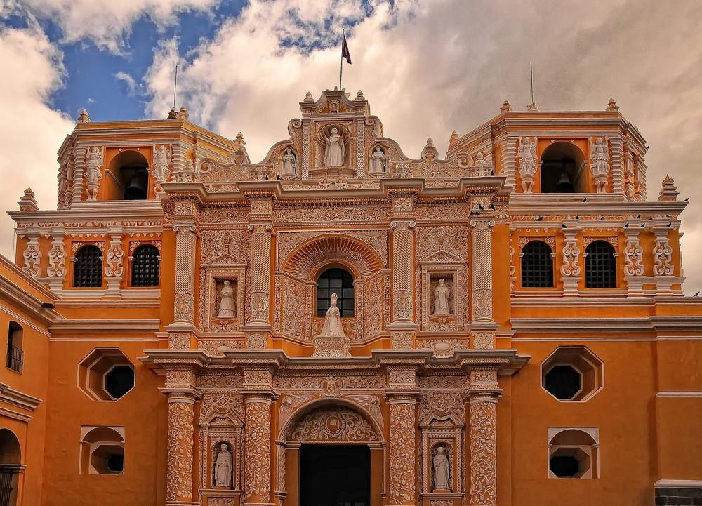
Nuestra Senora de la Merced

Slide 32
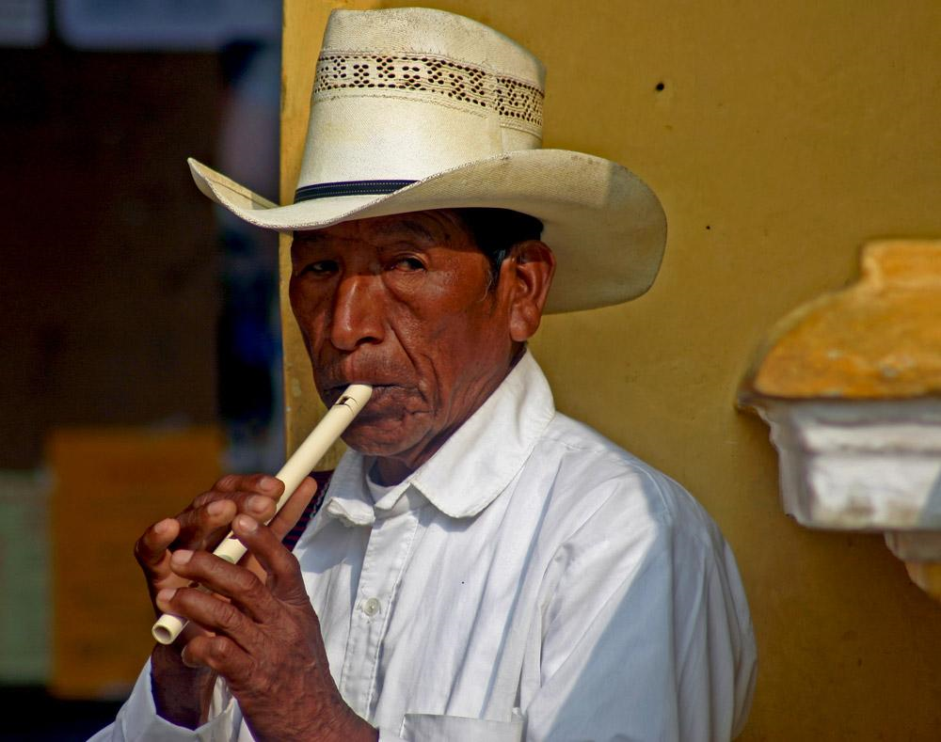
A variety of people making a living in a variety of ways

Slide 33
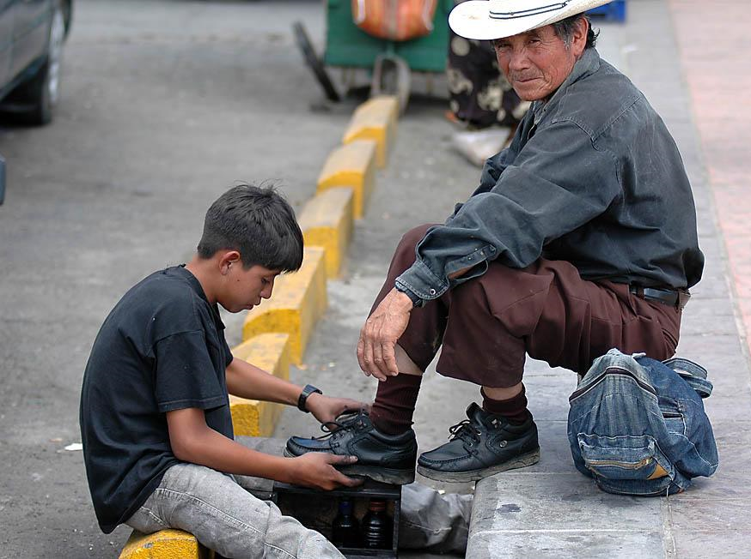

Slide 34
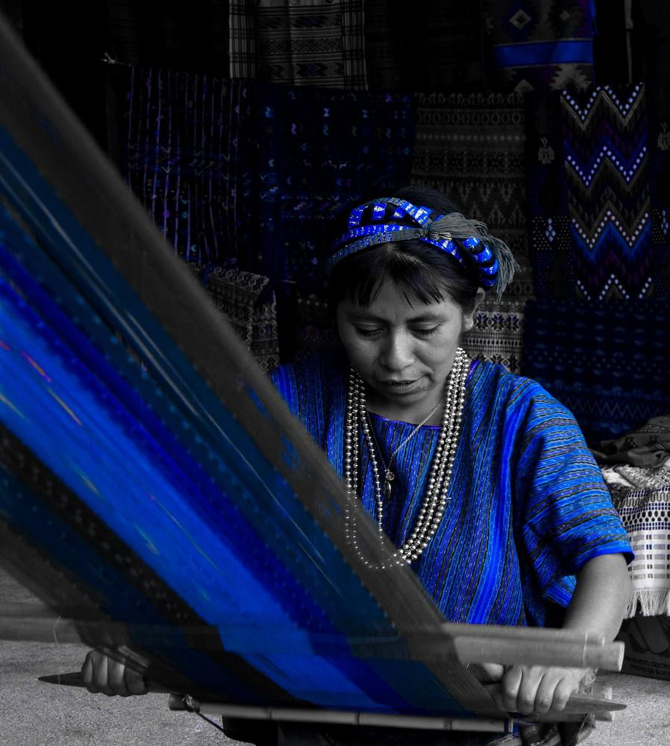

Slide 35
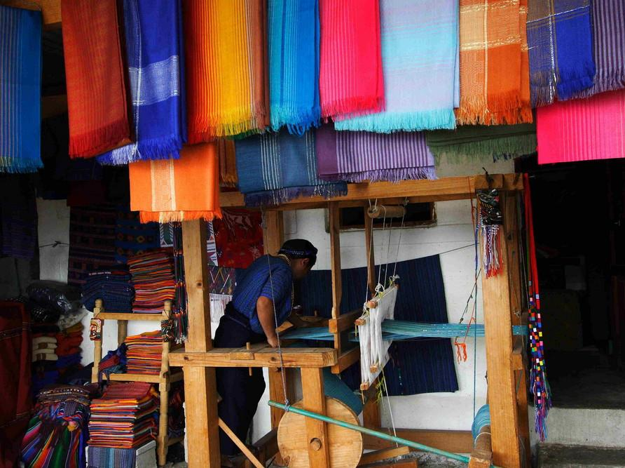

Slide 36
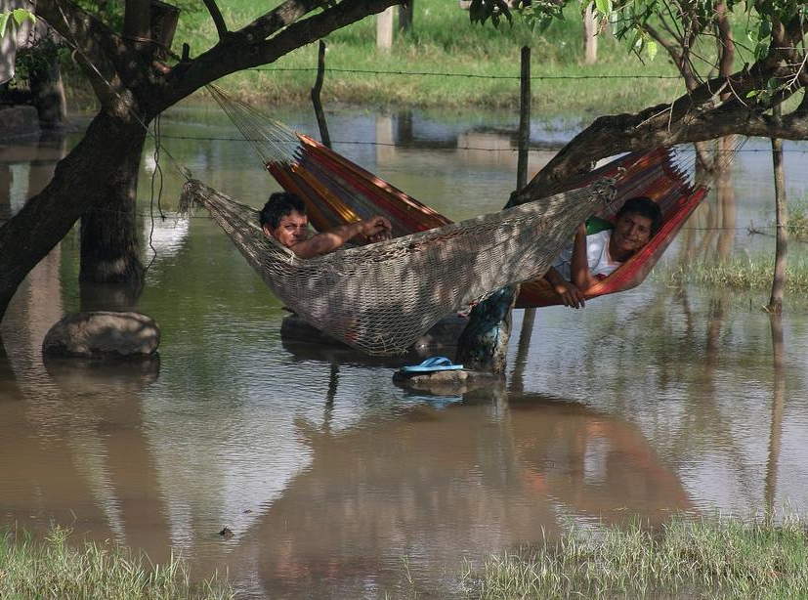

Slide 37
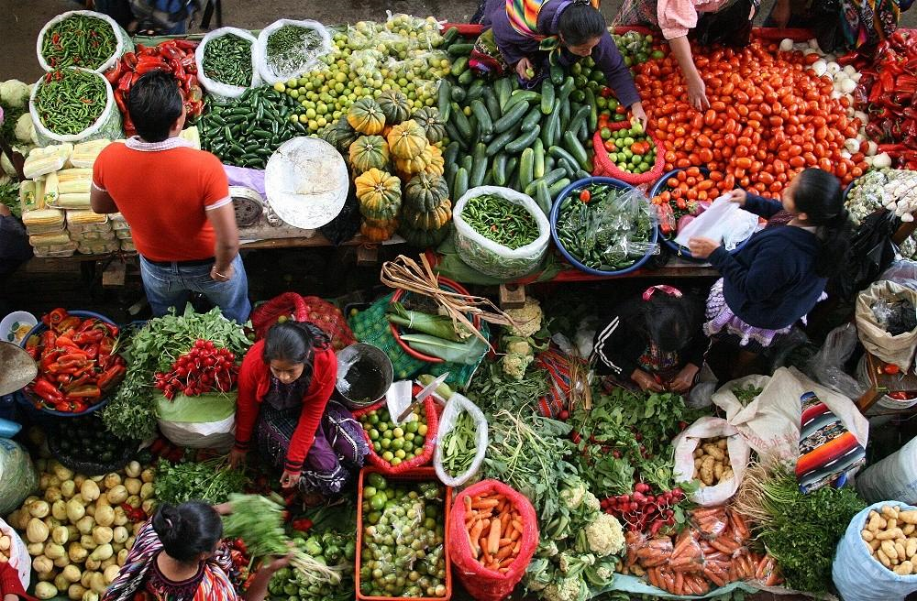

Slide 38
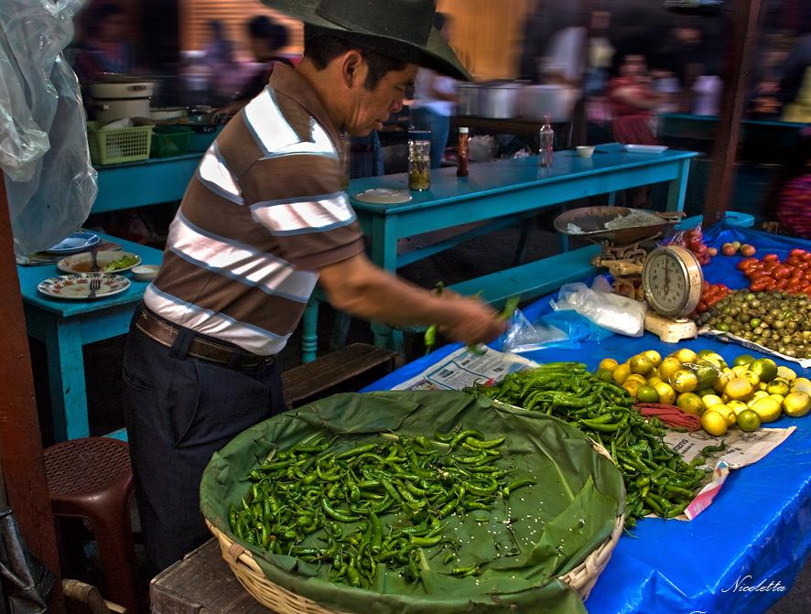

Slide 39
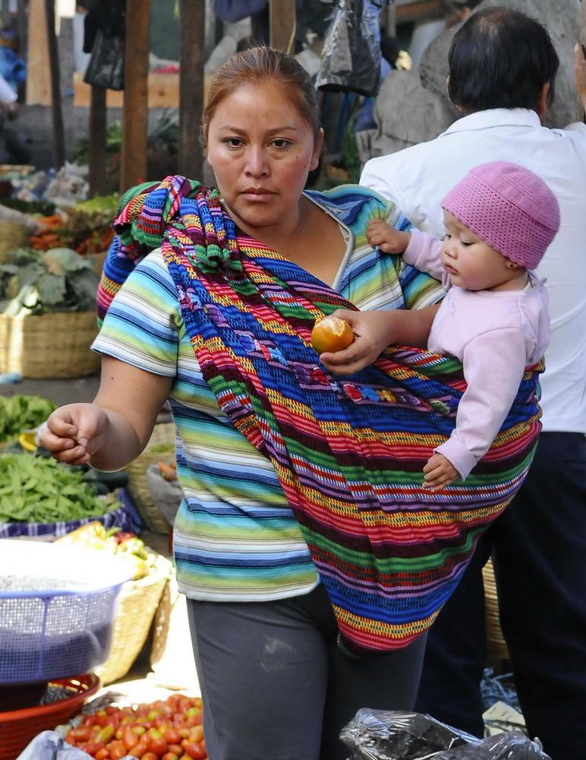

Slide 40
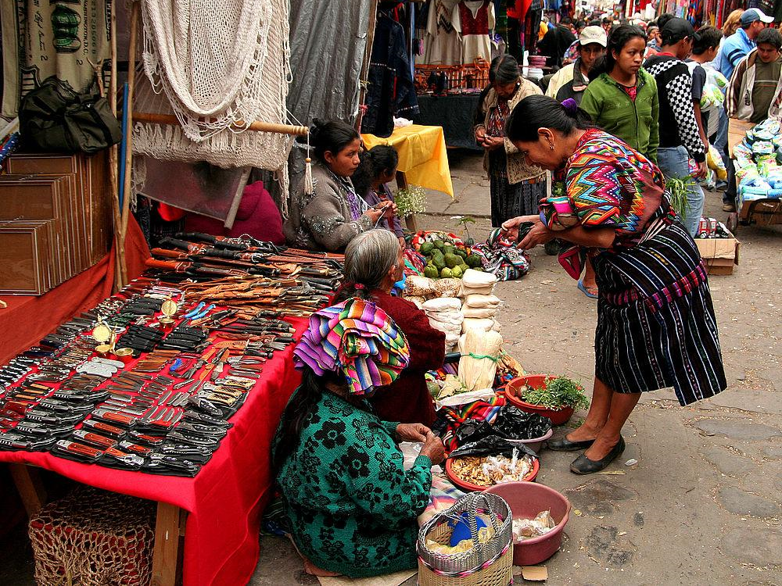

Slide 41
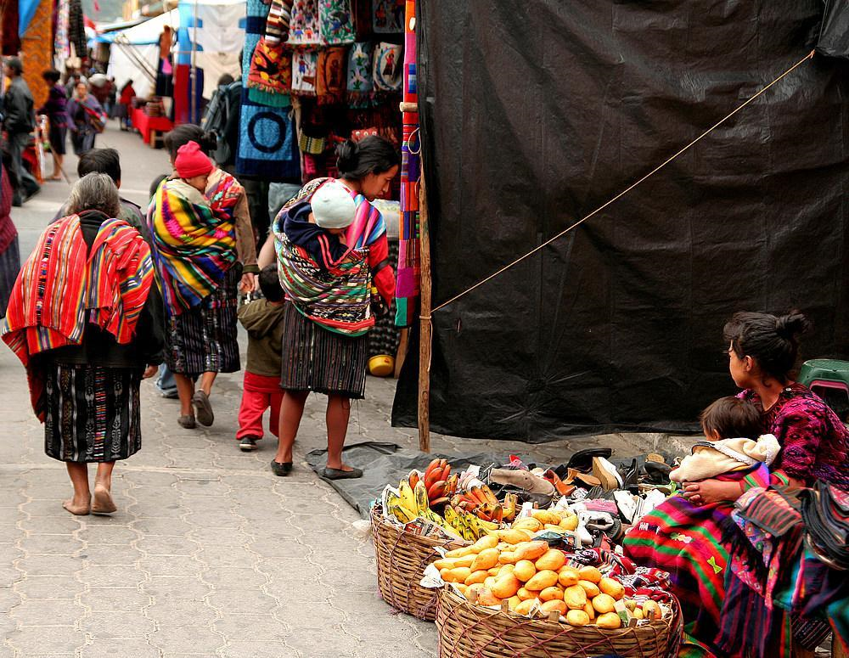

Slide 42
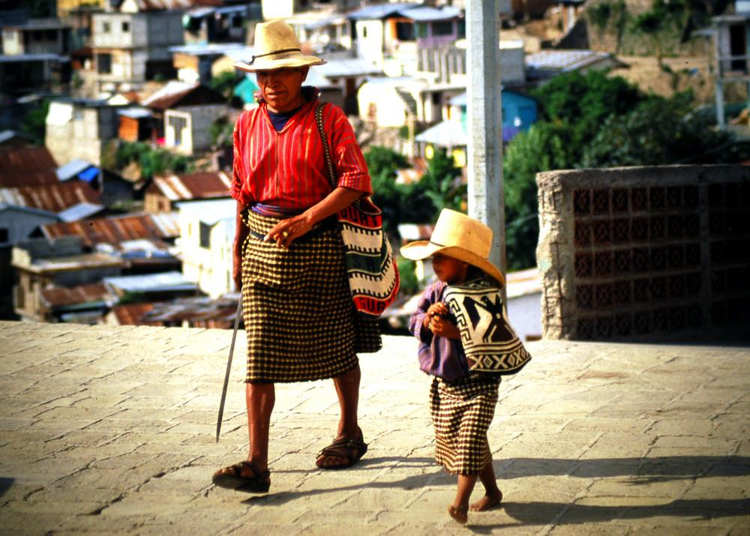

Slide 43
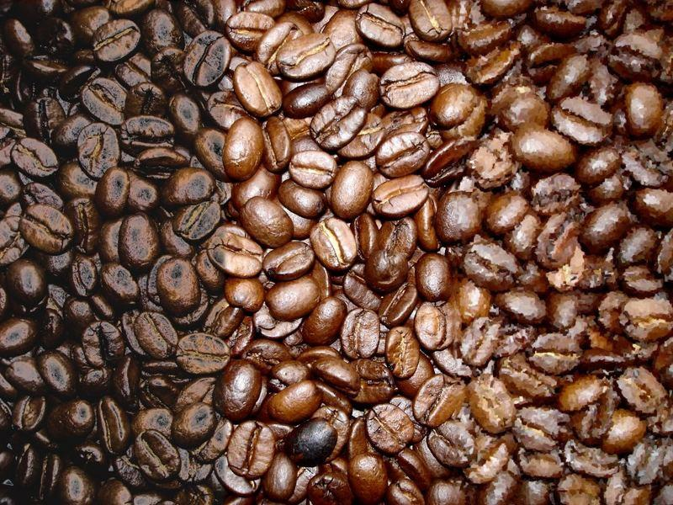

Slide 44
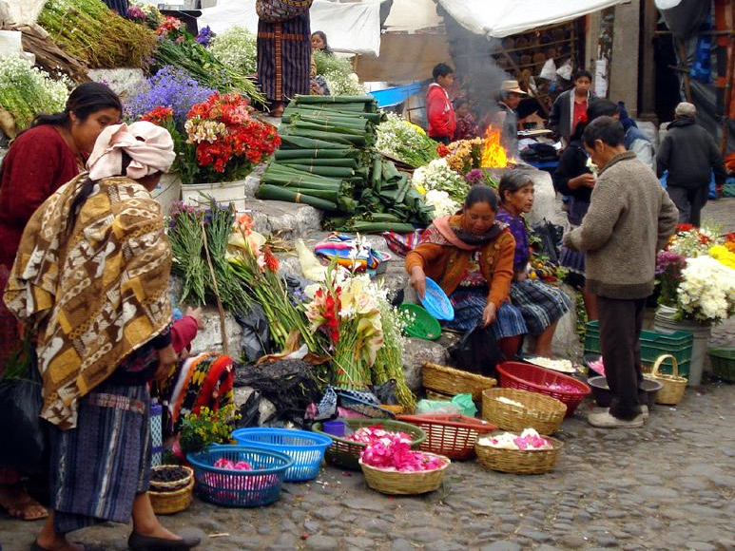

Slide 45
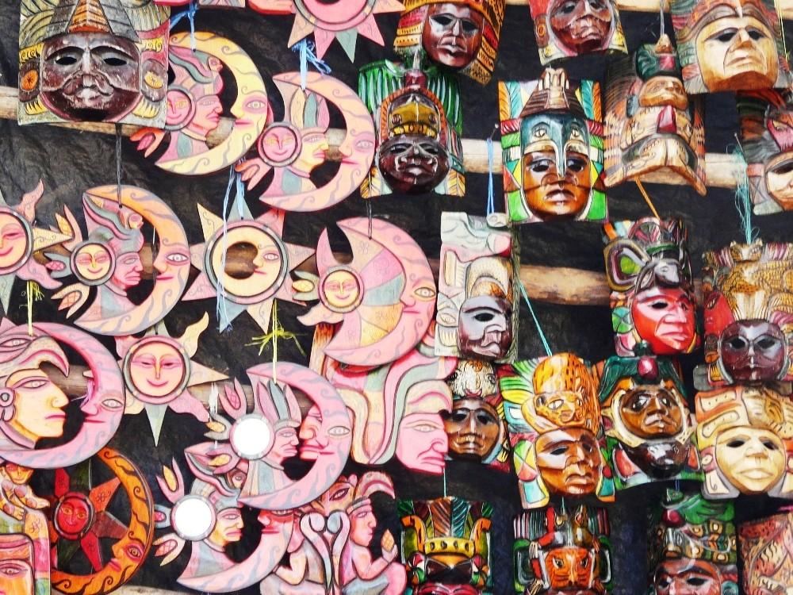

Slide 46
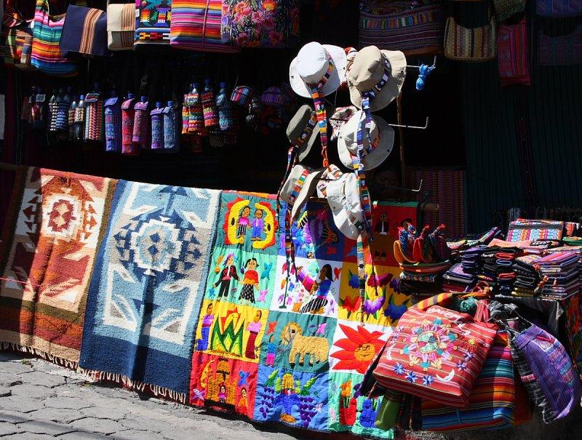

Slide 47
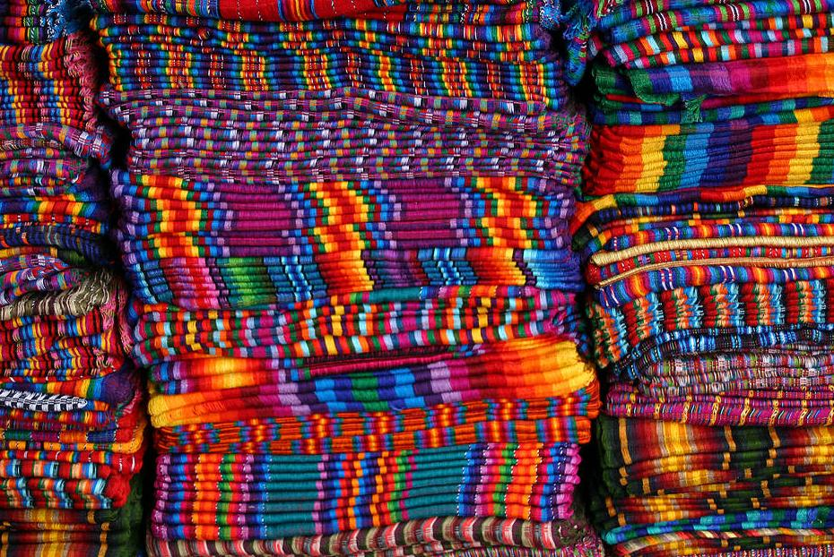

Slide 48
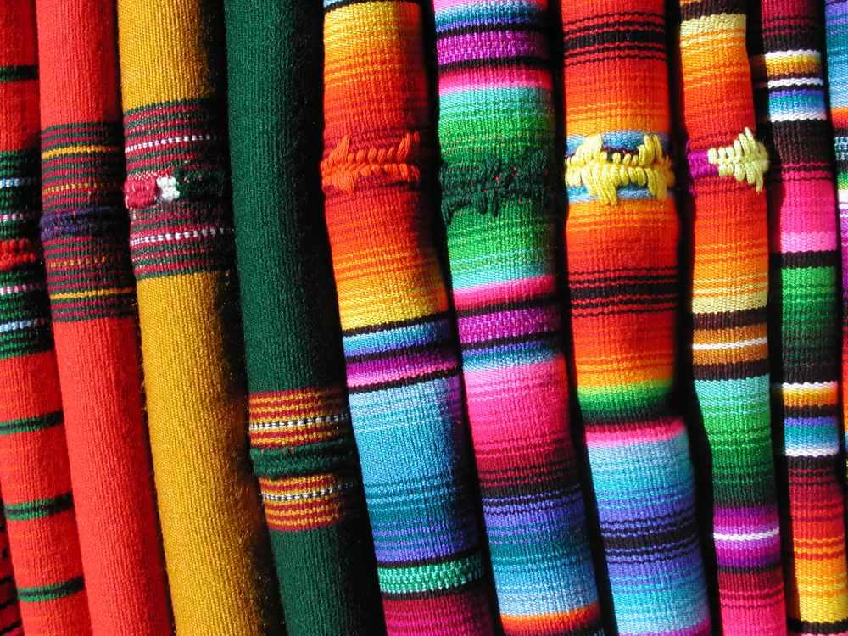

Slide 49


Slide 50
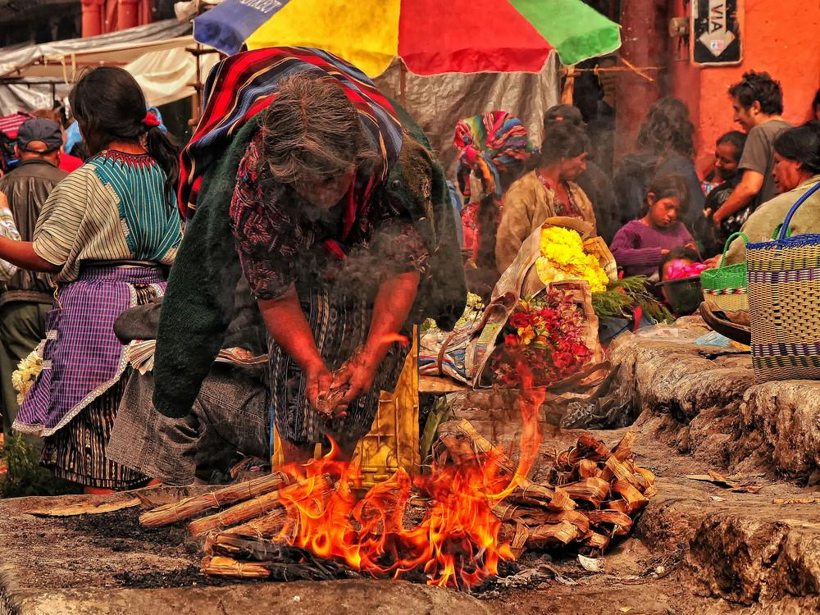

Slide 51
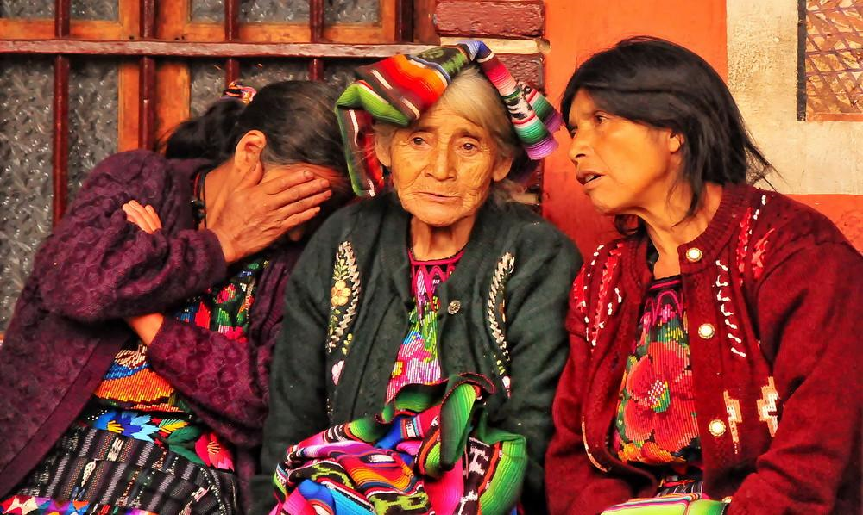
A variety of scenes from guatemala

Slide 52
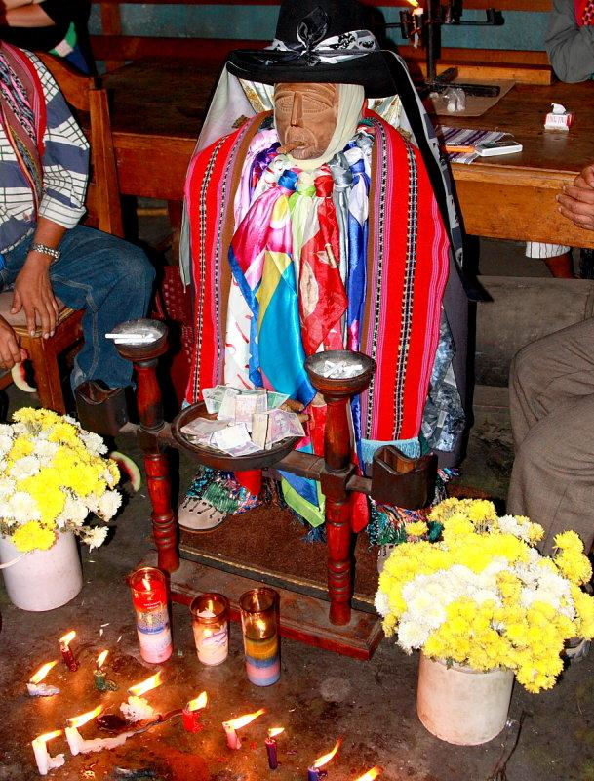

Slide 53
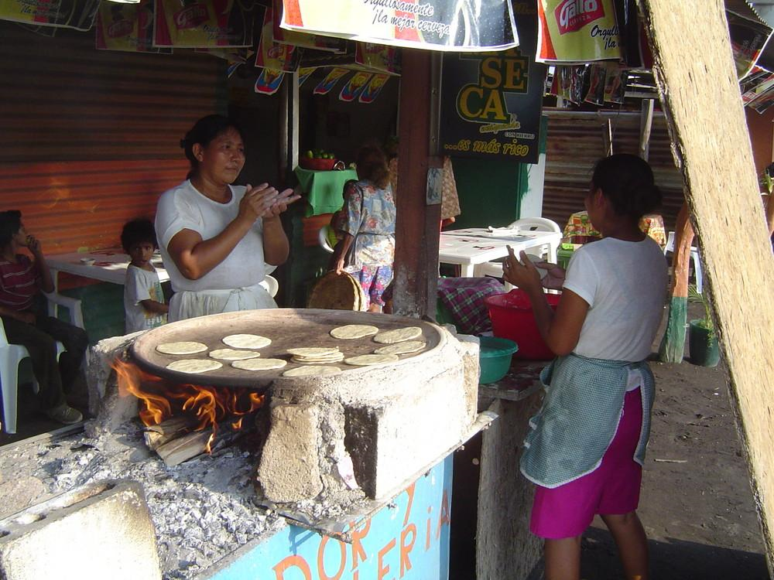

Slide 54
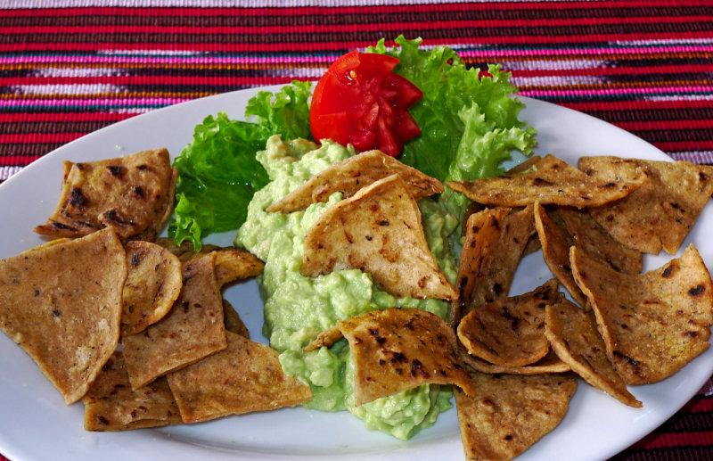

Slide 55
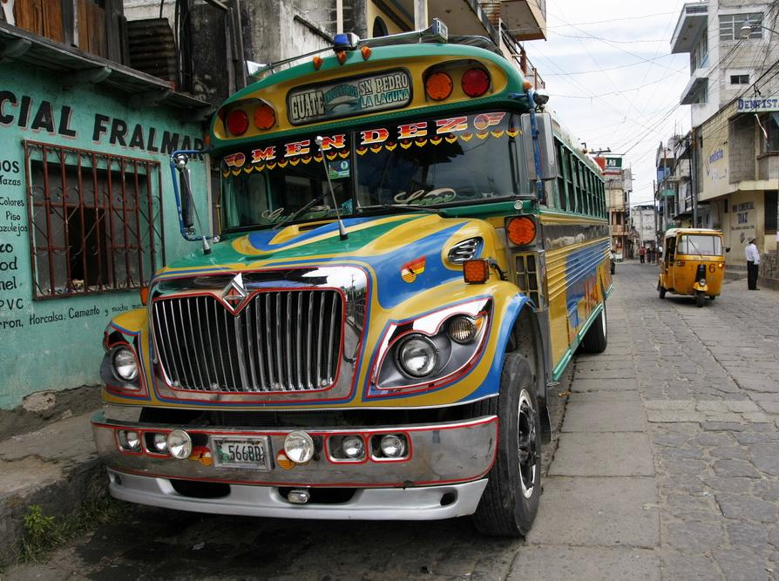

Slide 56


Slide 57


Slide 58


Slide 59


Slide 60


Slide 61


Slide 62


Slide 63


Slide 64


Slide 65


Slide 66


Slide 67
The future of guatemala

Slide 68


Slide 69



Slide 70


Slide 71


Slide 72


Slide 73


Slide 74


Slide 75


