Slide 1

Globalization: Eurodisney

Slide 2
Background
Disneyland Paris comprises two theme parks, a retail, dining and entertainment district, and seven Disney-owned hotels. Operating since 12 April 1992, it was the second Disney resort to open outside the United States (following Tokyo Disney Resort). A second theme park, Walt Disney Studios Park, opened to the public 16 March 2002.
With 15,405,000 combined visitors to the resort's Disneyland Park and Walt Disney Studios Park in the fiscal year of 2009, it is France's and Europe's most visited Tourist site.

Slide 3
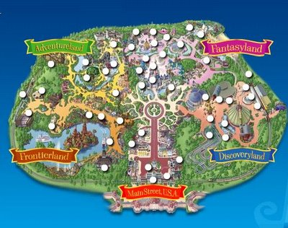

Slide 4
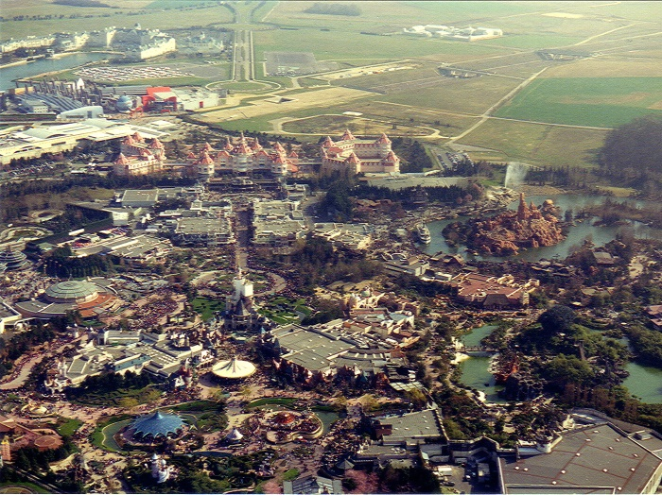

Slide 5
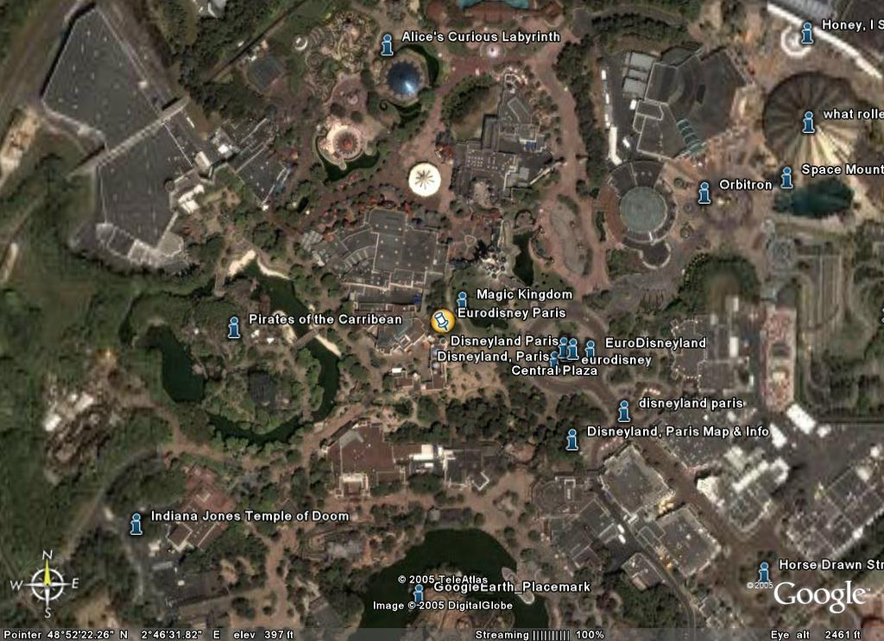

Slide 6
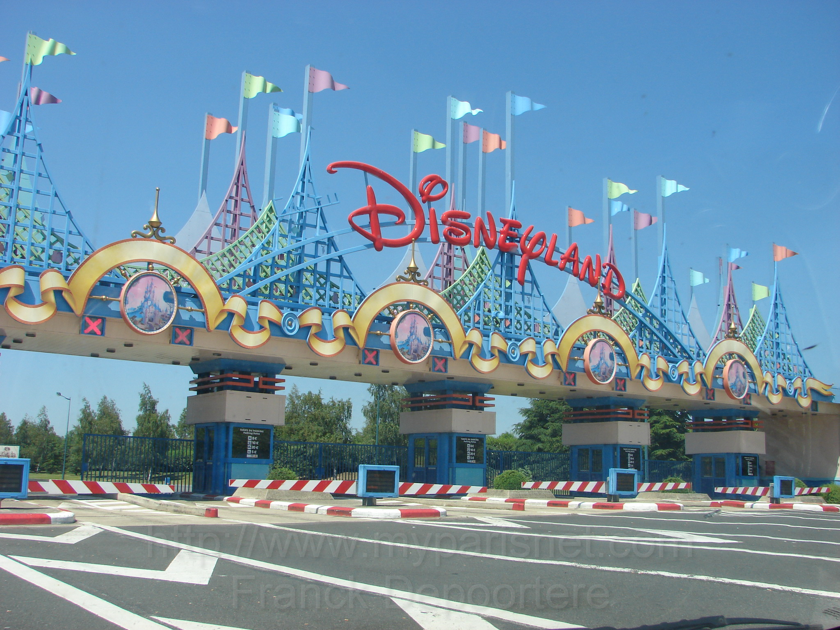

Slide 7
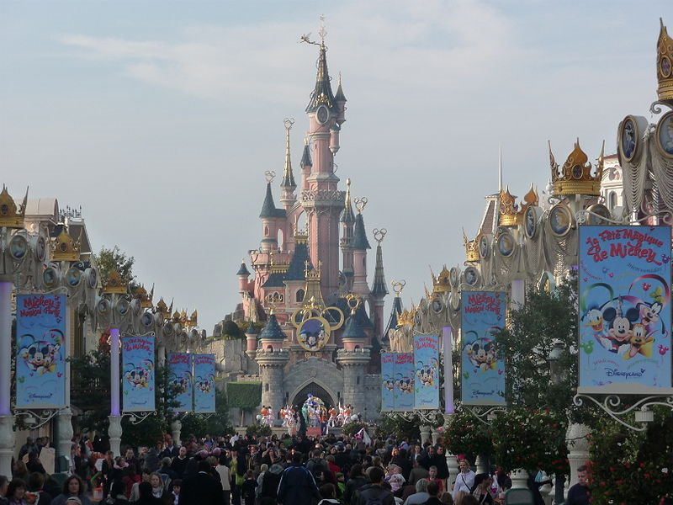

Slide 8
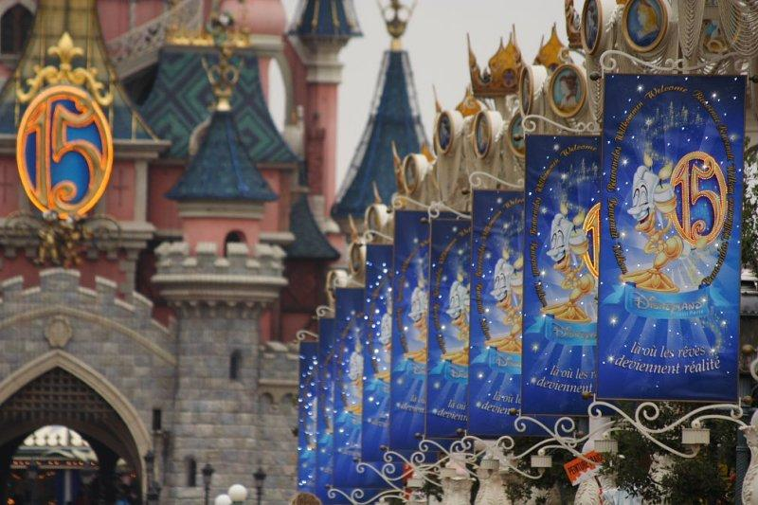

Slide 9
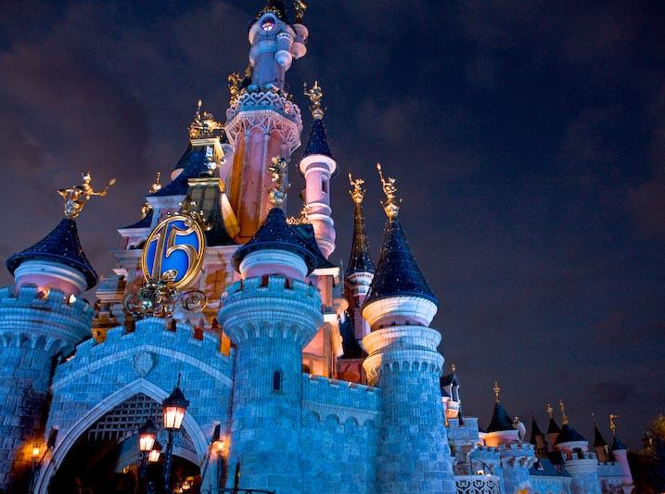

Slide 10
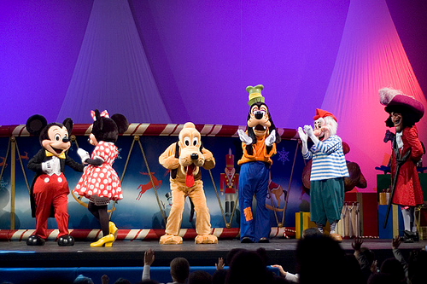

Slide 11
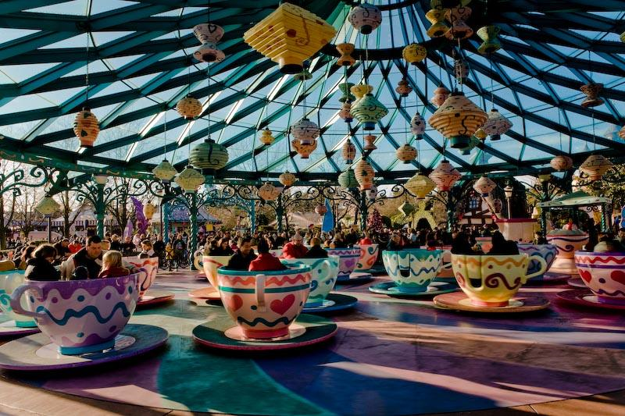

Slide 12


Slide 13
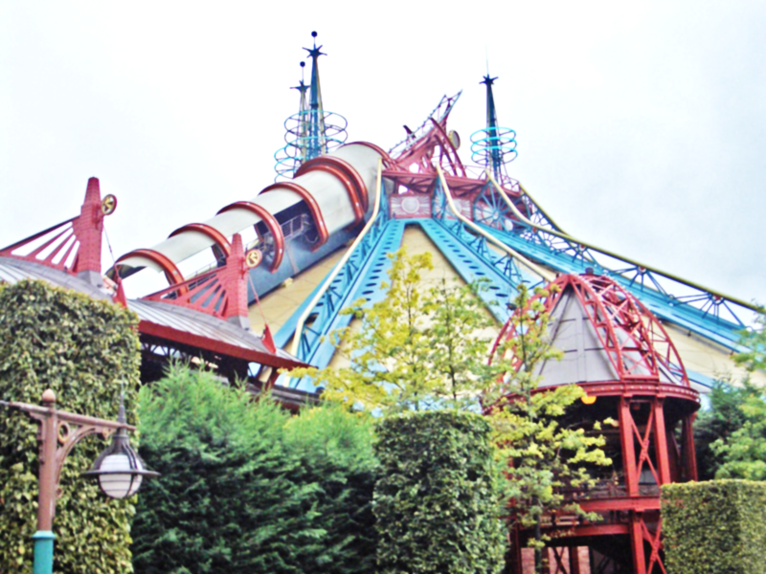

Slide 14
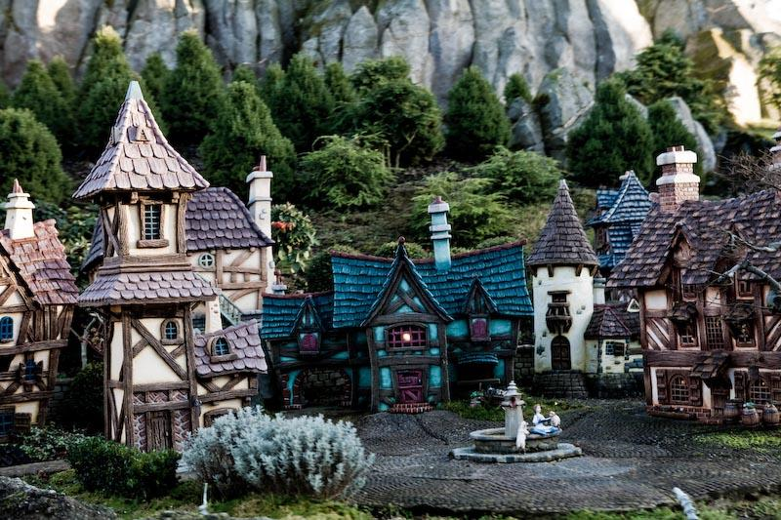

Slide 15
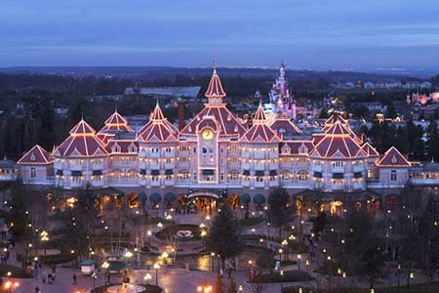

Slide 16
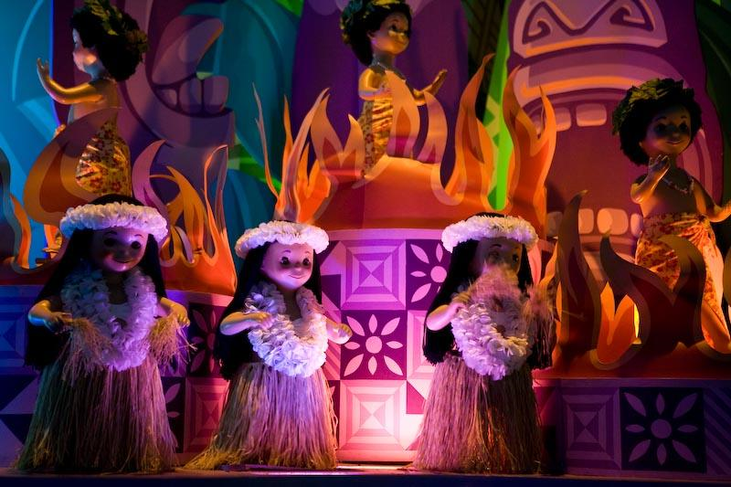

Slide 17
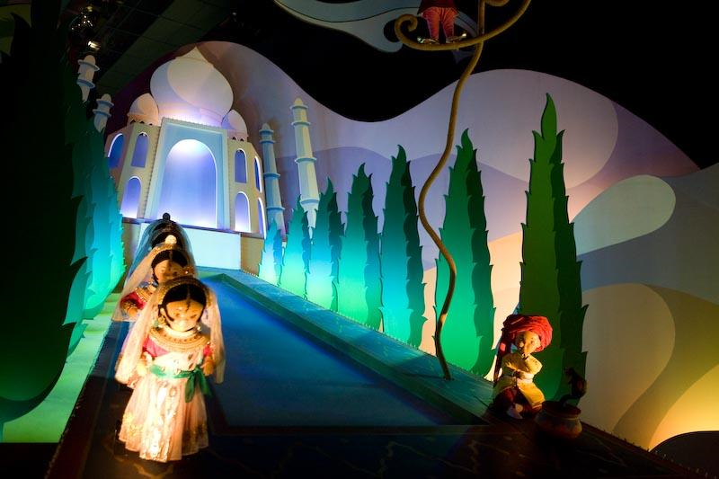

Slide 18



Slide 19


Slide 20
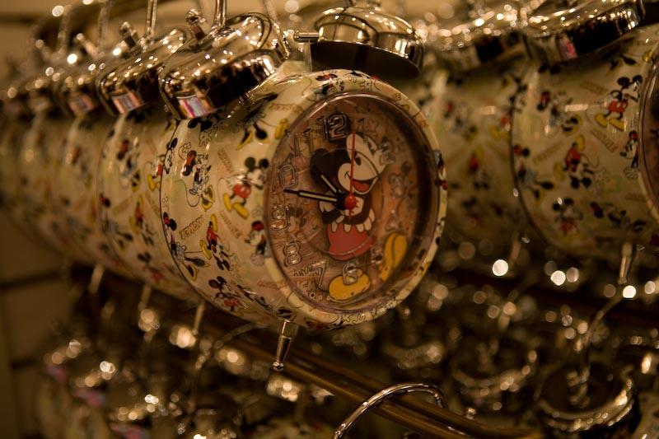

Slide 21
