Slide 1

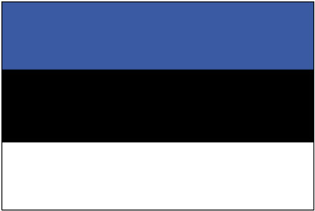
Estonia – Tallinn (capital)
UNESCO World Cultural Heritage site

Slide 2
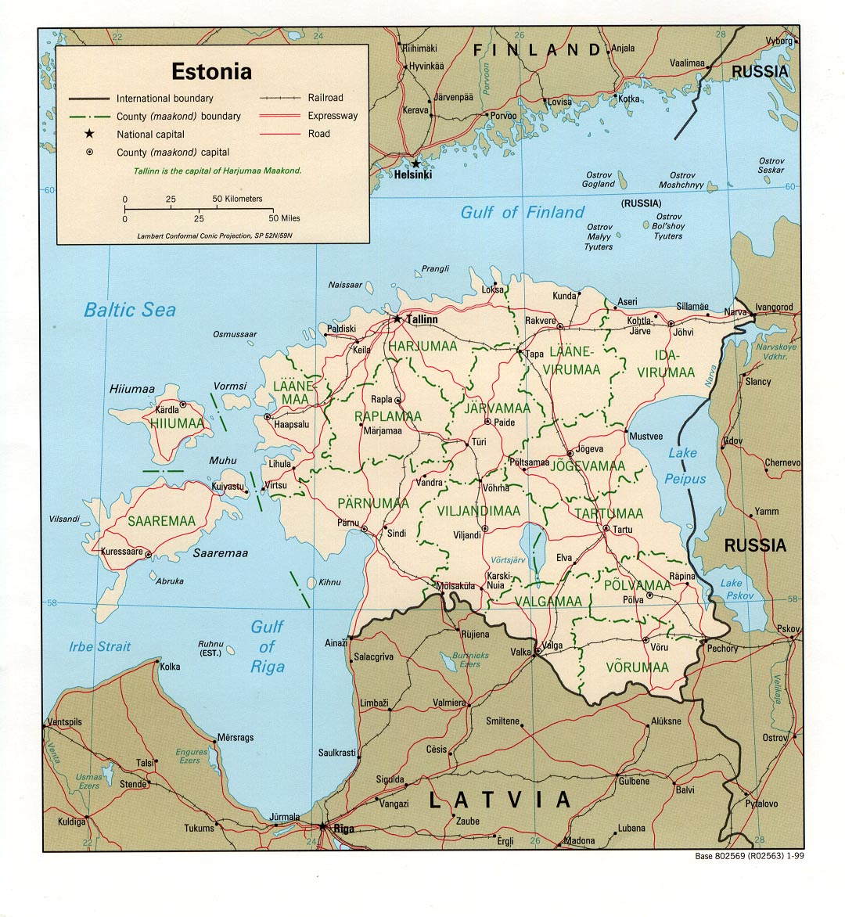
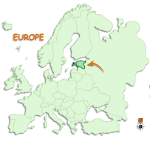


Slide 3
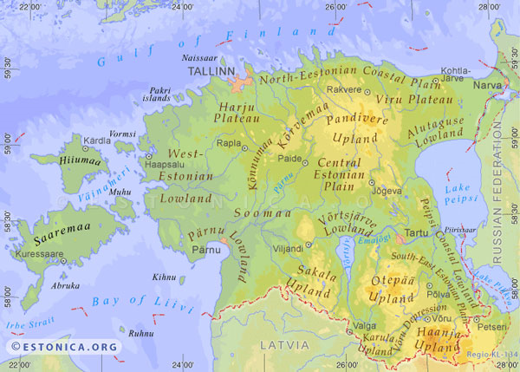

Slide 4
Population: 1.36 mil. (2002), 80% citizens, 7% citizens of other countries, and 13% stateless
Life expectancy - Male: 64.7; Female: 76.2 (2002)
Area: 45 227 km²
Distribution: 67.4% urban; 32.6% rural
Land Borders: Latvia (339 km), Russia (294 km)
Ethnic profile: Estonians (67.9%), Russians (25.6%), Ukrainians (2.1%), Byelorussians (1.2%), Finns (0.9%), others (2.3%)
Languages: Estonian is the official language,
Russian and English are also widely spoken
Religions: Predominantly Lutheran, Orthodox
GDP/capita: 4,500 EUR (2001)

Slide 5
Description:
The smallest of the Baltic States (Latvia, Lithuania, & Estonia), Estonia gained its independence from the Soviet Union in 1991. Ethnically and linguistically, Estonains are related to the Finns. Tallinn's medieval history is a major tourist attraction.
Perceiving historical roots, albeit unconsciously, is perhaps one of the most typical features of Estonians. In answering almost any question, an Estonian will reply at length, starting at least from the 13th century.

Slide 6
Tallinn
Tallinn is the capital of Estonia, an EU country with its own currency. Its old town is one of the best preserved examples of a medieval township and has been designated as a UNESCO World Cultural Heritage site. Sitting on a strategic crossroads among Western Europe, Northern Europe and Russia, the city was conquered and pillaged many times, yet retained much of its original characteristics. This fascinating destination is only two hours south of Helsinki, Finland by boat.

Slide 7
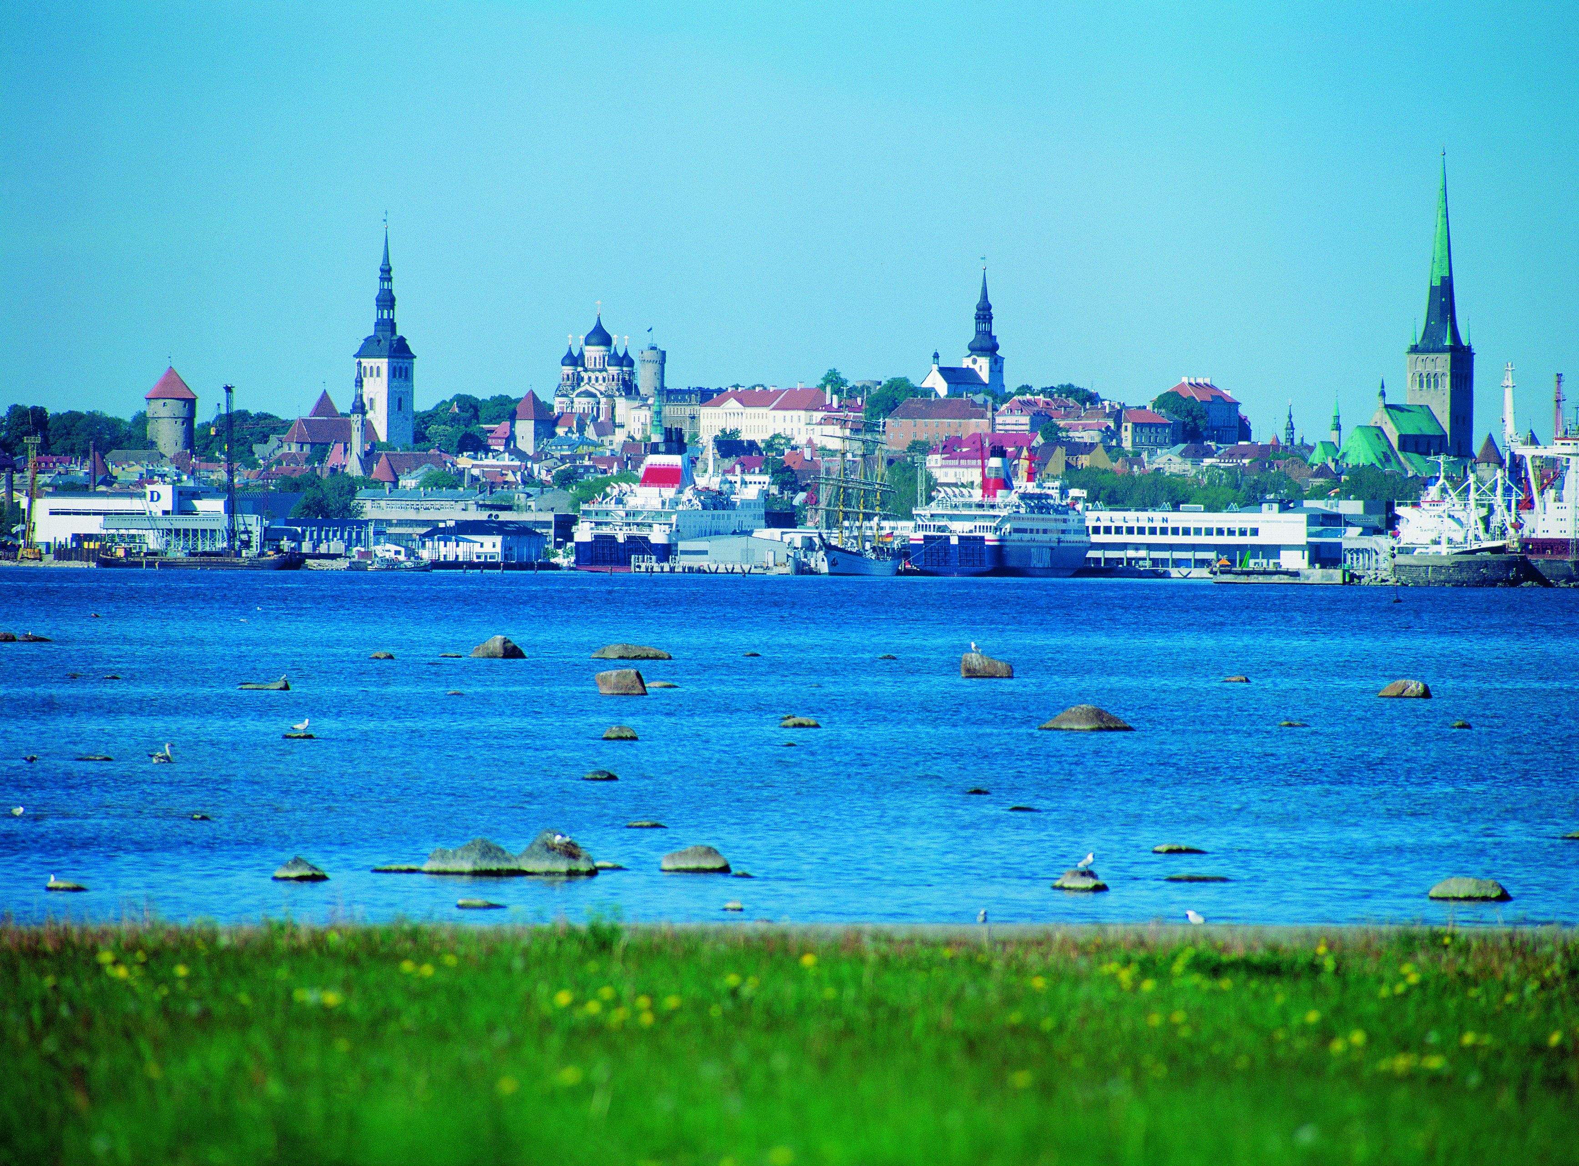

Slide 8
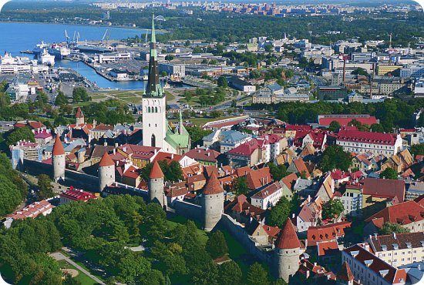

Slide 9
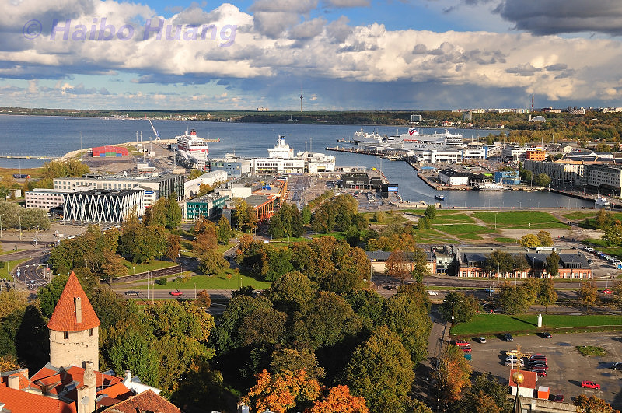

Slide 10
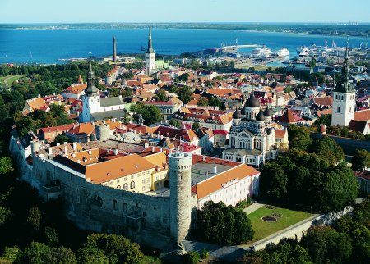

Slide 11
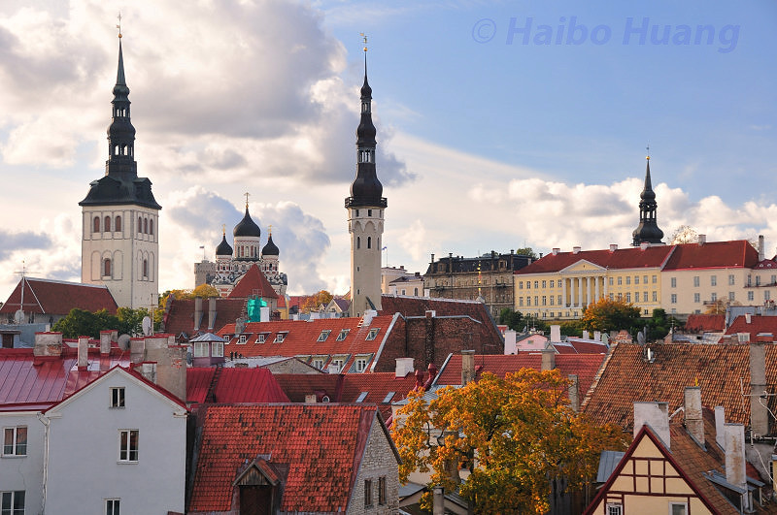

Slide 12
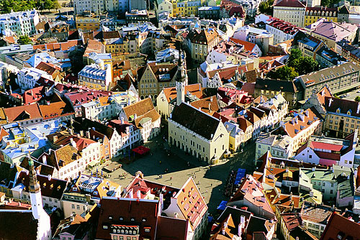

Slide 13
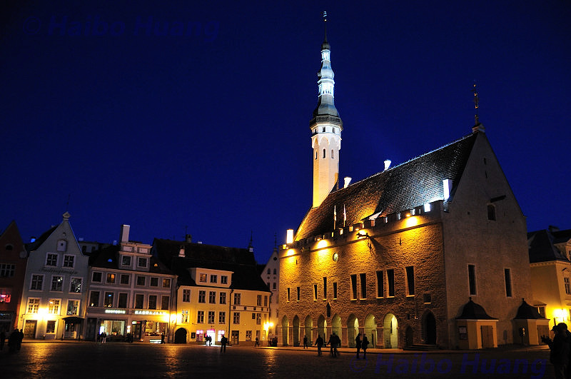

Slide 14
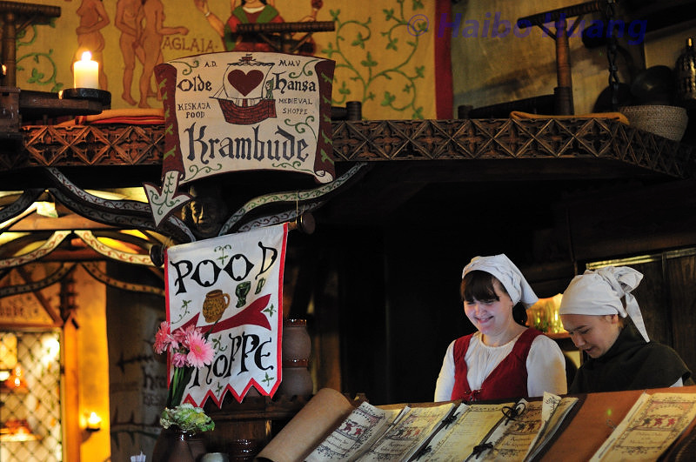

Slide 15
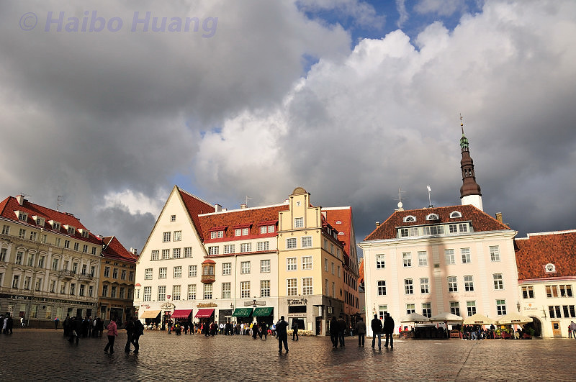

Slide 16
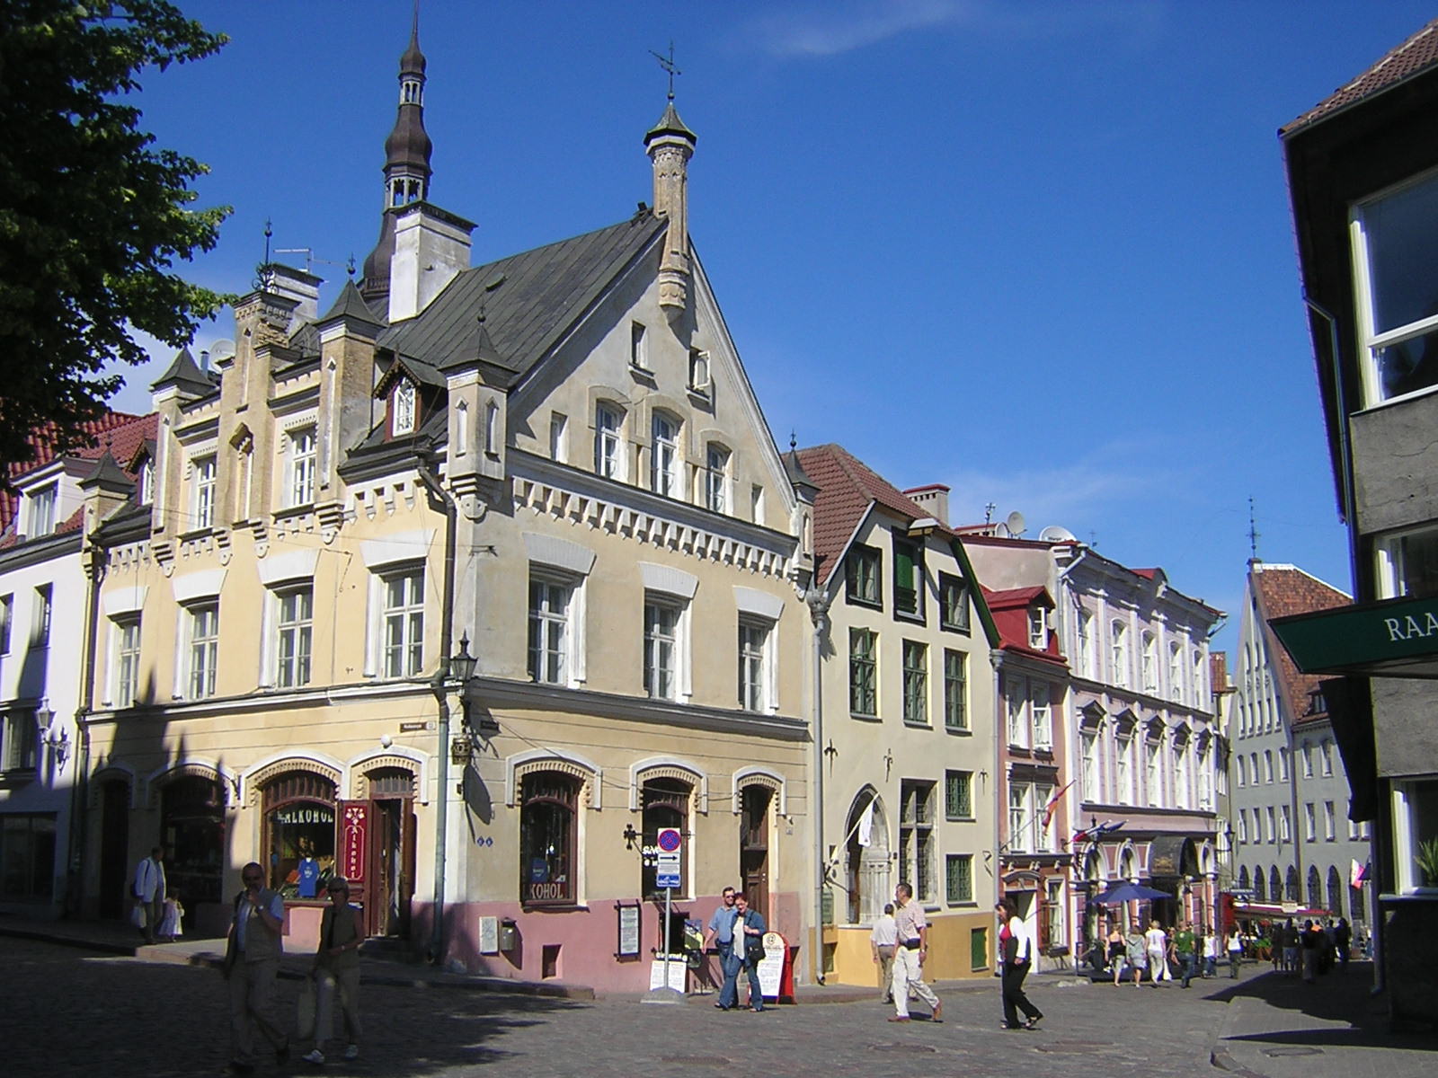

Slide 17
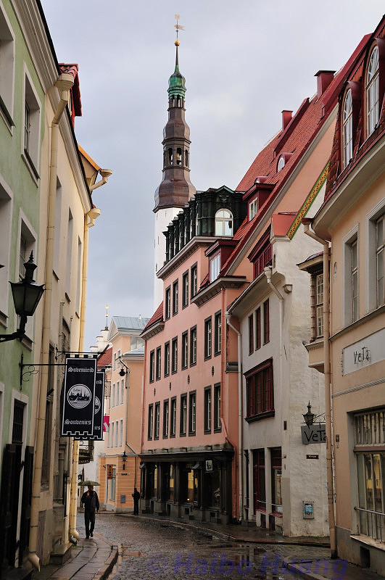
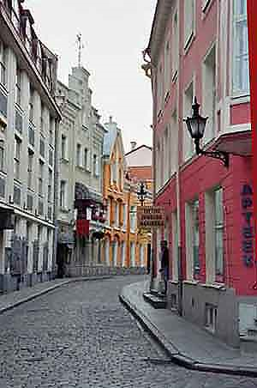

Slide 18
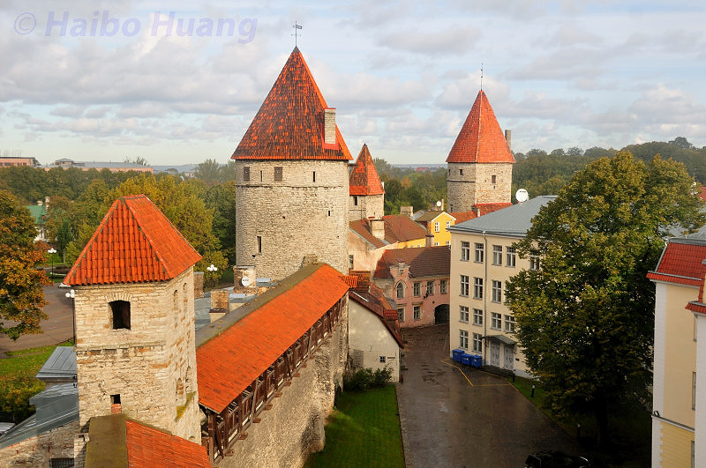

Slide 19
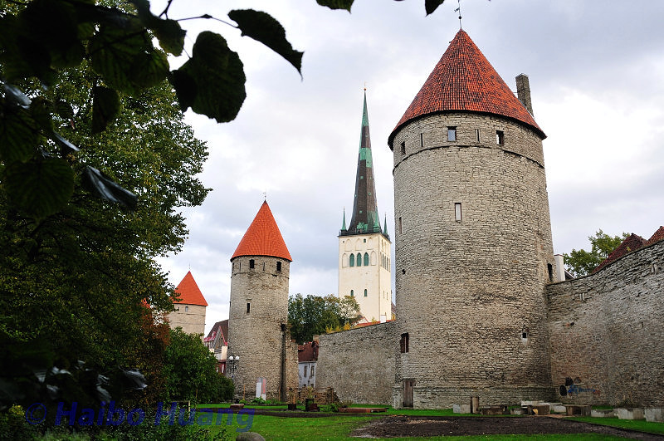

Slide 20
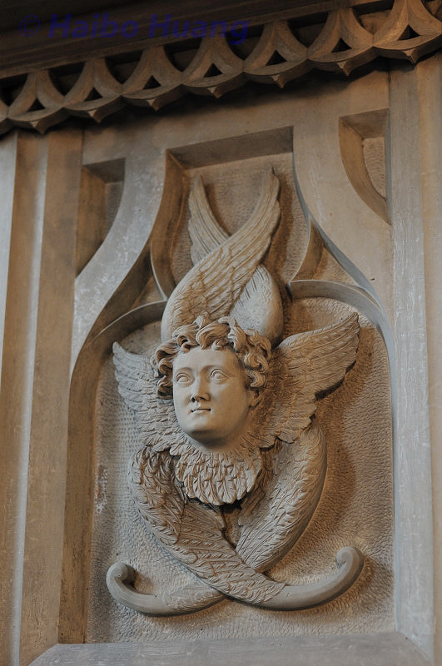
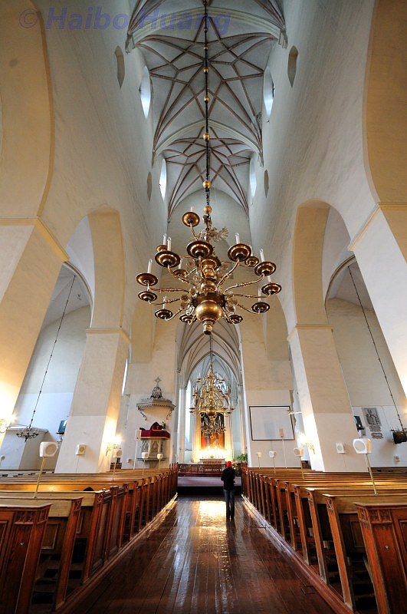

Slide 21
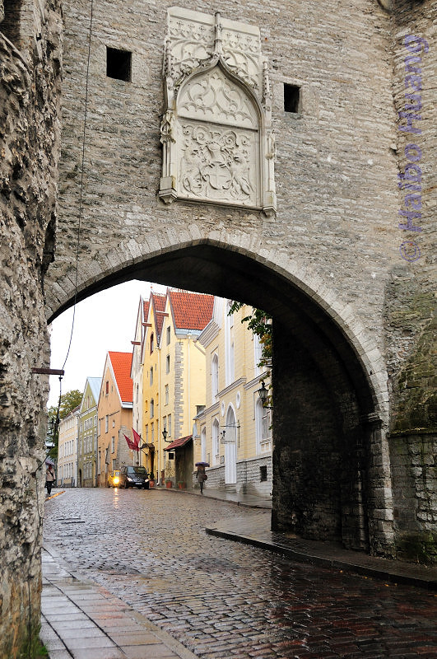
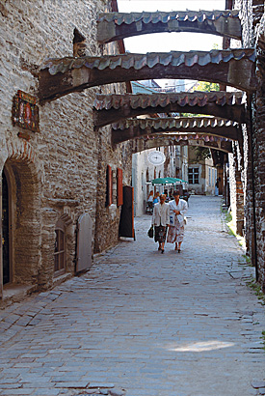

Slide 22
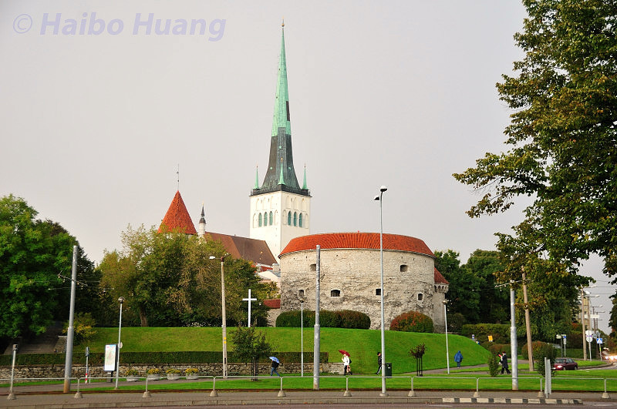

Slide 23
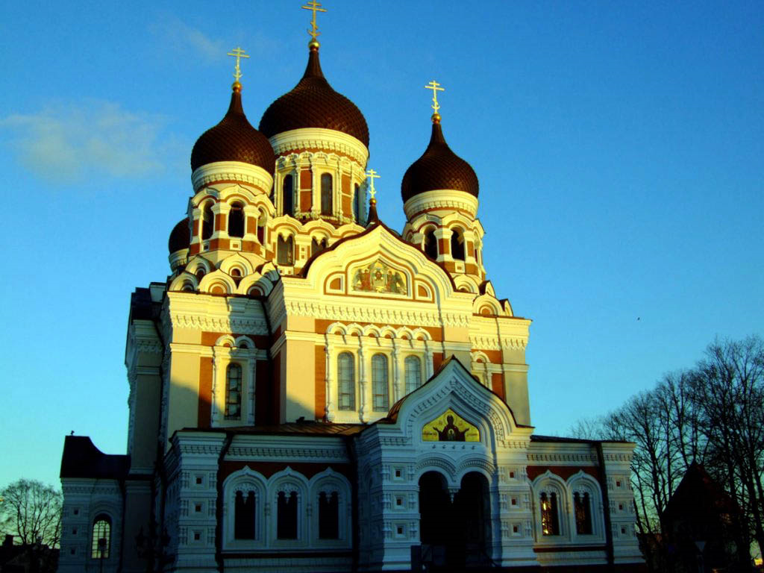

Slide 24
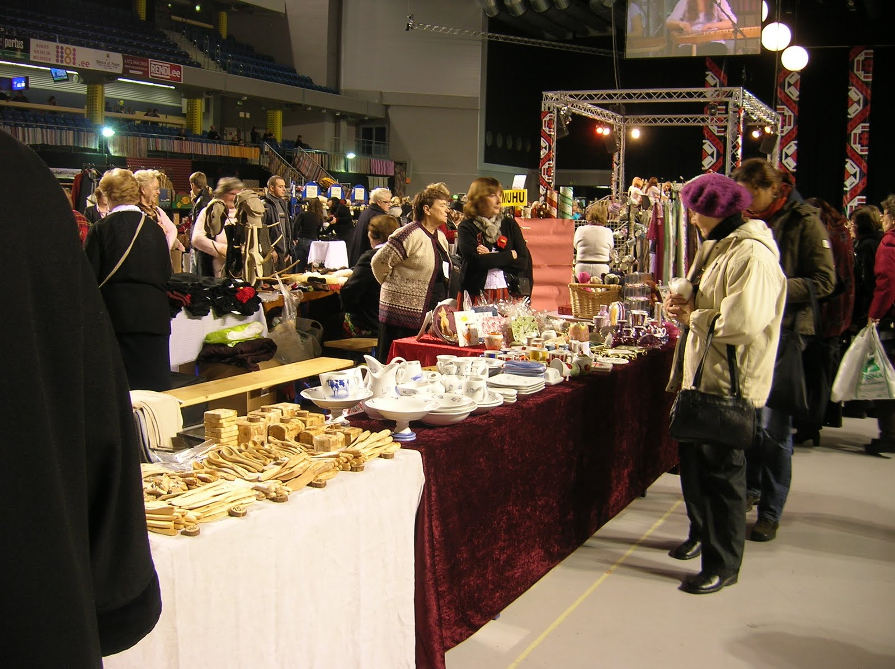
CRAFTS & CRAFT FAIRS

Slide 25
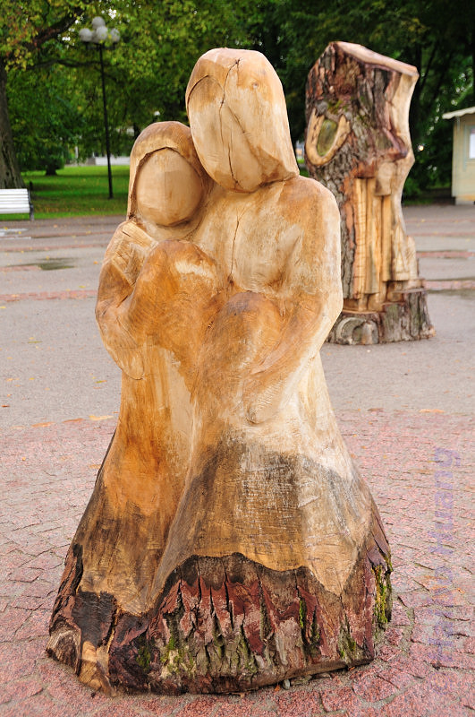
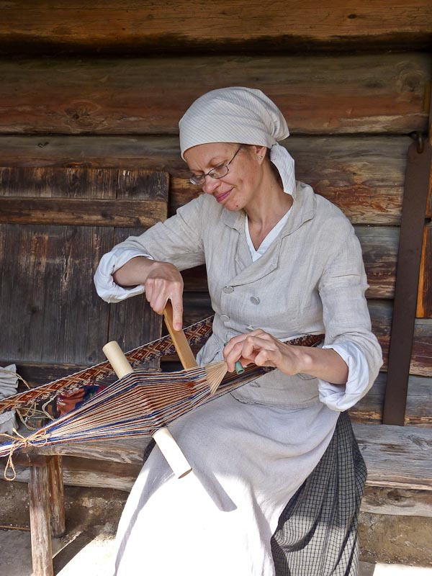

Slide 26
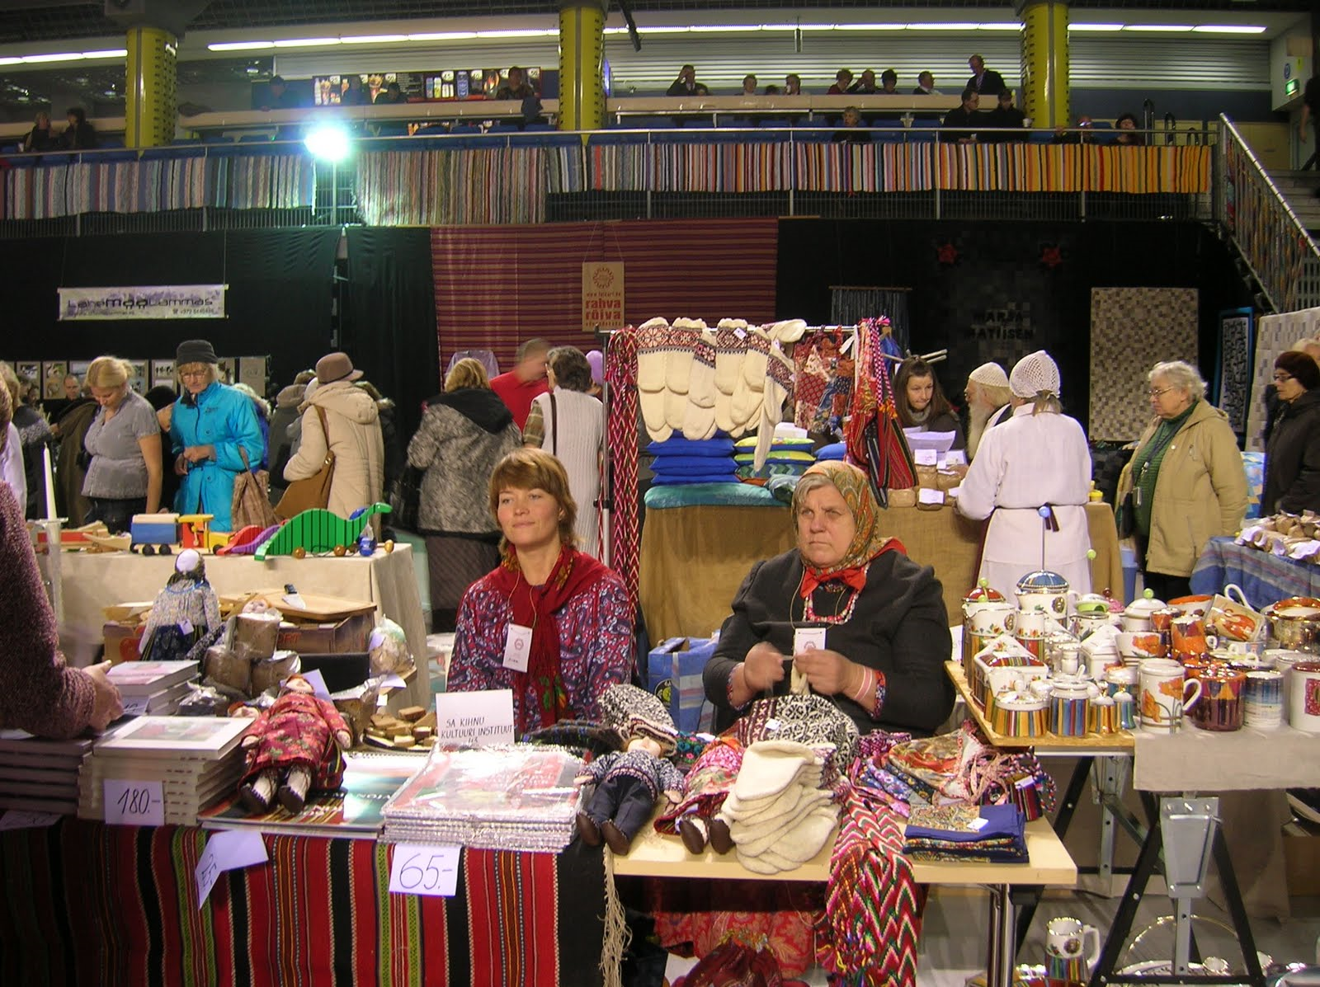

Slide 27
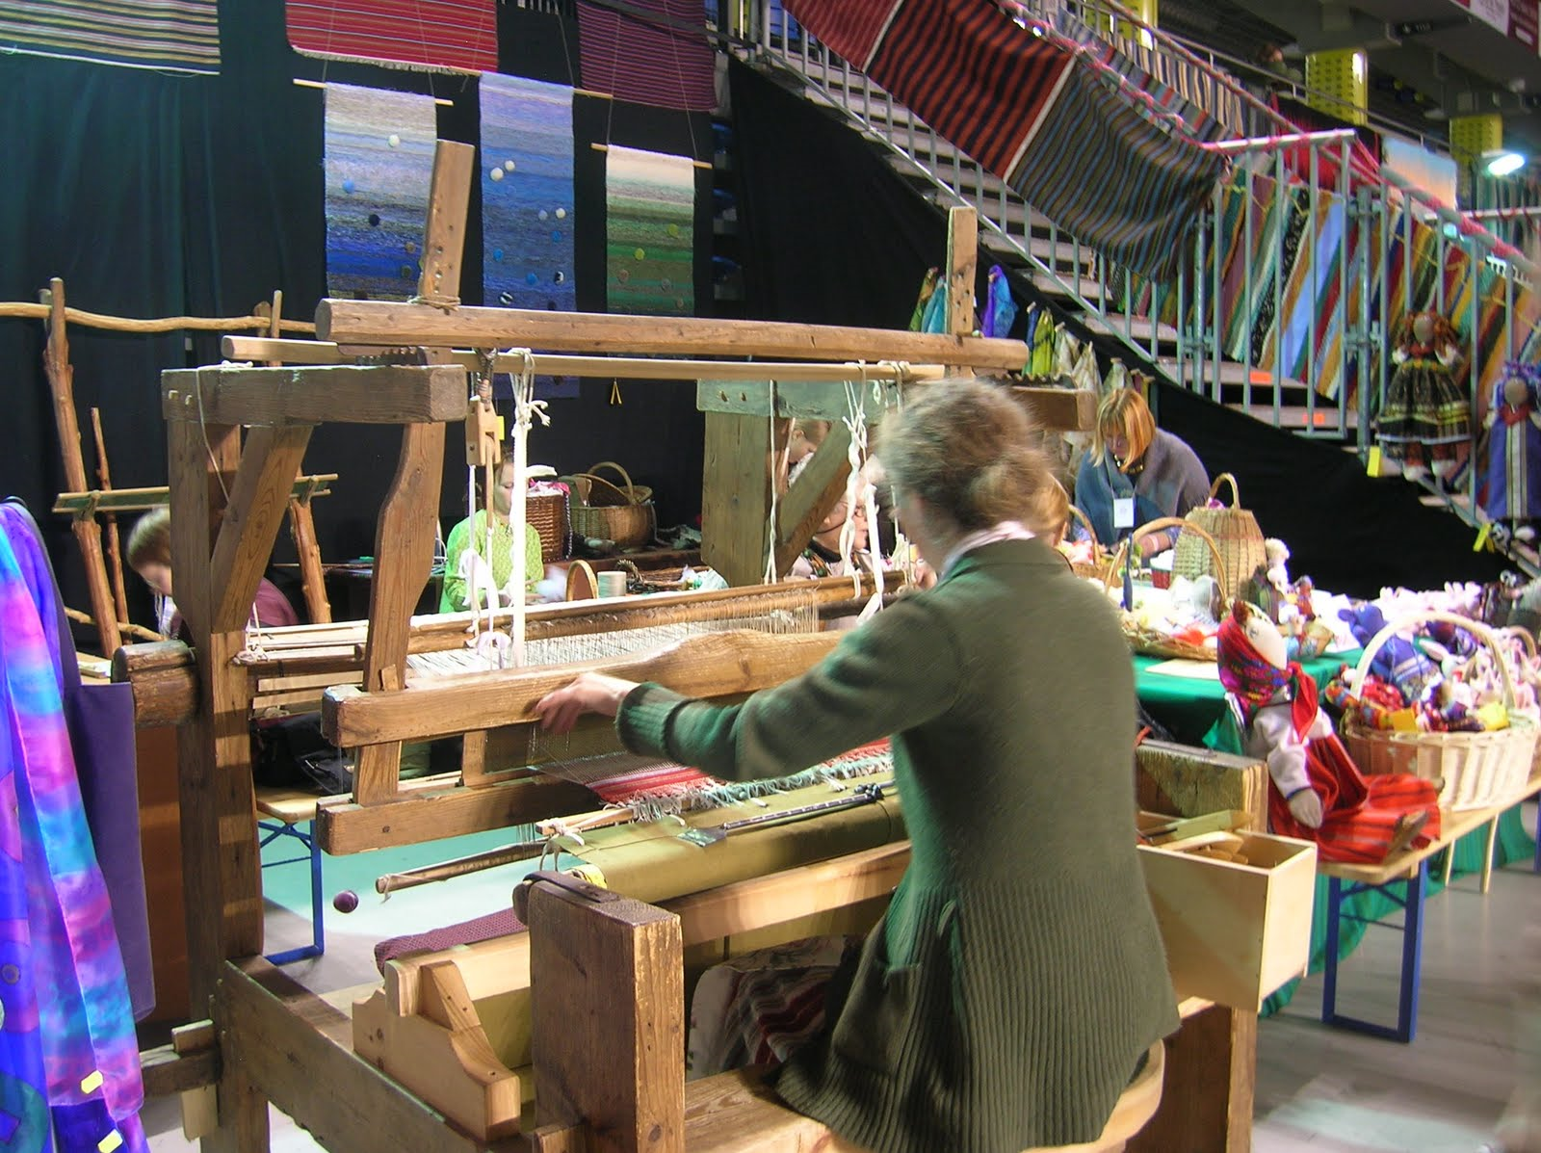

Slide 28
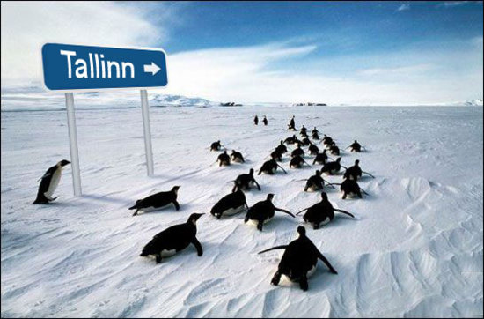
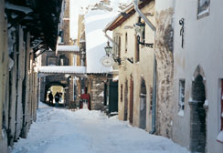
WINTER SCENES

Slide 29
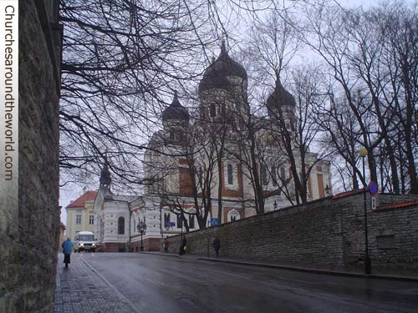

Slide 30
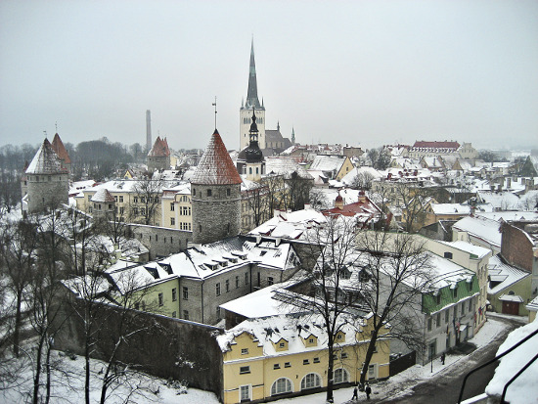

Slide 31
