Slide 1
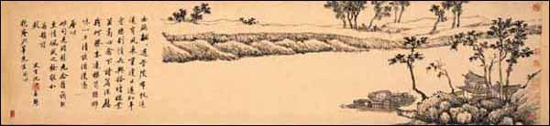
Chinese Art - Painting
Significantly different from Western art

Slide 2
Chinese painting
Chinese painting is one of the oldest continuous artistic traditions in the world. The earliest paintings were not representational but ornamental; they consisted of patterns or designs rather than pictures. Stone Age pottery was painted with spirals, zigzags, dots, or animals. It was only during the Warring States Period (403-221 B.C.) that artists began to represent the world around them.

Slide 3
Painting in the traditional style is known today in Chinese as guó huà 国画, meaning 'national' or 'native painting', as opposed to Western styles of art which became popular in China in the 20th century. Traditional painting involves essentially the same techniques as calligraphy and is done with a brush dipped in black or colored ink; oils are not used. As with calligraphy, the most popular materials on which paintings are made of are paper and silk. The finished work is then mounted on scrolls, which can be hung or rolled up. Traditional painting also is done in albums and on walls, lacquerwork, and other media.

Slide 4
The two main techniques in Chinese painting are:
Meticulous - Gong-bi (工筆) often referred to as "court-style" painting
Freehand - Shui-mo (水墨) loosely termed watercolour or brush painting. The Chinese character "mo" means ink and "shui" means water. This style is also referred to as "xie yi" (寫意) or freehand style.
Artists from the Han (202 BC) to the Tang (618–906) dynasties mainly painted the human figure. Much of what we know of early Chinese figure painting comes from burial sites, where paintings were preserved on silk banners, lacquered objects, and tomb walls. Many early tomb paintings were meant to protect the dead or help their souls get to paradise. Others illustrated the teachings of the Chinese philosopher Confucius, or showed scenes of daily life.

Slide 5
Many critics consider landscape to be the highest form of Chinese painting. The time from the Five Dynasties period to the Northern Song period (907–1127) is known as the "Great age of Chinese landscape". In the north, artists such as Jing Hao, Fan Kuan, and Guo Xi painted pictures of towering mountains, using strong black lines, ink wash, and sharp, dotted brushstrokes to suggest rough stone. In the south, Dong Yuan, Juran, and other artists painted the rolling hills and rivers of their native countryside in peaceful scenes done with softer, rubbed brushwork. These two kinds of scenes and techniques became the classical styles of Chinese landscape painting.

Slide 6
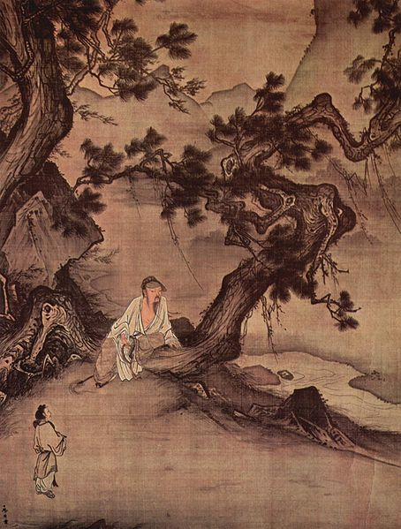

Slide 7
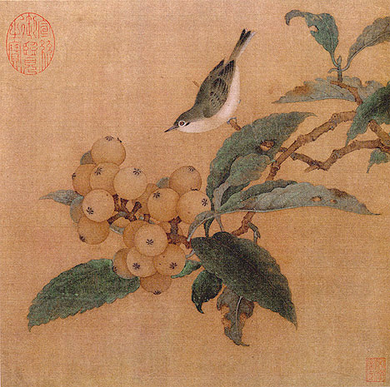

Slide 8
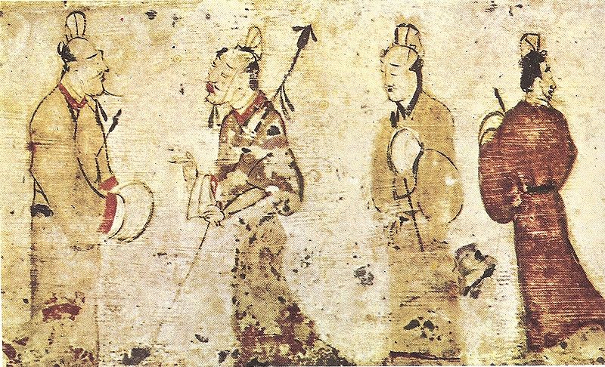

Slide 9
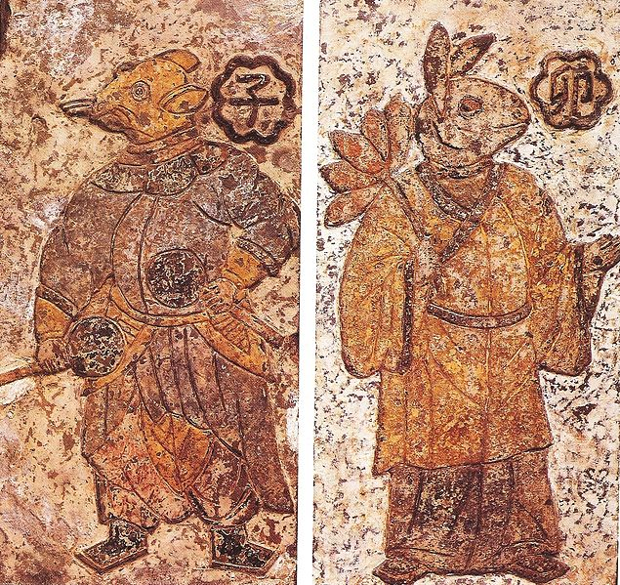

Slide 10
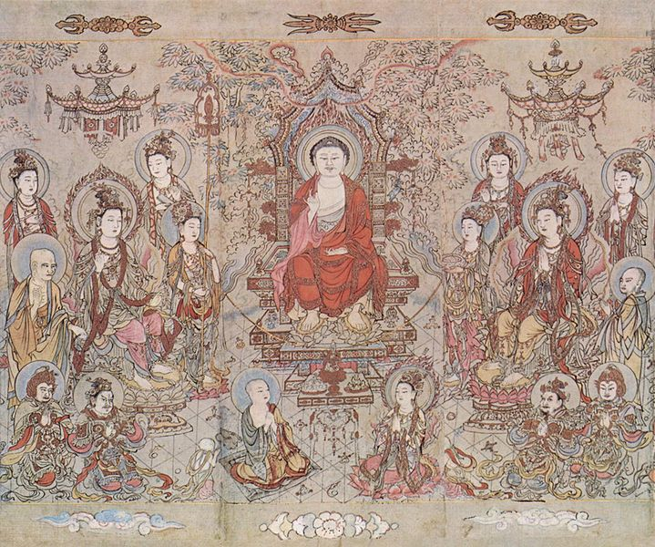

Slide 11
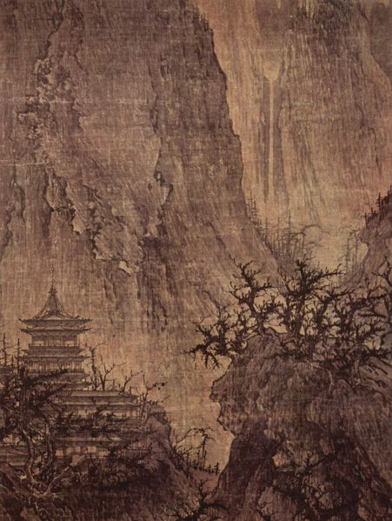

Slide 12
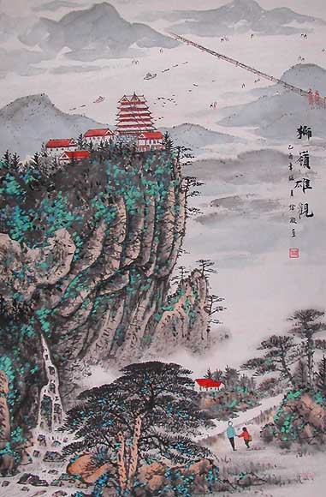

Slide 13
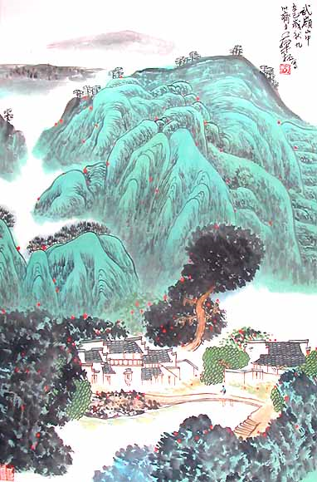

Slide 14
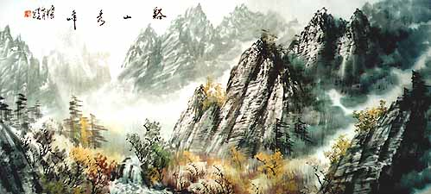

Slide 15
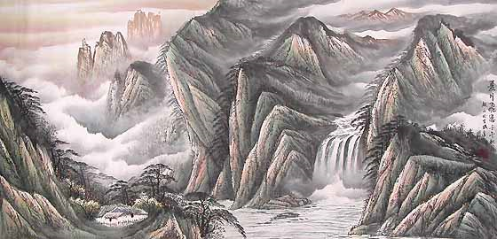

Slide 16
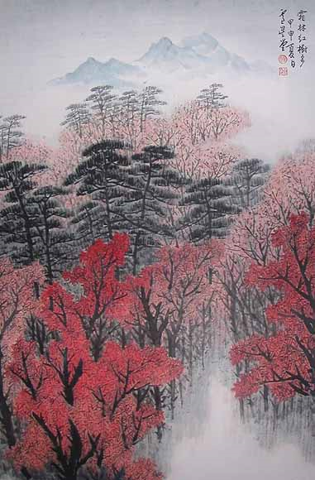

Slide 17
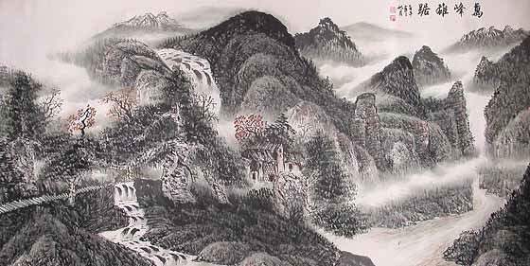

Slide 18
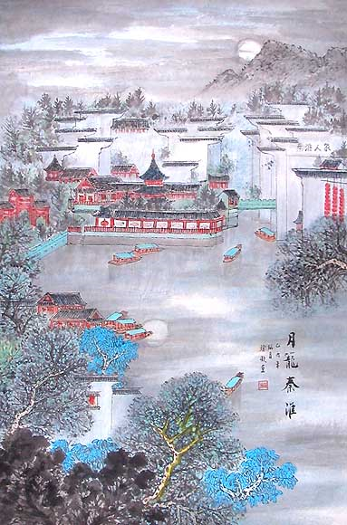

Slide 19
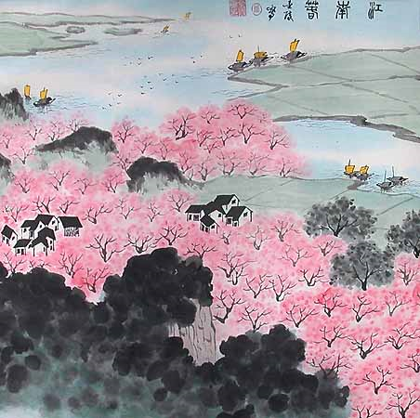

Slide 20
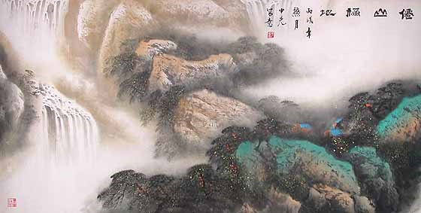

Slide 21
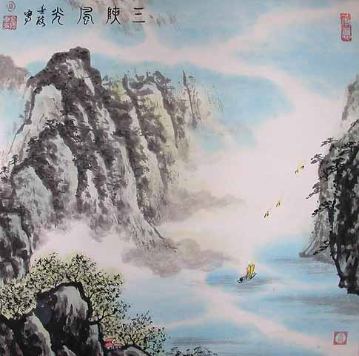

Slide 22
