Slide 1

China – Ethnic Minorities
55 recognized groups – 8% of China’s population – approximately 100,000,000 people. The Han Chinese make up 92%.

Slide 2
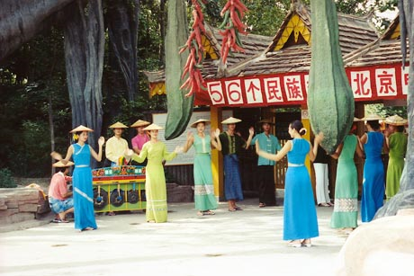
This colorful entrance presents a traditional depiction of ethnic minorities in China as happy providers of exotic culture to the more serious rulers at its center.
National Ethnic Minorities Theme Park

Slide 3
The political importance of the expansive National Ethnic Minorities Theme Park can be seen from its placement directly north of the Forbidden City and the Drum Tower, directly across from the site of the Olympic Village.
The National Ethnic Minorities Theme Park is targeting foreign tourists who do not have time to travel to all of China.
China's 55 official ethnic minorities account for about half of the poorest Chinese, according to state media. They live mostly in underdeveloped western, southern and northern areas. They make up about 100 million, or 8 per cent, of China's 1.3 billion people with China's 56th ethnic group, the Han Chinese, forming the 92-per-cent majority.

Slide 4
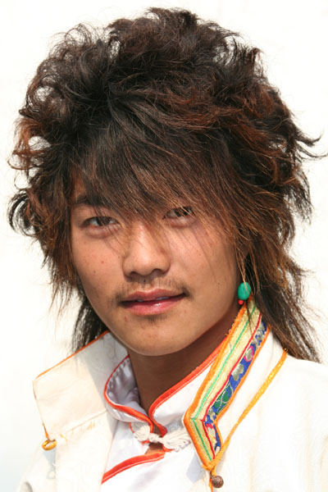
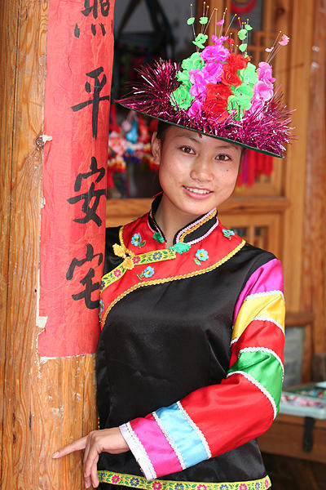

Slide 5
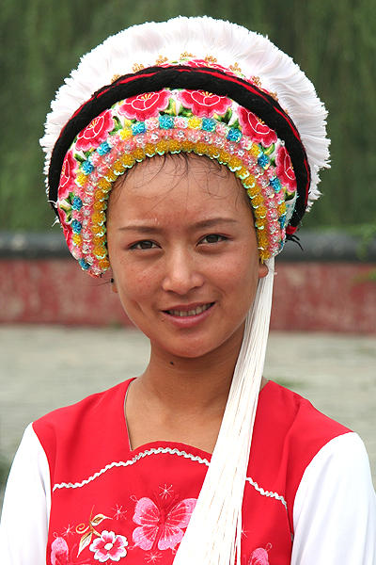
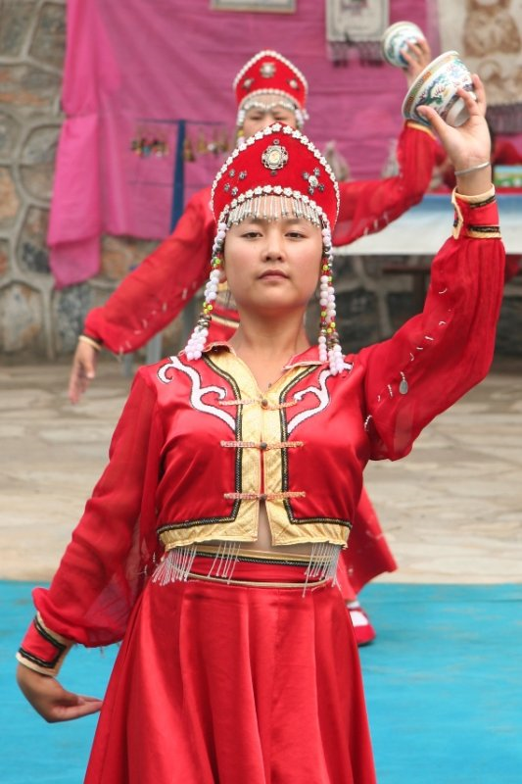

Slide 6
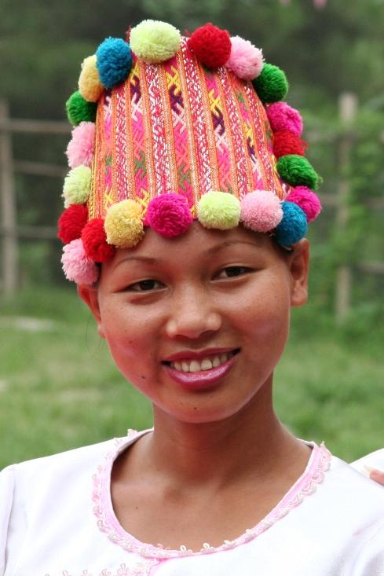
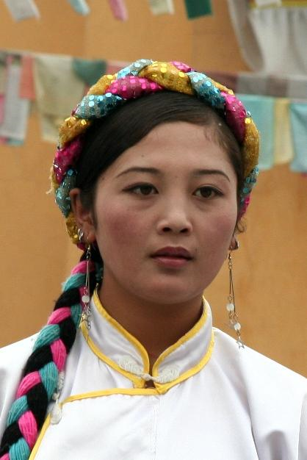

Slide 7
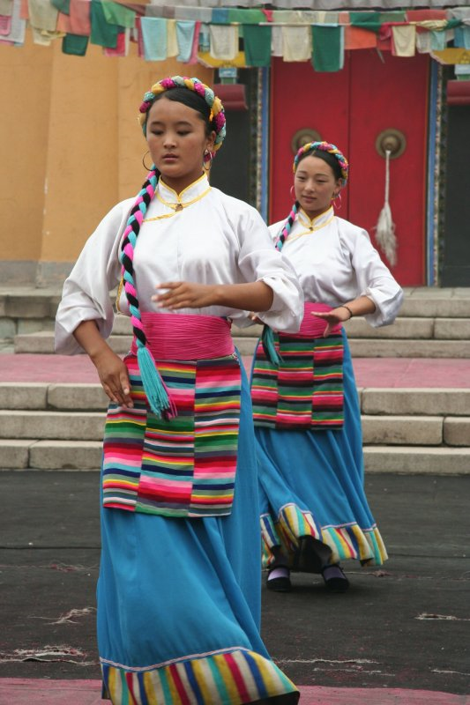
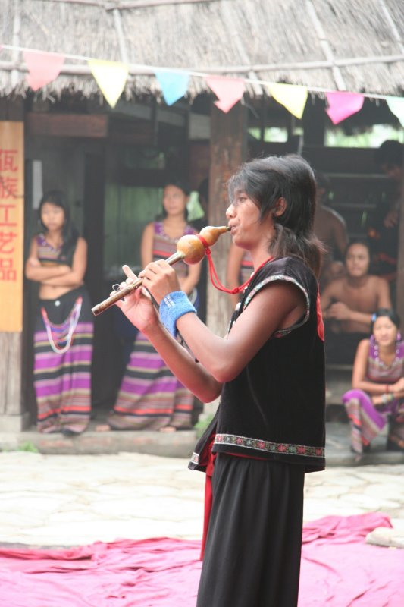

Slide 8
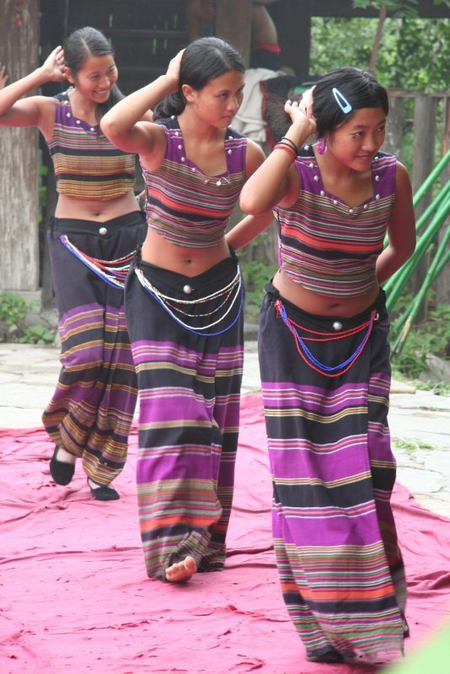

Slide 9
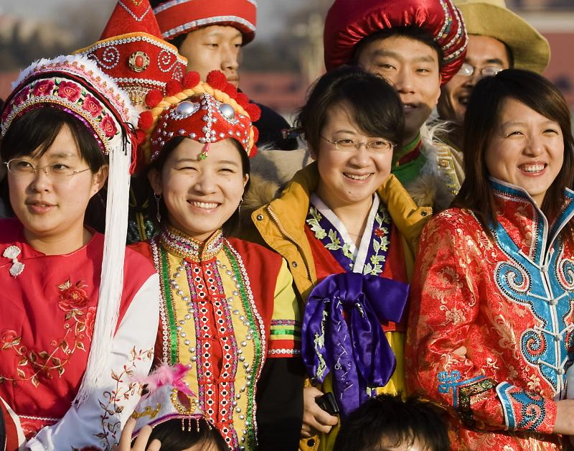

Slide 10
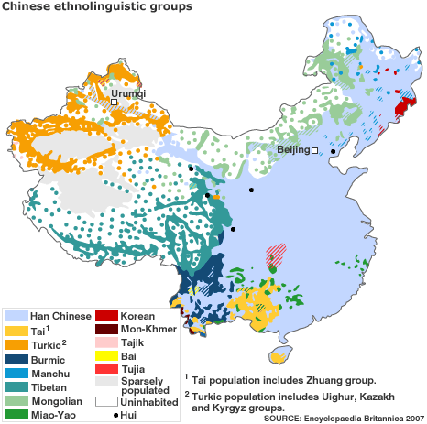

Slide 11
CHINESE ETHNIC MINORITIES
Fifty-five recognized ethnic minorities: Click on the linked title of each group for more information.

Slide 12
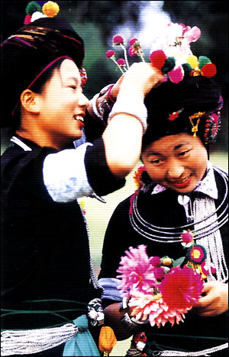
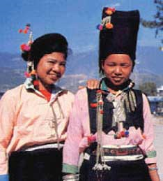
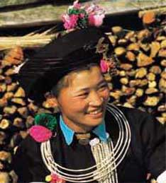
The Achang ethnic minority
Population: 33,936
Major area of distribution: Yunnan
Language: Achang
Religion: Buddhism

Slide 13
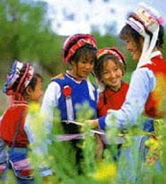
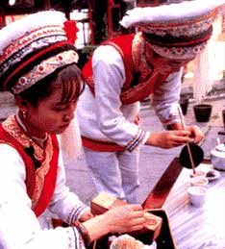
The Bai ethnic minority
Population: 1,858,063
Major area of distribution: Yunnan and Guizhou
Language: Bai
Religion: Buddhism

Slide 14
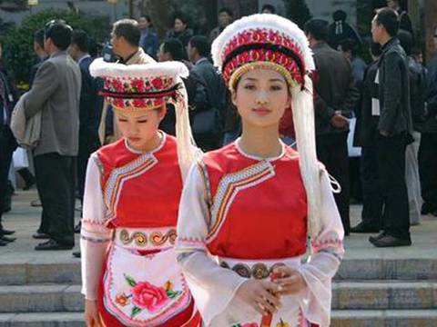
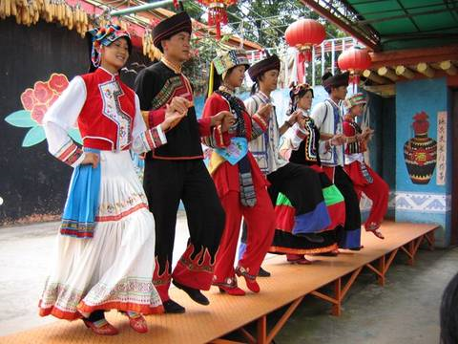
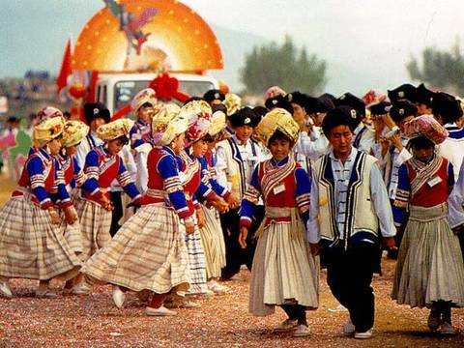


Slide 15
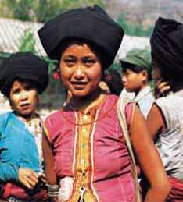
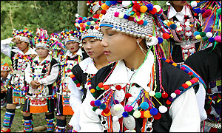
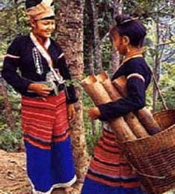
The Blang ethnic minority
Population: 91,882
Major area of distribution: Yunnan
Language: Blang
Religion: Buddhism

Slide 16
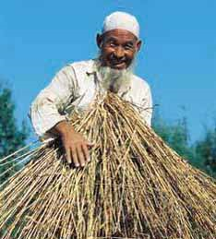
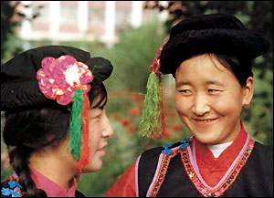
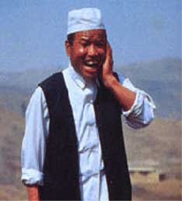
The Bonan ethnic minority
Population: 16,505
Major area of distribution: Gansu
Language: Bonan
Religion: Islam

Slide 17
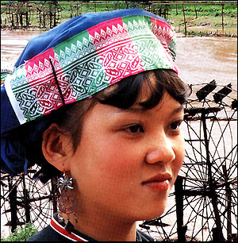
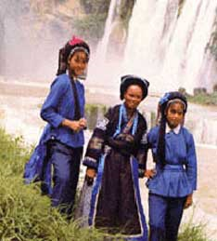
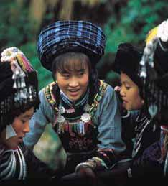
The Bouyei ethnic minority
Population: 2,971,460
Major area of distribution: Guizhou
Language: Bouyei
Religion: Polytheism

Slide 18
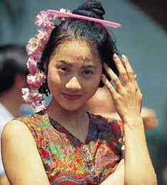
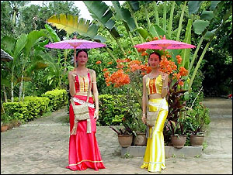
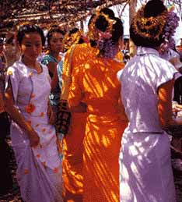
The Dai ethnic minority
Population: 1,158,989
Major area of distribution: Yunnan
Language: Dai
Religion: Buddhism

Slide 19
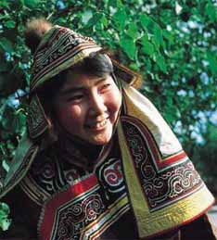
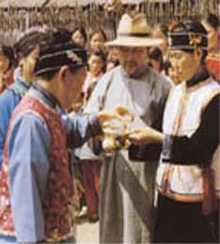
The Daur ethnic minority
Population: 132,394
Major areas of distribution: Inner Mongolia, Heilongjiang and Xinjiang
Language: Daur and Han
Religion: Shamanism

Slide 20
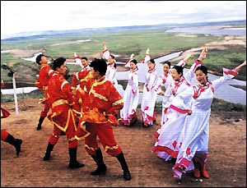

Slide 21
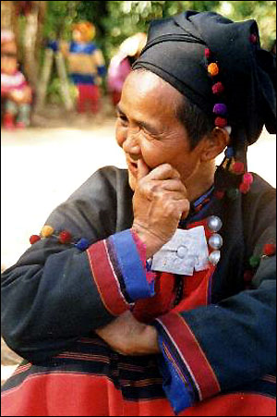
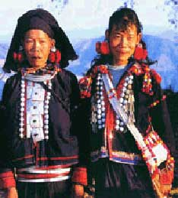
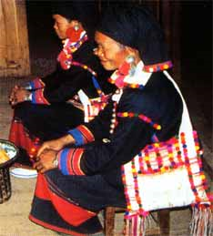
The De'ang ethnic minority
Population: 17,935
Major area of distribution: Yunnan
Language: De'ang
Religion: Buddhism

Slide 22
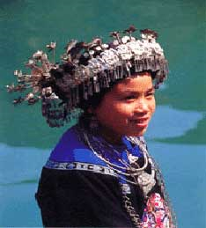
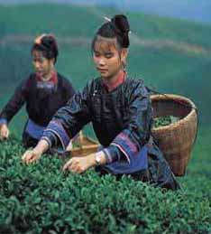
The Dong ethnic minority
Population: 2,960,293
Major area of distribution: Guizhou, Hunan and Guangxi
Language: Dong
Religion: Polytheism

Slide 23
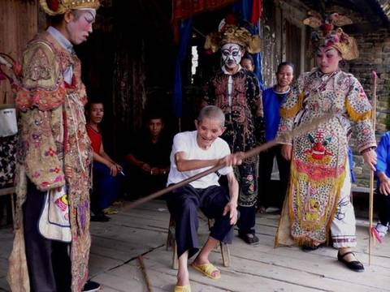
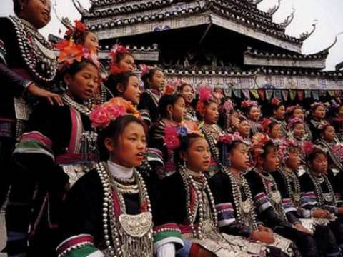
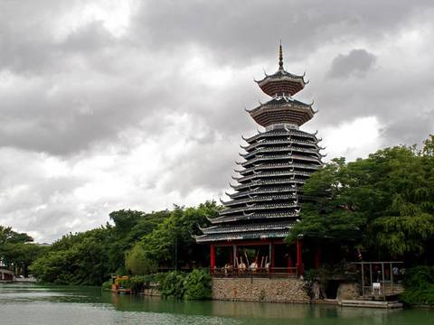
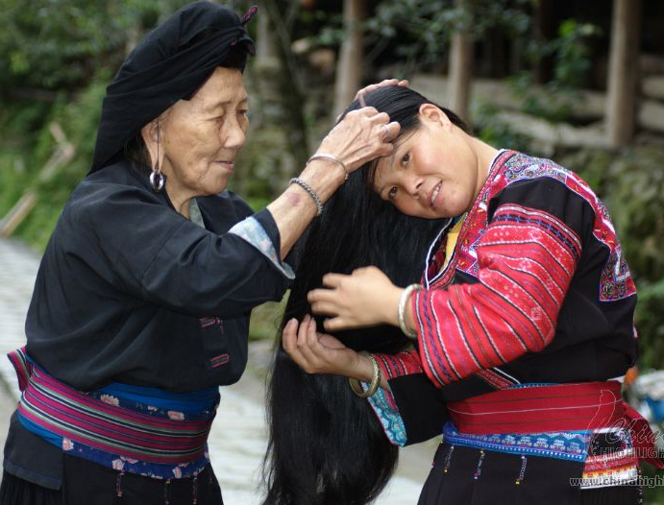

Slide 24
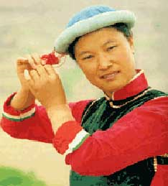
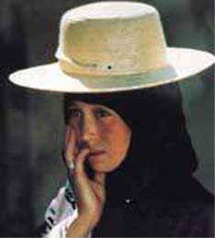
The Dongxiang ethnic minority
Population: 513,805
Major areas of distribution: Gansu and Xinjiang
Language: Dongxiang and Han Chinese
Religion: Islam

Slide 25
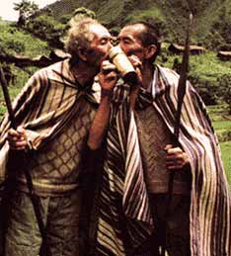
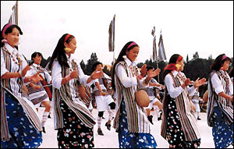
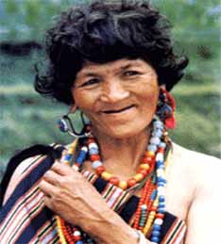
The Drung ethnic minority
Population: 7,426
Major area of distribution: Yunnan
Language: Drung
Religion: Polytheism

Slide 26
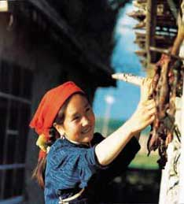

The Ewenki ethnic minority
Population: 30,505
Major areas of distribution: Inner Mongolia & Heilongjiang
Language: Ewenki and Han
Religion: Most Ewenkis are animists while those in the pastoral areas are followers of the Lamaist faith.

Slide 27


Slide 28


The Gaoshan ethnic minority
Population: 415,000
Major area of distribution: Taiwan and Fujian
Language: Gaoshan people speak 13 languages
Religion: Polytheism

Slide 29


Slide 30


The Gelo ethnic minority
Population: 579,357
Major area of distribution: Guizhou and Guangxi
Language: Gelo
Religion: Polytheism

Slide 31


Slide 32



The Hani ethnic minority
Population: 1,439,673
Major area of distribution: Yunnan
Language: Hani
Religion: Buddhism

Slide 33


The Hezhe ethnic minority
Population: 4,640
Major areas of distribution: Heilongjiang
Language: Hezhe and Han
Religion: originally Shamanism

Slide 34


The Hui ethnic miniroty
Population: 9,816,802
Major areas of distribution: Ningxia, Gansu, Henan, Hebei, Qinghai, Shandong, Yunnan, Xinjiang, Anhui, Liaoning, Heilongjiang, Jilin, Shanxi, Beijing, Tianjin
Language: Han (standard Chinese)
Religion: Islam

Slide 35



Slide 36



The Jing ethnic minority
Population: 22,517
Major area of distribution: Guangxi
Language: Jing
Religion: Buddhism and Taoism

Slide 37


The Jino ethnic minority
Population: 20,899
Major area of distribution: Yunnan
Language: Jino
Religion: Polytheism

Slide 38


Slide 39


The Jingpo ethnic minority
Population: 132,143
Major area of distribution: Yunnan
Language: Jingpo
Religion: Buddhism

Slide 40


The Kazak ethnic minority
Population: 1,250,458
Major areas of distribution: Xinjiang, Gansu and Qinghai
Language: Kazak
Religion: Islam

Slide 41


Slide 42


The Kirgiz ethnic minority
Population: 160,823
Major areas of distribution: Xinjiang and Heilongjiang
Language: Kirgiz
Religion: Islam

Slide 43


Slide 44


The Korean ethnic minority
Population: 1,923,842
Major areas of distribution: Jilin, Liaoning and Heilongjiang
Language: Korean and Han
Region: Buddhism

Slide 45


Slide 46



The Lahu ethnic minority
Population: 453,705
Major area of distribution: Yunnan
Language: Lahu
Religion: Buddhism

Slide 47


The Lhoba ethnic minority
Population: 2,965
Major area of distribution: Tibet
Language: Lhoba
Religion: Lamaism

Slide 48


The Li ethnic minority
Population: 1,247,814
Major area of distribution: Hainan
Language: Li
Religion: Polytheism

Slide 49


Slide 50


The Lisu ethnic minority
Population: 634,912
Major area of distribution: Yunnan and Sichuan
Language: Lisu
Religion: Polytheism

Slide 51


Slide 52


The Manchu ethnic minority
Population: 10,682,263
Major areas of distribution: Virtually scattered over all of China, the largest group, about 46.2 per cent of the total, live in Liaoning Province.
Language: Manchu (in both script and spoken language) and Han (standard Chinese)
Religion: Shamanism

Slide 53



The Maonan ethnic minority
Population: 107,166
Major area of distribution: Guangxi
Language: Maonan
Religion: Taoism, polytheism

Slide 54



The Miao ethnic minority
Population: 8,940,116
Major area of distribution: Guizhou, Hunan, Yunnan, Guangxi, Sichuan, Hainan and Hubei
Language: Miao
Religion: Polytheism

Slide 55





Slide 56



The Moinba ethnic minority
Population: 8,923
Major area of distribution: Tibet
Language: Moinba
Religion: Lamaism

Slide 57


The Mongolian ethnic minority
Population: 5,813,947
Major areas of distribution: Inner Mongolia, Liaoning, Jilin, Heilongjiang, Xinjiang, Henan, Hebei, Gansu, Qinghai, etc.
Language: Mongolian and Han
Religion: Lamaism

Slide 58


Slide 59



The Mulam ethnic minority
Population: 207,352
Major area of distribution: Guangxi
Language: Mulam
Religion: Taoism and Buddhism

Slide 60


The Naxi ethnic minority
Population: 308,839
Major area of distribution: Yunnan and Sichuan
Language: Naxi
Religion: Dongba and Lamaism

Slide 61



Dongba religion of the Naxi people

Slide 62



The Nu ethnic minority
Population: 28,759
Major area of distribution: Yunnan
Language: Nu
Religion: Polytheism

Slide 63


The Oroqen ethnic minority
Population: 8,196
Major areas of Distribution: Inner Mongolia and Heilongjiang
Language: Oroqen and Han
Religion: Shamanism or animism

Slide 64


Slide 65



The Ozbek ethnic minority
Population: 12,370
Major area of distribution: Xinjiang
Language: Osbek
Religion: Islam

Slide 66



The Pumi ethnic minority
Population: 33,600
Major area of distribution: Yunnan
Language: Pumi
Religion: Lamaism and Taoism

Slide 67



The Qiang ethnic minority
Population: 306,072
Major area of distribution: Sichuan
Language: Qiang
Religion: Animism

Slide 68



Slide 69


The Russian ethnic minority
Population: 15,609
Major area of distribution: Xinjiang and Inner Mongolia
Language: Russian
Religion: Orthodox Eastern Church

Slide 70


Slide 71


The Salar ethnic minority
Population: 104,503
Major areas of distribution: Qinghai, Gansu and Xinjiang
Language: Salar
Religion: Islam

Slide 72


Slide 73


The She ethnic minority
Population: 709,592
Major area of distribution: Fujian, Zhejiang, Jiangxi and Guangdong
Language: She
Religion: Ancestor worship

Slide 74


Slide 75


The Shui ethnic minority
Population: 406,902
Major area of distribution: Guizhou and Guangxi
Language: Shui
Religion: Polytheism

Slide 76


Slide 77



The Tajik ethnic minority
Population: 41,028
Major area of distribution: Xinjiang
Language: Tajik
Religion: Islam

Slide 78


The Tartar ethnic minority
Population: 4,890
Major area of distribution: Xinjiang
Language: Tartar
Religion: Islam

Slide 79


Slide 80


The Tibetan ethnic minority
Population: 5,416,021
Major area of distribution: Tibet, Qinghai, Sichuan, Gansu and Yunnan
Language: Tibetan
Religion: Lamaism

Slide 81





Slide 82


The Tu ethnic minority
Population: 241,198
Major areas of distribution: Gansu and Qinghai
Language: Tu and Han
Religion: Lamaism

Slide 83


Slide 84


The tujia ethnic minority
Population: 8,028,133
Major area of distribution: Hubei and Hunan
Language: tujia
Religion: Polytheism

Slide 85


Slide 86


The Uygur ethnic minority
Population: 8,399,393
Major area of distribution: Xinjiang
Language: Uygur
Religion: Islam

Slide 87





Slide 88



The Va ethnic minority
Population: 396,610
Major area of distribution: Yunnan
Language: Va
Religion: Buddhism

Slide 89


The Xibe ethnic minority
Population: 188,824
Major areas of distribution: Xinjiang, Jilin and Liaoning
Language: Xibe
Religion: Polytheism, Shamanism and Buddhism

Slide 90


Slide 91



The Yao ethnic minority
Population: 2,637,421
Major area of distribution: Guangxi, Hunan, Yunnan, Guangdong and Guizhou
Language: Yao and Miao
Religion: Polytheism

Slide 92





Slide 93


The Yi ethnic minority
Population: 7,762,286
Major area of distribution: Sichuan, Yunnan, Guizhou and Guangxi
Language: Yi
Religion: Polytheism

Slide 94


Slide 95


The Yugur ethnic minority
Population: 13,719
Major area of distribution: Gansu
Language: Yugur and Han Chinese
Religion: Lamaism

Slide 96


The Zhuang ethnic minority
Population: 16,178,811
Major area of distribution:
Language: Zhuang
Religion: Polytheism

Slide 97





Slide 98
Additional information:
http://www.orientaltravel.com/people.htm
http://yeschinatour.com/china-guides/

