Slide 1
Guadeloupe
A Division of France

Slide 2
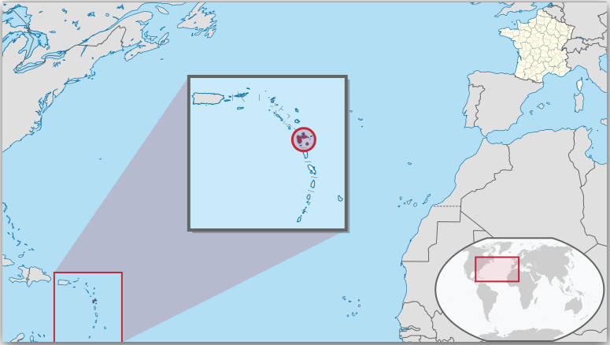
Location: Lesser Antilles

Slide 3
Overseas Region of France
As part of France, Guadeloupe is part of the European Union; hence, as for most EU countries, its currency is the euro.[2] However, Guadeloupe is not part of the Schengen Area. The prefecture and the capital of Guadeloupe is Basse-Terre. Christopher Columbus named the island Santa María de Guadalupe in 1493 after the Virgin Mary, venerated in the Spanish town of Guadalupe, in Extremadura.

Slide 4
Land area of 1,628 square kilometres (629 sq. mi)
A population of 400,000
Density:282.6/km² (731.8/sq mi.)
In 2006 the GDP per capita of Guadeloupe at market exchange rates, not at PPP, was €17,338 (US$21,780).
The economy depends on tourism, agriculture, light industry and services. But it especially depends on France for large subsidies and imports.

Slide 5
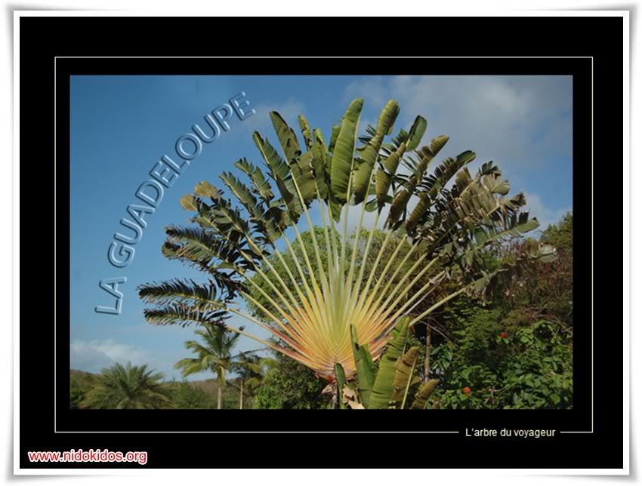

Slide 6
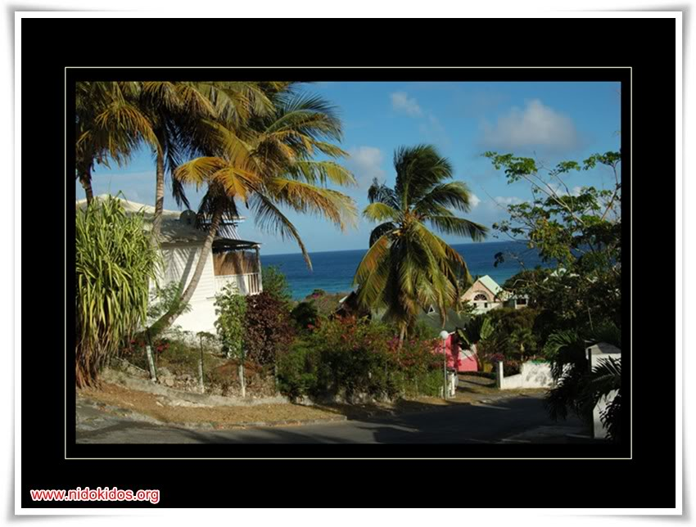

Slide 7
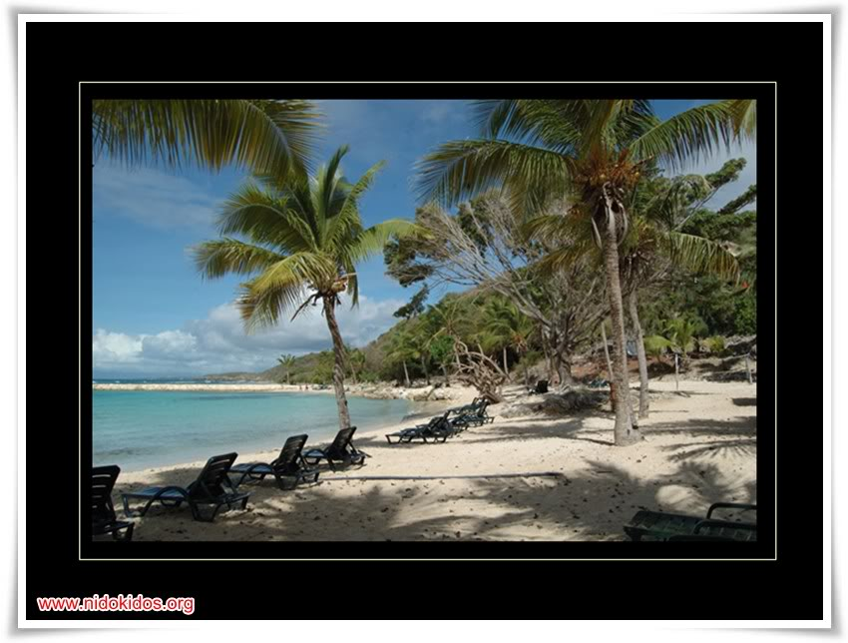

Slide 8
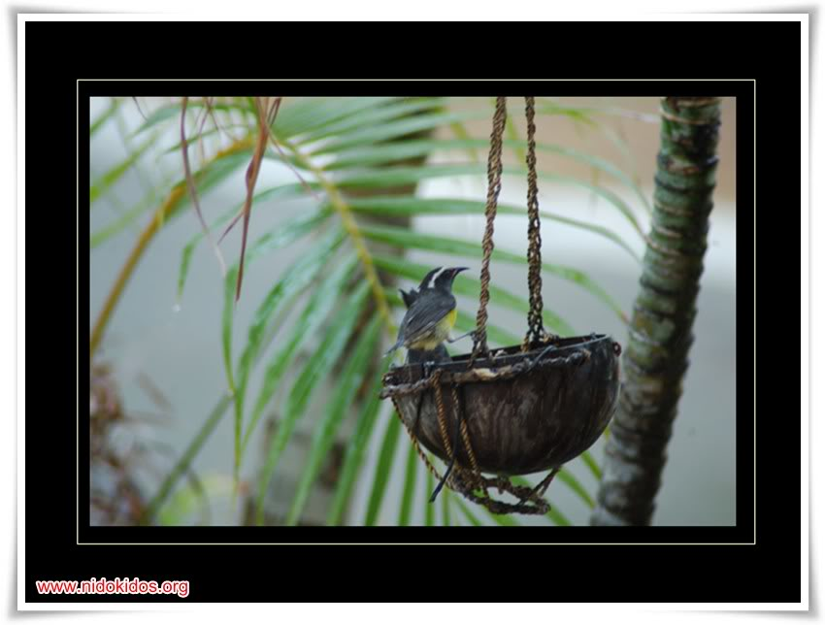

Slide 9
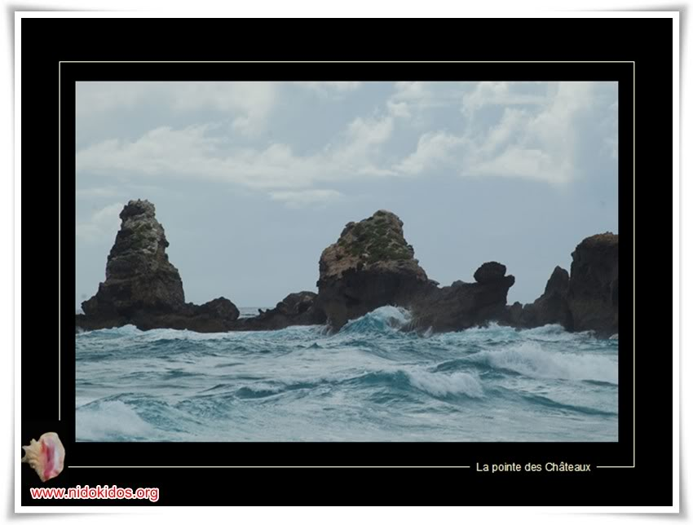

Slide 10
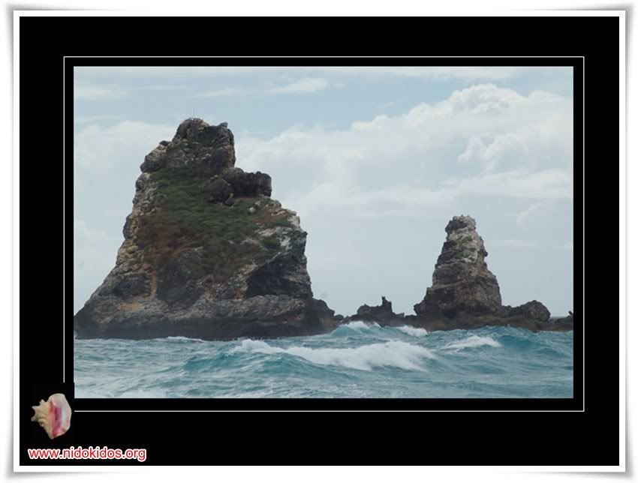

Slide 11
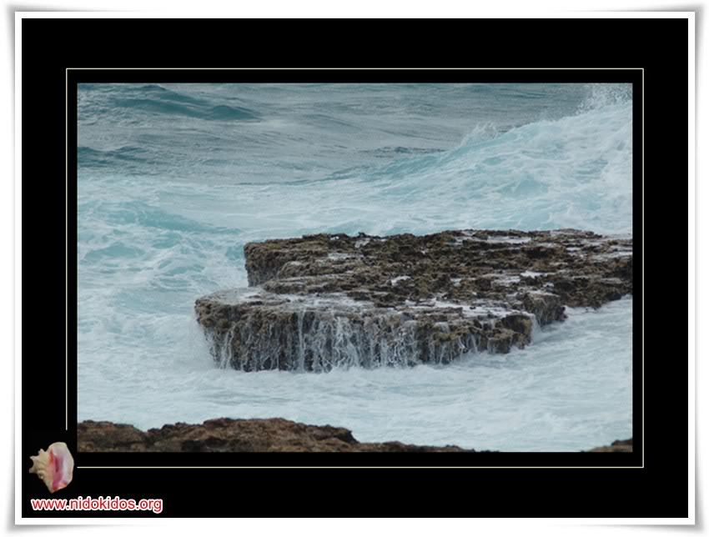

Slide 12
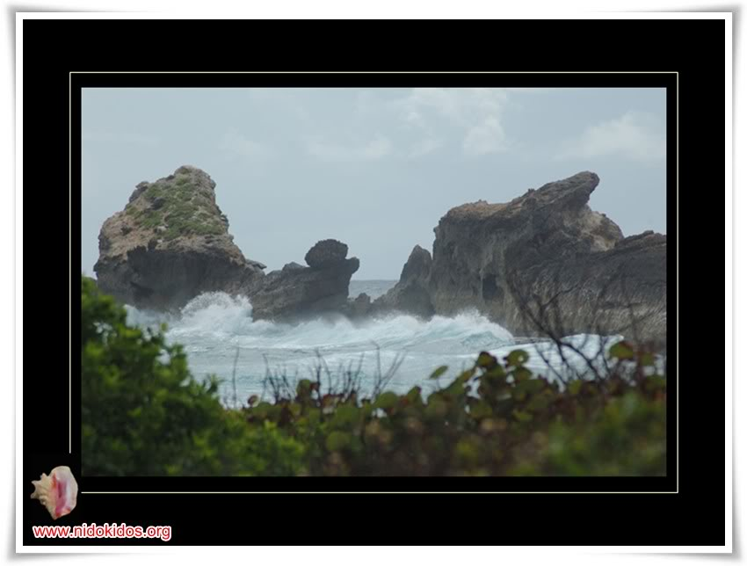

Slide 13
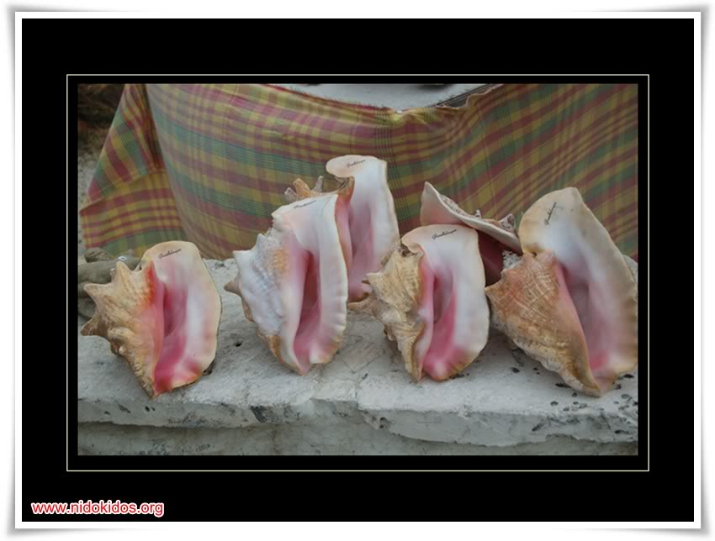

Slide 14
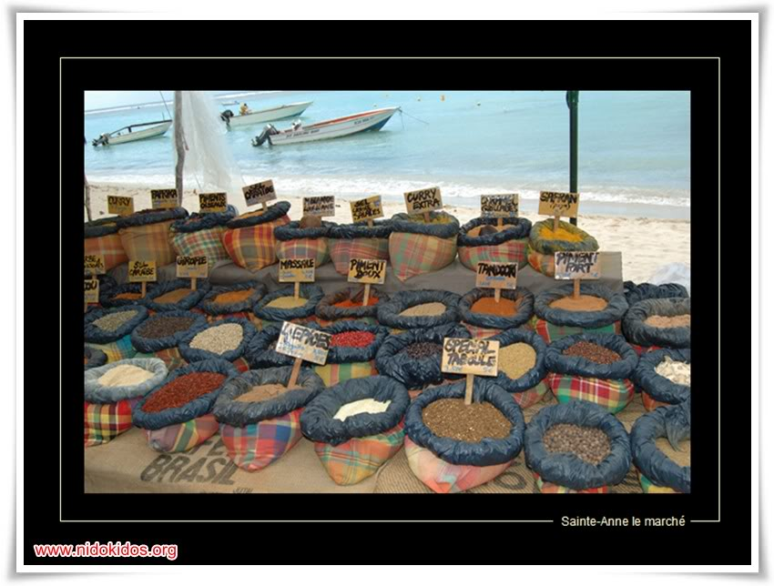

Slide 15
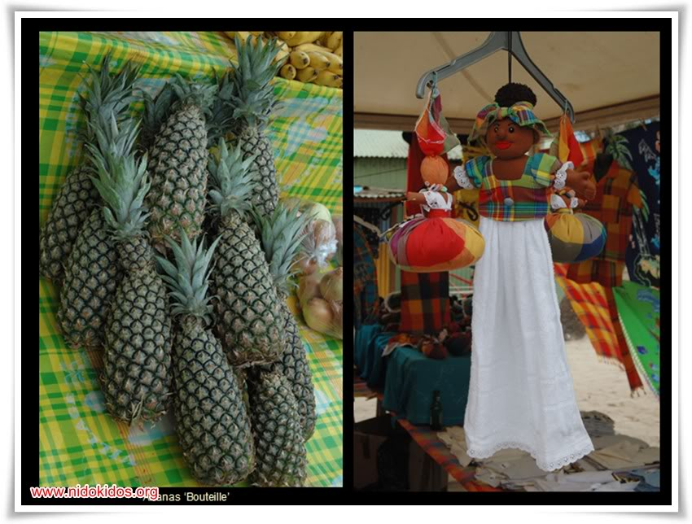

Slide 16
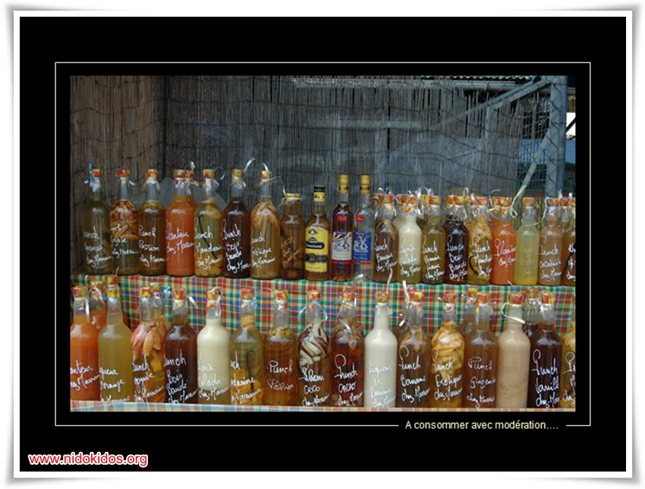

Slide 17
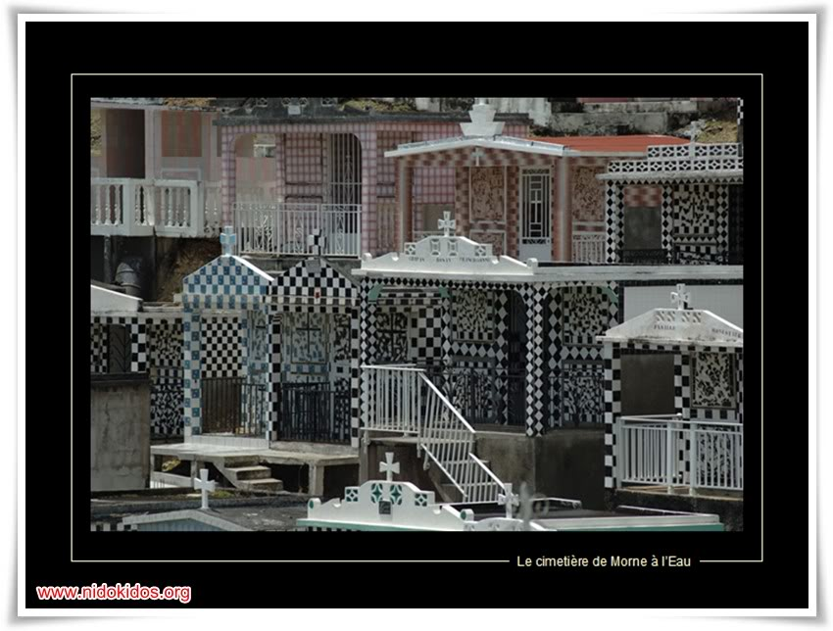

Slide 18
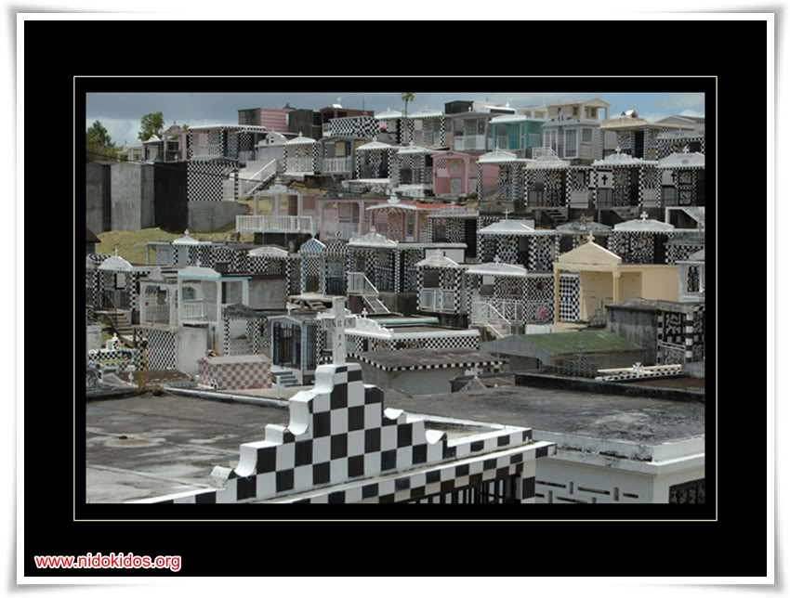

Slide 19
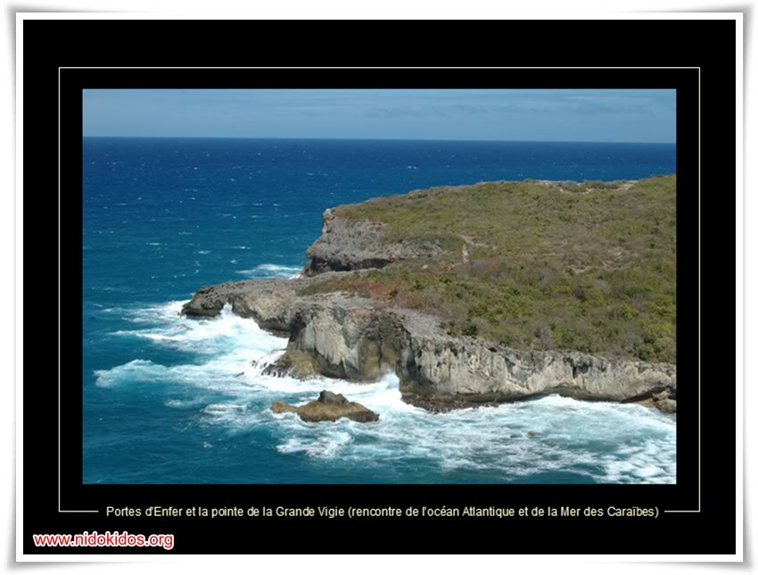

Slide 20
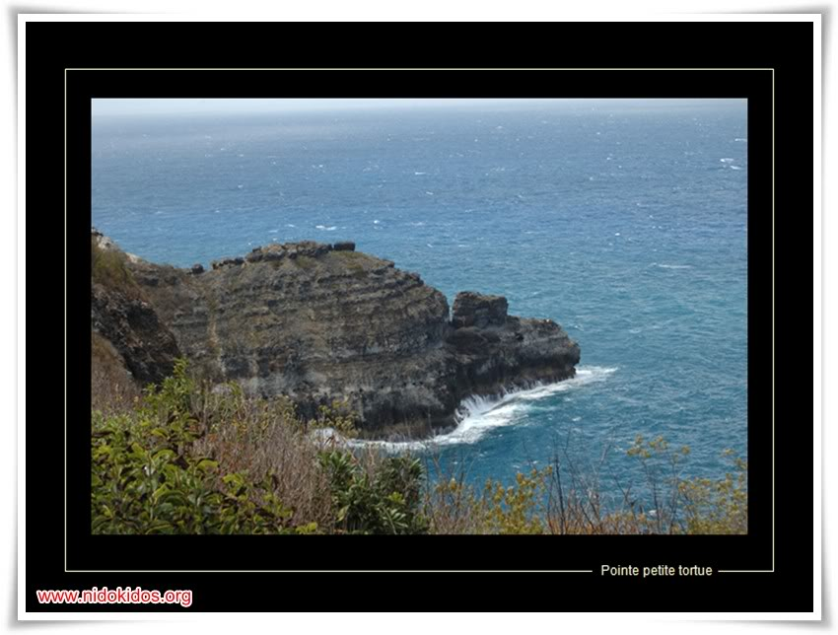

Slide 21
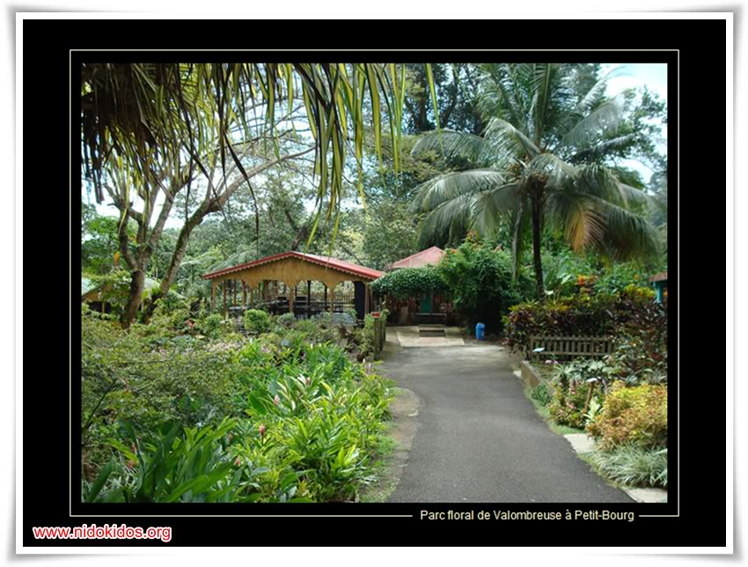

Slide 22
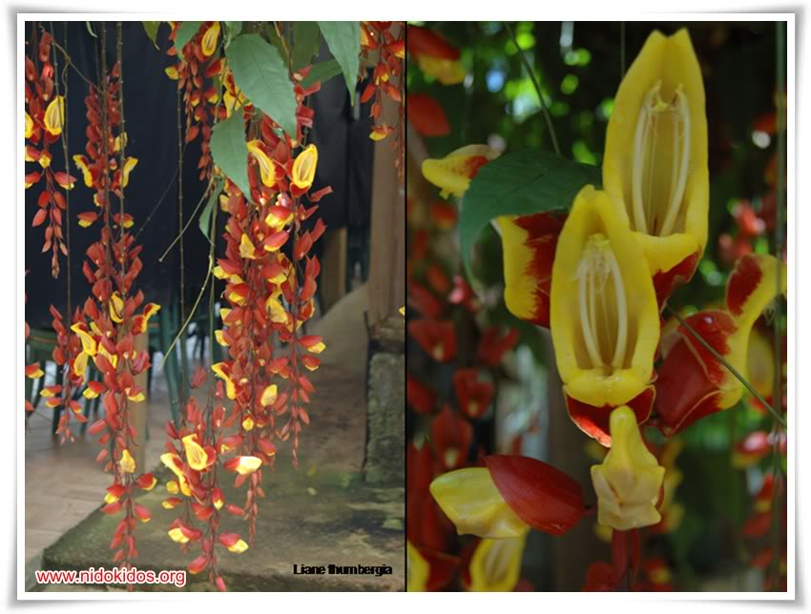

Slide 23
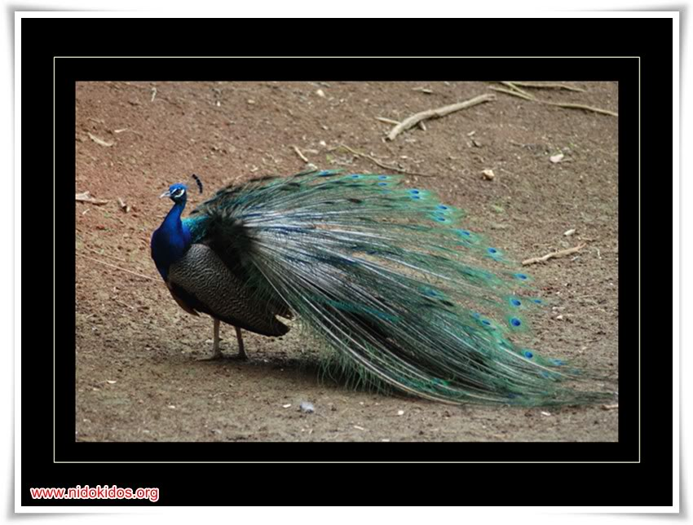

Slide 24
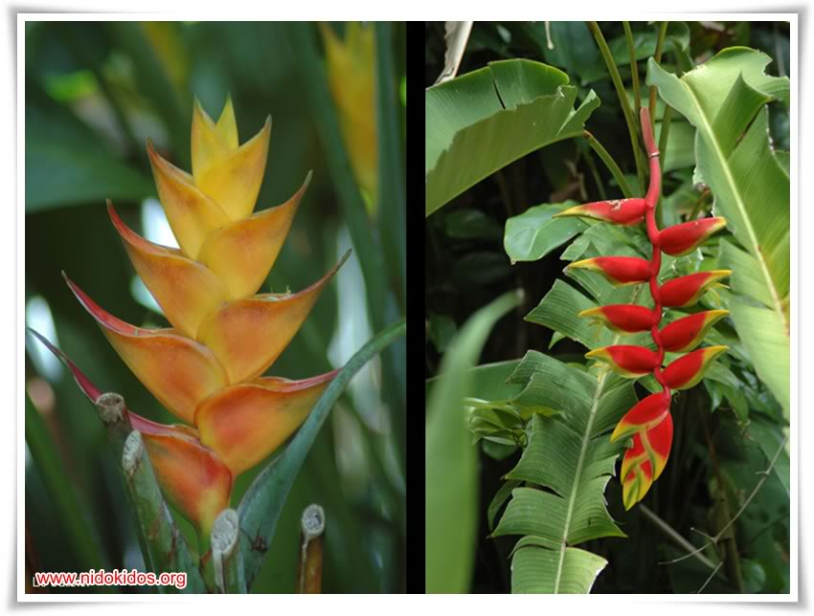

Slide 25
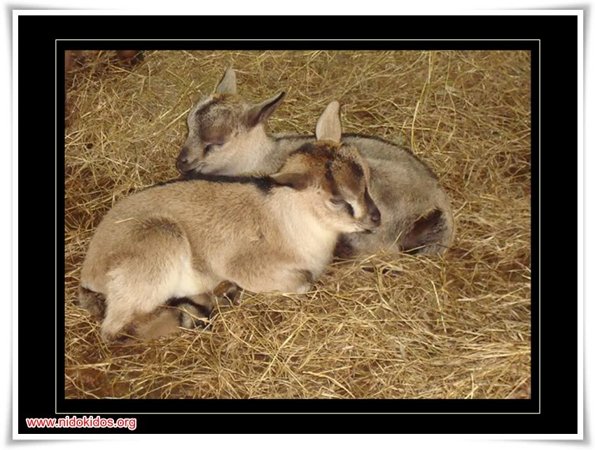

Slide 26


Slide 27
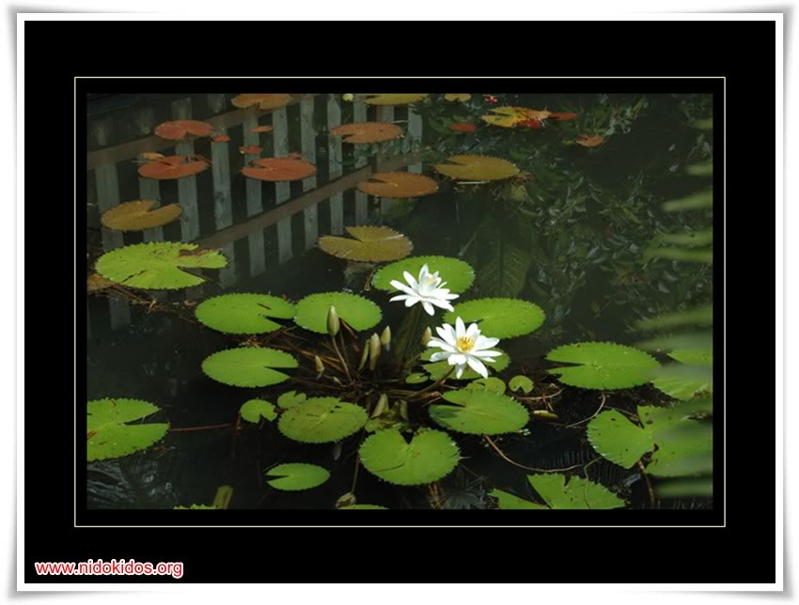

Slide 28
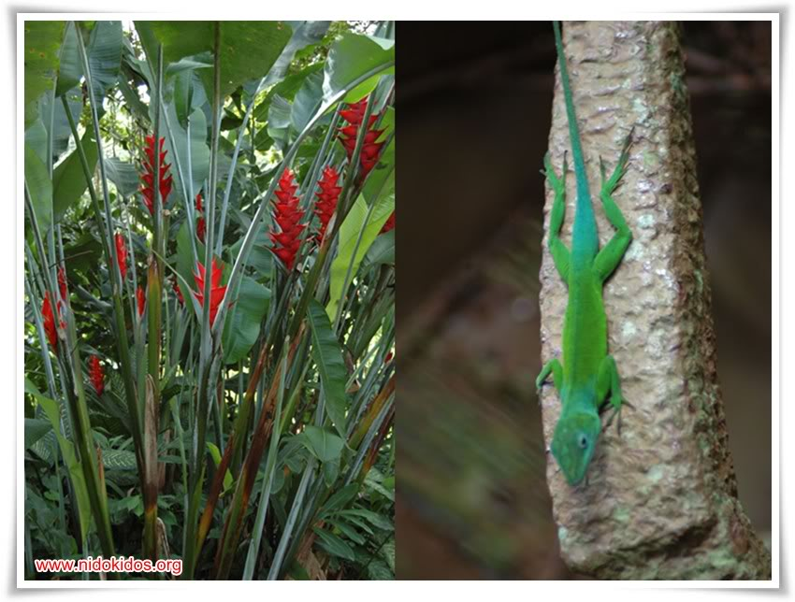

Slide 29
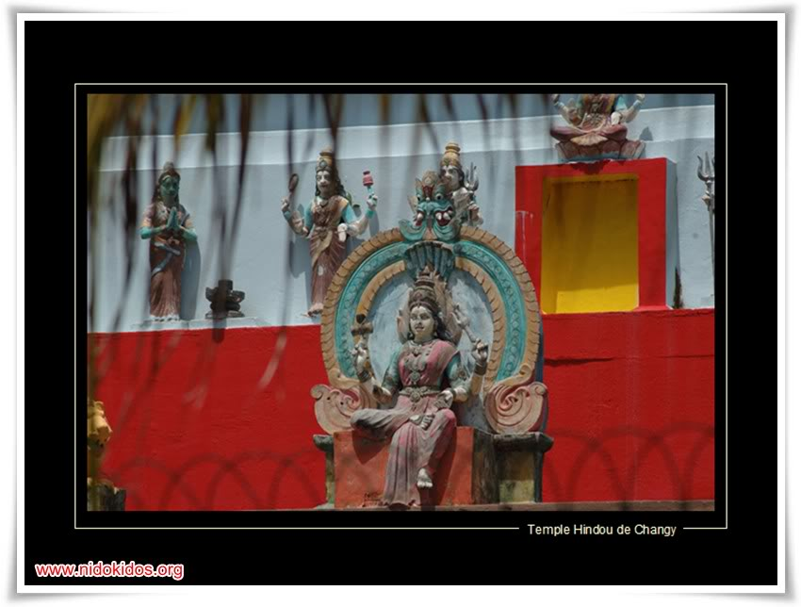

Slide 30
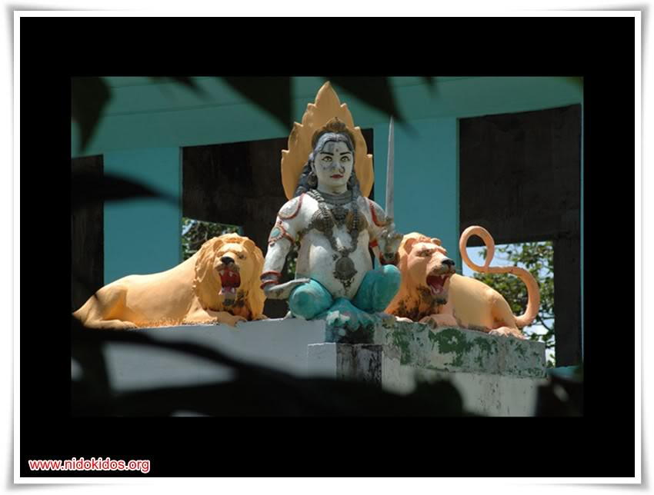

Slide 31
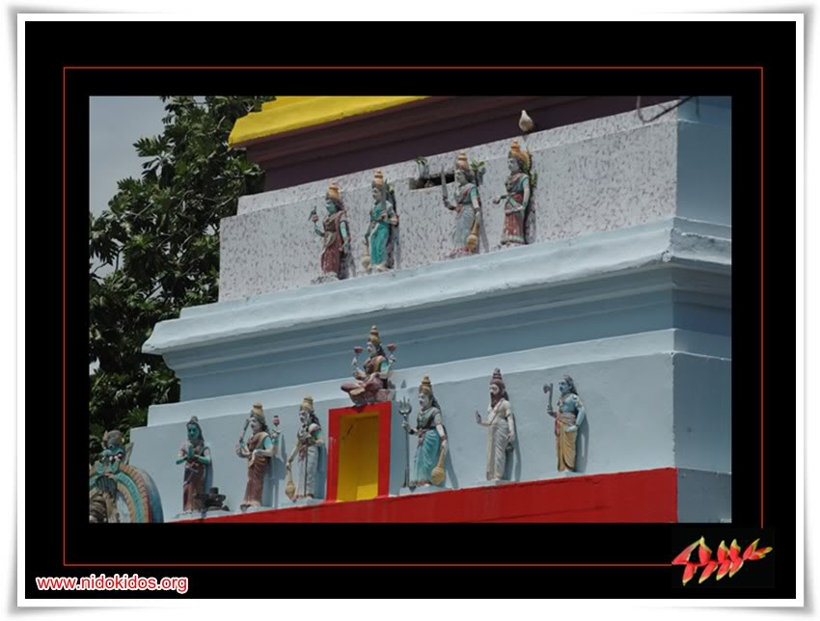

Slide 32
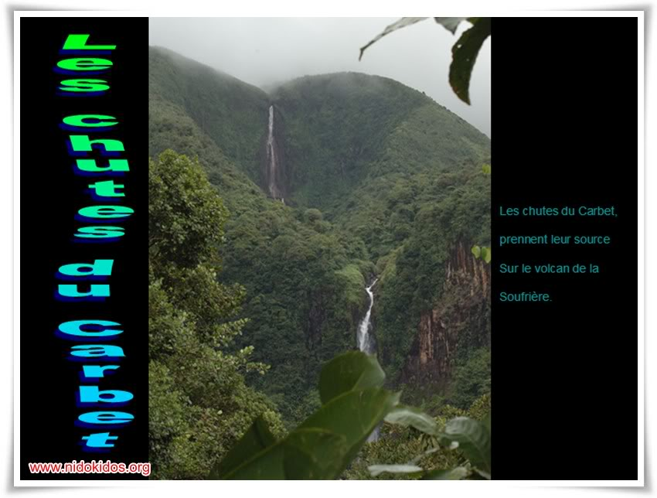

Slide 33
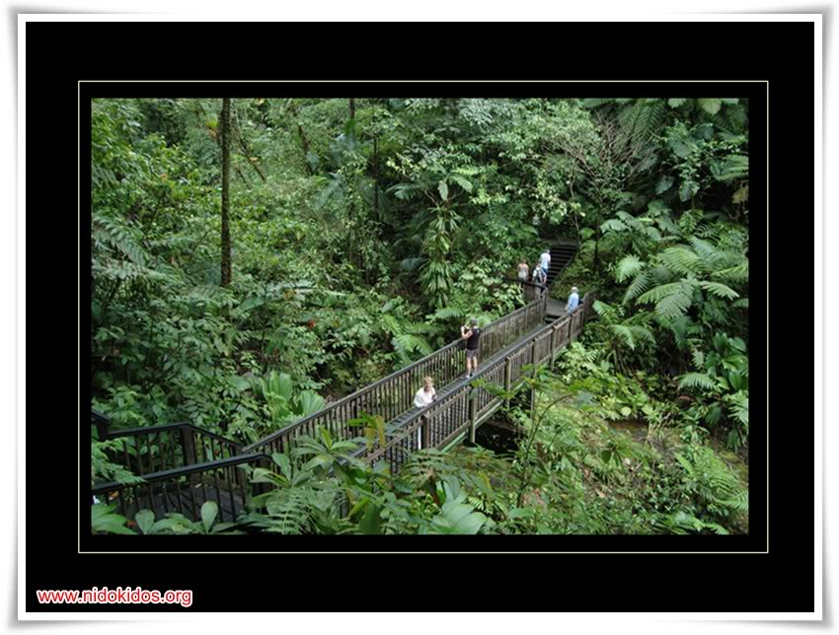

Slide 34
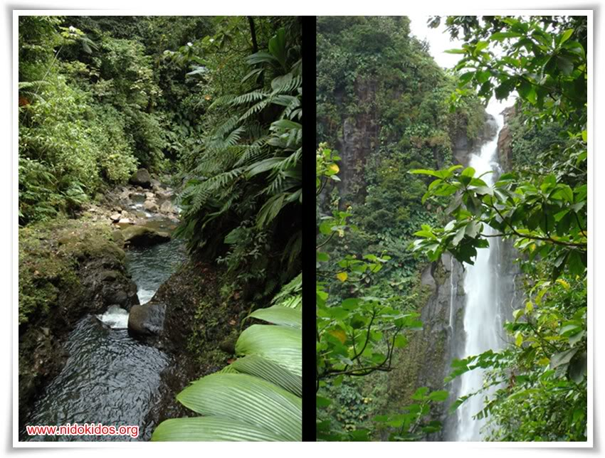

Slide 35
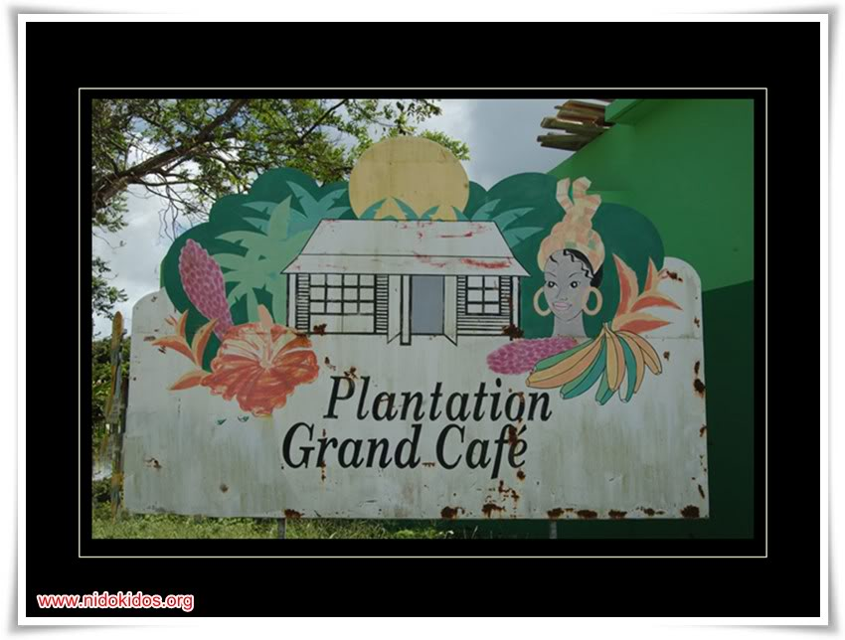

Slide 36
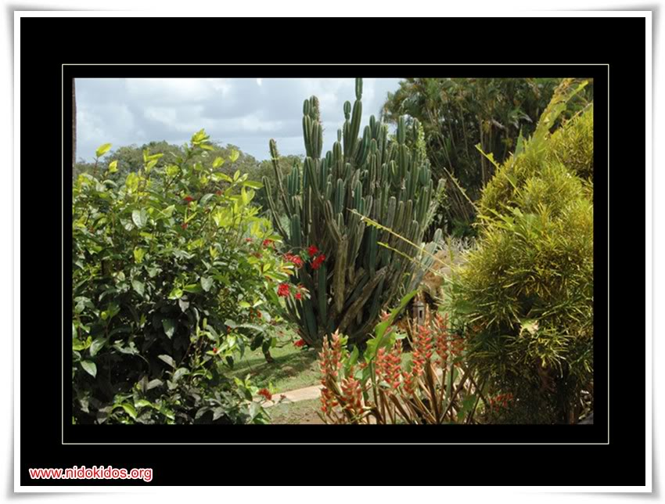

Slide 37
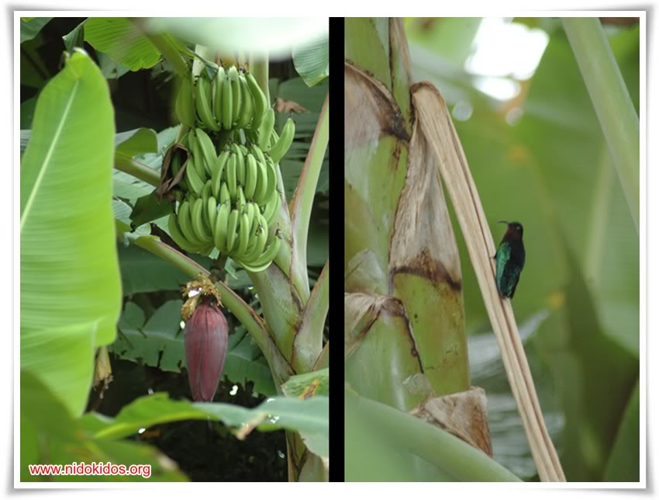

Slide 38
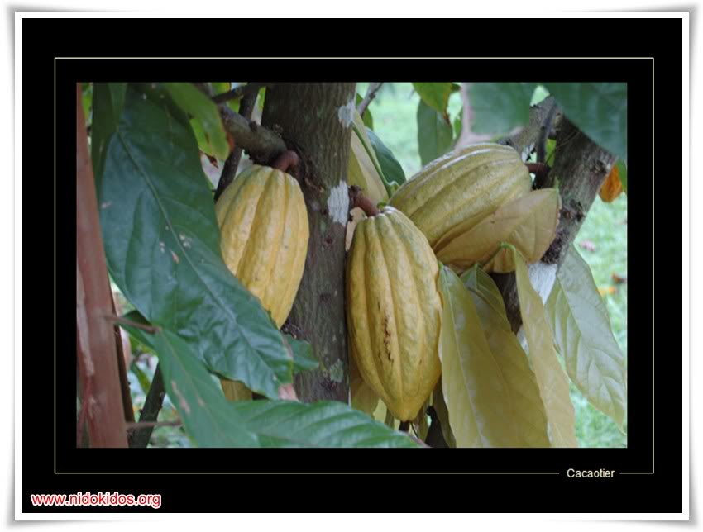

Slide 39
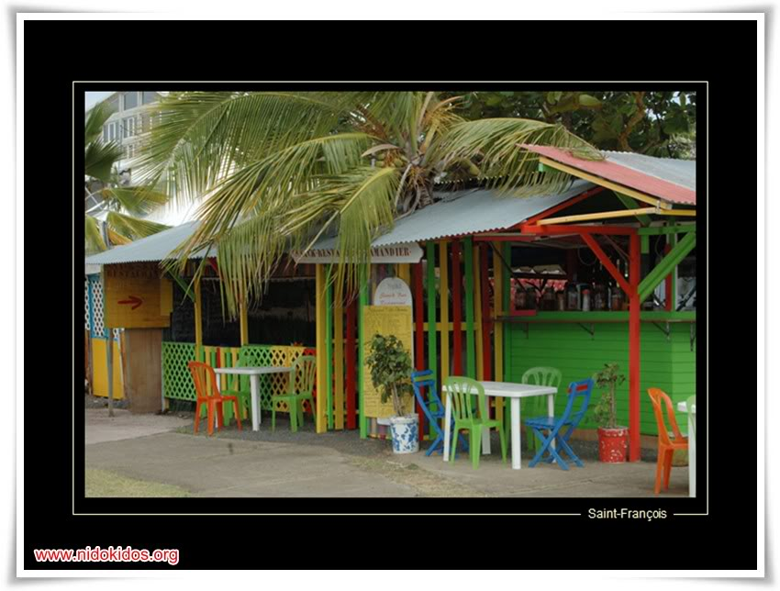

Slide 40
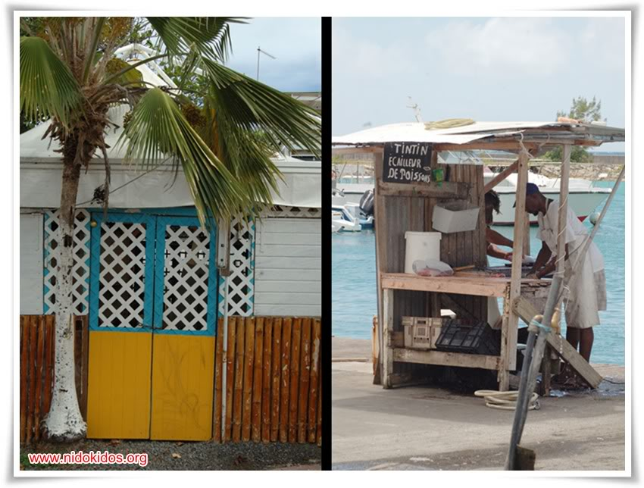

Slide 41
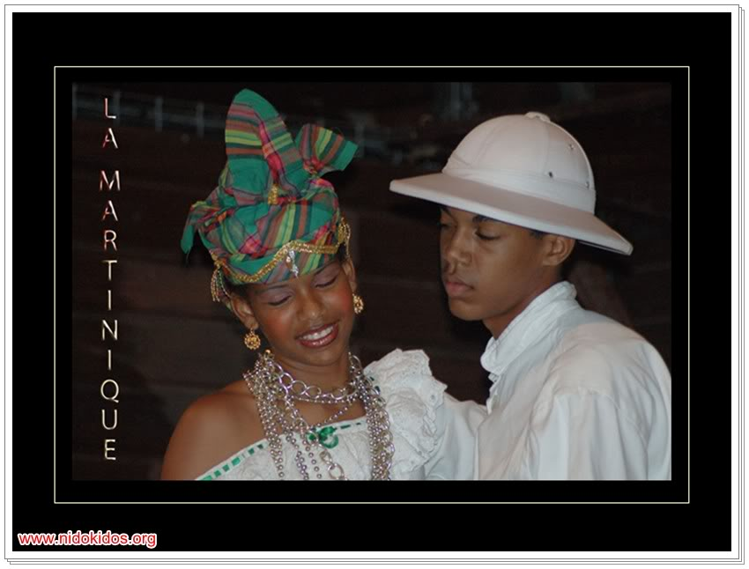

Slide 42
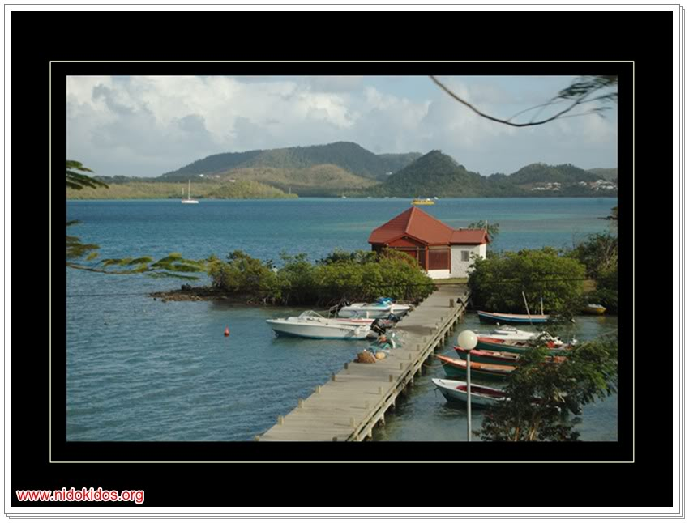

Slide 43
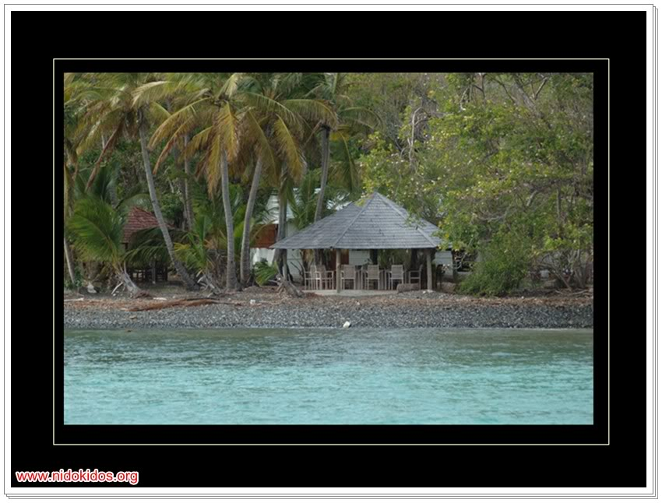

Slide 44
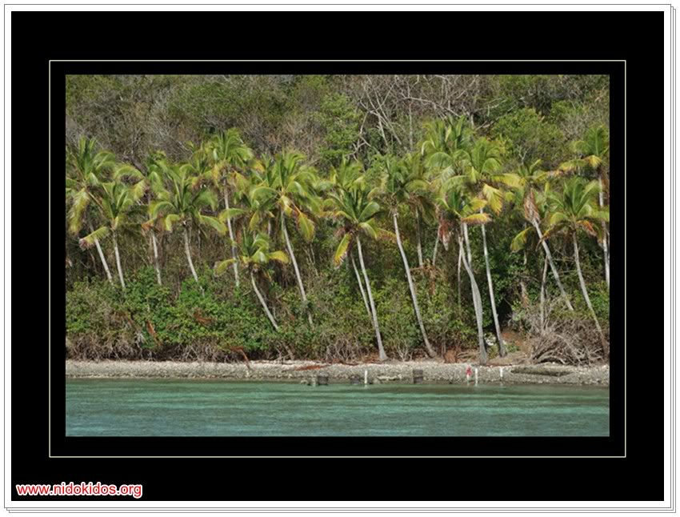

Slide 45
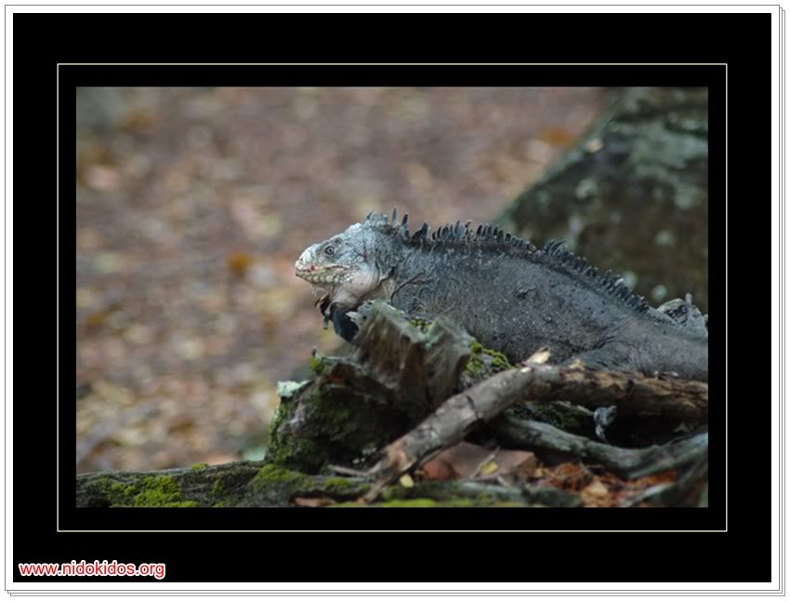

Slide 46
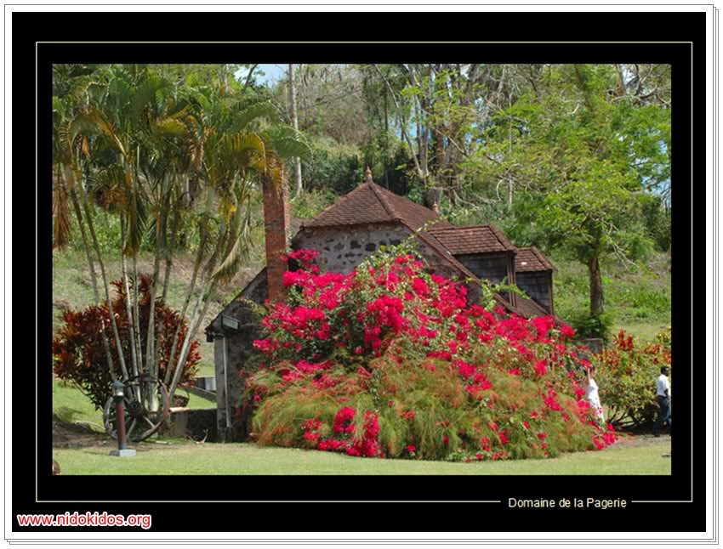

Slide 47
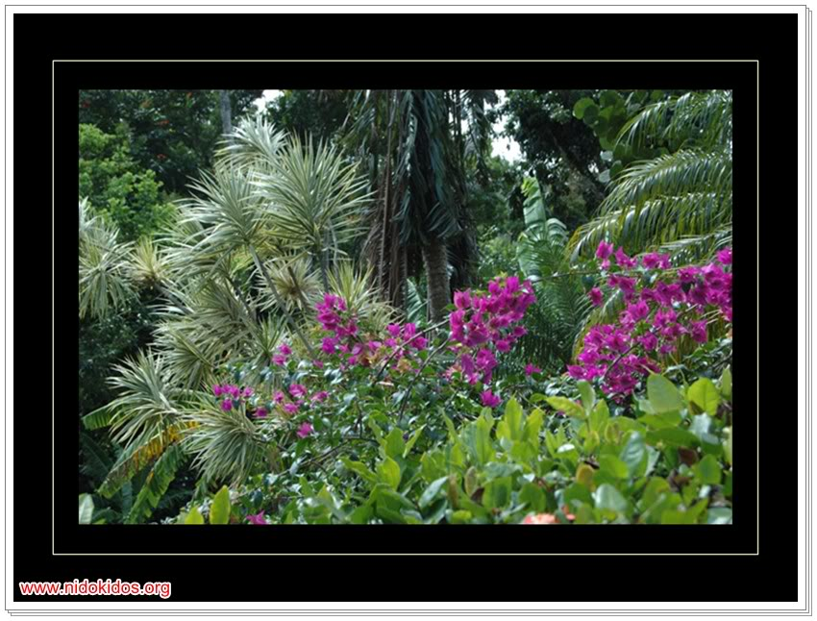

Slide 48
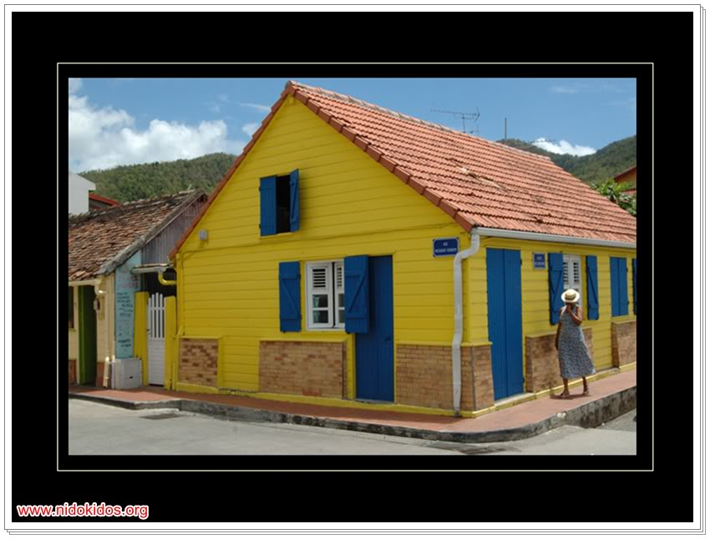

Slide 49
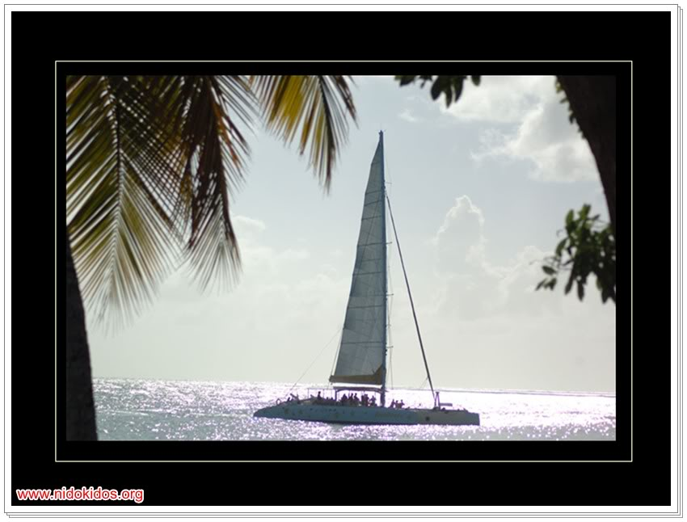

Slide 50
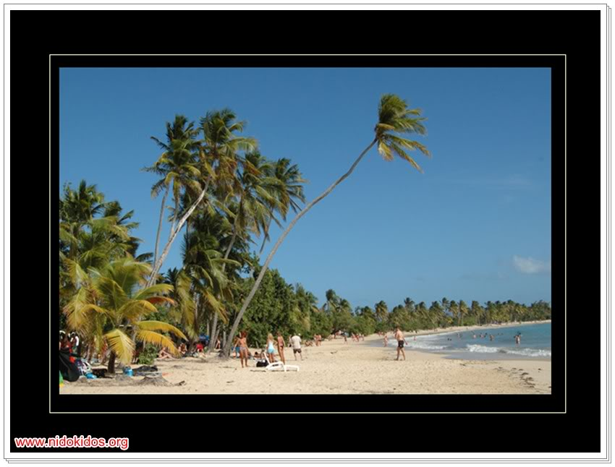

Slide 51
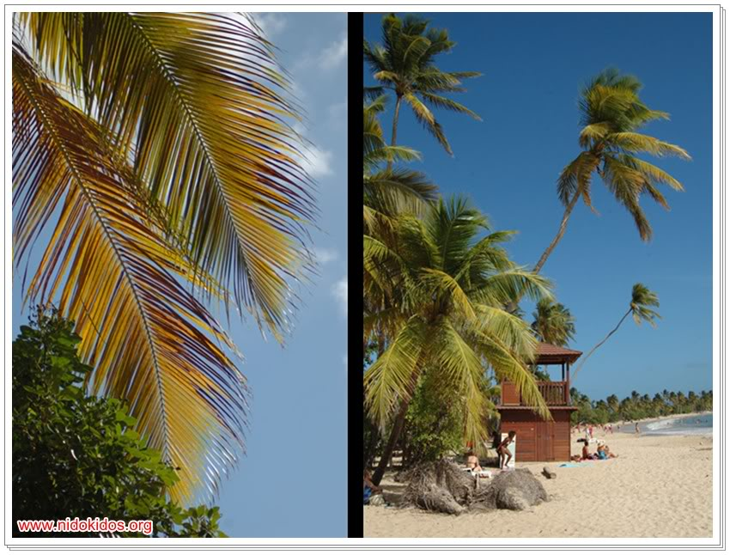

Slide 52
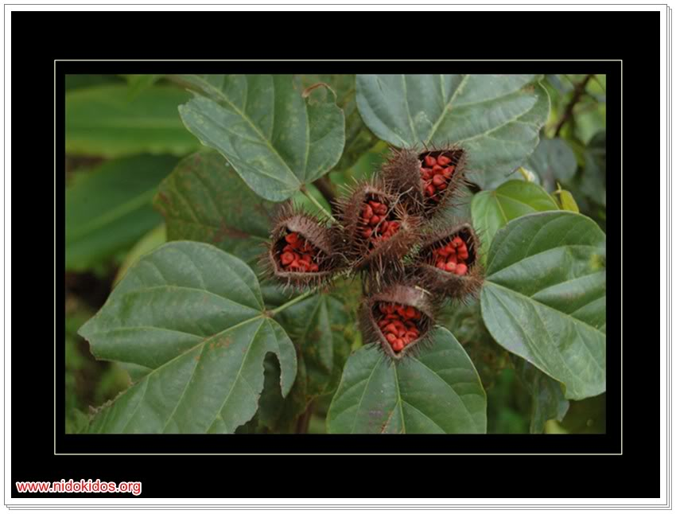

Slide 53
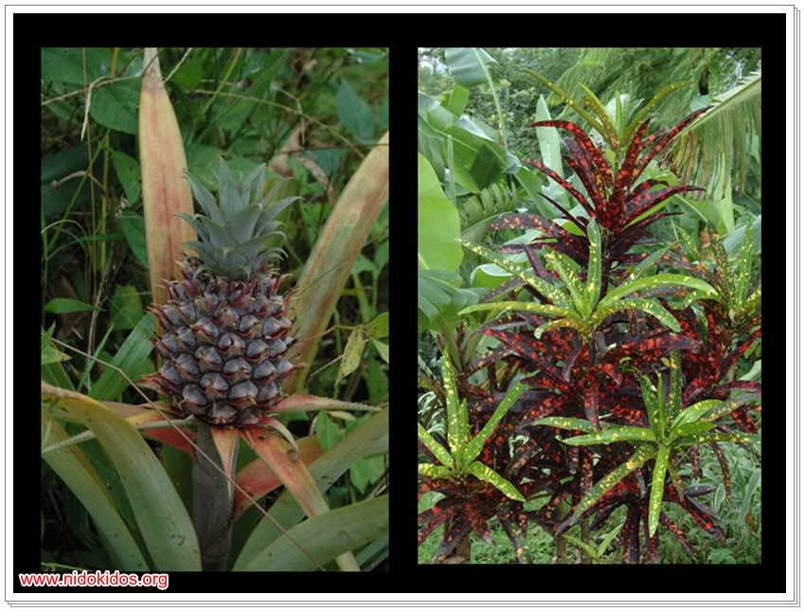

Slide 54
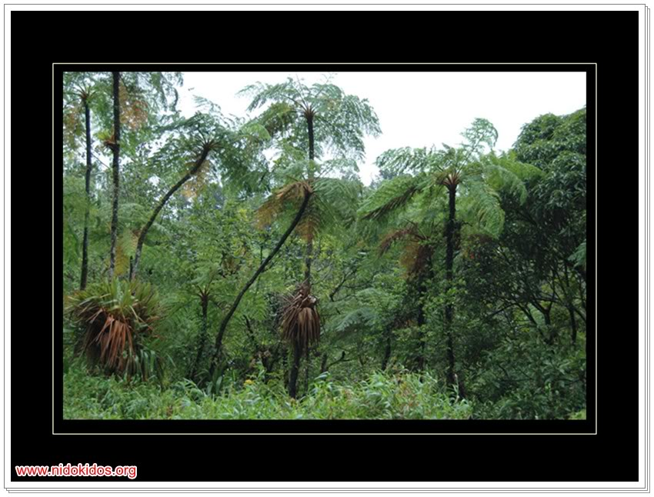

Slide 55


Slide 56


Slide 57


Slide 58


Slide 59


Slide 60


Slide 61


Slide 62


Slide 63


Slide 64


Slide 65


Slide 66


Slide 67


Slide 68


Slide 69


Slide 70


Slide 71


Slide 72


