Slide 1
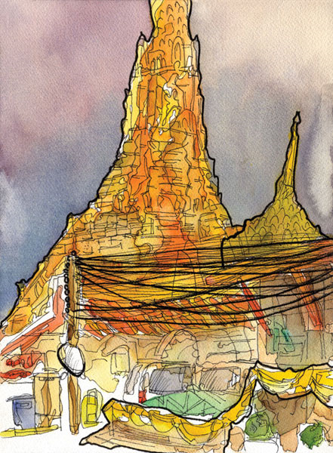
Wat Arun Bangkok, Thailand

Slide 2
Wat Arun
Wat Arun is a Buddhist temple (wat) in the Bangkok Yai district of Bangkok, Thailand, on the west bank of the Chao Phraya River. The full name of the temple is Wat Arunratchawararam Ratchaworamahawihan

Slide 3
Architecture
The outstanding feature of Wat Arun is its central prang (Khmer-style tower). Begun in 1809, it may have been named "Temple of the Dawn" because the first light of morning reflects off the surface of the temple with a pearly iridescence. Steep steps lead up to two terraces. The height is reported by different sources as between 219 ft. and 282 ft. The corners are surrounded by 4 smaller satellite prangs. The prangs are decorated by seashells and bits of porcelain which had previously been used as ballast by boats coming to Bangkok from China.

Slide 4
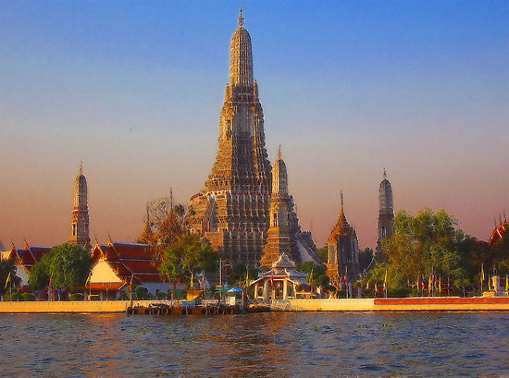

Slide 5
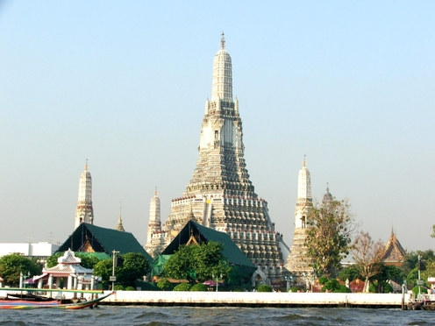

Slide 6
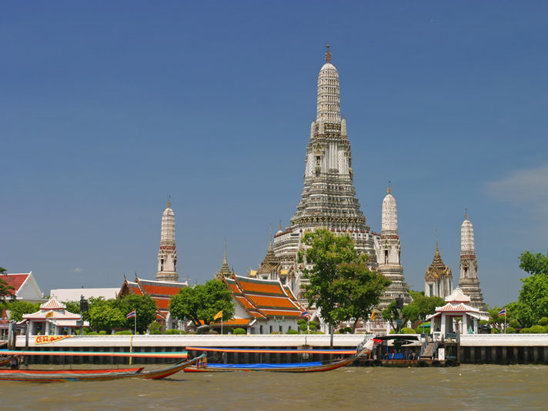

Slide 7
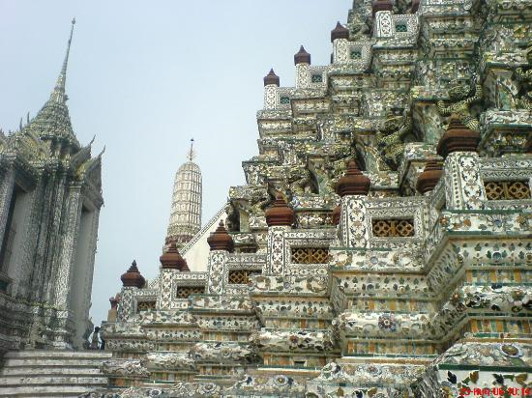

Slide 8
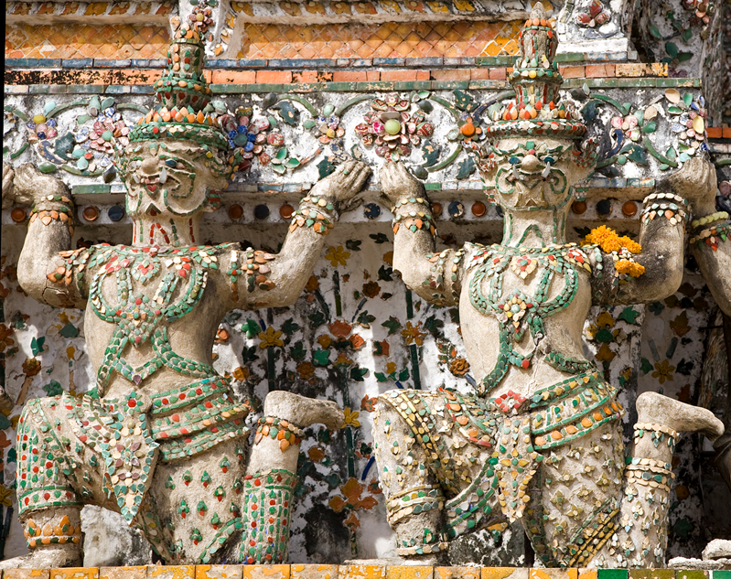

Slide 9
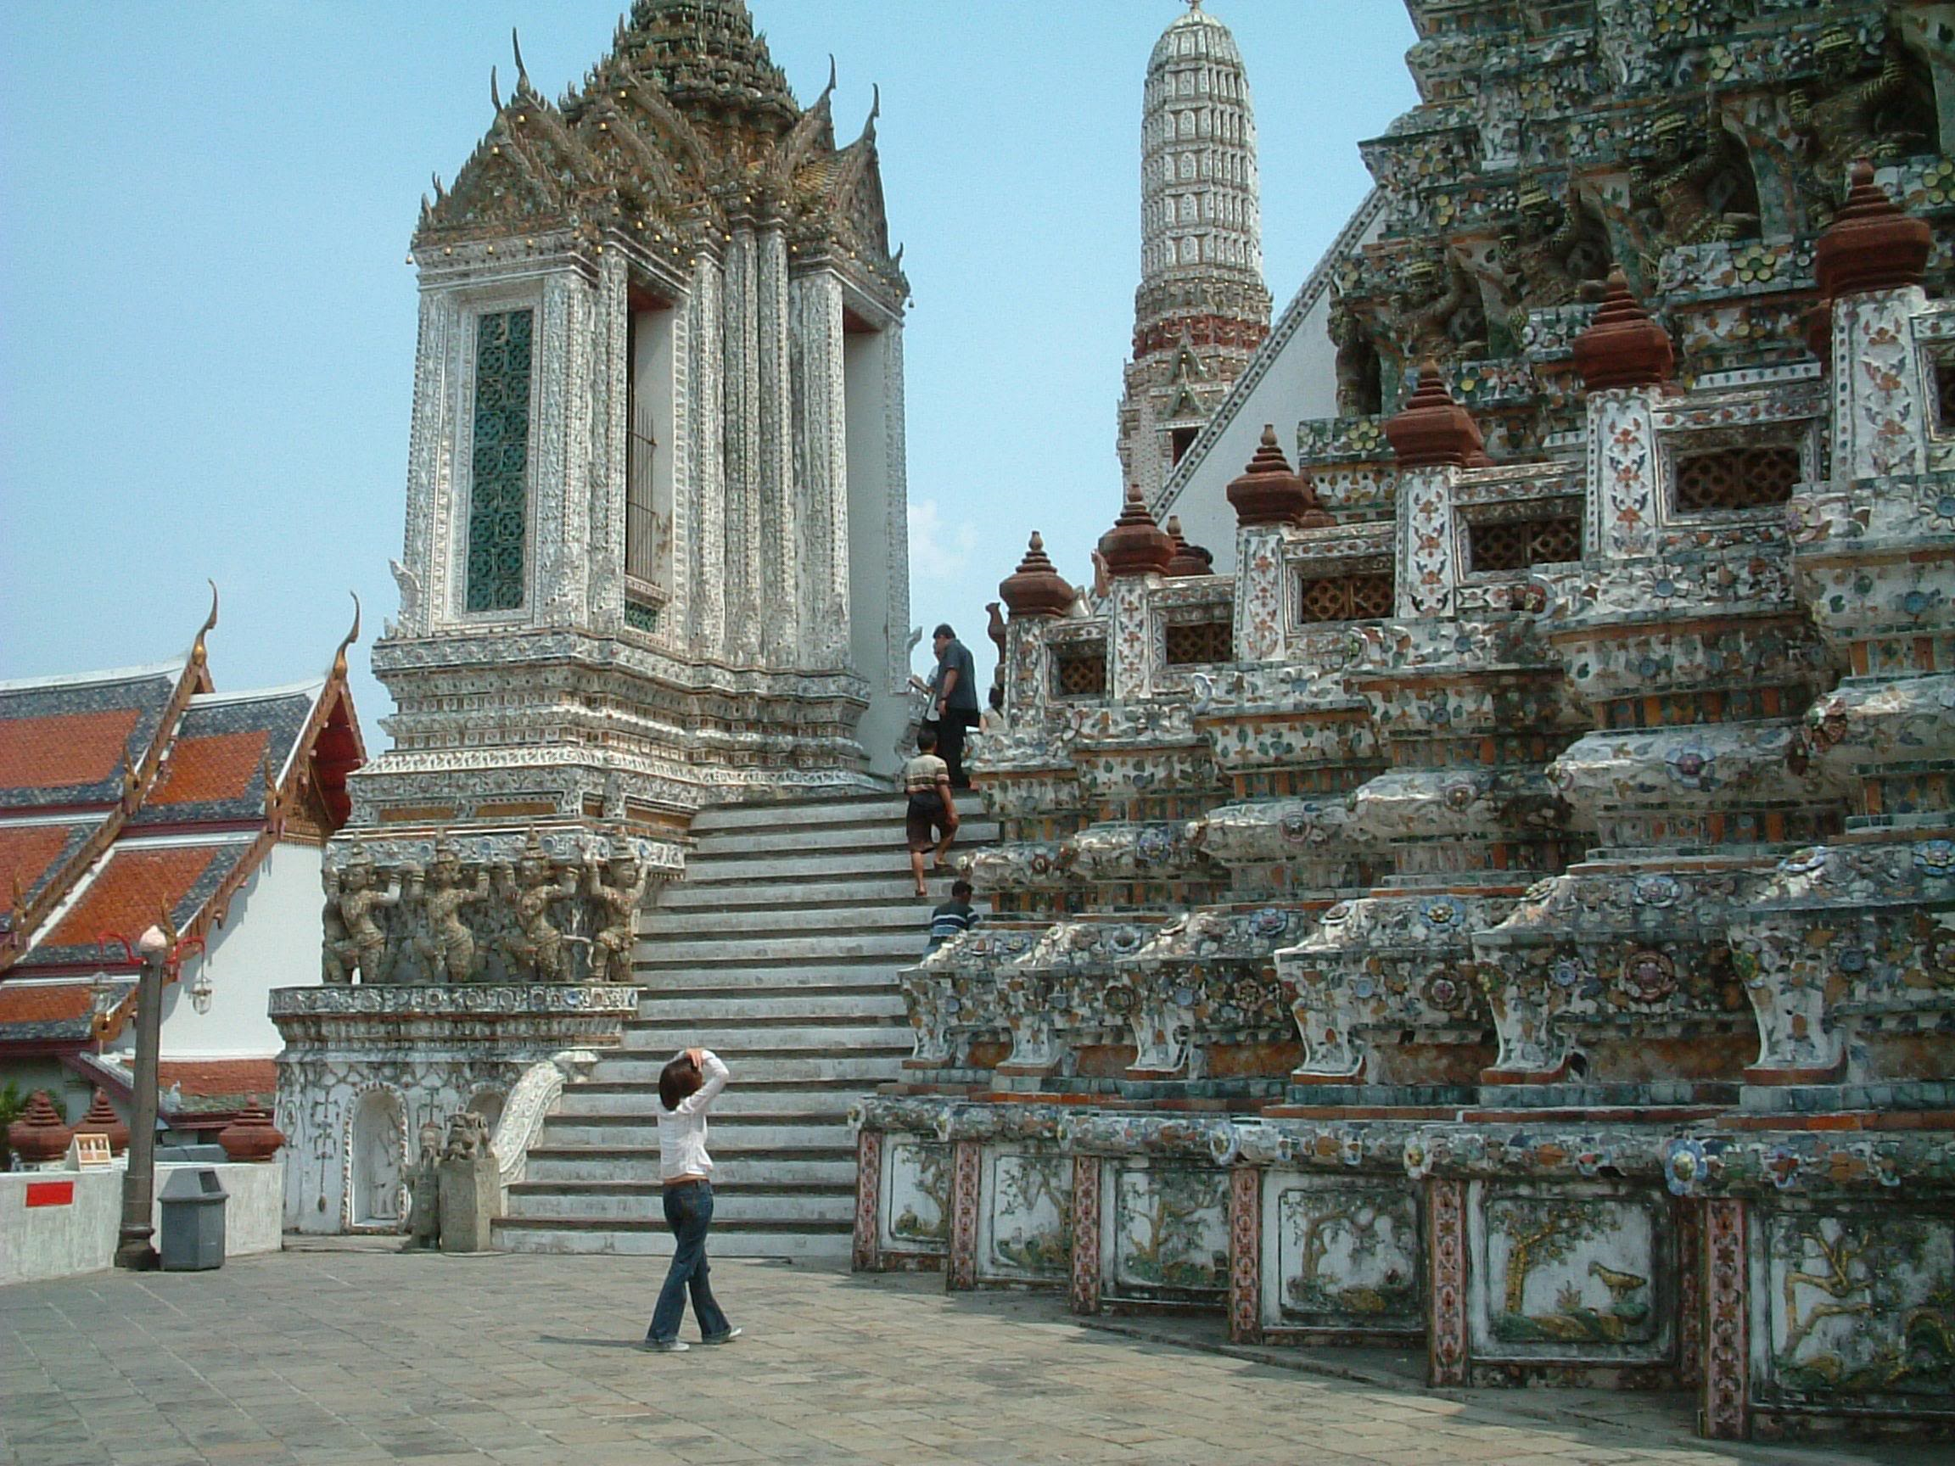

Slide 10
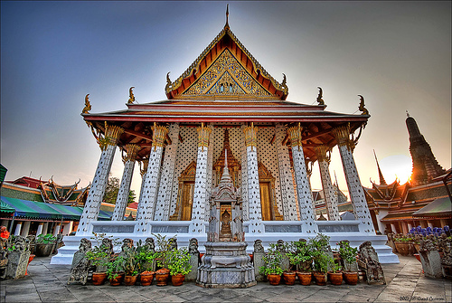

Slide 11
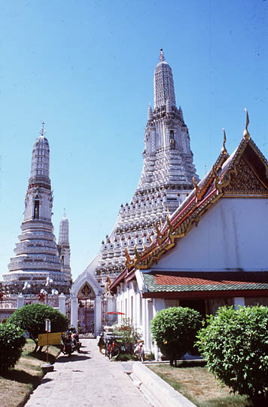
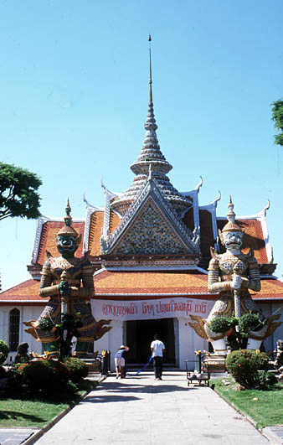

Slide 12
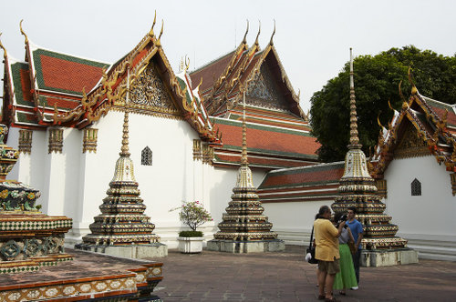

Slide 13
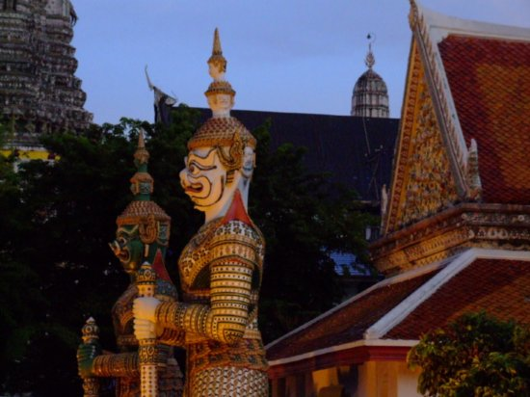

Slide 14
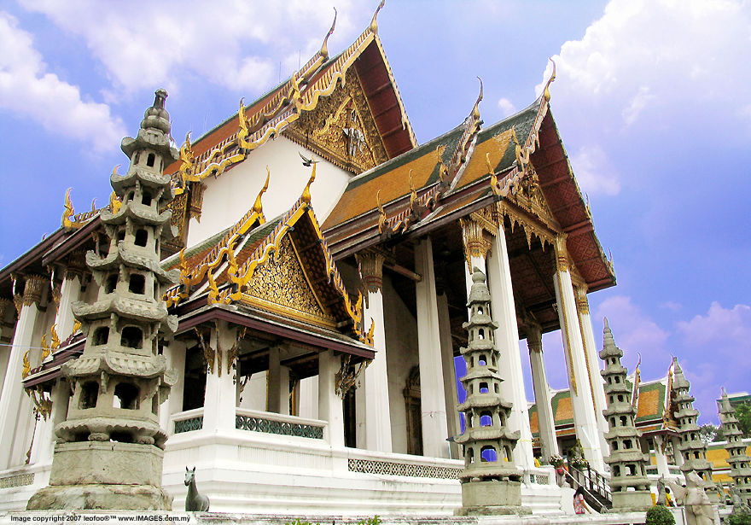

Slide 15
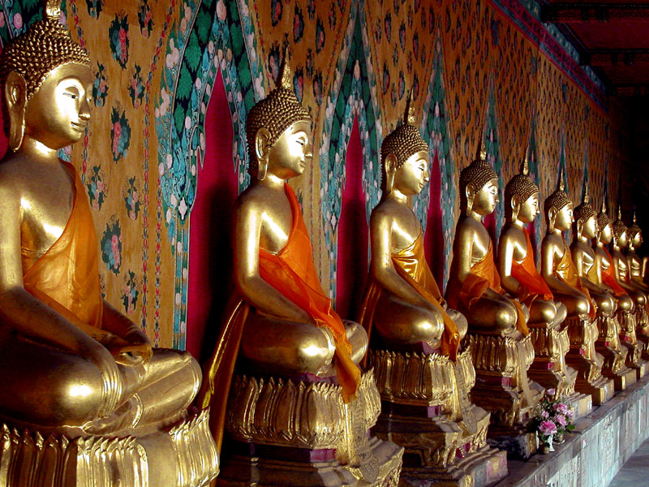

Slide 16
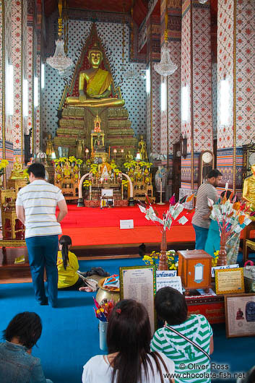
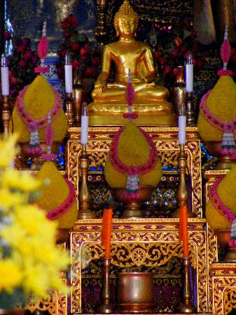

Slide 17
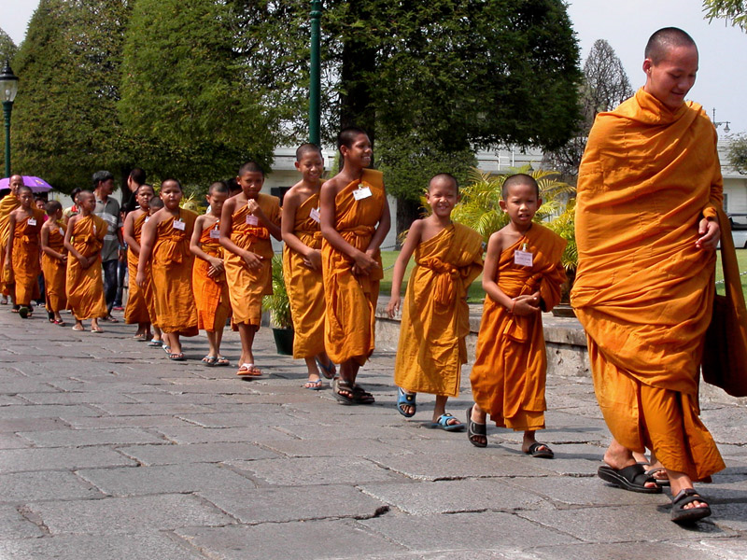

Slide 18
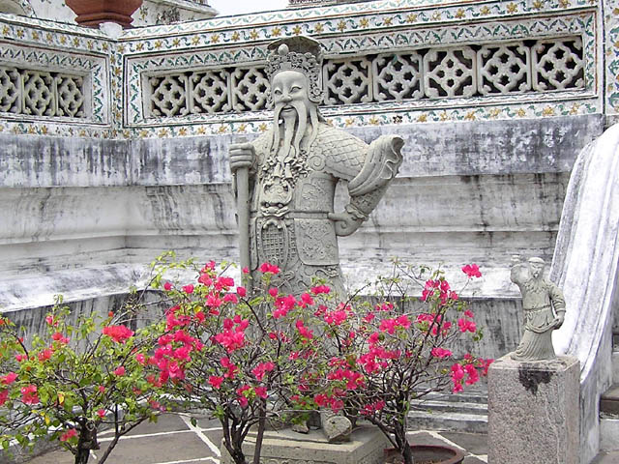

Slide 19
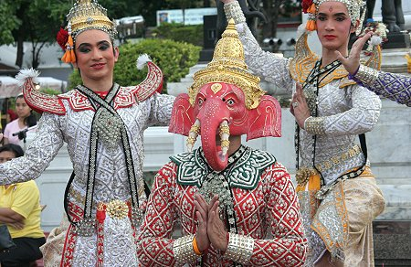

Slide 20
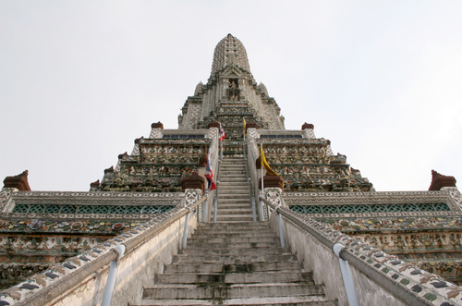

Slide 21
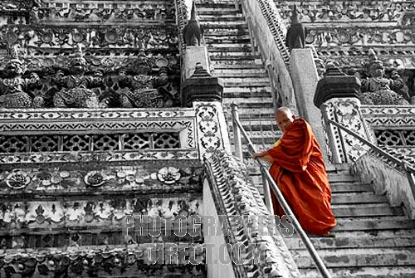

Slide 22
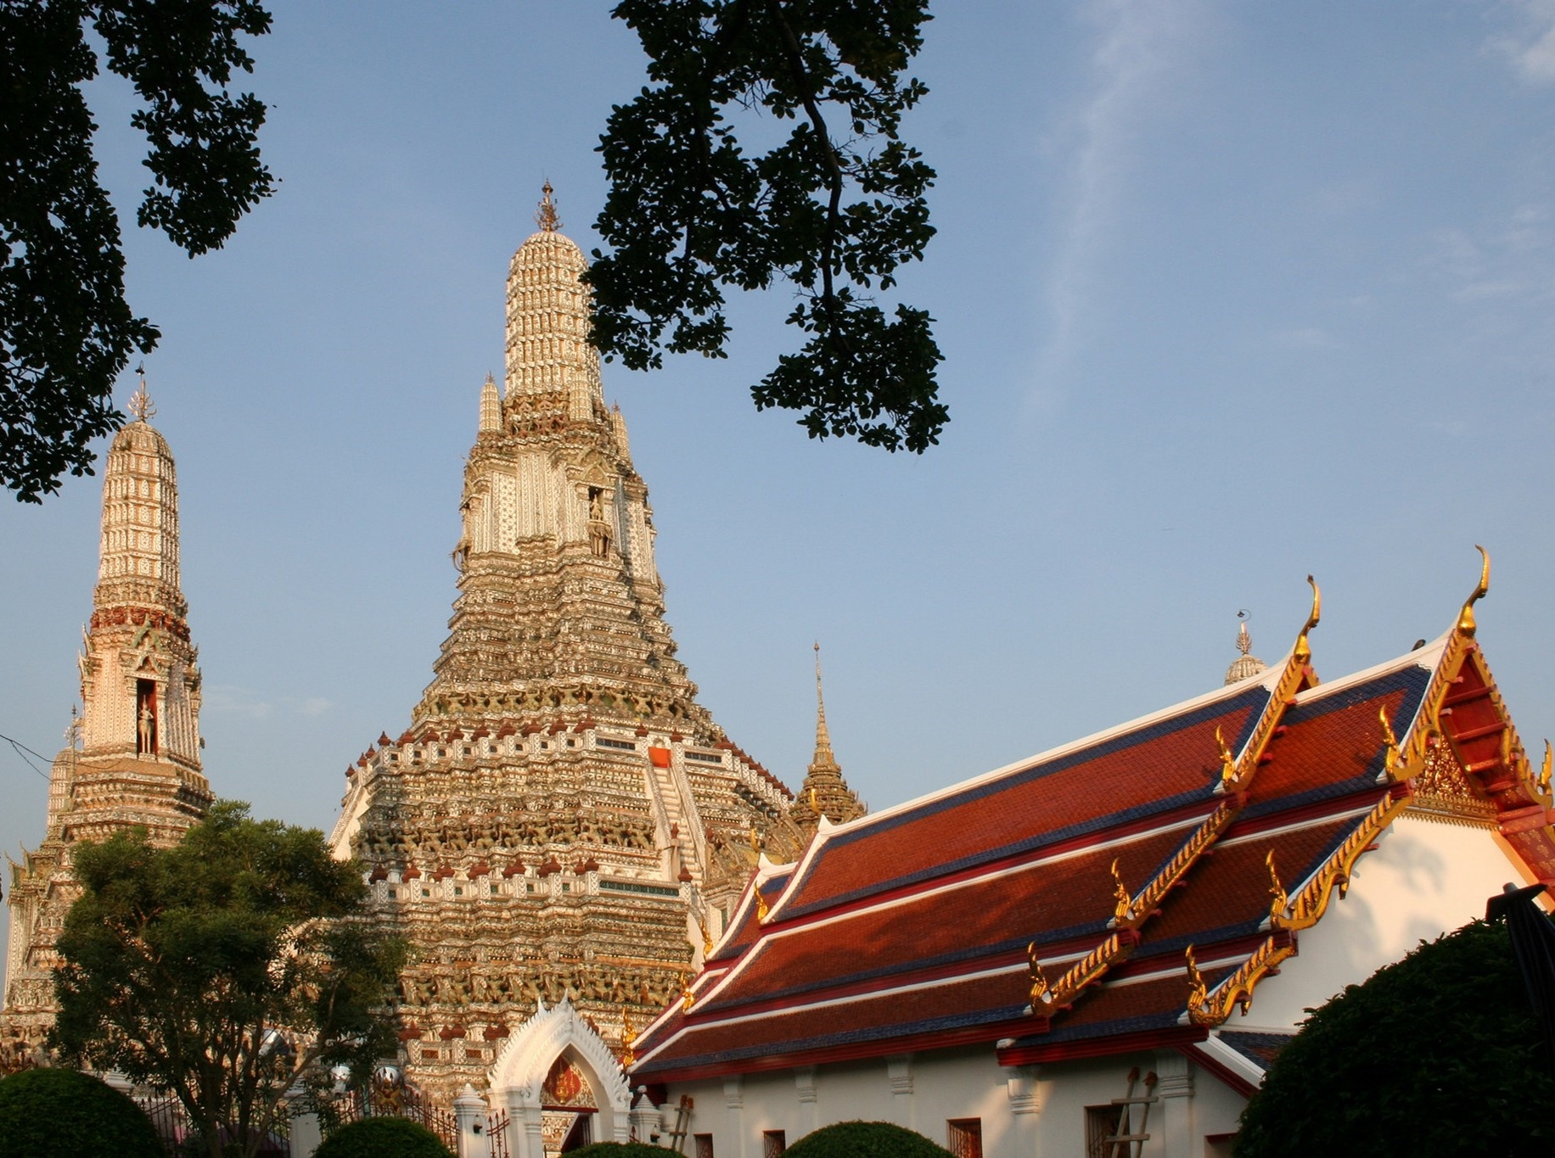

Slide 23
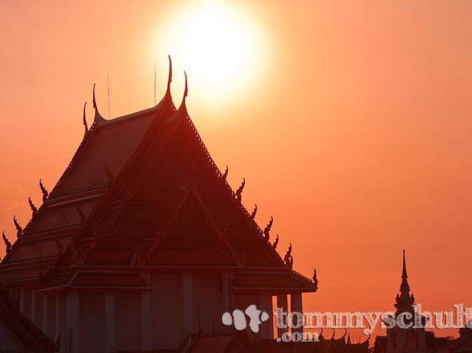

Slide 24
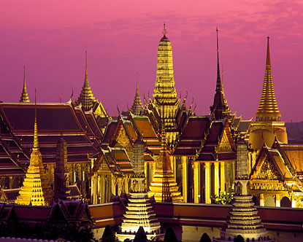

Slide 25
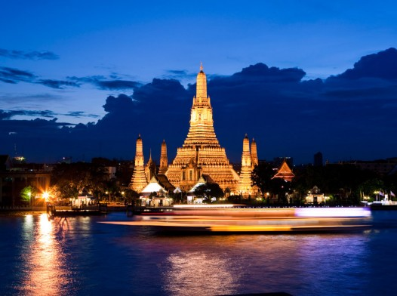

Slide 26


Slide 27
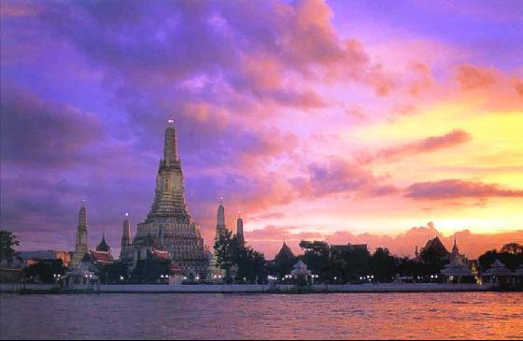

Slide 28
