Slide 1
Missouri Region – Natural Wonders

Slide 2
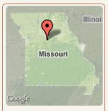
Arrow Rock
Stroll through the history of a once-bustling river town that’s now the serene village of Arrow Rock. You’ll walk streets lined with the architecture of the historic “Boone’s Lick Country.” At Arrow Rock State Historic Site, you may wander into the historic Old Tavern, which dates back to 1834 and provides a dining experience in a period setting or see displays of old-time wares at the Huston Store. You can learn about it all through exhibits in the visitor center. The historic site is part of the larger Village of Arrow Rock, which features quaint stores and a bevy of antique shops

Slide 3
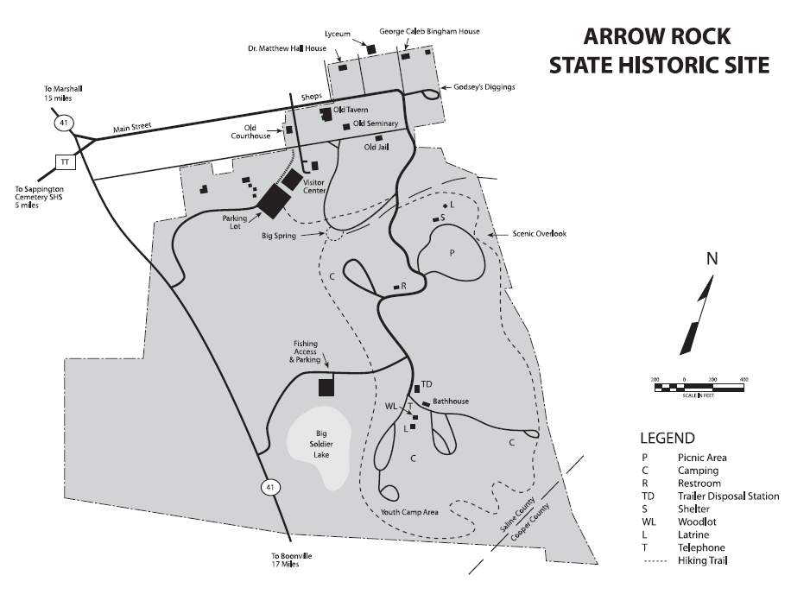

Slide 4
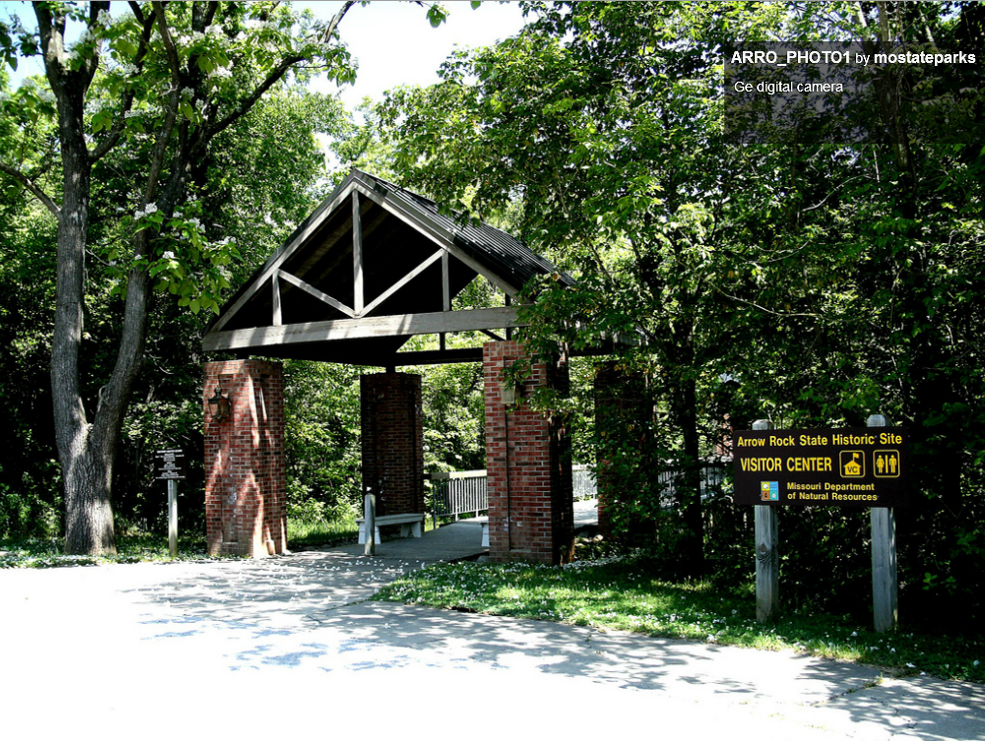

Slide 5
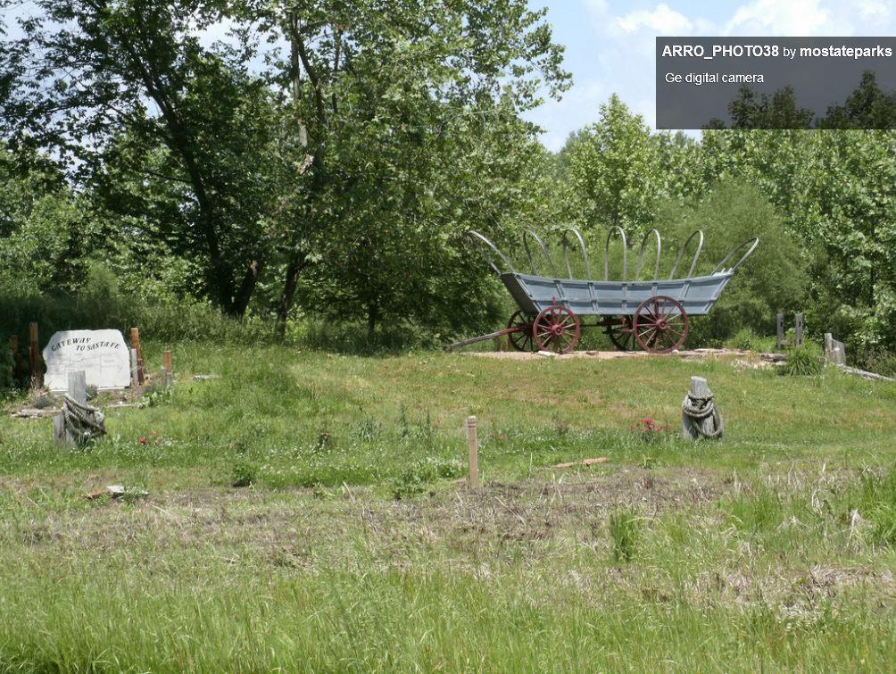

Slide 6
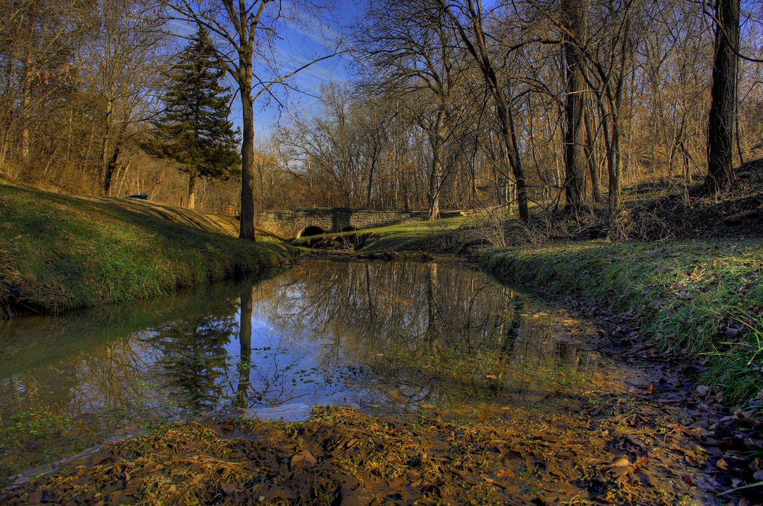

Slide 8
Prairie State Park
Tallgrass prairies once covered more than a third of Missouri; today, less than one percent remains, much of it preserved at Prairie State Park. Visitors to the park see panoramic vistas of swaying grass and ever-changing wildflowers. They also may spot an elk or the park’s resident bison herd. The park’s visitor center offers exhibits and interpretive programs designed to inform visitors about the special place.

Slide 9
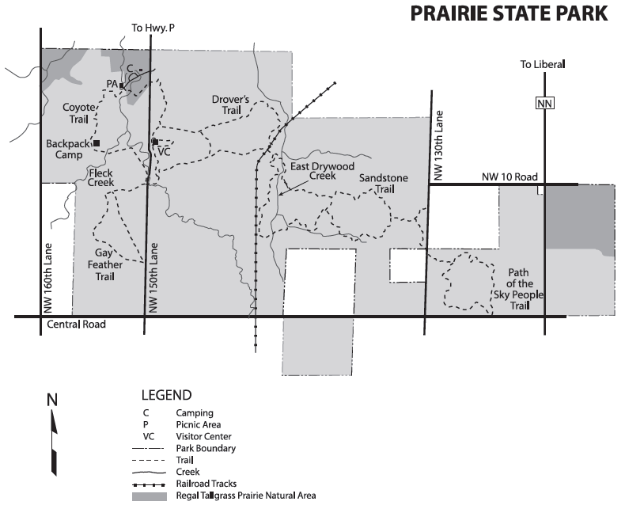

Slide 10
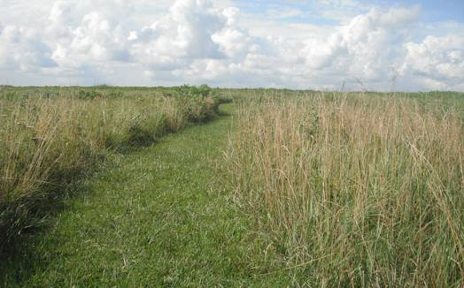

Slide 11
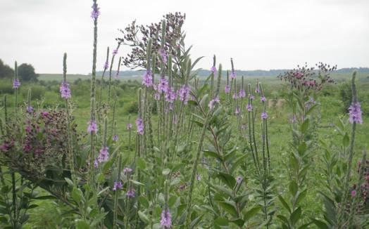

Slide 12
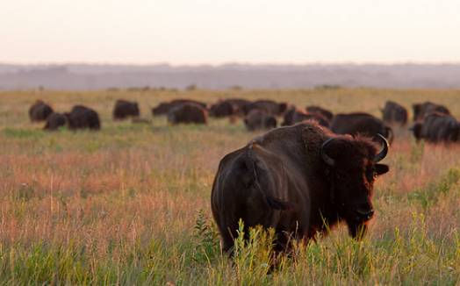

Slide 13
Elephant Rocks State Park
The giant elephant-shaped granite boulders are the star at Elephant Rocks State Park. The coarsely crystalline red granite forms are popular with history buffs (who like to read the names of the 19th century miners who used to work in the area and who carved their names into rocks), children (who love to climb and scramble over and through the rocks) and parents (who revel in taking pictures of their children pretending to push the rocks). The park has a trail that winds through the rocks, which is an interpretative Braille trail. Abundant picnic areas and vibrant fall colors add to the park’s appeal.

Slide 15
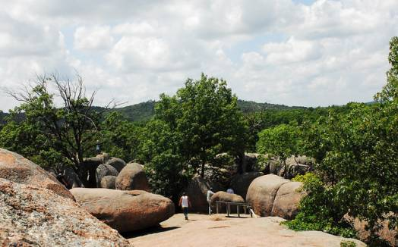

Slide 16
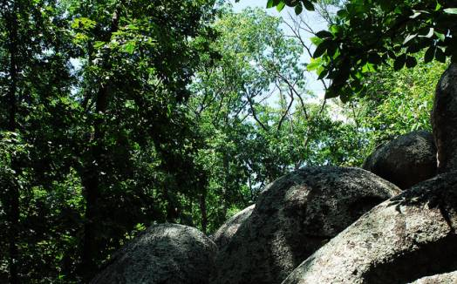

Slide 17
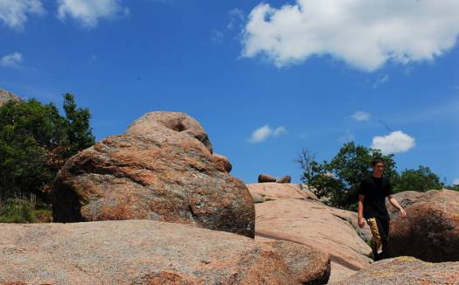

Slide 18
Bennett Springs State Park
The Bennett Spring area was founded by pioneers who used the cool, rushing waters of the spring-fed stream for gristmills. Now, it’s one of America’s premier trout destinations where people come to wrestle with rainbow trout and fish a stream that’s stocked every night. Bennett Spring State Park has fishing, hiking that runs from simple to strenuous, and a lodge with hearty stick-to-your ribs food. The park's proximity to Interstate 44 makes it an easy trip from all parts of Missouri.

Slide 19
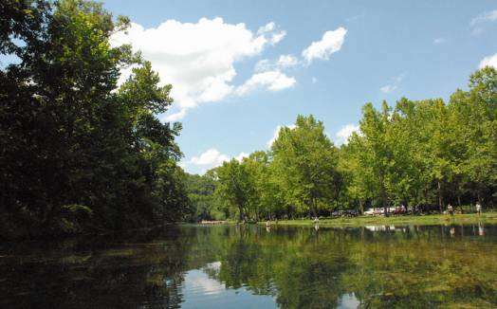

Slide 20
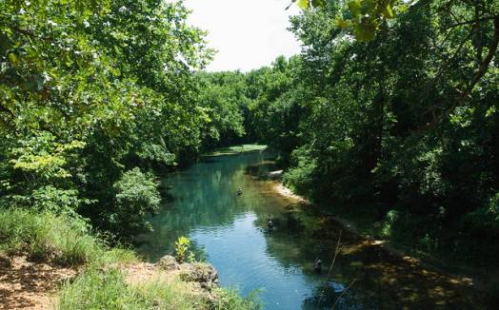

Slide 21
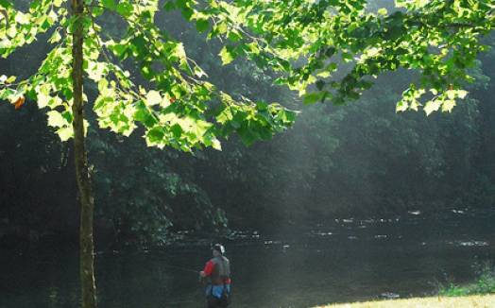

Slide 22
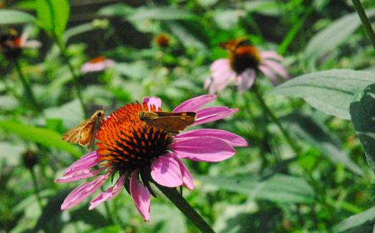

Slide 23
Castlewood State Park
In the early 1900s, the area that’s now Castlewood State Park was a popular retreat for partying St. Louisans. The dance clubs are gone, but the winding Meramec River and the lush valley that surrounds it remain. The park has hiking and mountain biking trails that range from those great for first-time riders to ones that even the most experienced will return to time after time. The park is considered one of the best mountain biking locations in the St. Louis area. Good fishing, broad meadows filled with wildlife, and plenty of recreational facilities make the park a favorite for people who want an adventure or just to get away.

Slide 24
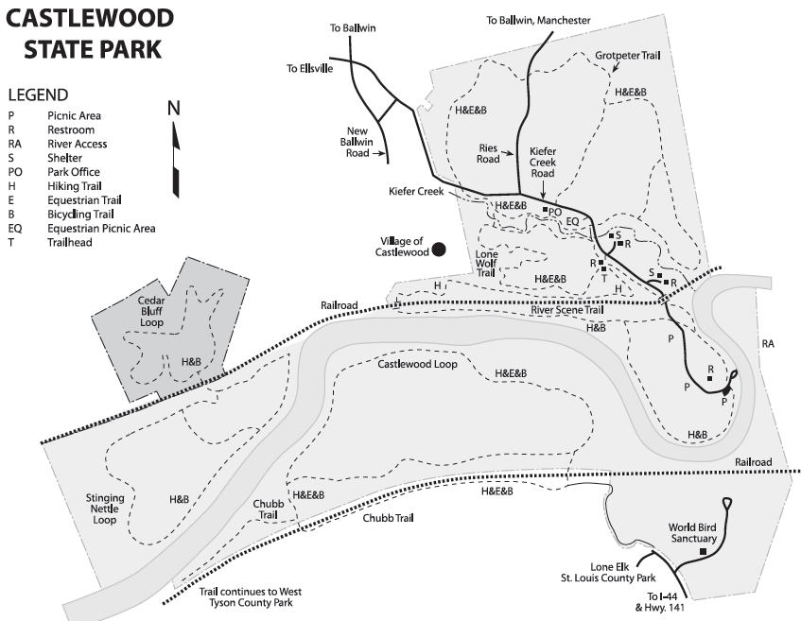

Slide 25
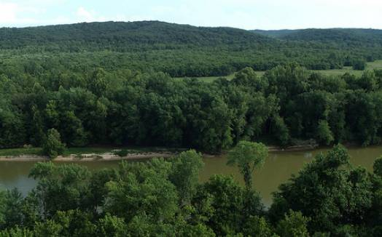

Slide 26
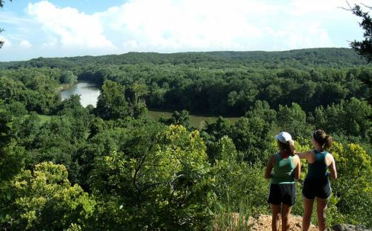

Slide 27
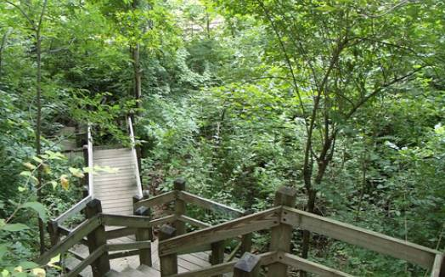

Slide 28
Edward "Ted" and Pat Jones-Confluence Point State Park
Standing at the point where two of the nation’s mightiest rivers merge, Edward “Ted” and Pat Jones- Confluence Point State Park provides a unique perspective on America. Confluence Point is where Western expansion really began and where the Lewis and Clark Expedition set off on their journey up the Missouri. The park’s wetlands are part of the Mississippi River flyway, making it a great place to see waterfowl, including bald eagles and raptors.

Slide 29
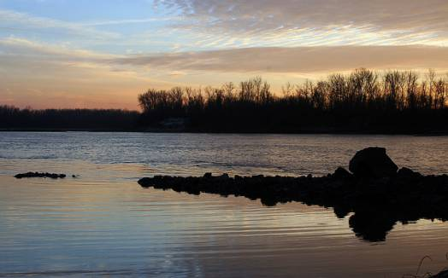

Slide 30
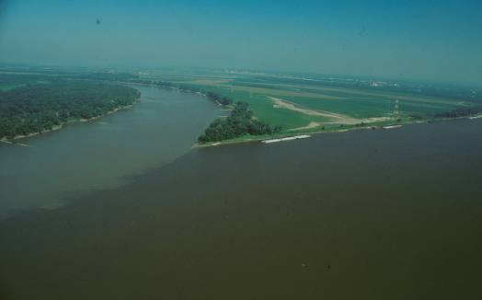

Slide 31
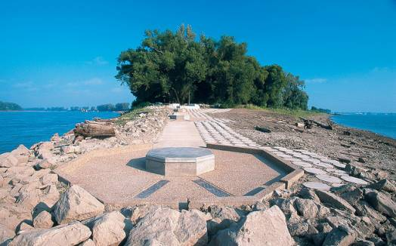

Slide 32
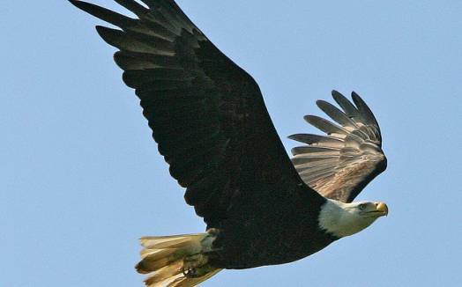

Slide 33
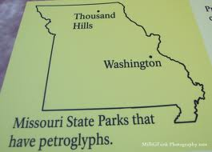
Washington State Park
Petroglyphs, quaint hiking shelters and incredible Ozark overlooks define the Washington State Park experience. Easy access to the Big River makes the park great for swimming or fishing and the park’s three hiking trails address every type of hike, from easy strolls to power hikes. Buildings constructed by African-American Civilian Conservation Corps stonemasons complement the park and add to its sense of history.

Slide 34
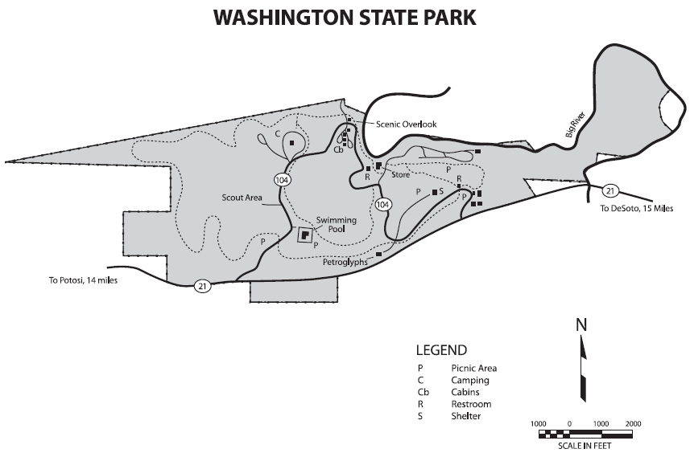

Slide 35
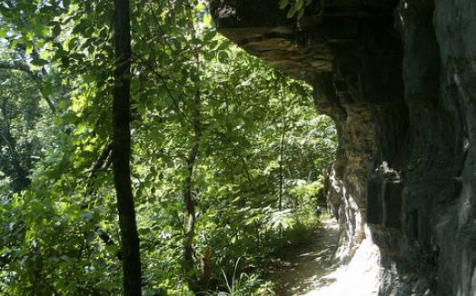

Slide 36
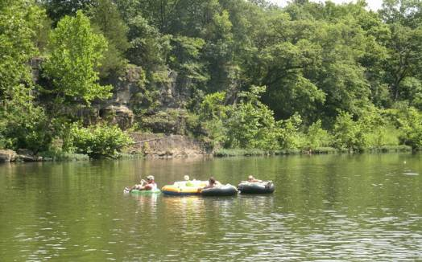

Slide 37
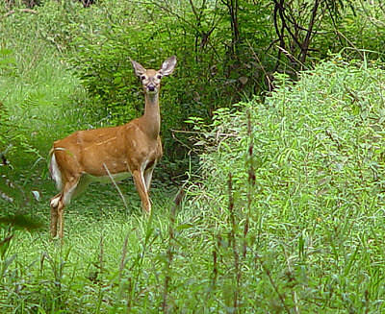

Slide 38
Onondaga Cave State Park
Descend into the depths of Onondaga Cave State Park and drop into a world of wonder: towering stalagmites, dripping stalactites, and active flowstones help make the cave a National Natural Landmark and illustrate why Missouri is often called “The Cave State.” Visitors can take guided tours into the underground wonderland. But if you prefer the surface, the park’s Vilander Bluff Natural Area provides a panoramic view of the Meramec River. Easy access to the Meramec River allows visitors to canoe or fish in a bucolic setting.

Slide 39
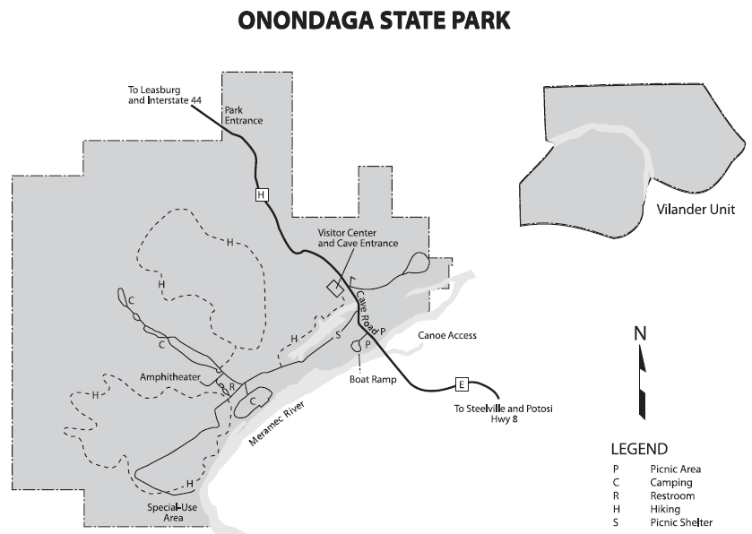

Slide 40
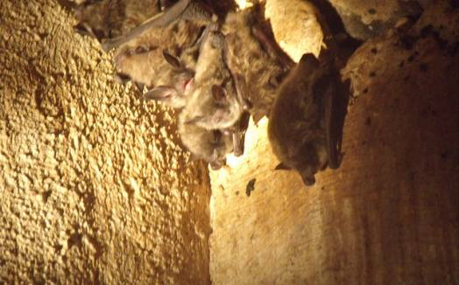

Slide 41
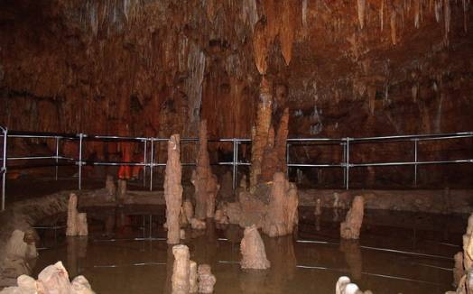

Slide 42
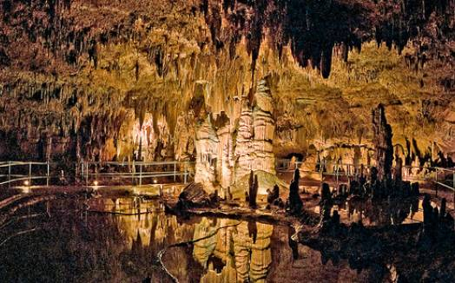

Slide 43
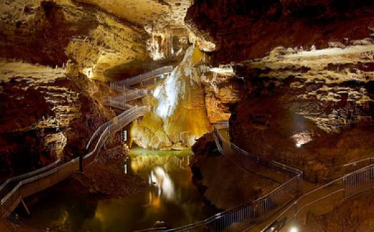

Slide 44
Johnson's Shut-Ins State Park
Play in the shallows of the East Fork of the Black River. Shoot through Mother Nature’s hydraulics in the shut-ins. Hike a trail that will show you 1.4 billion years of geologic history. Take your horse on a pretty mountain trail. Johnson’s Shut-Ins State Park is a jewel of the system, a place with something for everyone: pretty picnic areas, Ozark landscapes, natural places to swim, great campsites.

Slide 45
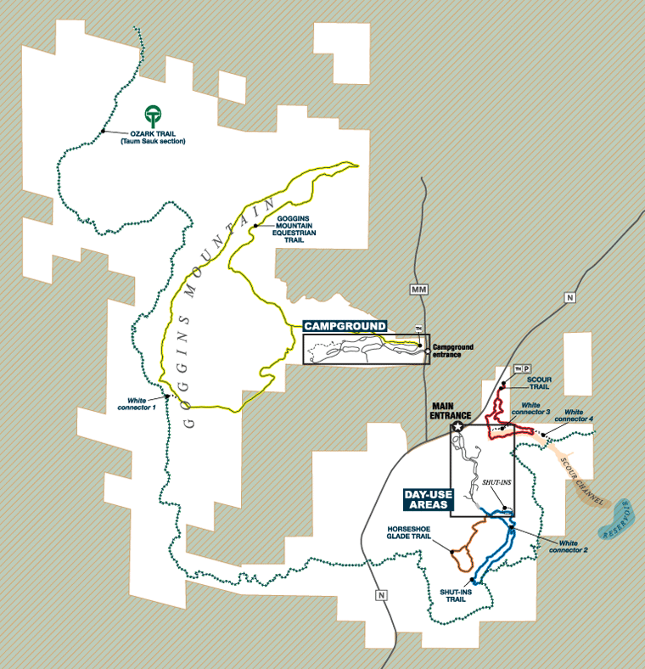

Slide 46
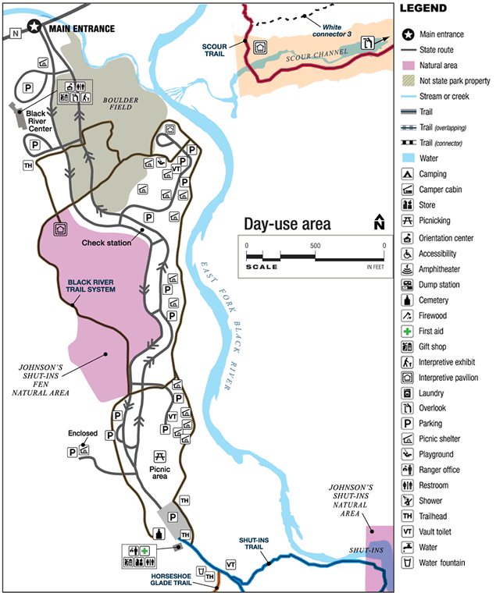

Slide 47
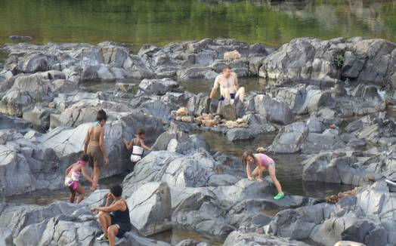

Slide 48
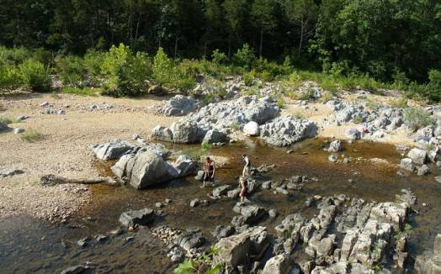

Slide 49
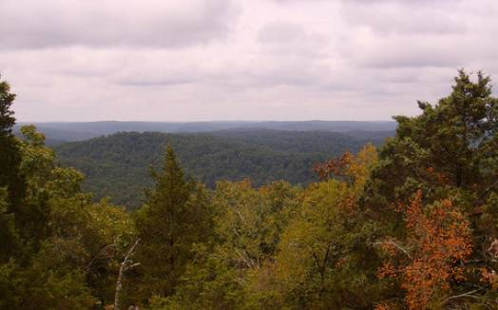

Slide 50
Wakonda State Park
The clear water of Wakonda State Park's six lakes attract thousands of migratory waterfowl each year, making the park a bird lover’s paradise. The lakes also offer anglers a chance to catch largemouth bass, bluegill, crappie and catfish. Two of the lakes have boat ramps, making it even easier to get into the water. A swimming beach provides a great place to cool off, and campsites make the park a perfect place to stay for awhile.

Slide 51
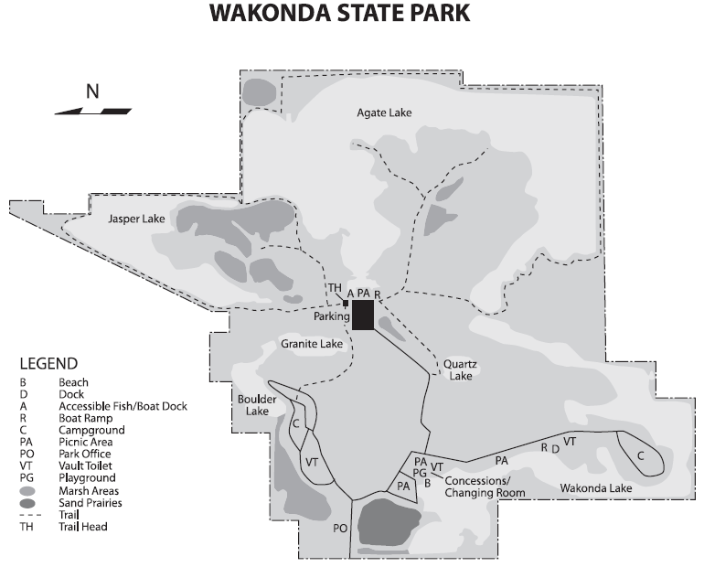

Slide 52
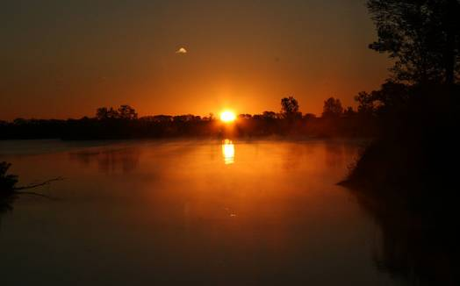

Slide 53
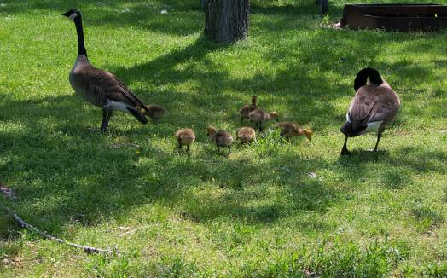

Slide 54
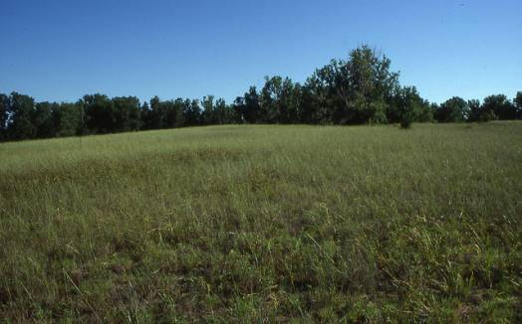

Slide 55
Van Meter State Park
Van Meter State Park features remnants of the Missouria Indian village that sat at the Great Bend of the Missouri River, marked on a map by Jacques Marquette and Louis Jolliet in 1673. A hand-dug earthwork -- Old Fort -- and several burial mounds lie within the park’s boundaries. The state’s Indian history is interpreted in displays and exhibits at the park’s Missouri’s American Indian Cultural Center. For outdoor enthusiasts, the park features hiking trails and an 18-acre fishing lake. The boardwalk that leads visitors through the Oumessourit Natural Area takes them over a freshwater marsh and fens, and through bottomland and upland forests. The park’s lofty trees shade picnic sites, picnic shelters and a campground.

Slide 56
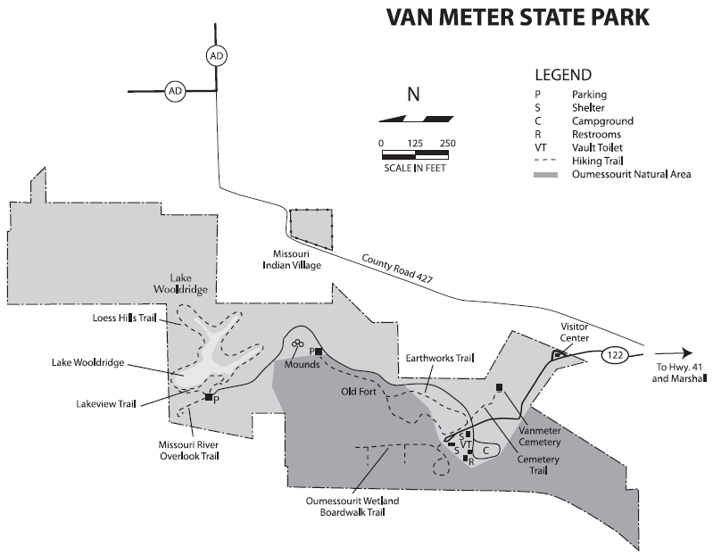

Slide 57
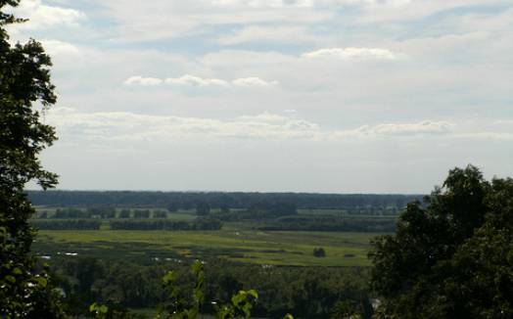

Slide 58
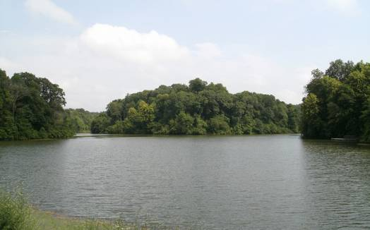

Slide 59
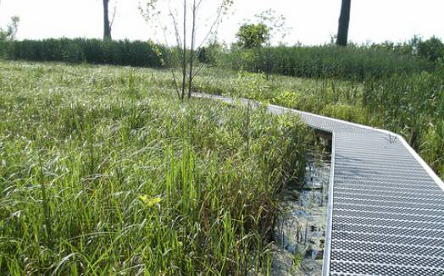

Slide 60
Rock Bridge Memorial State Park
Just minutes from Columbia, Rock Bridge Memorial State Park gives visitors the chance to scramble, hike and bicycle through a scenic environment – and lets them peek into Missouri’s underworld. The park contains some of the most popular hiking trails in the state and also offers solitude while hiking in the Gans Creek Wild Area. Visitors can also see a large cave system with its rock bridge, sinkholes, a spring and underground stream at the Devil's Icebox. You can explore Connor's Cave in the light of the opening for a taste of the underground world.

Slide 61
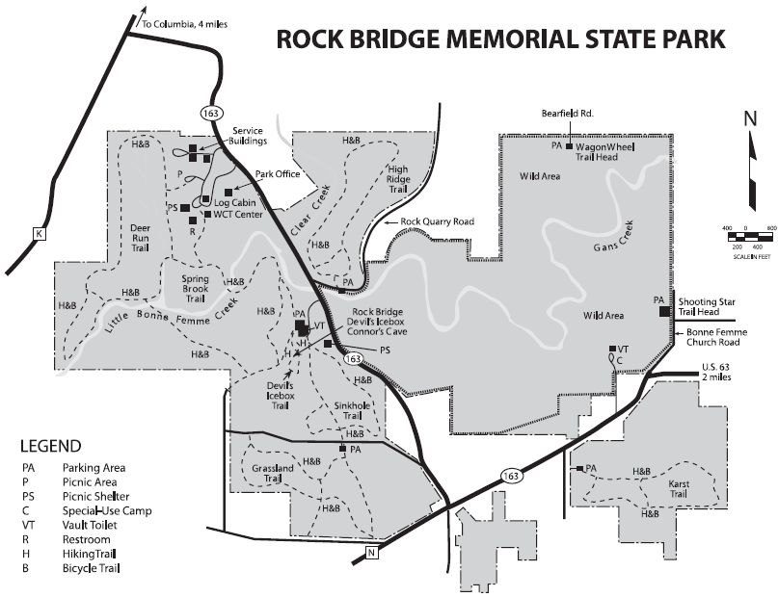

Slide 62
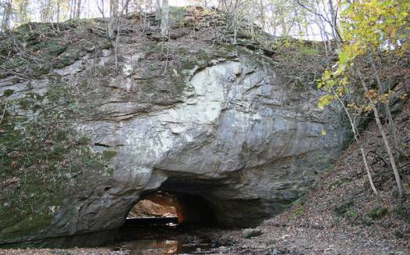

Slide 63
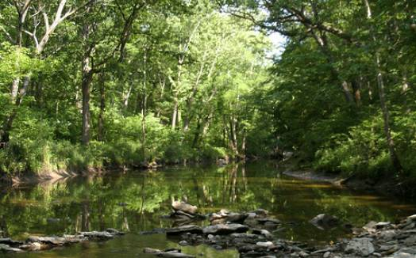

Slide 64


Slide 65


Slide 66
Roaring River State Park
Fight trophy trout in one of the most breathtaking settings imaginable at Roaring River State Park. The park contains one of the premier trout fisheries in the nation, stocked each night. The natural setting – towering hills above a deep blue spring -- provides a scenic backdrop to adventures. Seven trails cut through the parks rugged terrain, and lodging options from campsites to cabins make Roaring River a place to experience a unique slice of Missouri.

Slide 67


Slide 68


Slide 69


Slide 70
Grand Gulf State Park
Some people call Grand Gulf State Park the “Little Grand Canyon.” Some just call it “breathtaking.” The park is one of the natural wonders of the Ozarks, presenting the most spectacular collapsed cave system in the Ozarks. The "Grand Gulf" stretches for more than a mile between 130 foot high walls. Visitors can view the gulf from trails on top or from the floor where they can walk under the natural bridge, which spans 250 feet with a 75-foot high opening. There is no official trail leading to the bottom so visitors should use extreme caution when attempting to access the bottom. Interpretive trails detail the formation of the gulf.

Slide 71


Slide 72


Slide 73


Slide 74


