Slide 1
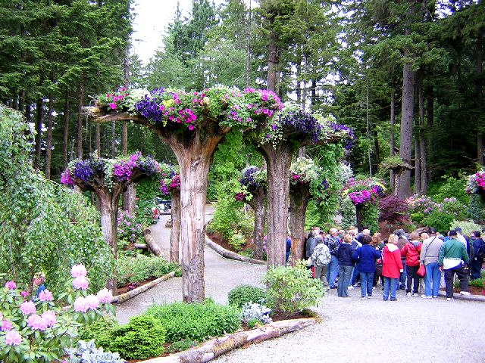
The Upside Forest of Mendenhall Gardens.

Slide 2
Background
While Alaska's glaciers may have world wide renown, the Mendenhall Valley contains its own marvel lovingly crafted by Glacier Garden Rainforest Adventure owners Steve and Cindy Bowhay.
Dotted throughout the garden, upside down trees, known as the 'Flower Towers', have had their tops buried in the ground and their roots thrust up in the air, forming a basket that cradles brilliantly bright trailing flowers. Netting and mosses form a bed in the center of the root ball for flowers such as begonias, fuchsias, and petunias to bloom and delicately hang down from the tree.

Slide 3
The Mendenhall Glacier is one of the world's few drive-up glaciers. In 1984, heavy rain and snow deposits caused a landslide that demolished much of the face of Thunder Mountain, uprooting nearly everything and destroying one of the main streams. The land was left destroyed and bare until 1985 when Steve and Cindy Bowhay purchased some six and a half acres, beginning a reclamation process that would end up with them acquiring an additional 44.5 acres of the area, much of it part of the Tongass National Rainforest.
Steve, a landscaper by trade, wanted to use the stream's water for a hydro-electricity plant to power new greenhouses; settling ponds were designed throughout in order to slow the rate of water-erosion and provide a series of waterfalls on the Gardens property. Their plan for the rest of the land was to create a guided tour for visitors to enjoy both the beautiful landscape as well as the natural panoramic view of Juneau that the Thunder Mountain rock face cliff provides.

Slide 4
During the process of rebuilding the stream, stories have it that Steve accidentally damaged the moving equipment and, in a fit of frustration, used the machine to pick up a large fallen tree stump and slam it upside down into the soft mud. The image of roots hanging down like petunia vines apparently gave him the inspiration to repeat his action, inverting over 20 other dead Spruce and Hemlock trees in order to plant 75-100 flowers in the 'root bowls' each year.
Other flowers that flourish in the garden include Rhododendrons, Azaleas, Japanese Maples, Devil's Club, Elderberry shrubs, Sitka Spruce, and Western Hemlock. The gardens are open from May through September, offering tours aboard their covered carts to cruise ship passengers and landlubbers alike.

Slide 5
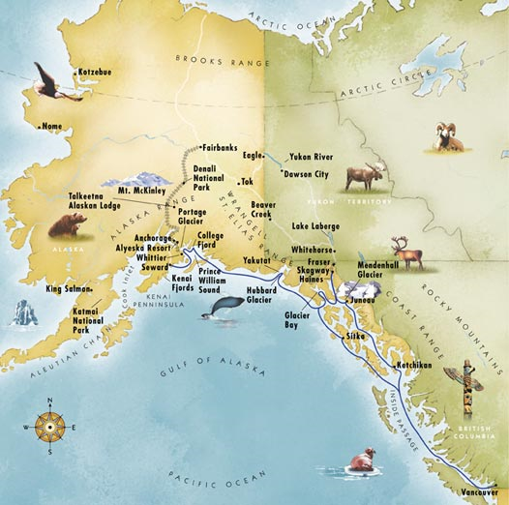

Slide 6
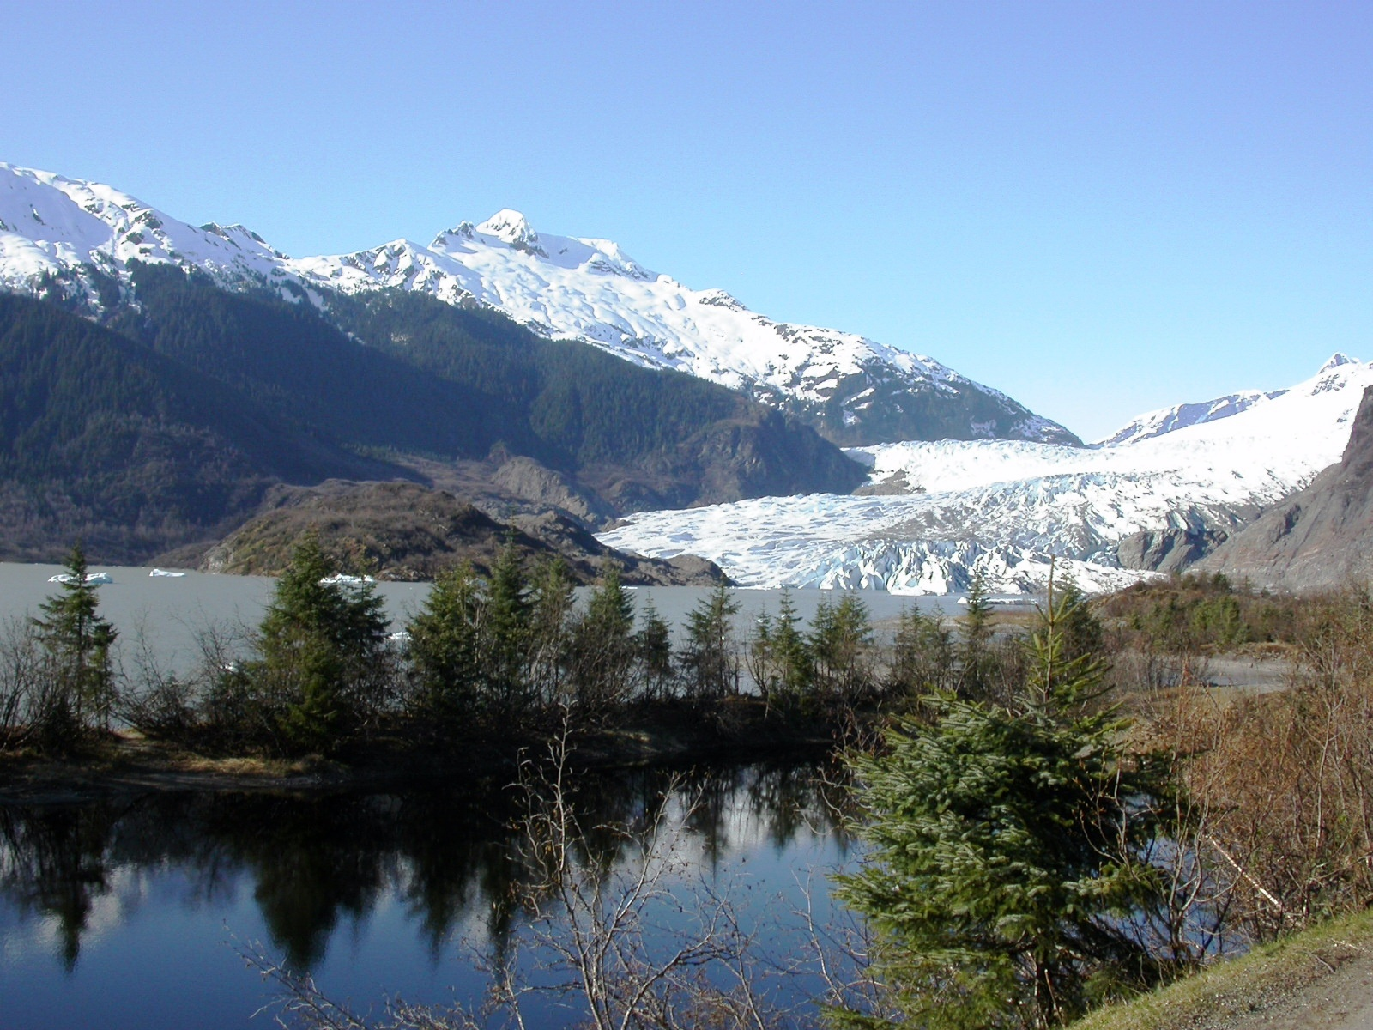
Mendenhall Glacier

Slide 7
Mendenhall Gardens

Slide 8
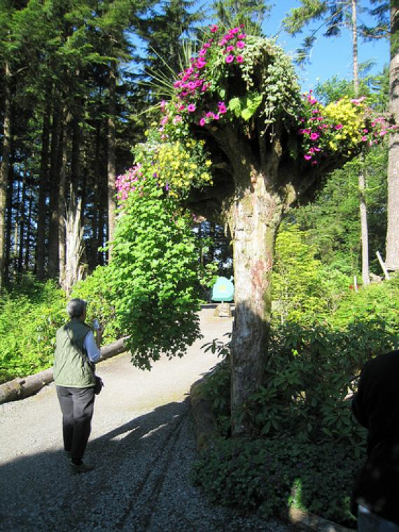

Slide 9
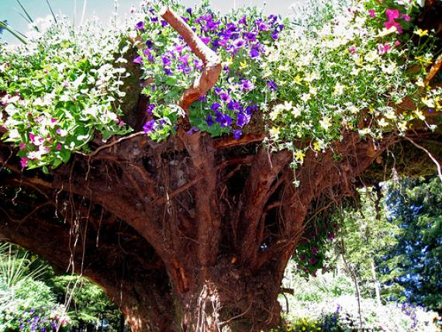

Slide 10
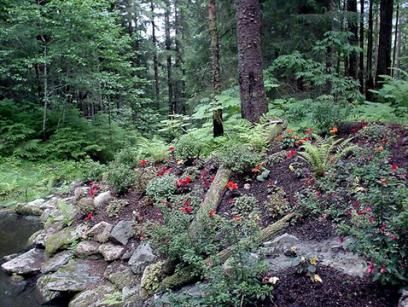

Slide 11
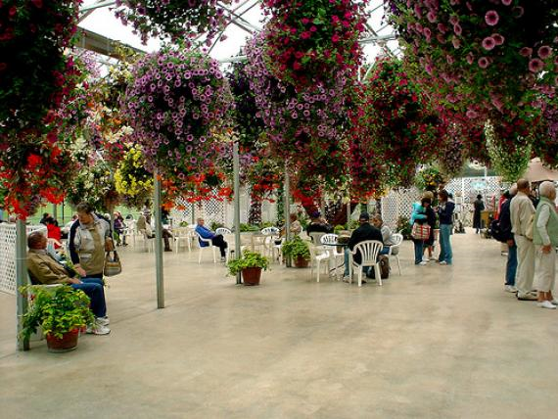

Slide 12
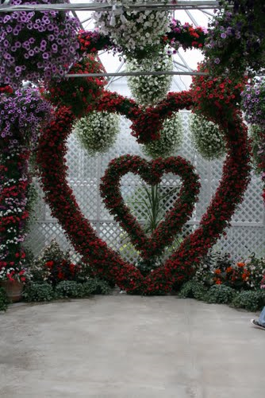

Slide 13
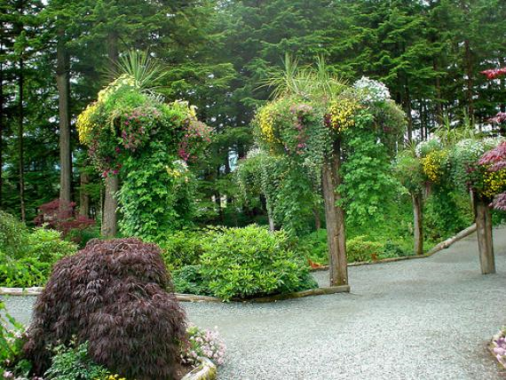

Slide 14
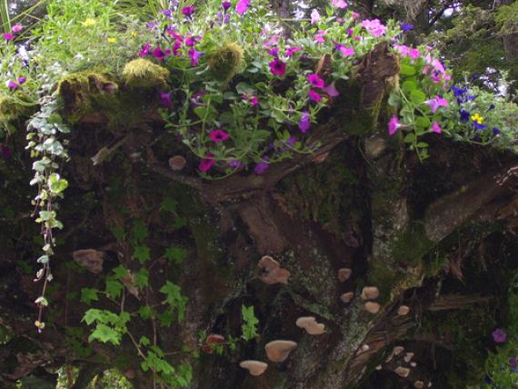

Slide 15
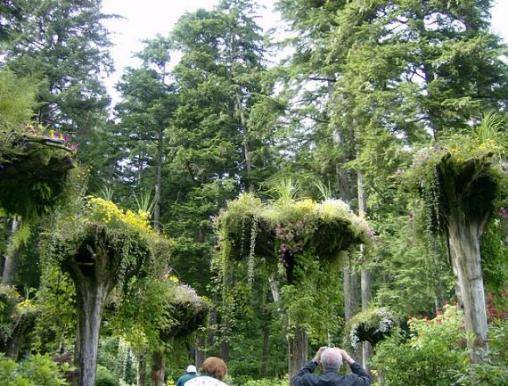

Slide 16
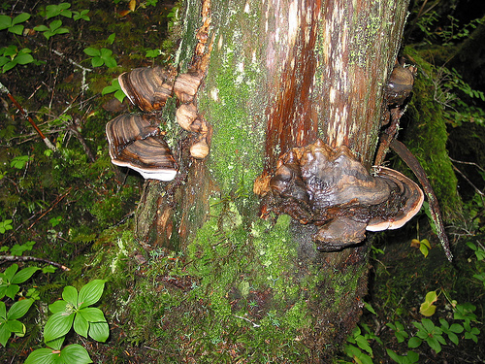

Slide 17
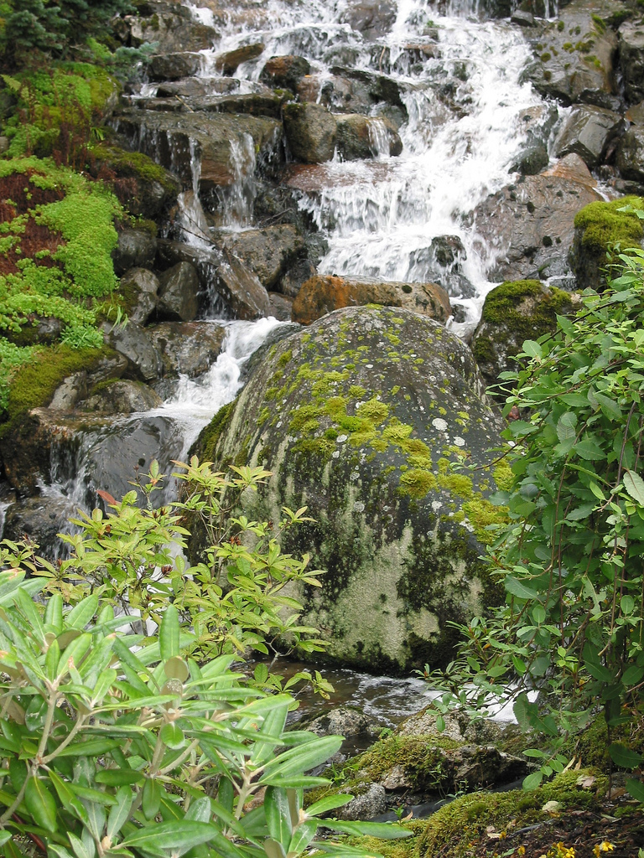

Slide 18
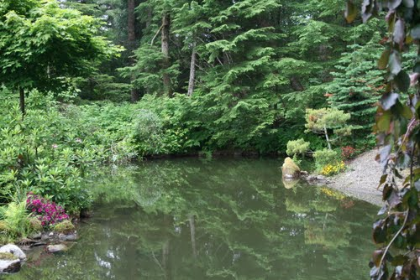

Slide 19
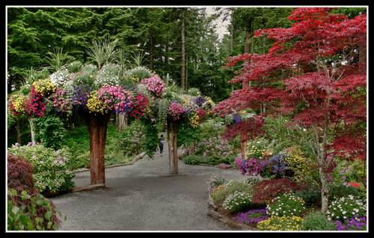

Slide 20
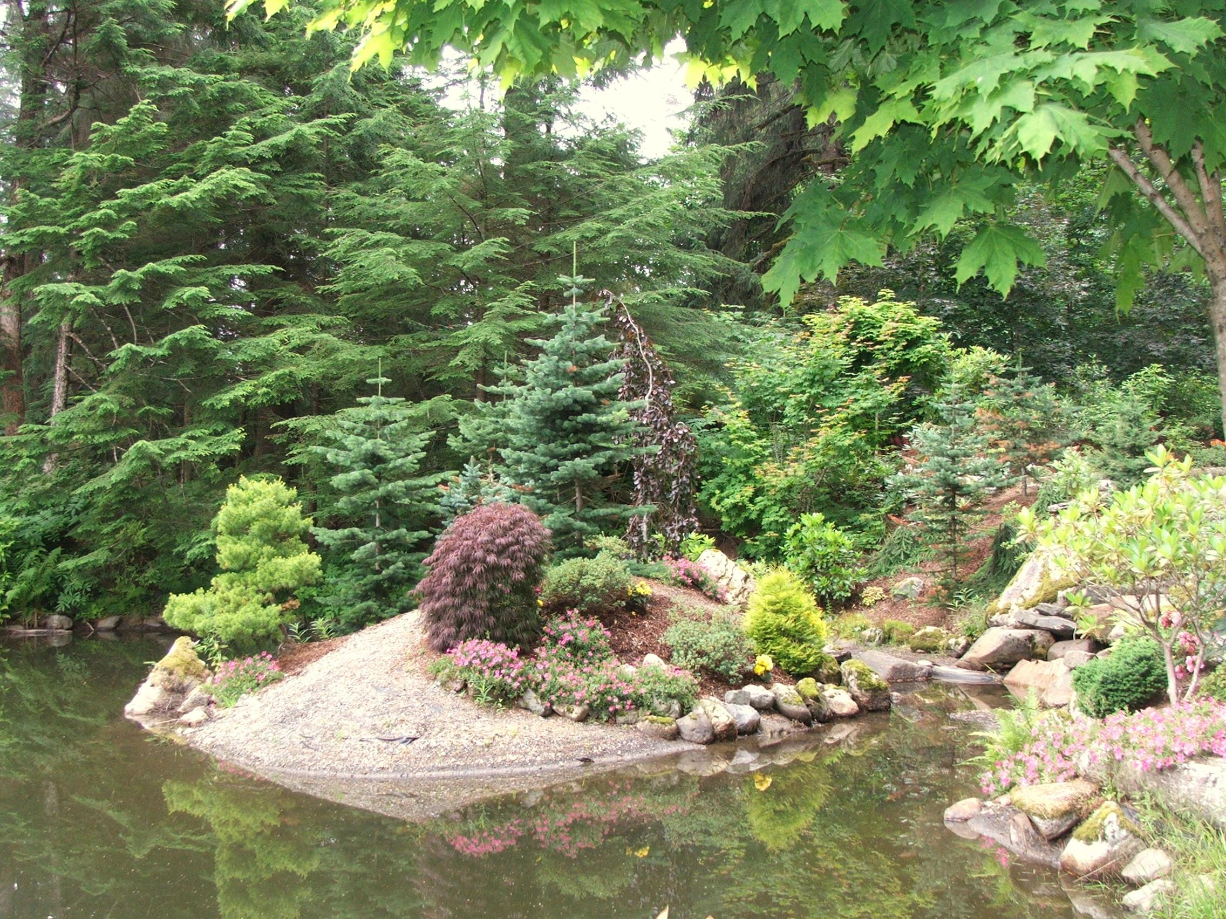

Slide 21
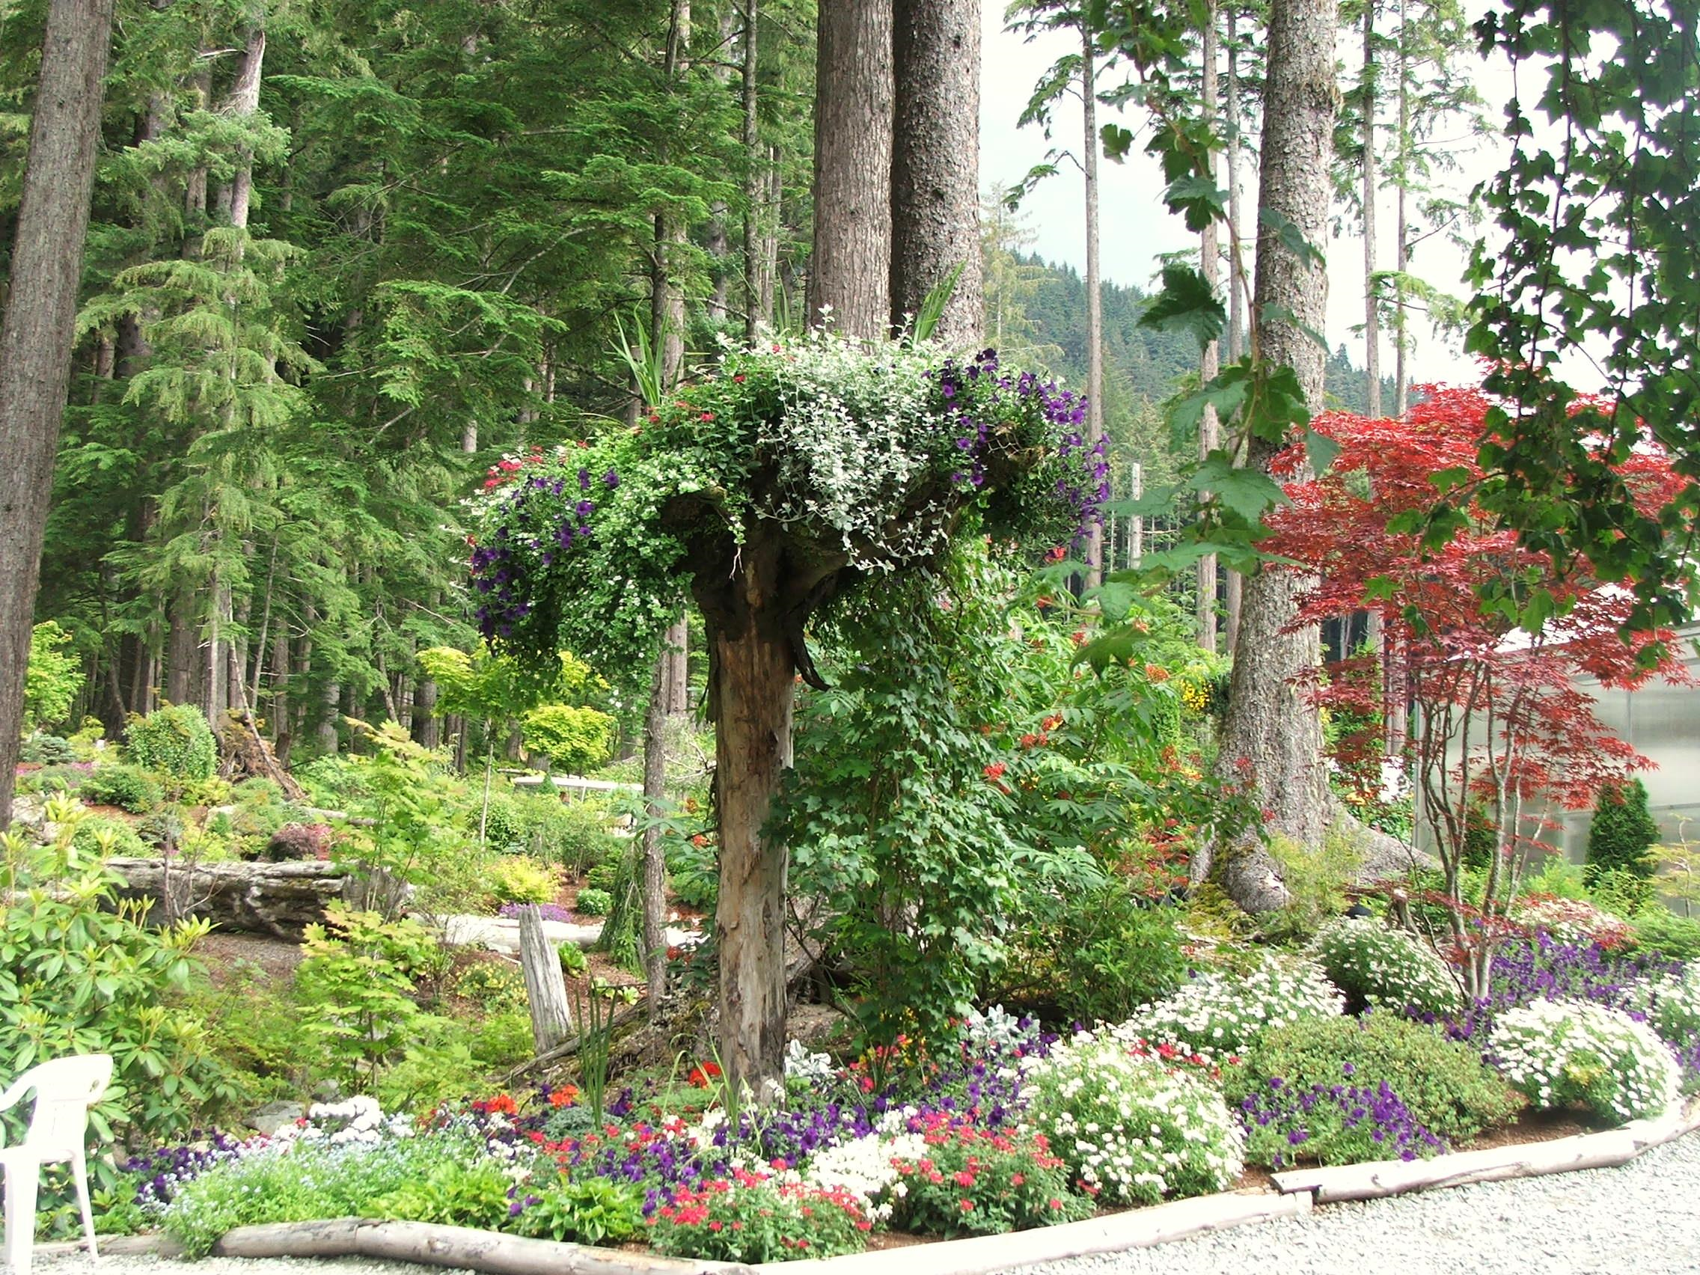

Slide 22
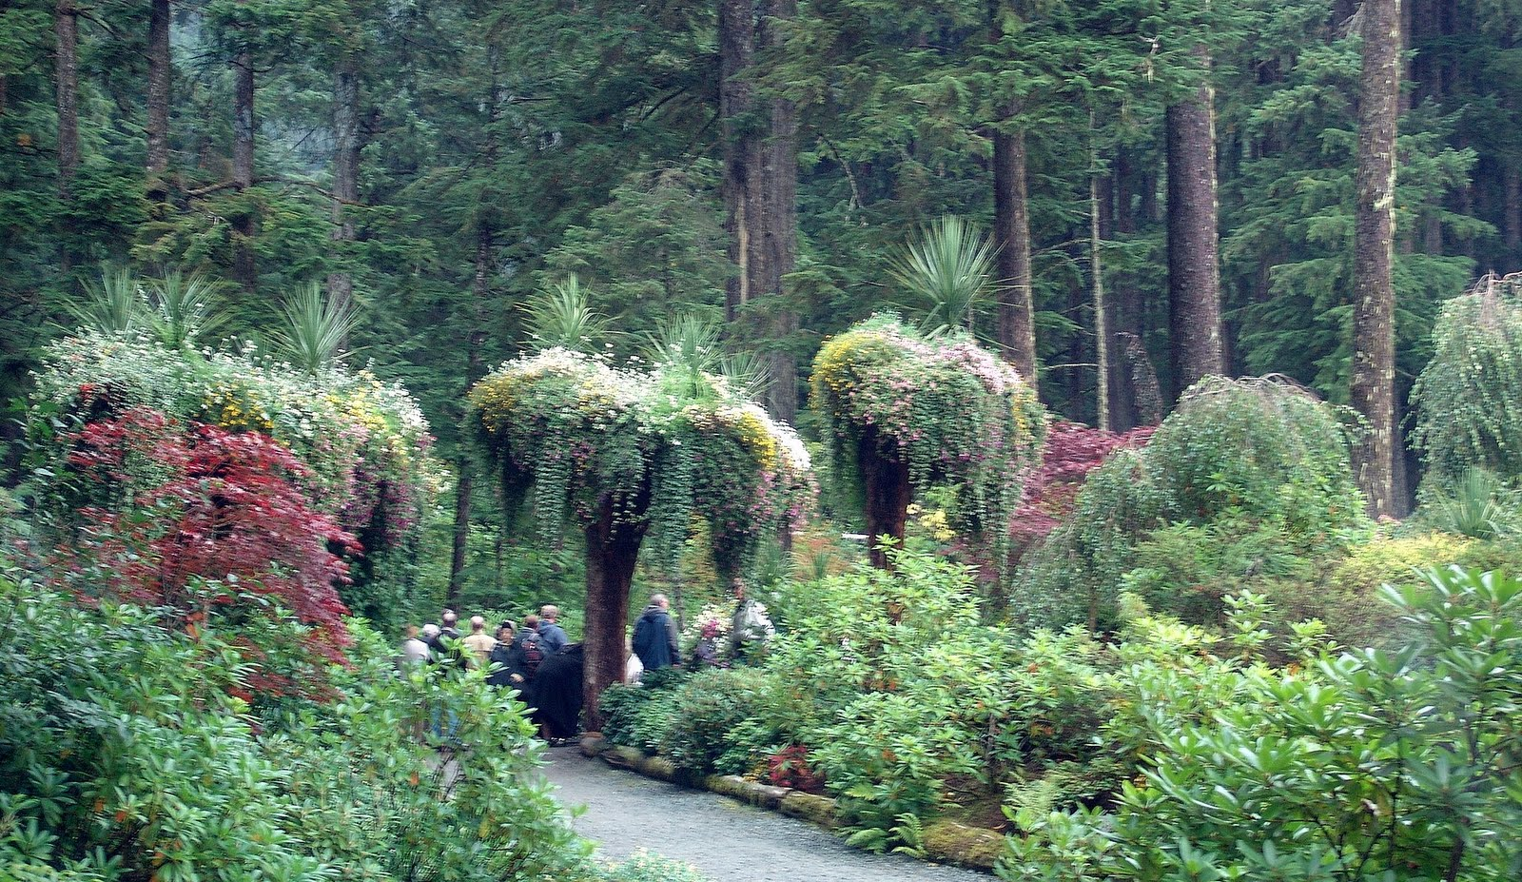

Slide 23
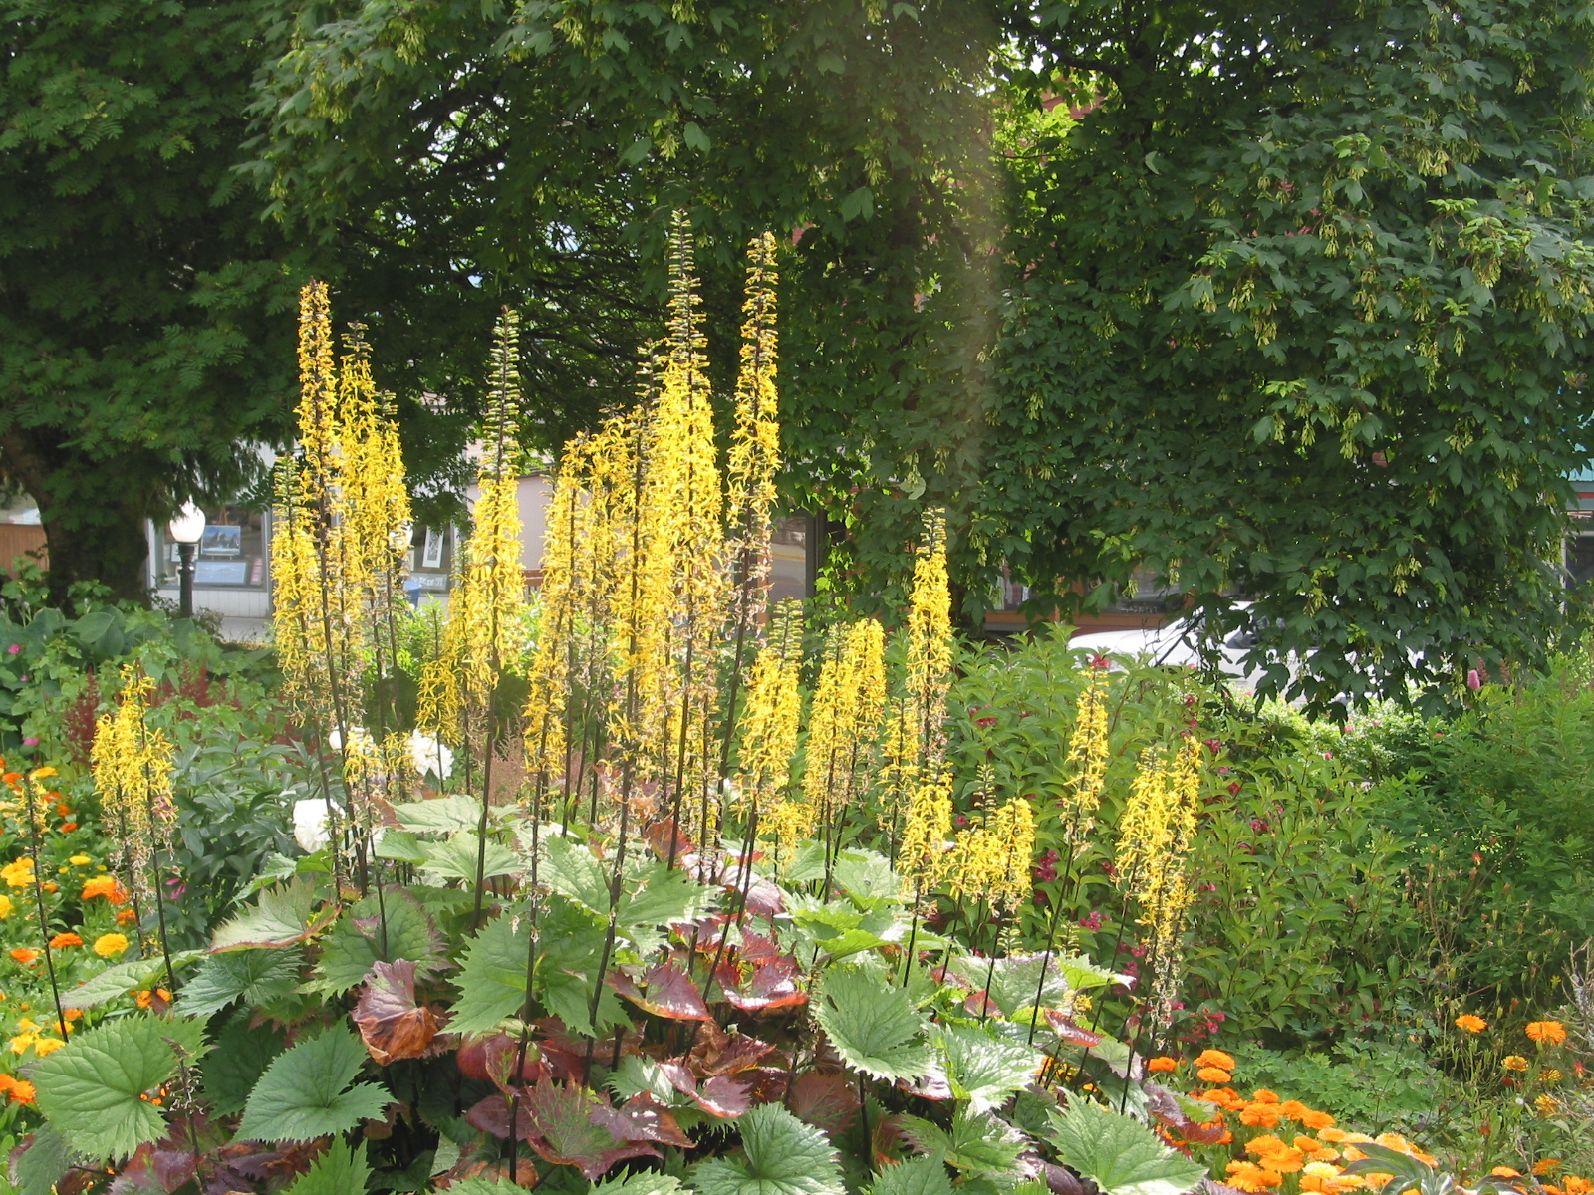

Slide 24
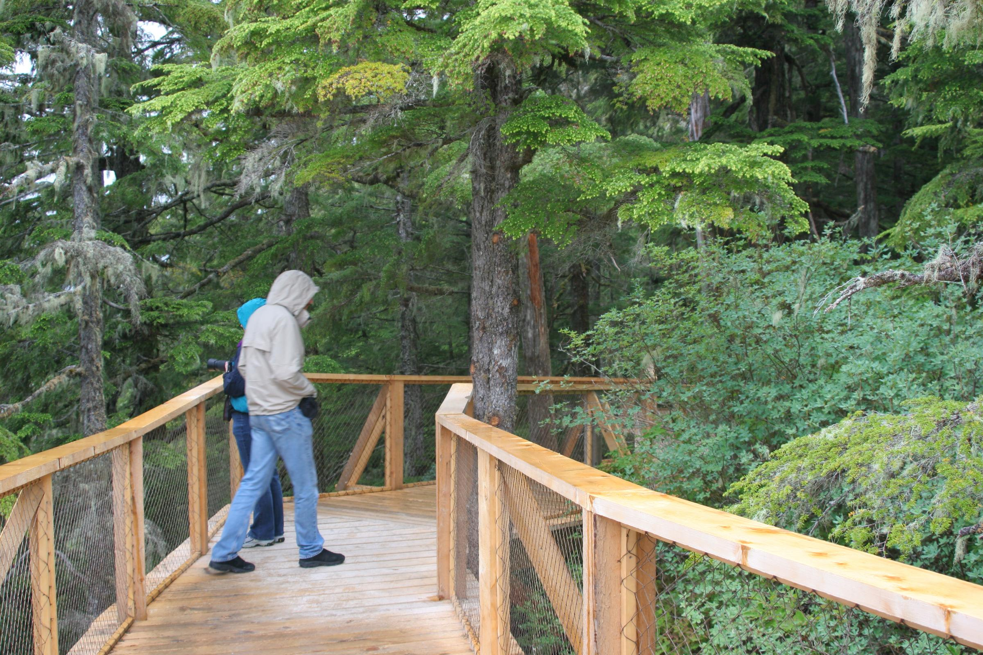

Slide 25
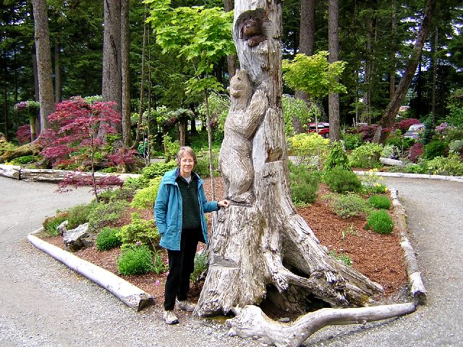

Slide 26
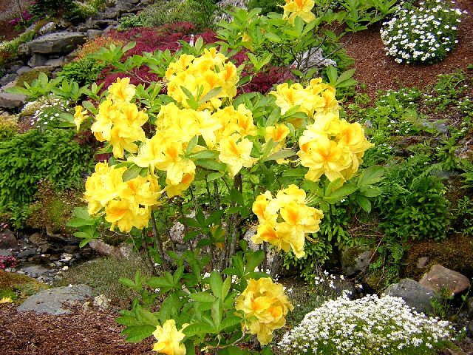

Slide 27
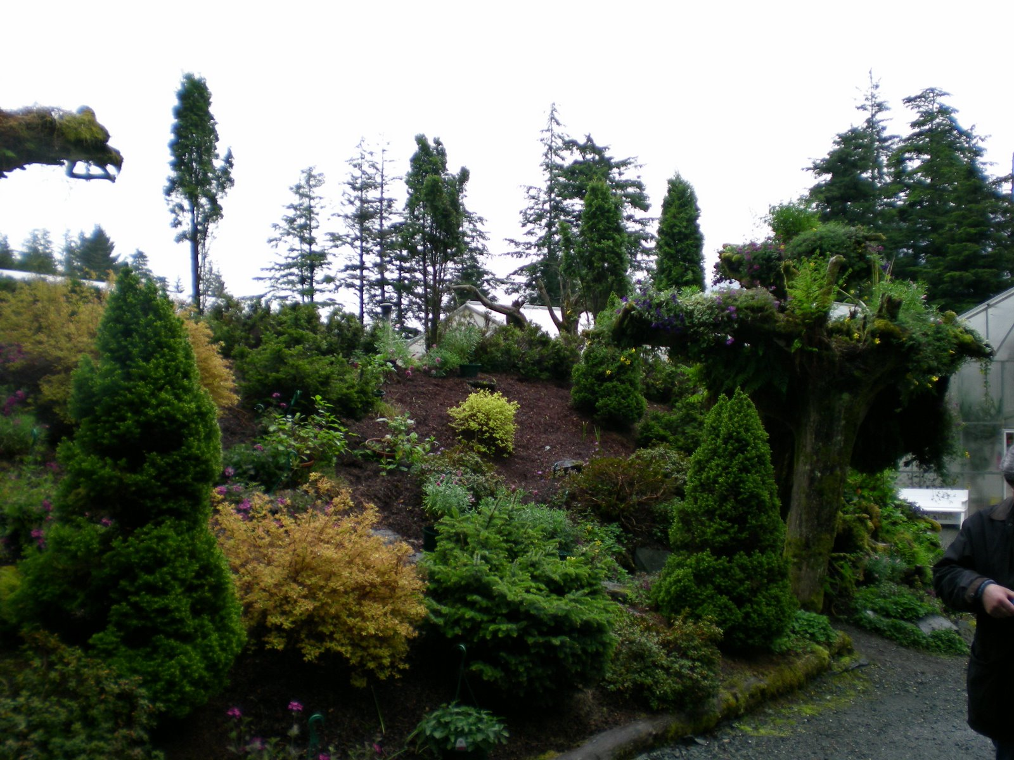

Slide 28
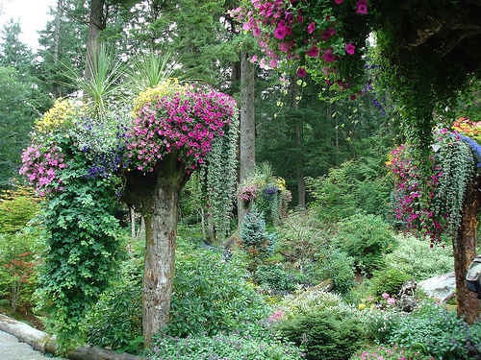

Slide 29
