Slide 1
USA – Views of America
A Visual Overview

Slide 2
Greatest Variety
Regarding; climate, landforms, and agriculture; the United States has the greatest variety of any country in the world.
The only country in the world to contain all of the Koppen climate types so that any kind of plant in the world can be grown somewhere in the U.S.A.
It’s difficult to think of any landform type that isn’t found somewhere in the U.S.A.

Slide 3
Gulf-Atlantic coast & piedmont

Slide 4
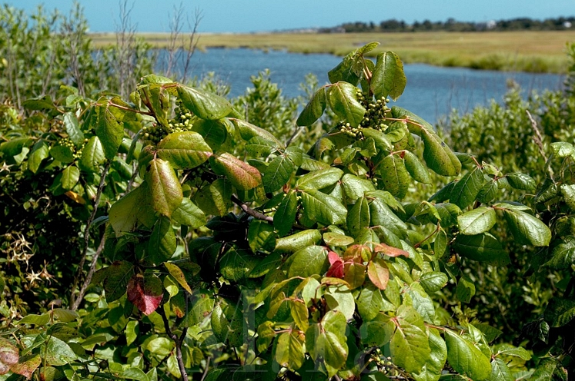
Poison Oak, Nantucket Island Coast

Slide 5
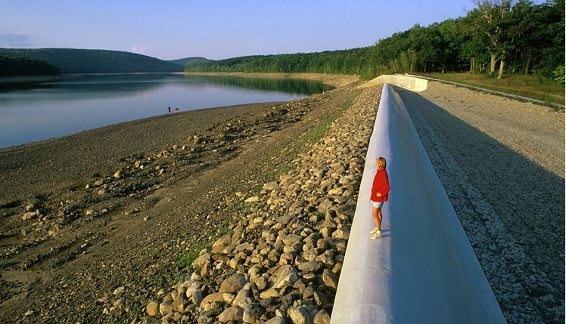
Woman standing on dry spillway at Oak Ridge Reservoir in New Jersey under drought conditions in the summer of 1999. Water level in reservoir is extremely low. Oak Ridge New Jersey USA.

Slide 6
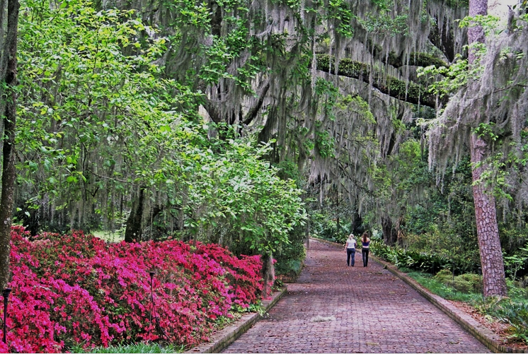
Azalea flowering women walking in oak trees at Alfred Maclay Gardens State Park Tallahassee Florida

Slide 7
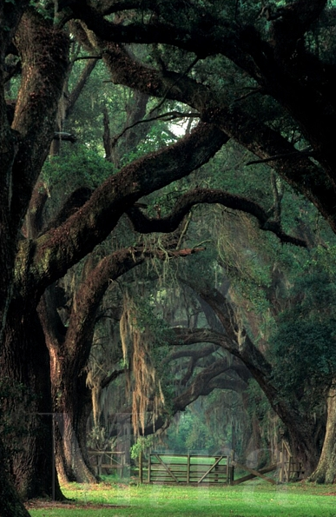
Live Oak trees with Spanish Moss in Louisiana

Slide 8
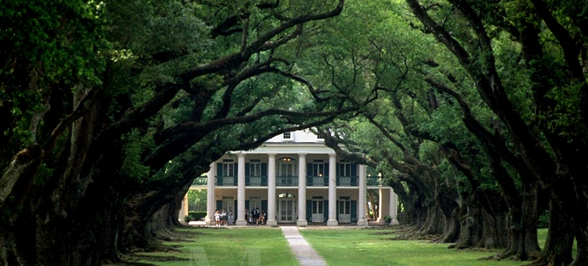
Exterior view of Oak Alley plantation house framed at the end of a tree-lined boulevard. Vacherie, Louisiana.

Slide 9
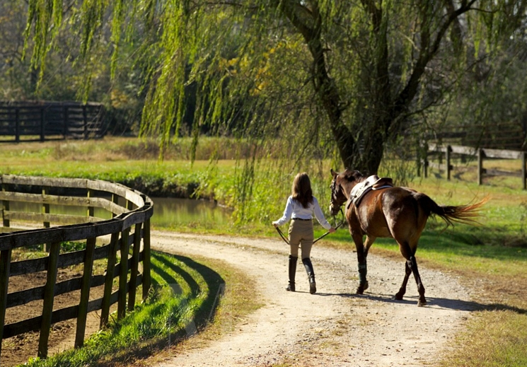
Young woman walks with horse under massive live oak tree.

Slide 10
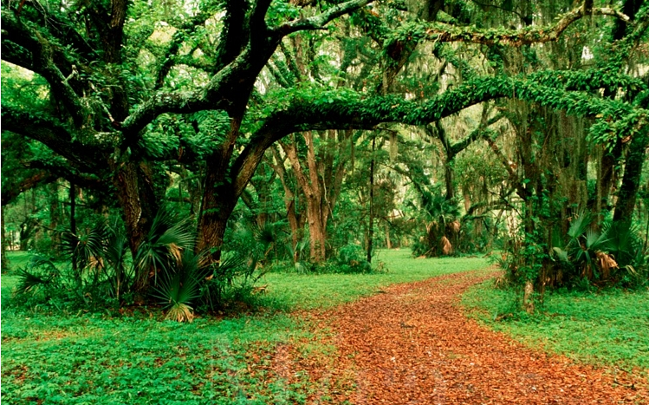
Live Oak forest. Spring Island, South Carolina.

Slide 11
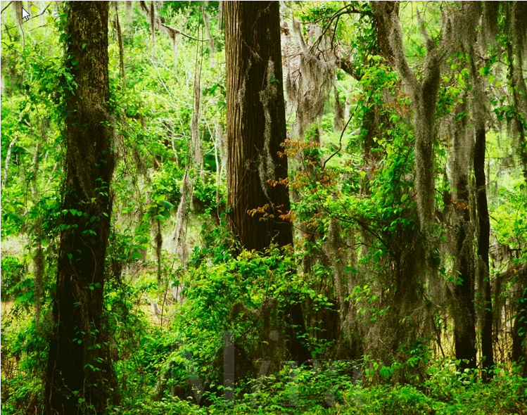
Bald cypress and oak trees with Spanish moss along Clark Lake Delta National Forest Mississippi

Slide 12

Picturesque garden scene at night in the Oaks city park, with lighted water fountain and decorative lights on the shrubbery. New Orleans, Louisiana.

Slide 13
Appalachian Mountains

Slide 14
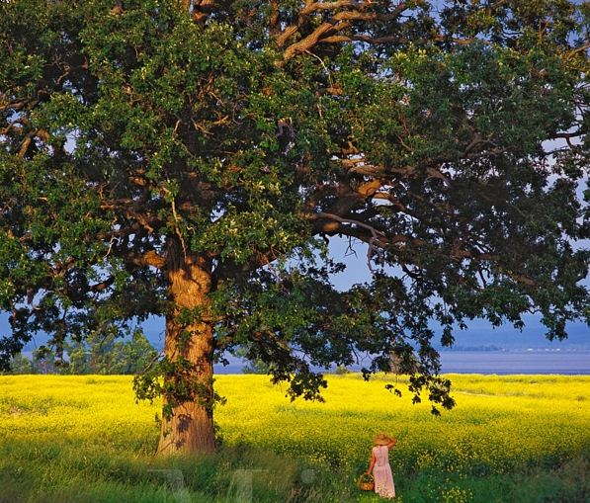
North Hero, Vermont. In the Lake Champlain Islands in Vermont.

Slide 15
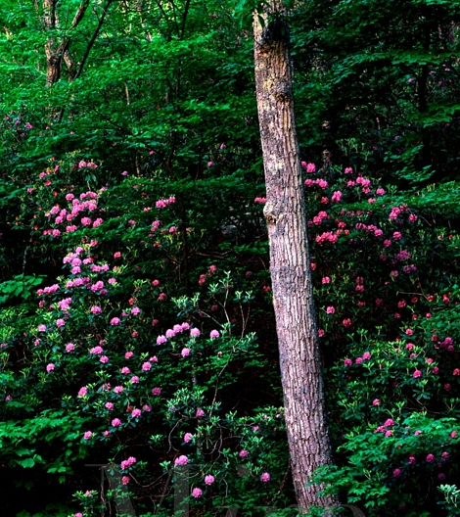
Mountain laurel and chestnut oak on North Mountain George Washington National Forest Virginia

Slide 16
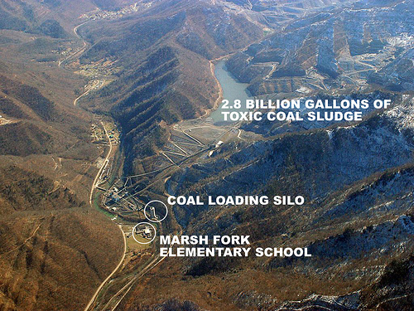
West Virginia Coal Mine

Slide 17
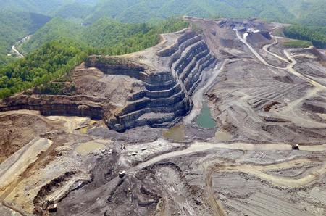
Mountain top removal coal mine in West Virginia

Slide 18
Central Interior Plains

Slide 19
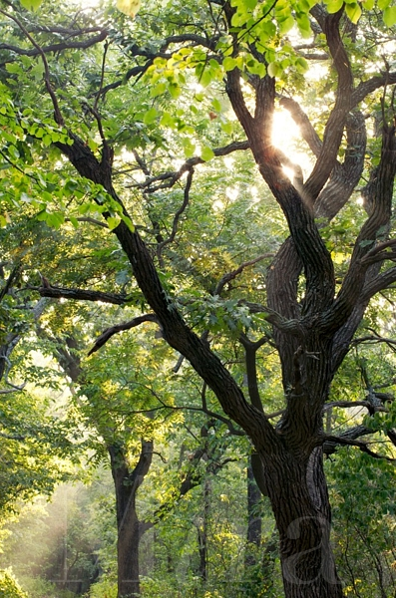
Oak tree and sun, Waubonsie State Park, Fremont County, Iowa

Slide 20
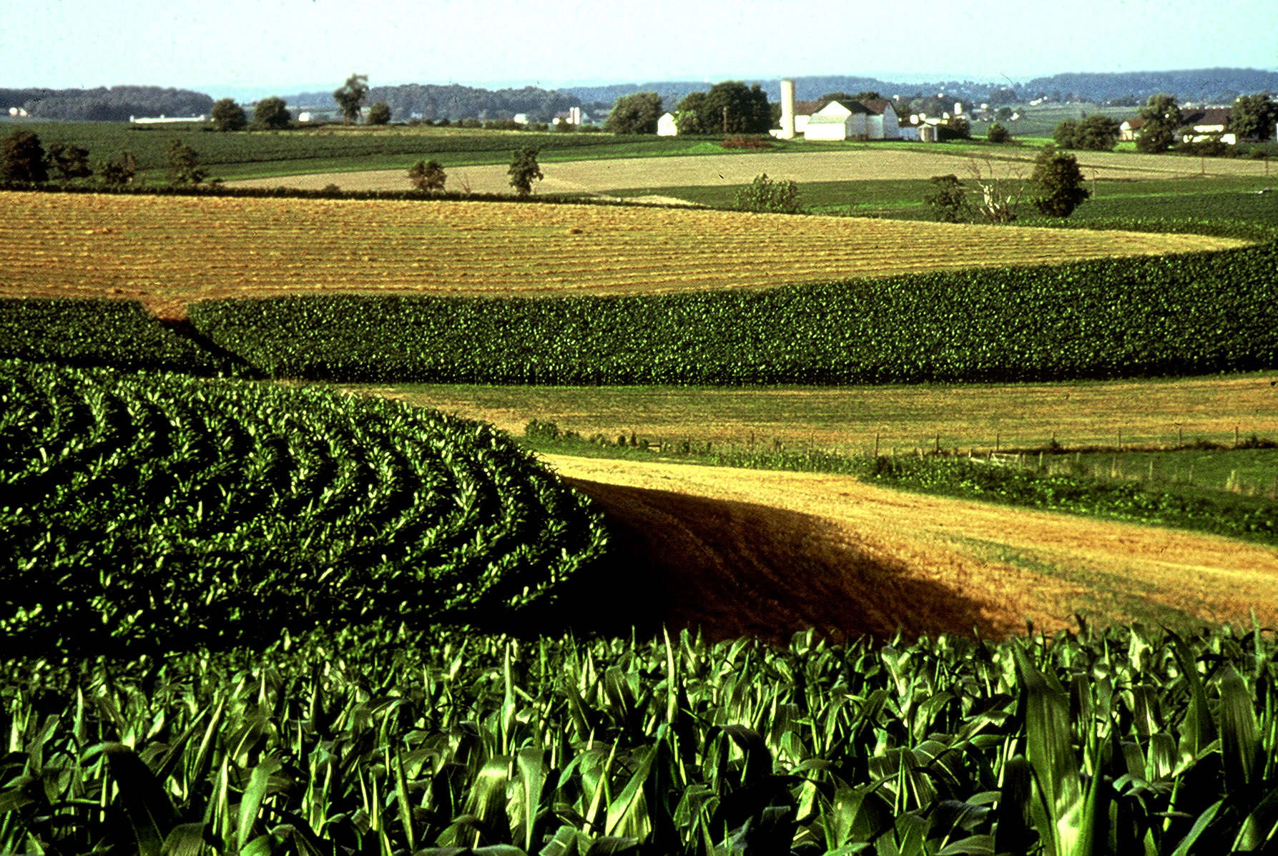
Iowa corn fields

Slide 21

Springfield, IL, Abraham Lincoln, Illinois, The Lincoln Tomb at Oak Ridge Cemetery in Springfield.

Slide 22
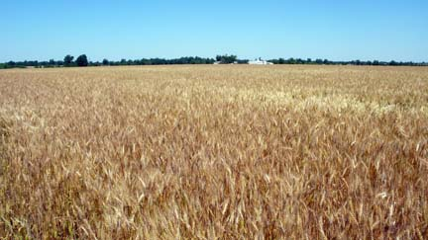
Missouri winter wheat

Slide 23
Ozark Highlands

Slide 24
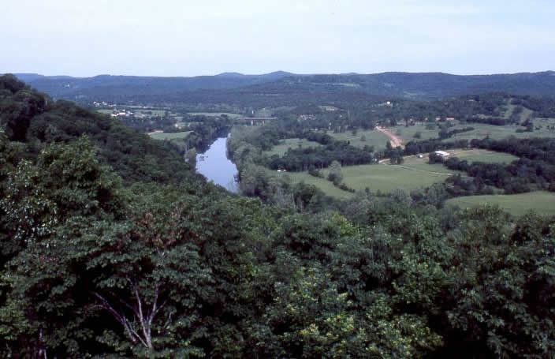

Slide 25
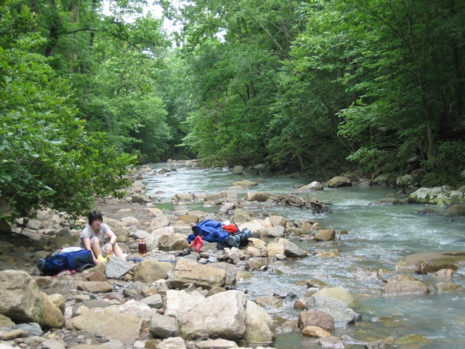

Slide 26
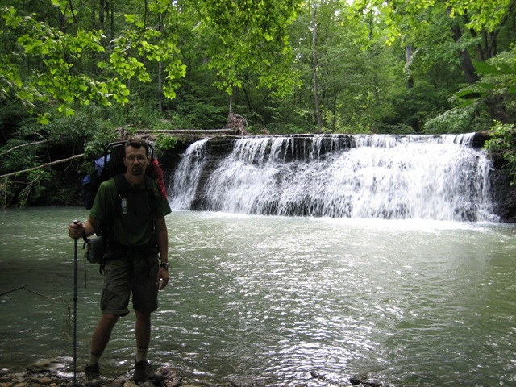

Slide 27
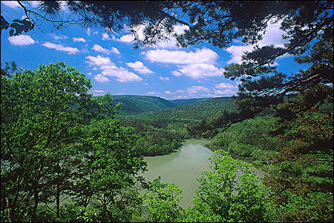

Slide 28
Great plains

Slide 29
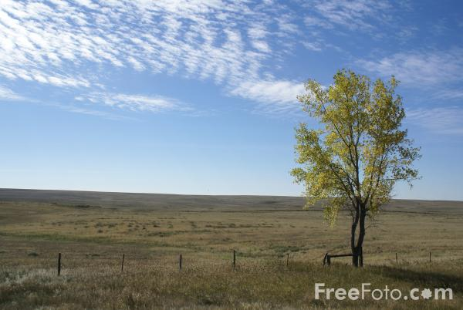

Slide 30
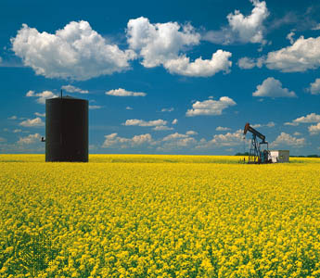

Slide 31
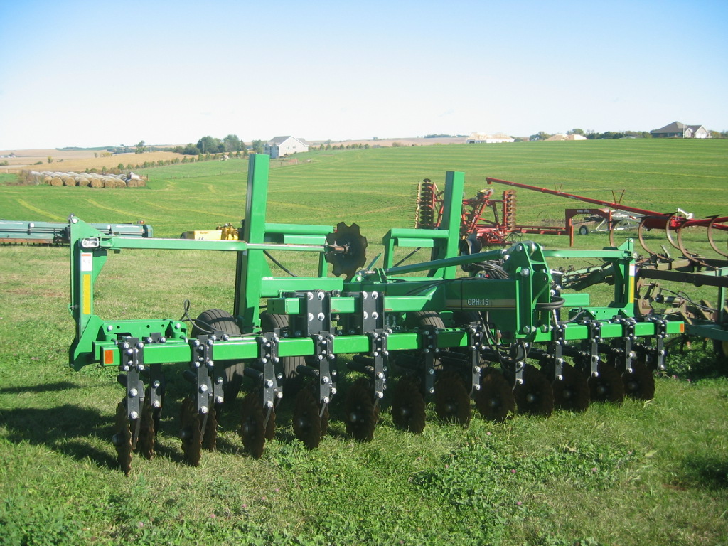

Slide 32
Rocky Mountains

Slide 33
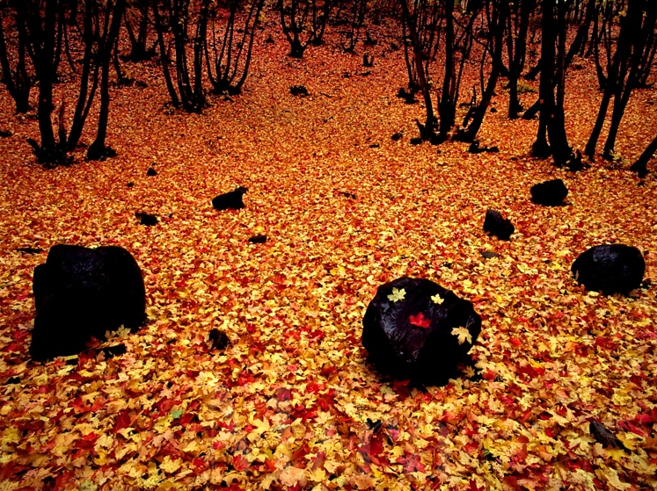
Art in Nature 9409-0218 - Autumn Carpet - A carpet of colorful Oak and Maple leaves covers the forest floor in Payson Canyon. Wasatch Range, Rocky Mountains, Utah.

Slide 34
Intermountain basins and plateaus

Slide 35
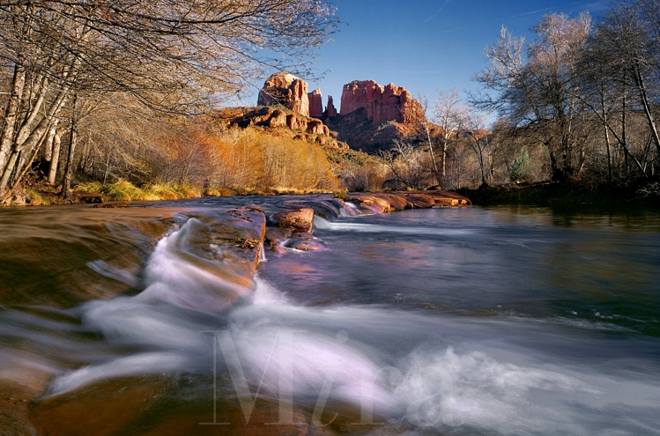
Red Rock Crossing, Oak Creek Canyon, Sedona, Arizona

Slide 36
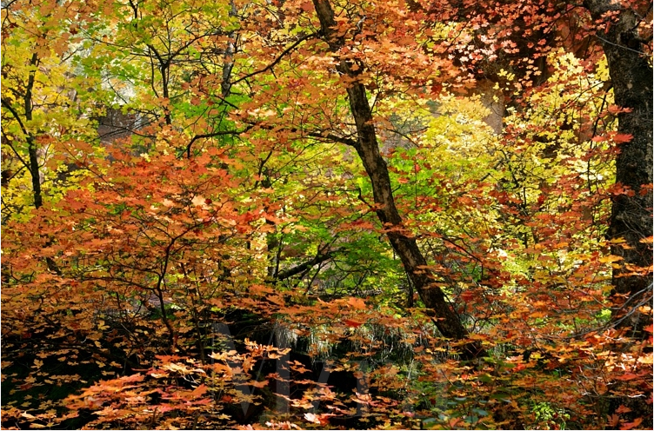
West Fork of Oak Creek trail, Coconino National Forest, near Sedona, Arizona

Slide 37
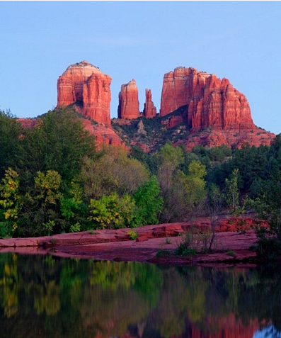
Cathedral Rock and Oak Creek, Sedona, Arizona

Slide 38
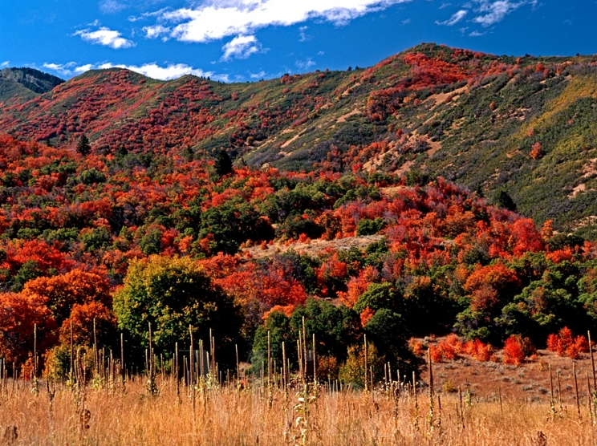
Covered Bridge Canyon near Spanish Fork in Utah is one of the truly great places in the world to capture the vivid colors of oak and maple in autumn

Slide 39
California & Sierra Nevada

Slide 40
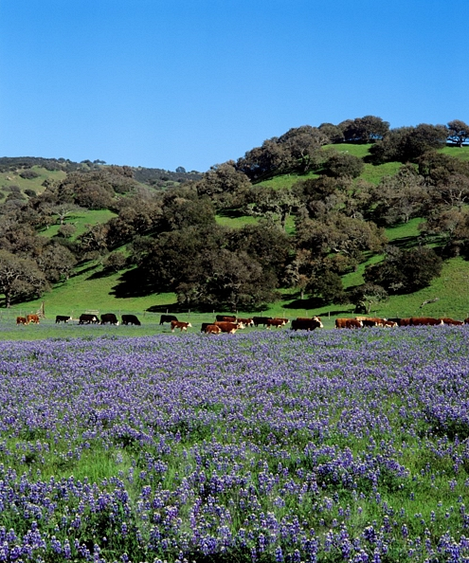
Lupin fields and oak woodlands with grazing cattle - Monterey county, California

Slide 41
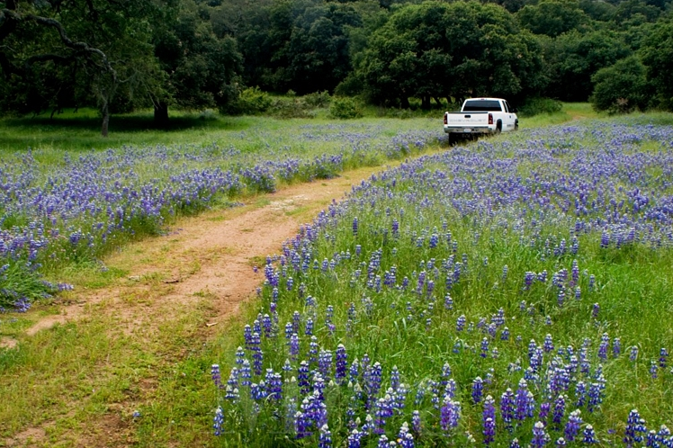
A Chevy pick up truck drives through wildflowers on a cattle ranch in the Coastal Mountain Range of Monterey County - CALIFORNIA.

Slide 42
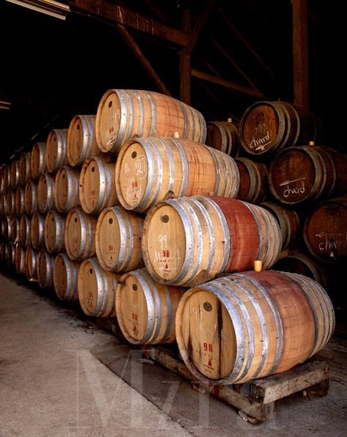
Oak barrel casks for aging wine - Monterey county, California.

Slide 43
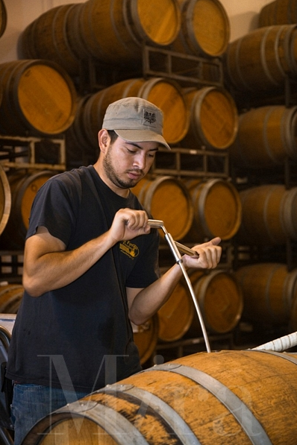
Winery worker stirs the sediment in an oak barrel at Joullian Vineyards - Carmel Valley, California

Slide 44
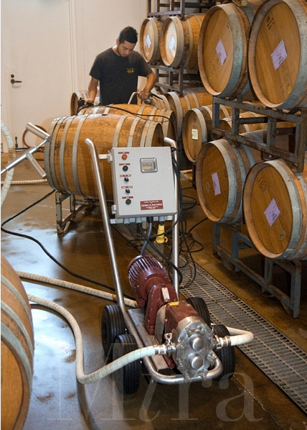
Winery worker pumps the grape juice from one oak barrel to another to remove sediment at Joullian Vineyards - Carmel Valley, California

Slide 45
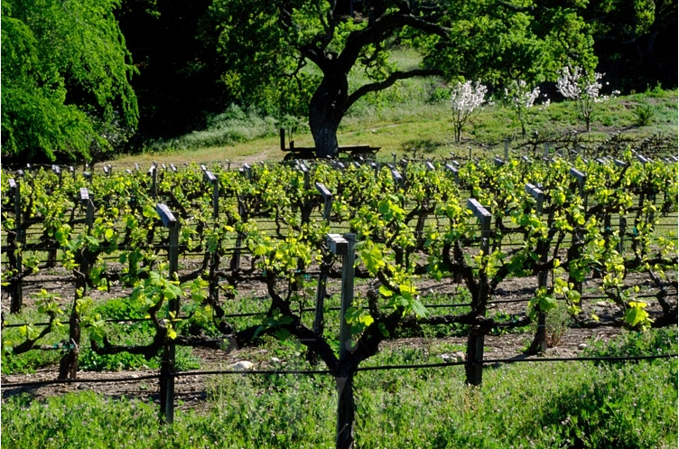
First growth of wine grape vines - Carmel Valley, California

Slide 46
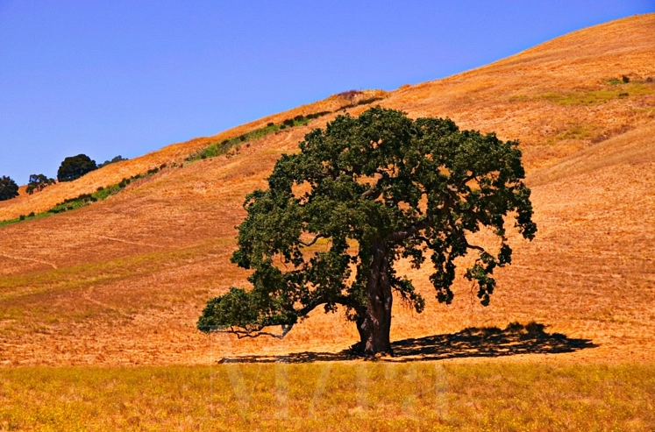
Oak tree, Sonoma, California

Slide 47
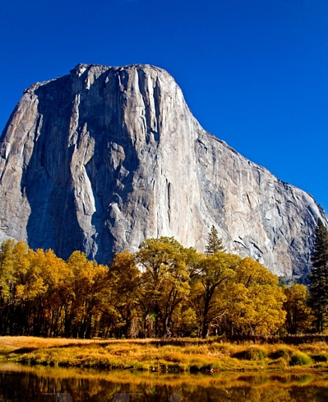
El Capitan rises above the Merced River during autumn - Yosemite National Park, California

Slide 48
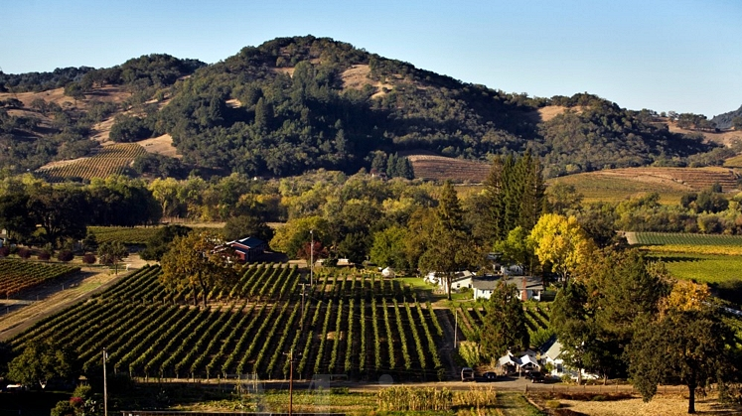
Redwood Ranch Vineyards in the heart of the Alexander Valley - Healdsburg, California

Slide 49
Pacific Northwest & Cascade Mountains

Slide 50
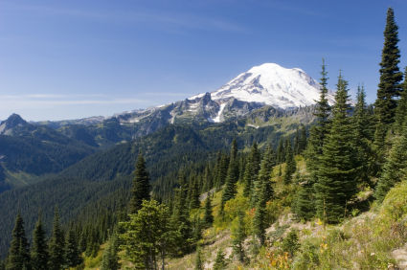

Slide 51
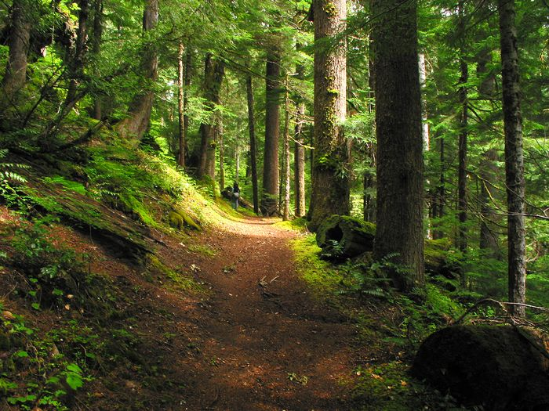

Slide 52
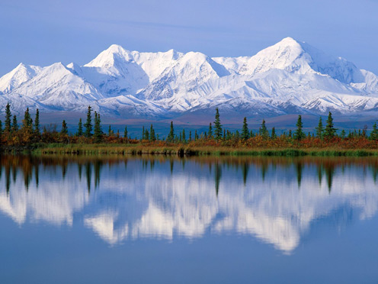

Slide 53
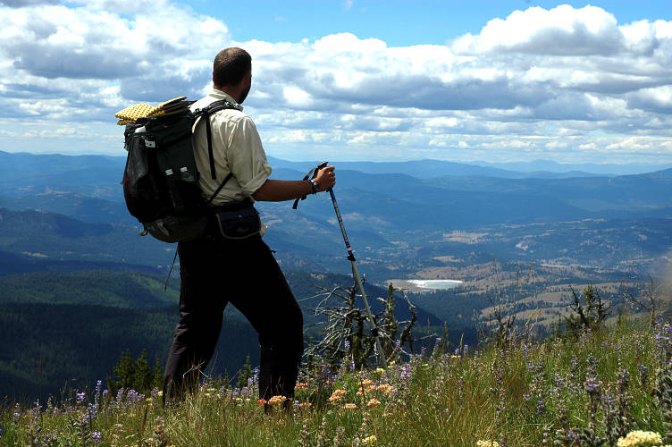

Slide 54
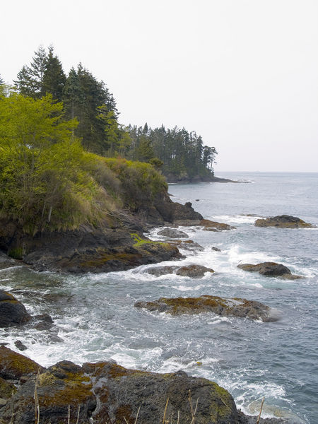

Slide 55
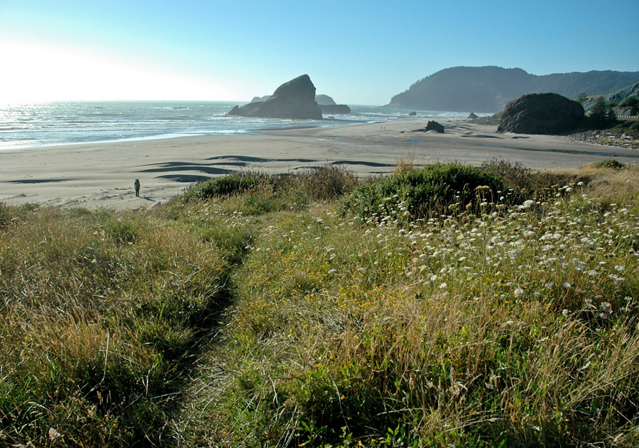

Slide 56
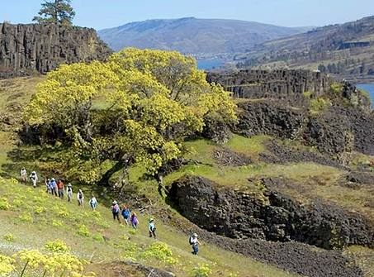

Slide 57
Alaska

Slide 58
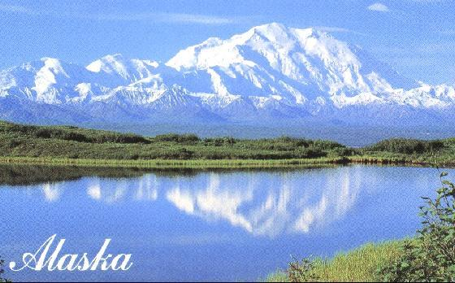

Slide 59
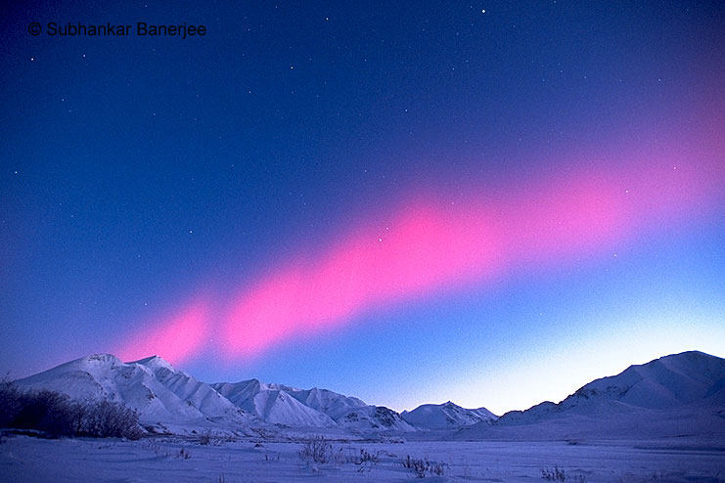

Slide 60
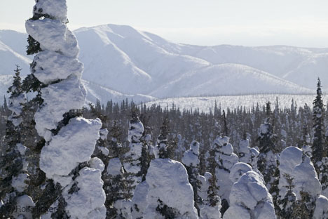

Slide 61
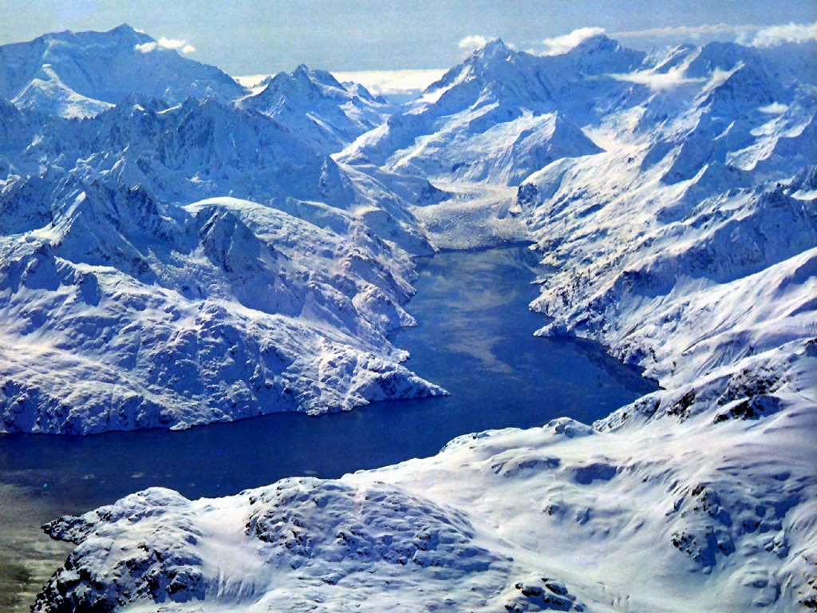

Slide 62
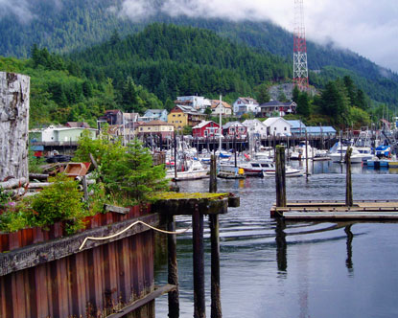

Slide 63
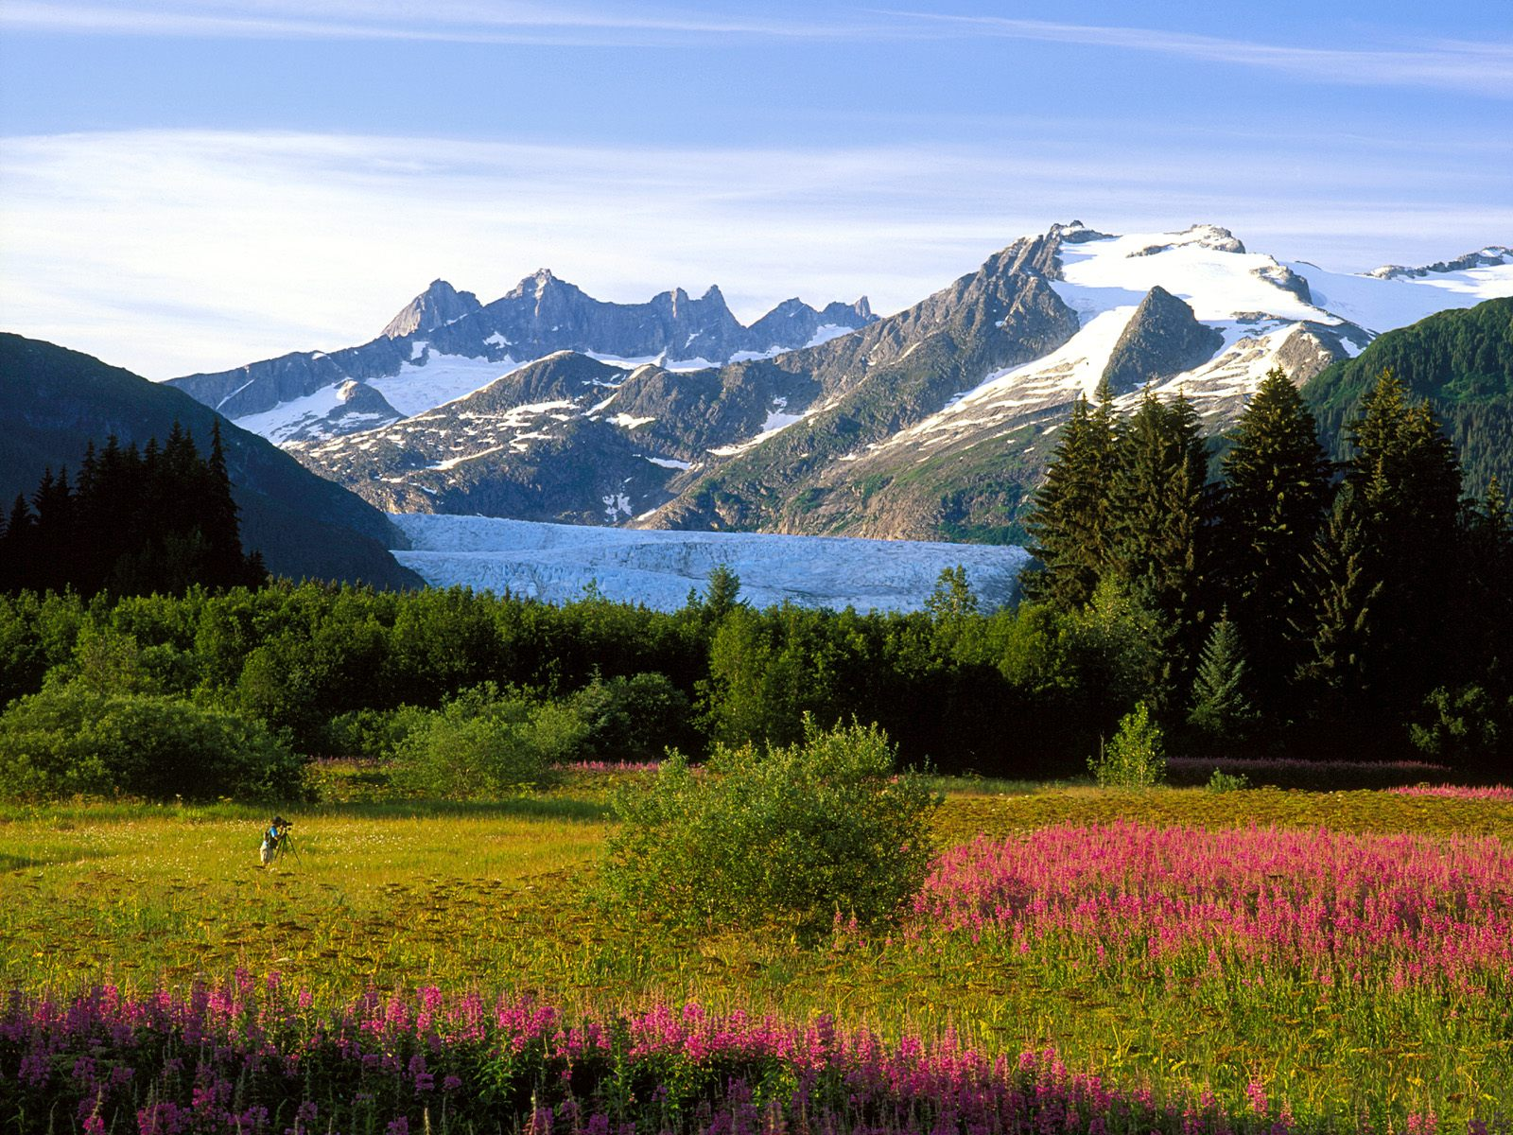

Slide 64
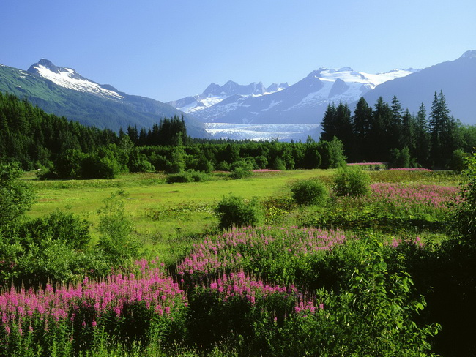

Slide 65


Slide 66
Hawaii

Slide 67


Slide 68


Slide 69


Slide 70


Slide 71


Slide 72


Slide 73
Puerto Rico

Slide 74


Slide 75


Slide 76


Slide 77


Slide 78


