Slide 1
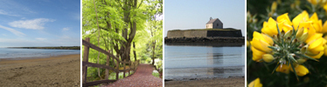
The Natural Beauty of the United Kingdom

Slide 2
2011 Photo Competition Winners

Slide 3
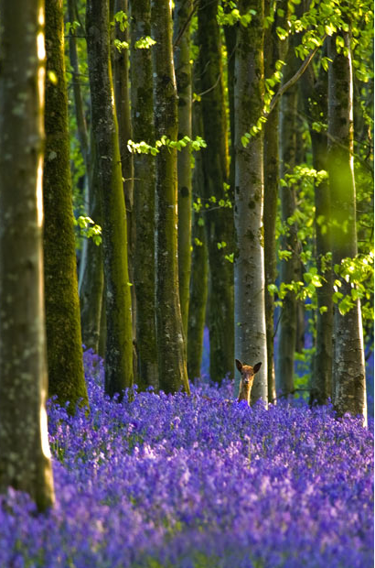
South West (Dorset) winner: Deer Bells, Dorset by Kris Dutson from Dorchester

Slide 4
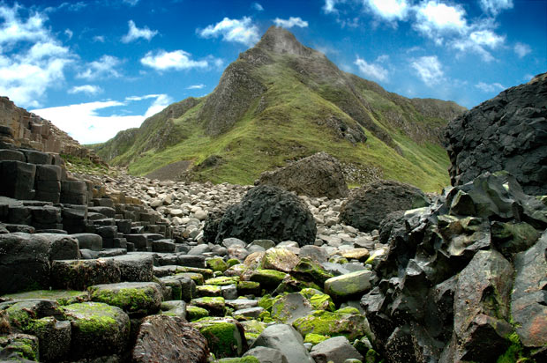
Northern Ireland (Antrim) winner: Causeway view by Jurgen Dabeedin from Potters Bar

Slide 5
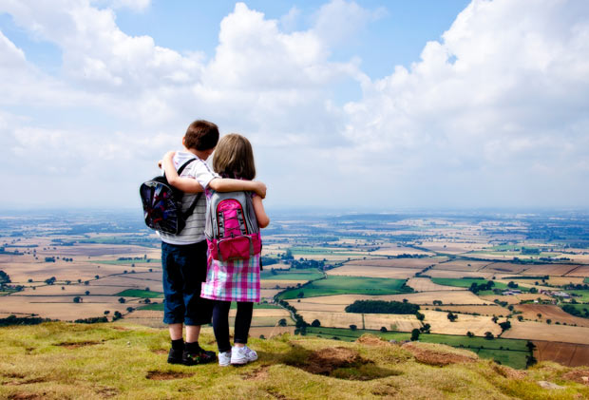
West Midlands (Shropshire) winner: Our world, our future by Brett Critchley

Slide 6
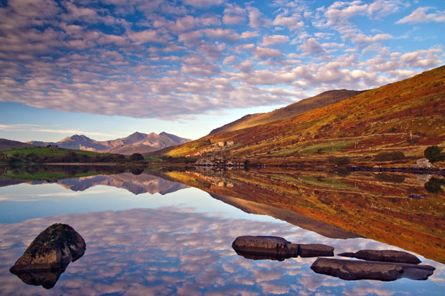
Wales (Caernarvonshire) winner: Snowdon sunrise by Simon Kitchin of Flintshire

Slide 7
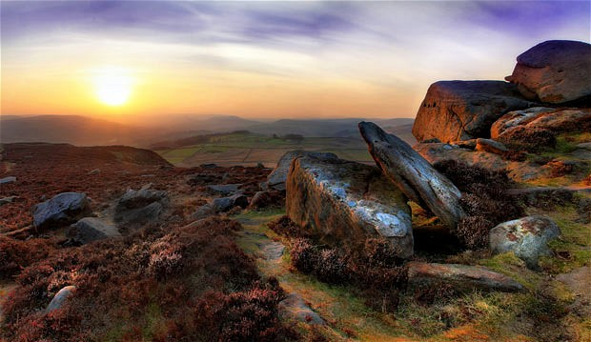
East Midlands (Derbyshire) winner: Volcanic Millstone Sunset by Paul Willows

Slide 8
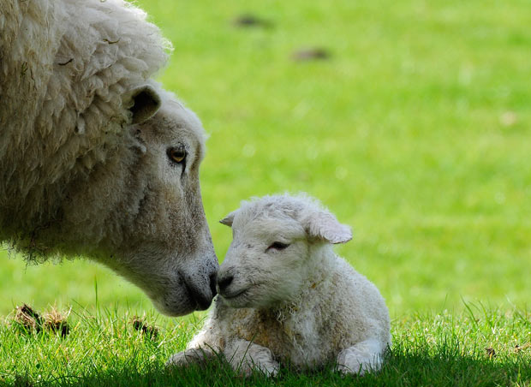
South East (Sussex) winner: ewe with lamb by William Richardson from London

Slide 9
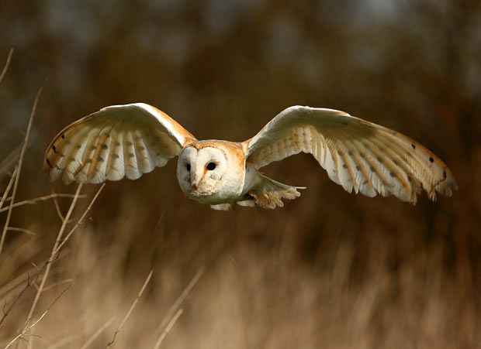
East Anglia (Norfolk) winner: Barn owl by Bill Pound

Slide 10
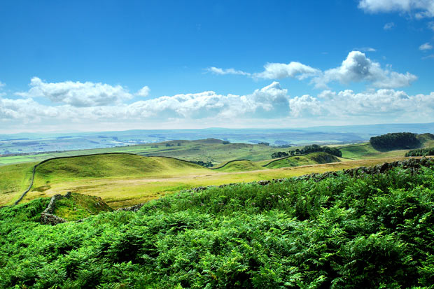
North East (Northumberland) winner: Hadrian's Wall by Derek Bates

Slide 11
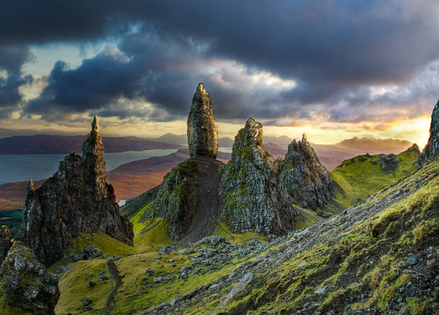
Scotland (Ross & Cromarty) winner: Old Man of Storr by Alistair Swan from Ayr

Slide 12
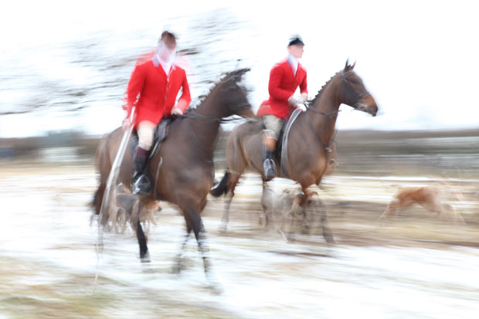
North West (Cheshire) winner: Cheshire Forest Hunt by David Coles of Cheshire

Slide 13
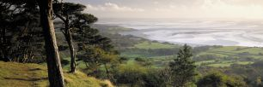
Additional photos of the natural beauty of the UK

Slide 14
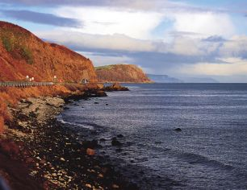
Antrim Coast, Northern Ireland

Slide 15
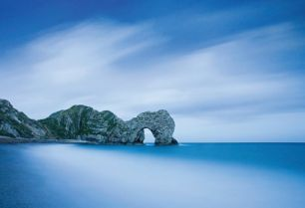
Dorset

Slide 16
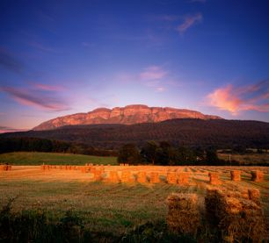
Binevenagh

Slide 17
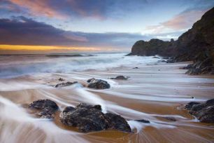
South Devon

Slide 18
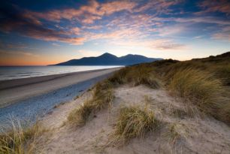
Lecale Coast

Slide 19
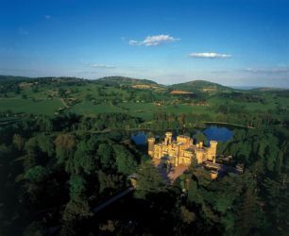
Malvern Hills

Slide 20
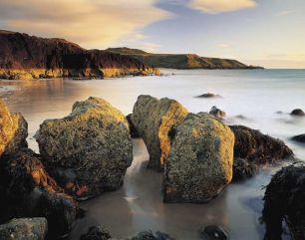
Llyn Peninsula

Slide 21
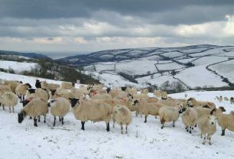
North Devon Coast

Slide 22
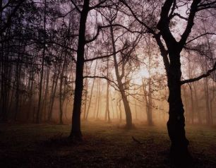
The Chilterns

Slide 23
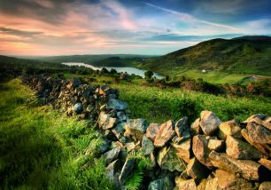
The Ring of Gullion

Slide 24
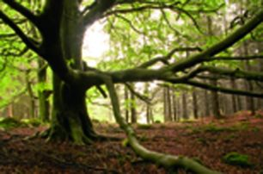
Forest of Bowland

Slide 25
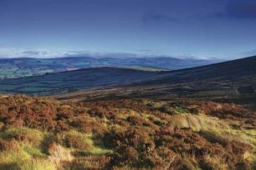
The Sperrins

Slide 26
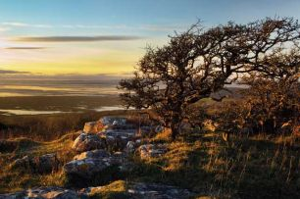
Arnside and Silverdale

Slide 27
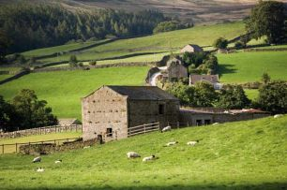
Nidderdale

Slide 28
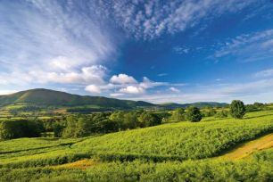
Shropshire Hills

Slide 29
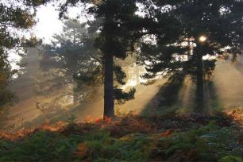
Cannock Chase

Slide 30
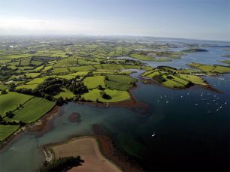
Strangford Lough

Slide 31
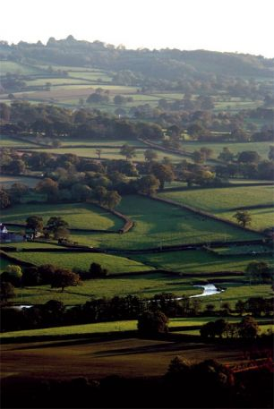
Blackdown Hills

Slide 32
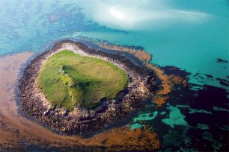
Isles of Scilly

Slide 33
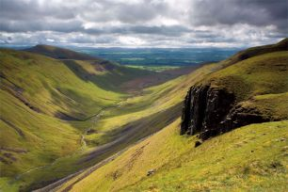
North Pennines

Slide 34
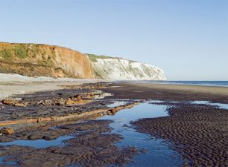
Isle of Wight

Slide 35
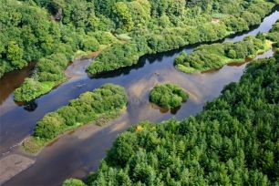
Tamar Valley

Slide 36
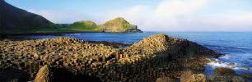
Causeway Coast

Slide 37
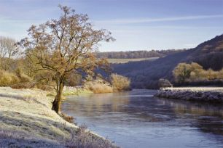
Wye Valley

Slide 38
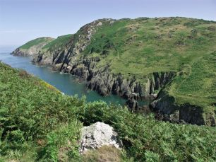
Anglesey

Slide 39
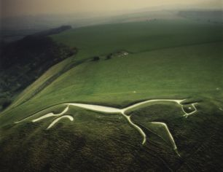
North Wessex Downs

Slide 40
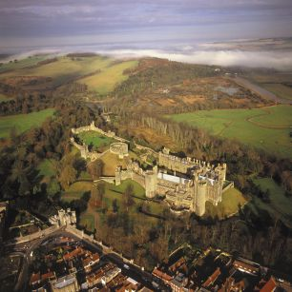
East Hampshire Downs / Sussex Downs

Slide 41
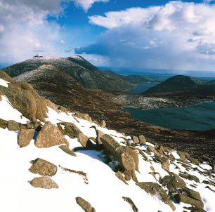
Mourne, Northern Ireland

Slide 42
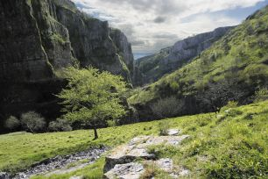
Mendip Hills

Slide 43
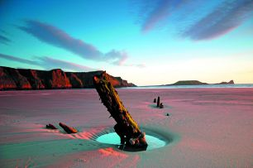
Gower

Slide 44
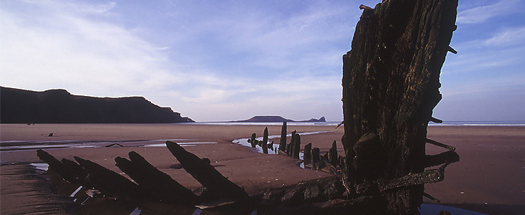

Slide 45
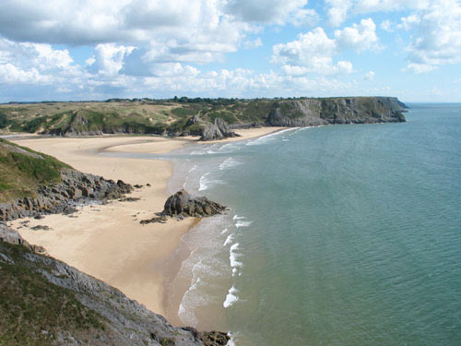

Slide 46
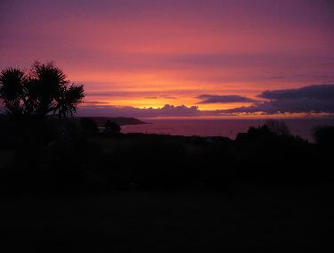
Gower

Slide 47
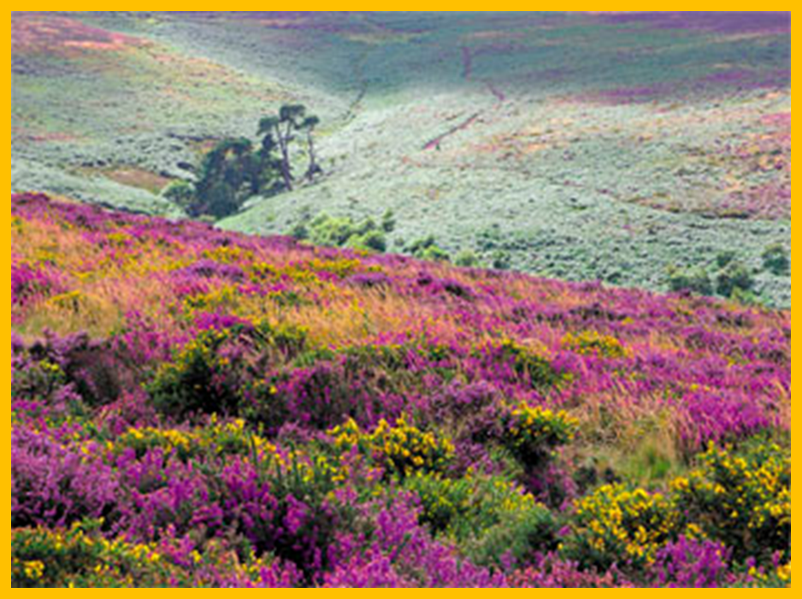
Quantock Hills

Slide 48
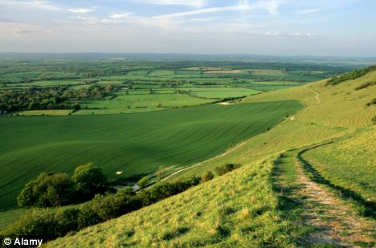

Slide 49
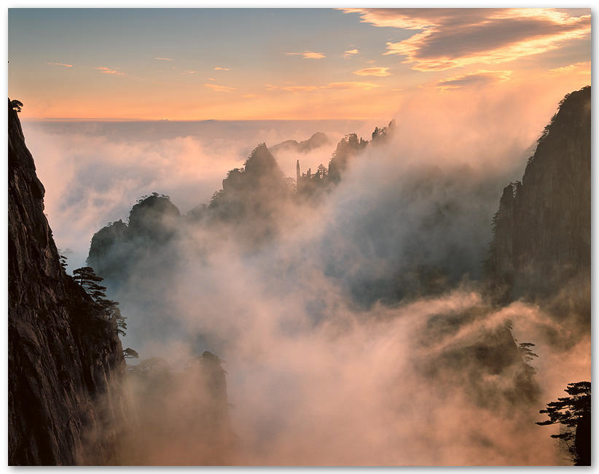

Slide 50
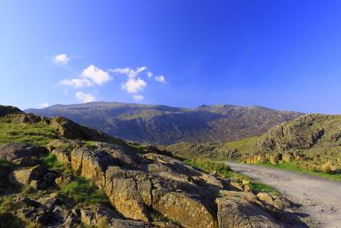
Wales

Slide 51
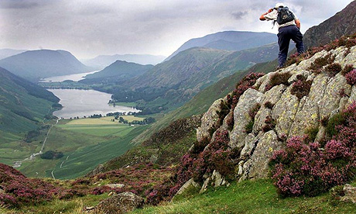

Slide 52


Slide 53

Devon

Slide 54


Slide 55


Slide 56


Slide 57


Slide 58


Slide 59


Slide 60


Slide 61



Slide 62


Slide 63


Slide 64


Slide 65





