Slide 1
Tribe Area Of Kawardha - Chhattisgarh - India

Slide 2
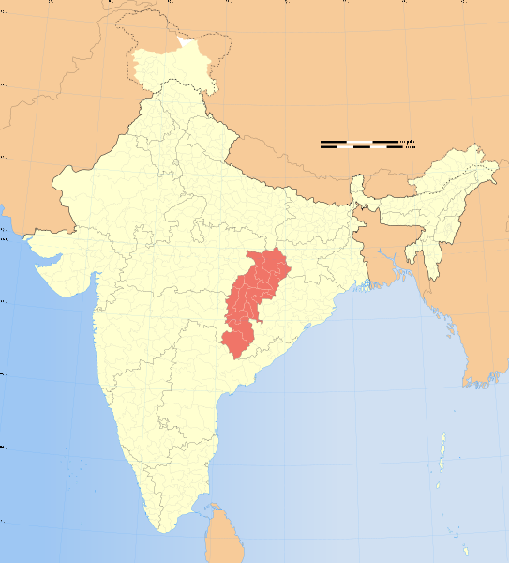
Background
This collection of photos is the result of three visits to Bhoramdeo Jungle Retreat in Kawardha - Chhattisgarh in Central India. The photo's are taken in an area of thirty by thirty km. Bhoramdeo is situated close to the Maikal hills. From here it is possible to walk to several Baiga villages in the hills and Gond villages in the plains. In the whole Kawardha district is one other hotel, the more expensive Palace Hotel Most people come here because it is situated halfway Raipur and Kanha National park.

Slide 3
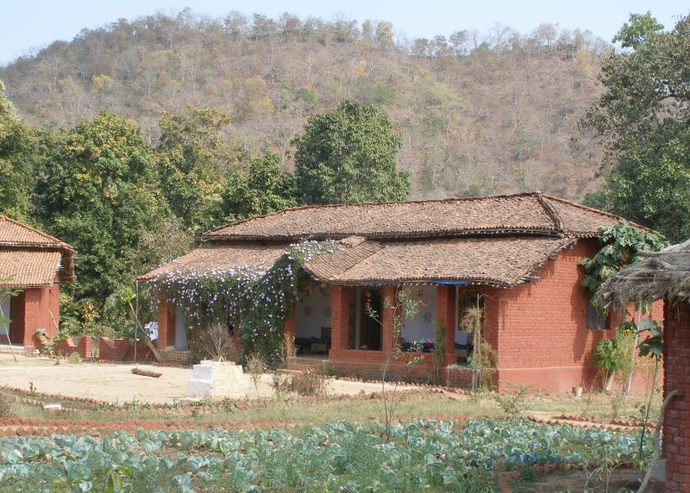
Bhoramdeo Jungle Retreat

Slide 4
Bhoramdeo Jungle Retreat is Nestled at the foot of the Maikal Hills 18 kms from the District Headquarters of Kawardha (Chhattisgarh, Central India).
It is midway between Raipur and Kanha National Parkoffers an ideal base from which to explore tribal Gond and Baiga villages under the guidance of expert guides.

Slide 5
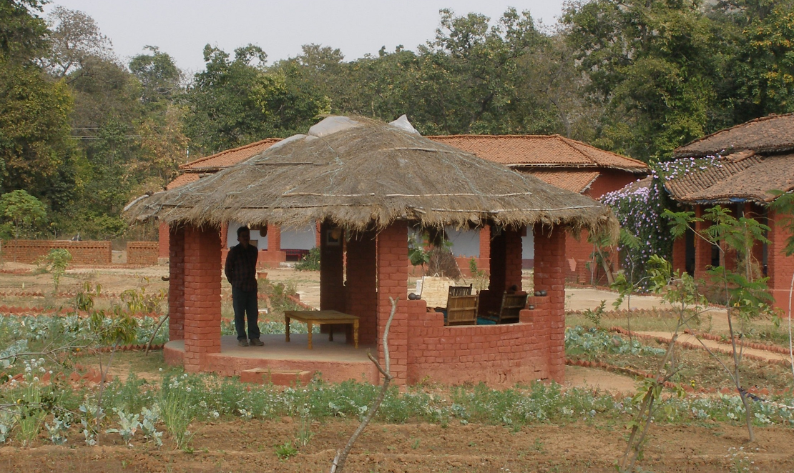

Slide 6
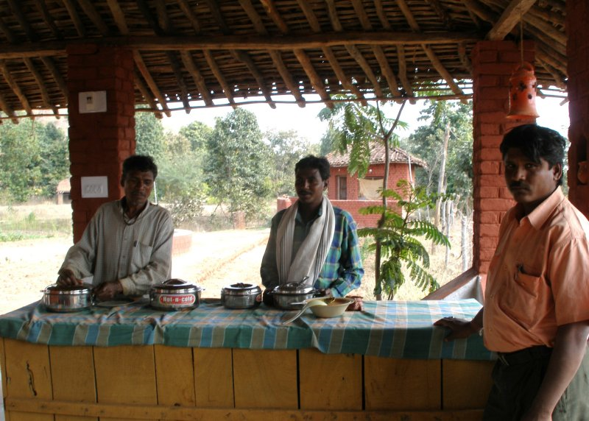

Slide 7
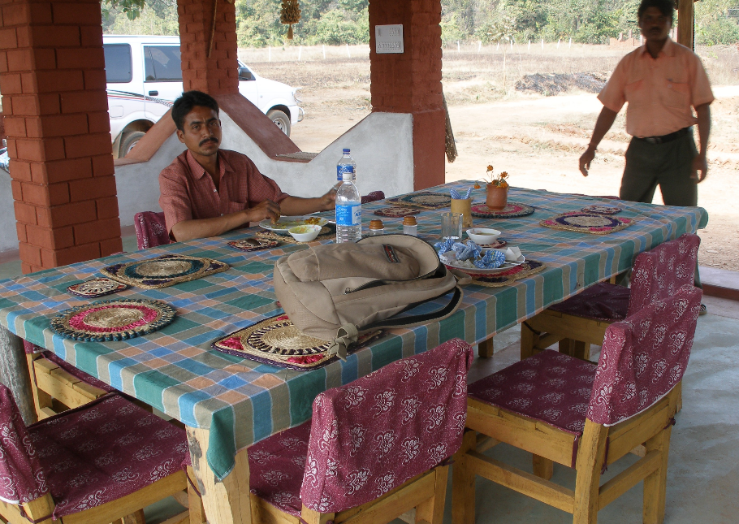

Slide 8
Scenes near the Bhoramdeo Jungle Retreat

Slide 9
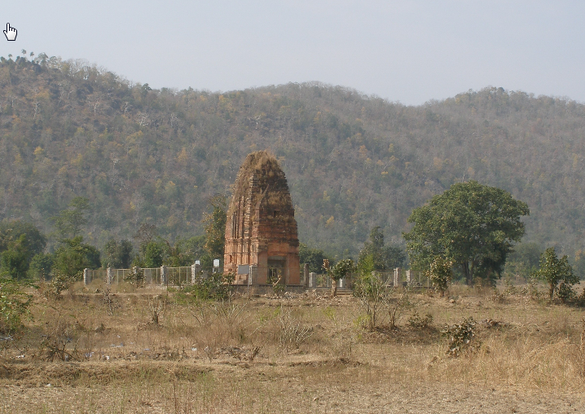

Slide 10
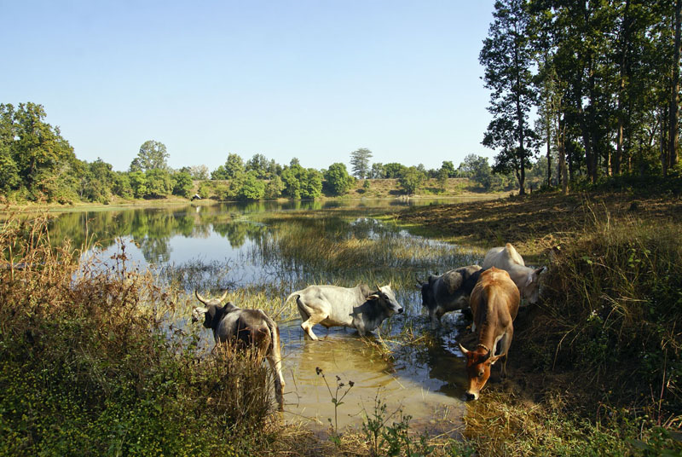

Slide 11
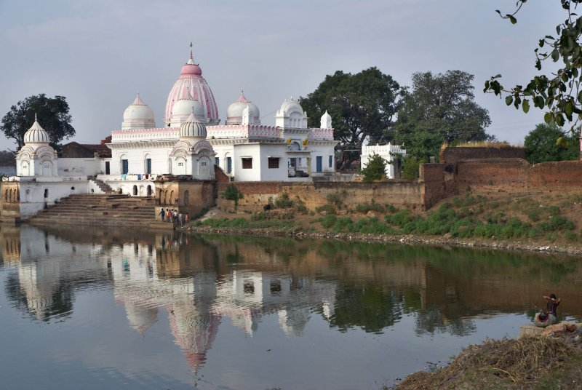

Slide 12
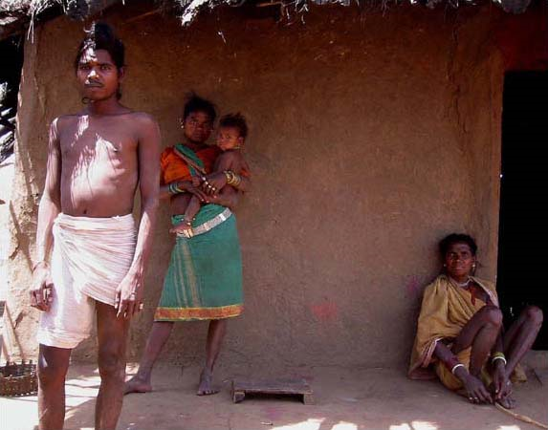
Baiga villages

Slide 13
In Baiga Tribes you will find an openness and dignity so refreshing and pure, even when life treats them cruelly. They have magical qualities that relax, beguile and reward anyone who has the good sense to spend time in their calming company, and their humour can bring a smile to the lips of even the most tension filled of souls.
The most fascinating gift these wonderful people have is their jungle instinct and ability to gently & voicelessly teach those of us who have been distanced from our planet, just how to balance our lives by simply spending more time closer to the only world that can ever truly support, protect and nurture us – the natural world.
Baiga Tribesmen say that it is and always will be their Kartavya, (duty), to live close to Mother Nature, protecting Her from destruction. Baigas were able guardians of the natural world in the past by, because most “civilized” people were fearful of entering the dense Central Sal jungles.

Slide 14
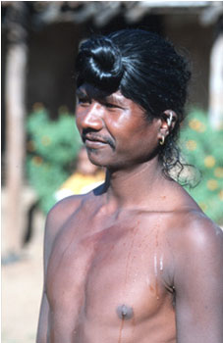
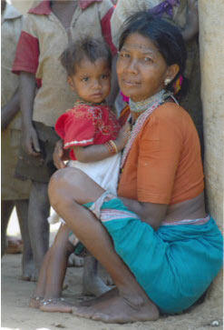
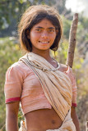
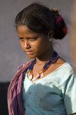
People of Baiga Villages

Slide 15
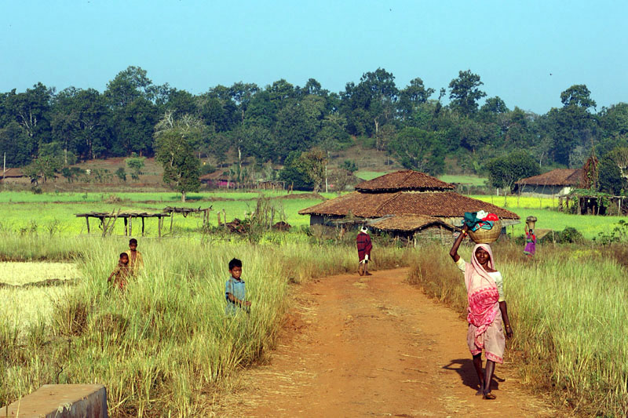

Slide 16
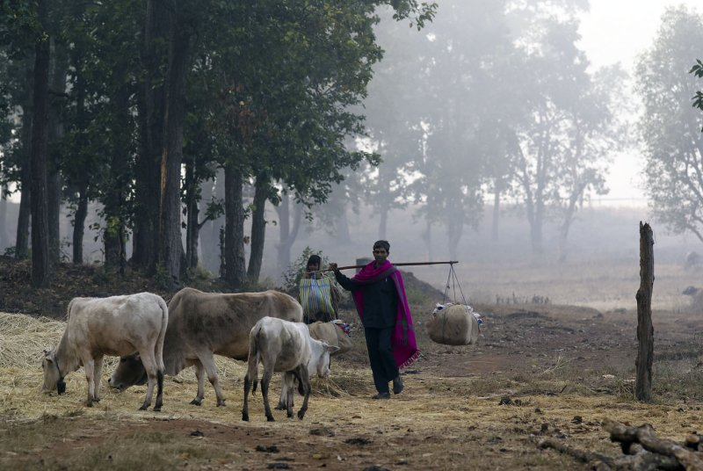

Slide 17
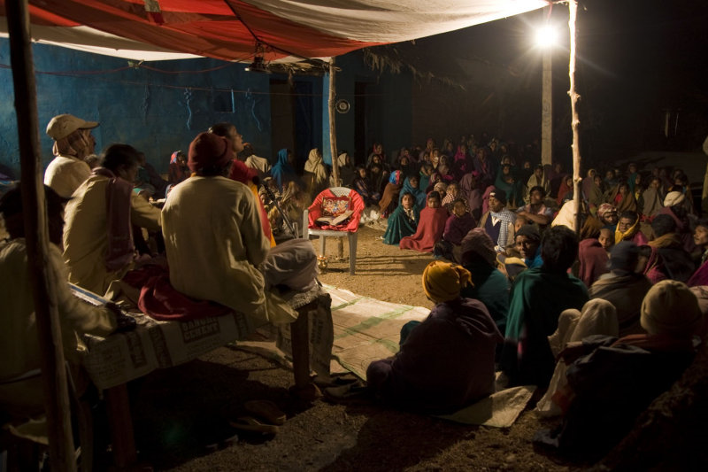

Slide 18
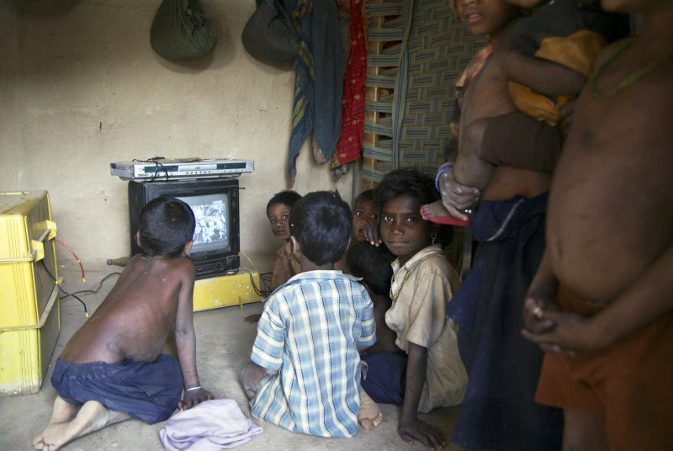

Slide 19
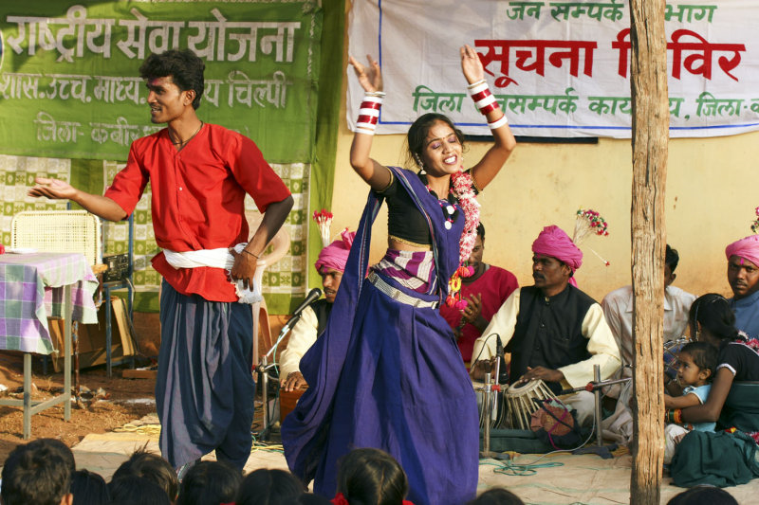

Slide 20
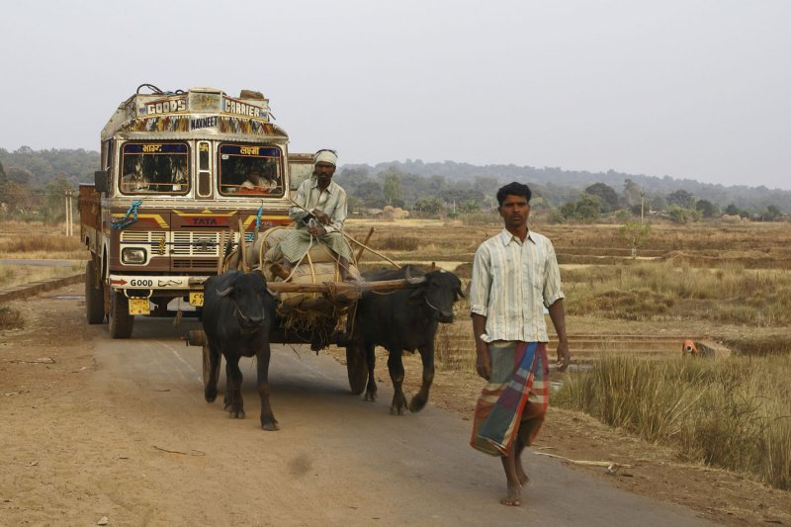

Slide 21
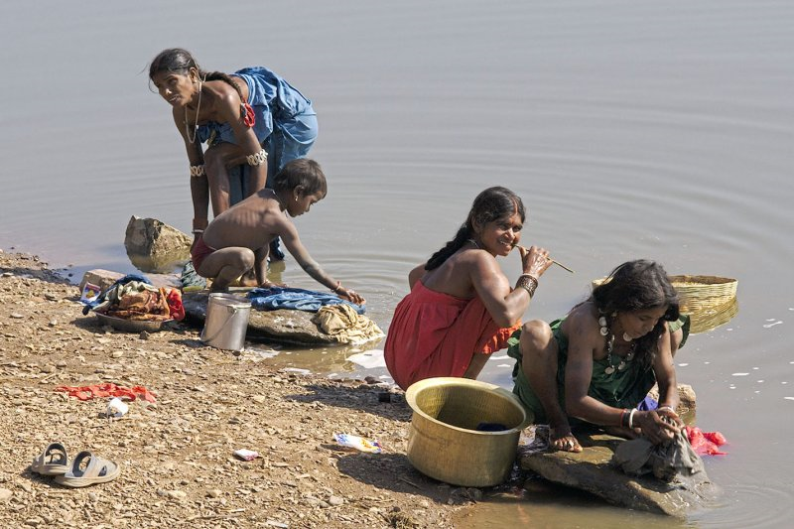

Slide 22
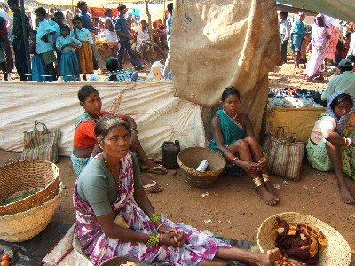
Gond Villages

Slide 23
The Gondi (Gōndi) are a people in central India. The Gondi, or Gond people are spread over the states of Madhya Pradesh, eastern Maharashtra (Vidarbha), Chhattisgarh, northern Andhra Pradesh, and western Orissa. With over four million people, they are the largest tribe in Central India.
The Gondi language is related to Telugu and other Dravidian languages. About half of Gonds speak Gondi languages, while the rest speak Indo-Aryan languages including Hindi.
The Gonds are traditionally agriculturalists; some practice shifting cultivation, while others raise cereals or herd cattle^{[2]}. Gond society is highly stratified and does not conform to the usual image of egalitarianism among tribals.
Traditional Gond religion involves a distinct pantheon of gods and spirits, which many Gonds practice along with Hinduism. A small number of Gond have converted to Islam, and now form a distinct Muslim Raj Gond community.

Slide 24
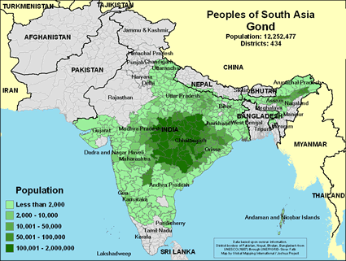

Slide 25
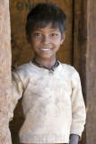
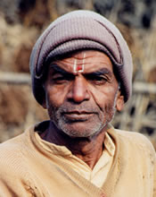
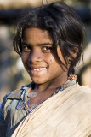
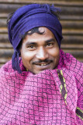
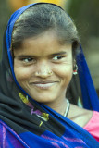
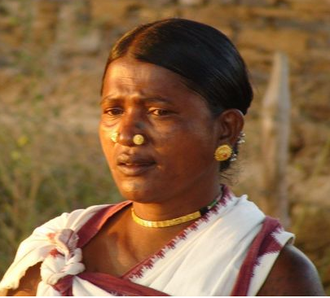
People of Gond Villages

Slide 26
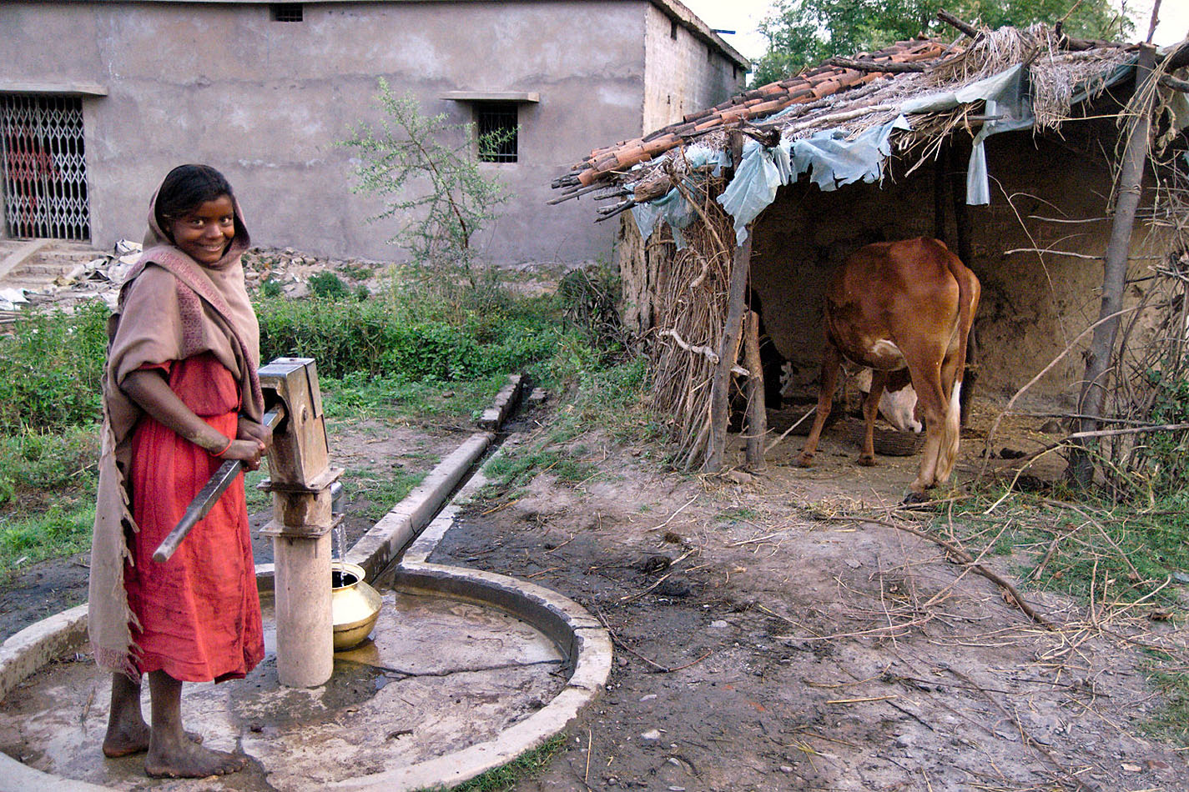

Slide 27
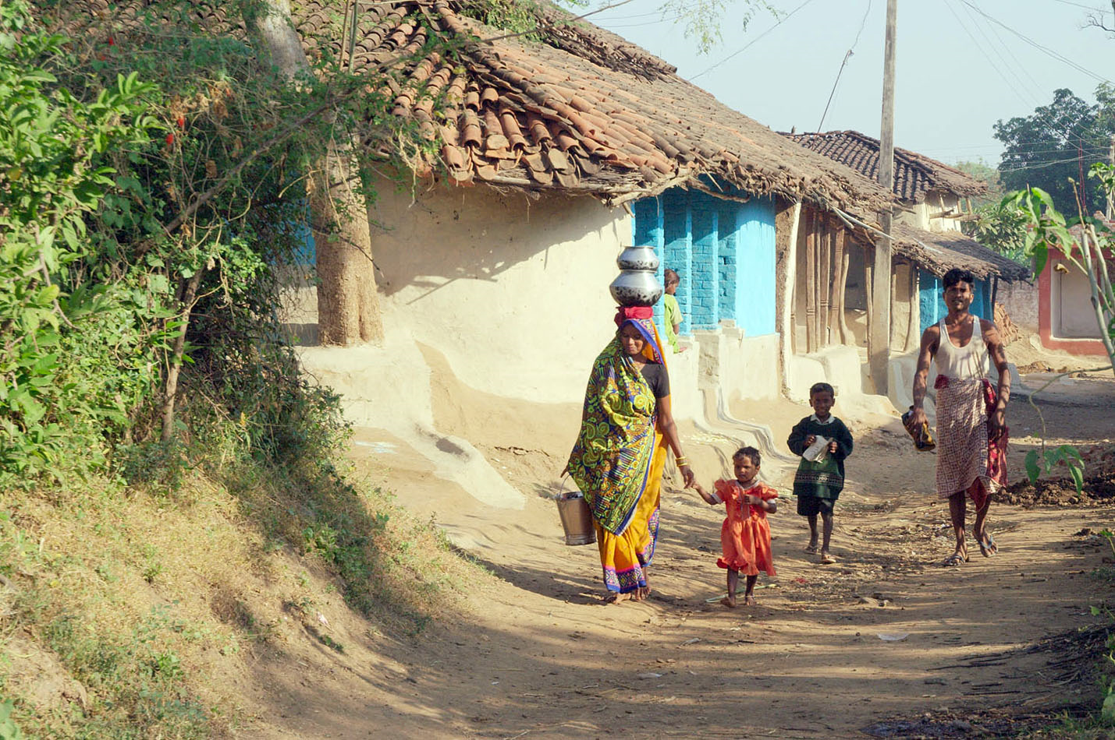

Slide 28
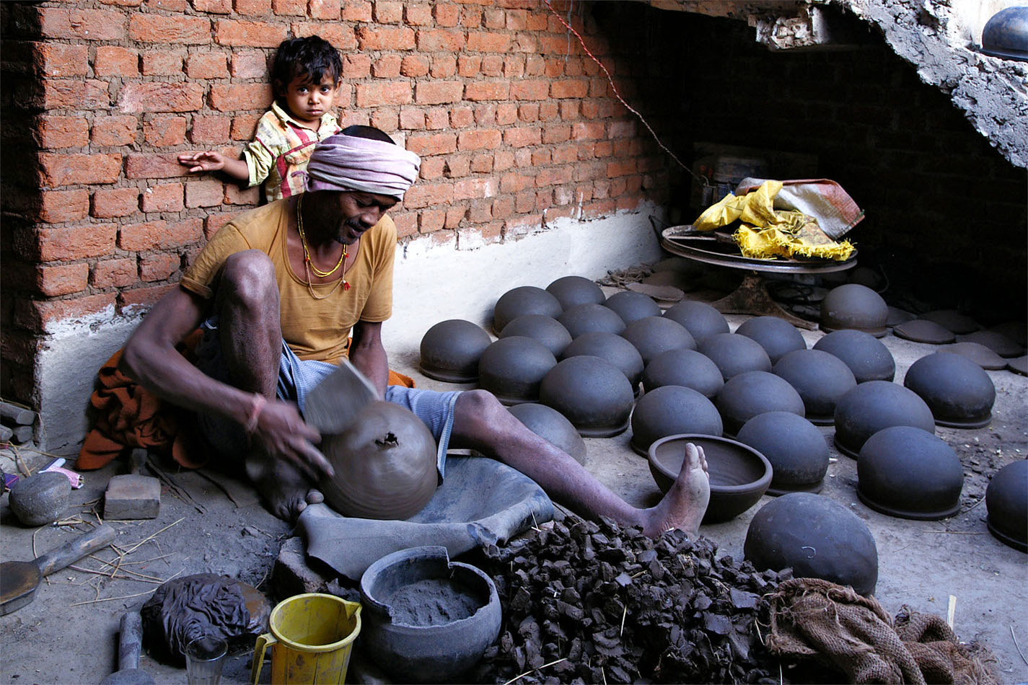

Slide 29
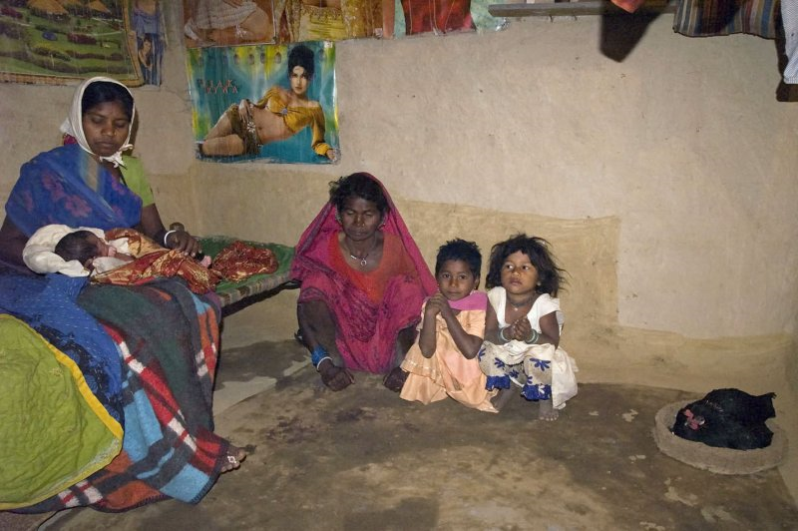

Slide 30
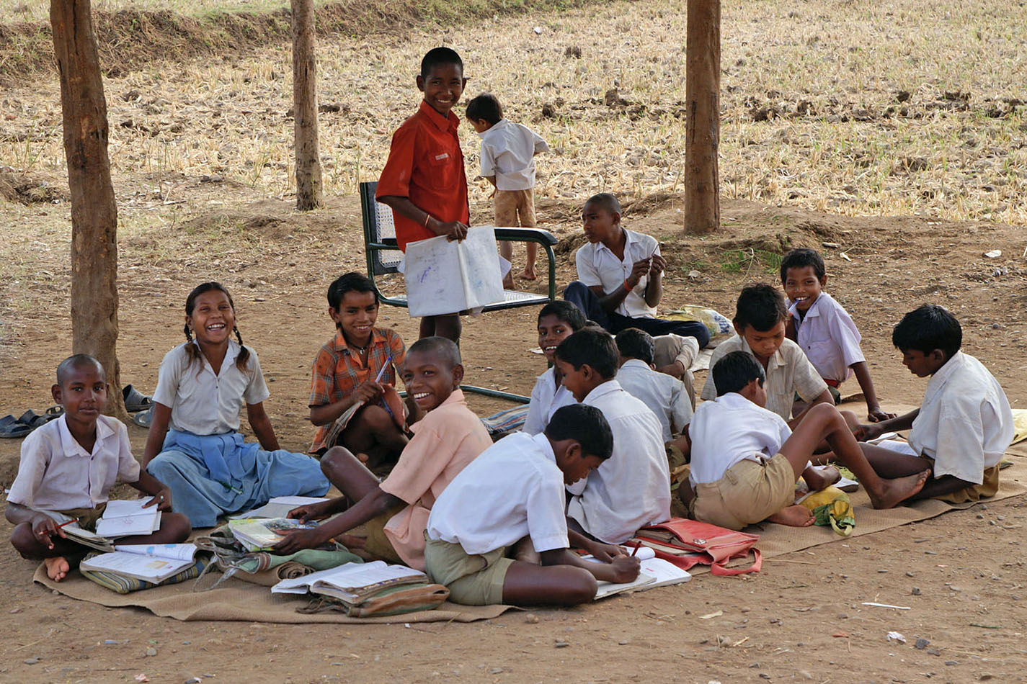

Slide 31
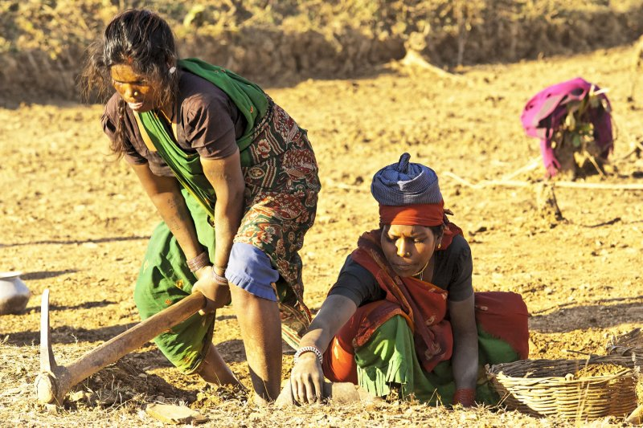

Slide 32
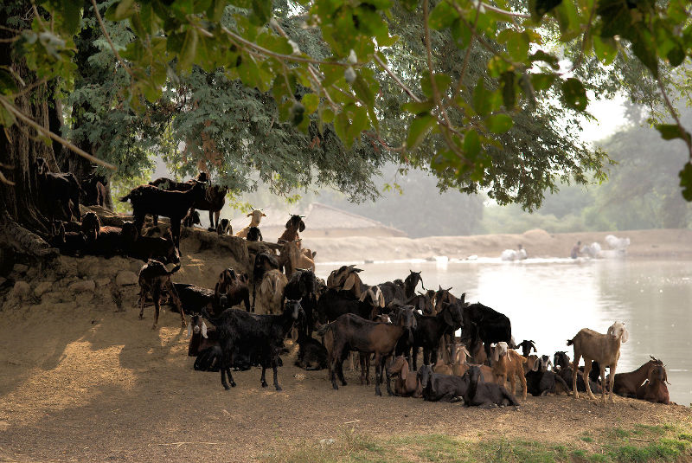

Slide 33
