Slide 1
SPAIN: San Fermin Festival
A week of festivities!

Slide 2
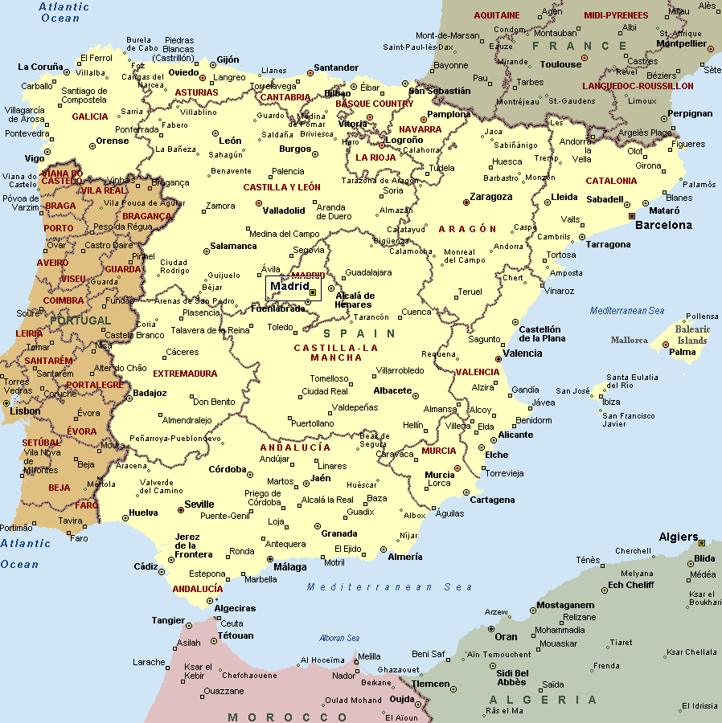
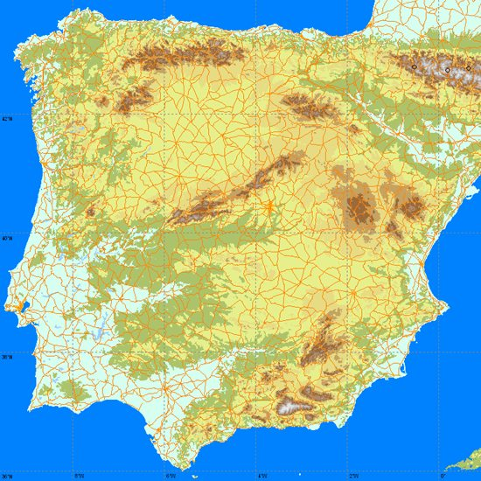

Slide 3
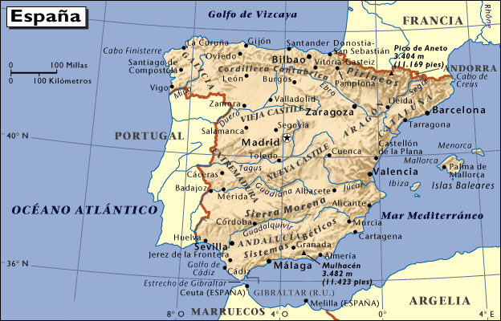

Slide 4
Description
The festival of San Fermín (or Sanfermines) in the city of Pamplona (Navarre, Spain), is a deeply rooted celebration held annually from 12:00, 6 July, when the opening of the fiesta is marked by setting off the pyrotechnic chupinazo, to midnight 14 July, with the singing of the Pobre de Mí. While its most famous event is the encierro, or the running of the bulls, the biggest day is 7 July, when thousands of people accompany a replica of the statue of Saint Fermin along the streets in the old part of Pamplona. San Fermín is accompanied by dancers and street entertainers, such as the Gigantes (giant-sized figures who represent the King and Queen of Europe, Asia, Africa, and America) and the Cabezudos (the Bigheads). The week-long celebration involves many other traditional and folkloric events.

Slide 5
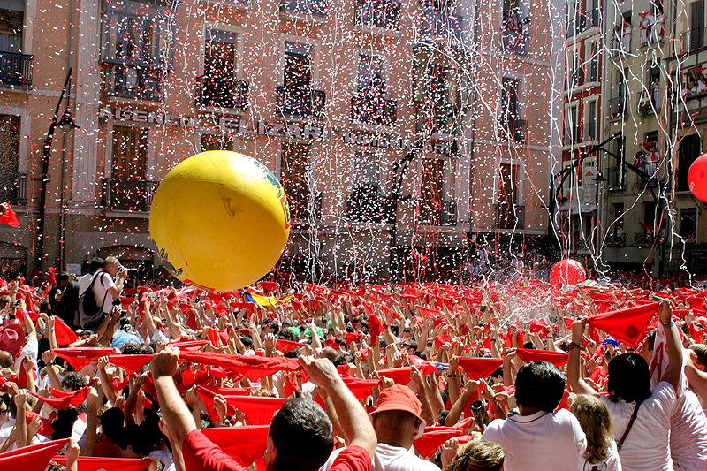
Town Hall of Pamplona seconds before the initiation of the San Fermín festival

Slide 6
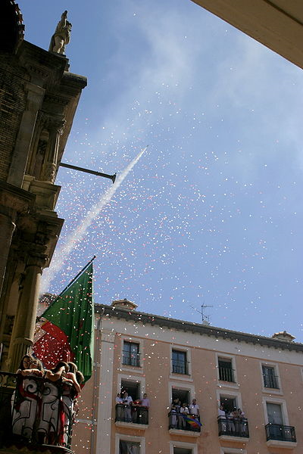
The Chupinazo signals the start fo the festival.

Slide 7
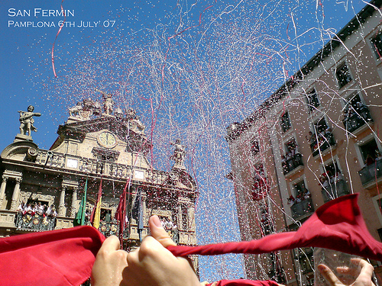

Slide 8
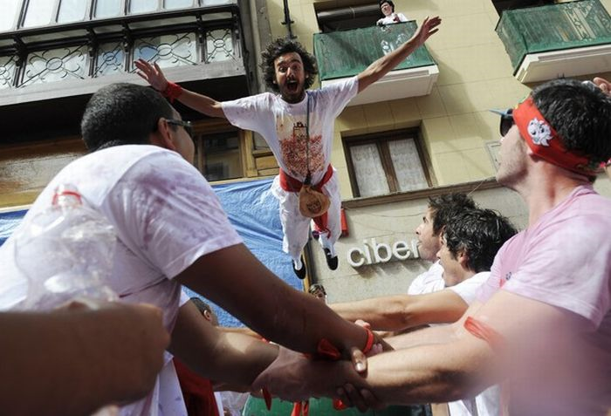

Slide 9
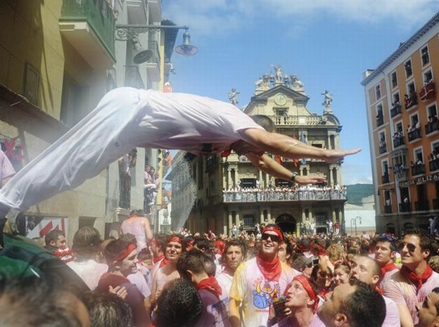

Slide 10
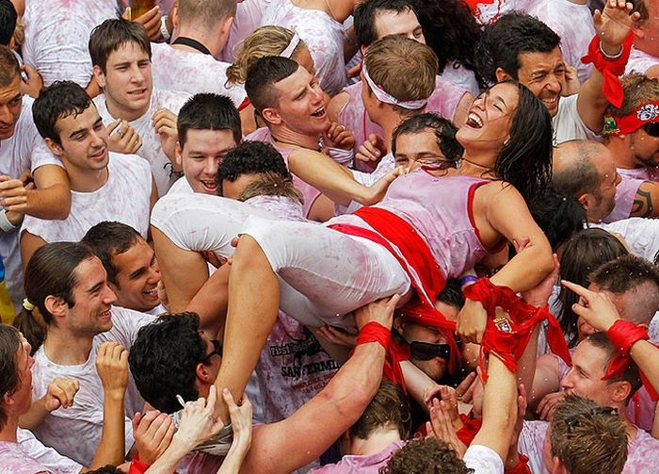

Slide 11
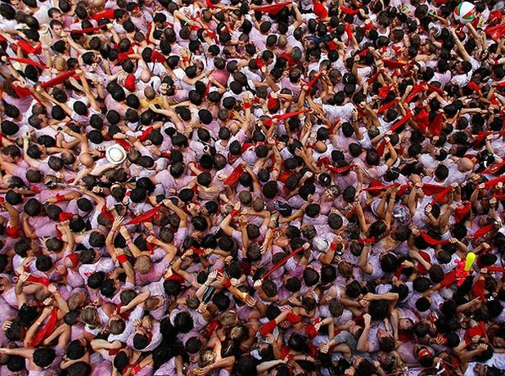

Slide 12
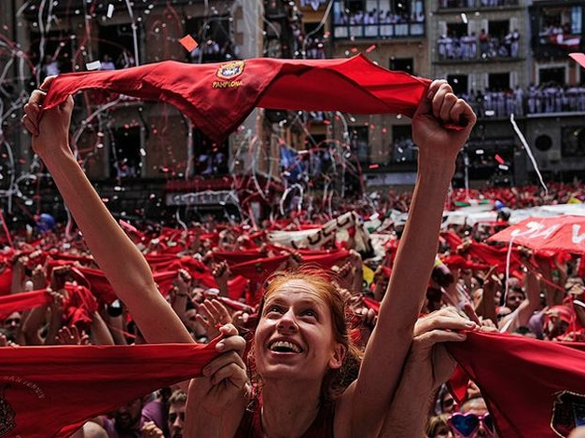

Slide 13
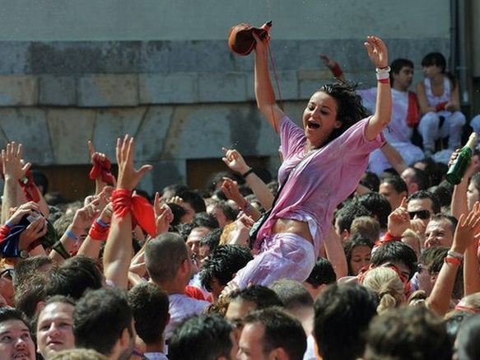

Slide 14
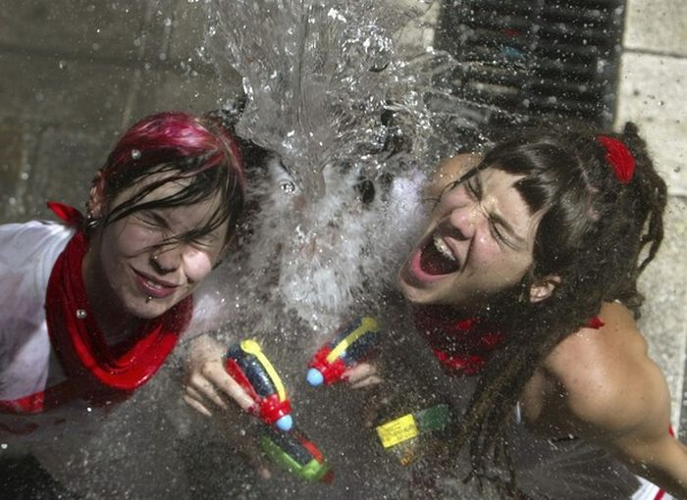

Slide 15
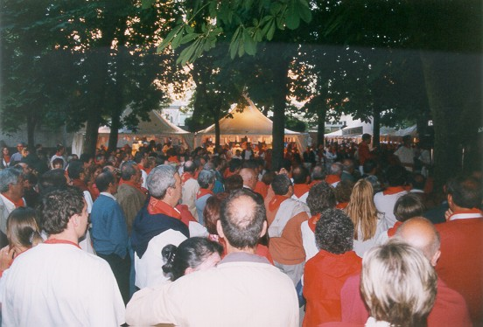

Slide 16
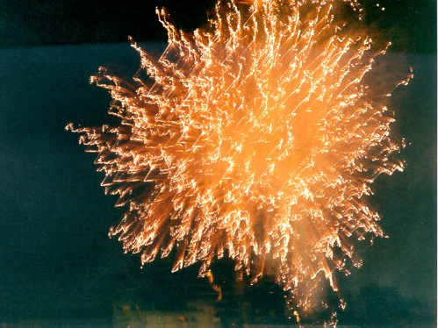

Slide 17
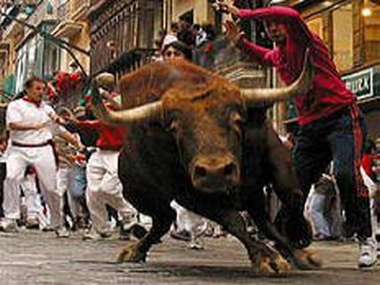
The running of the bulls
“Only” 200 to 300 people get injured each year: mostly cuts, scrapes, and bruises. They say there are few serious injuries.

Slide 18
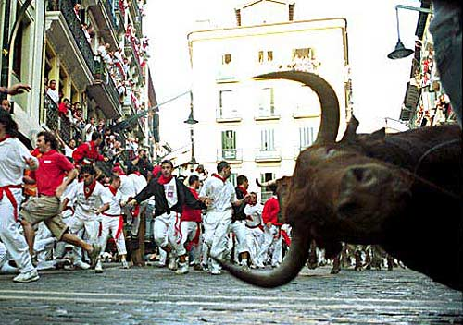

Slide 19
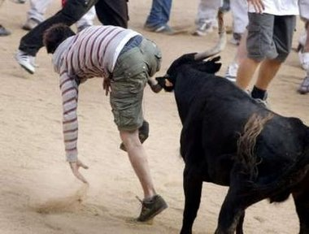

Slide 20
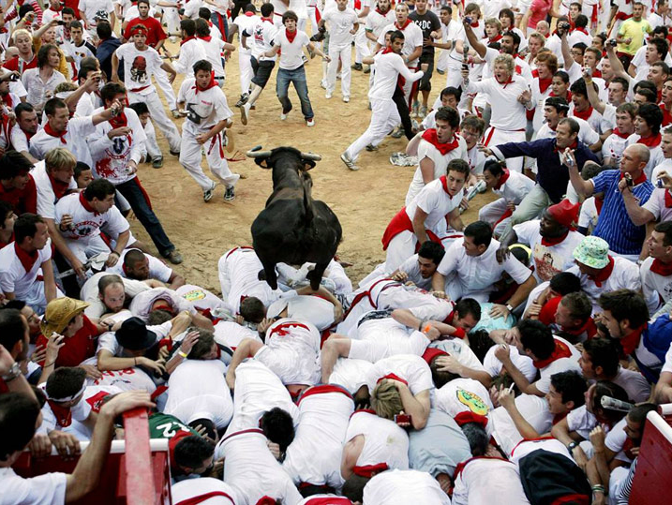

Slide 21
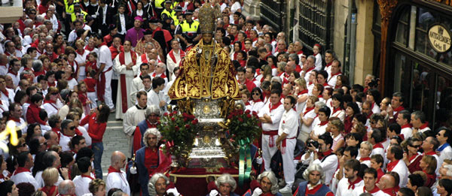
The big procession
The religious aspect of the festival.

Slide 22
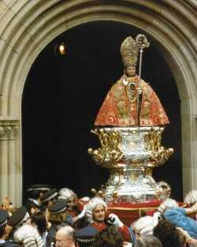

Slide 23
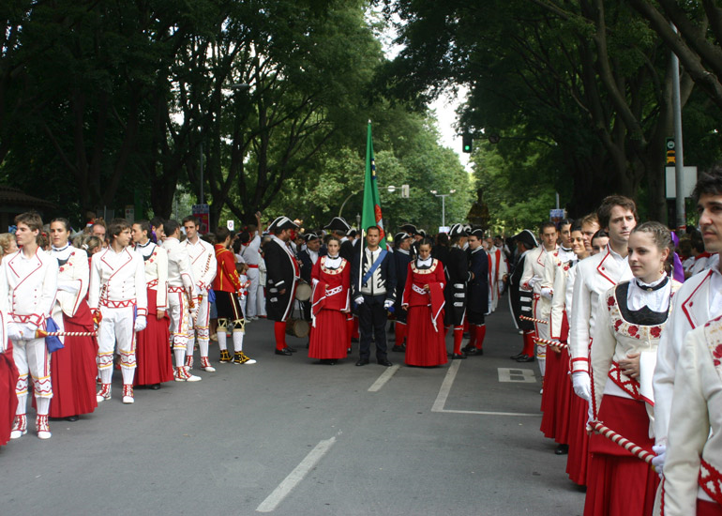

Slide 24
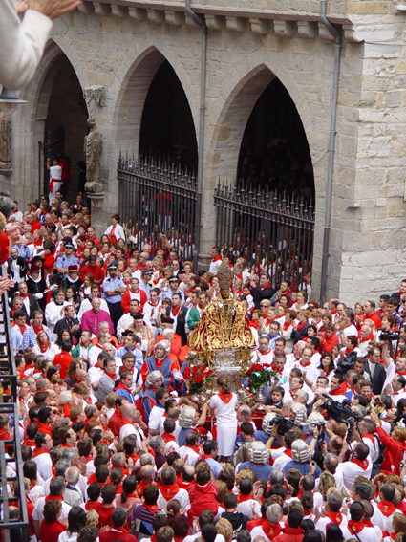

Slide 25
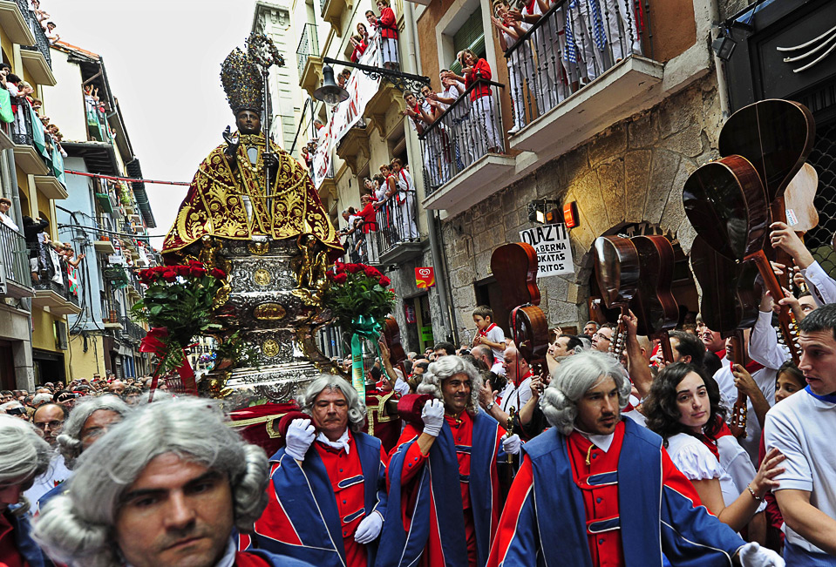

Slide 26
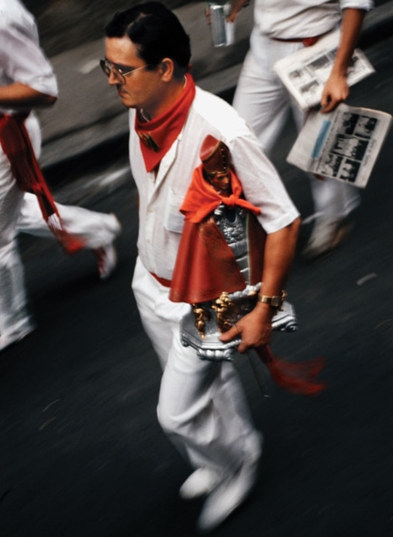

Slide 27
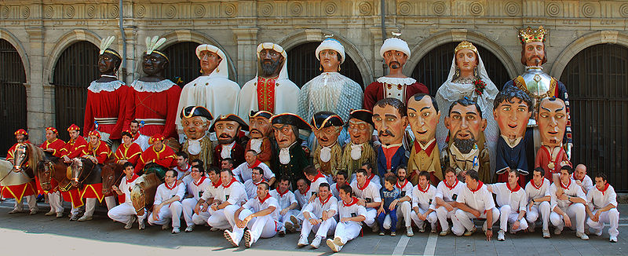
Parade of the giants
All figures from the Pamplona's giants and big-heads parade

Slide 28
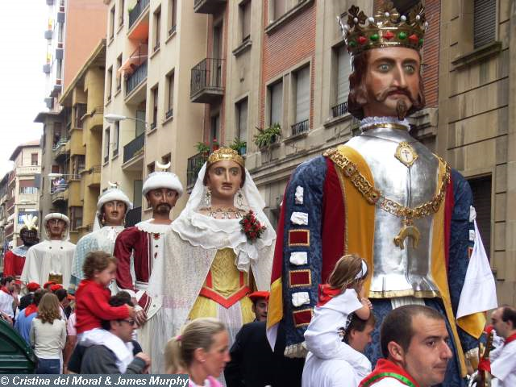

Slide 29
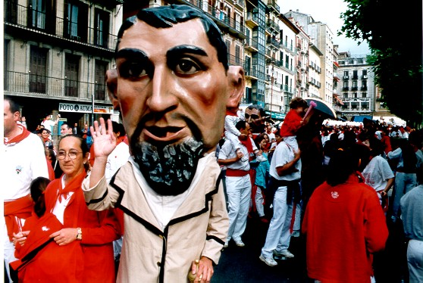

Slide 30
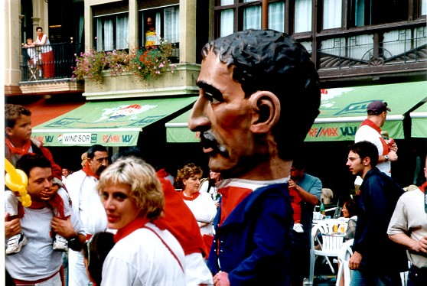

Slide 31
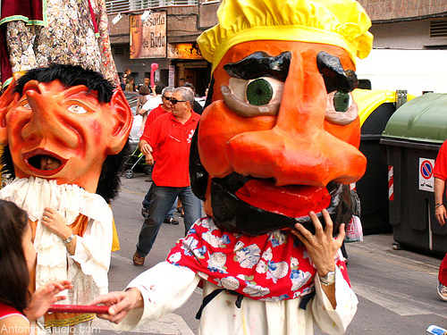

Slide 32
