Slide 1
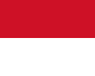
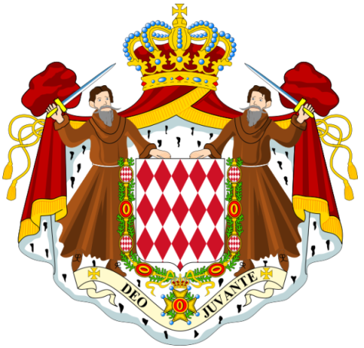
Monaco

Slide 2
Monaco
Its area is 1.98 km2 (0.76 sq mi) with a population of 35,986 as of 2011. Monaco boasts the world's highest GDP nominal per capita at $215,163 and is the most densely populated country in the world. Monaco also has the world's highest life expectancy at almost 90 years, and the lowest unemployment rate. After a recent expansion of Port Hercule Monaco's total area is 2.05 km2 (0.79 sq mi), with new plans to extend the district of Fontvieille, with land reclaimed from the Mediterranean Sea. Monaco is a principality governed under a form of constitutional monarchy, with Prince Albert II as head of state. The House of Grimaldi has ruled Monaco since 1297, and the state's sovereignty was officially recognized by the Franco-Monegasque Treaty of 1861. Despite Monaco being independent and pursuing its own foreign policy course, its national defence is the responsibility of France.

Slide 3
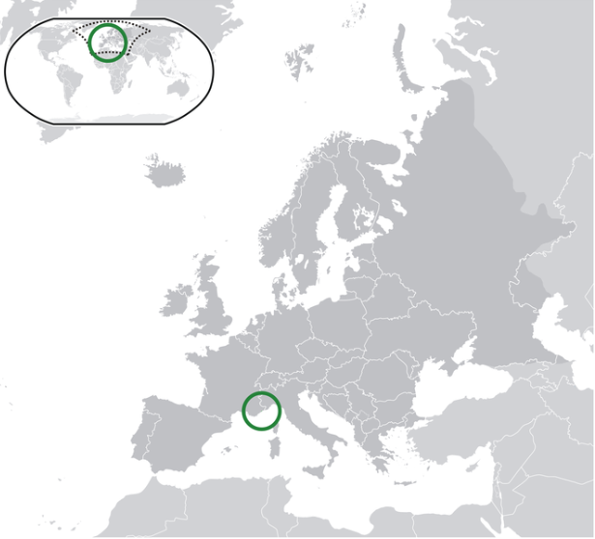

Slide 4
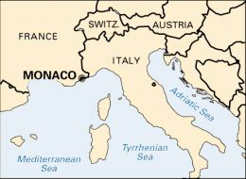

Slide 5
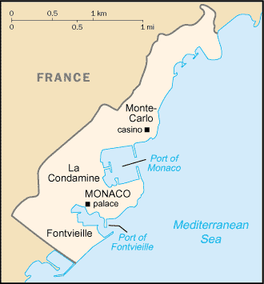

Slide 6
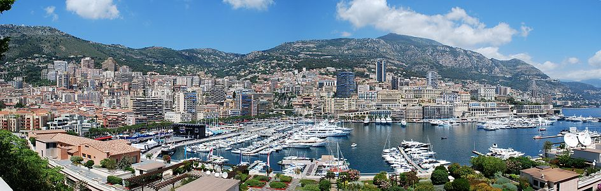

Slide 7
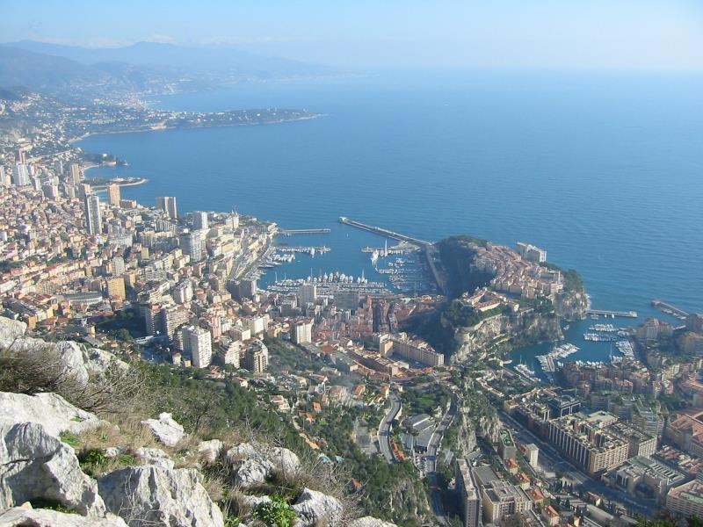

Slide 8
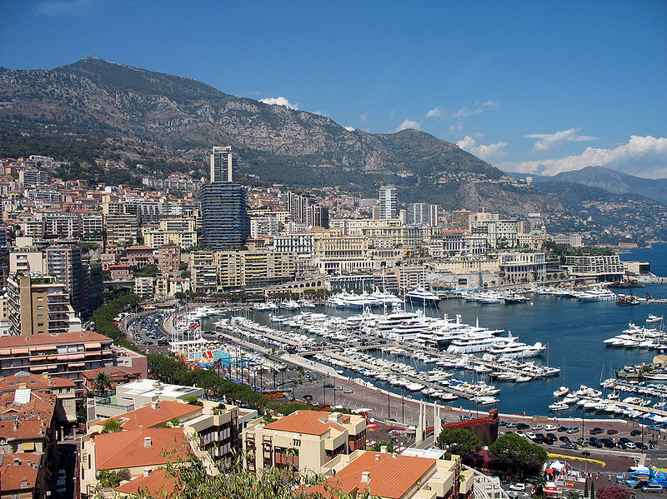
View of the Port of Hercules, La Condamine, Monaco

Slide 9
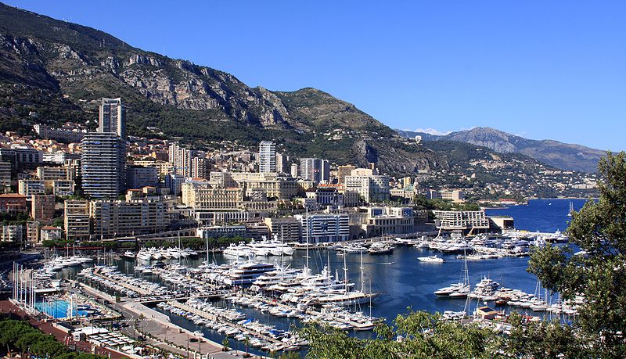

Slide 10
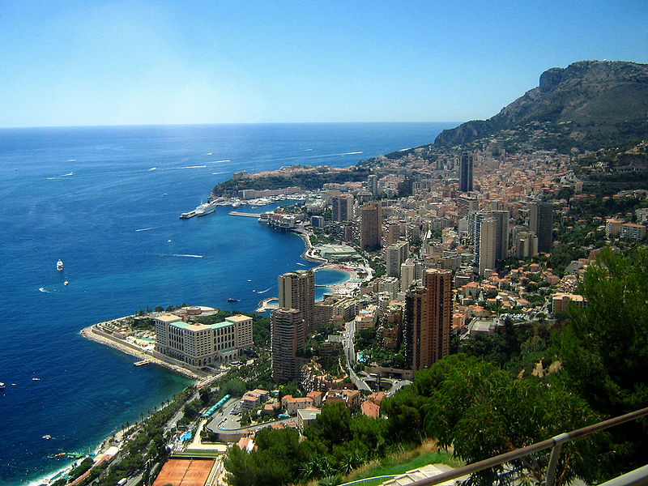

Slide 11
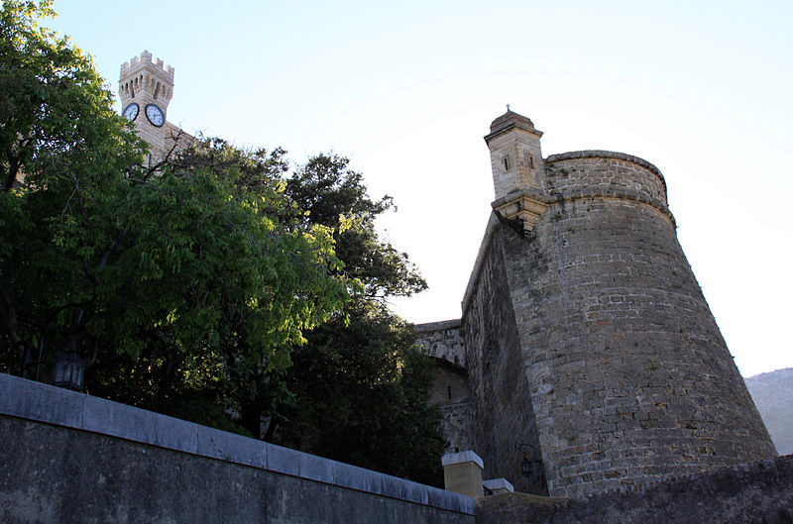
The palace

Slide 12
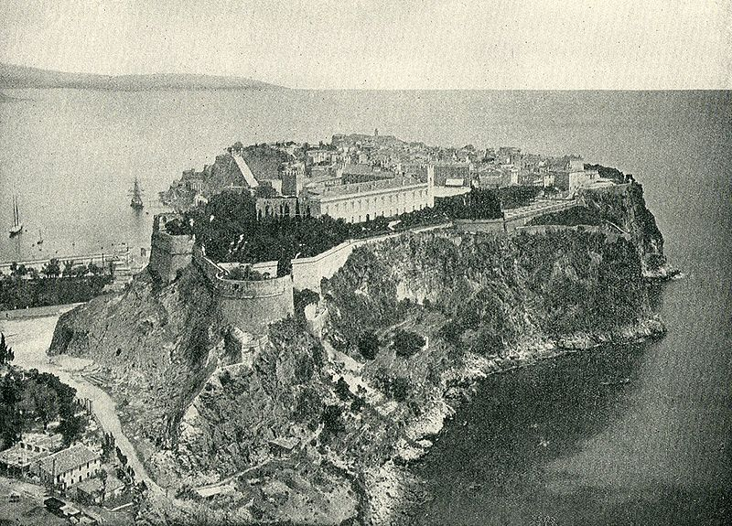
The Palace in 1890

Slide 13
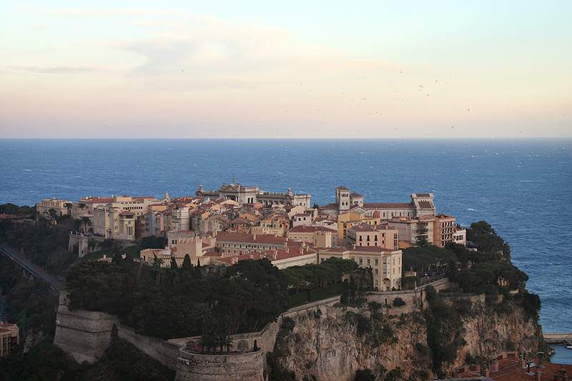

Slide 14
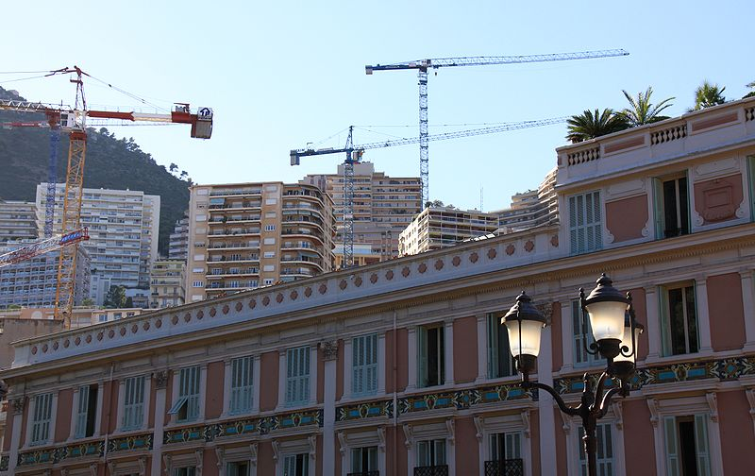
Palace in the Foreground

Slide 15
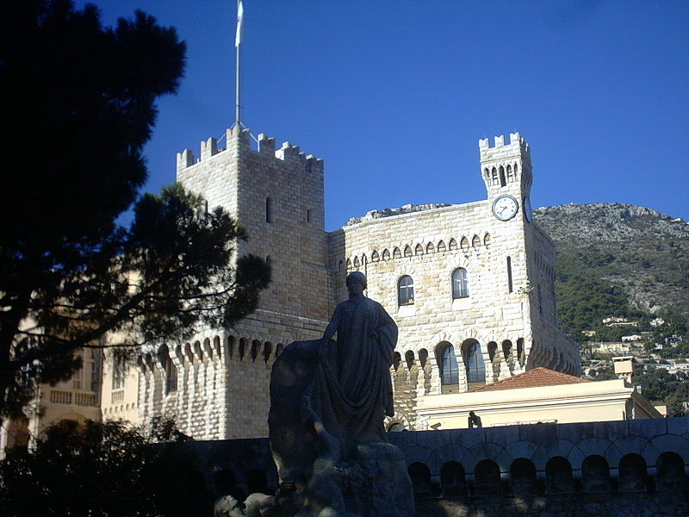

Slide 16
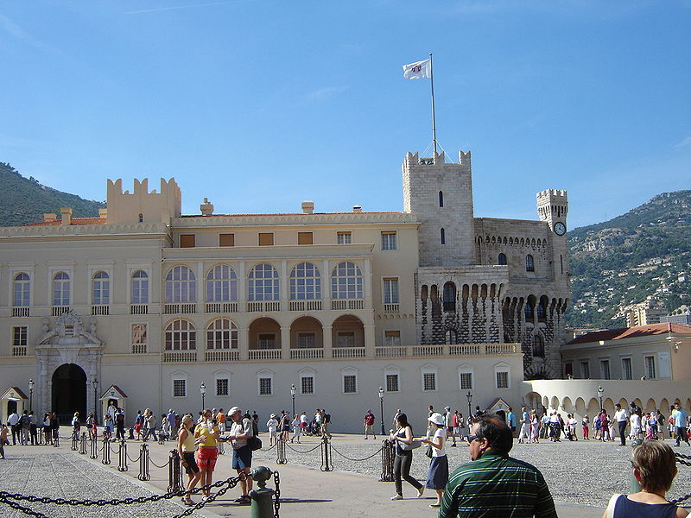

Slide 17
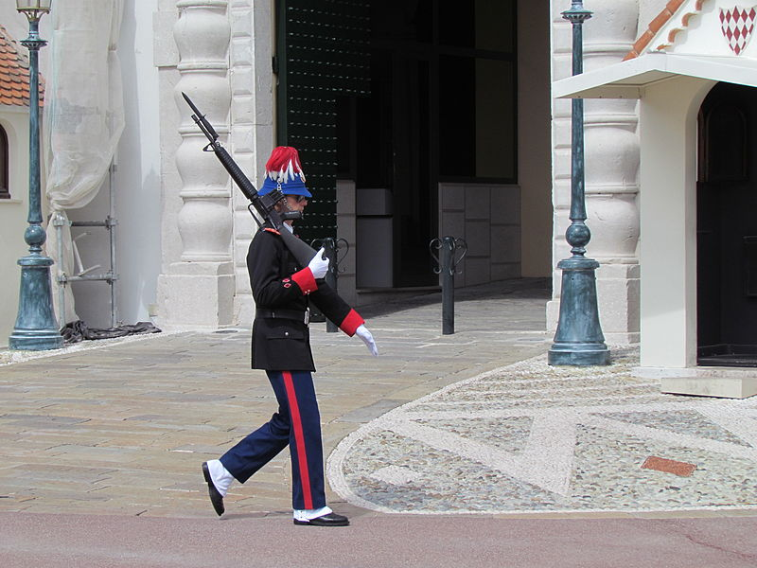
Palace Guard

Slide 18
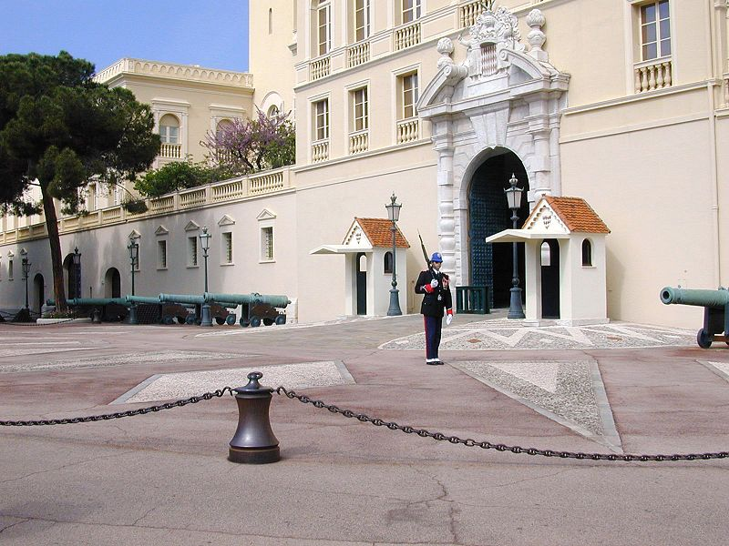

Slide 19
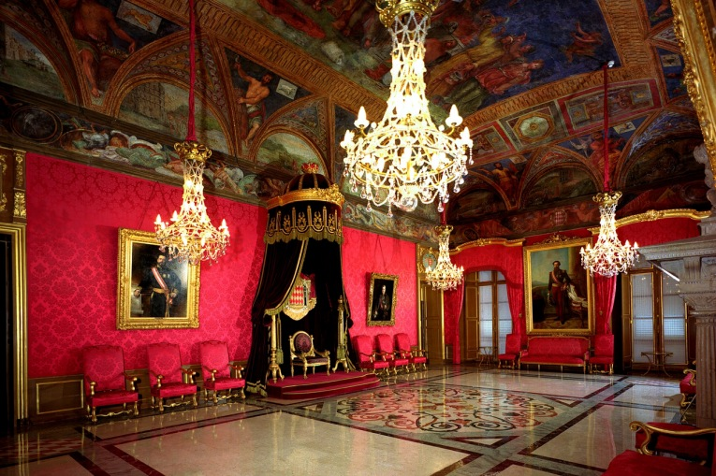
Throne Room

Slide 20
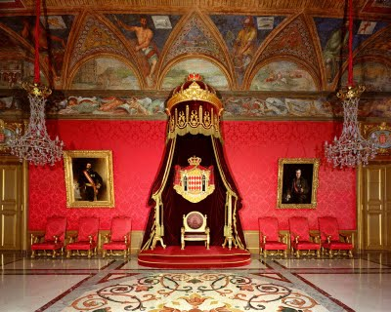

Slide 21
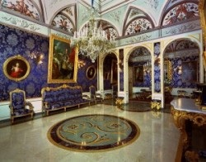
The Blue Drawing room

Slide 22
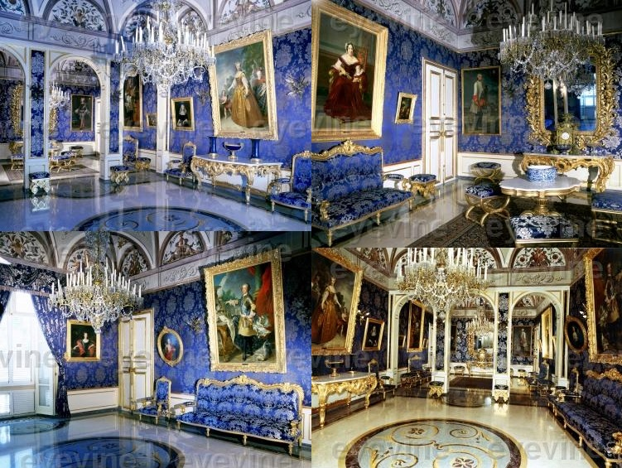

Slide 23
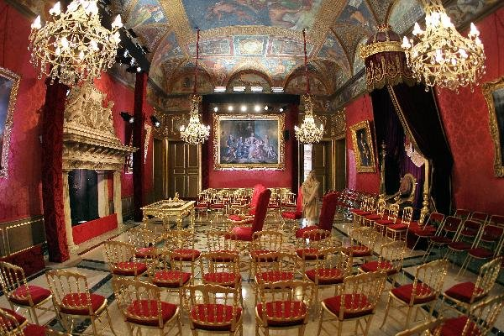
Throne Room prepared for the civil wedding ceremony

Slide 24
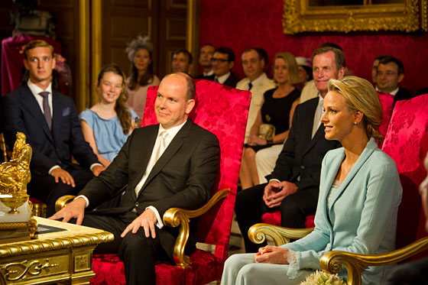
The civil ceremony

Slide 25
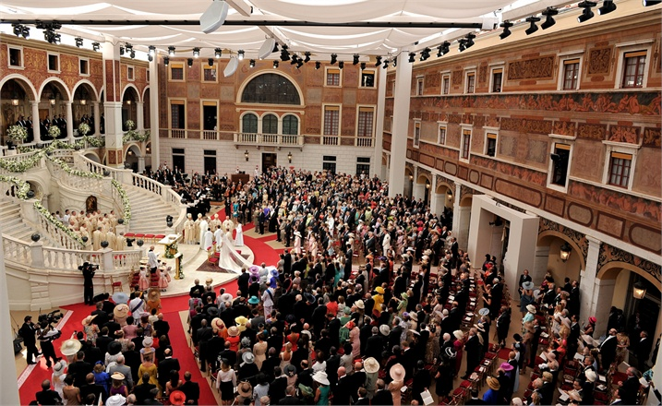
Inner-Palace Courtyard

Slide 26
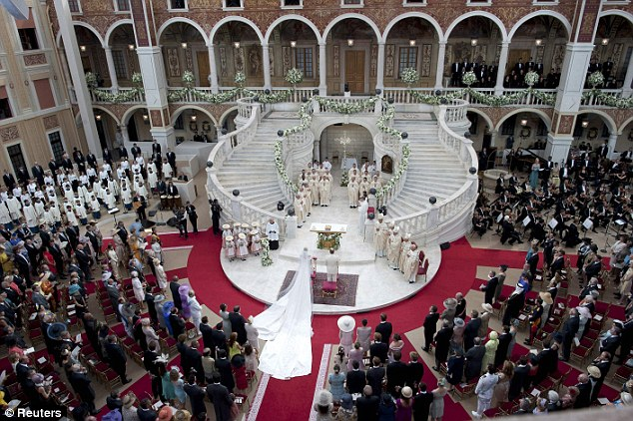
Prince Albert’s Palace Wedding 7/4/2011

Slide 27
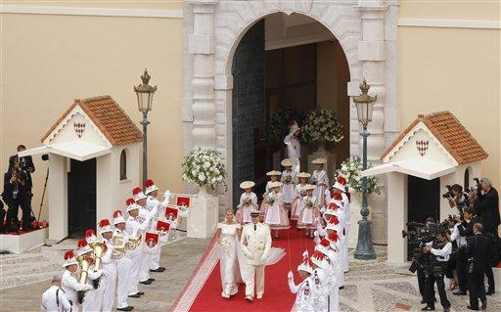
Prince Albert’s wedding July 4, 2011

Slide 28
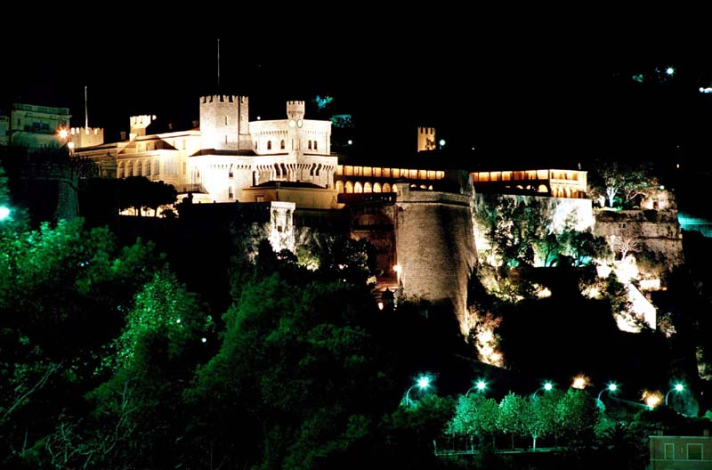
The Palace at Night

Slide 29
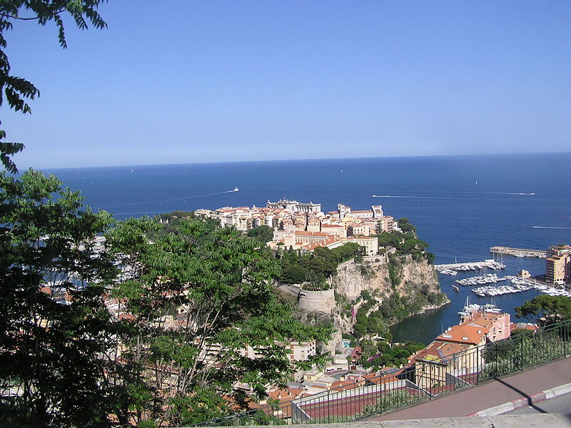
The Palace

Slide 30
Outside the palace Grounds

Slide 31
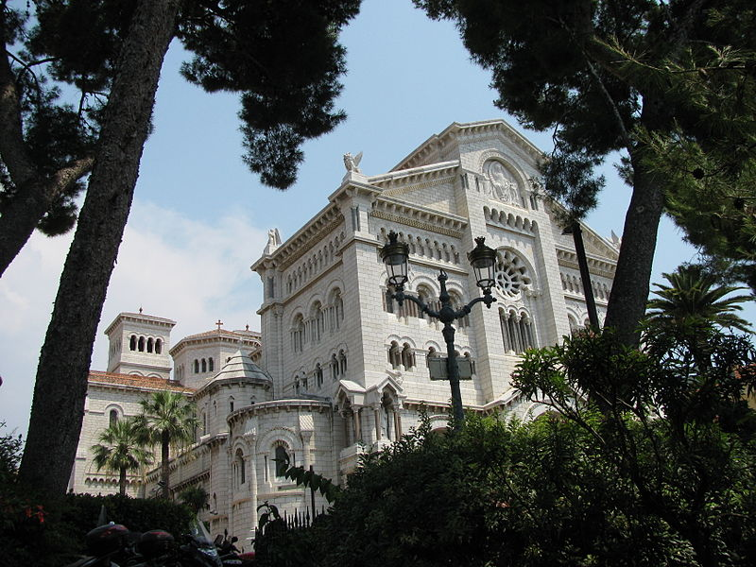
The Cathedral

Slide 32
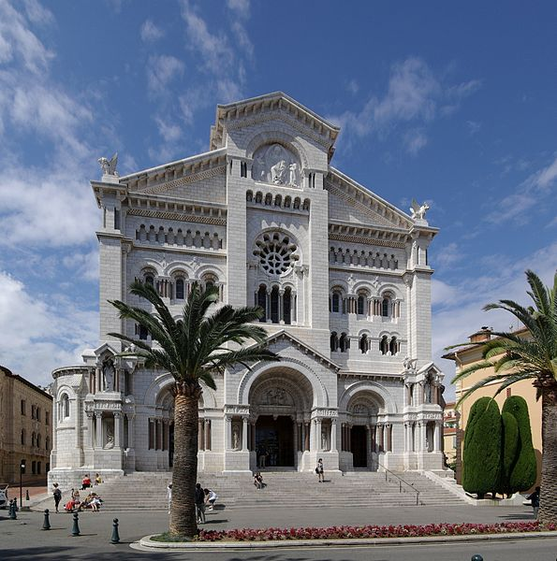

Slide 33
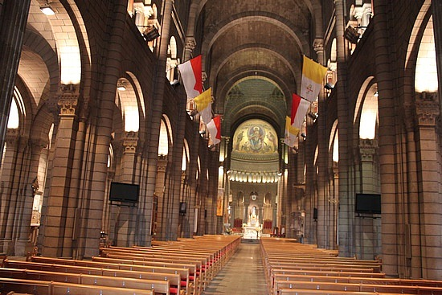
Cathedral Interior

Slide 34
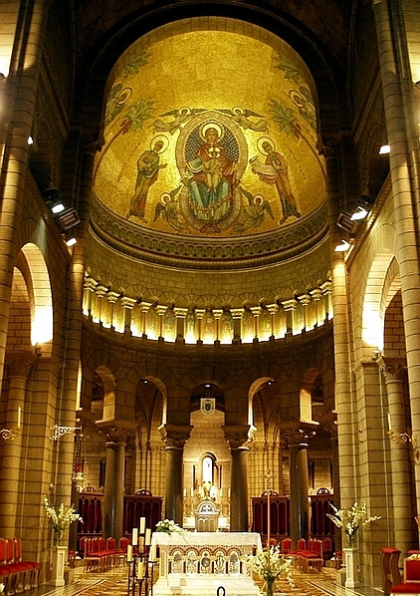
The Cathedral Sanctuary

Slide 35
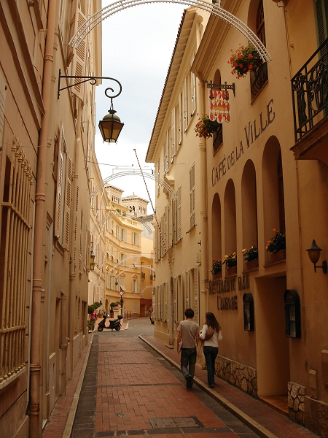
Old town scenes

Slide 36
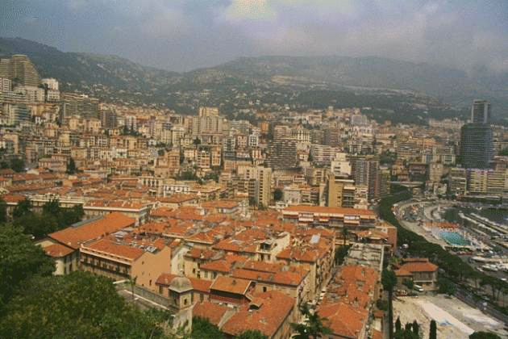
Old Town in the Foreground

Slide 37
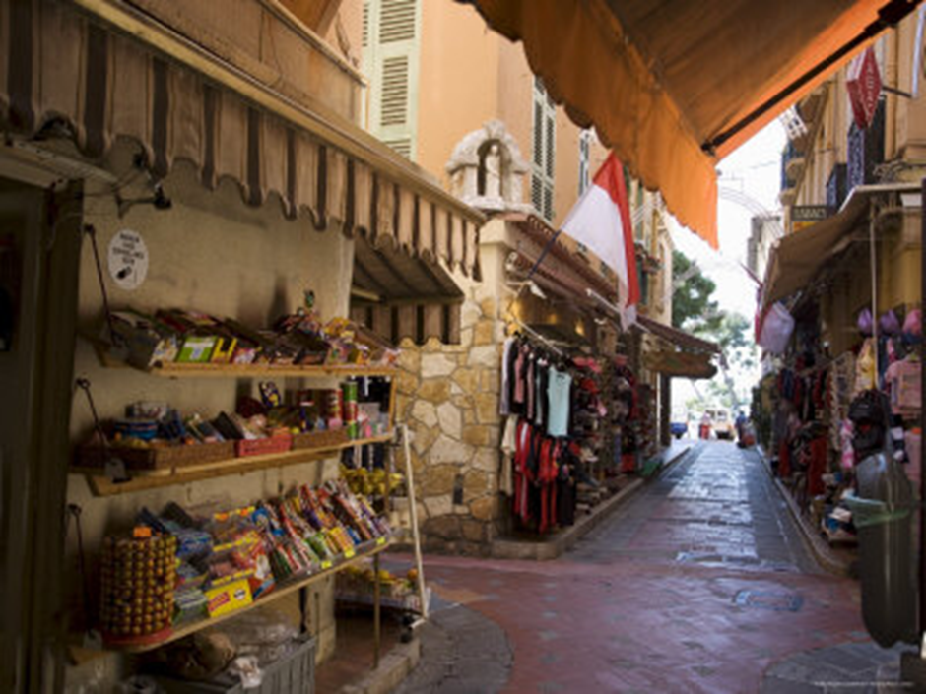

Slide 38
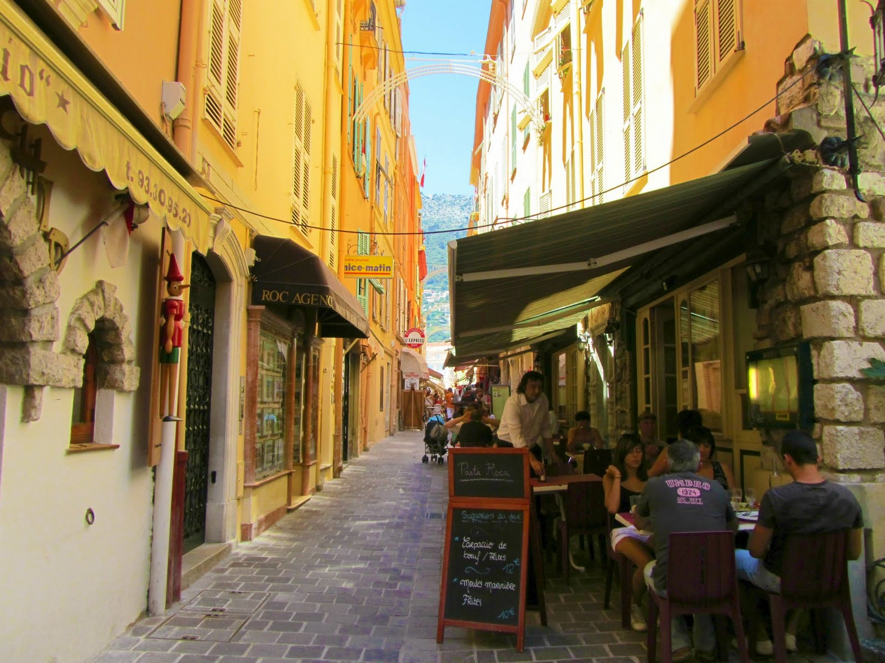

Slide 39
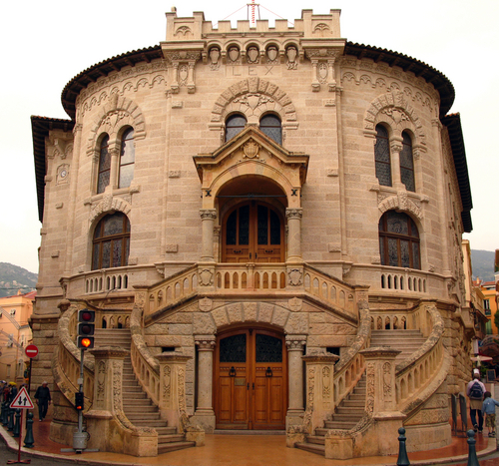
Palace of Justice

Slide 40
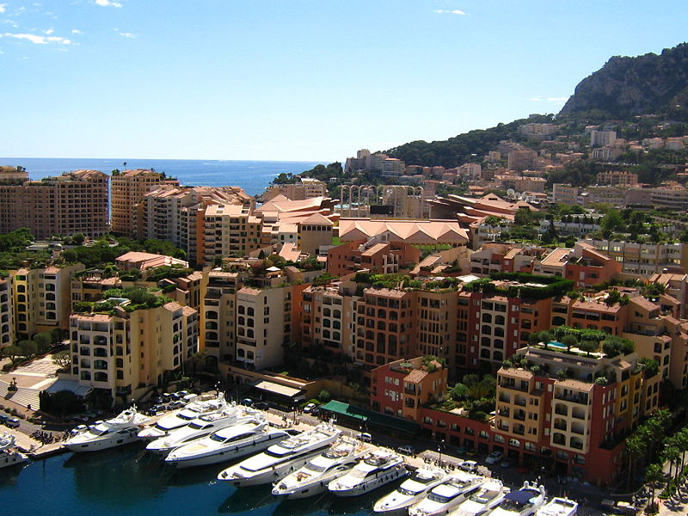
Fontvieille and its new harbour

Slide 41
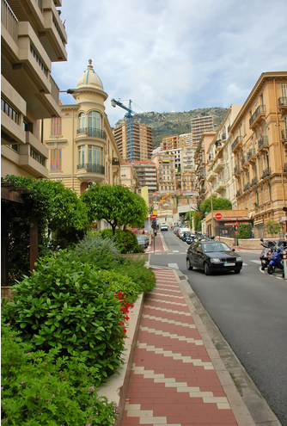
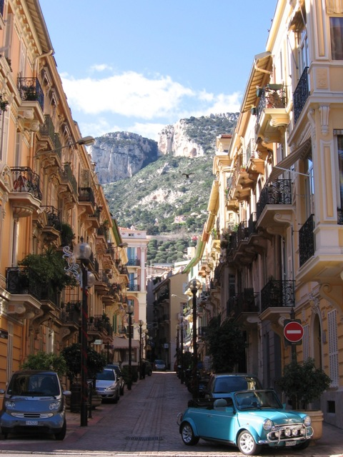
Street scenes

Slide 42
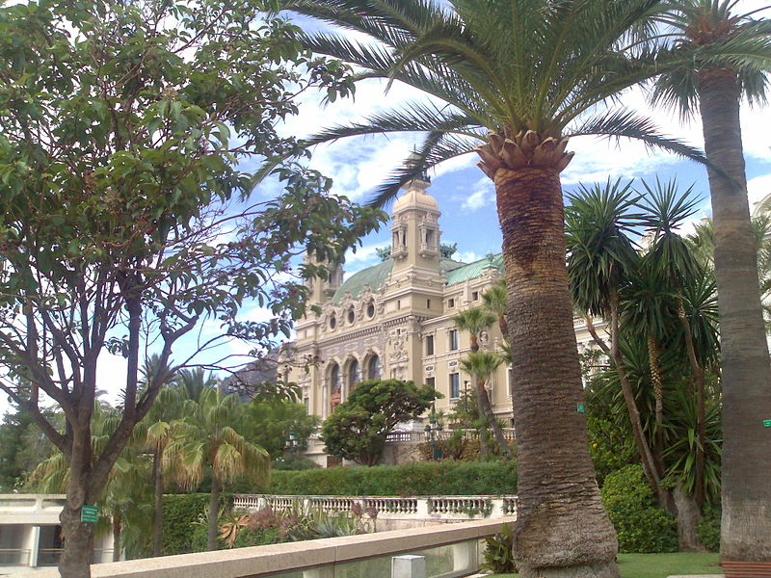
Monte Carlo Casino

Slide 43
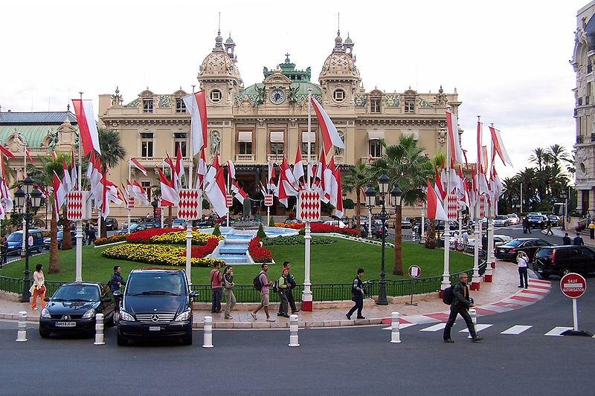
Monte Carlo Front View

Slide 44
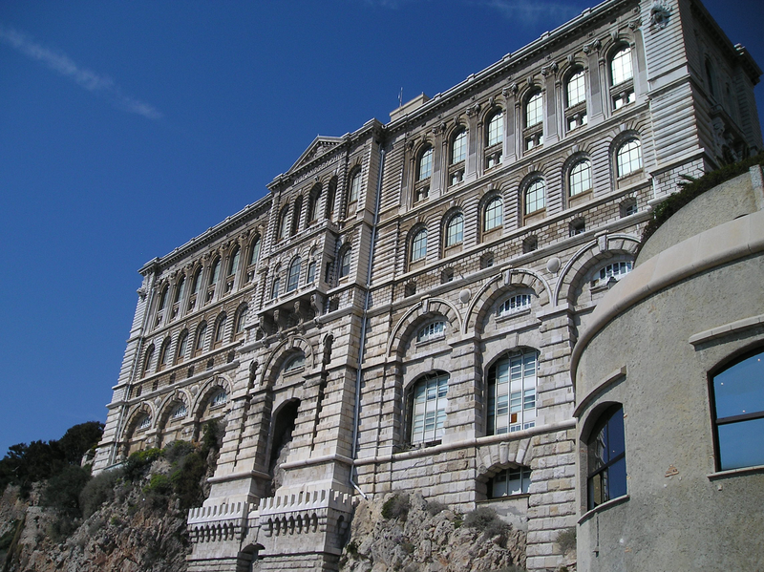
Monaco Oceanographic Institute

Slide 45
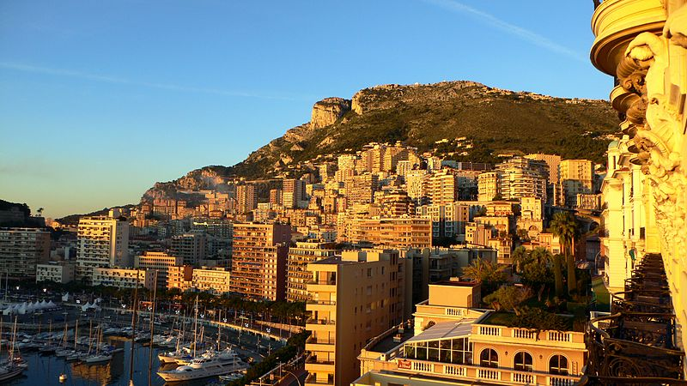
Sunset in Monaco

