Slide 1
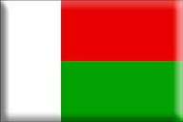
Madagascar

Slide 2
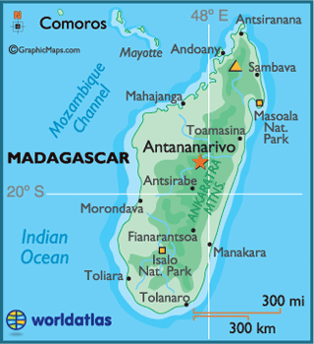
Region: Southeast Africa (Island Nation)
Area total: 587,041 km2
Coast line: Indian Ocean
Capital: Antananarivo

Slide 3
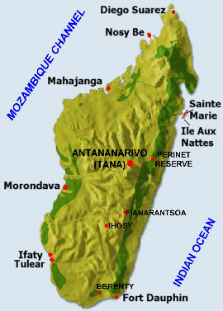
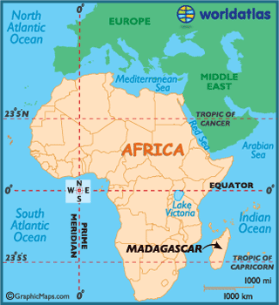

Slide 4
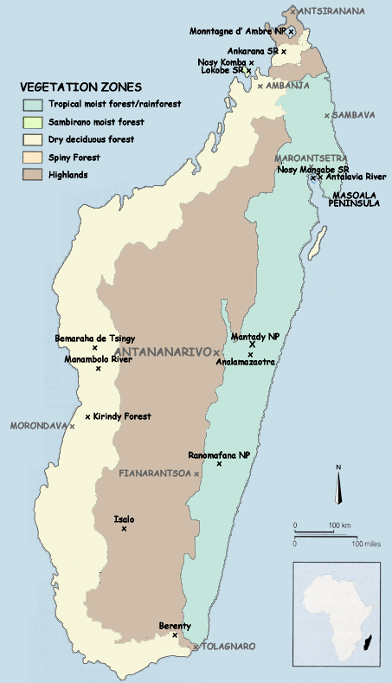
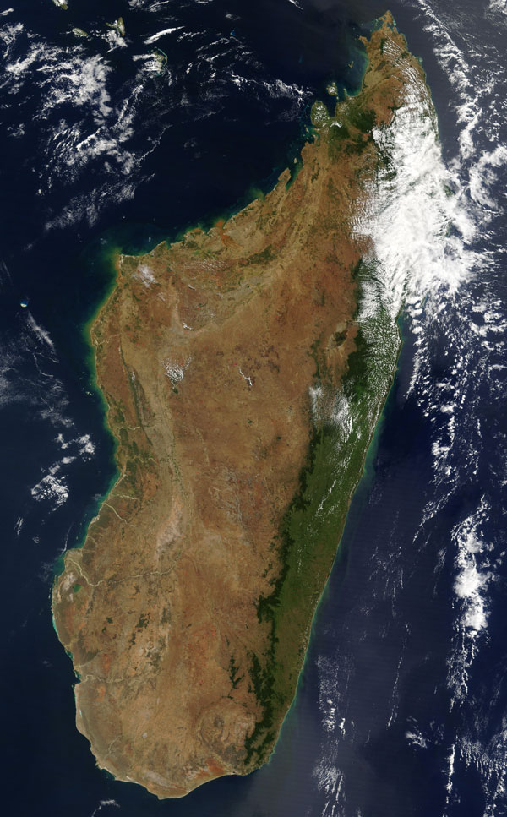

Slide 5
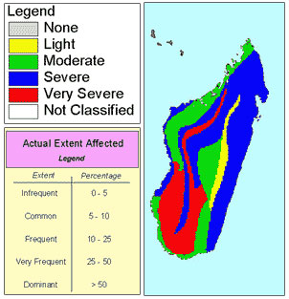
Map showing human induced soil degradation and erosion in Madagascar

Slide 6
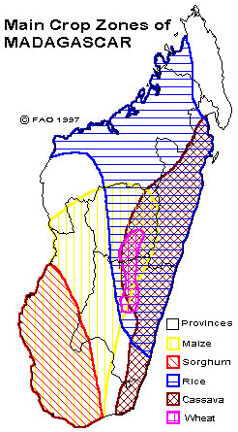
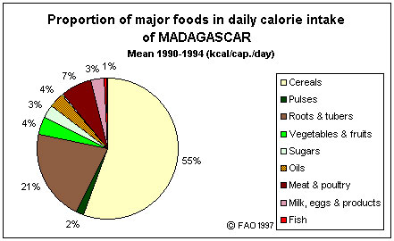

Slide 7
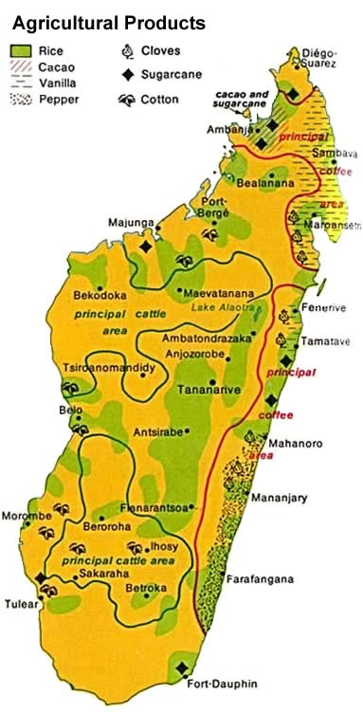
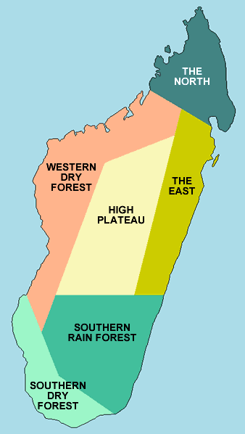

Slide 8
Cities & Towns

Slide 9
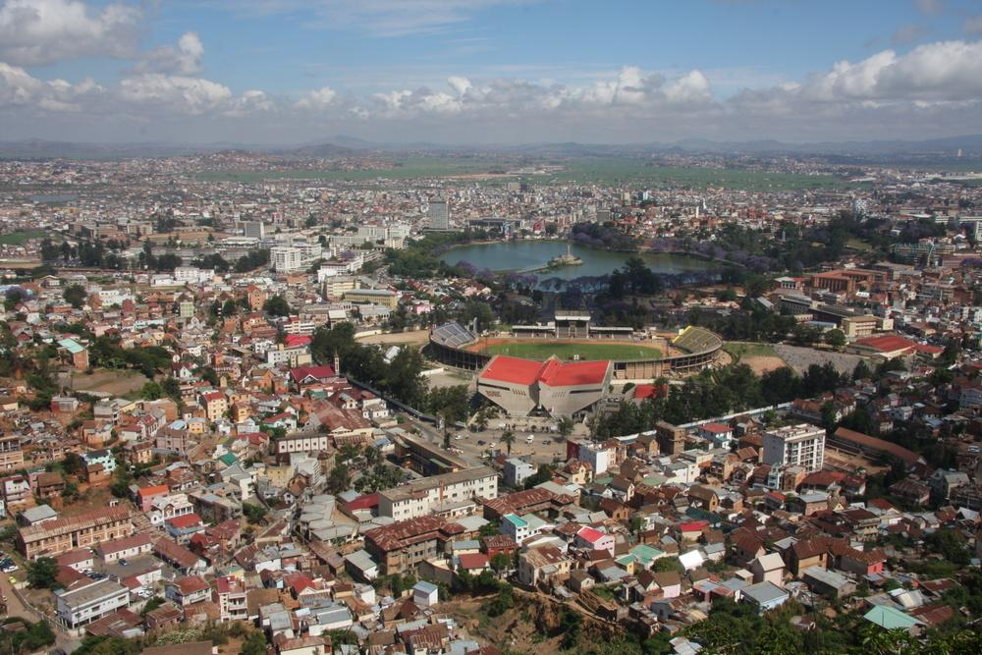
Antananarivo

Slide 10
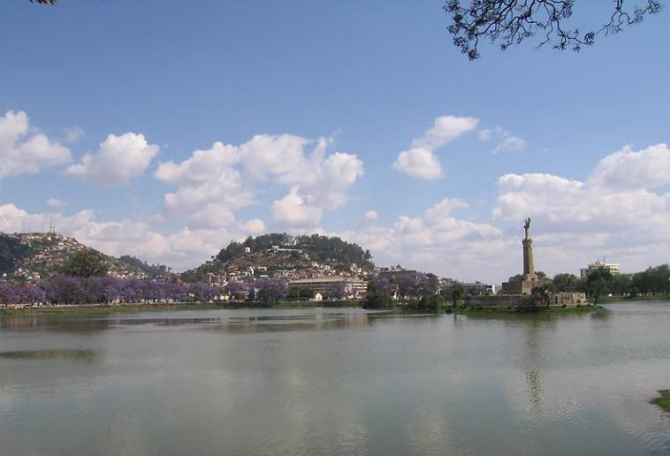

Slide 11
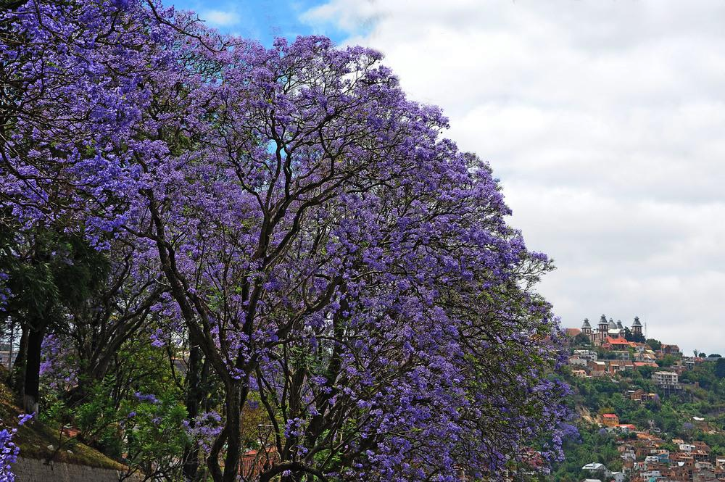
Spring in Antananarivo

Slide 12
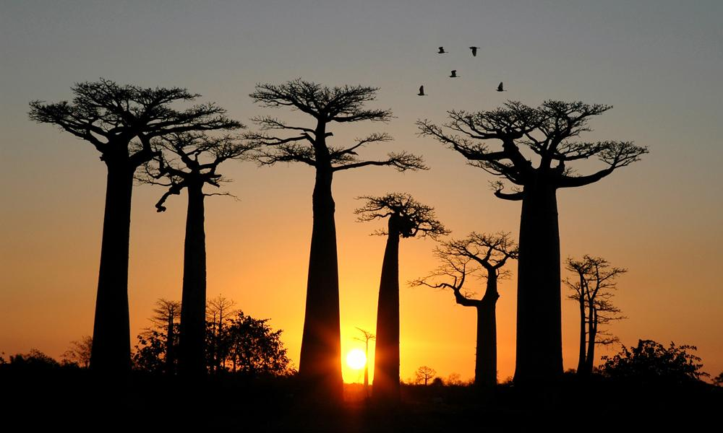
Baobab avenue

Slide 13
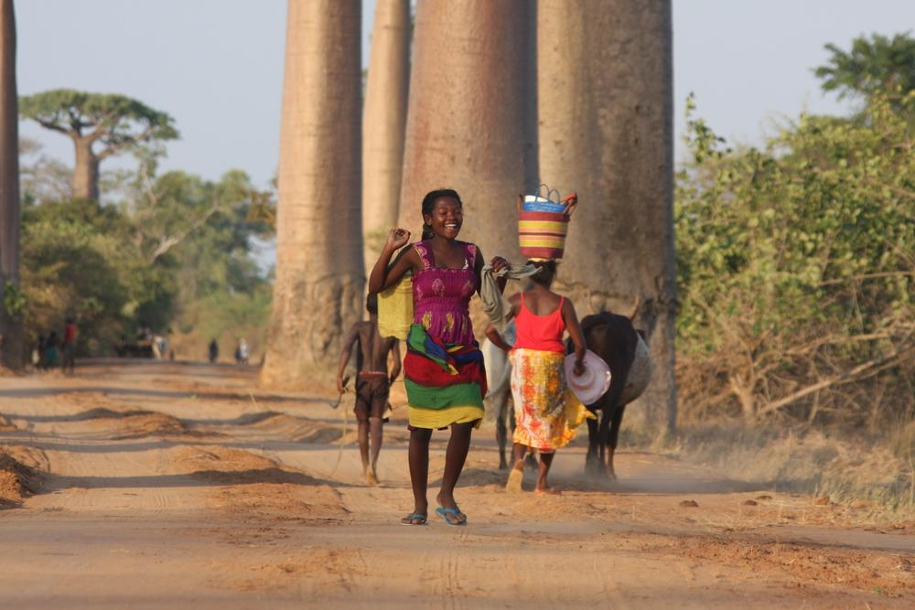
Baobab avenue

Slide 14
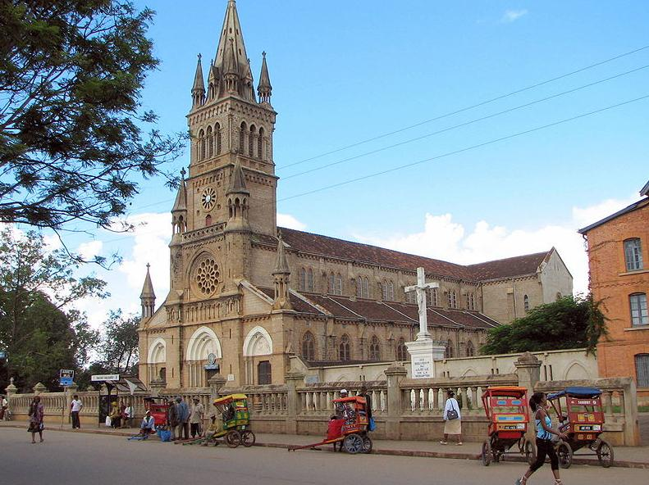
Roman Catholic cathedral in Antsirabe

Slide 15
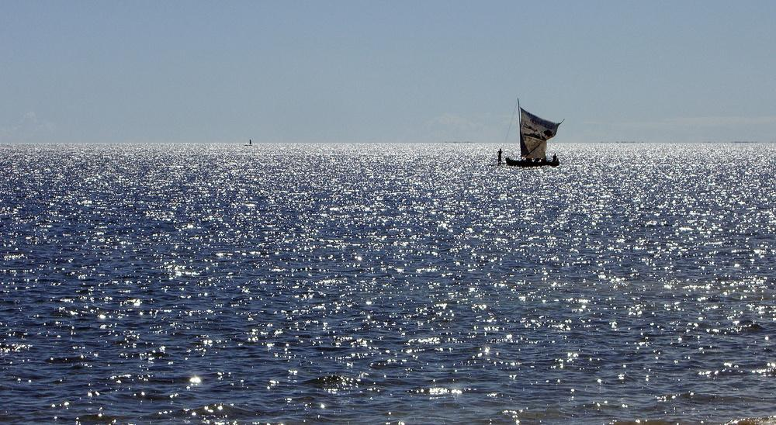

Slide 16
Natural Environment

Slide 17
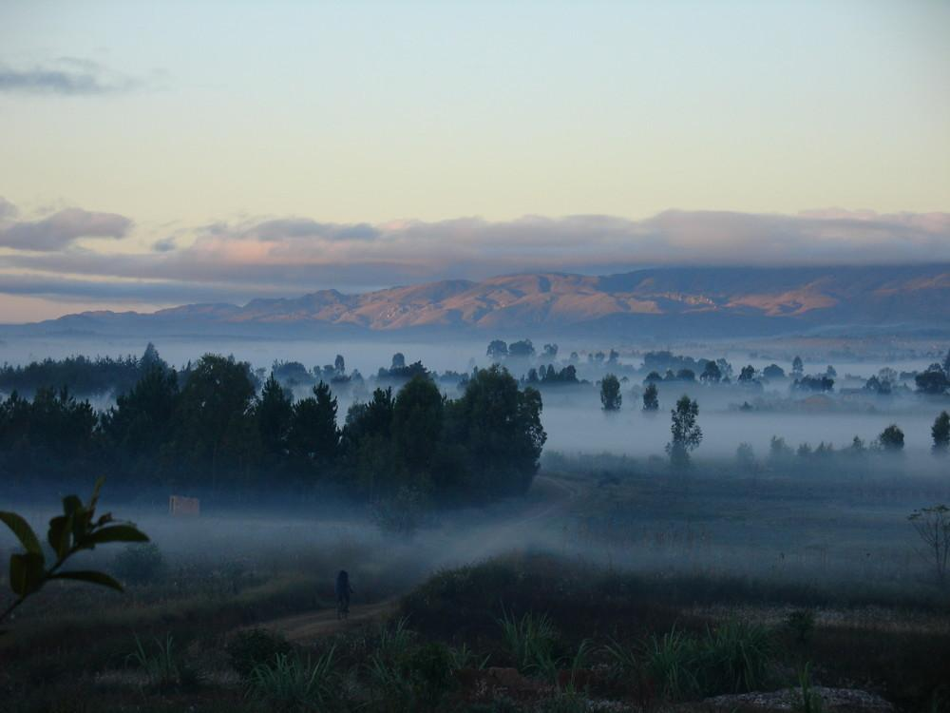
Malagasy landscape at dawn

Slide 18
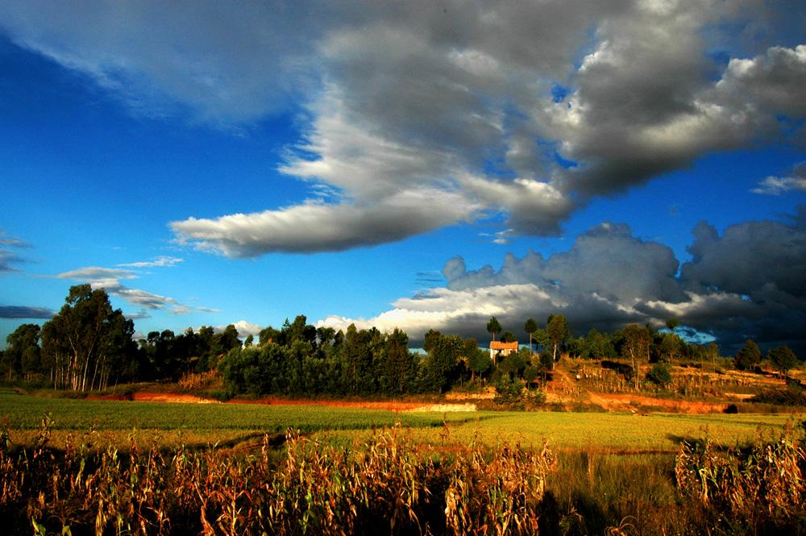
Madagascar highlands

Slide 19
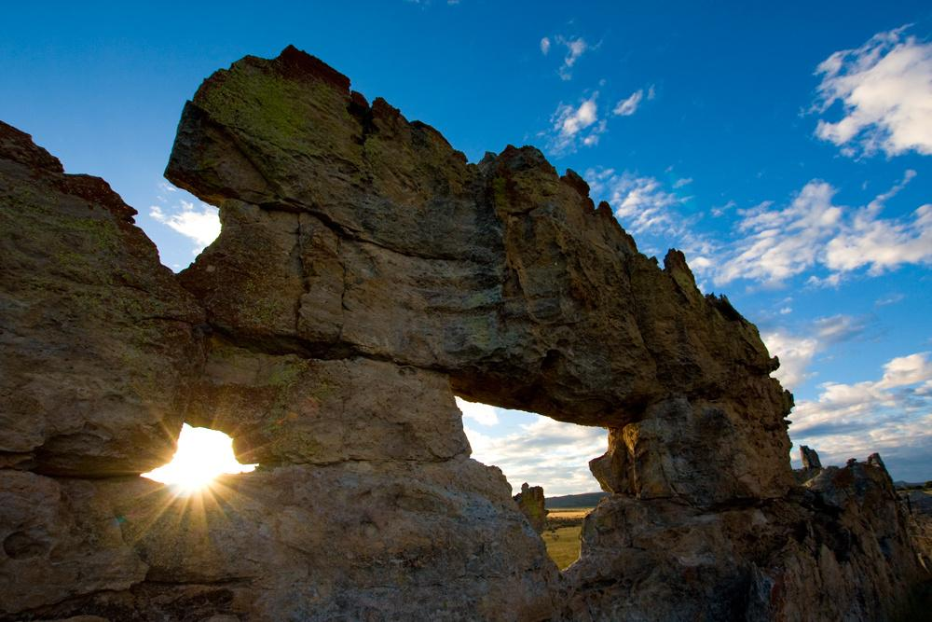
Isalo Mountains

Slide 20
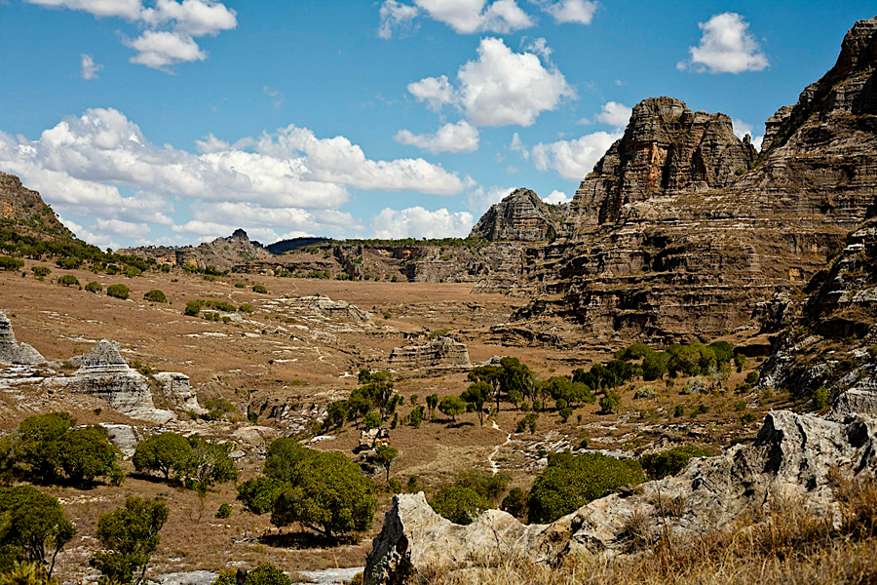

Slide 21
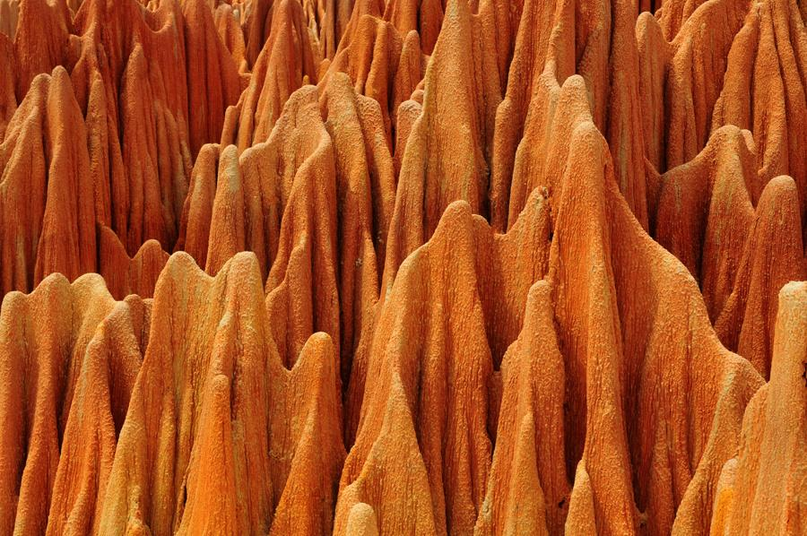
The red Tsingy in Madagascar-sand formation

Slide 22
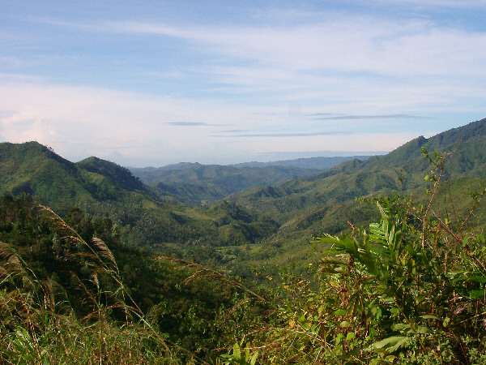

Slide 23
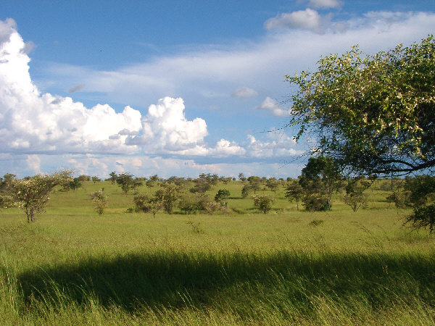

Slide 24
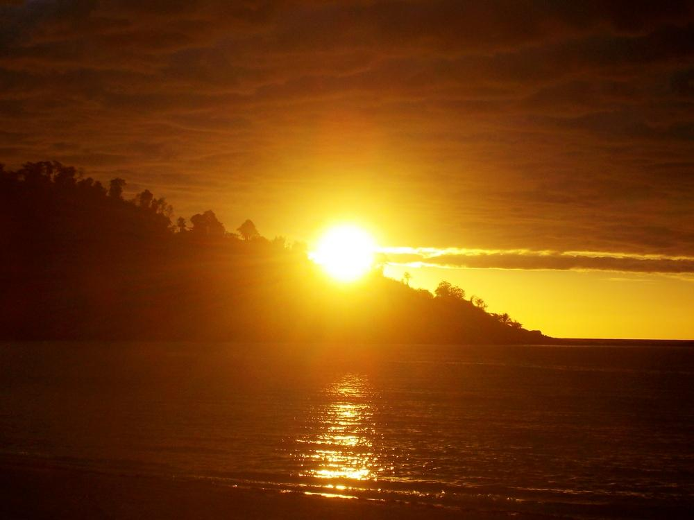
Nosy Be Sunset on Andilana Beach

Slide 25
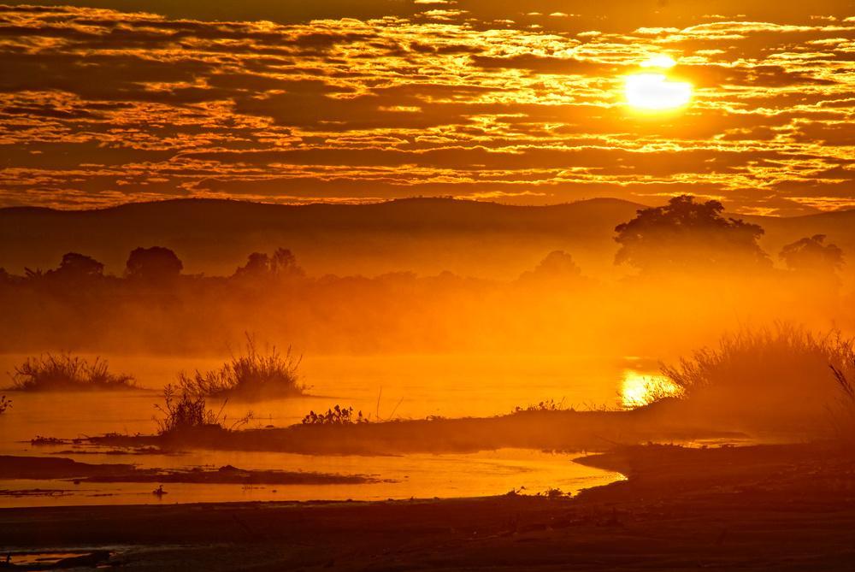

Slide 26
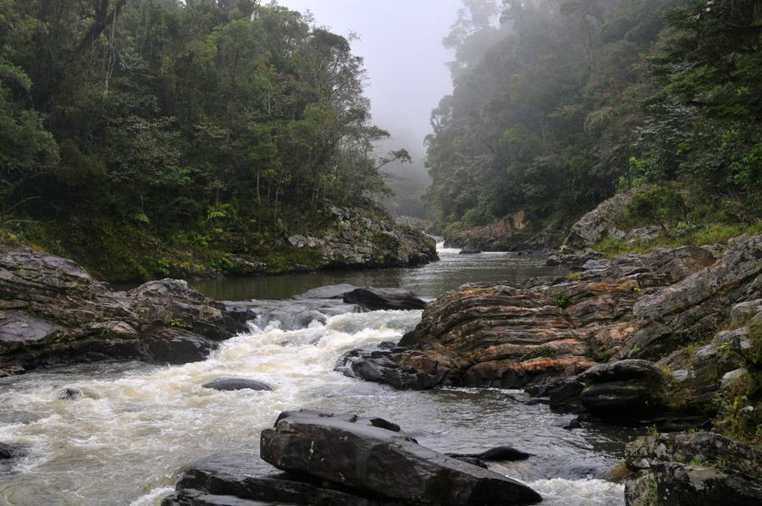

Slide 27
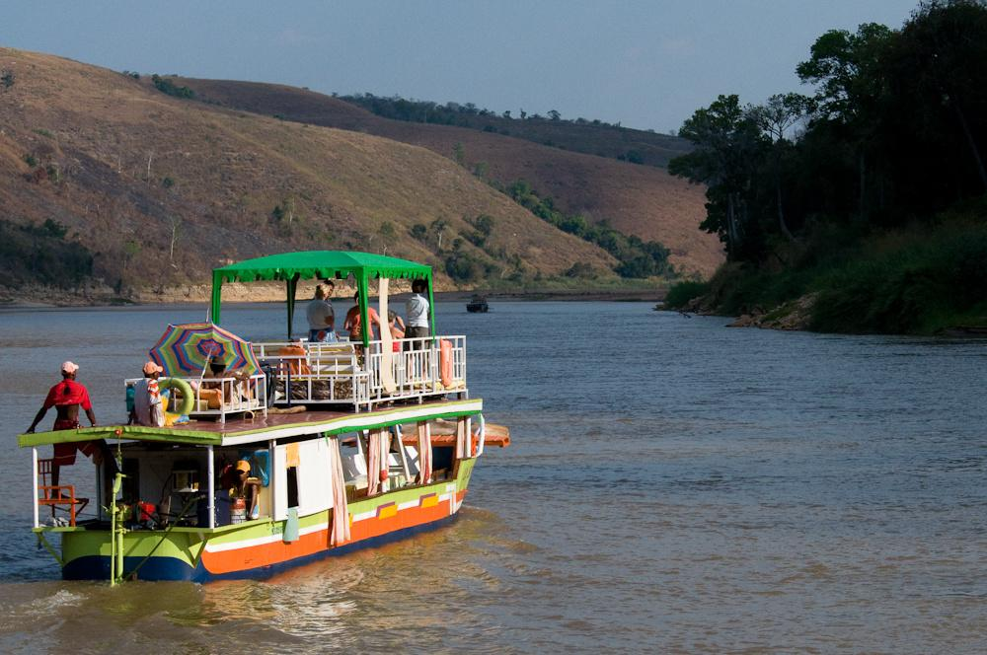
Sailing on the Tsiribihina

Slide 28
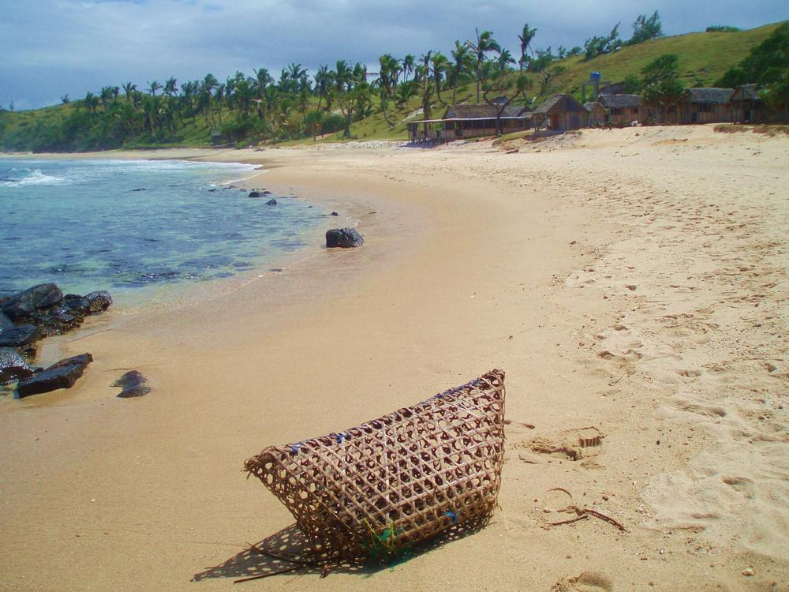
Ille-Saint-Marie

Slide 29
The People of madagascar

Slide 30
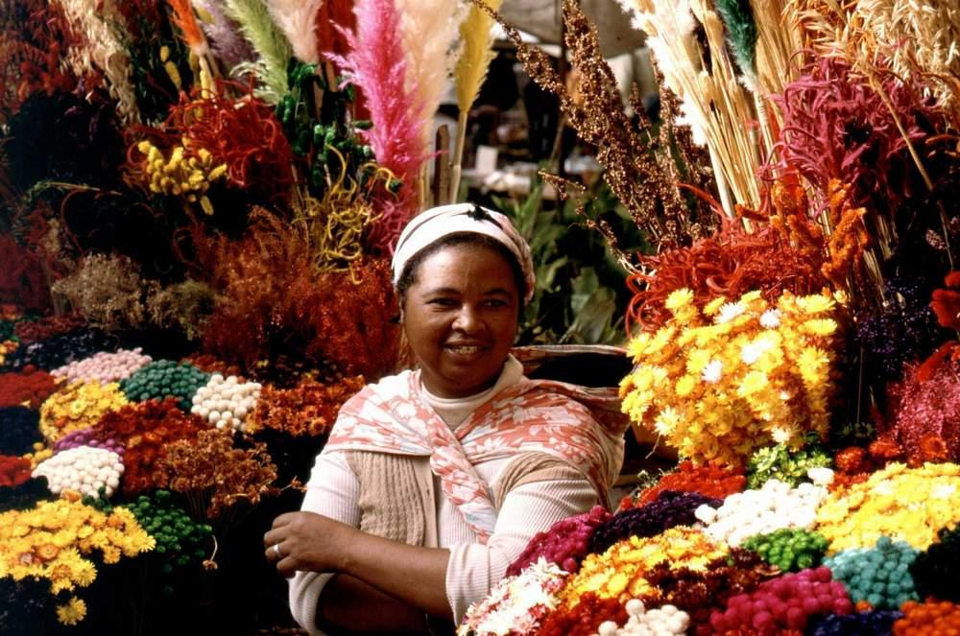

Slide 31
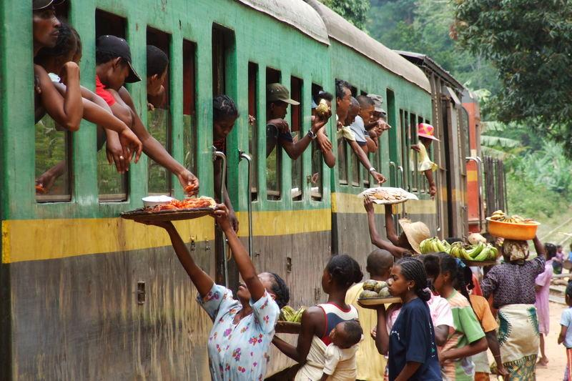

Slide 32
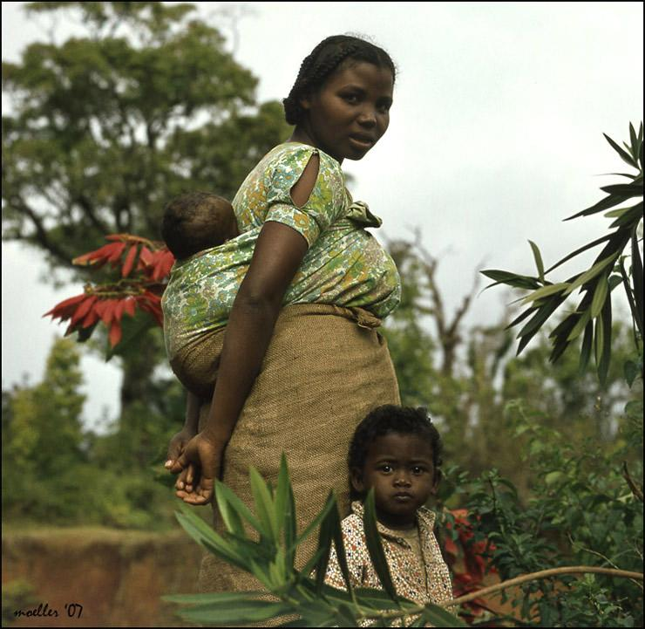

Slide 33
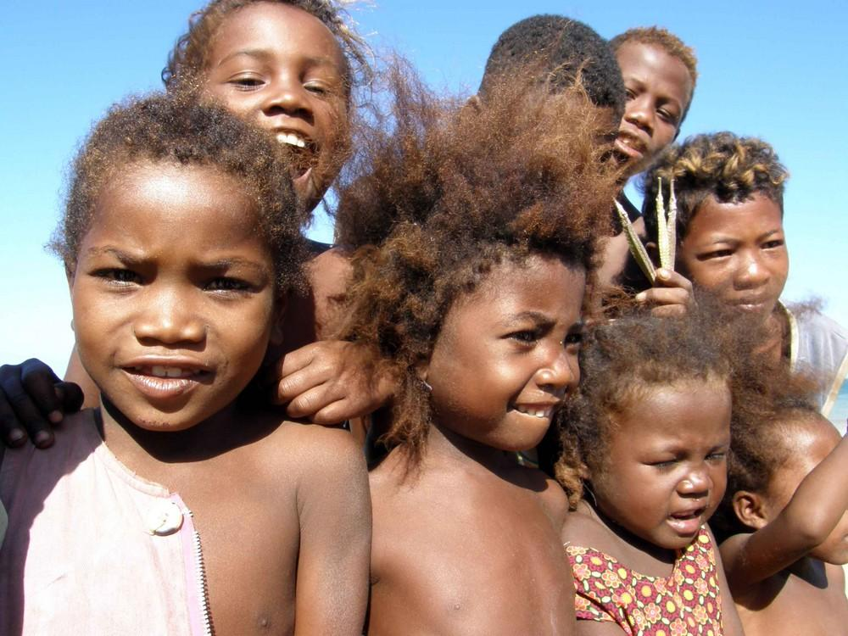

Slide 34
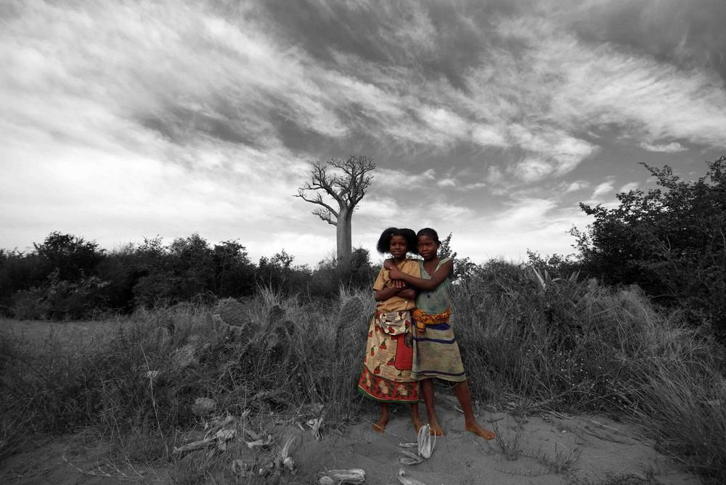

Slide 35
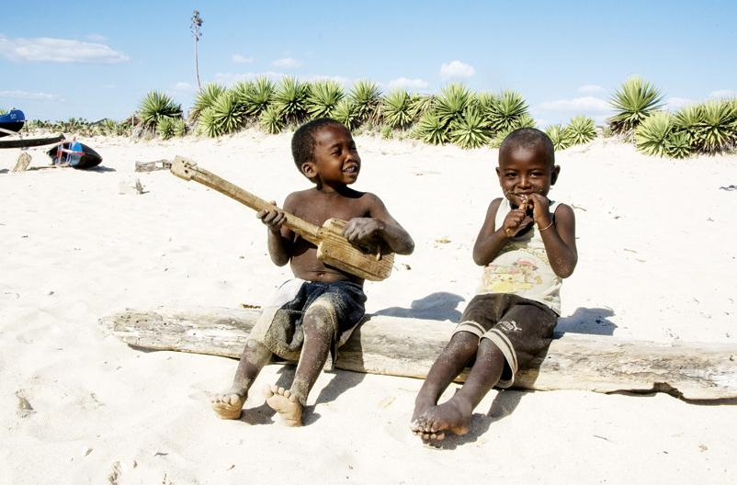

Slide 36
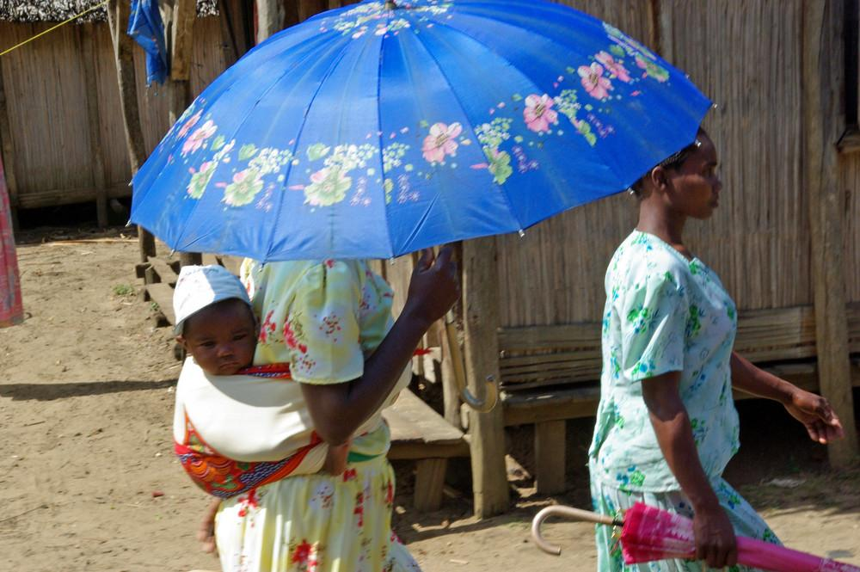

Slide 37
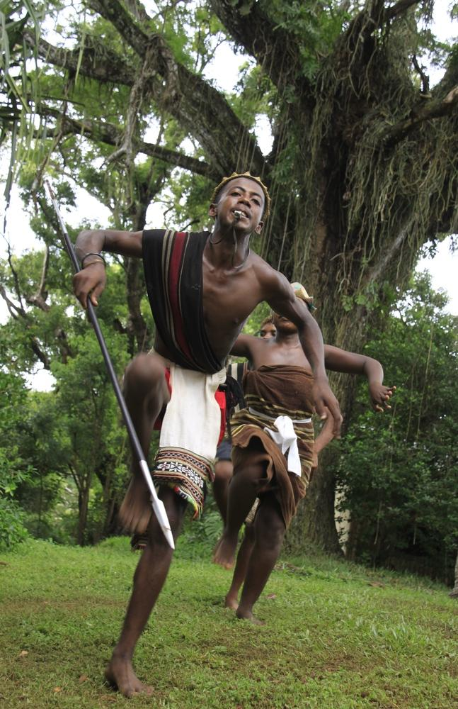

Slide 38
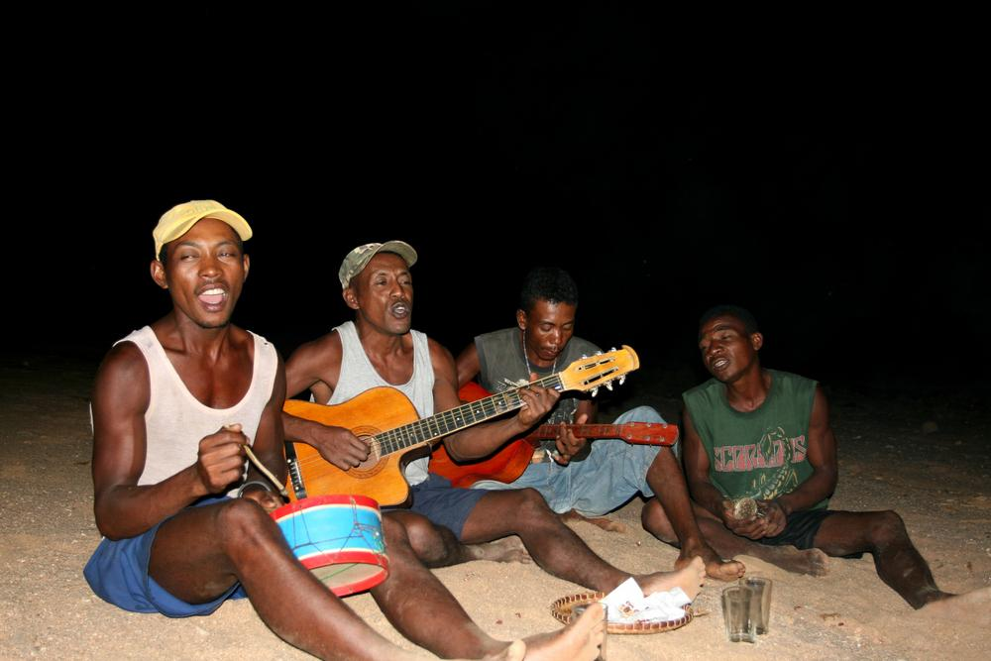

Slide 39
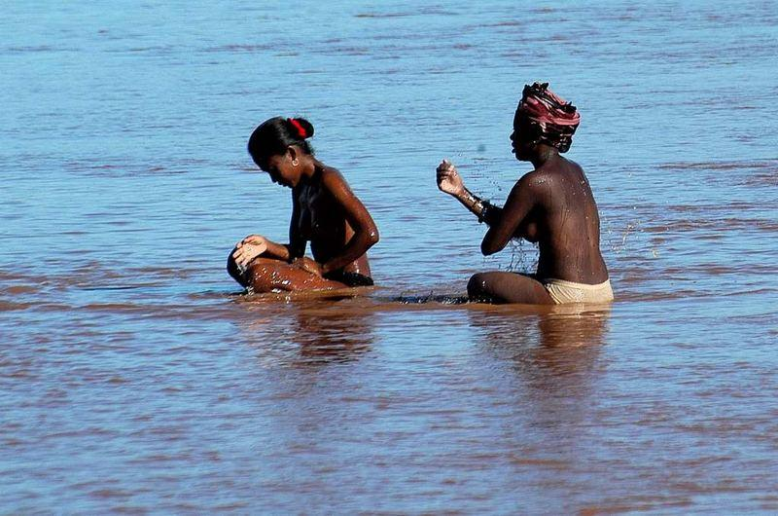

Slide 40
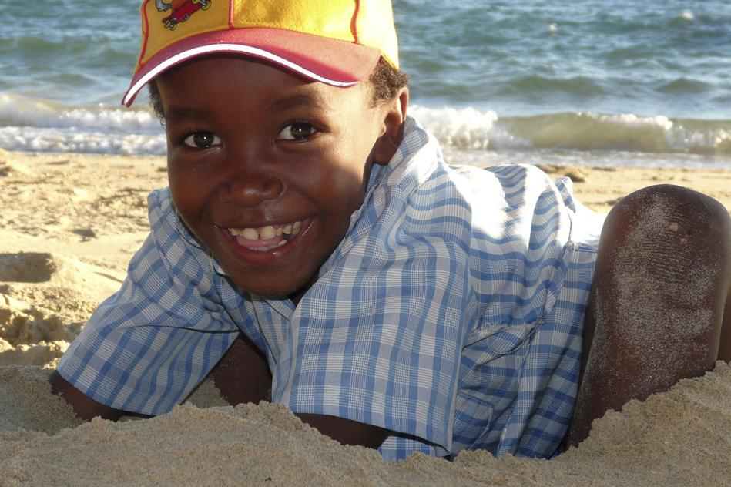

Slide 41
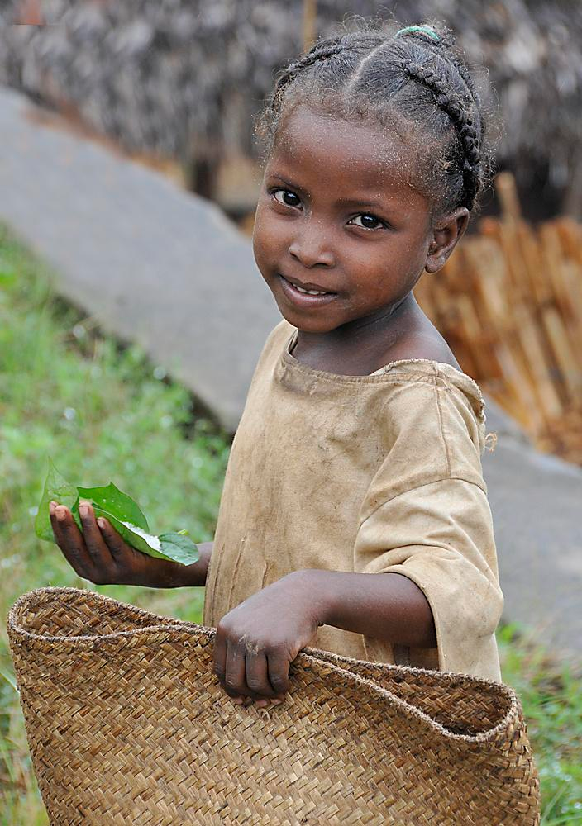

Slide 42
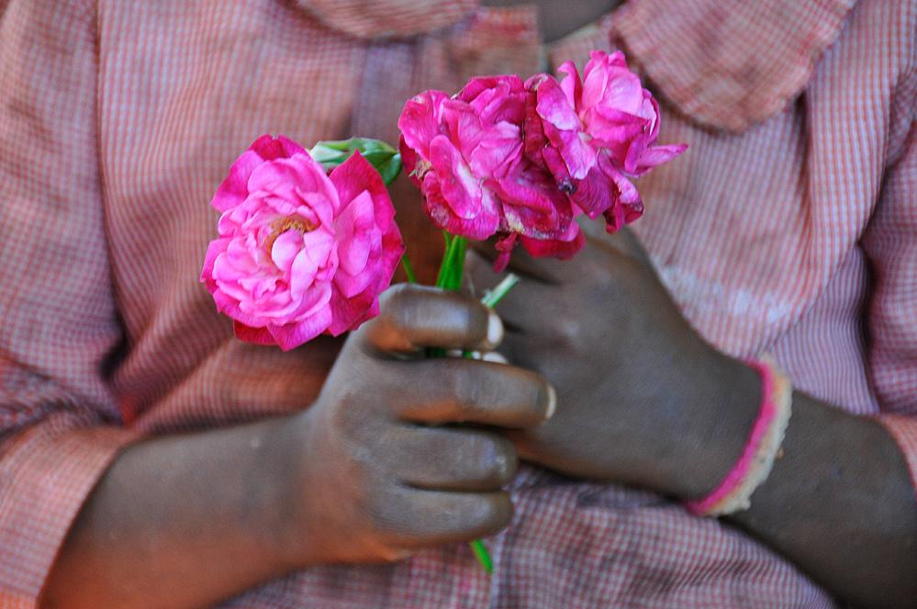

Slide 43
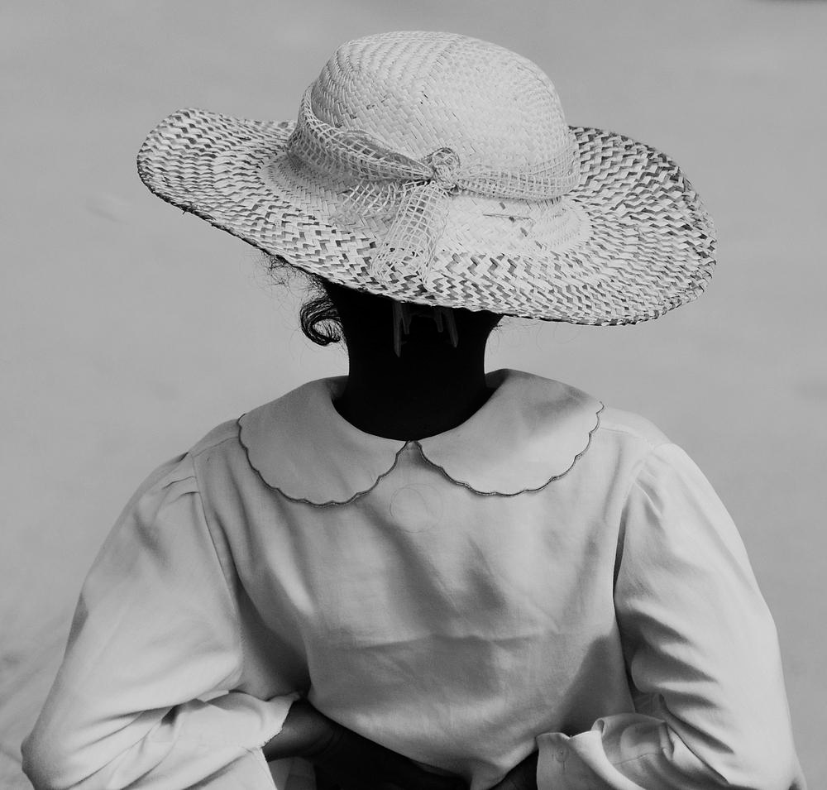

Slide 44
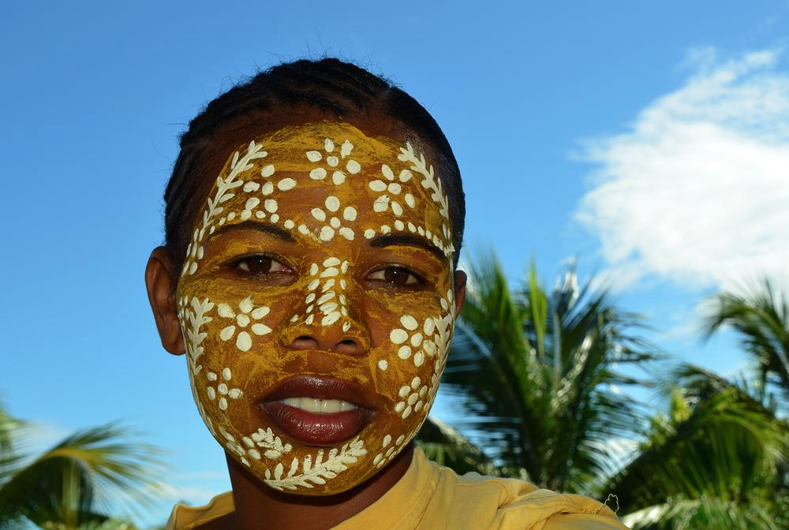
Sakalava tribe girl

Slide 45
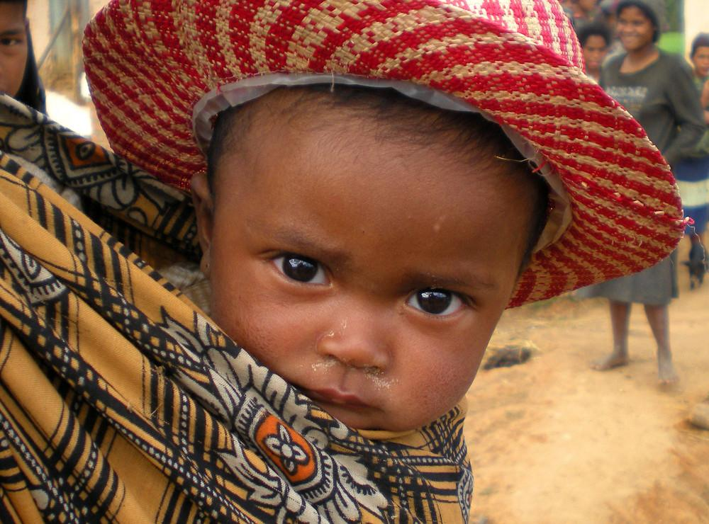

Slide 46
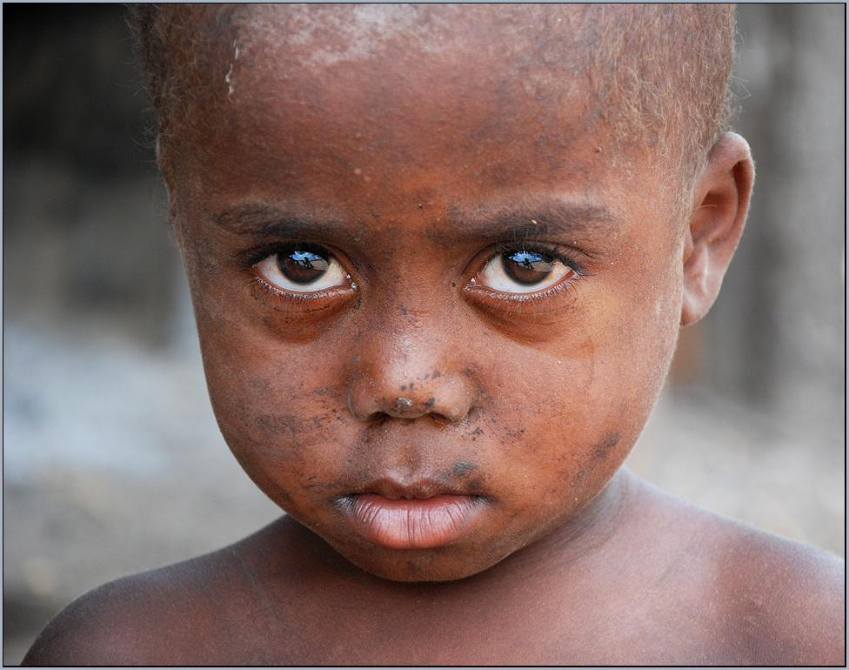

Slide 47
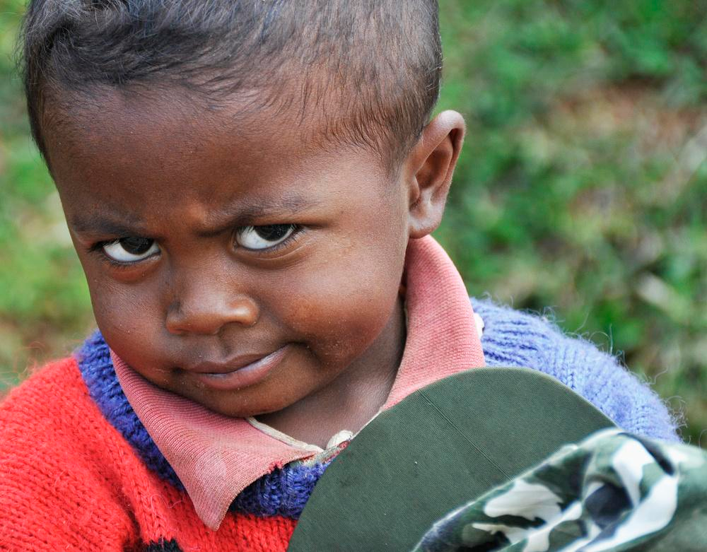

Slide 48
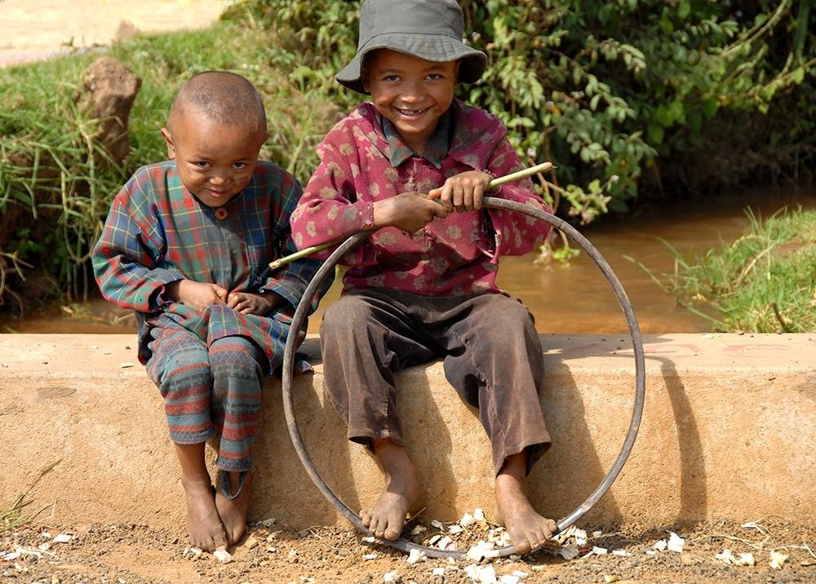

Slide 49
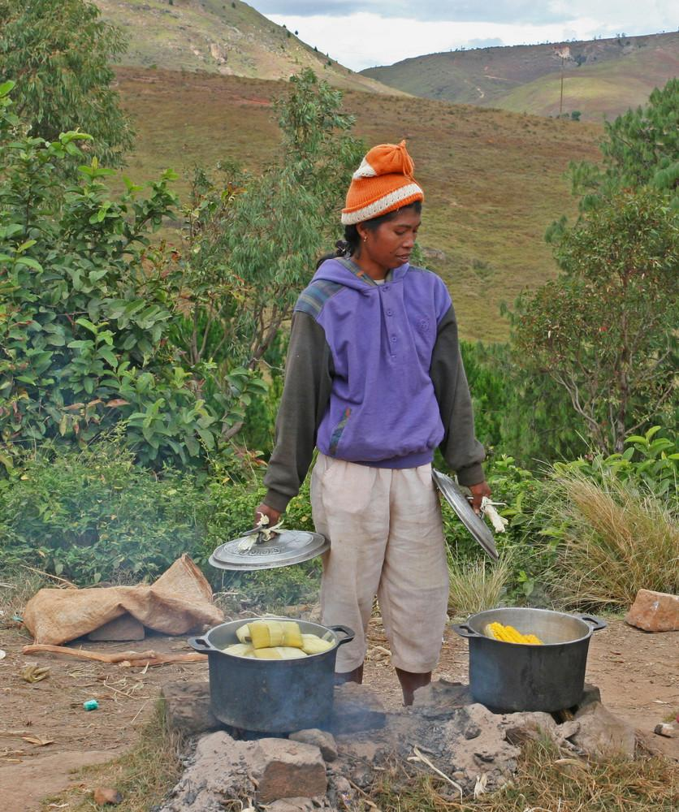

Slide 50


Slide 51
Elements of the culture

Slide 52


Slide 53

Canoe trip

Slide 54


Slide 55


Slide 56

Ferry between Manambolo and Bekopaka

Slide 57

On the way to the Tsingy de Bemaraha

Slide 58


Slide 59


Slide 60

Ancestor worship-on-Madagascar

Slide 61


Slide 62


Slide 63


Slide 64


Slide 65


Slide 66


Slide 67


Slide 68


Slide 69

Zebu dealer in Ambalavaho

Slide 70


Slide 71


Slide 72


Slide 73


Slide 74


Slide 75


Slide 76


Slide 77
Fauna & Flora

Slide 78

Land of Lemurs

Slide 79


Slide 80


Slide 81


Slide 82


Slide 83


Slide 84


Slide 85


Slide 86


Slide 87







Slide 88


Slide 89


Slide 90


Slide 91



Slide 92




Slide 93


Slide 94


Slide 95


Slide 96


