Slide 1
Italy’s High-Speed Train

Slide 2
Private Enterprise
Italy launched Europe's first private high-speed train service this week.The dark-red bullet-shaped "Italo" trains are run by NTV, a company headed by Ferrari boss Luca di Montezemolo who wants to take a quarter of the market from state rail network Trenitalia.
ROME, ITALY - APRIL 20: Italo, the new high speed train from the railway company New Passenger Transport SpA, known as NTV, ahead of its inaugural trip to Naples, at Stazione Tiburtina on April 20, 2012 in Rome, Italy. The new NTV railway company will run its maiden public high speed train journey on April 28, from Rome to Naples.

Slide 3
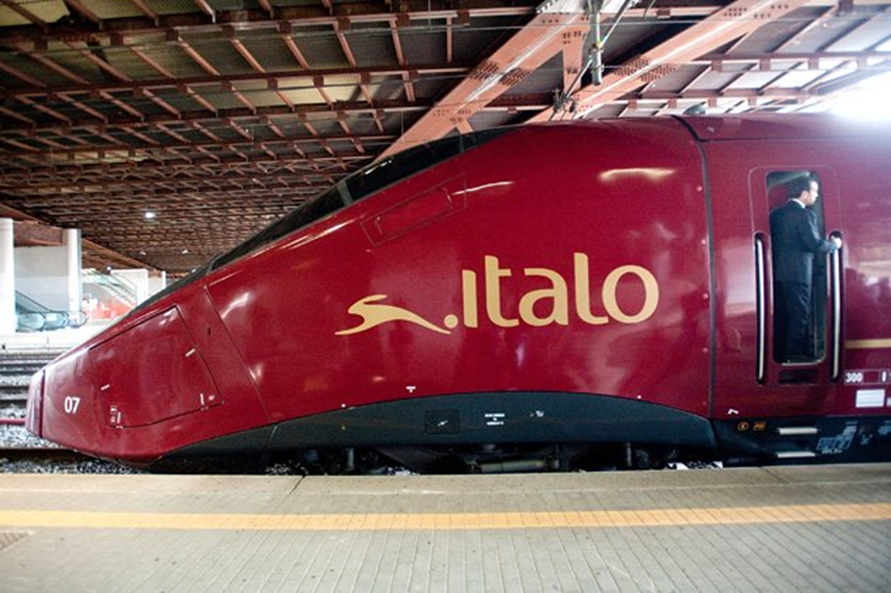

Slide 4
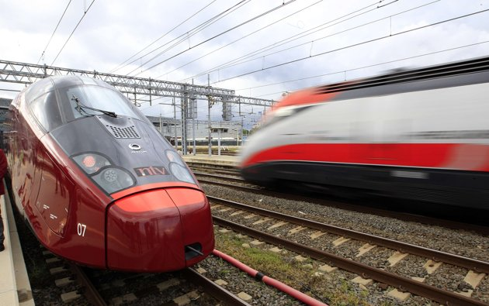

Slide 5
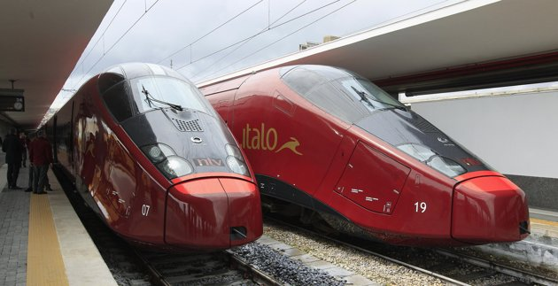

Slide 6
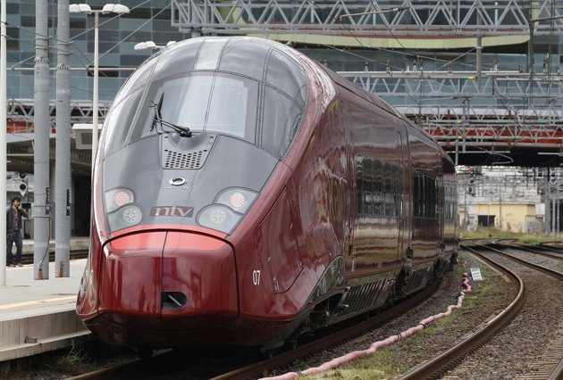

Slide 7
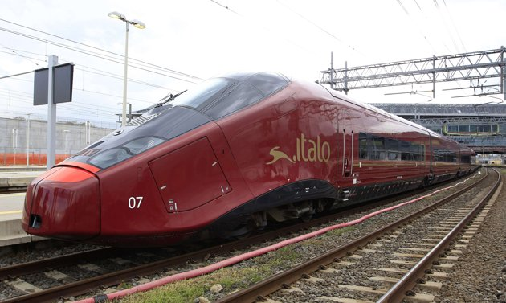

Slide 8
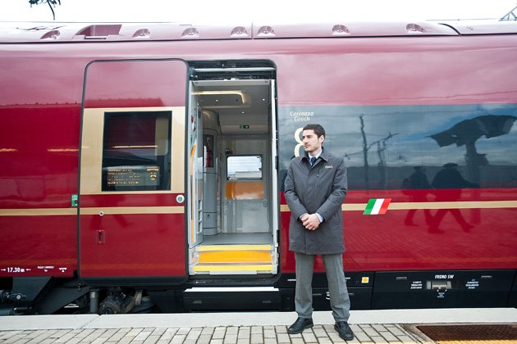

Slide 9
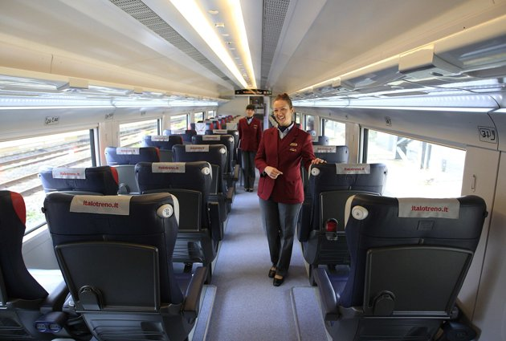

Slide 10
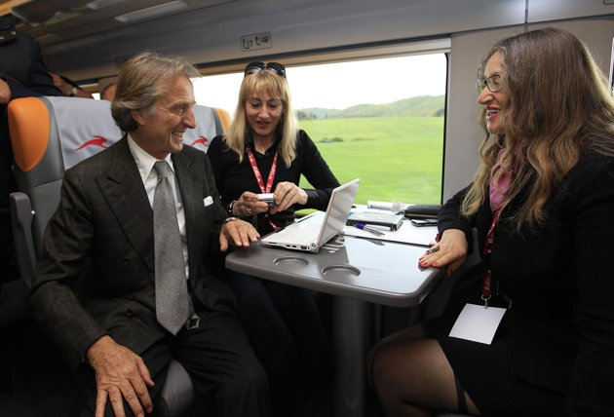

Slide 11
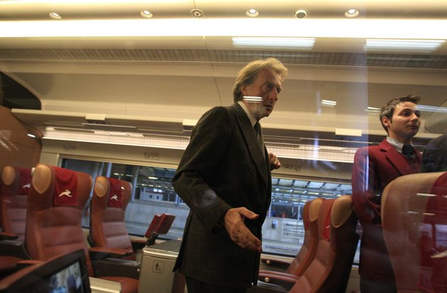

Slide 12
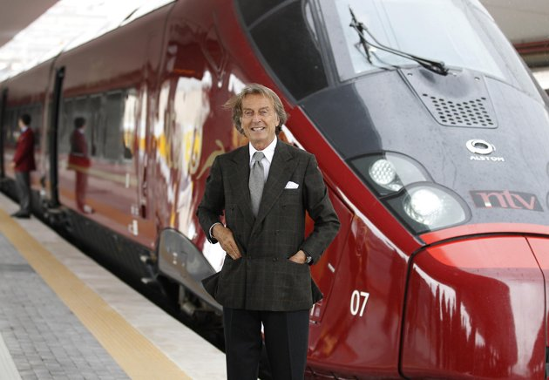

Slide 13
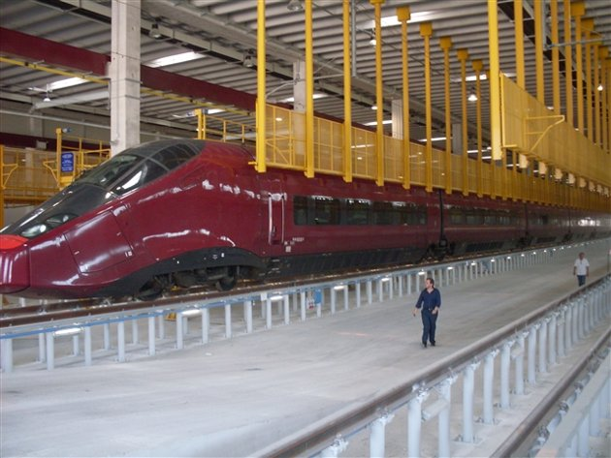

Slide 14
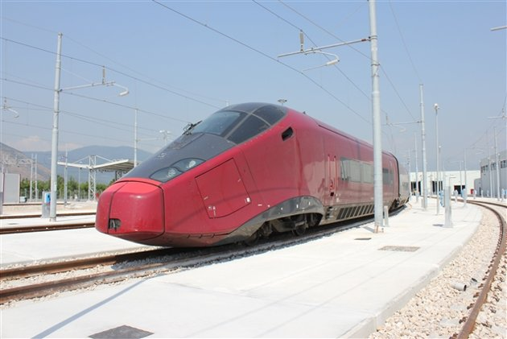

Slide 15
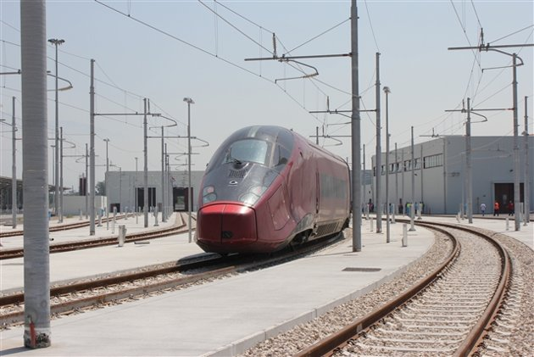

Slide 16
