Slide 1
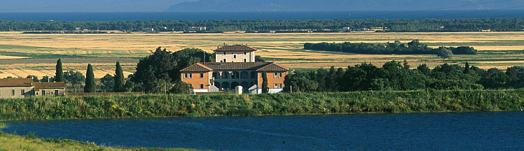
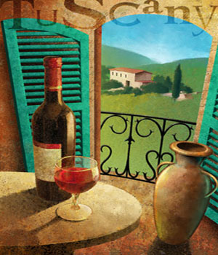
Italy - Tuscan Villas and Scenes

Slide 2
Tuscany
Tuscany is a region in Italy. It has an area of about 23,000 square kilometres (8,900 sq mi) and a population of about 3.75 million inhabitants. The regional capital is Florence (Firenze). Tuscany is known for its gorgeous landscapes, its rich artistic legacy and its vast influence on high culture. Tuscany is widely regarded as the true birthplace of the Italian Renaissance, and has been home to some of the most influential people in the history of arts and science, such as Petrarch, Dante, Botticelli, Michelangelo, Niccolo Machiavelli, Leonardo da Vinci, Galileo Galilei, Amerigo Vespucci, Luca Pacioli and Puccini. Due to this, the region has several museums (such as the Uffizi, the Pitti Palace and the Chianciano Museum of Art).

Slide 3
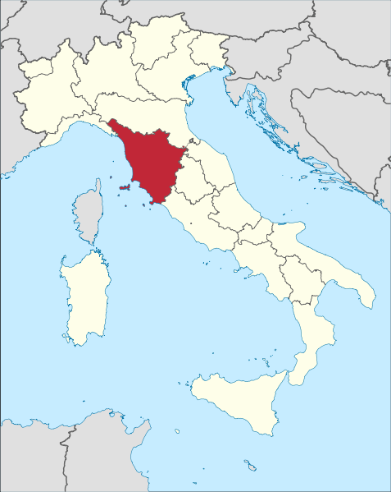

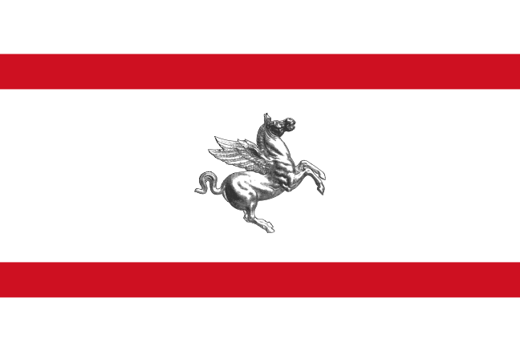

Slide 4
Tuscany has a unique culinary tradition, and is famous for its wines (most famous of which are Chianti, Vino Nobile di Montepulciano, Morellino di Scansano and Brunello di Montalcino). Six Tuscan localities have been designated World Heritage Sites: the historic centre of Florence (1982), the historical centre of Siena (1995), the square of the Cathedral of Pisa (1987), the historical centre of San Gimignano (1990), the historical centre of Pienza (1996) and the Val d'Orcia (2004). Furthermore, Tuscany has over 120 protected nature reserves. This makes Tuscany and its capital city Florence very popular tourist destinations, attracting millions of tourists every year. Florence itself receives an average of 10 million tourists a year, placing the city as one of the most visited in the world (in 2007, the city became the world's 46th most visited city, with over 1.715 million arrivals).

Slide 5
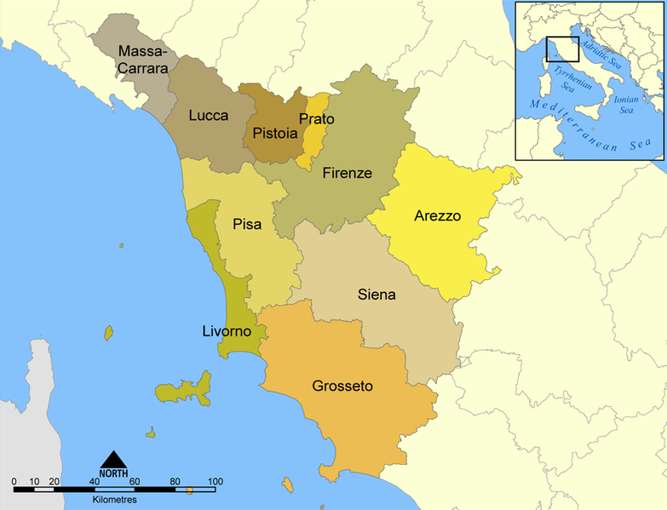
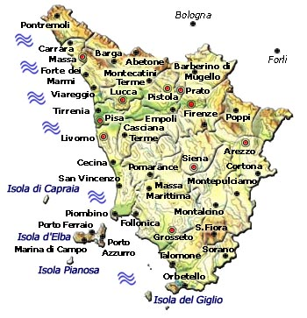
The Ten Provinces of Tuscany

Slide 6
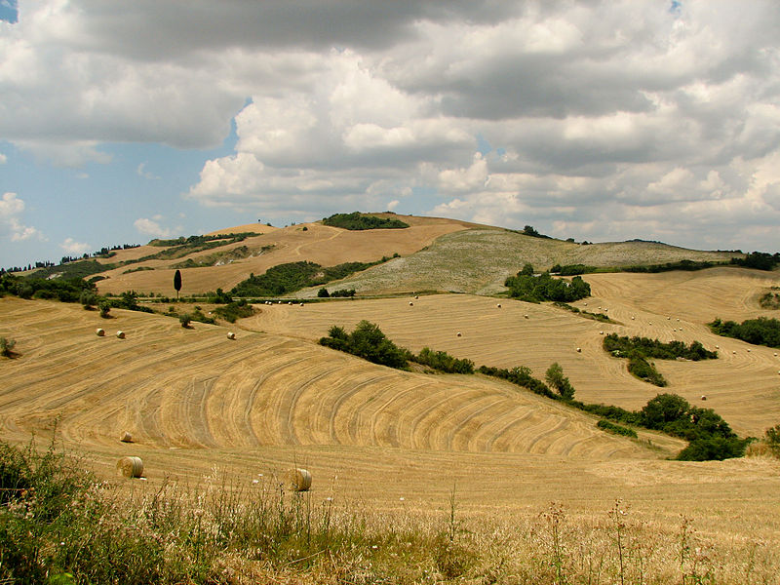
Landscape near Sienna

Slide 7
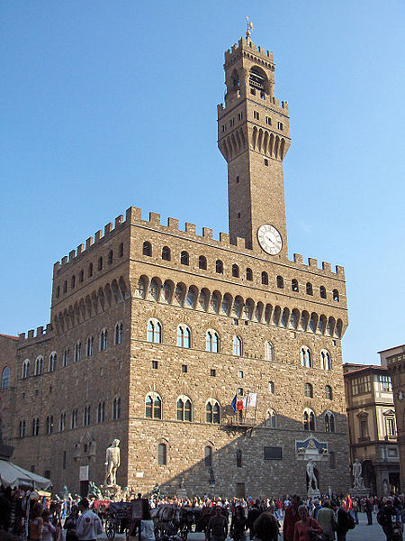
Palazzo Vecchio in Florence. Original location of Michelangelo’s David.

Slide 8
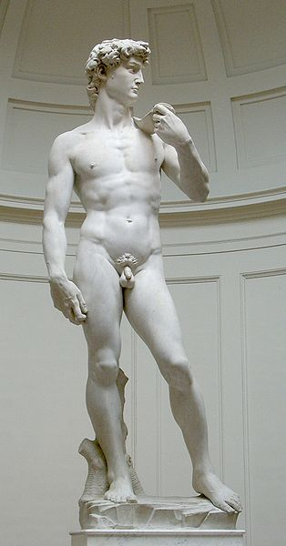
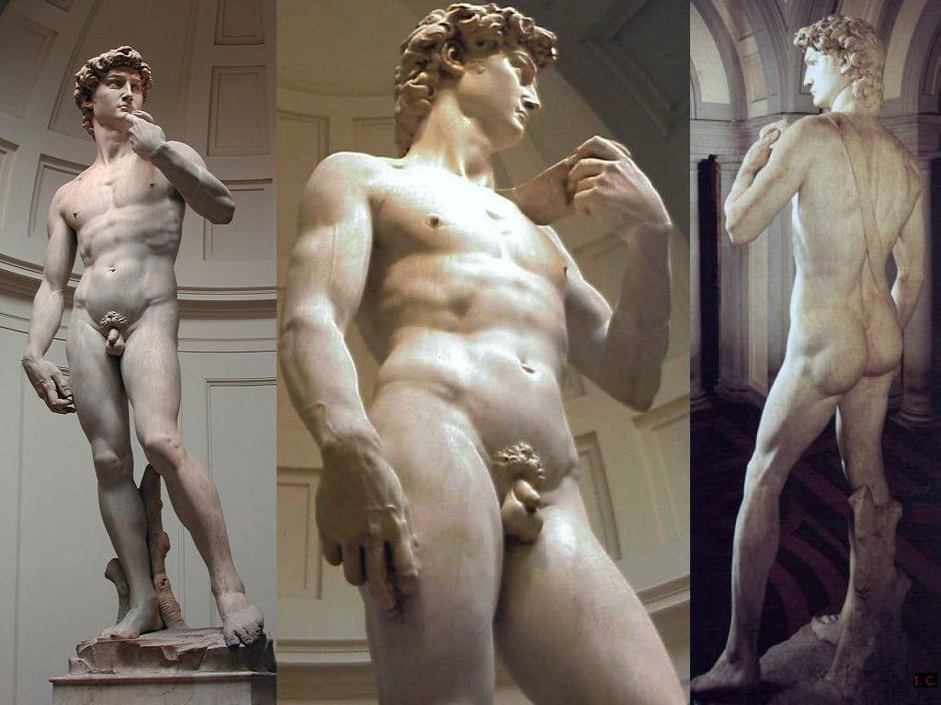
Today, David is preserved in the Academy of Art.

Slide 9
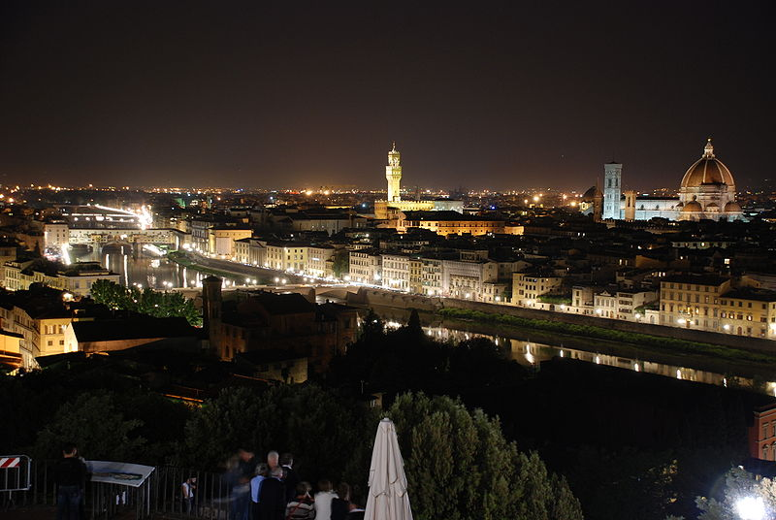
Florence – birthplace of the Renaissance

Slide 10
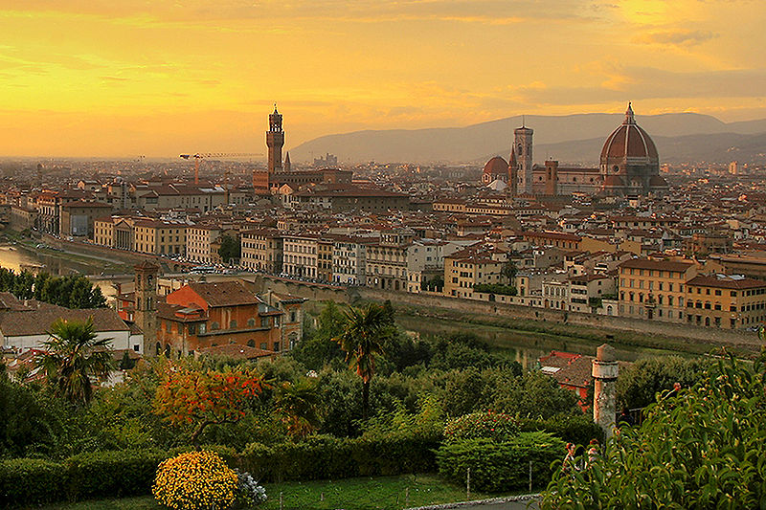

Slide 11
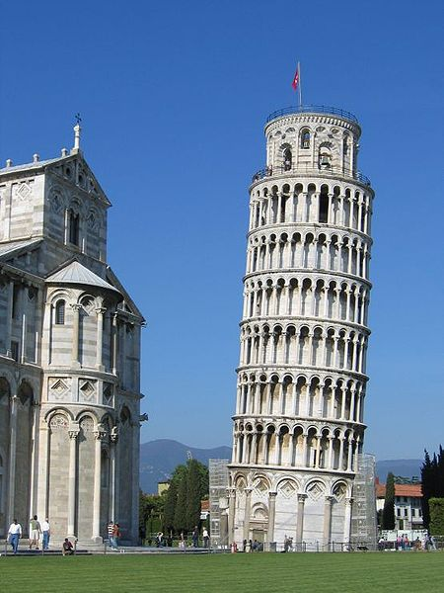
Pisa

Slide 12
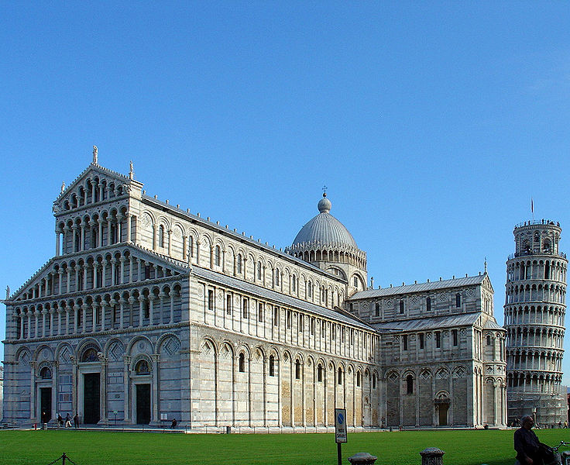

Slide 13
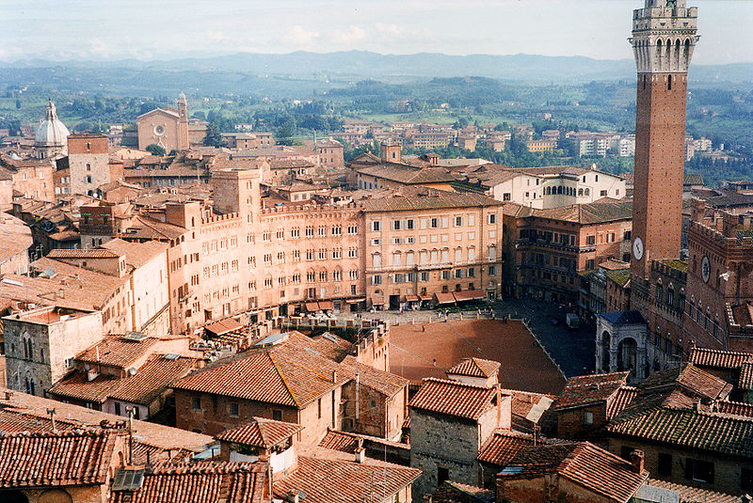
Siena

Slide 14
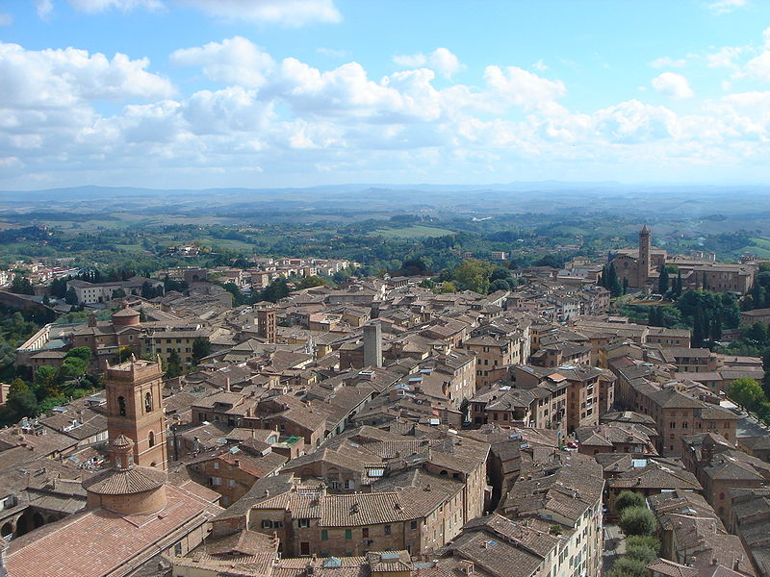

Slide 15
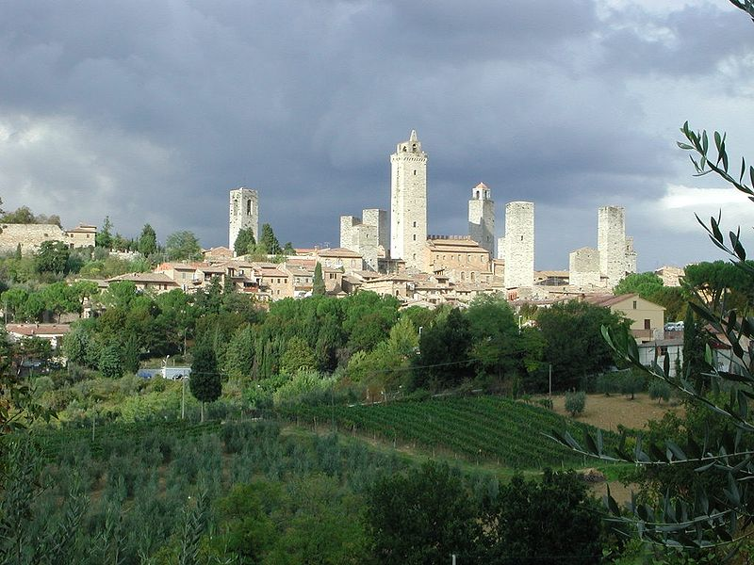
San Gimignano

Slide 16
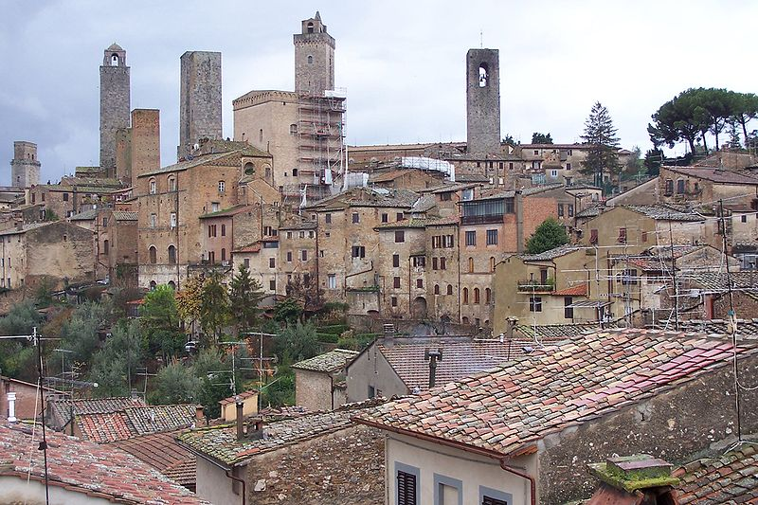

Slide 17
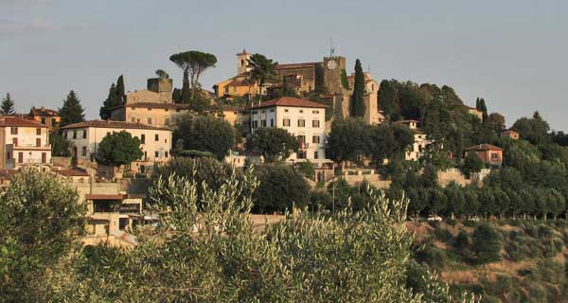
Montecatini Terme

Slide 18
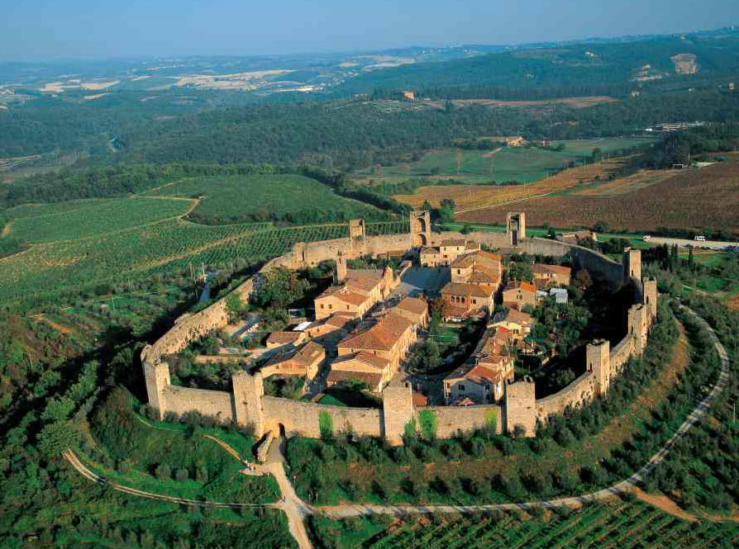

Slide 19
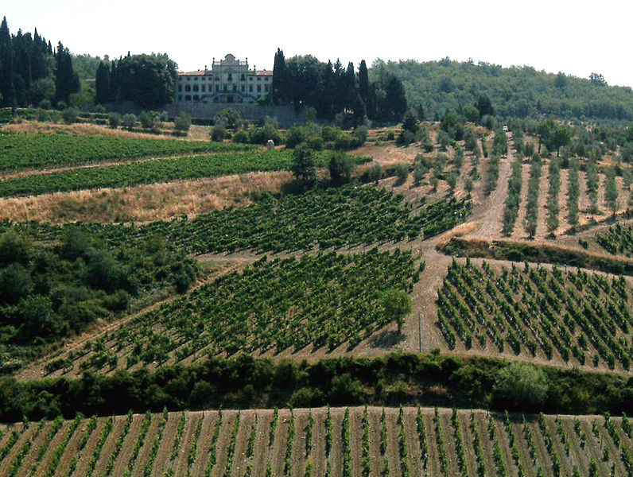
Vineyards in the Chianti region

Slide 20
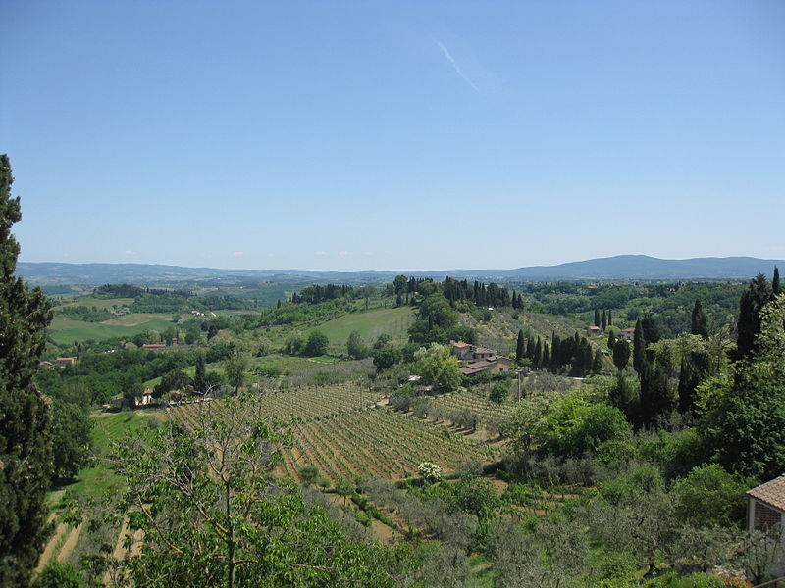
Hills of Tuscany

Slide 21
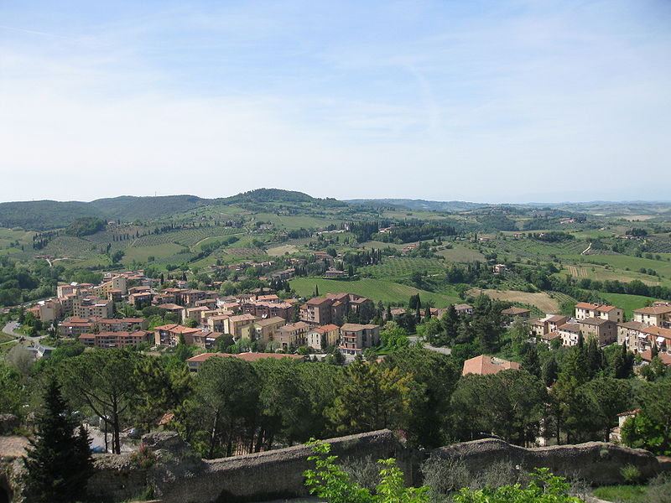

Slide 22
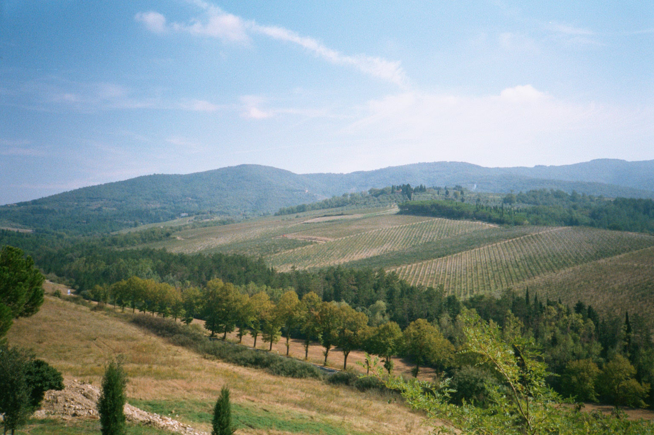

Slide 23
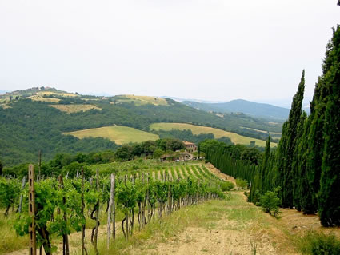

Slide 24
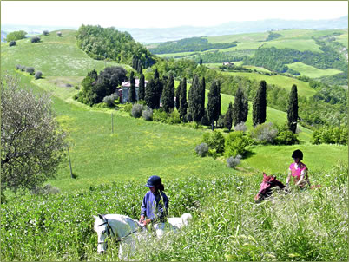

Slide 25
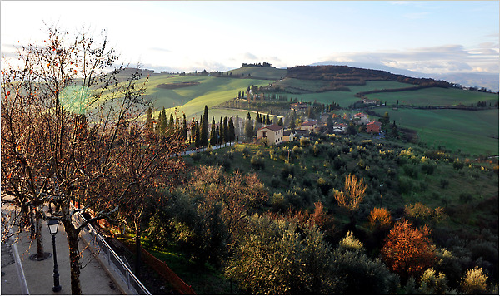
Tuscan Autumn

Slide 26
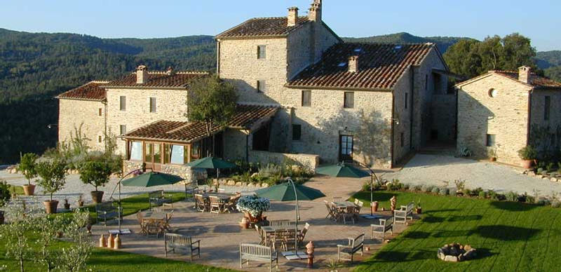
Villa Ferraia in the vicinity of Siena

Slide 27
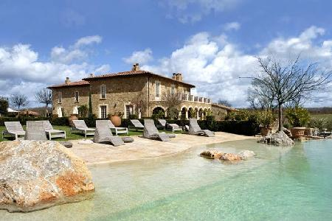
Borgo Santo Pietro – Siena area

Slide 28
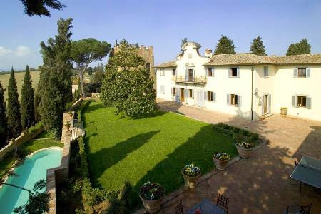
Villa Ginevra - Siena Area

Slide 29
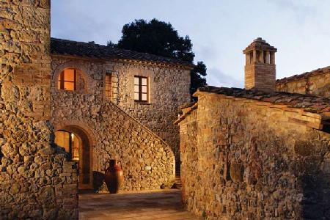
Escaiole - Siena Area

Slide 30
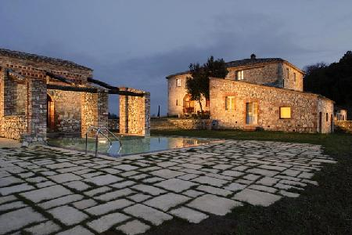
San Giuseppe - Siena Area

Slide 31
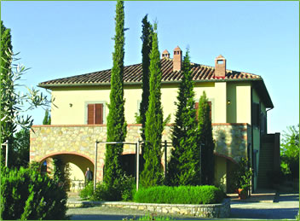
Gori villa

Slide 32
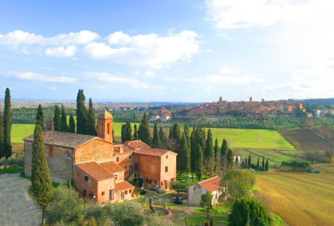

Slide 33
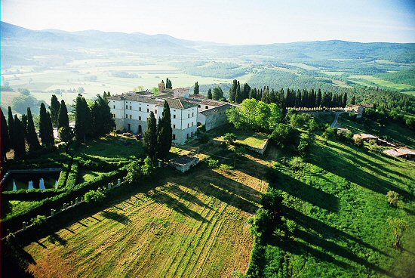

Slide 34
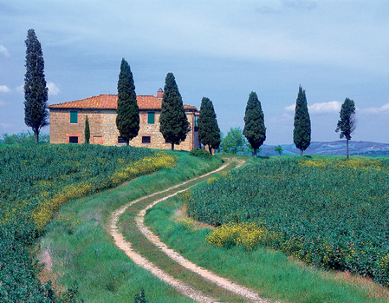

Slide 35
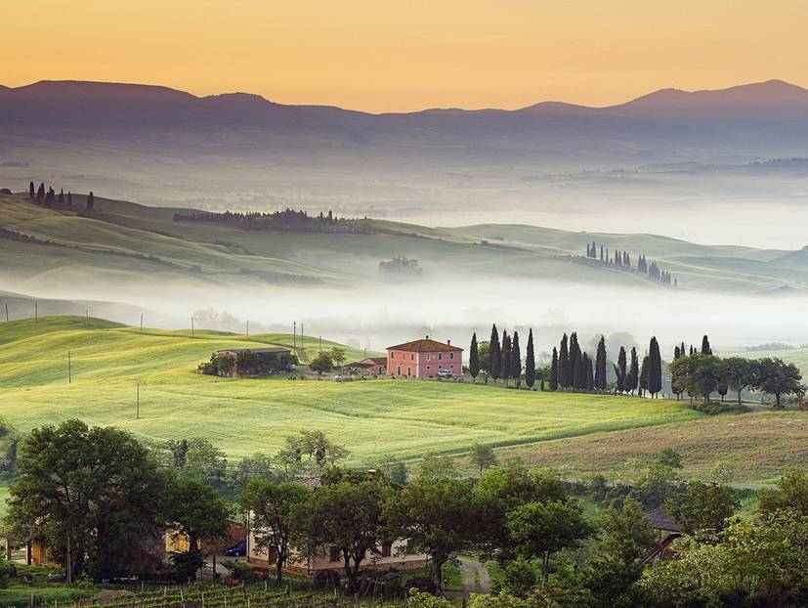

Slide 36
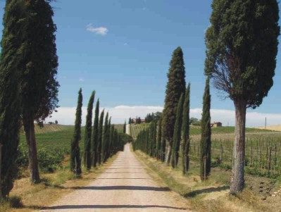

Slide 37
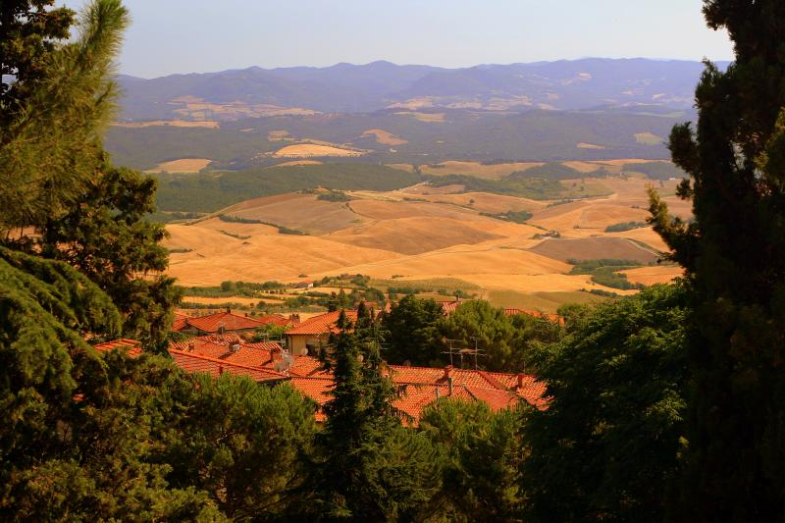

Slide 38
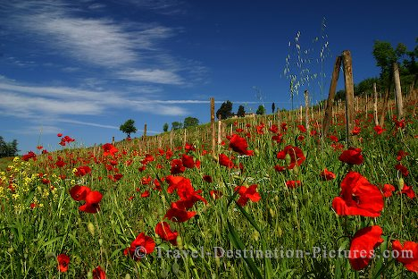

Slide 39
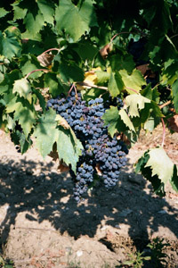
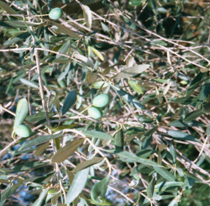
Olives & Grapes

