Slide 1
Italy – Jewel of the Mediterranean Part 4

Slide 2
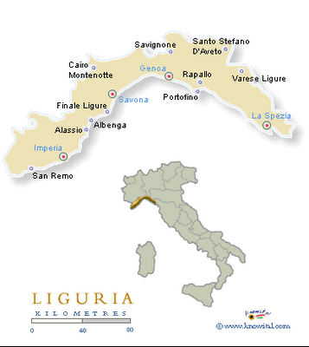
Italian Riviera Towns

Slide 3
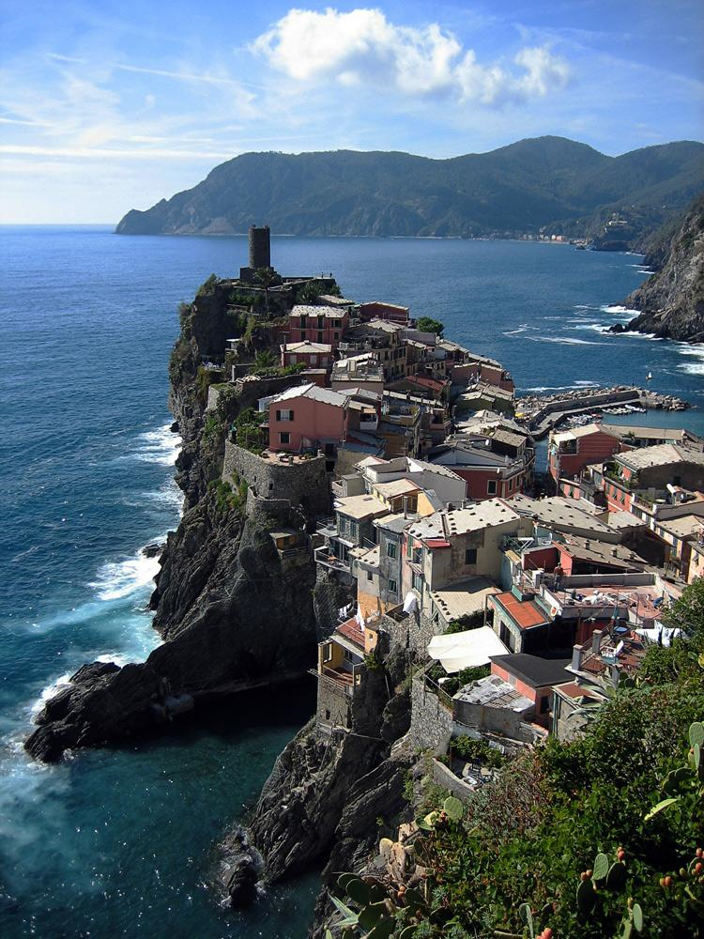
The Cinque Terre is a rugged portion of coast on the Italian Riviera.

Slide 4
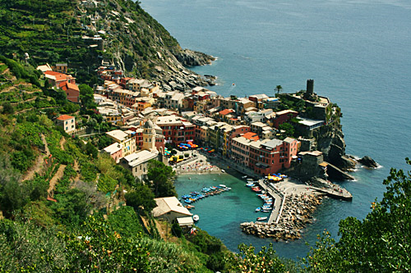
Cinque Terre

Slide 5
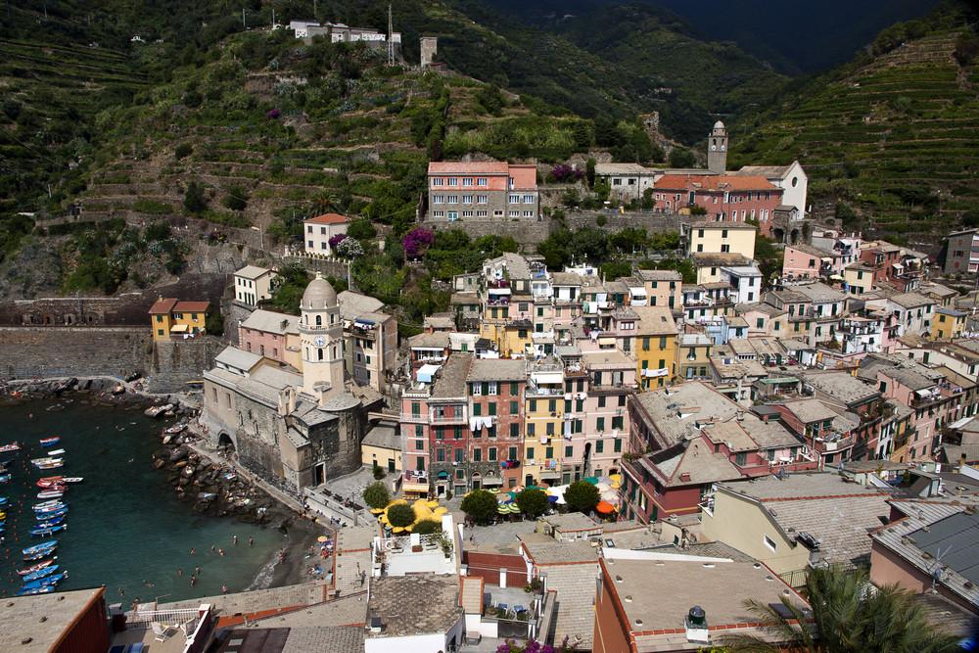
Vernezza

Slide 6
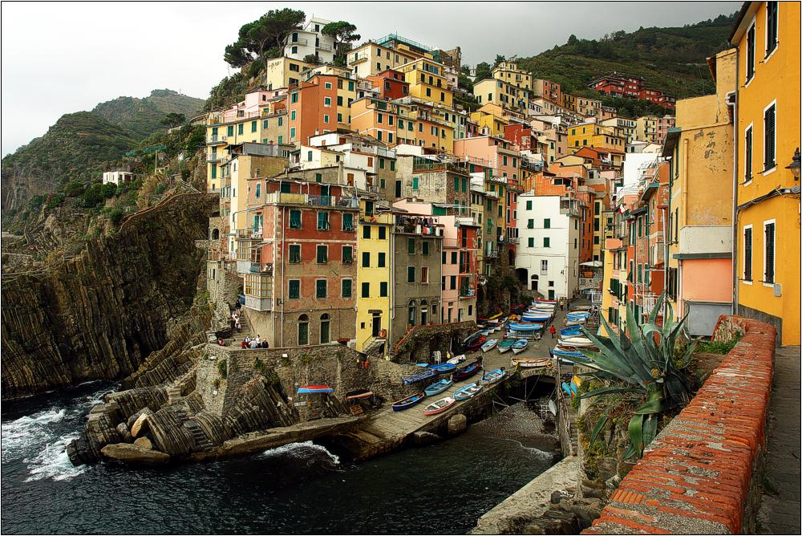
Riomaggiore

Slide 7
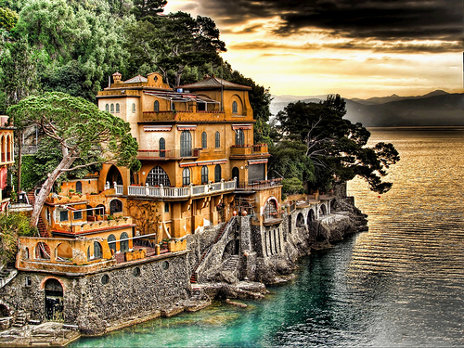
Portofino

Slide 8
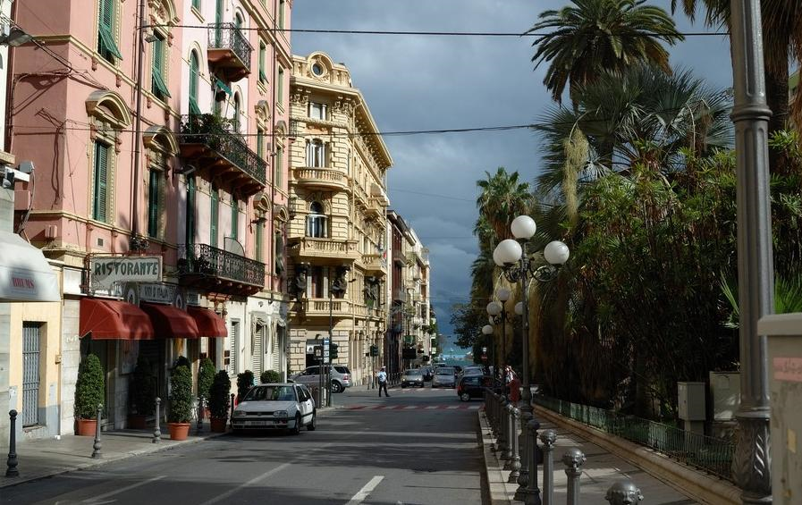
San Remo

Slide 9
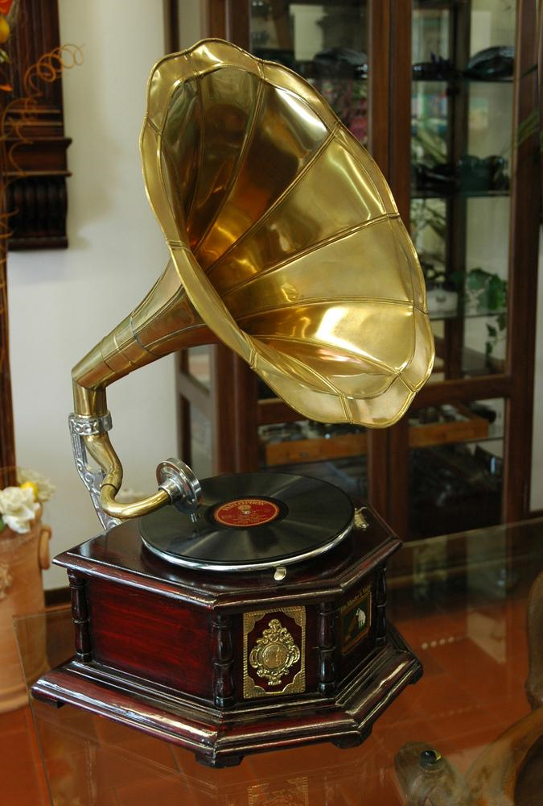
San Remo Music Festival

Slide 10
San Remo Music Festival
The Ariston Theater hosts the celebre annual Sanremo Music Festival, a very popular song contest held in the city since 1951. This festival inspired the Eurovision Song Contest, which started in 1956, and for years the Sanremo festival selected the Italian entry. The internationally notable song "Nel Blu Dipinto di Blu", also known as "Volare", was performed at this festival for the first time by Domenico Modugno in 1958. The festival is so popular amongst Italians that it is often referred to simply as "Il Festival".

Slide 11
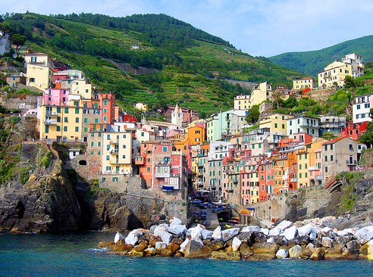

Slide 12
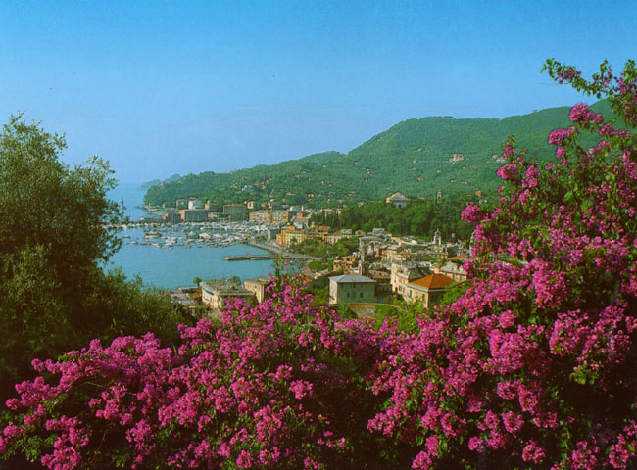

Slide 13
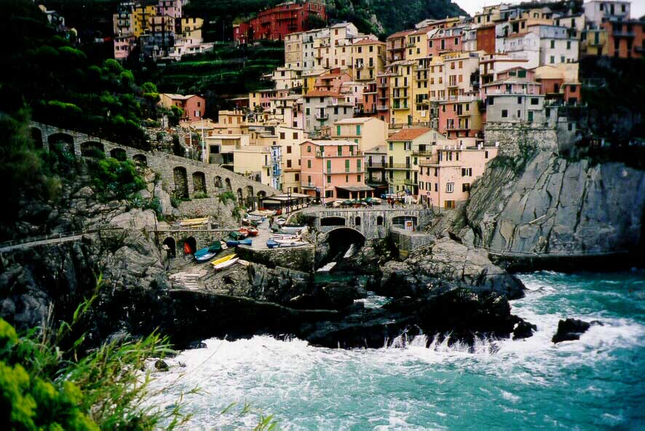
Manarola

Slide 14
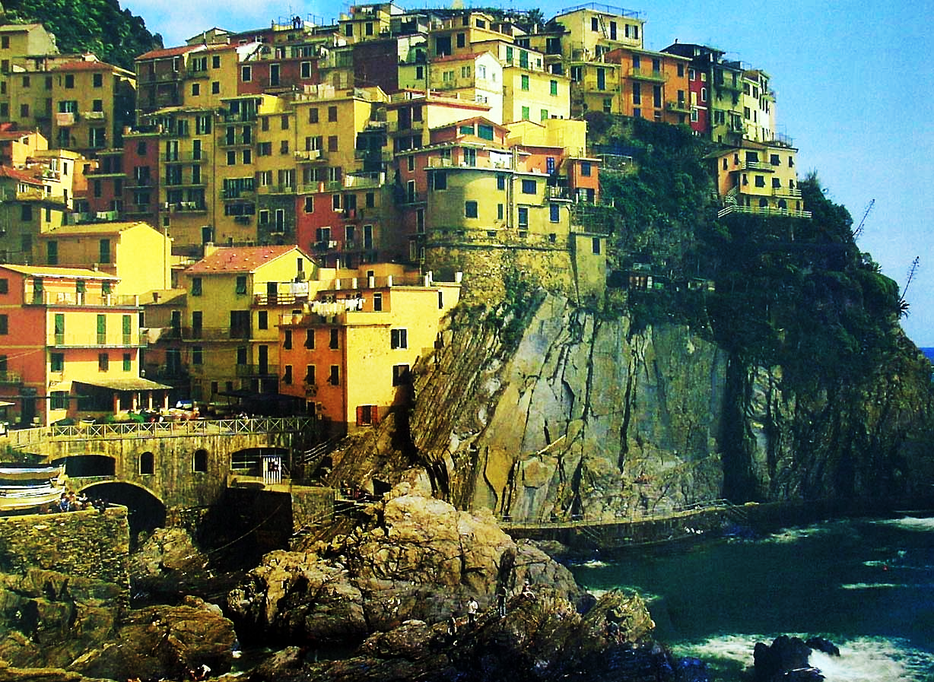

Slide 15
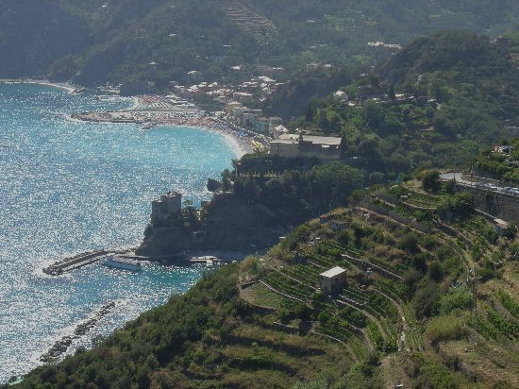

Slide 16
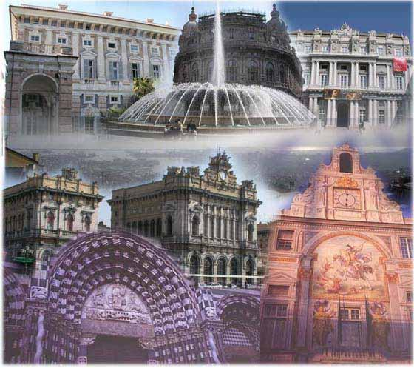
Genoa

Slide 17
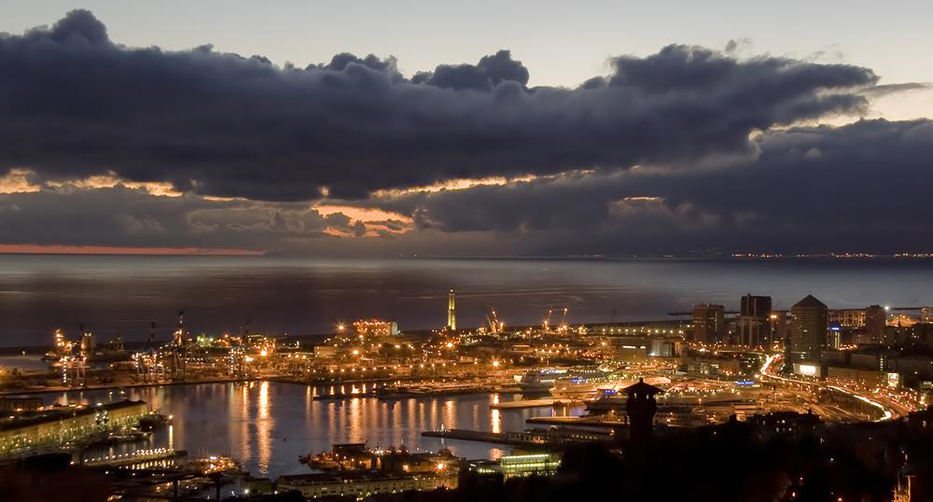
Genoa

Slide 18
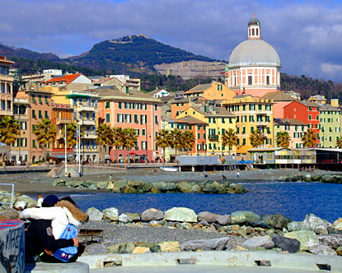

Slide 19
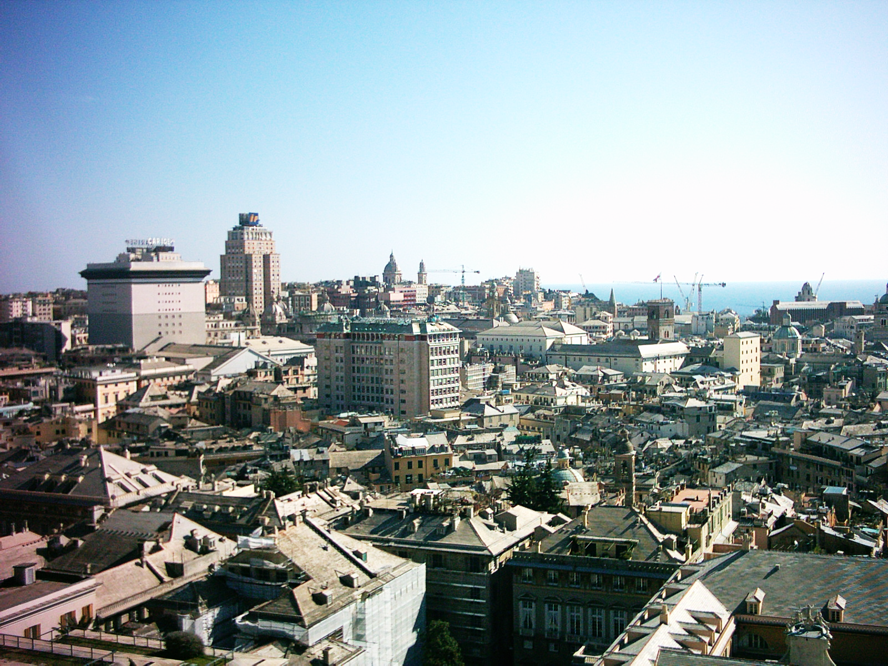
Skyline

Slide 20
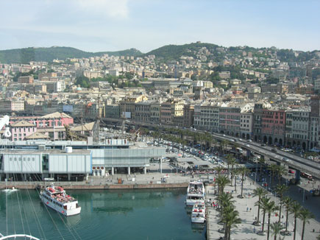
Port City

Slide 21
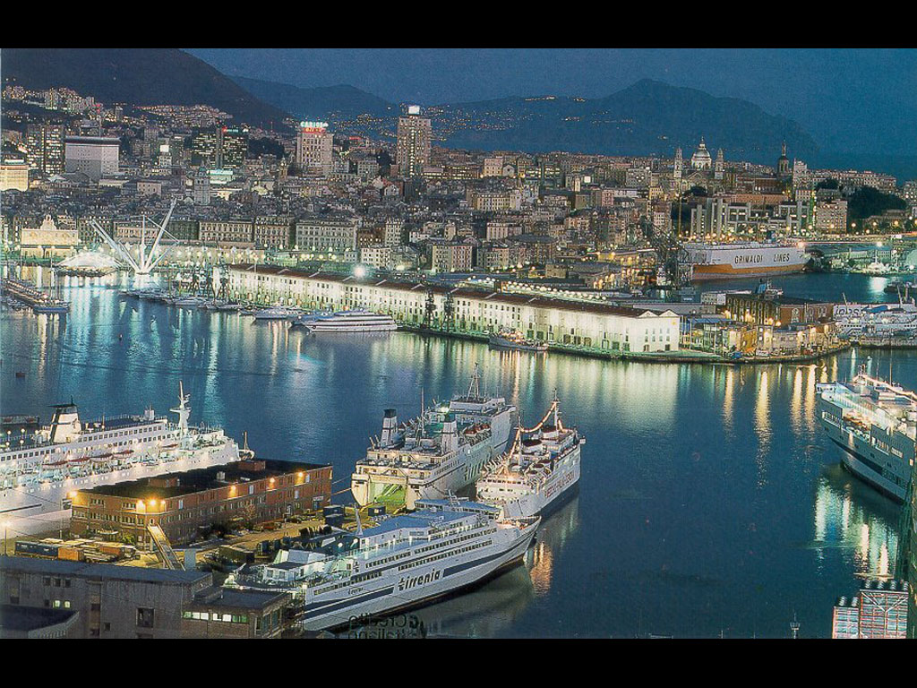

Slide 22
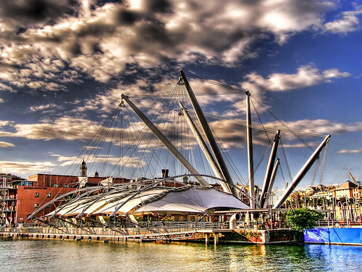
Modernized Port Facilities

Slide 23
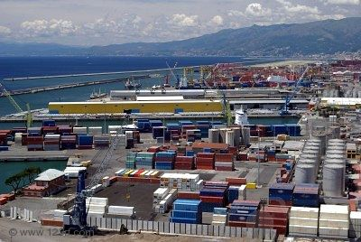
Container ship handling facility

Slide 24
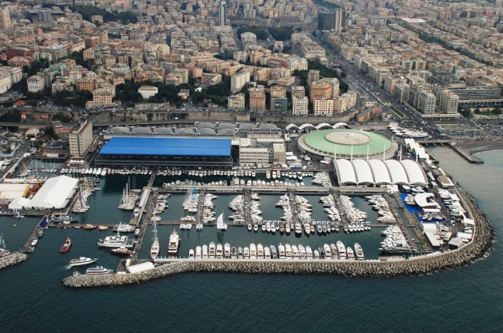
Genoa International Boat Show

Slide 25
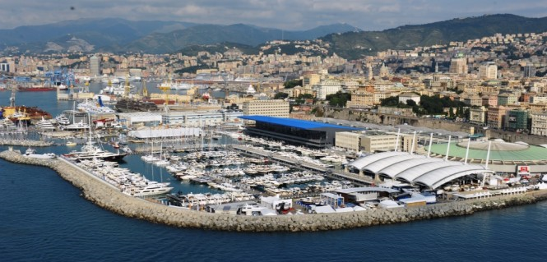

Slide 26
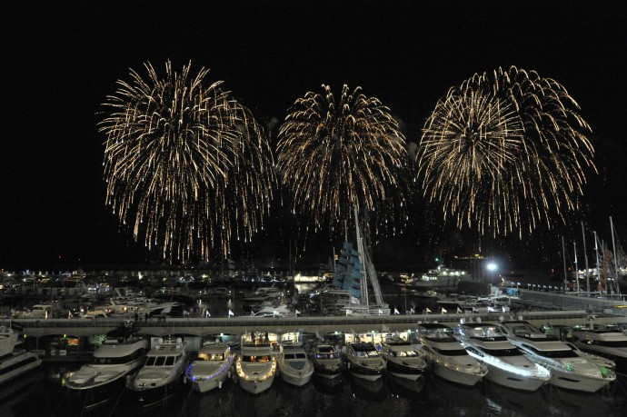

Slide 27
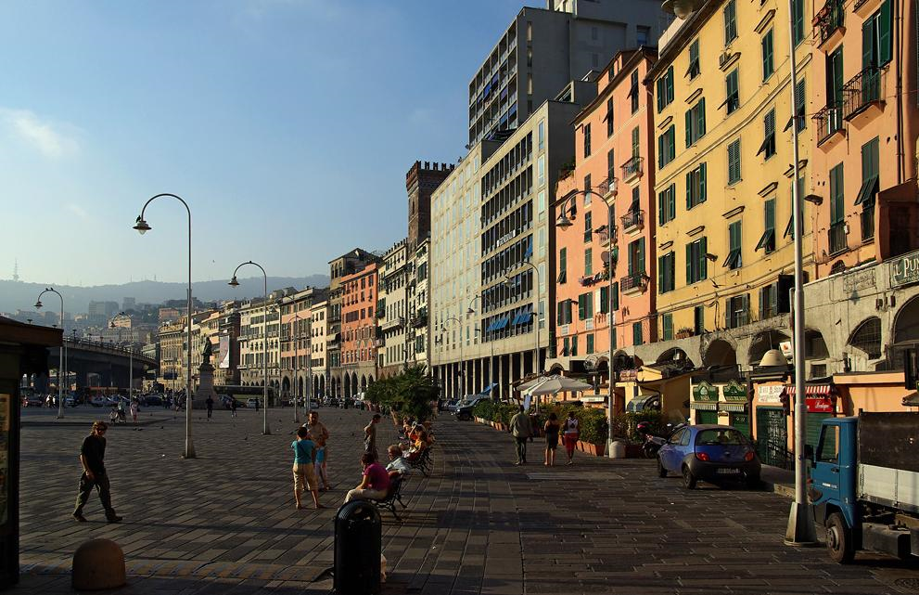

Slide 28
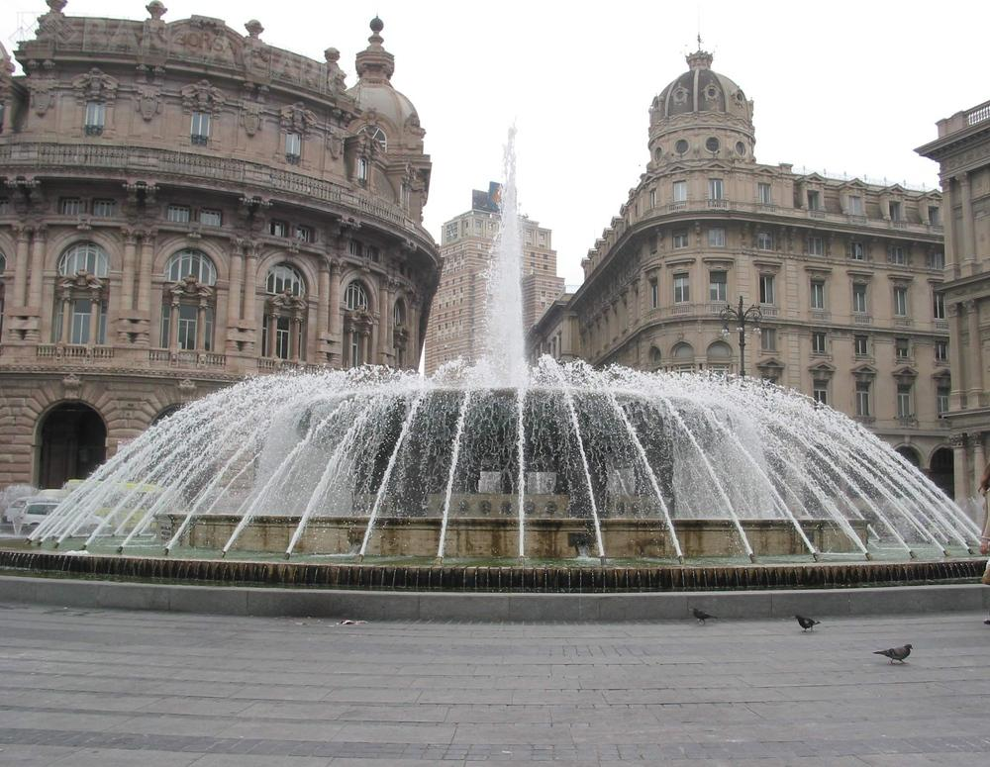
Genova-The Piazza de Ferrari

Slide 29
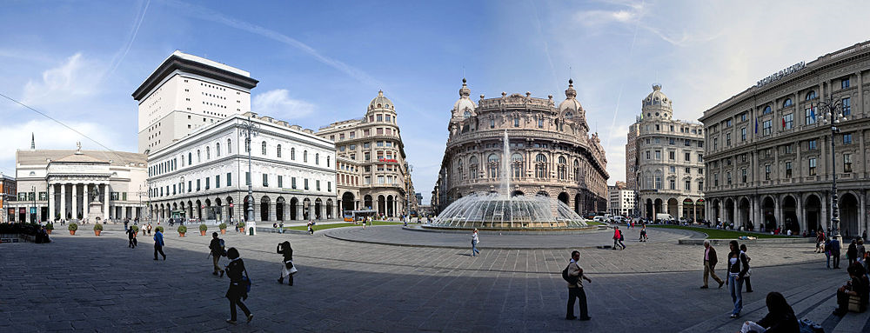
The Piazza de Ferrari

Slide 30
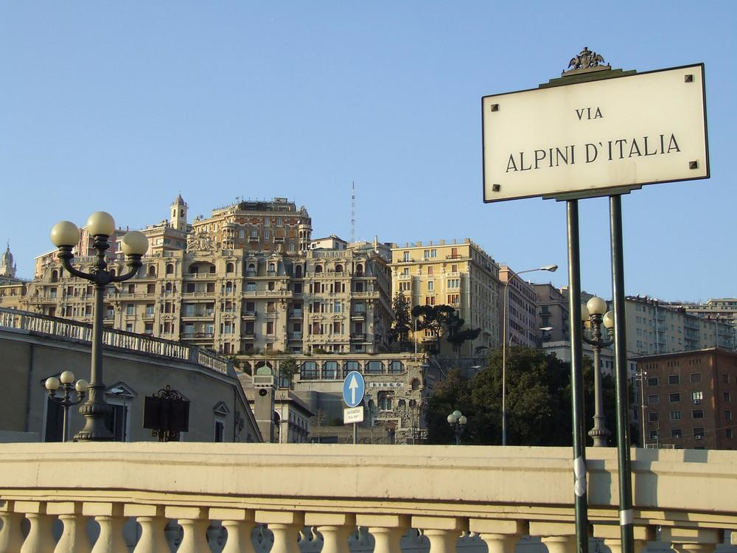

Slide 31
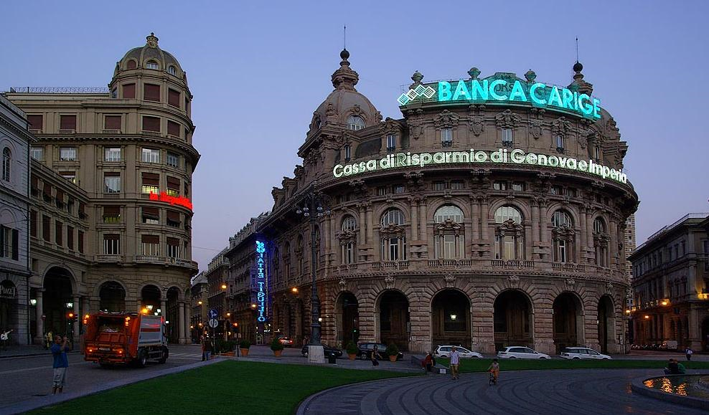

Slide 32
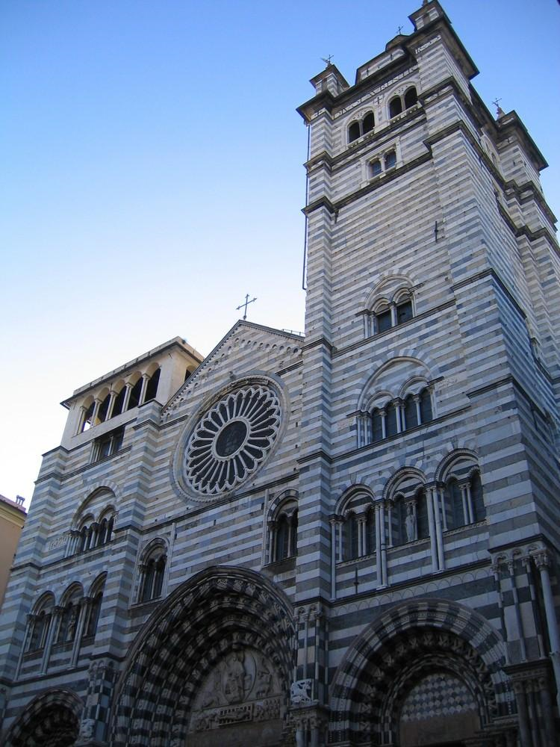
Cathedral San Lorenzo

Slide 33
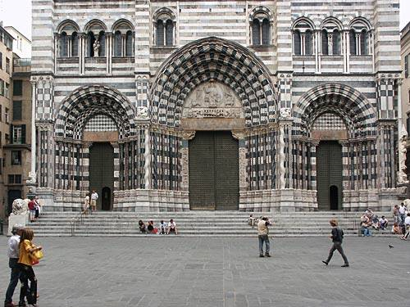

Slide 34
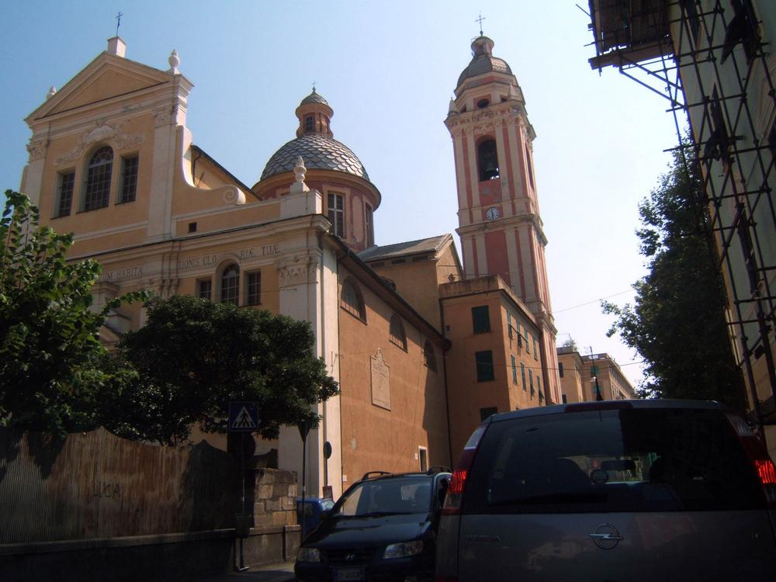
Chiesa a Di Negro - Genova

Slide 35
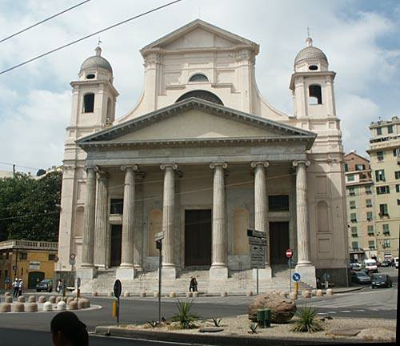
Chiesa della SS. Annunziata del Vastato

Slide 36
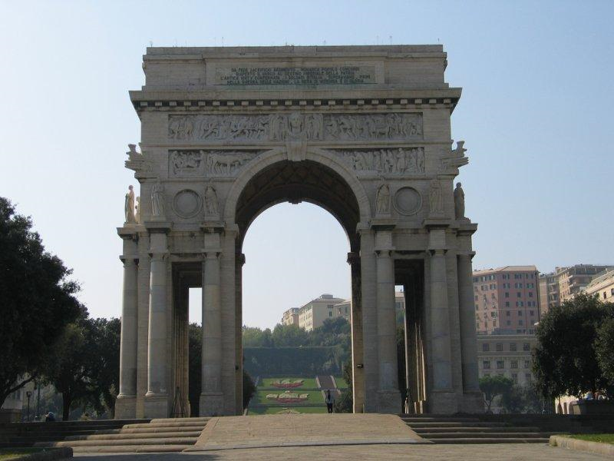
Arc of Victory

Slide 37
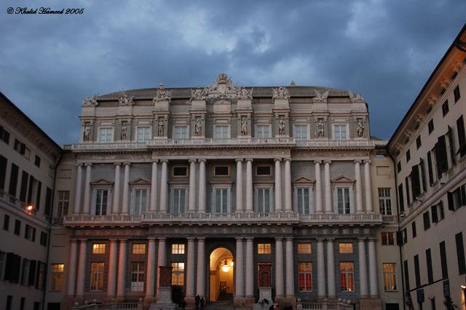
Ducale Palace

Slide 38
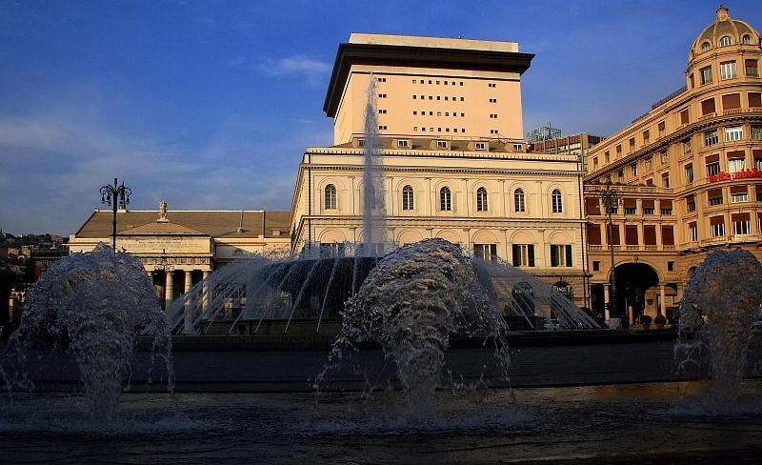
The prestigious neoclassical Theatre "Carlo Felice"

Slide 39
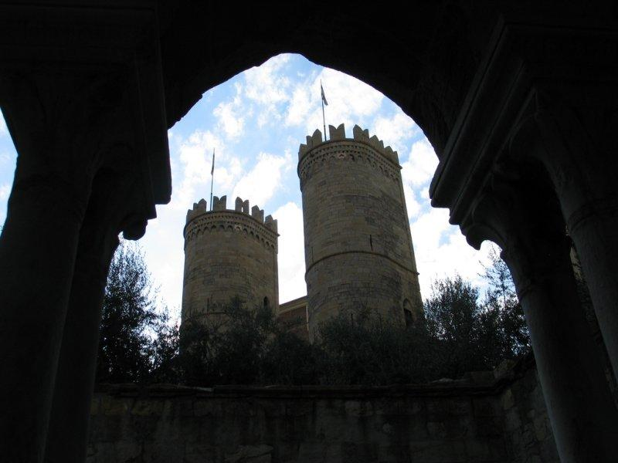
Porta Soprana: Medieval gates of Genoa is a rare survival of the city's golden age and its best known landmark.

Slide 40
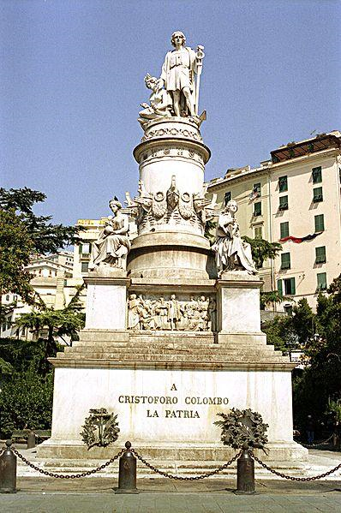
Monument to Christopher Columbus.

Slide 41
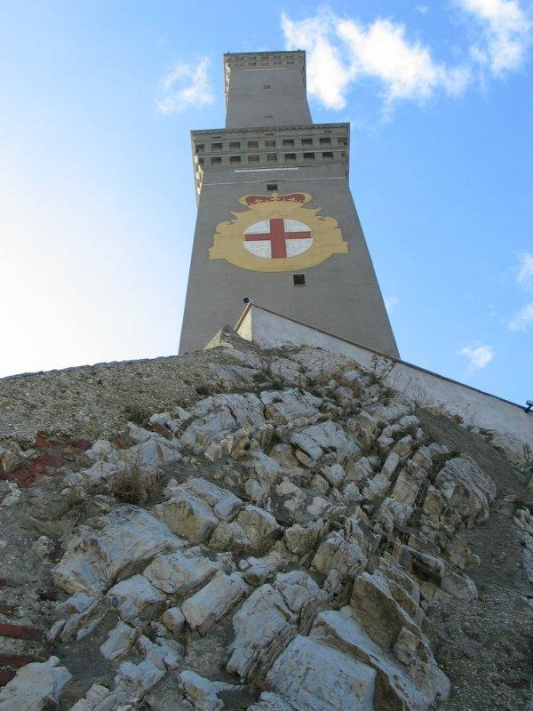
Ancient lighthouse of Genova

Slide 42
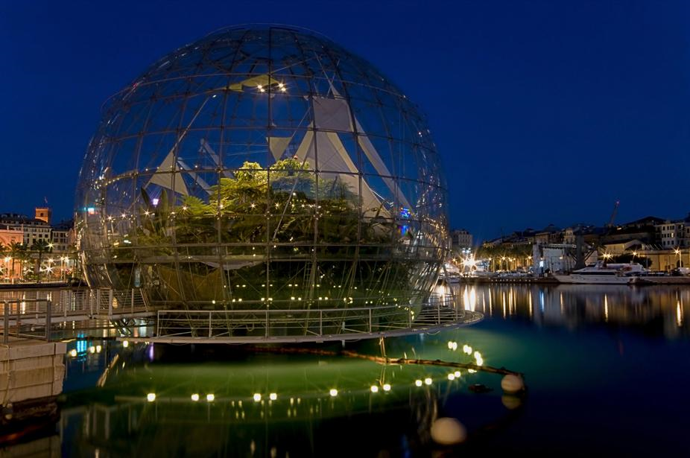
Biosphere

Slide 43
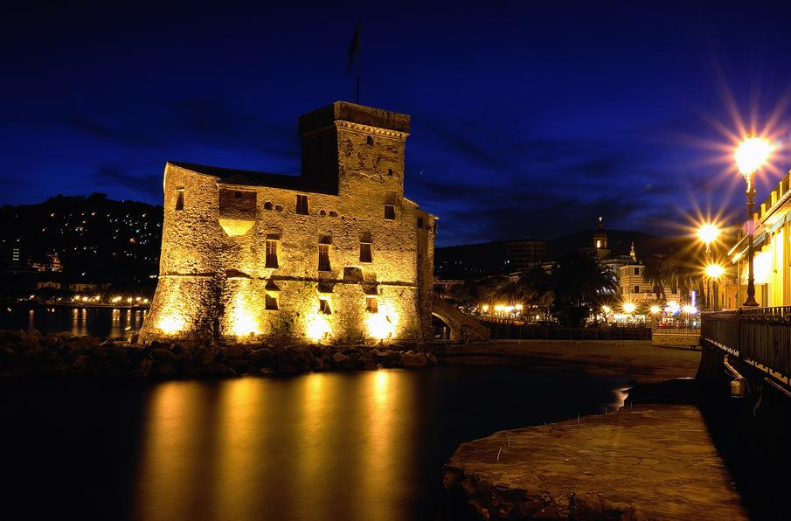
Medieval Castle

Slide 44
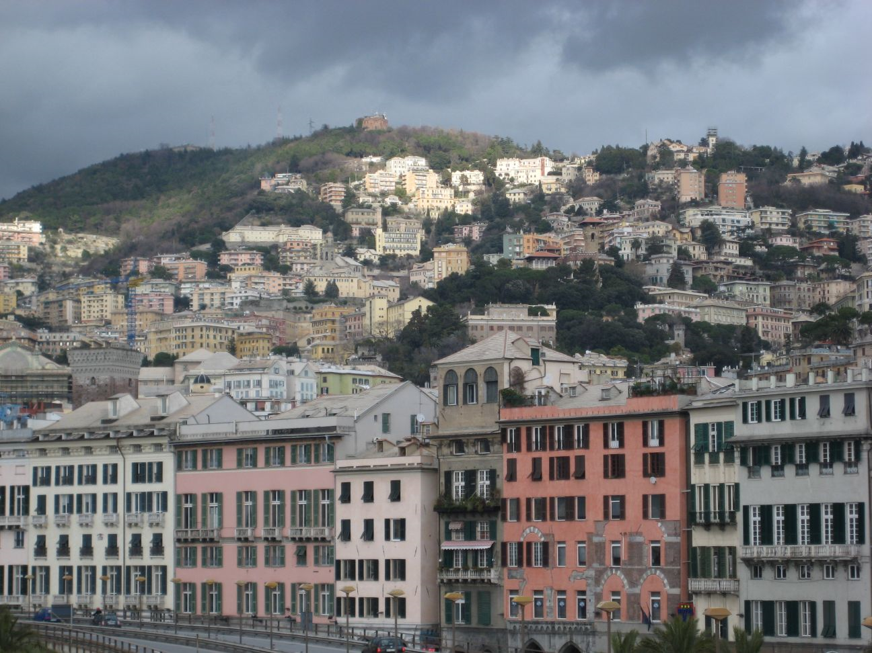

Slide 45
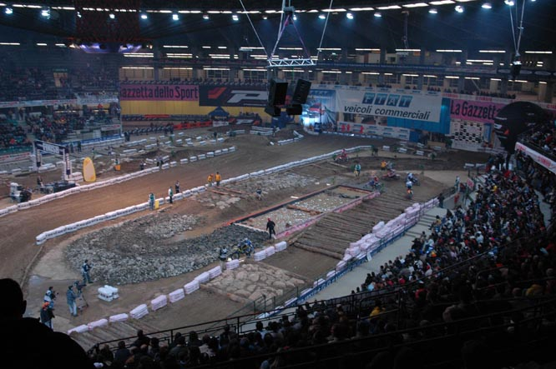
Genoa Stadium

Slide 46
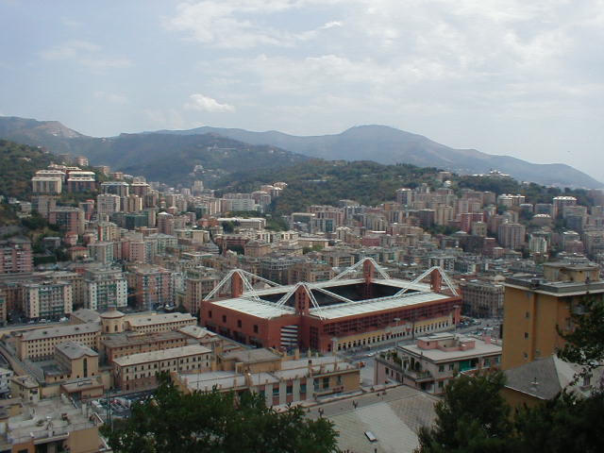
Ferrari Stadium

Slide 47
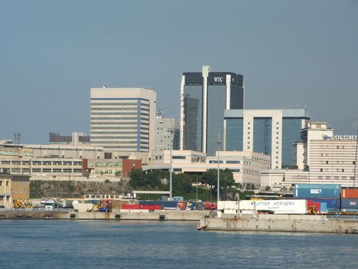
Genoa World Trade Center

Slide 48
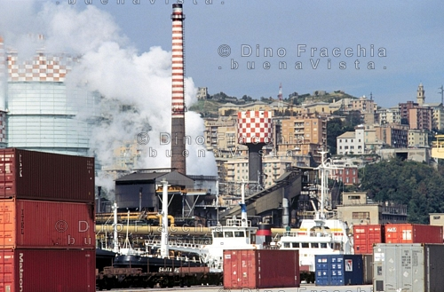
Industrial District

Slide 49
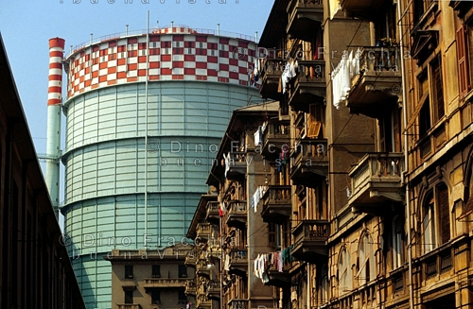

Slide 50
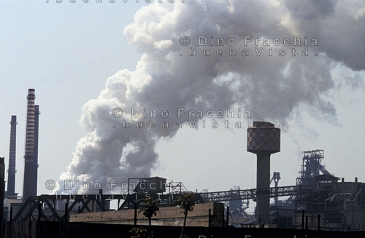

Slide 51
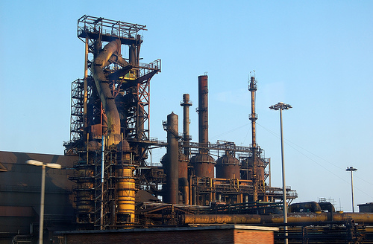

Slide 52
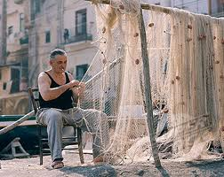

Fresh Seafood

Slide 53
Commercial Establishments

Slide 54


Slide 55


Slide 56


Slide 57


Slide 58


Slide 59


Slide 60


Slide 61


Slide 62


Slide 63


Slide 64


Slide 65


