Slide 1
Italy – Jewel of the Mediterranean Part 3

Slide 2
Milan
Industrial/Commercial/Fashion center and primate city of Italy

Slide 3
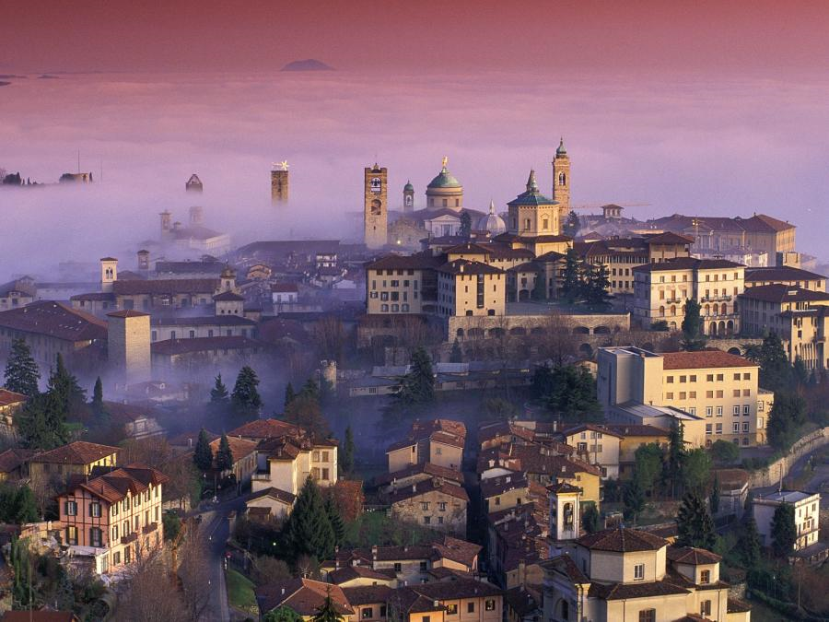

Slide 4
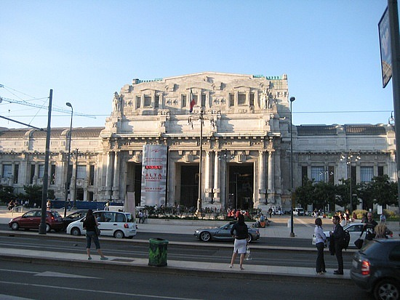
Train Station

Slide 5
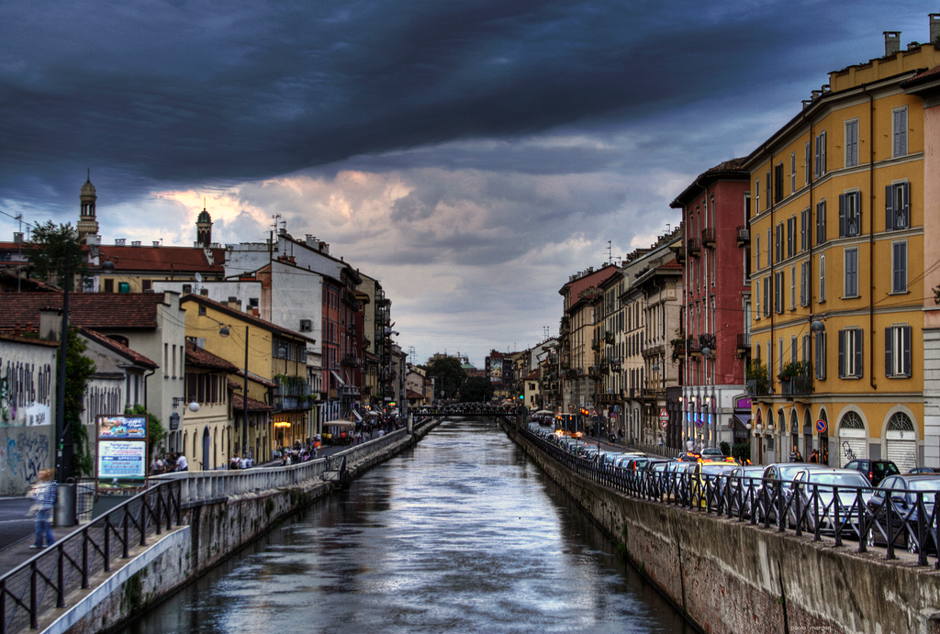
Grand Canal

Slide 6
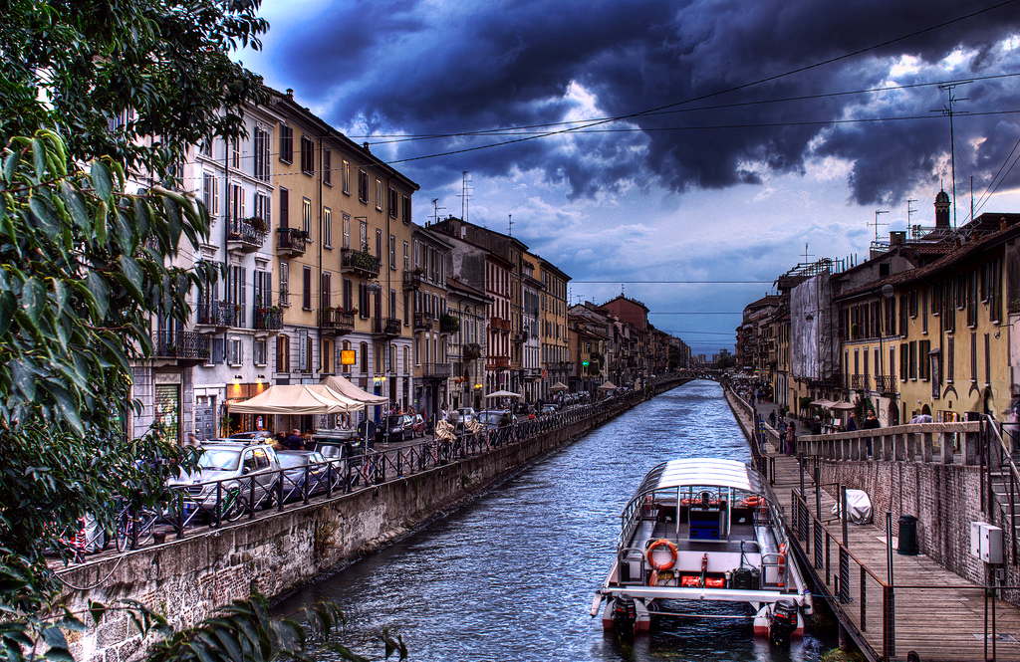

Slide 7
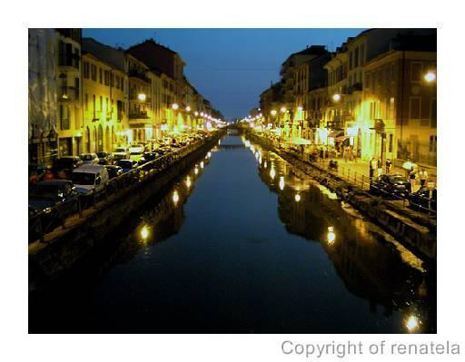

Slide 8
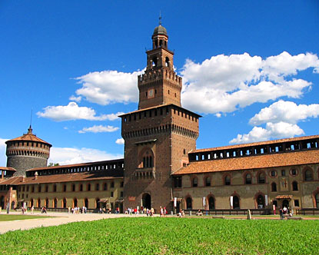
Sforza Castle

Slide 9
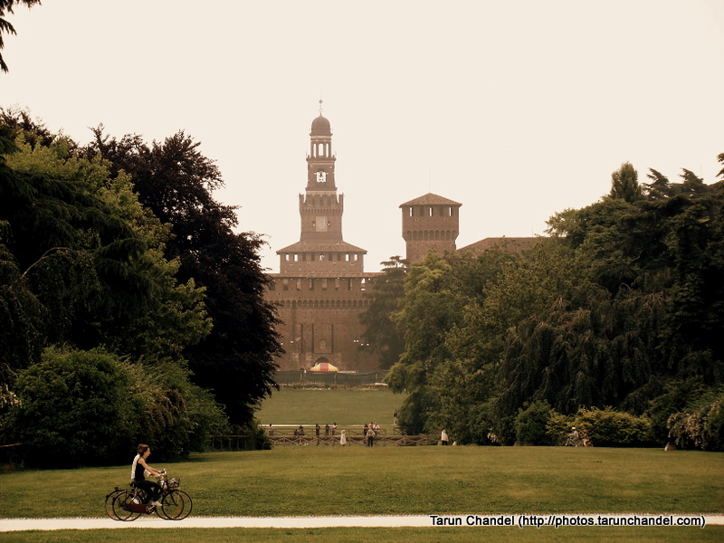

Slide 10
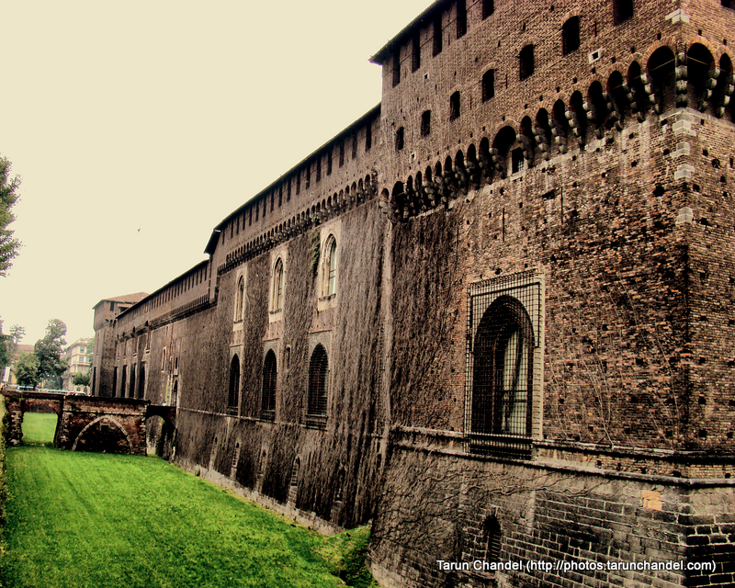

Slide 11
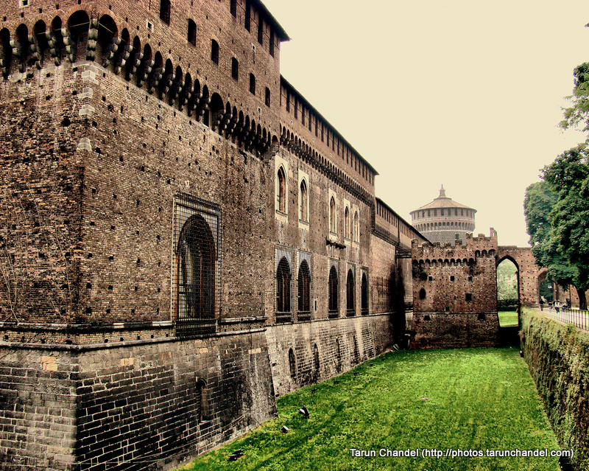

Slide 12
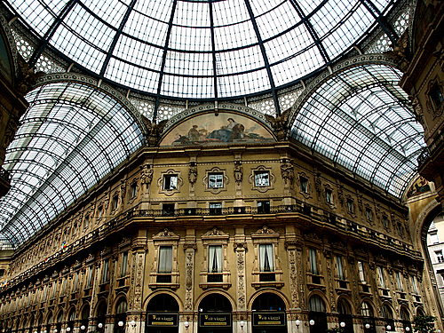
Galleria Shopping

Slide 13
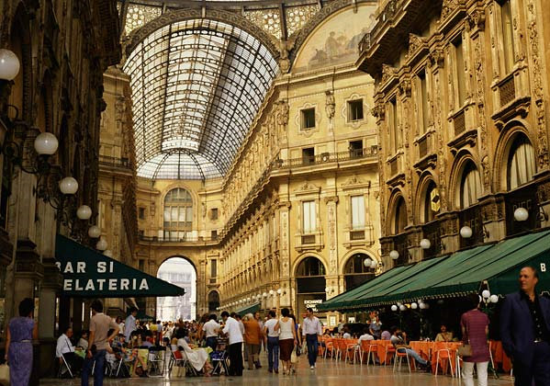

Slide 14
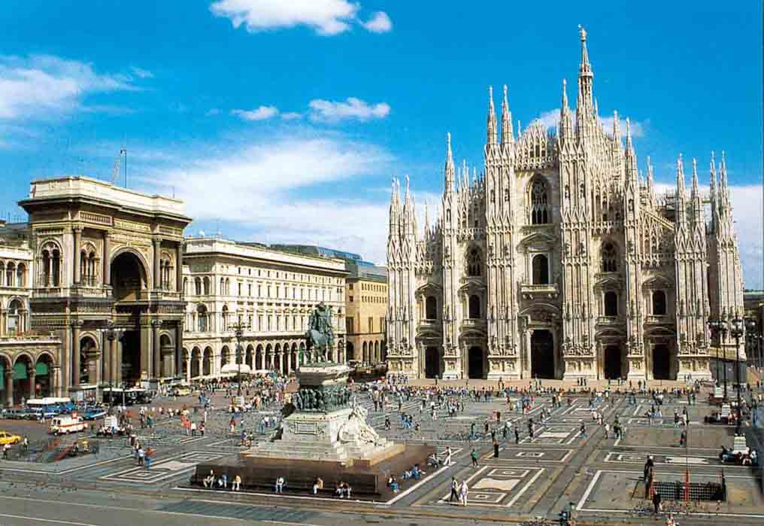
Duomo

Slide 15
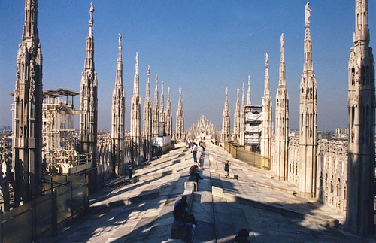
Duomo (Cathedral) roof

Slide 16
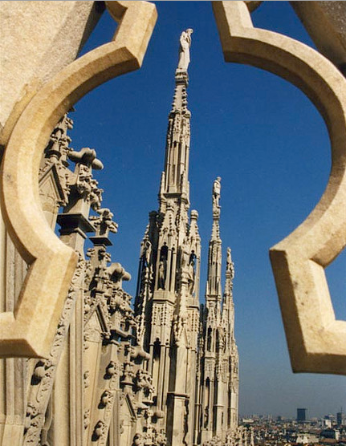
Duomo detail shot.

Slide 17
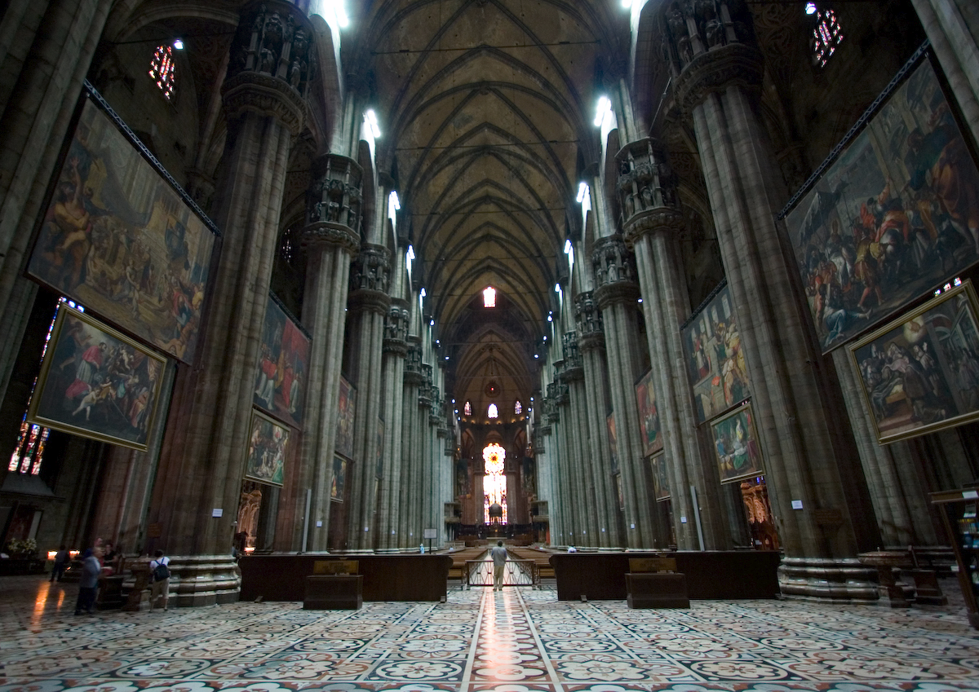

Slide 18
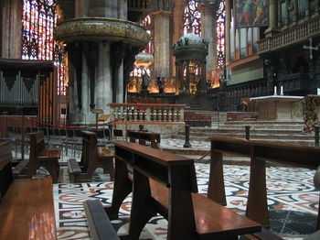

Slide 19
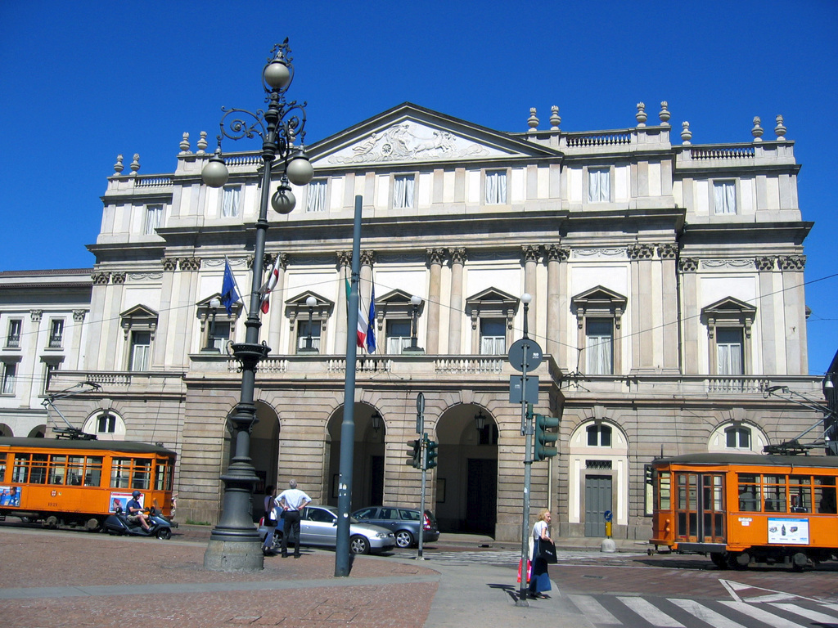
La Scala Opera House

Slide 20
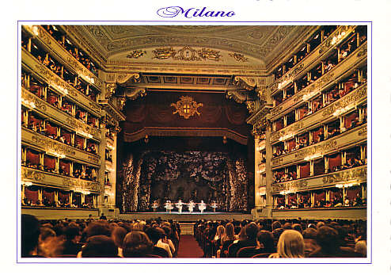
La Scala Opera

Slide 21
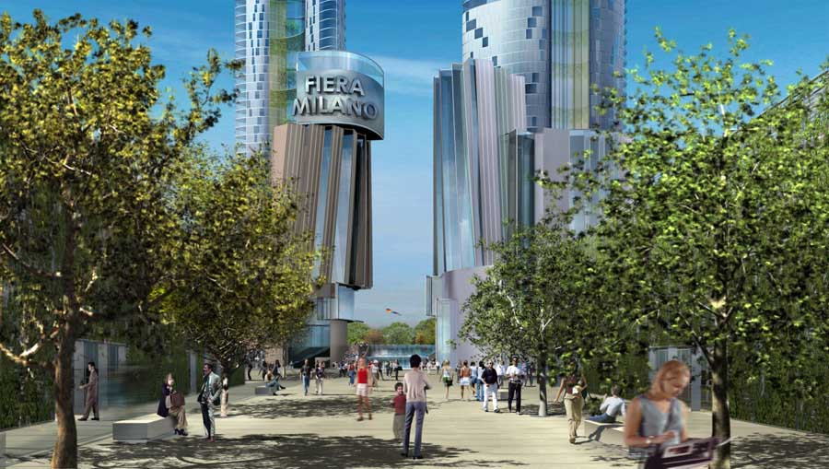
Modern housing planned

Slide 22
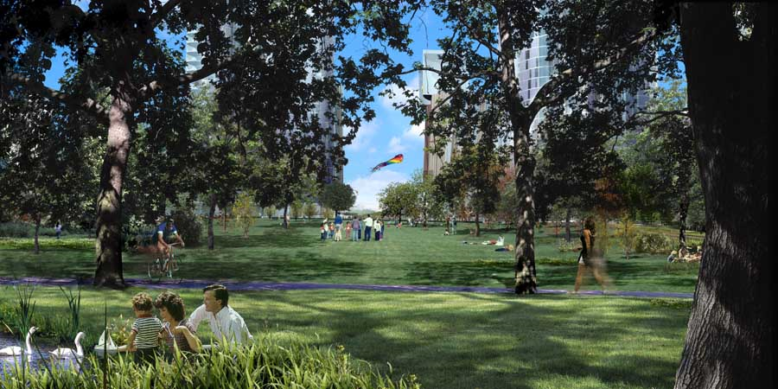

Slide 23
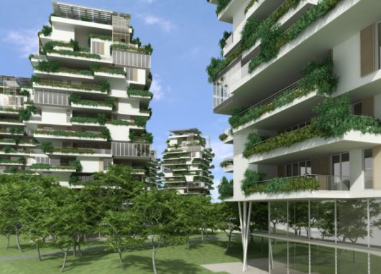

Slide 24
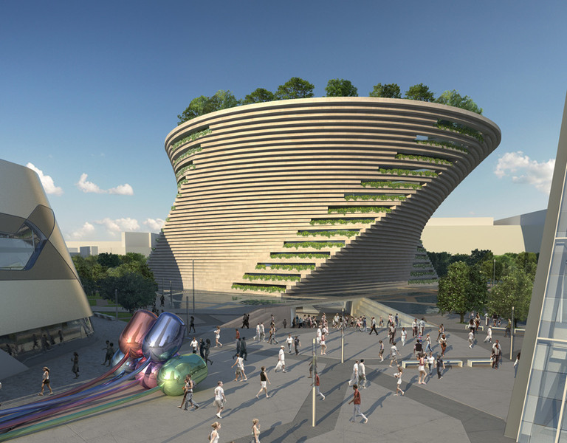

Slide 25
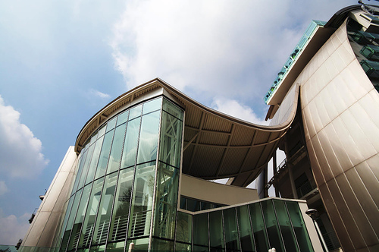

Slide 26
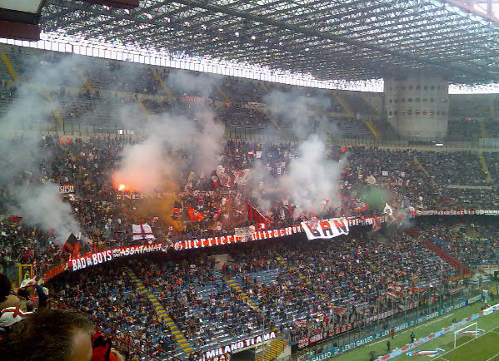
The Giuseppe Meazza soccer stadium

Slide 27
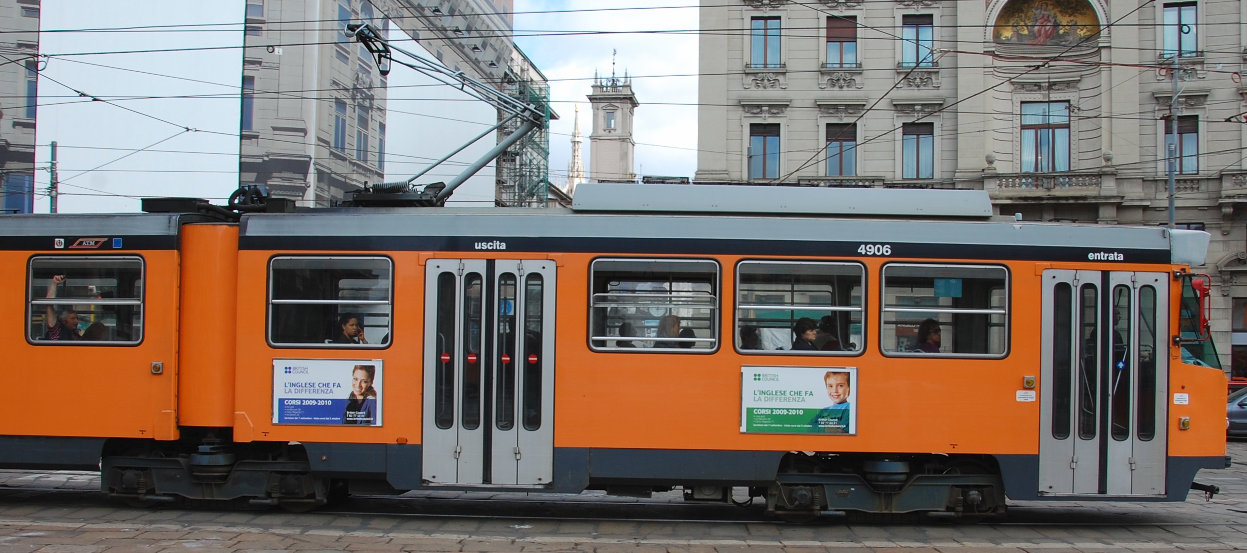
Public Transportation

Slide 28
The Commercial/Business Side of Milan

Slide 29
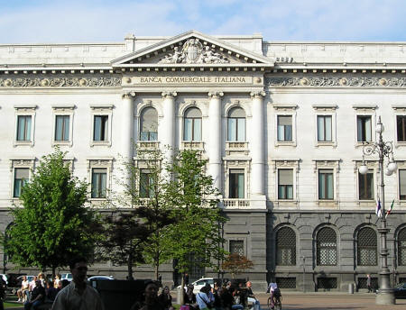
Commercial Bank of Italy

Slide 30
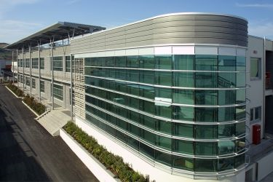
ICA Lab

Slide 31
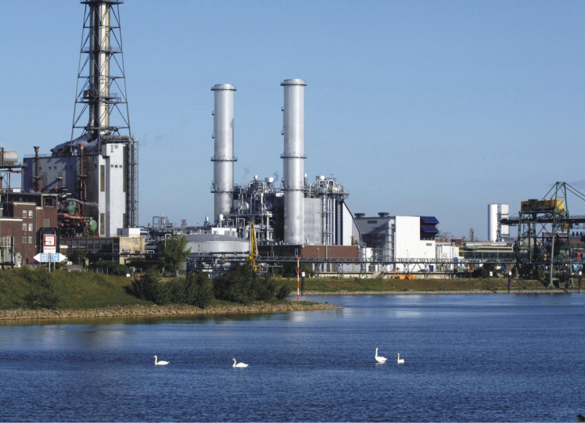
Chemicals & Petrochemicals

Slide 32
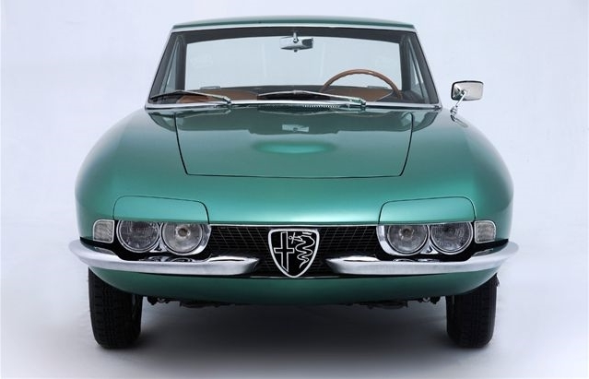

Slide 33
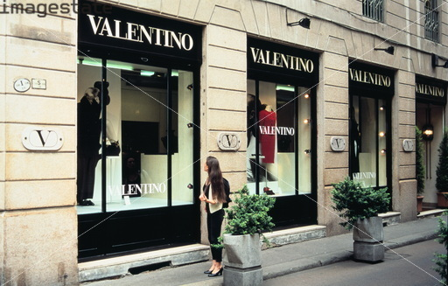
Via Montenapoleone is the centre of Milan's fashion industry

Slide 34
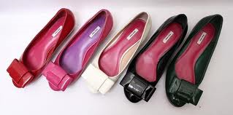
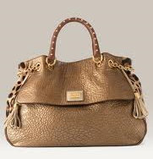
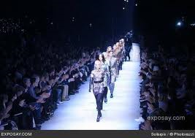

Slide 35
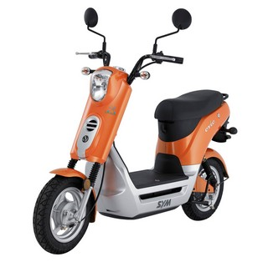

Slide 36
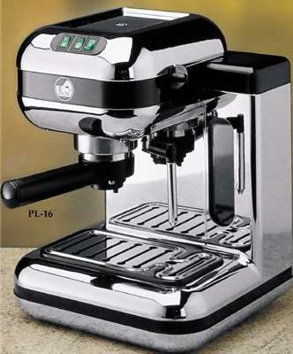

Slide 37
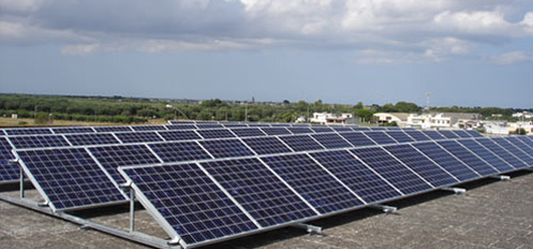
Italian photovoltaics

Slide 38
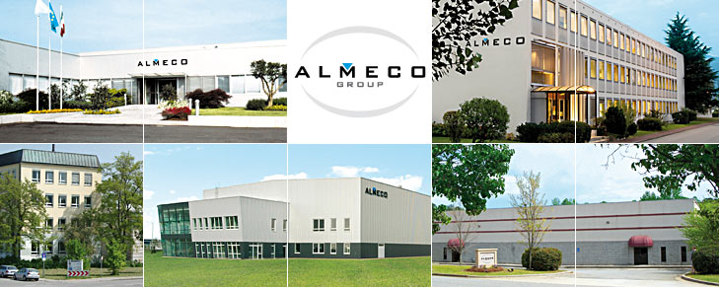
Aluminum

Slide 39
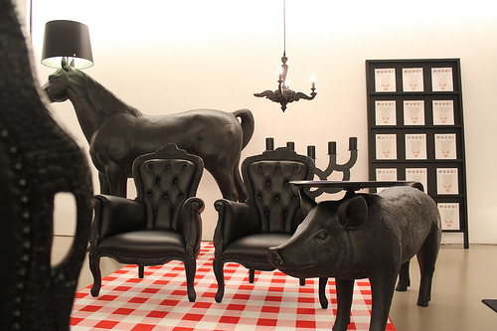
Home Furnishings

Slide 40
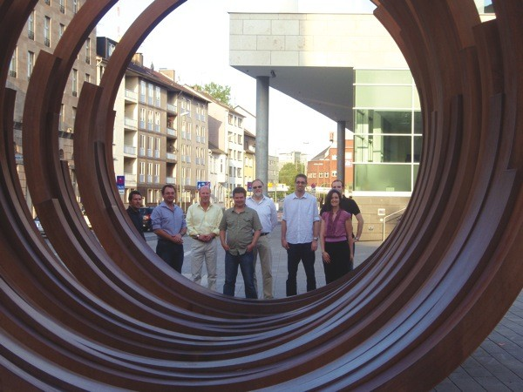


Slide 41
The Italian Riviera (Liguria)

Slide 42
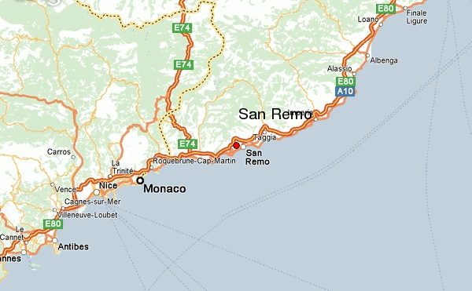
San Remo

Slide 43
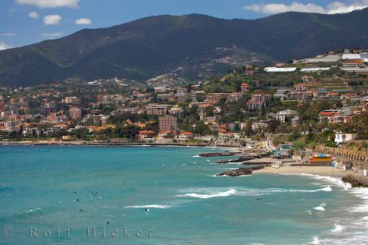

Slide 44
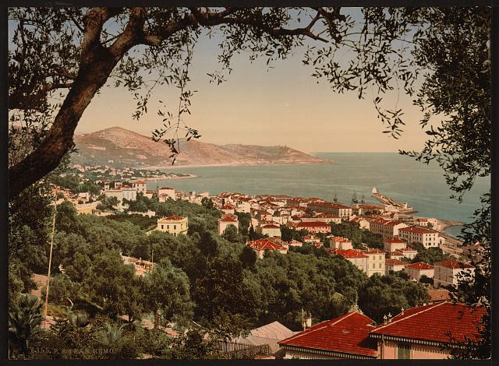

Slide 45
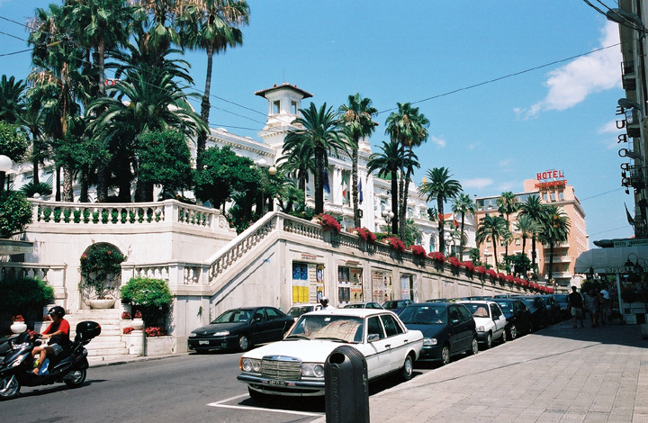
Casino

Slide 46
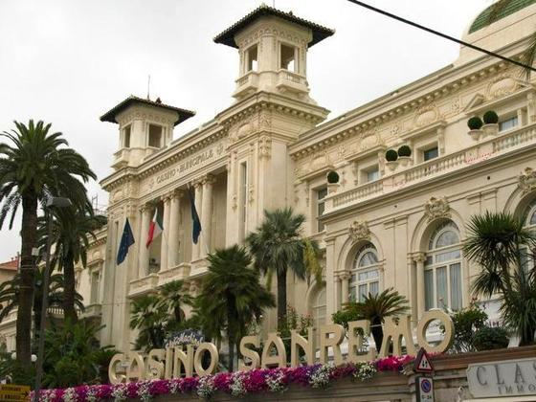

Slide 47
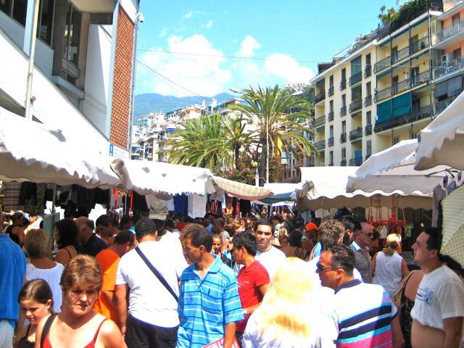

Slide 48
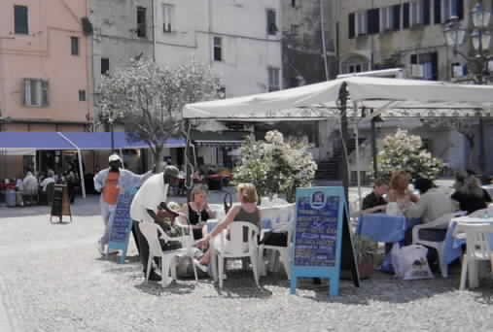

Slide 49
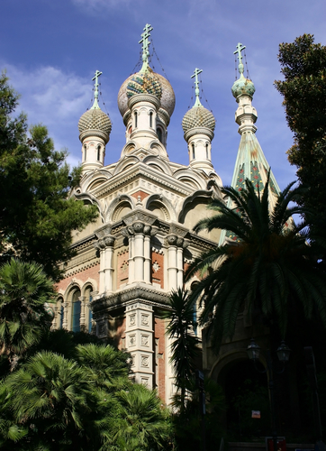
Russian Orthodox Church – San Remo was a favorite vacation spot for Russian royalty.

Slide 50
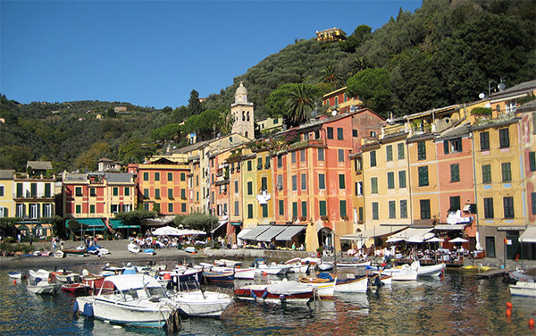

Slide 51
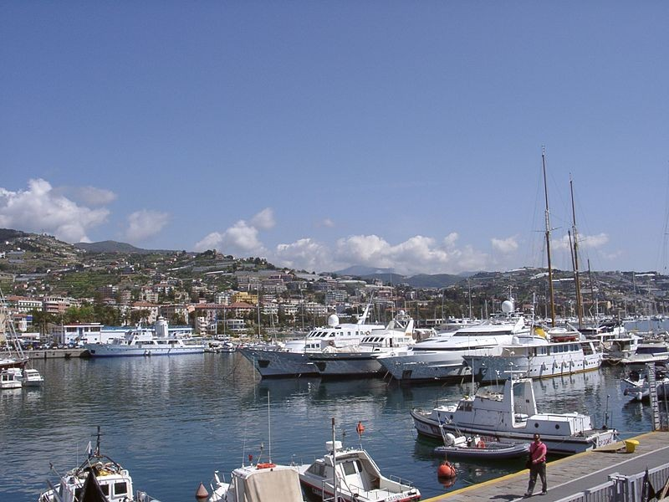
Harbor of San Remo

Slide 52
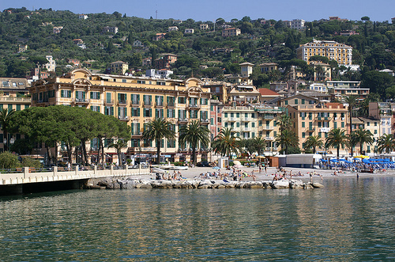

Slide 53
Dolceacqua

Slide 54


Slide 55


Slide 56


Slide 57


Slide 58

The dark, narrow streets of the medieval part of Dolceacqua were easy to defend if the town were attacked.

Slide 59


Slide 60


Slide 61



Slide 62


Slide 63


Slide 64

Ruins of the medieval castle

Slide 65


Slide 66


Seborga (claims to be an independent microstate.

Slide 67


Slide 68


Slide 69


Slide 70


Slide 71


Slide 72

The Prince of Seborga
But the principality's future has suddenly turned cloudy. Prince Giorgio I died at his home in Seborga on Nov. 25, 2009 after suffering from Lou Gehrig's disease, the principality announced. He was 73. Succession plans are uncertain.

Slide 73

Town Church

Slide 74



Slide 75




Slide 76


Slide 77
Sicily and Islands

Slide 78

Trapani

Slide 79


Slide 80

Aeolian Islands or Lipari Islands

Slide 81

Isola Bella

Slide 82

Palermo

Slide 83

Patio interior Calle Vittorio Emanuele - Palermo

Slide 84

Cathedral of Palermo

Slide 85

Theatre Massimo Vittorio Emanuele

Slide 86

Duomo at Siracusa

Slide 87

Cathedral Square and City Hall with Maria Carafa

Slide 88

Noto in Sicily

Slide 89

Taormina - Theater Greco-Sicily

Slide 90

Taormina

Slide 91

Catania

Slide 92

Sanctuary of Tindari

Slide 93

Milazzo

Slide 94

Mount Etna - fuming
One of the most active volcanoes in the world and is in an almost constant state of activity.

Slide 95

Regional Park 'Etna
. The sundial, also known as or more correctly scioto sundial is an instrument for measuring time based on the detection of the position of the Sun has very ancient origins and in its most general sense means most of the dials on the walls of these buildings. Strictly speaking, it should be understood only with the meridian indicator of the passage of the Sun at noon.

Slide 96

The residence of the famous Admiral Horatio Nelson.

Slide 97

Woman Basin in Cefalu
The Arabic wash house
The medieval wash-house is located at the mouth of Cefalino. Characteristic of the wash-house is the low temperature of the water, which makes it a cool place where you refresh.

Slide 98
Great Greco-Roman Ruins

Slide 99

Segesta

Slide 100


Slide 101

Greek theater at Segesta

Slide 102

Valley of the Temples (Agrigento)

Slide 103

Doric Temple (Selinunte)

Slide 104

The Greek Theatre (Syracuse)

Slide 105

Roman Mosaic of P.zza Armerina

Slide 106
Sicilian Culture and Products

Slide 107

Ceramics

Slide 108

Salt Farm & Windmill

Slide 109

Tunny-Fishery (Favignana)

Slide 110


Winery

Slide 111


Sicilian Wedding Cart & Festival of Flowers (Noto)

Slide 112

Cassata Cake

Slide 113




Olive Grove

Slide 114



Citrus Fruit

Slide 115




Sicilian Weddings

