Slide 1
Italy – Jewel of the Mediterranean – Part 2
Enchantment Abounds!

Slide 2
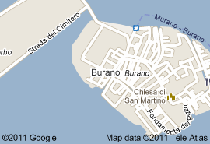
Burano
Burano is one of the prettiest islands in the lagoon: it is a miniature Venice where all the houses are painted in bright colors. Burano is famous for its lace work, an art carried out since the sixteenth century and which is famous worldwide.

Slide 3
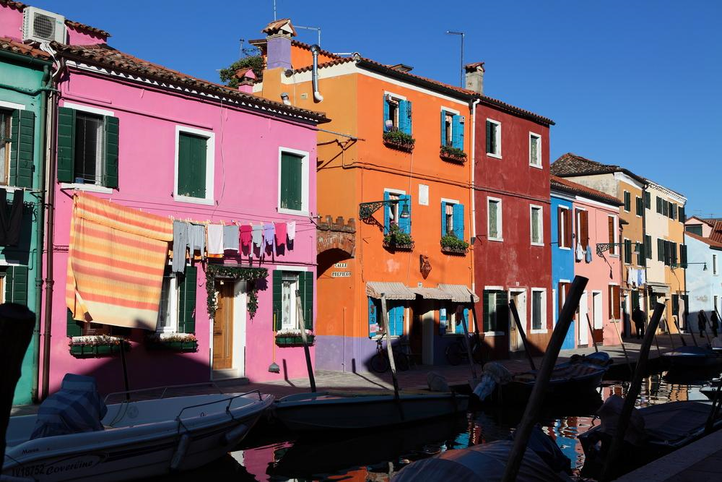

Slide 4
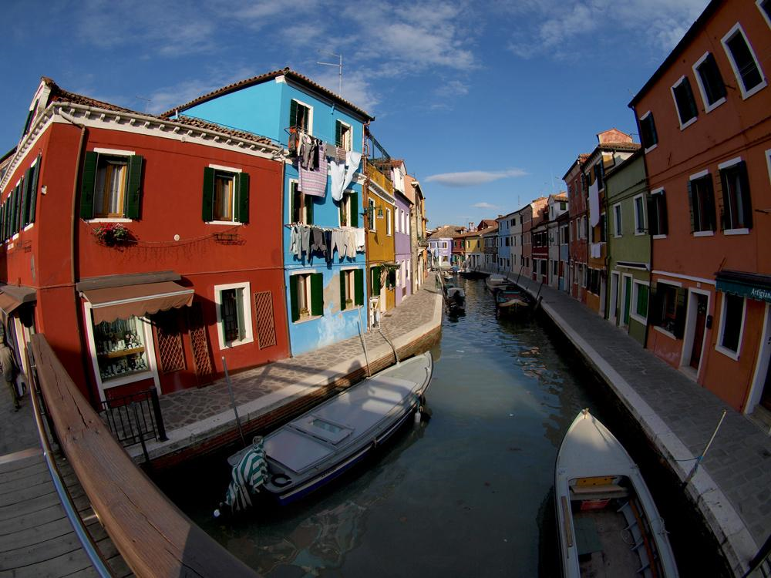

Slide 5
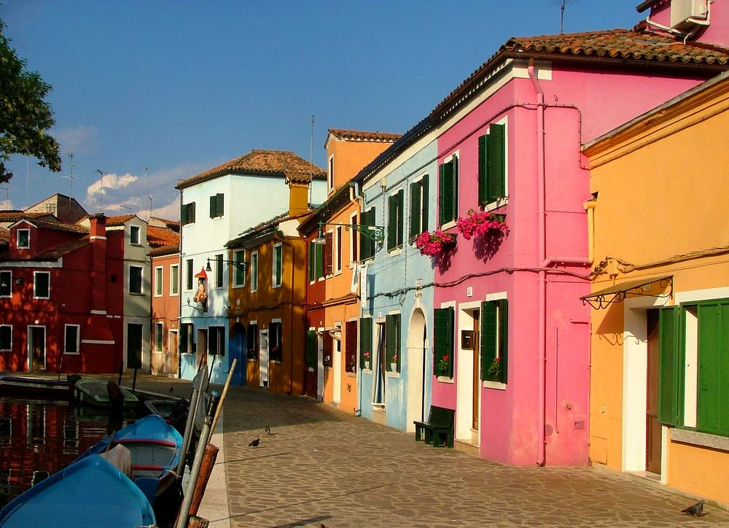

Slide 6
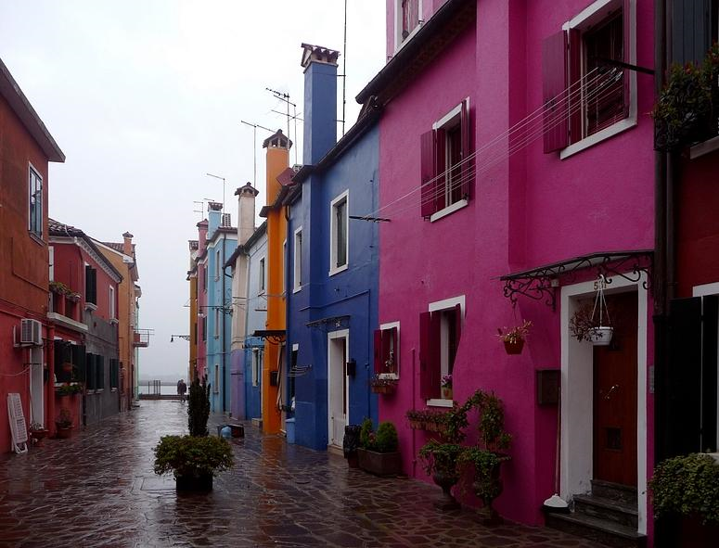
Burano in Winter

Slide 7
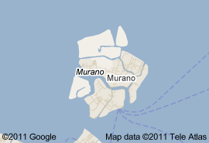
Murano
Murano glass is a famous product of the Venetian island of Murano. Located off the shore of Venice, Italy, Murano has been a commercial port as far back as the 7th century. By the 10th century, the city had become well-known for its glassmakers, who created unique Murano glass. While Murano glassmakers have settled and operate elsewhere, some say authentic Murano glass is fabricated only in Murano.

Slide 8
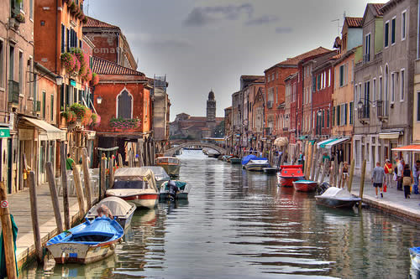

Slide 9
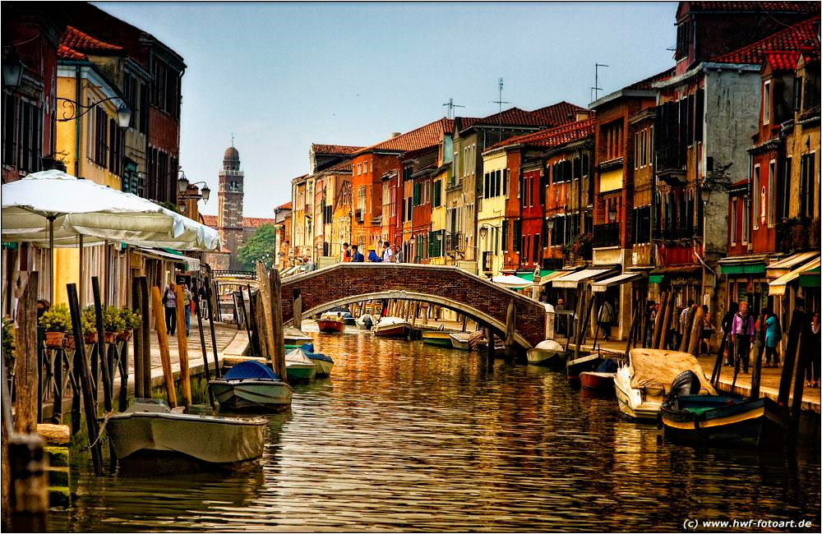

Slide 10
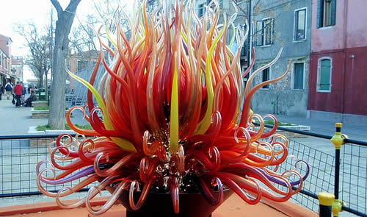

Slide 11
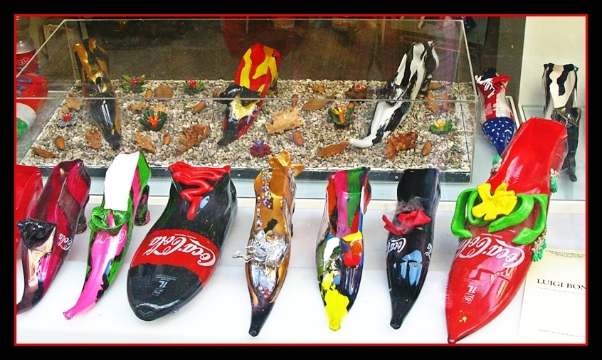

Slide 12
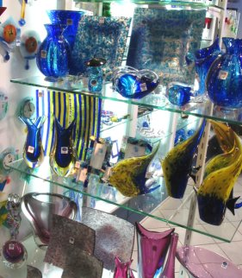
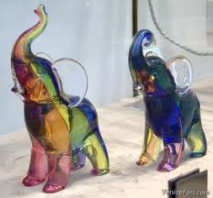
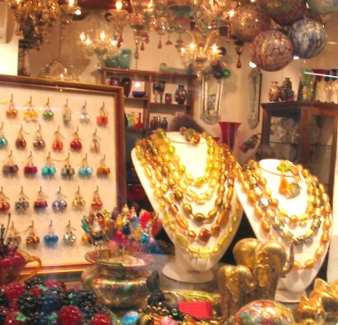

Slide 13
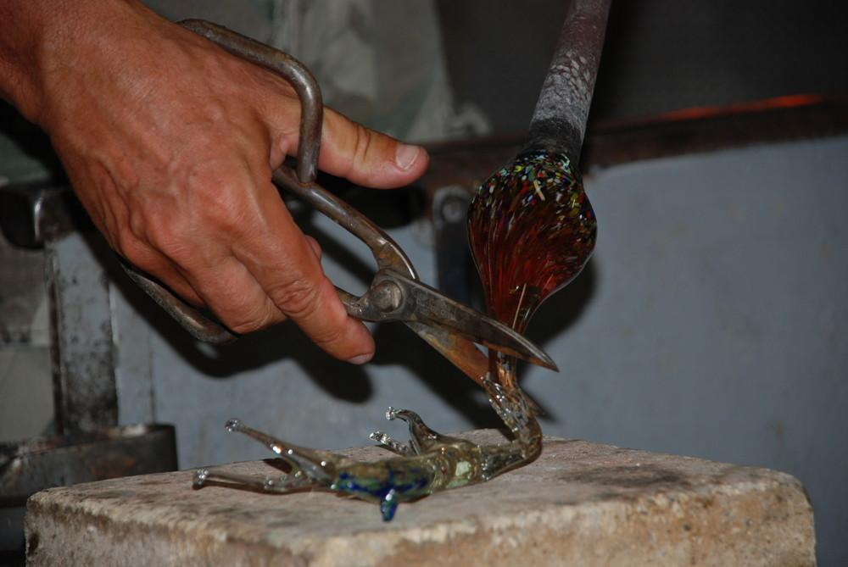

Slide 14
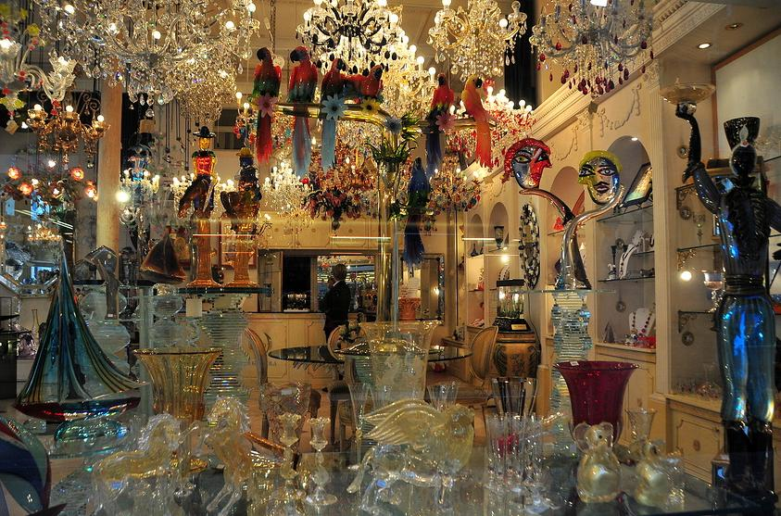

Slide 15
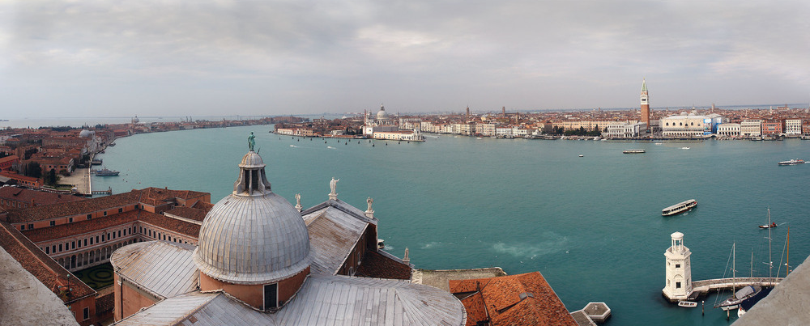

Slide 16
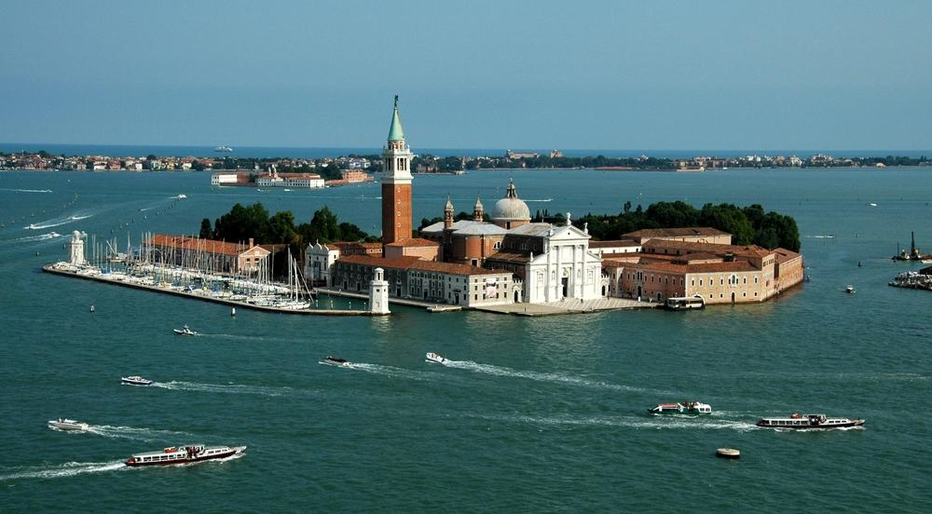

Slide 17
Outside of rome & Venice

Slide 18
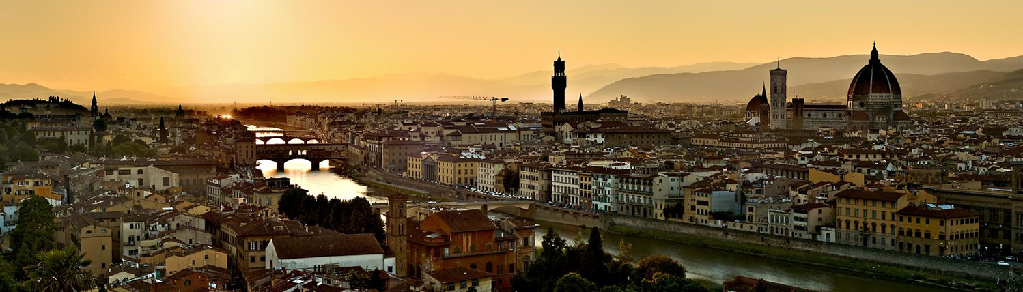
Florence – cradle of the renaissance

Slide 19
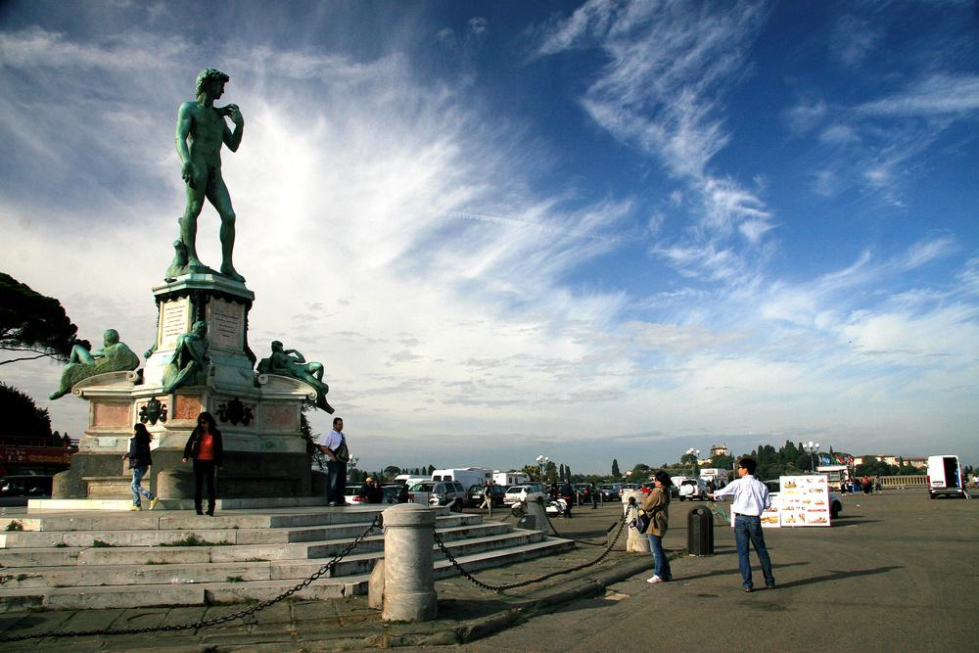
Michelangelo square - Statue of David – overlooks the River Arno and the old city

Slide 20
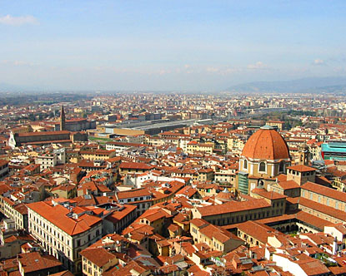
Florence

Slide 21
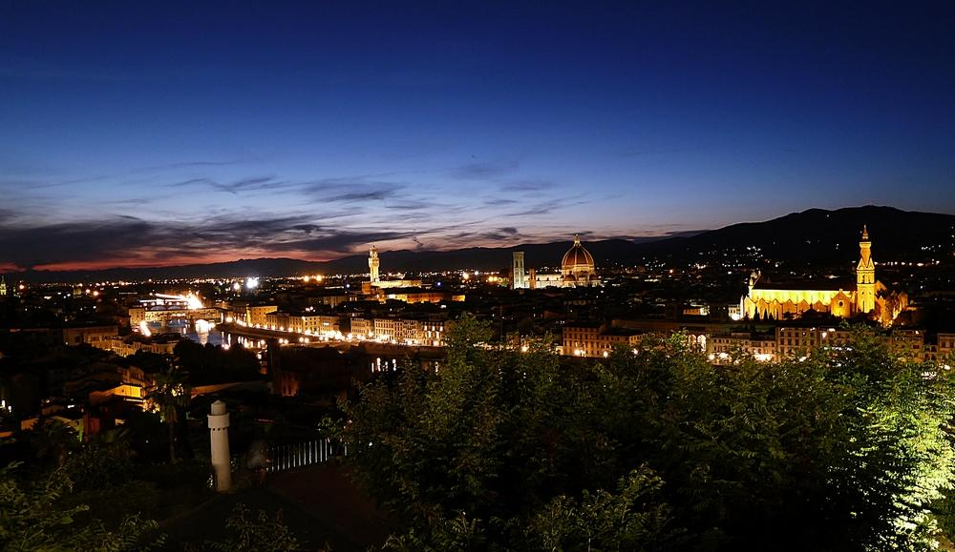

Slide 22
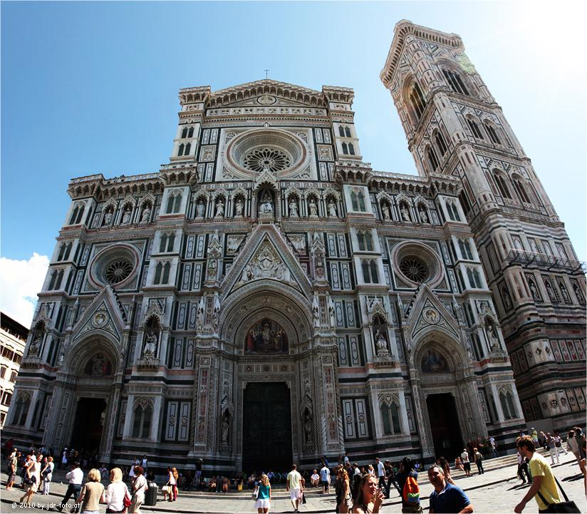
Duomo: Cathedral of Santa Maria del Fiore and the Giotto Bell Tower

Slide 23
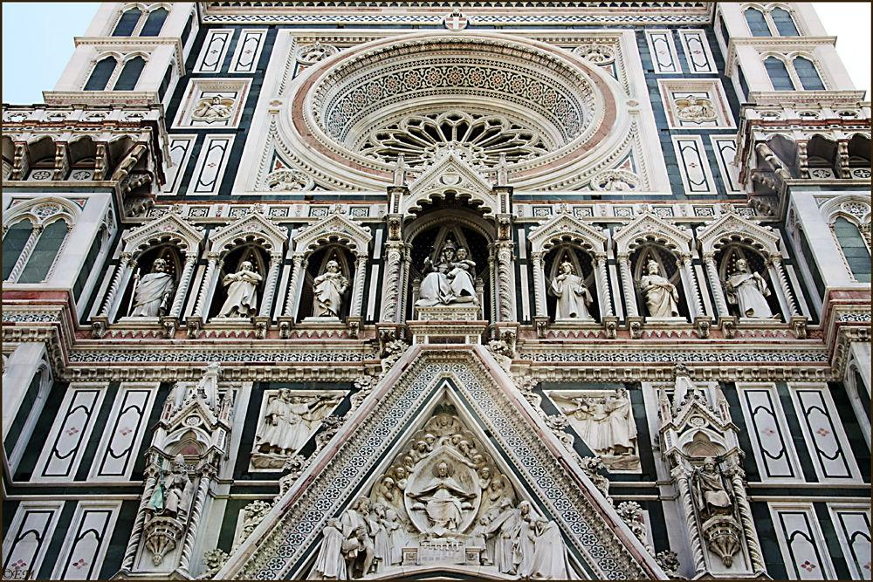

Slide 24
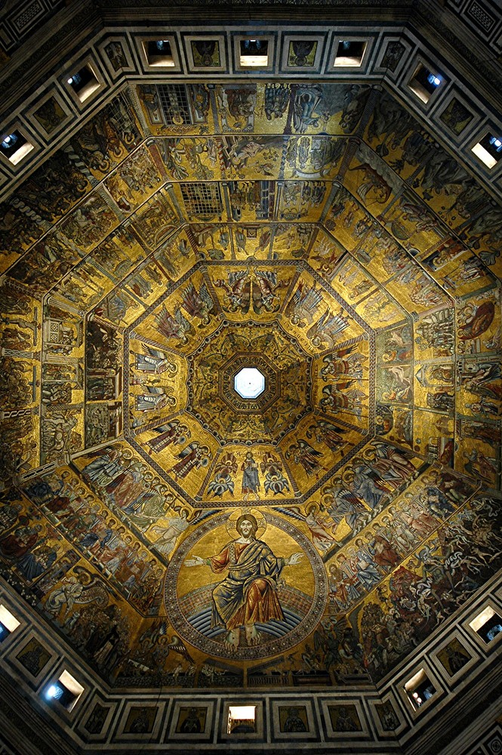
Duomo – interior shot of the dome

Slide 25
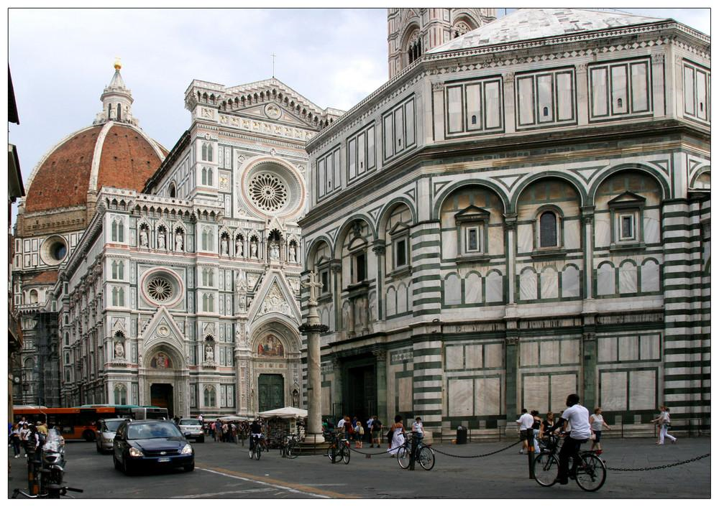

Slide 26
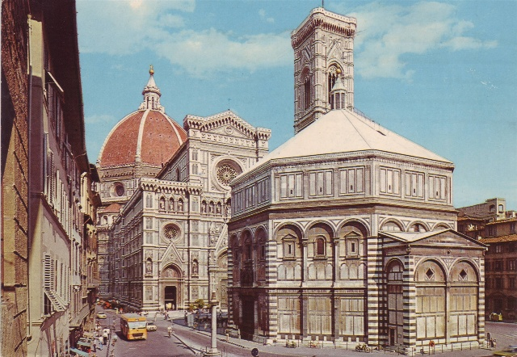
Duomo: from behind the baptistery

Slide 27
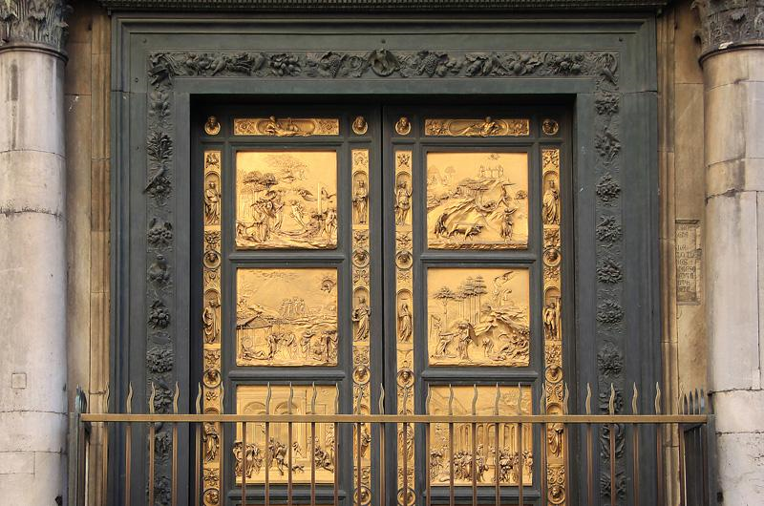
Baptistery doors: Door of Heaven

Slide 28
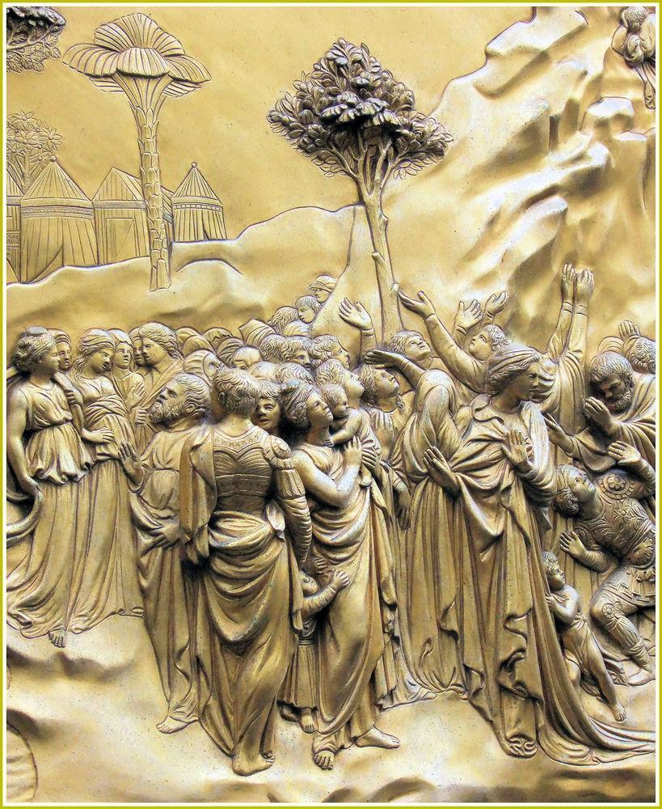
North door of the Baptistery of Florence, the door of paradise, bronze, detail.

Slide 29
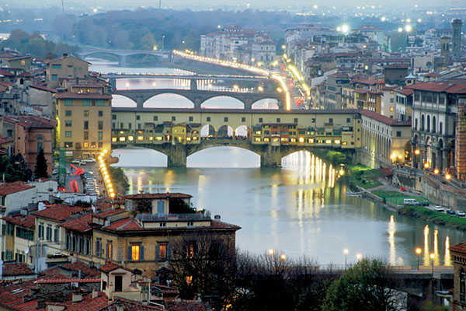
Florence

Slide 30
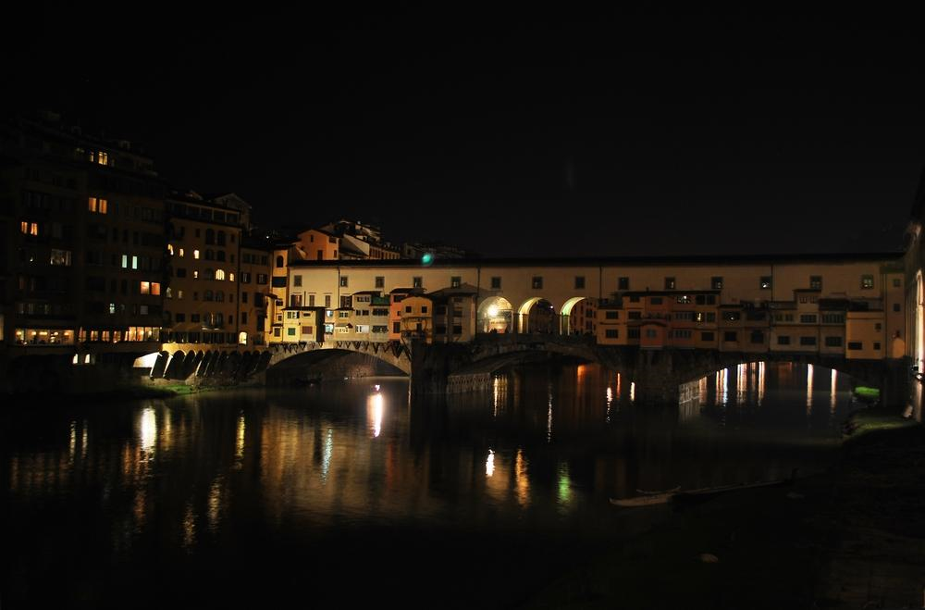
Ponte Vecchio

Slide 31
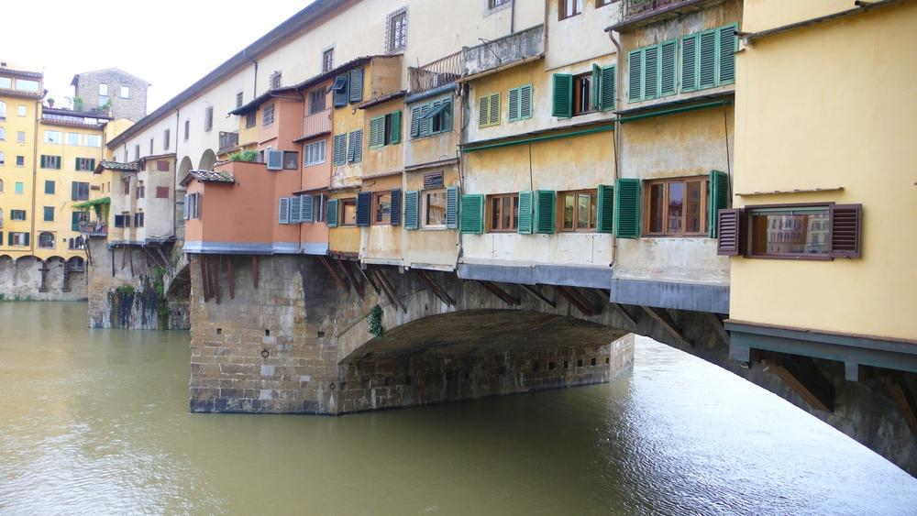

Slide 32
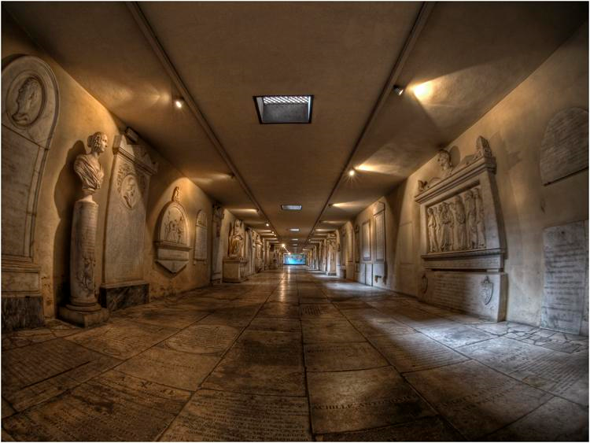
Avenue of the tombstones

Slide 33
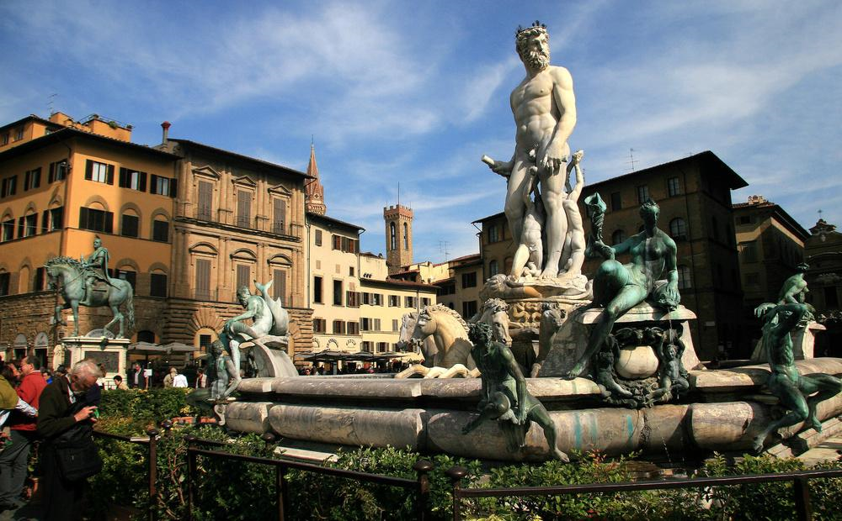
Fountain of Neptune: situated on the Piazza della Signoria

Slide 34
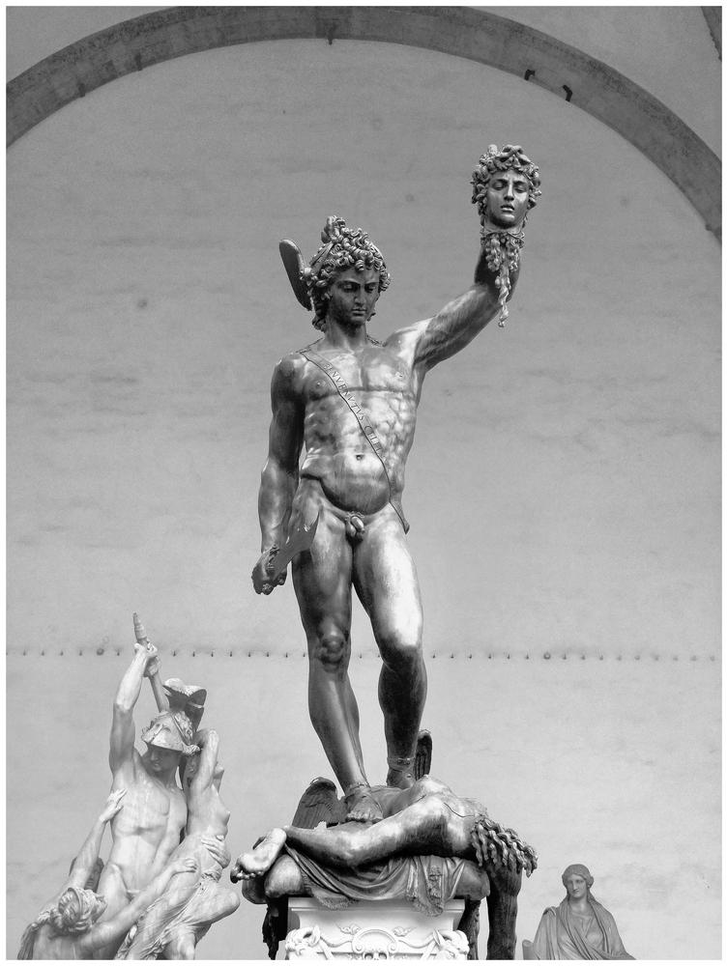
Perseus and the Gorgon: one of many sculptures in the The Loggia dei Lanzi, also called the Loggia della Signoria, near the Palazzo Vecchio

Slide 35
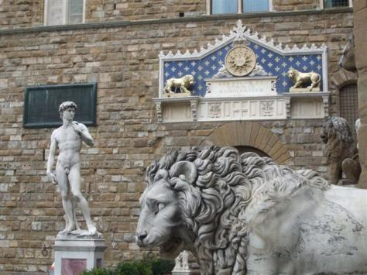
Florence: Replica of David in front of the Palazzo Vecchio in the Piazza della Signoria

Slide 36
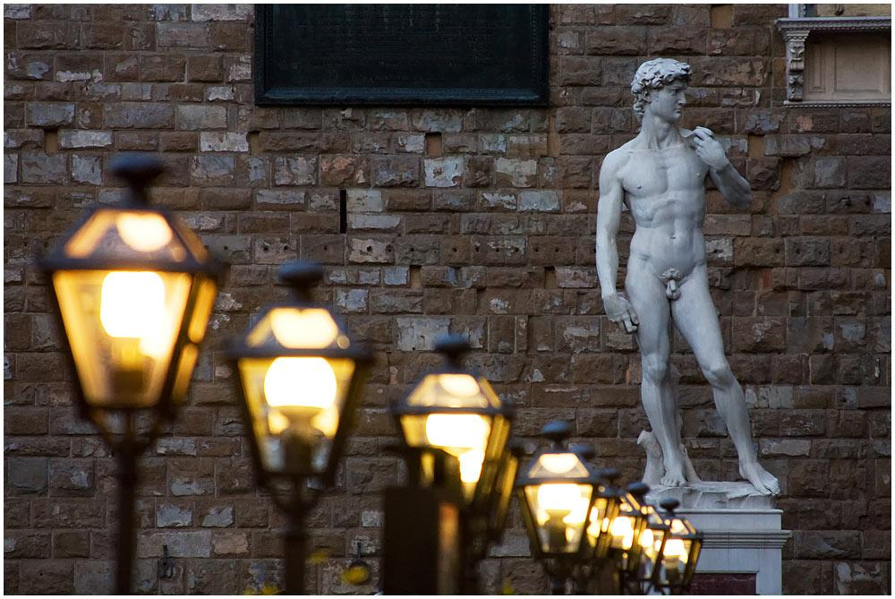
The Statue of David, completed by Michelangelo in 1504, is one of the most renowned works of the Renaissance.

Slide 37
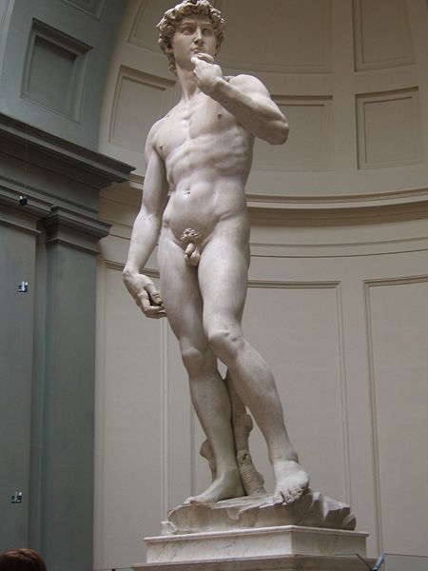
David (Michelangelo) in Florence. The original sculpture has been moved to the Academy of Art (museum) to protect it from weather and polluted air.

Slide 38
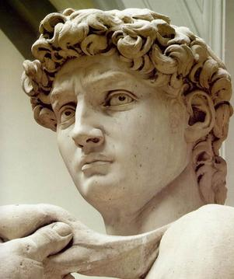
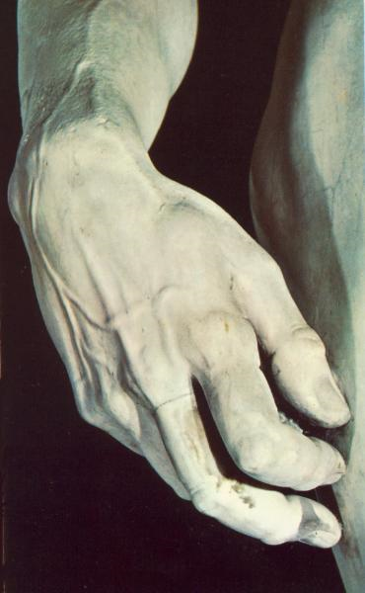

Slide 39
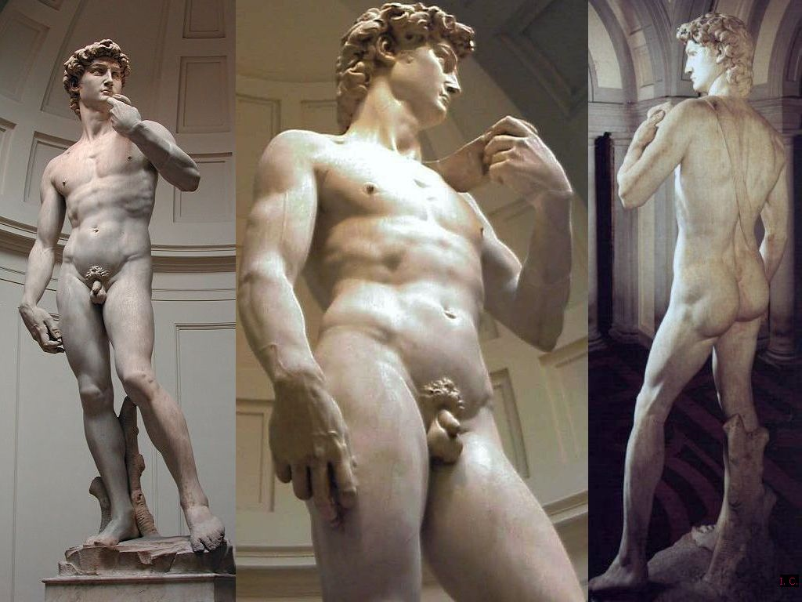

Slide 40
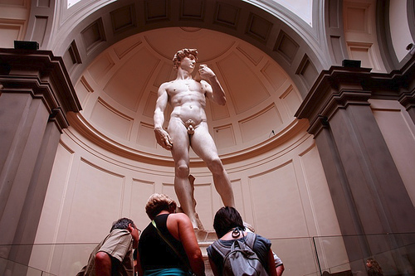

Slide 41
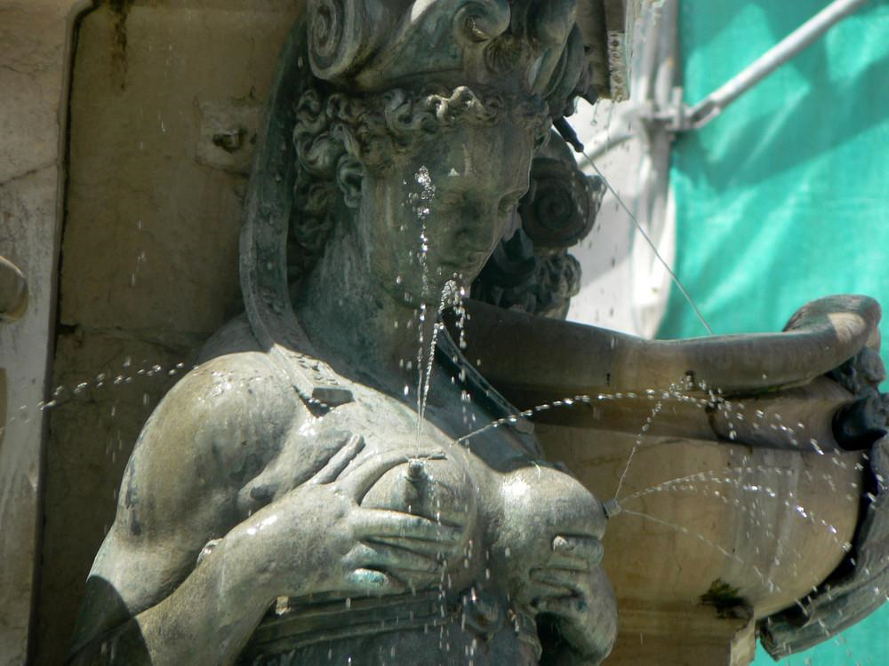
Madonna

Slide 42
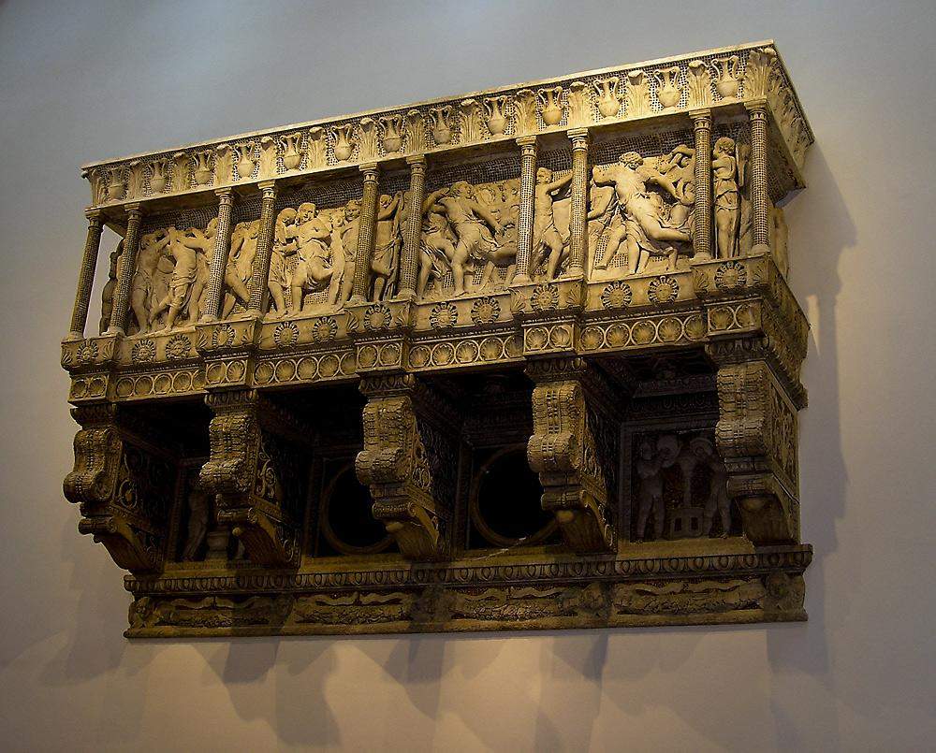
The singer pulpit by Donatello

Slide 43
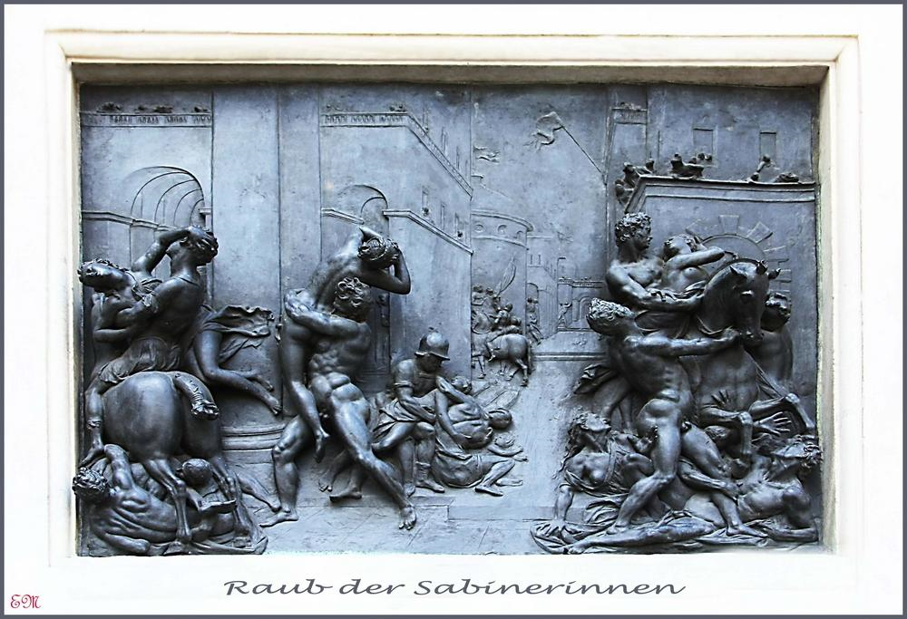
The rape of the Sabine Women

Slide 44
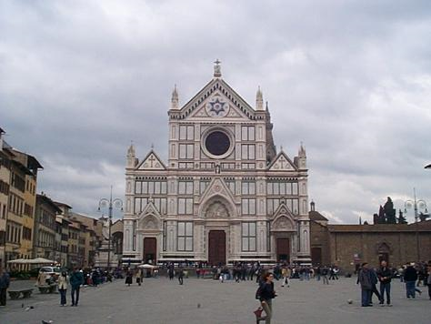
Santa Croce, Florence

Slide 45
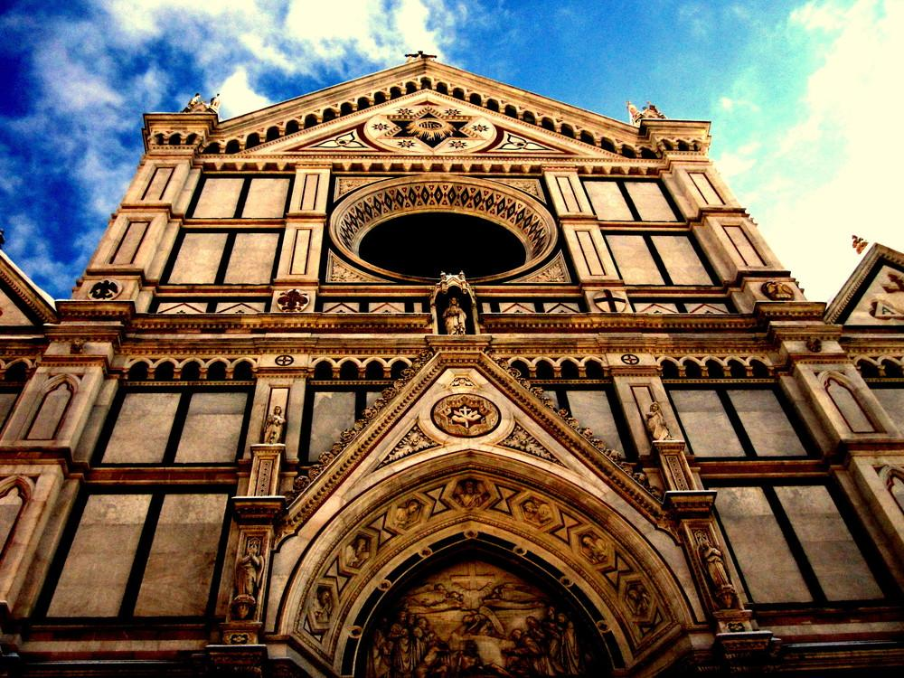
Santa Croce

Slide 46
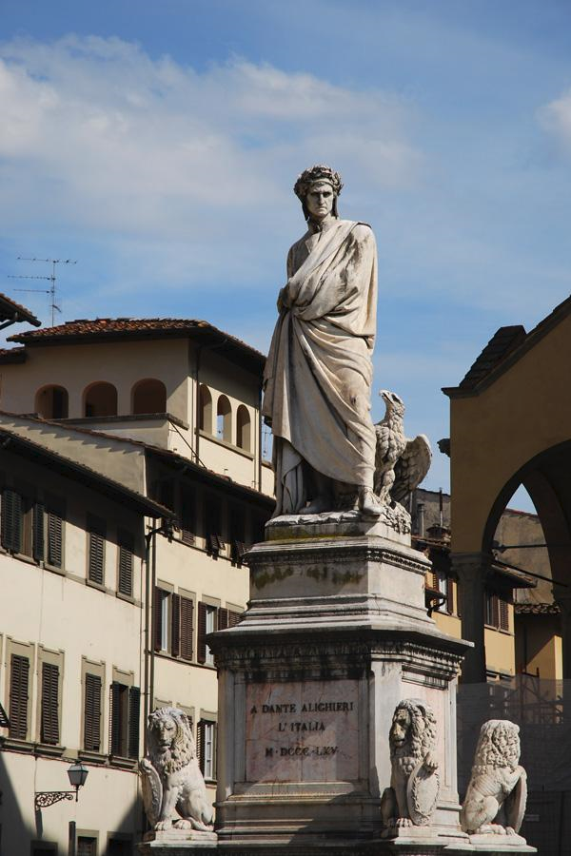
DANTE Alighieri (Monument of Dante in front of Santa Croce-Florence) He was a major Italian poet of the Middle Ages. His "Divine Comedy" is considered the greatest literary work and a masterpiece of world literature.

Slide 47
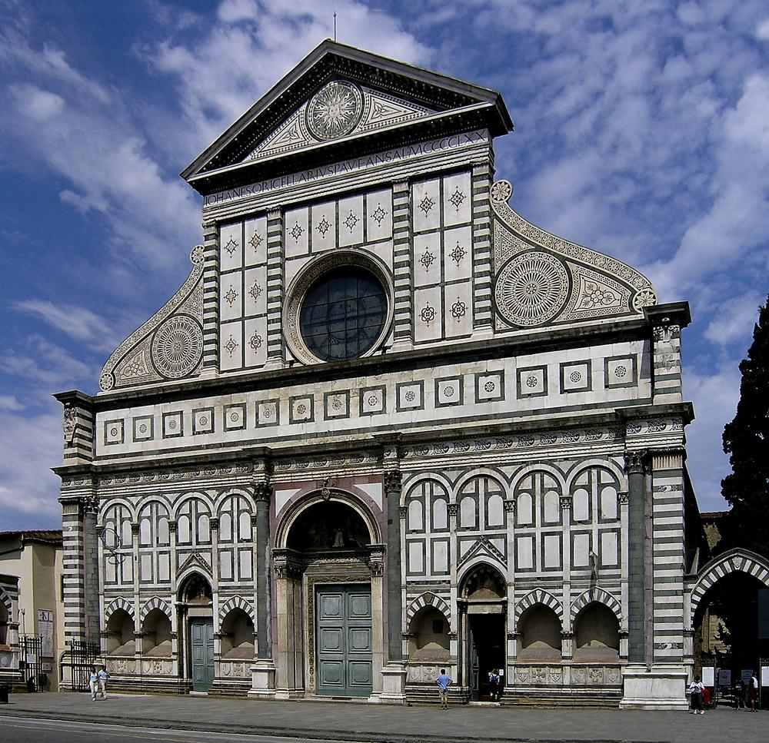
The basilica of Santa Maria Novella

Slide 48
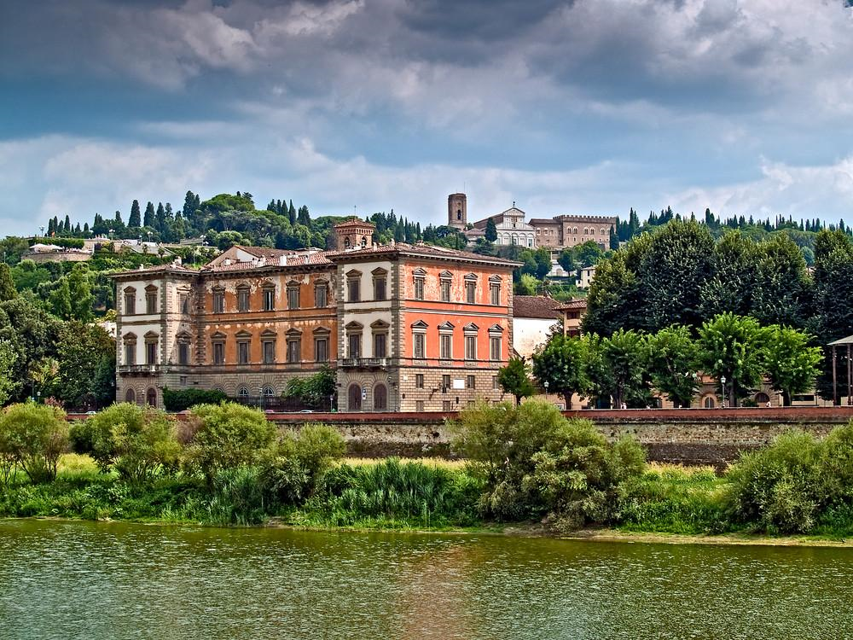

Slide 49
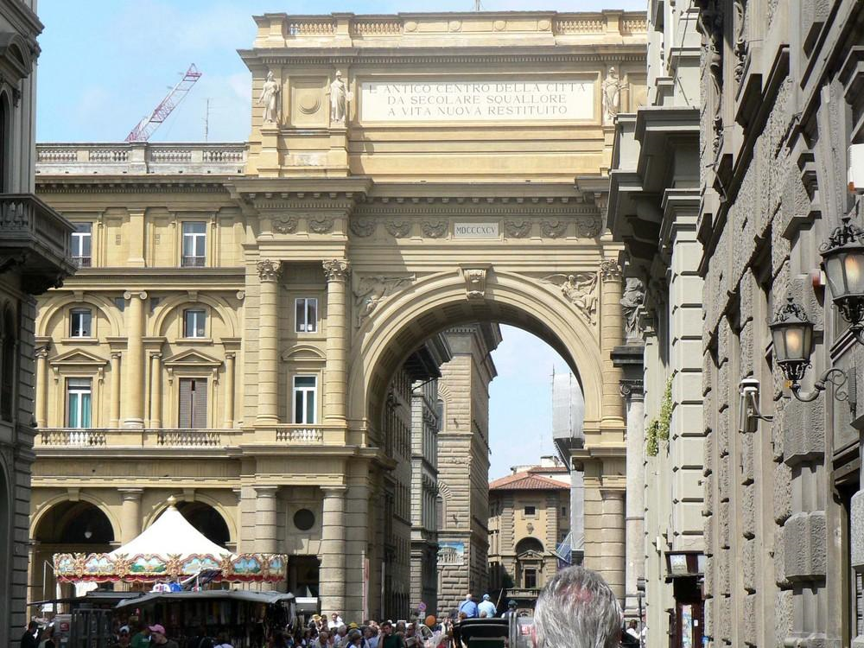
Piazza Republica

Slide 50

The cave of Buontalenti-Florence - Boboli Gardens

Slide 51

Villa Medici in Poggio Caiano

Slide 52

Milan Duomo

Slide 53

Milan skyline (industrial air pollution)

Slide 54

Milan City Center

Slide 55

Naples

Slide 56

Naples

Slide 57

Naples

Slide 58

Palermo, Sicily

Slide 59

Palermo Duomo

Slide 60

Palermo

Slide 61

Civita di Bagnoregio

Slide 62

Villa D’Este at Tivoli near Rome

Slide 63
sights

Slide 64

Mt. Etna, Sicily

Slide 65

Lake Como

Slide 66

Lake Garda

Slide 67

Garda

Slide 68

Blue Grotto, Isle of Capri

Slide 69

Pieta (Michelangelo)

Slide 70


Slide 71


Slide 72


Slide 73


Slide 74

Tomb of Pope John XXIII

Slide 75


Slide 76

Italian Alps

Slide 77
Apennine Mountains

Slide 78


Slide 79

Amalfi Coast

Slide 80
Products of Italy

Slide 81


Slide 82


Slide 83



Slide 84


Slide 85


Slide 86


Slide 87


Slide 88


Slide 89




Slide 90


Slide 91
Italian agriculture

Slide 92

Olive Grove

Slide 93

Vinyard

Slide 94


Citrus: oranges & lemons

Slide 95

Wheat Field (Durum wheat)

Slide 96


Fig Trees

Slide 97
Italian people

Slide 98





Sicilians

Slide 99





Tuscans

Slide 100





Northern Italians

