Slide 1
Italy – Jewel of the Mediterranean – Part 1
Enchantment Abounds!

Slide 2

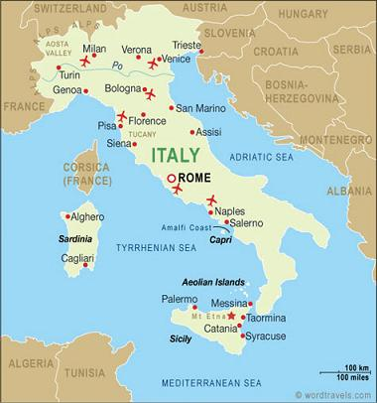
Region: Europe
Area total: 301,338 km2
Coast line: Mediterranean Sea, Adriatic Sea, Tyrrhenian Sea
Capital: Rome

Slide 3
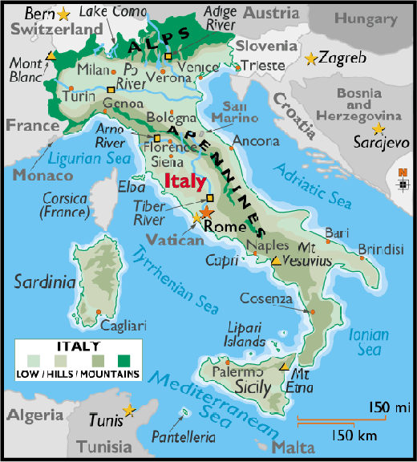

Slide 4
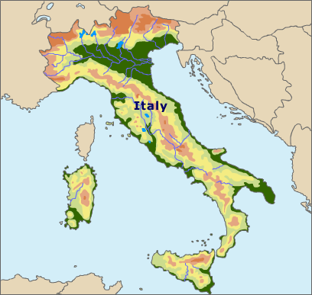

Slide 5
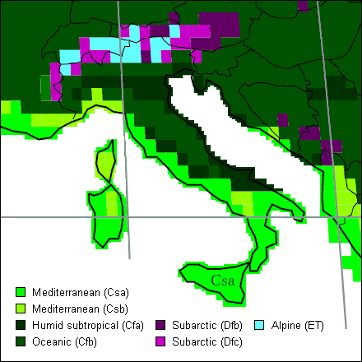
Climate Map

Slide 6
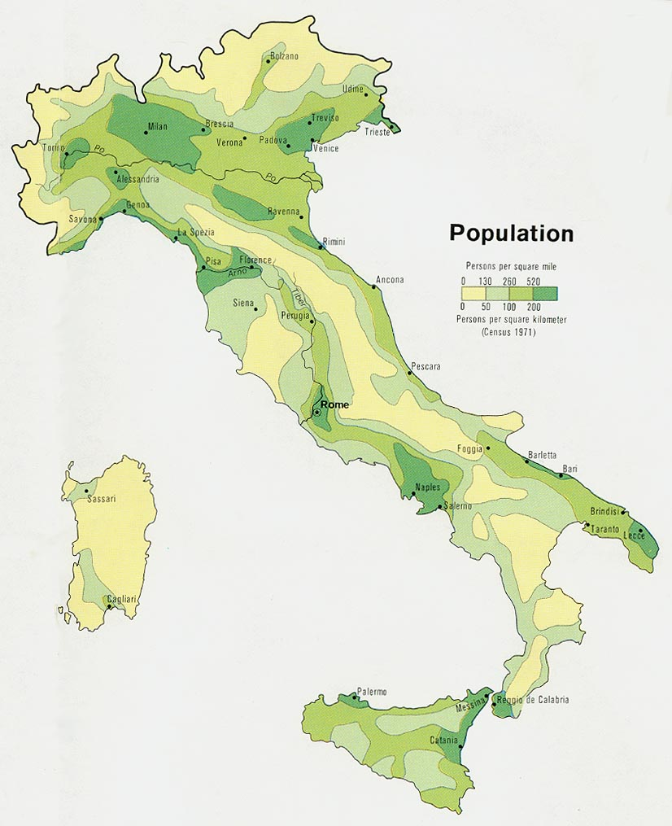

Slide 7
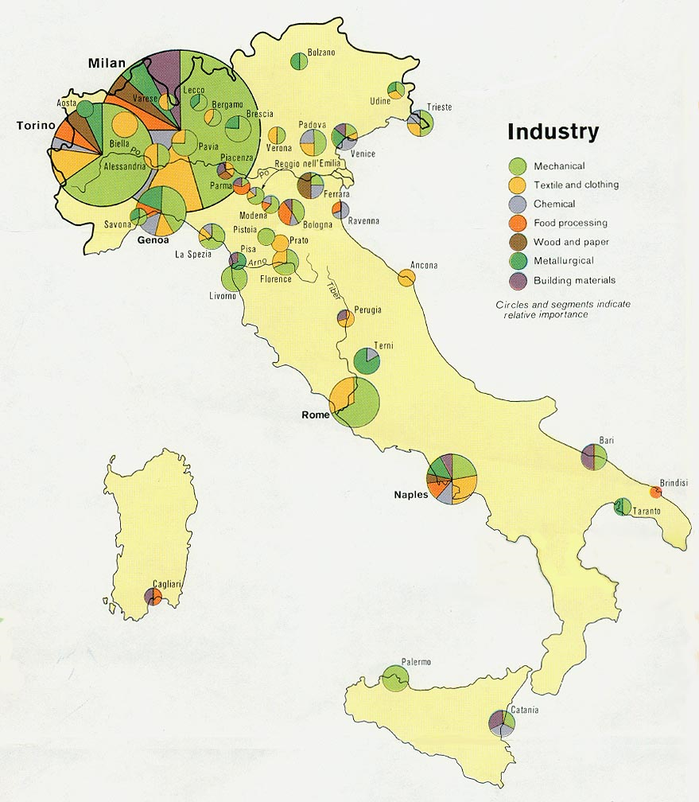

Slide 8
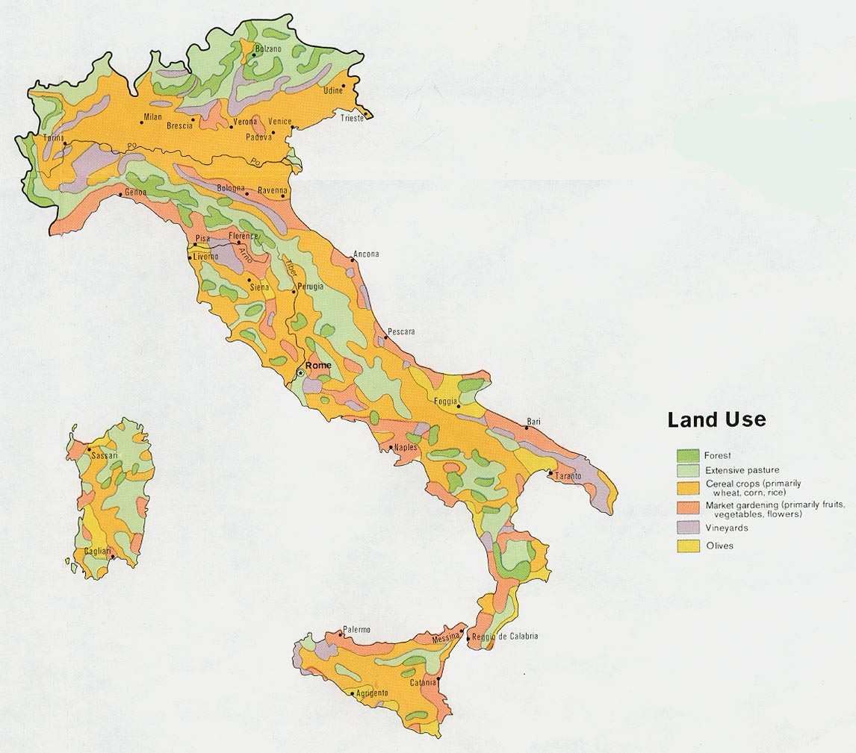

Slide 9
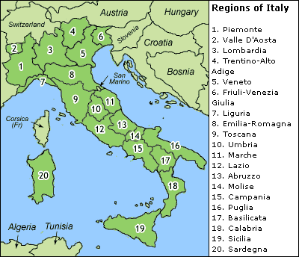

Slide 10
Rome – The eternal City

Slide 11
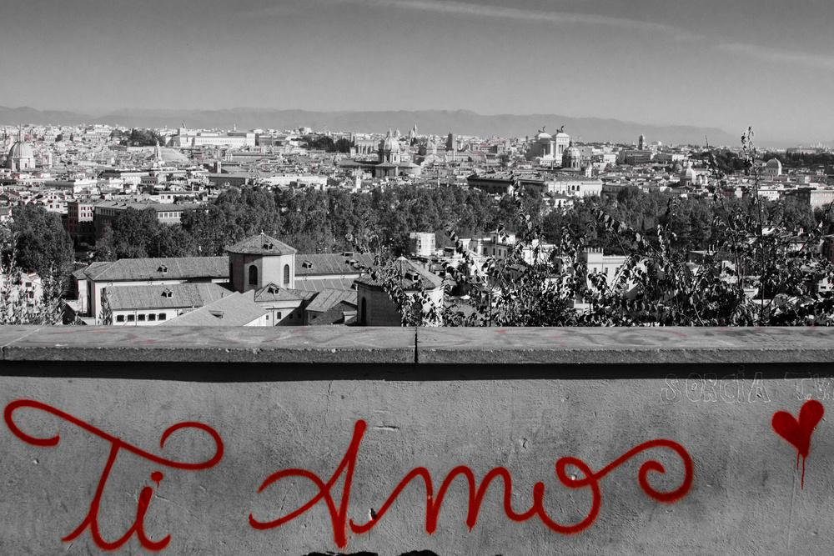
I Love You, Rome!

Slide 12
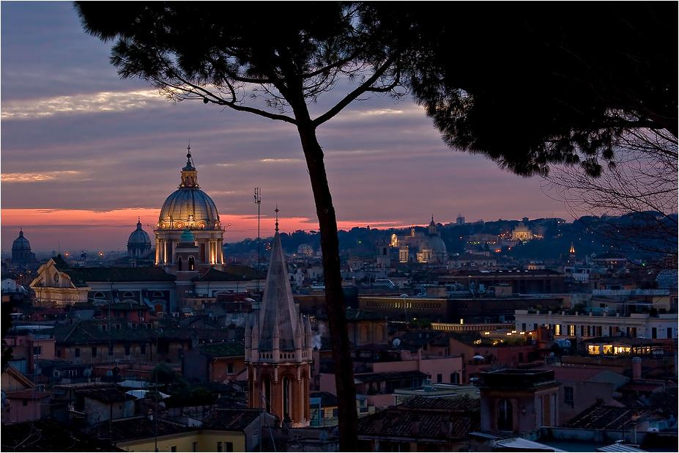

Slide 13
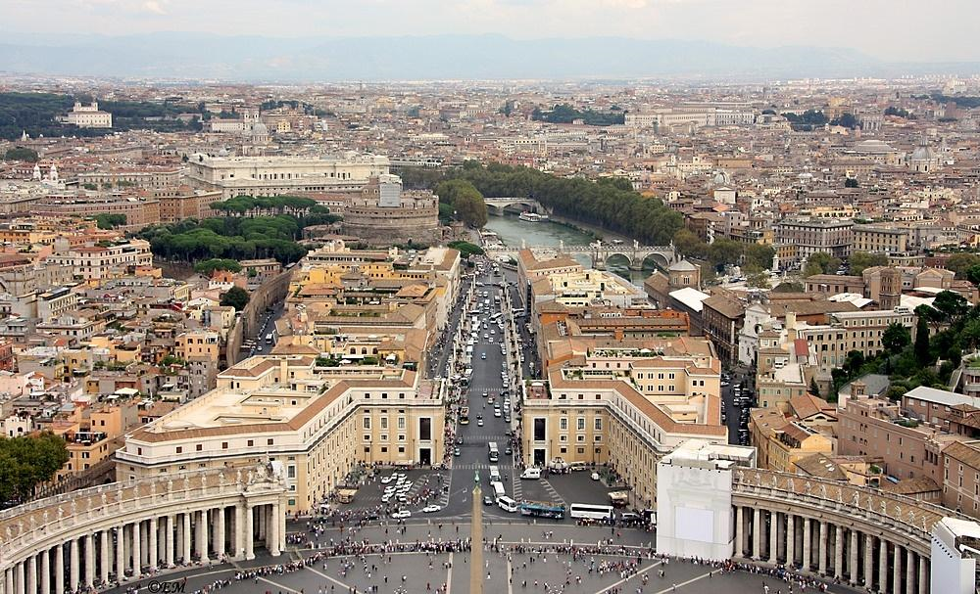
From the roof of St. Peter’s

Slide 14
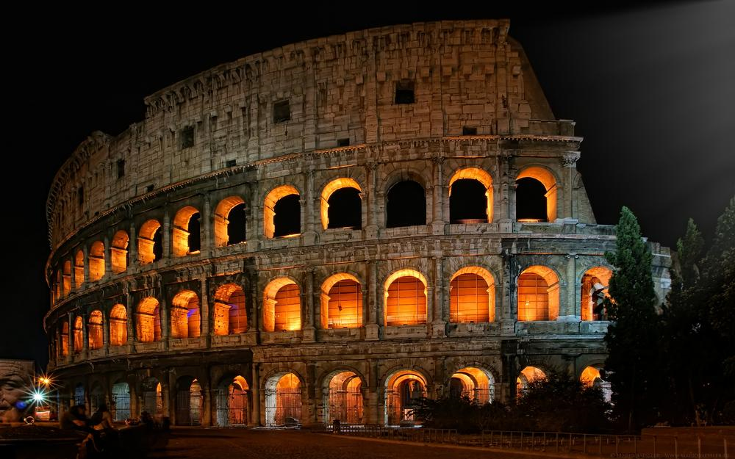
Colesseum

Slide 15
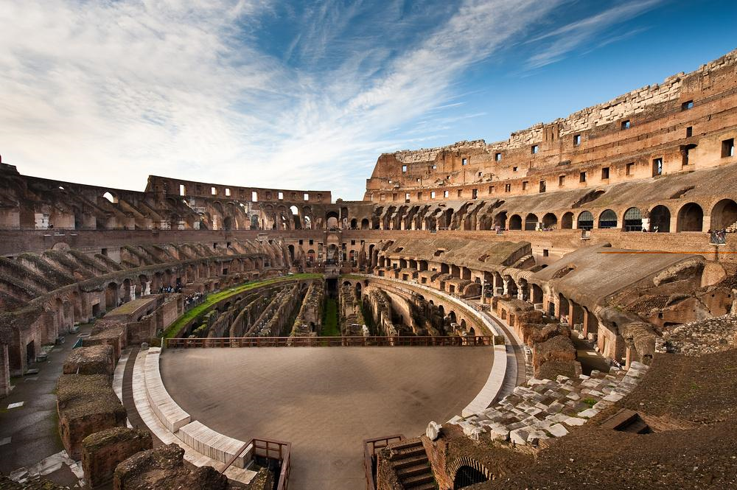
Colesseum Interior

Slide 16
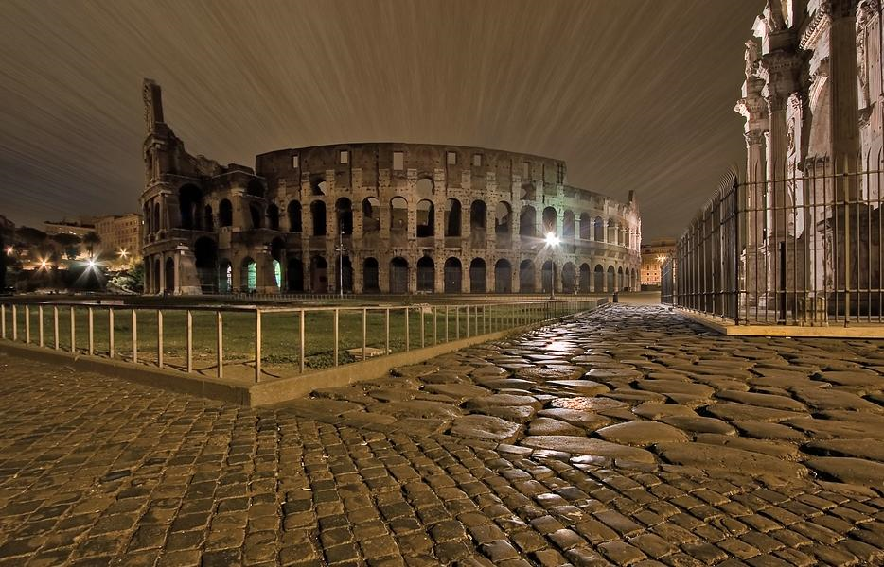

Slide 17
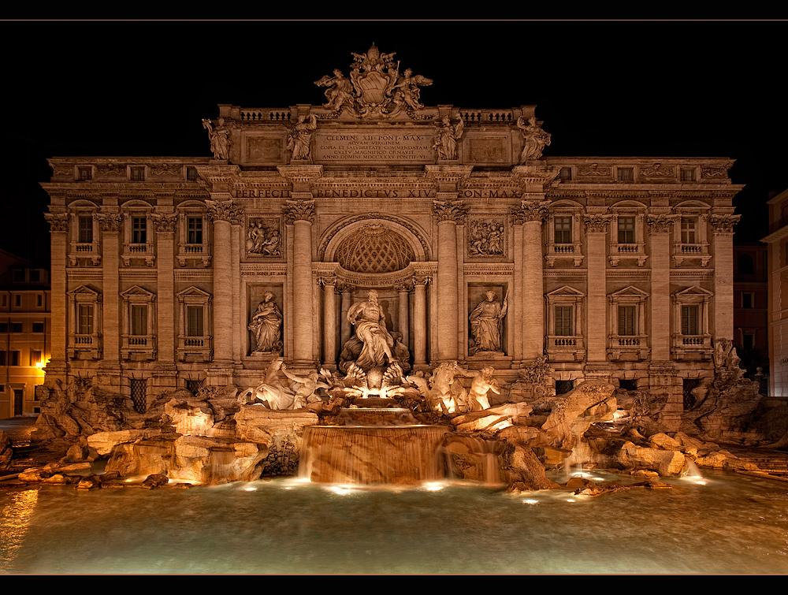
Fountain Trevi

Slide 18
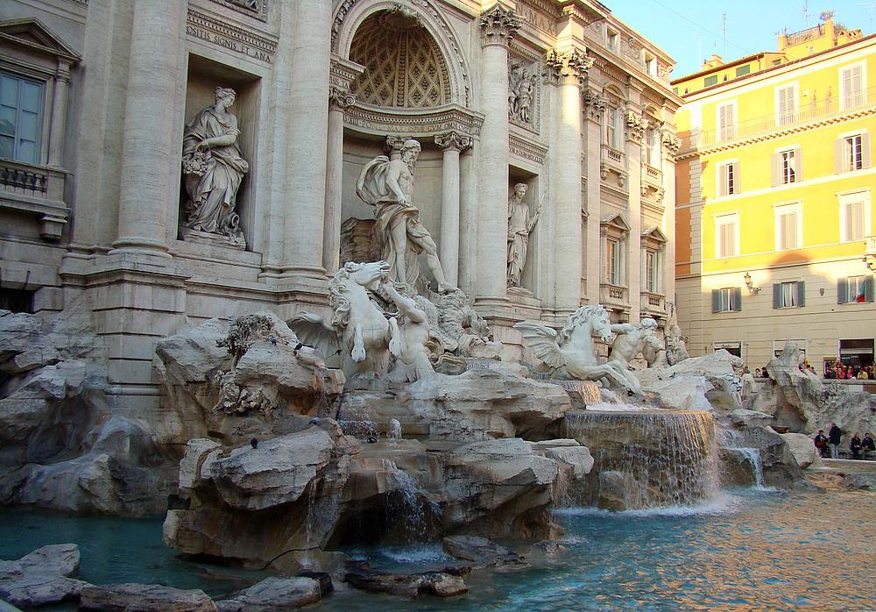

Slide 19
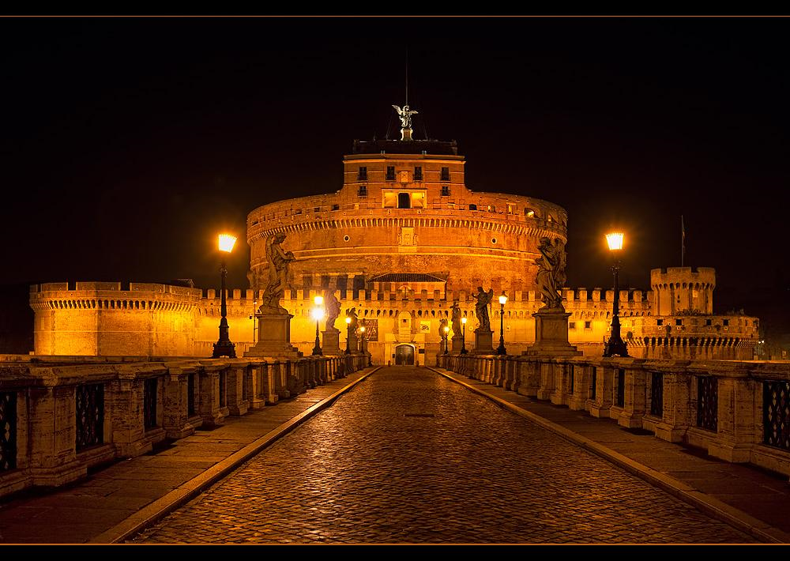
Castle Sant‘ Angelo and the Bridge of Angels

Slide 20
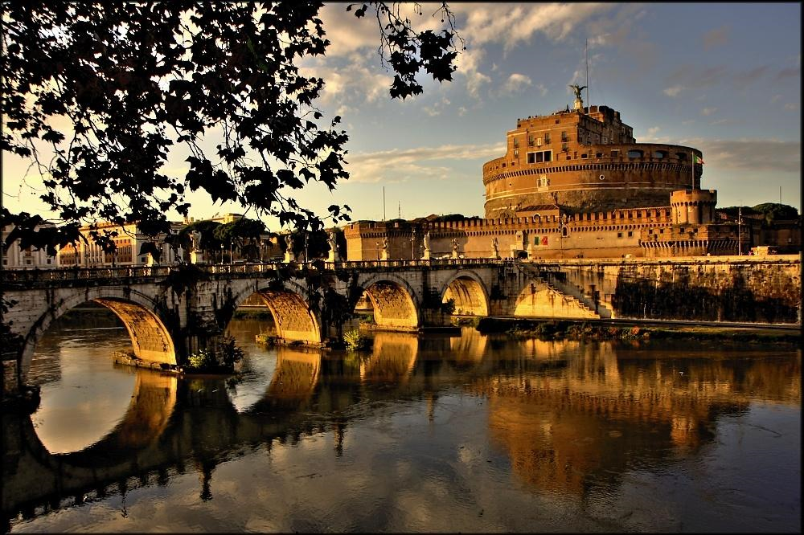

Slide 21
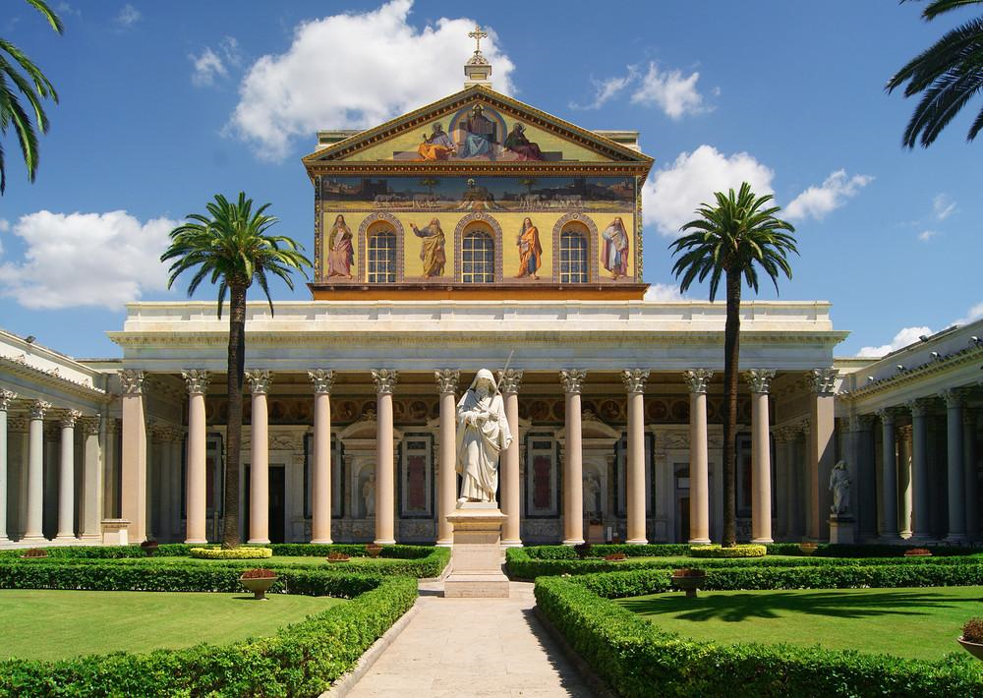
Basilica of St. Paul

Slide 22
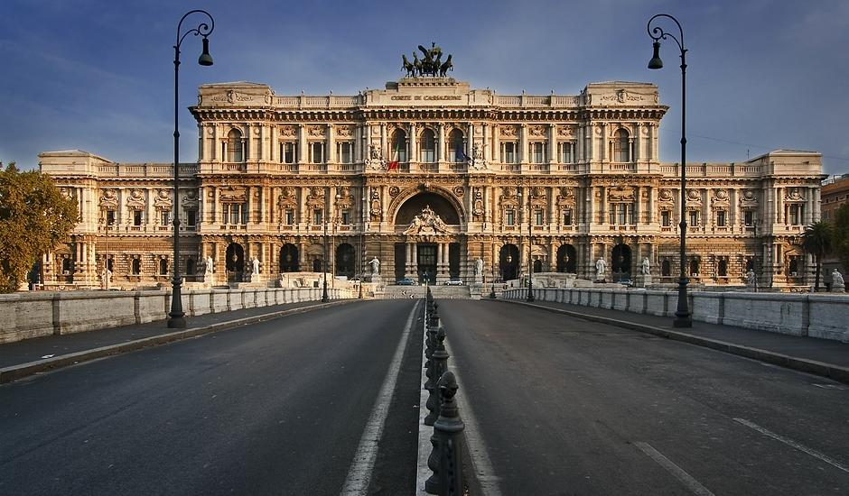
Courthouse

Slide 23
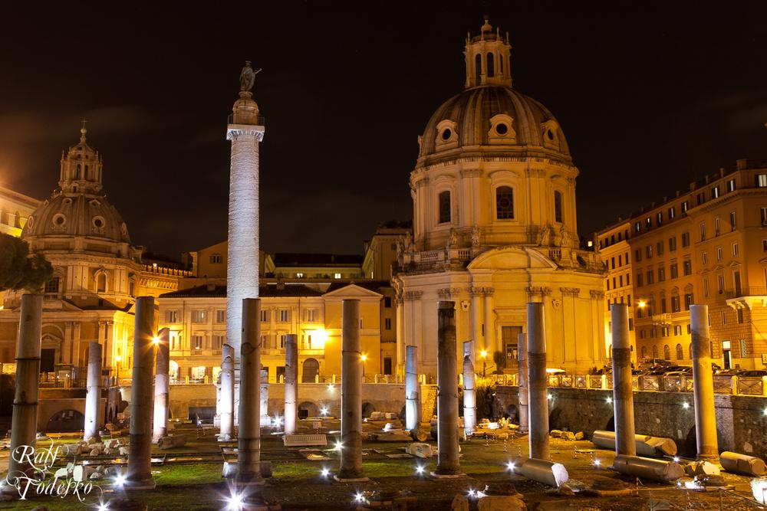
Columns Garden

Slide 24
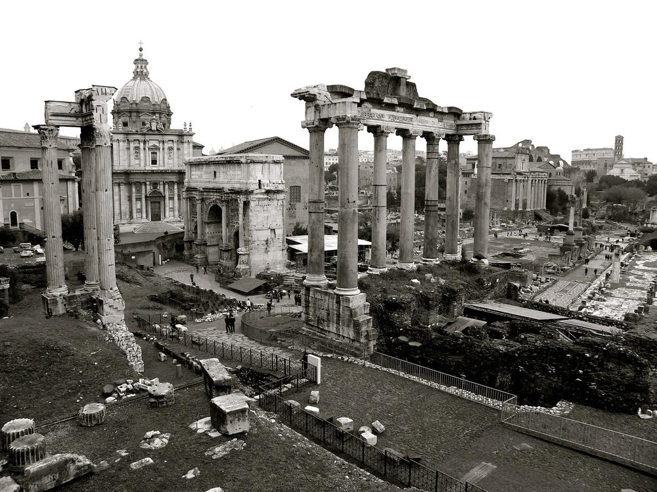
Roman Forum

Slide 25
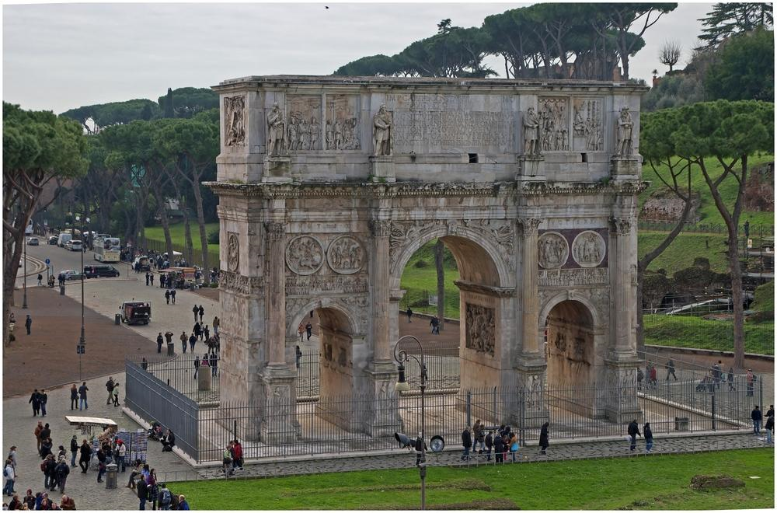
Arch of Constantine

Slide 26
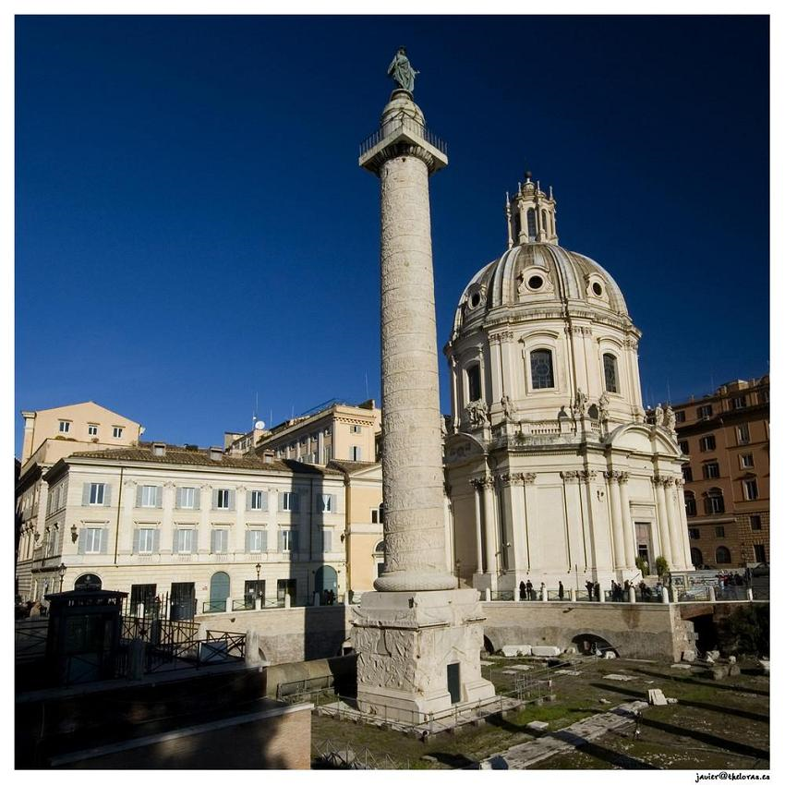
Trajan’s Column

Slide 27
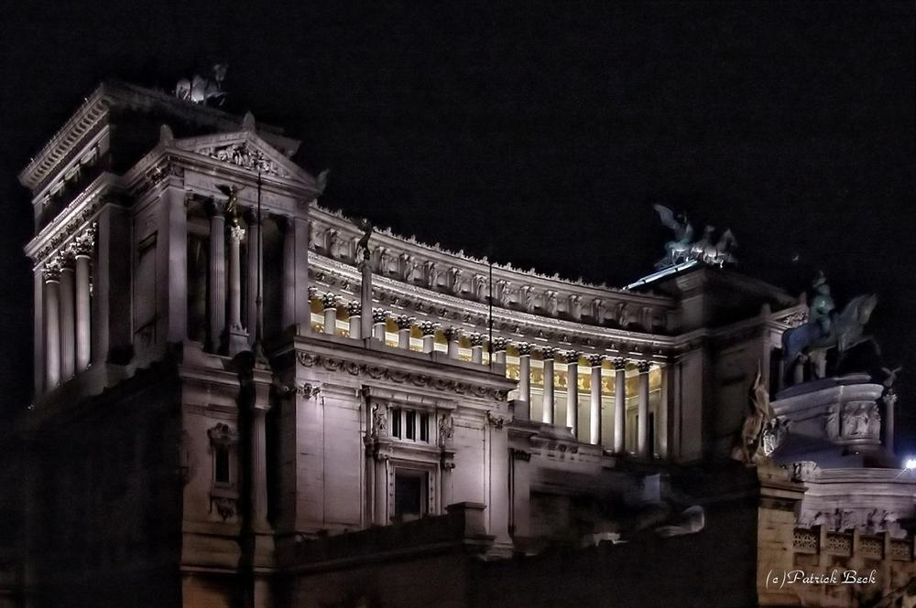
The Monument of Victor Emmanuel II

Slide 28
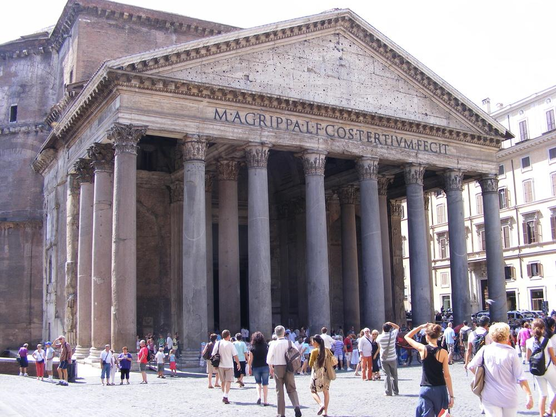
Pantheon

Slide 29
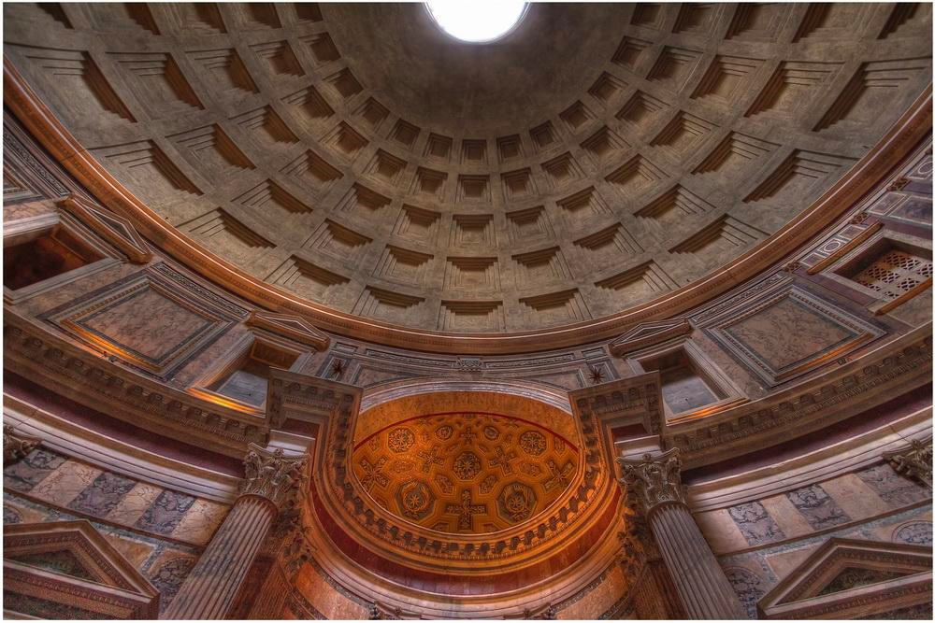
Pantheon Dome - Interior

Slide 30
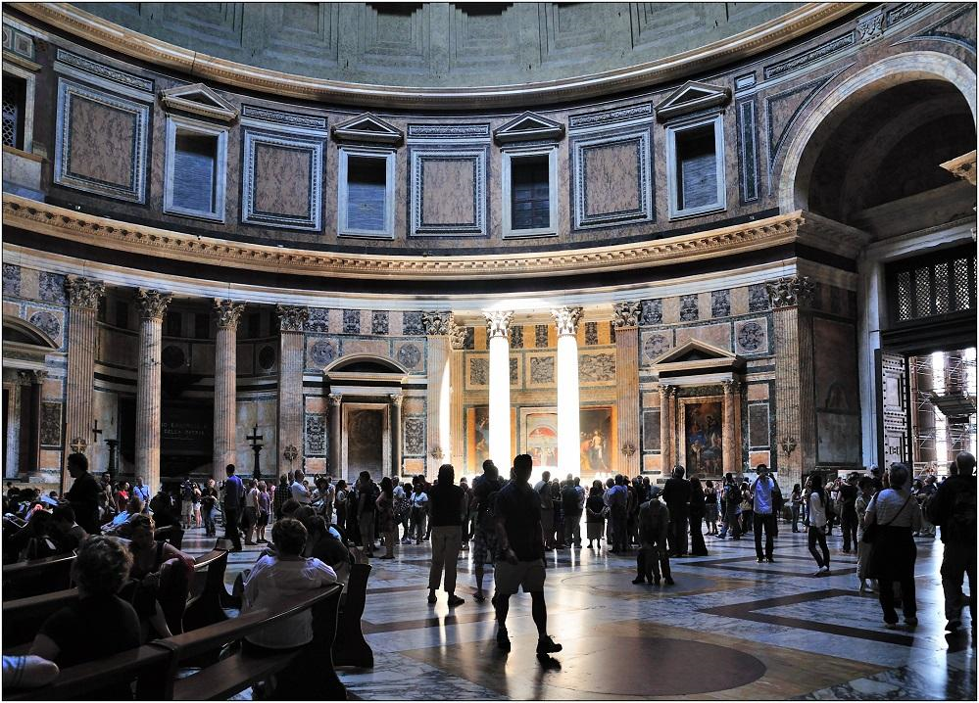

Slide 31
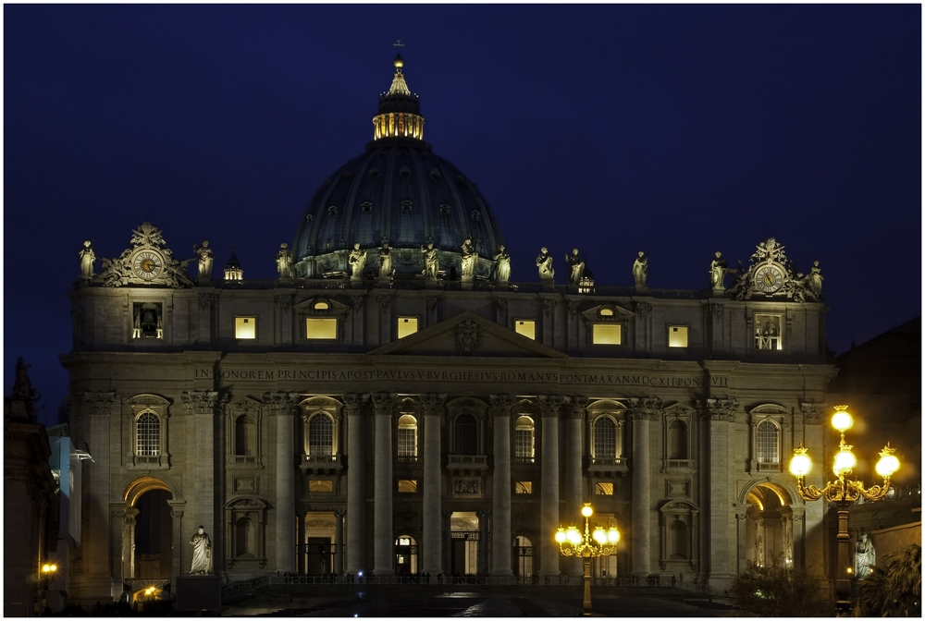
St.Peter's Basilica

Slide 32
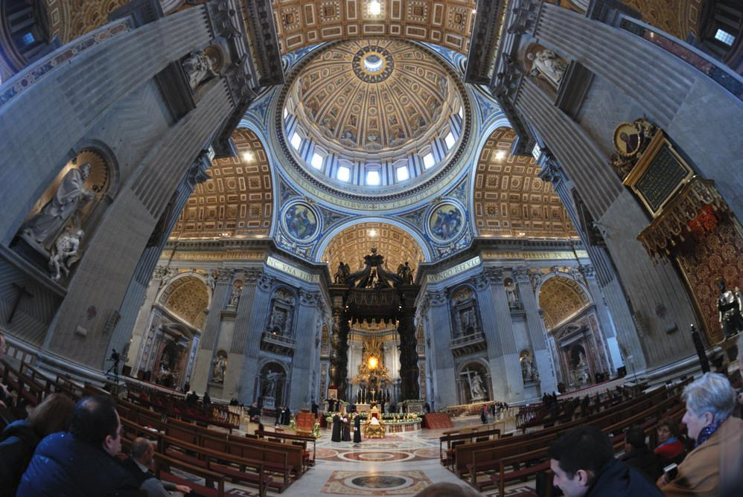
St. Peter’s Interior

Slide 33
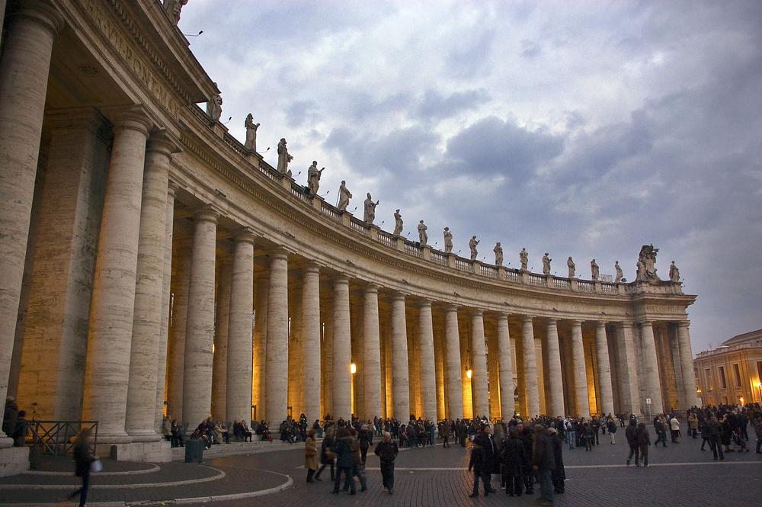
St. Peter’s “Square” (It’s circular)

Slide 34
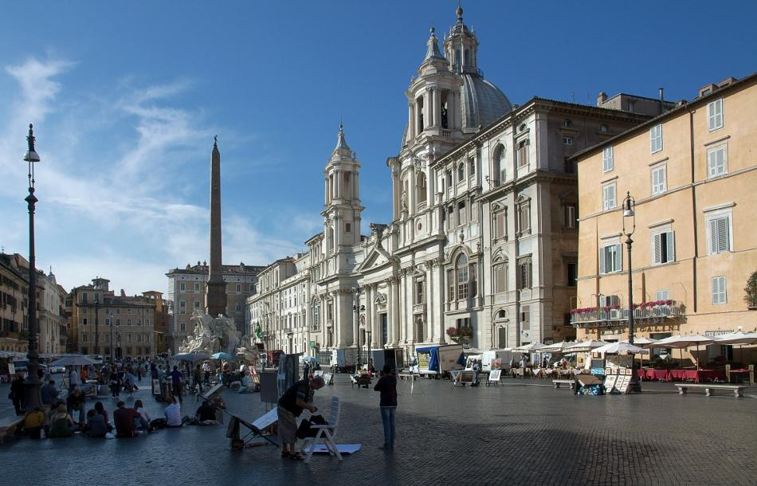
Piazza Navona

Slide 35
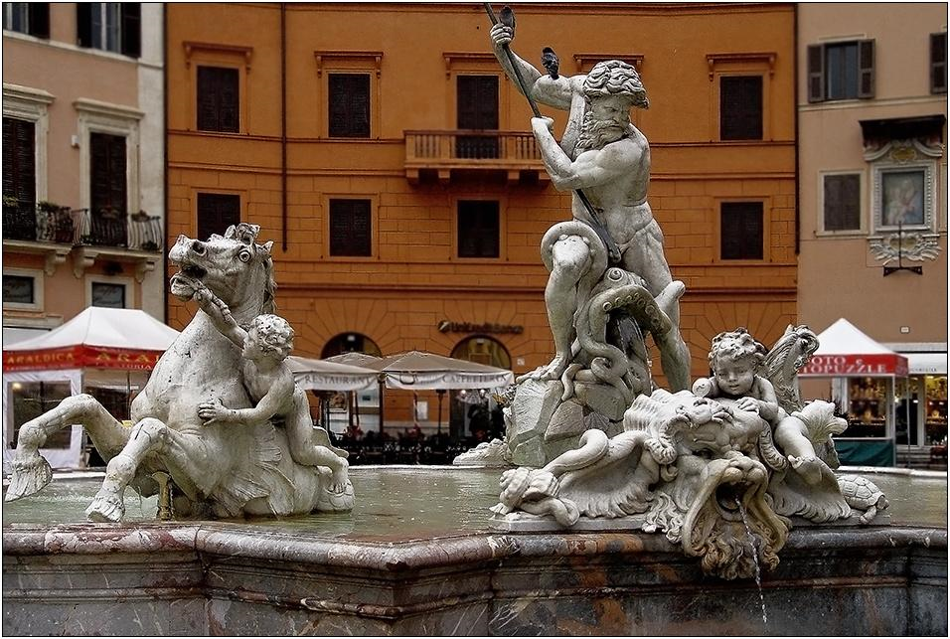
Neptune Fountain (Bernini) Piazza Navona

Slide 36
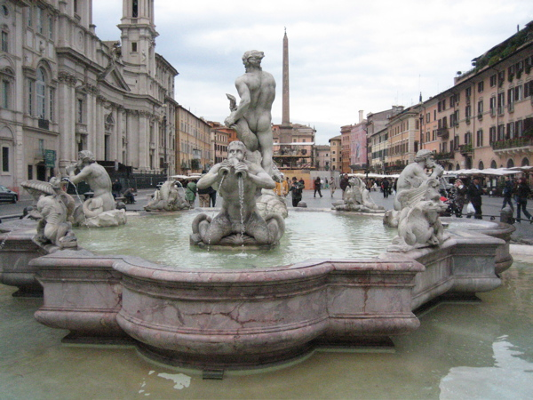
Four Rivers Fountain (Bernini) Piazza Navona

Slide 37
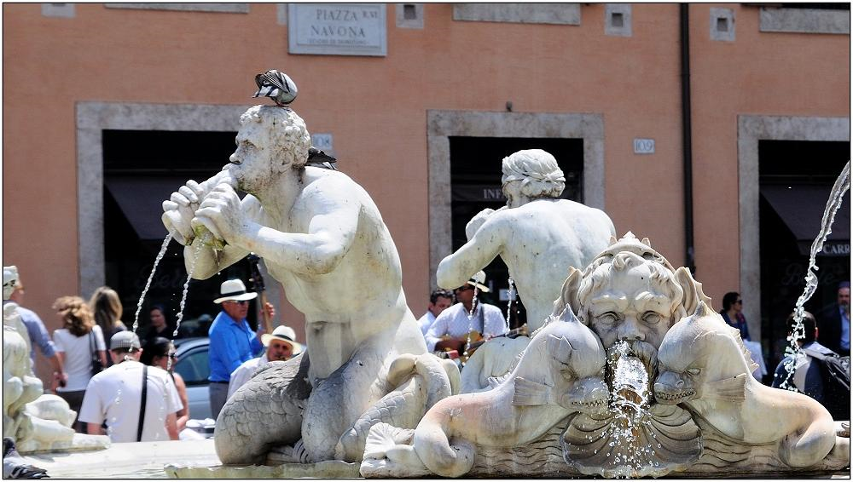
Moro Fountain (Bernini) Piazza Navona

Slide 38
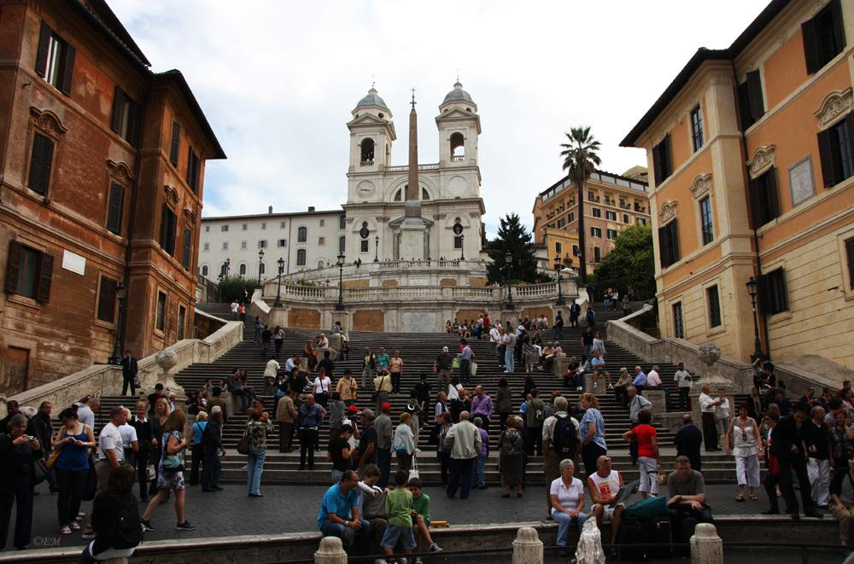
Spanish steps-Rome

Slide 39
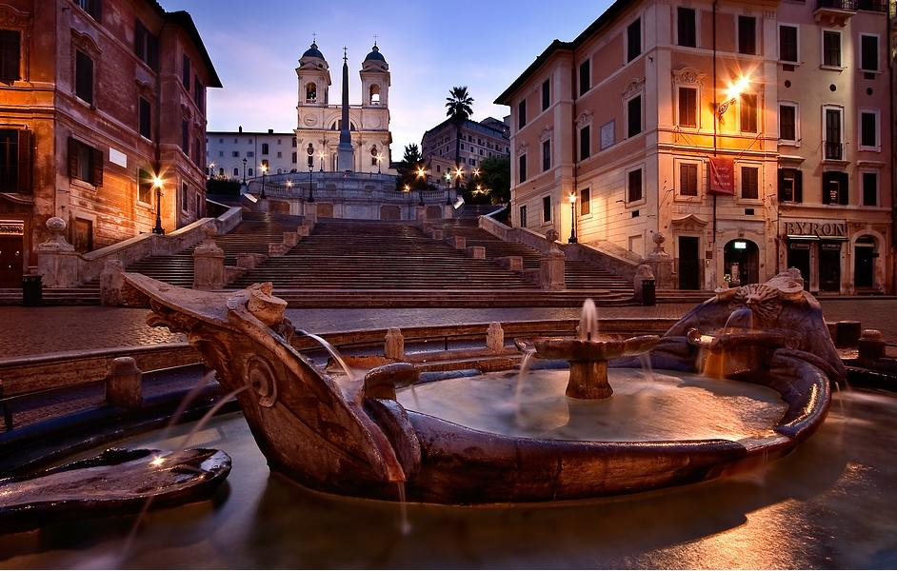

Slide 40
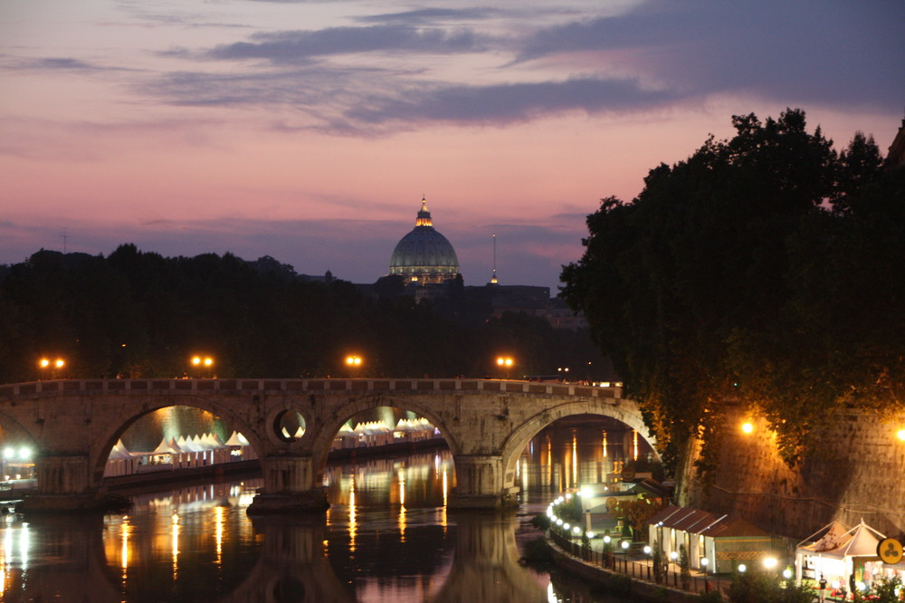
Tiber River at night

Slide 41
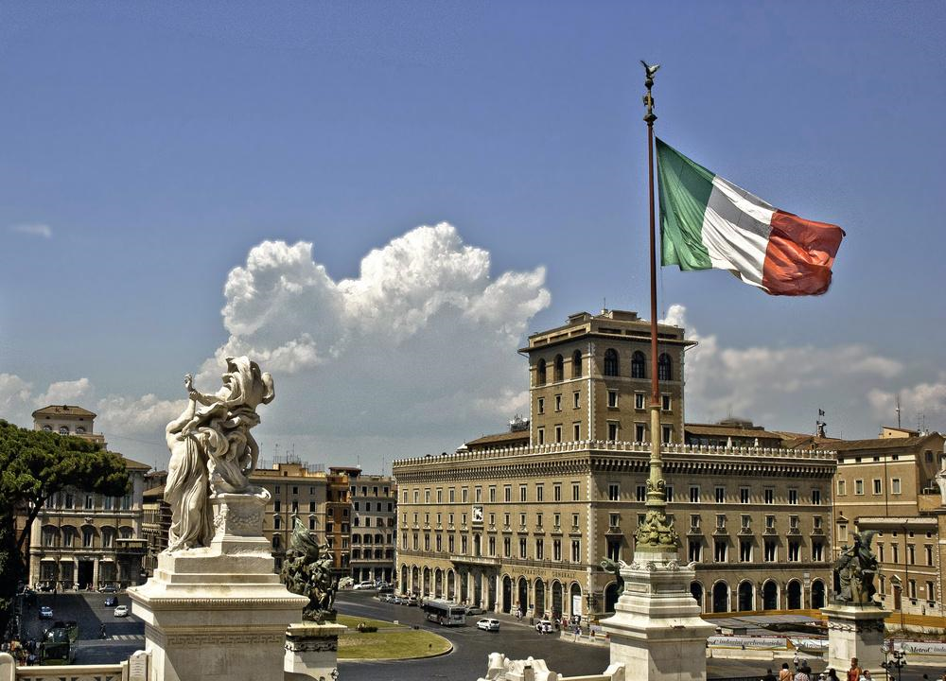
View from the Victor Emmanuel Monument

Slide 42
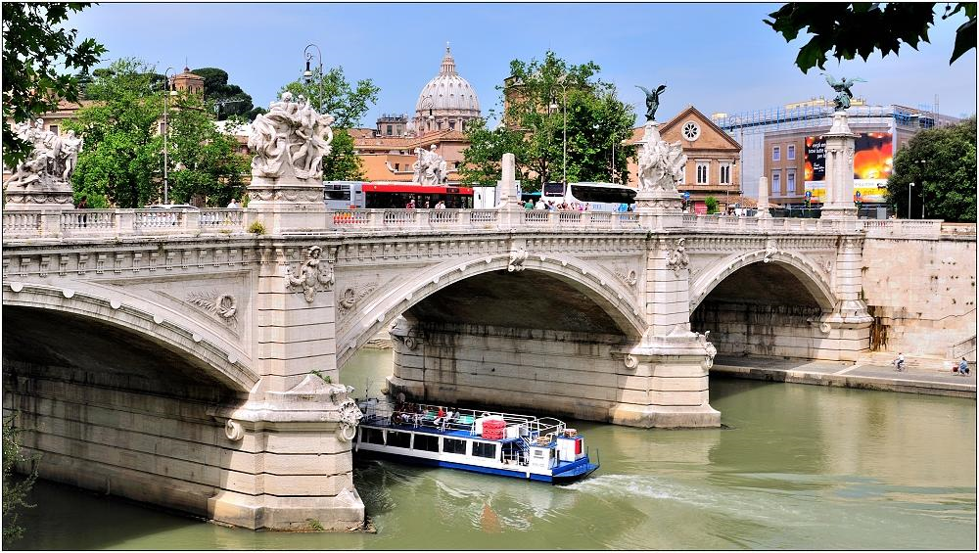
Bridge- Vittorio Emanuele II

Slide 43
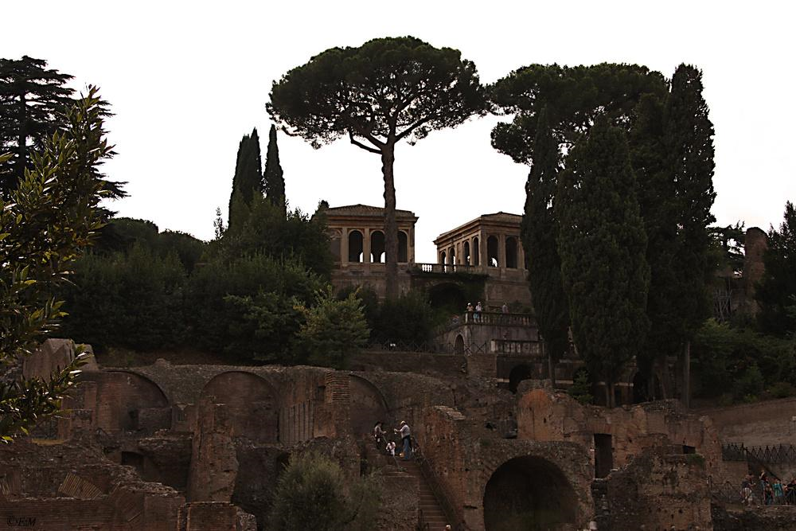
Palatin

Slide 44
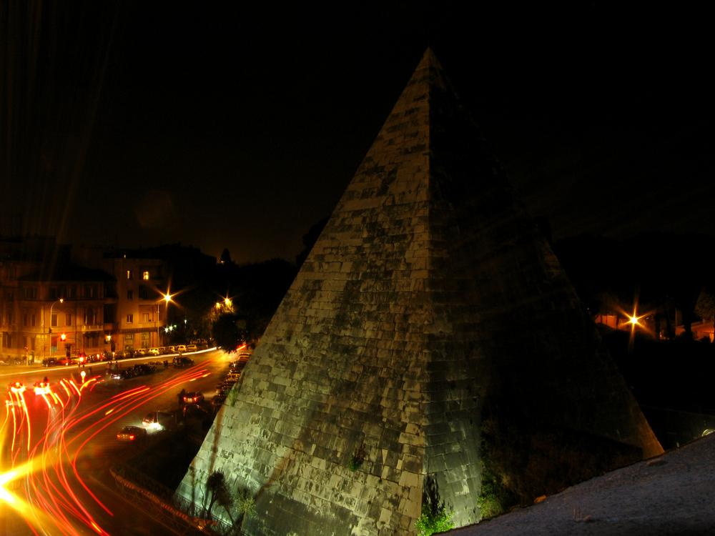
Pyramid in
Pyramid in Rome

Slide 45
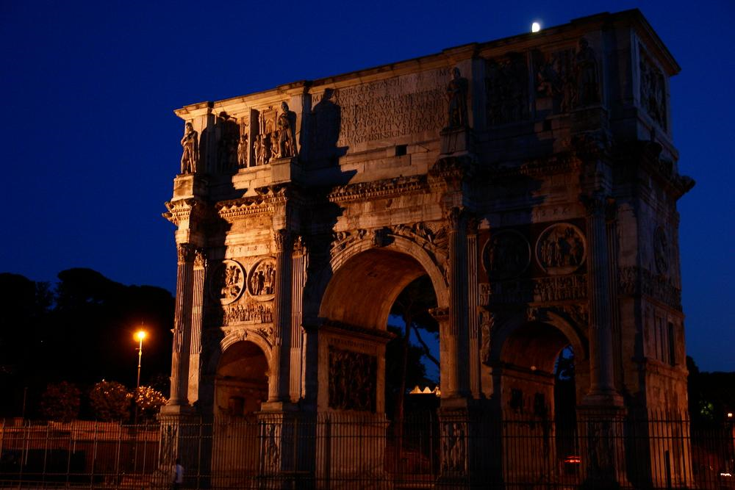

Slide 46
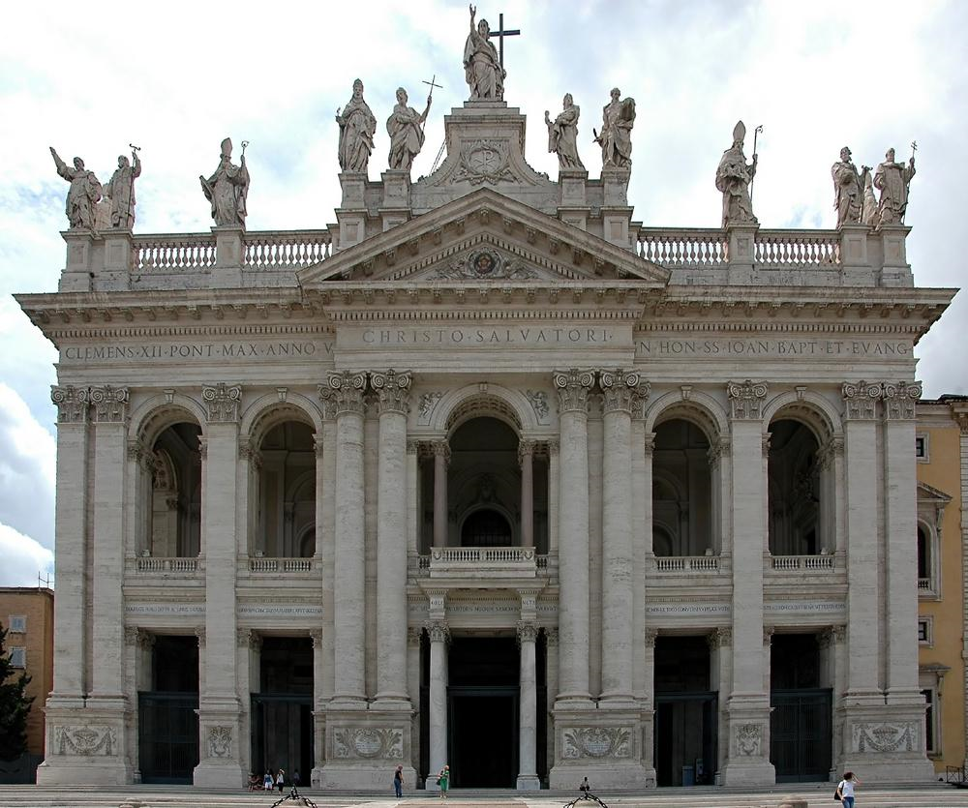

Slide 47
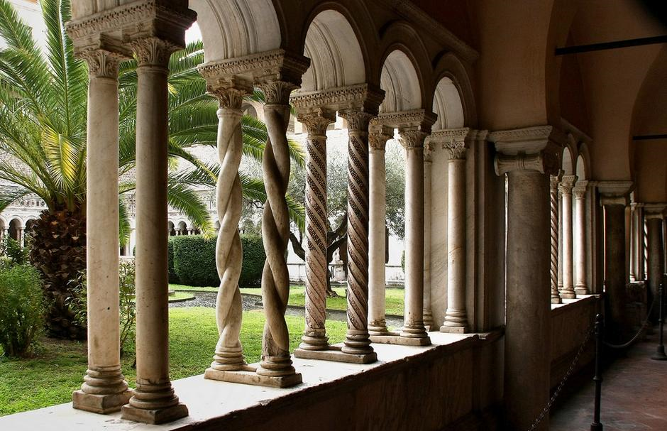
San Giovanni

Slide 48
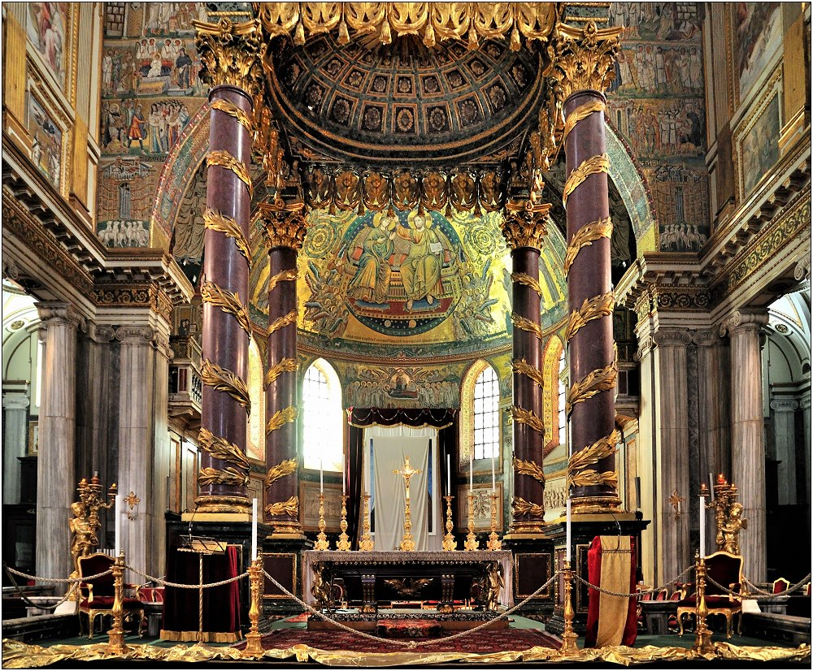
The Basilica di Santa Maria Maggiore

Slide 49
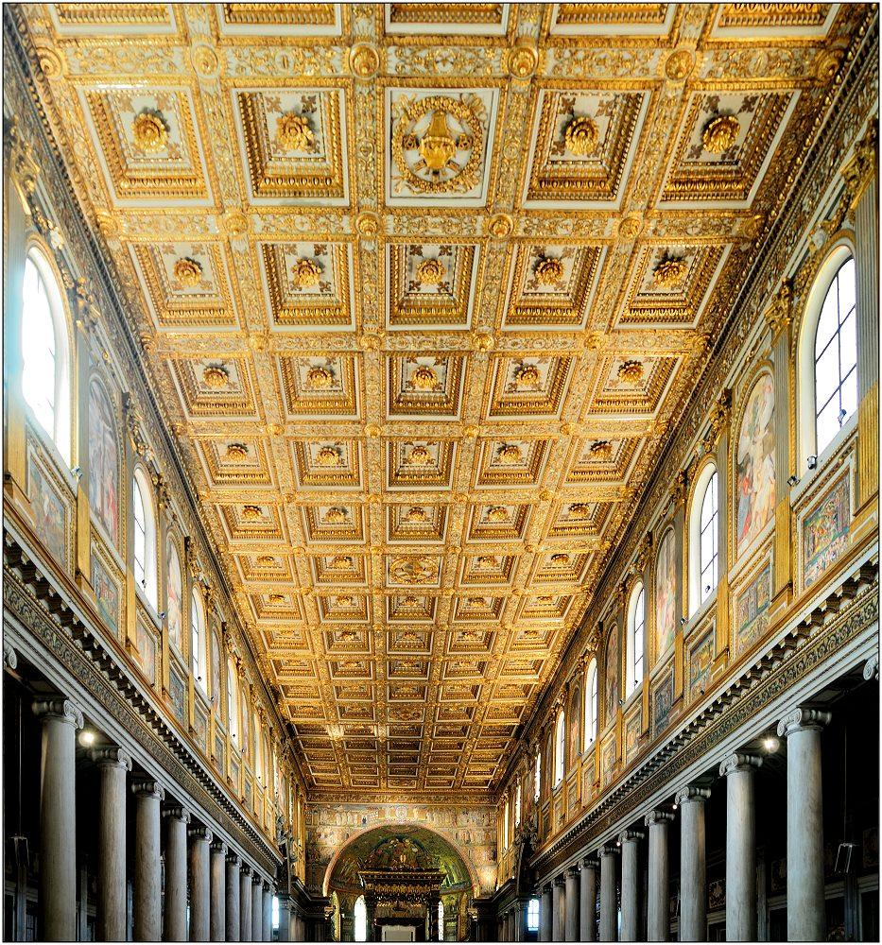
Basilica di Santa Maria Maggiore

Slide 50
Verona – Setting of the Romeo & Juliet Story

Slide 51
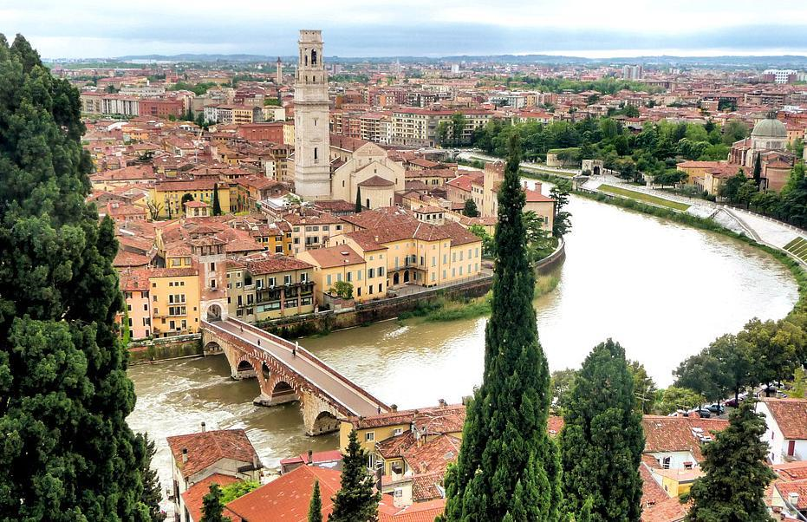
Verona-Pietra Bridge-Lamberti Tower-Cathedral of Santa Maria Matricolare the Adige.

Slide 52
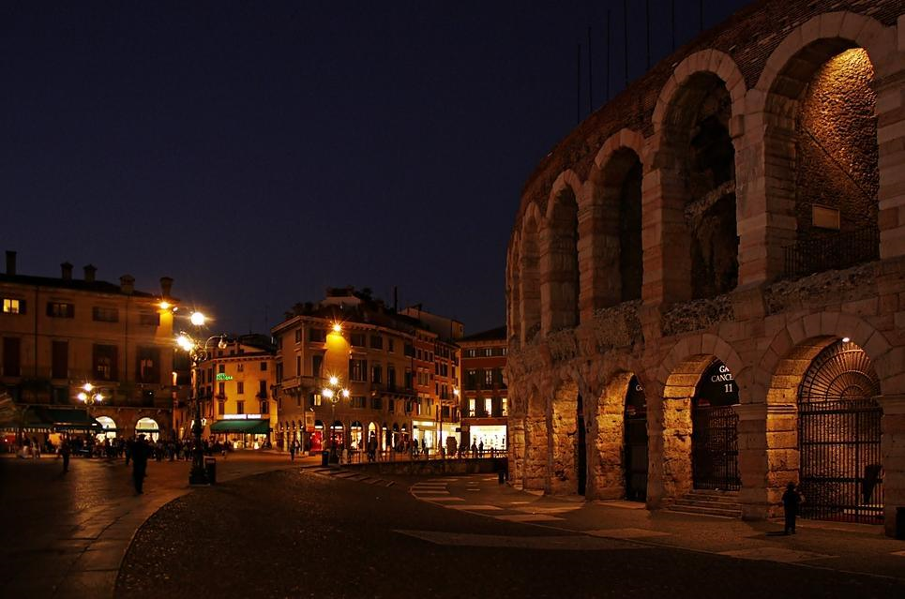
Arena

Slide 53
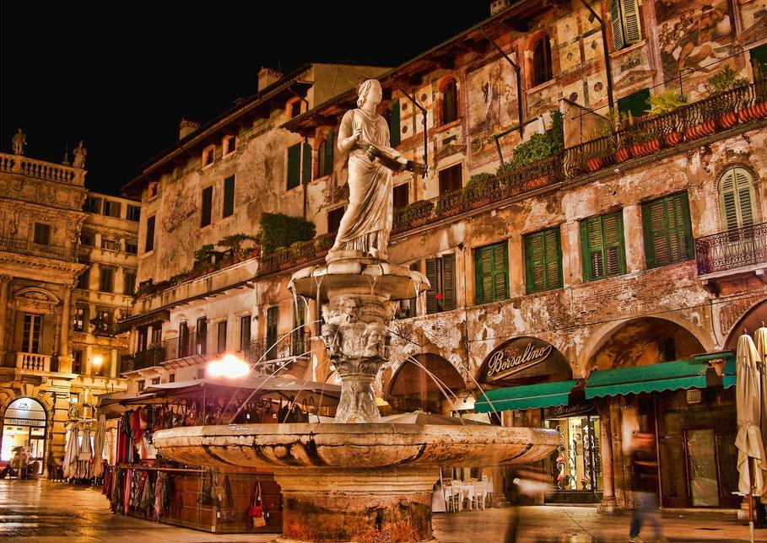
Madonna Verona - Piazza delle Erbe fountain marble statue is the symbol of the city.

Slide 54

San Zeno Maggiore - Verona

Slide 55

The Gates of the Bra.

Slide 56

Tomb

Slide 57

Kloster Shrine of Our Lady of Lourdes.

Slide 58

Juliet’s House

Slide 59

Juliet’s balcony

Slide 60

Waiting for Romeo

Slide 61


Slide 62


Slide 63

Artistic Door Knocker

Slide 64
Tuscan Towns

Slide 65
San Gimignano
San Gimignano is a small walled medieval hill town in the province of Siena, Tuscany, north-central Italy. It is mainly famous for its medieval architecture, especially its towers, which may be seen from several kilometres outside the town.

Slide 66


Slide 67


Slide 68


Slide 69
Siena

Slide 70

Cathedral Siena

Slide 71

Cathedral Dome

Slide 72

Campo Square where Palio (horse races) held.

Slide 73

Palio

Slide 74

Historical area in Siena

Slide 75

The fountain Gaia - Sieana

Slide 76
Pisa

Slide 77


Slide 78

Pisa tower - Cathedral - Baptistery

Slide 79

Cathedral - Santa Maria Assunta

Slide 80


Slide 81

Pisa Cathedral - Pulpit

Slide 82

Baptistery

Slide 83


Slide 84


Slide 85

Birds - Pisa - Arno

Slide 86


Slide 87
Venice

Slide 88

Carnival (Mardi Gras)

Slide 89


Slide 90


Slide 91


Slide 92


Slide 93


Slide 94

Bell Tower

Slide 95

Piazza San Marco

Slide 96
Famous for its pigeons and the stunning architecture, Piazza San Marco is the central landmark and gathering place in Venice, the most vibrant spot where most of the festivals take place. Dominated by the San Marco Basilica, the Doge’s Palace and the Basilica’s campanile, it’s one of the best places for photographers to spend time.

Slide 97

San Marco Square-Doge's Palace

Slide 98

Venice

Slide 99

San Marco-Doge's Palace

Slide 100

Venice

Slide 101


Slide 102

Venice: Rialto Bridge

Slide 103


Slide 104


Slide 105



Slide 106

Grand Canal

Slide 107


Slide 108


Slide 109

Tradition: Gondolas

Slide 110


Slide 111


Slide 112
The Grand Hotel des Bains
The Grand Hotel des Bains was a hotel on the Lido di Venezia. It was built in 1900 to attract wealthy tourists. It was known among other things, by Thomas Mann's residence in 1911, the inspierte him to the novella Death in Venice. Luchino Visconti's film of the same name was filmed there in 1971. The hotel was also used for Shepheard's Hotel in Cairo for the film The English Patient. Sergei Pavlovich Diaghilev died in the hotel in 1929

Slide 113


