Slide 1
Ireland – The Emerald Isle

Slide 2
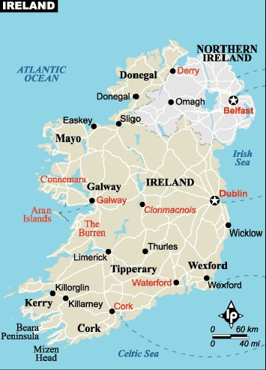

Slide 3
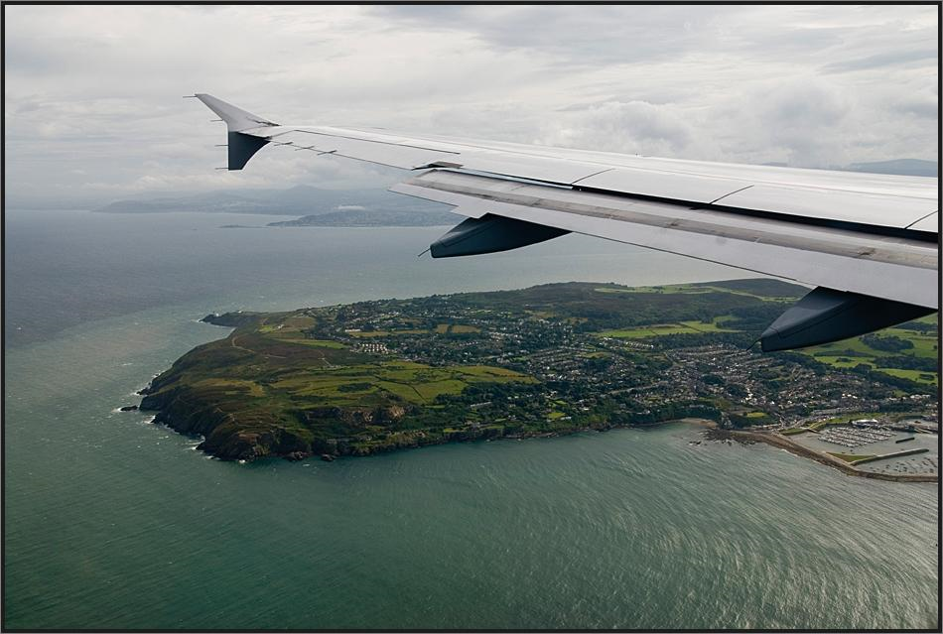
Dublin

Slide 4
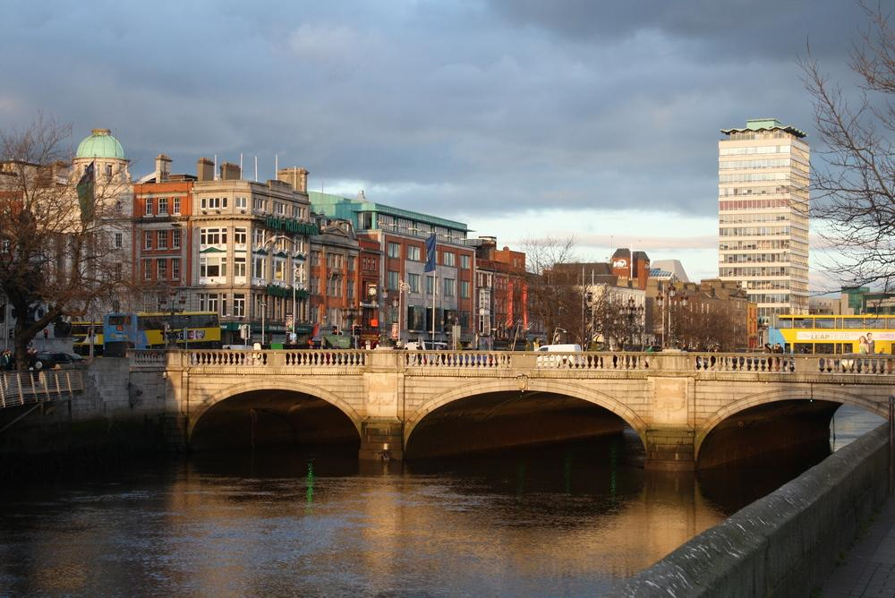

Slide 5
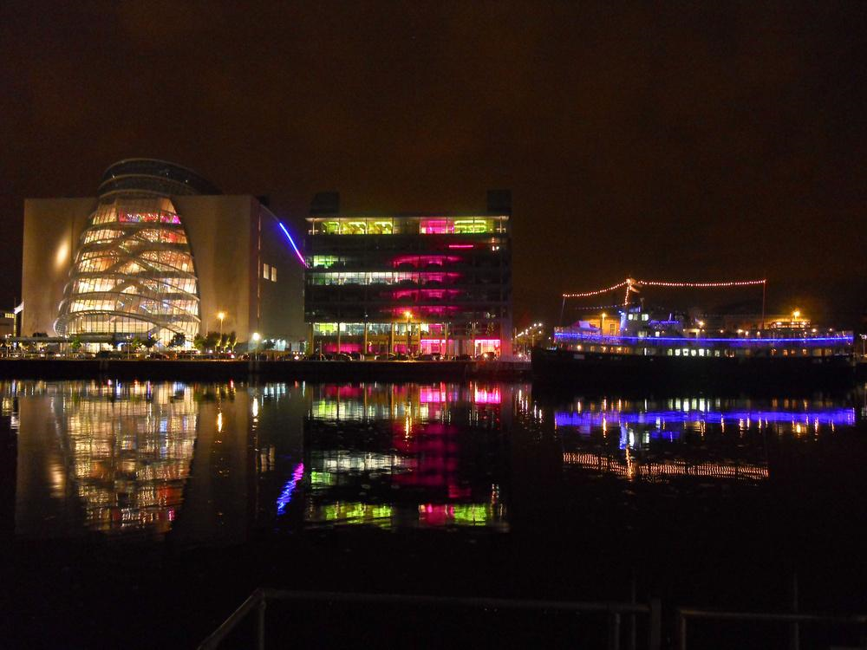
River Liffey at night

Slide 6
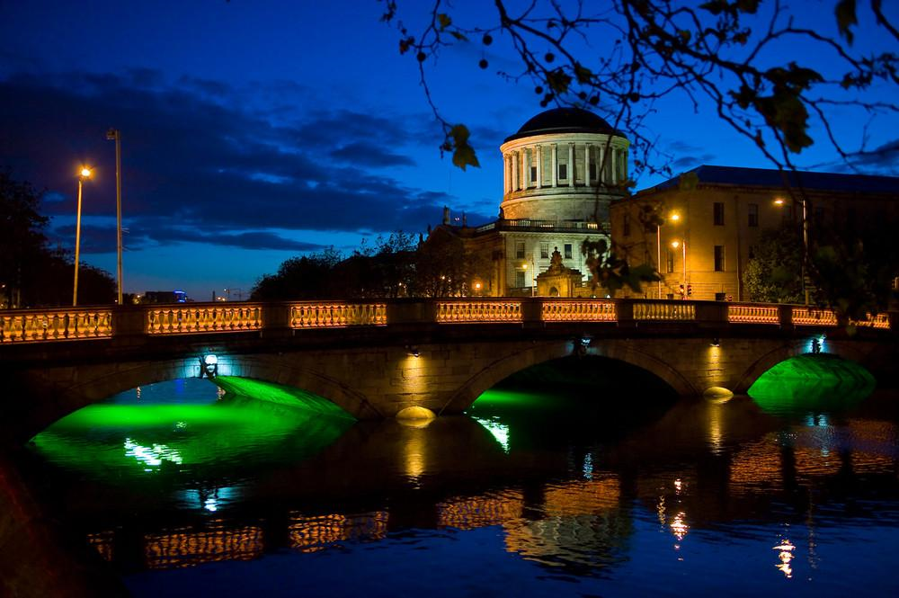

Slide 7
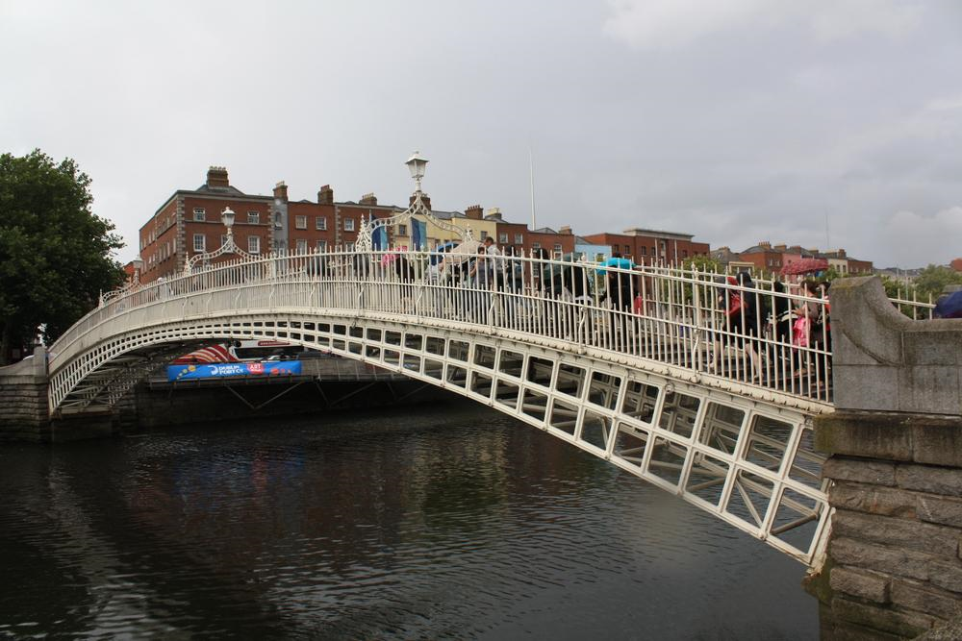
Half Penny Bridge

Slide 8
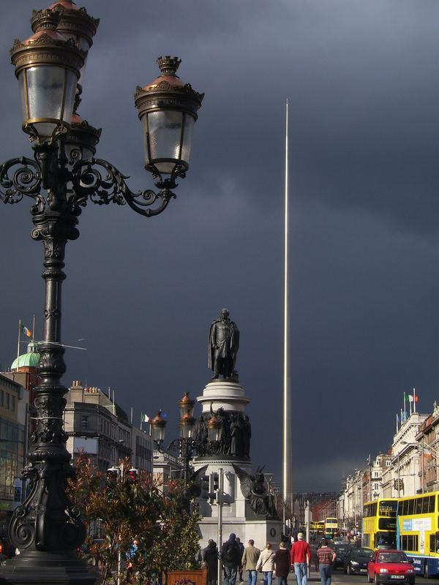
Spire - Dublin

Slide 9
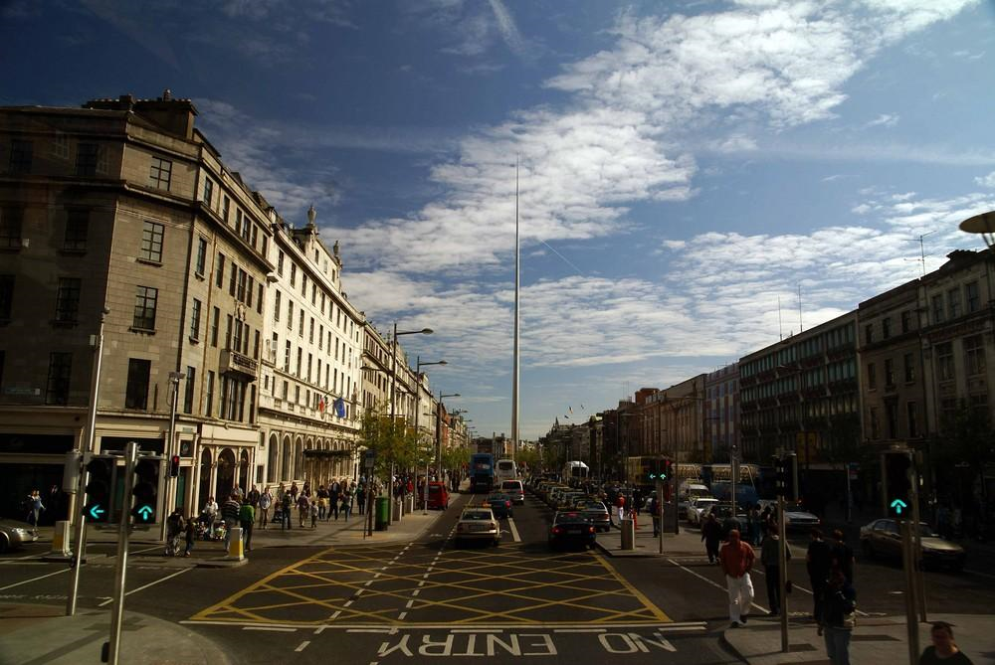

Slide 10
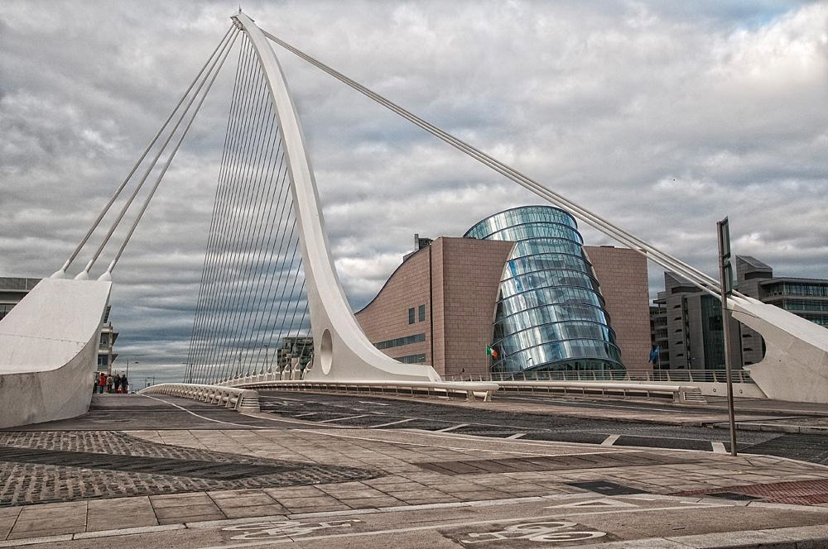
Convention Centre-Samuel Beckett-Bridge-Dublin

Slide 11
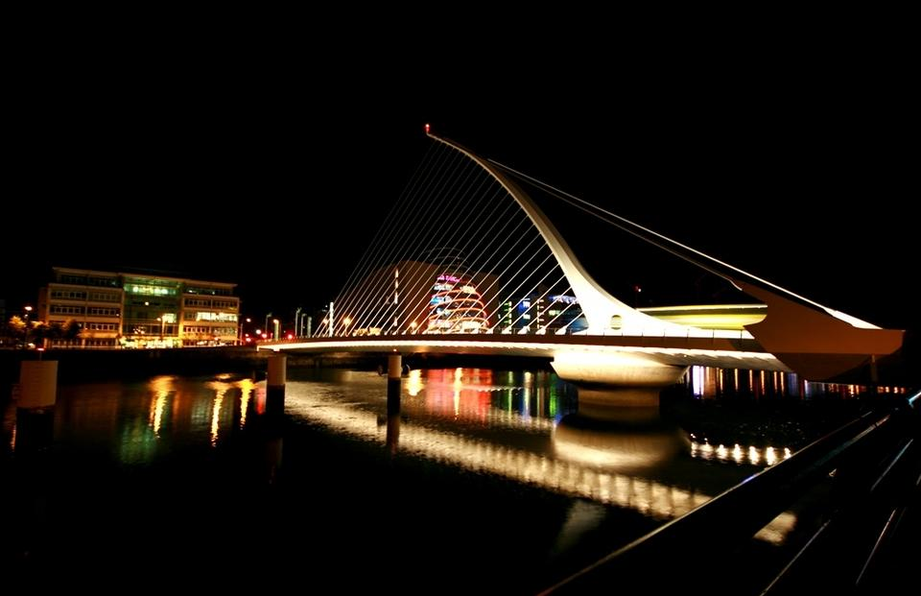

Slide 12
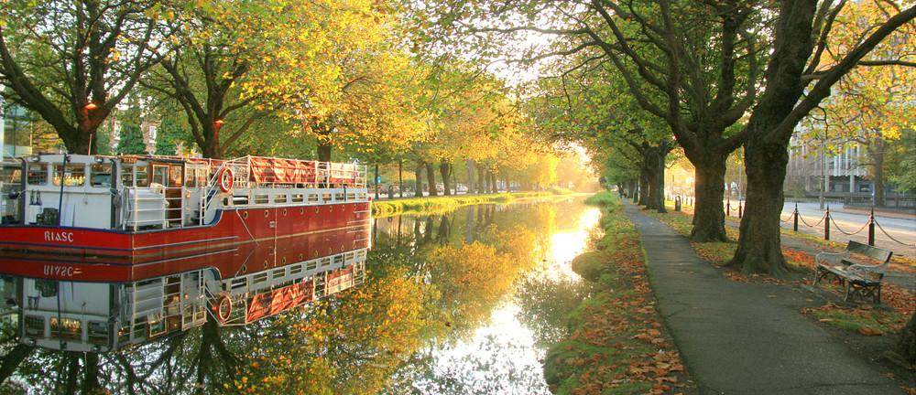
Grand Canal

Slide 13
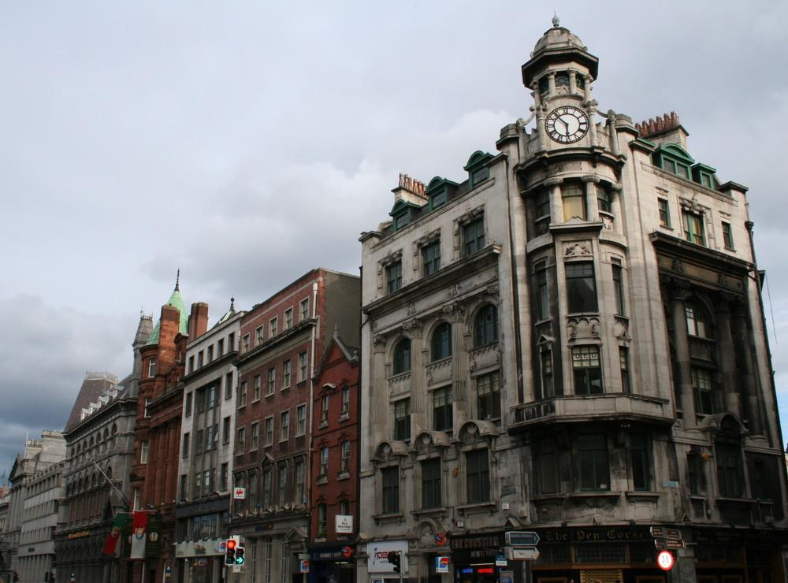

Slide 14
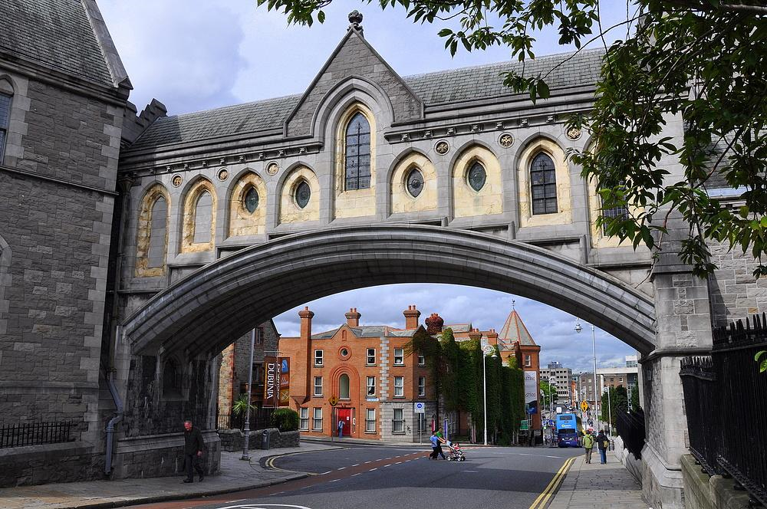

Slide 15
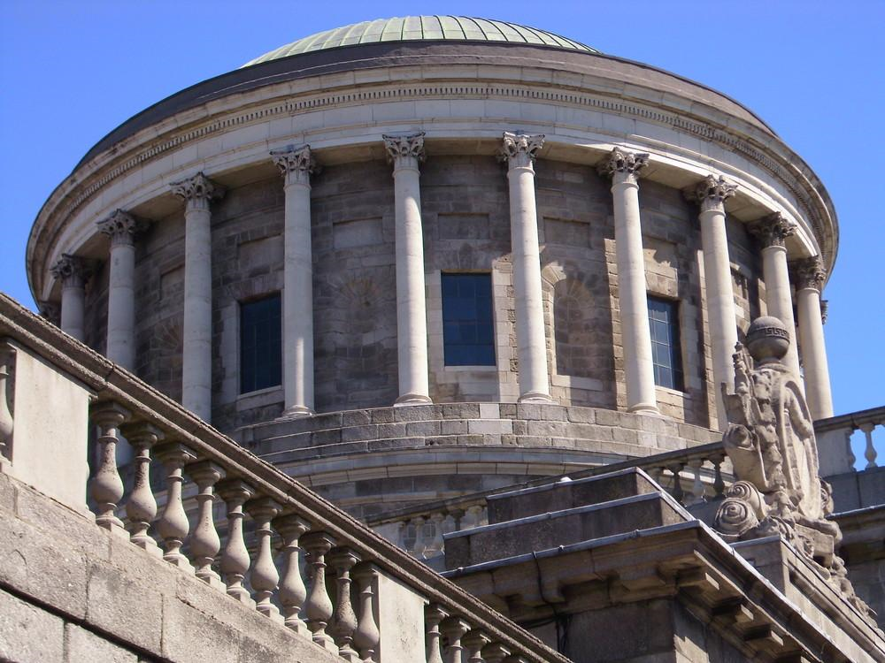
Four Court

Slide 16
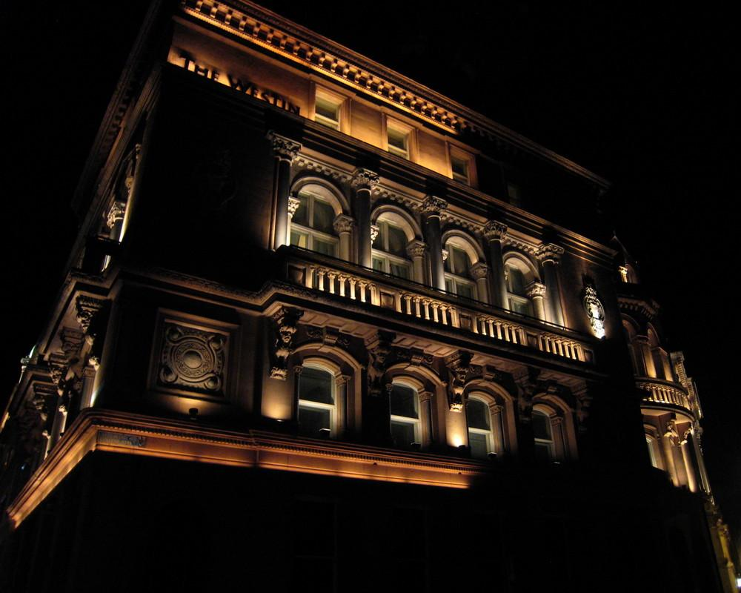

Slide 17
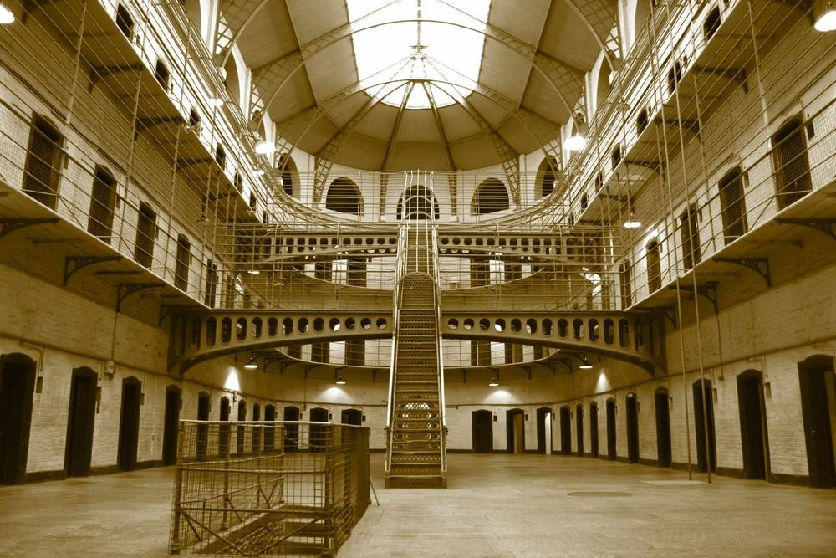
Kilmainham Gaol

Slide 18
Kilmainham Gaol
It is a former prison, located in Kilmainham in Dublin, which is now a museum. Kilmainham Gaol played an important part in Irish history, as many leaders of Irish rebellions were imprisoned and some executed in the prison by the British and latterly in 1923 by the Irish Free State.

Slide 19
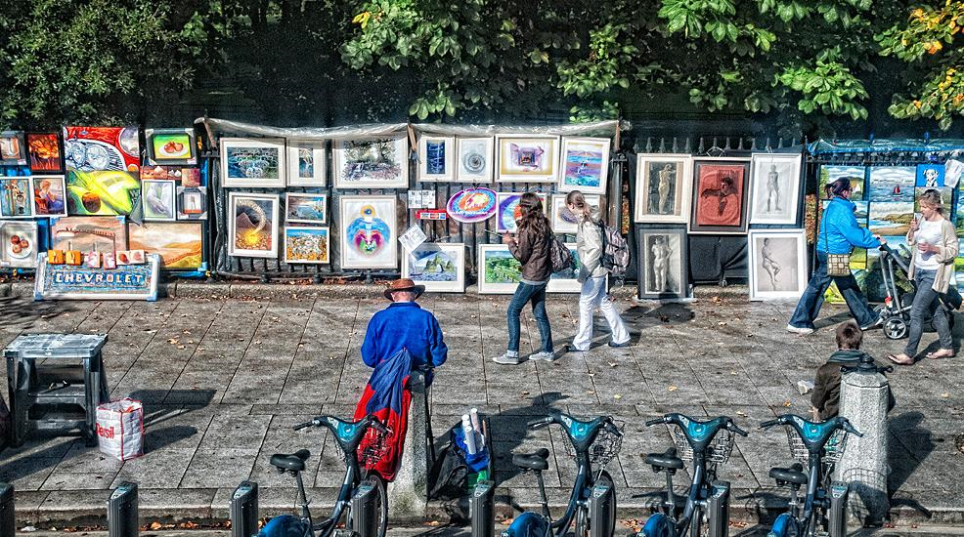
Merrion Square-Dublin

Slide 20
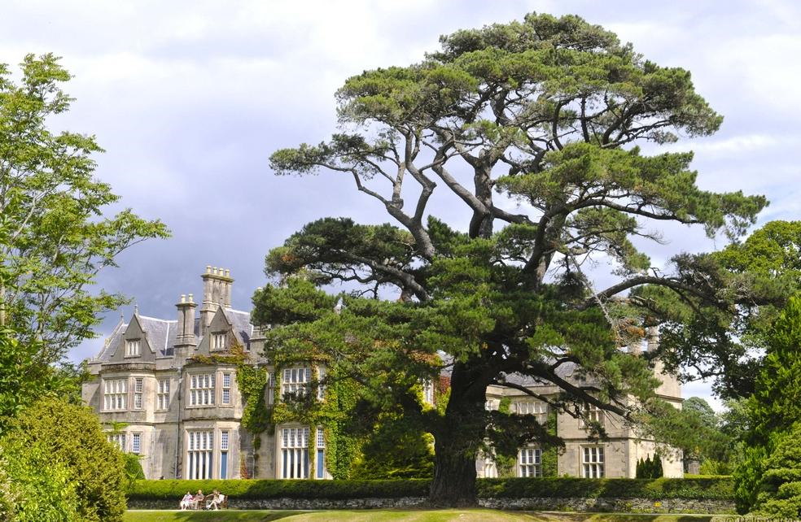
Muckross House

Slide 21
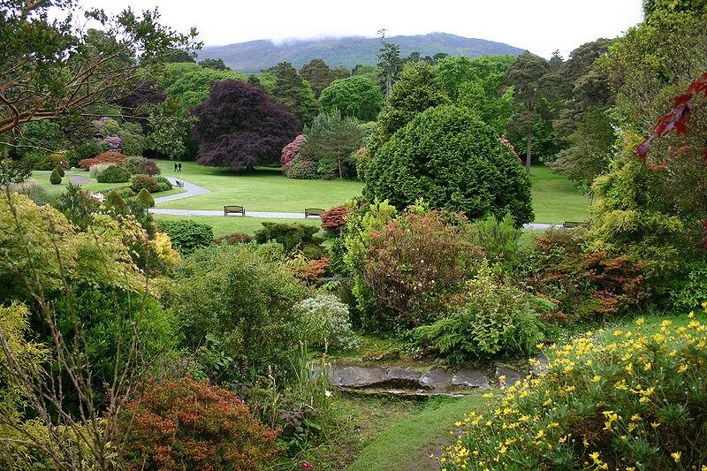
Muckross House Gardens

Slide 22
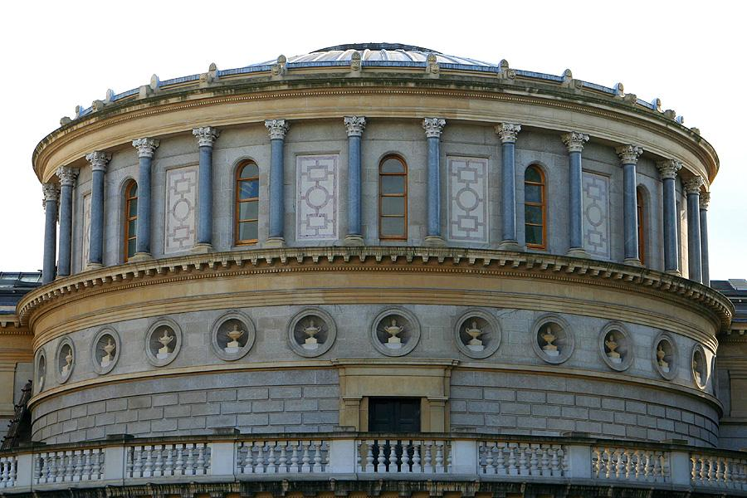
National lMuseum

Slide 23
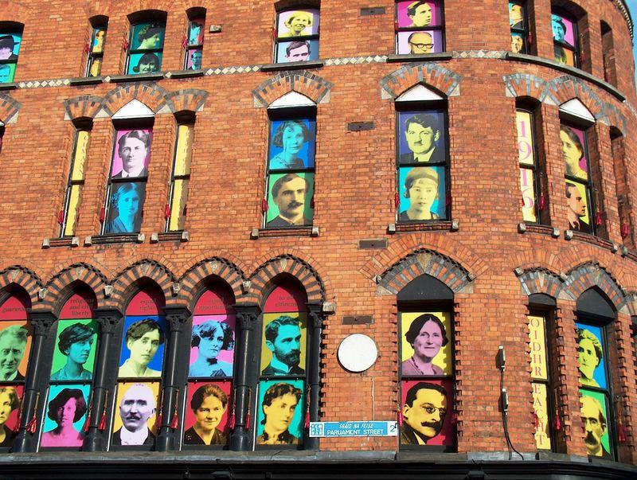

Slide 24
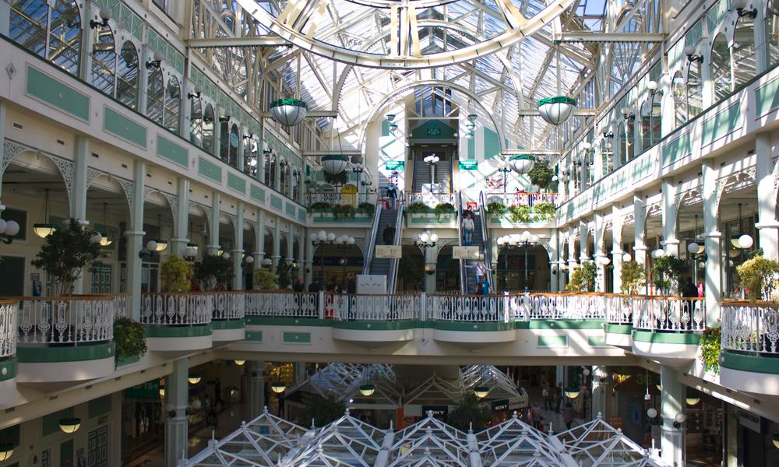
Saint Stephens Warehouse

Slide 25
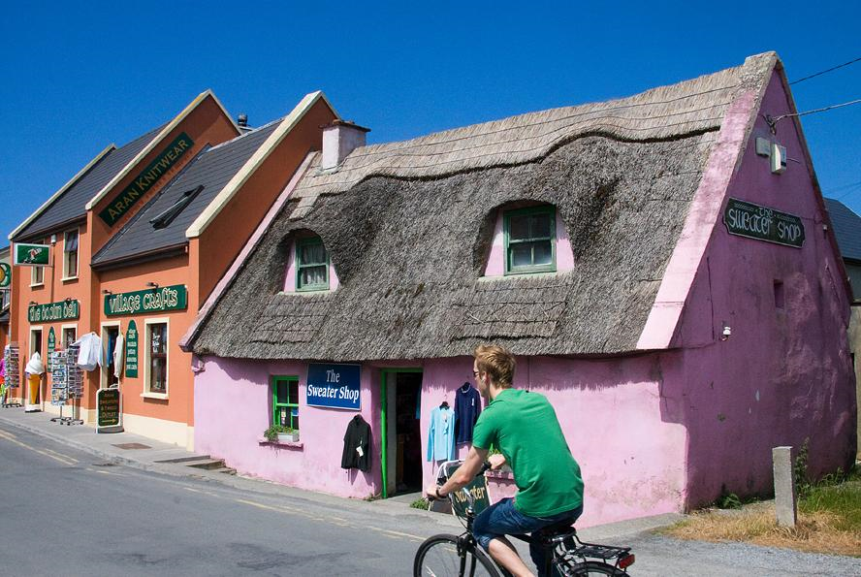
Doolin

Slide 26
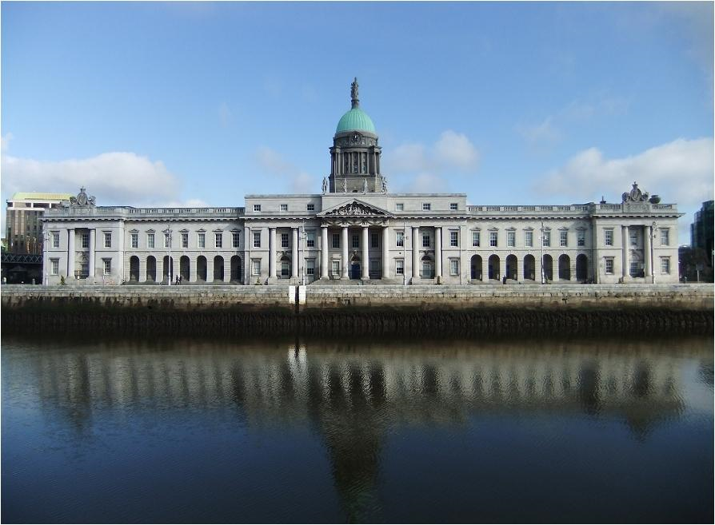
Custom House

Slide 27
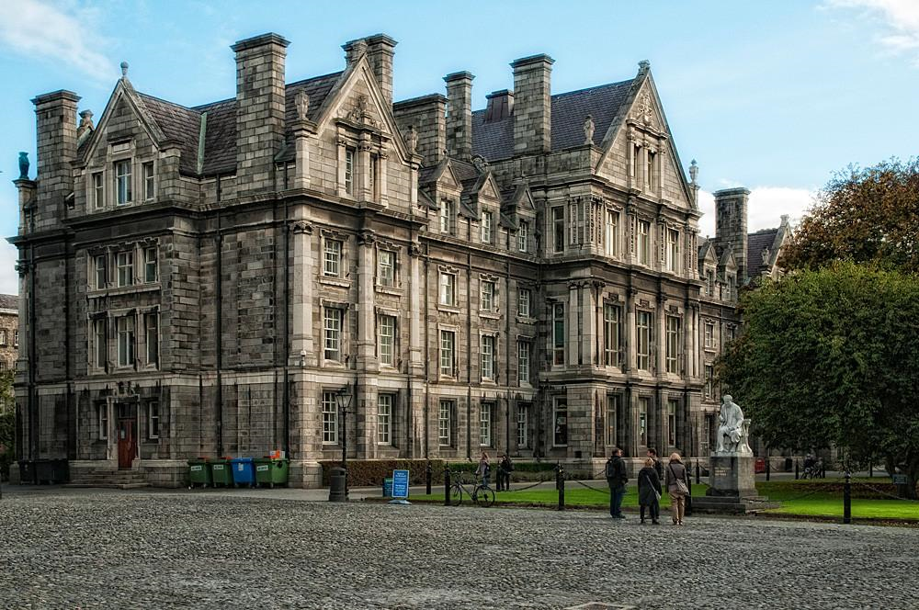
Trinity College

Slide 28
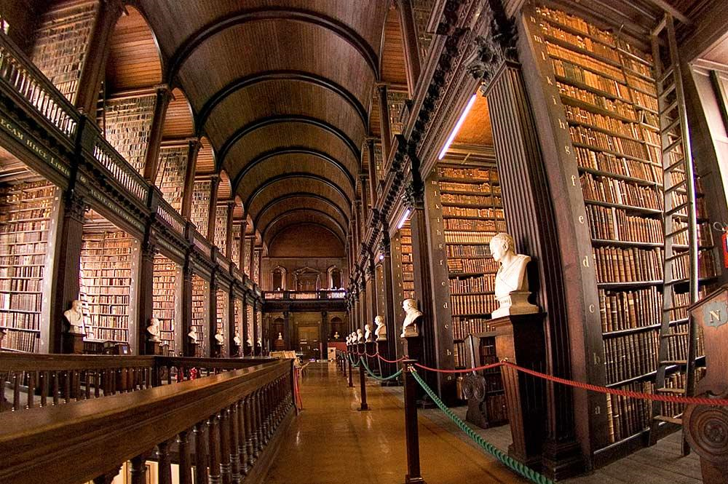
Trinity College Library

Slide 29
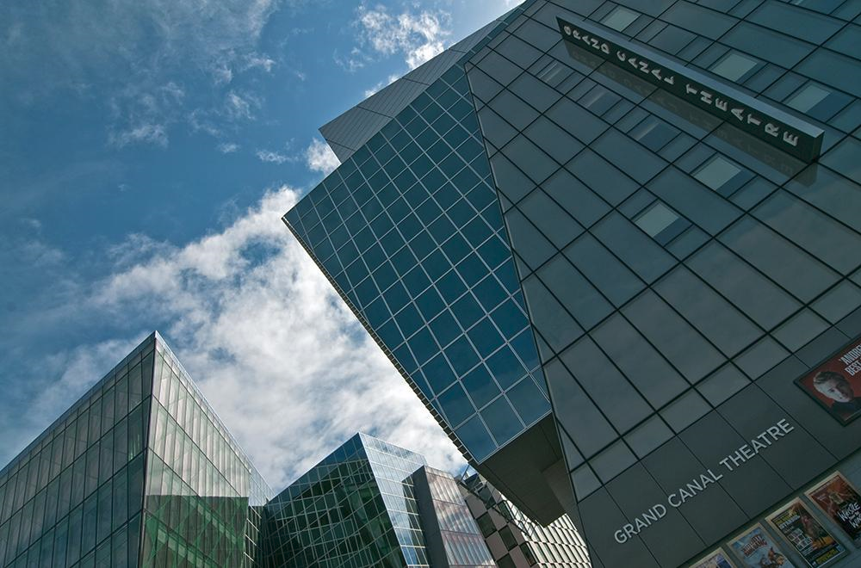

Slide 30
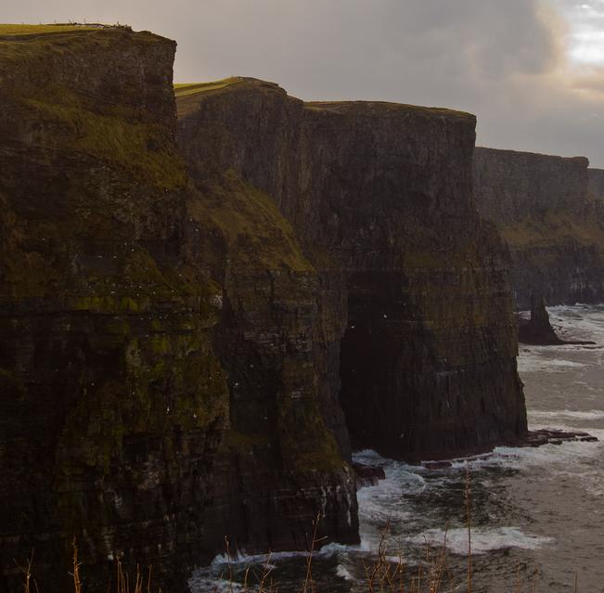
Cliffs of Moher

Slide 31
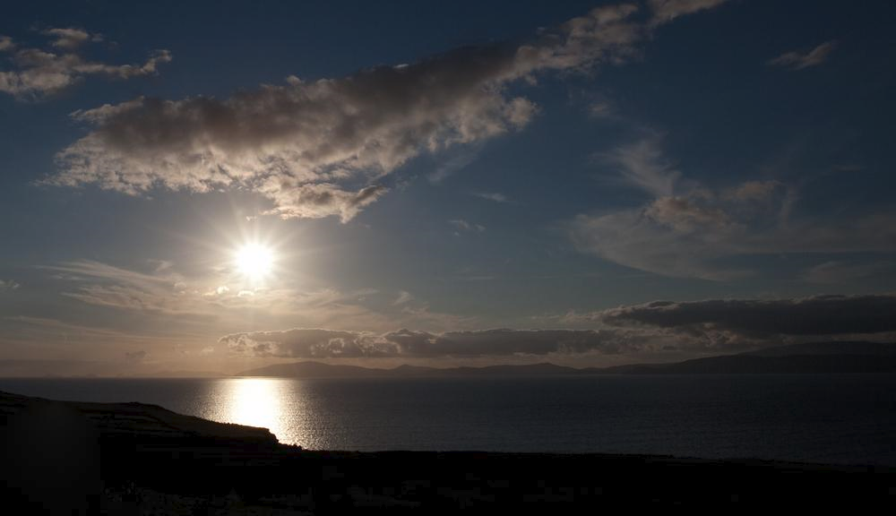
Dingle bay

Slide 32
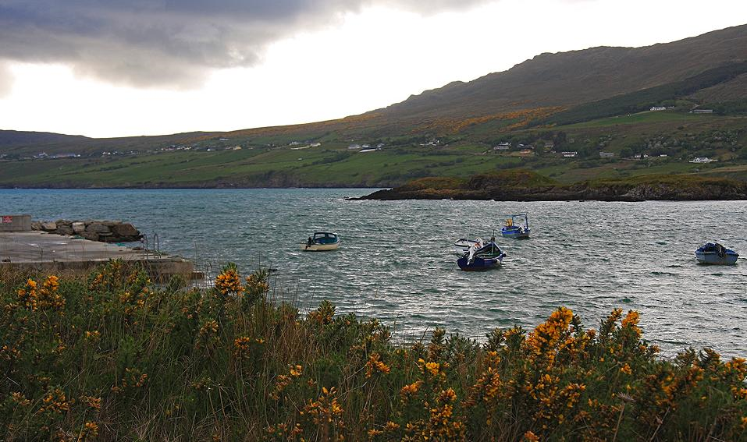
Fintragh Bay

Slide 33
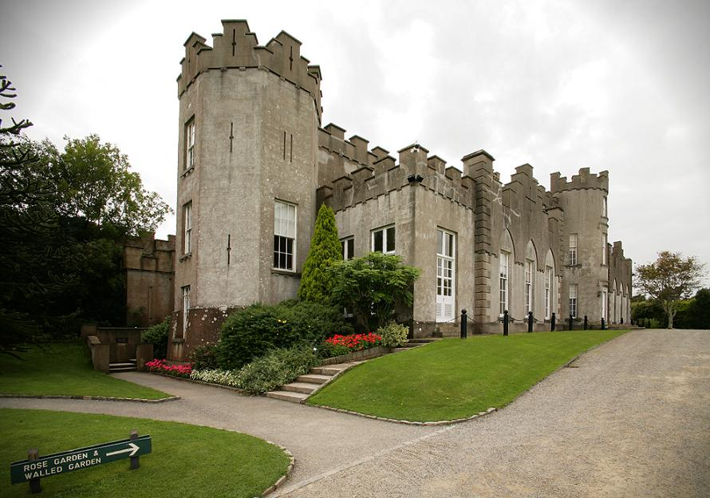
Ardgillan Castle

Slide 34
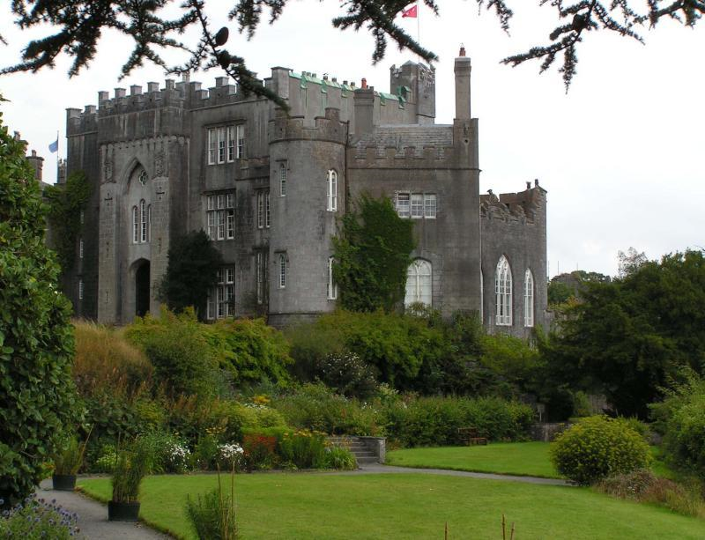
Birr Castle

Slide 35
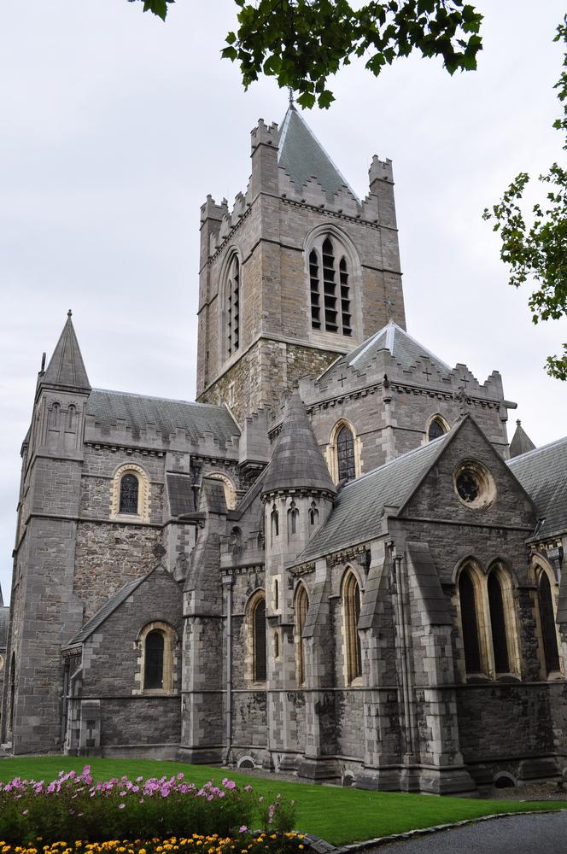
Christ Church

Slide 36
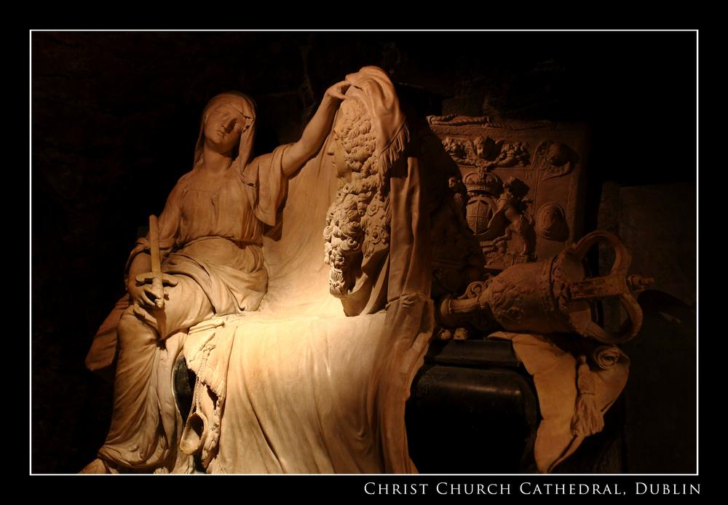

Slide 37
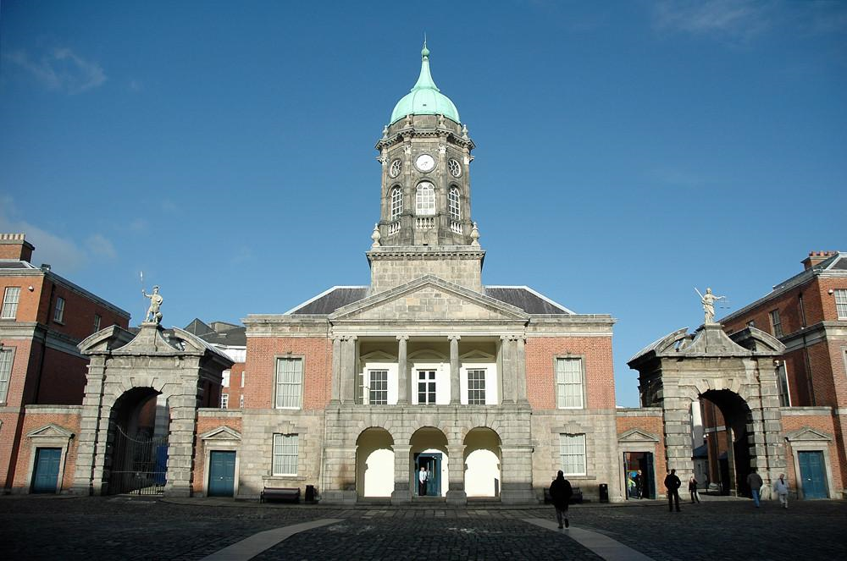
Dublin Castle

Slide 38
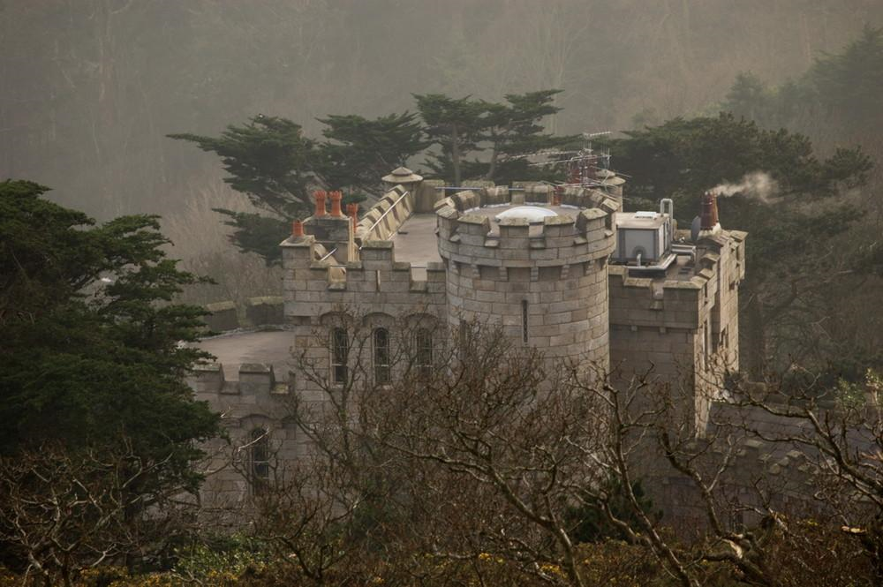
Enyas Castle

Slide 39
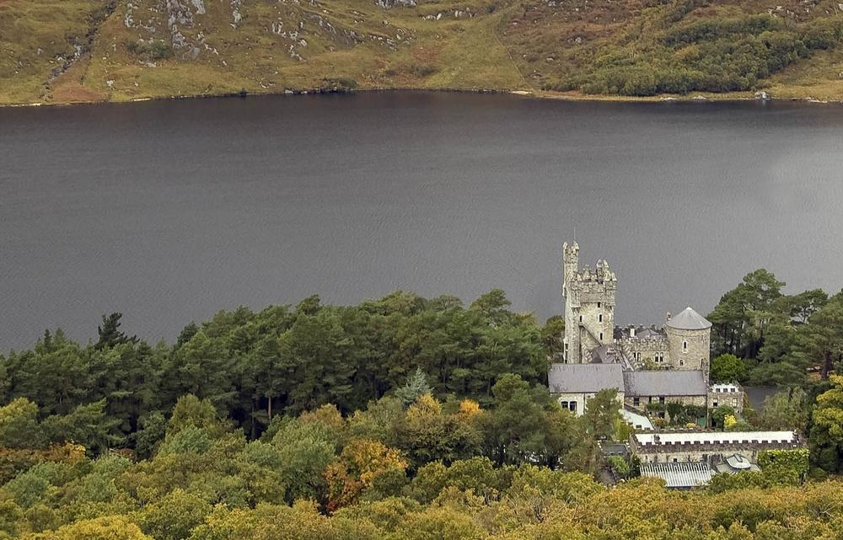
Glenveagh Castle

Slide 40
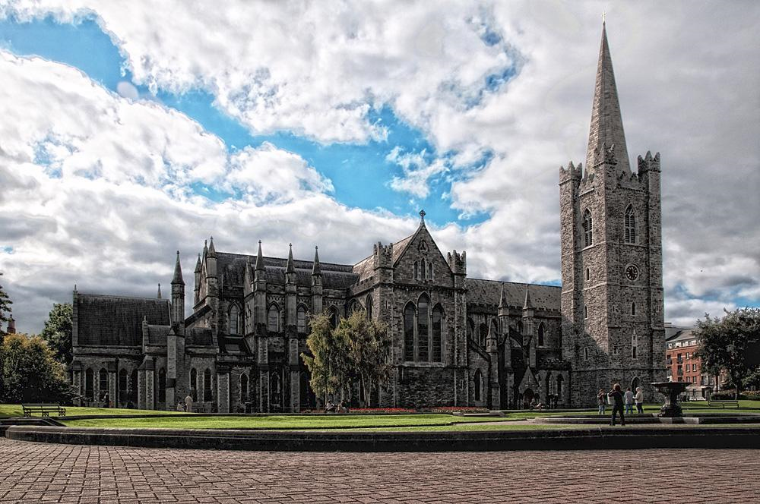
St-Patricks. Cathedral

Slide 41
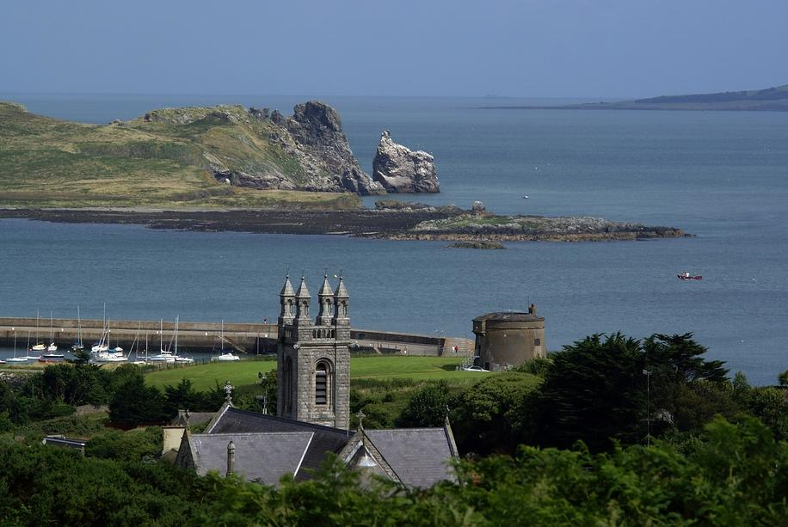
Howth Castle

Slide 42
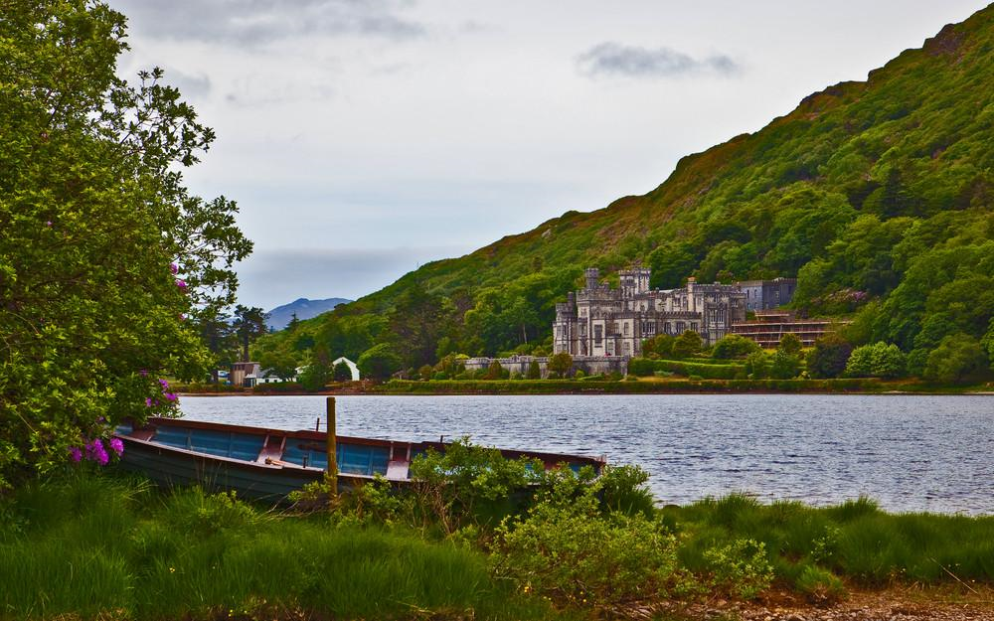
Kylemore Abbey - probably the most beautiful abbey in Ireland.

Slide 43
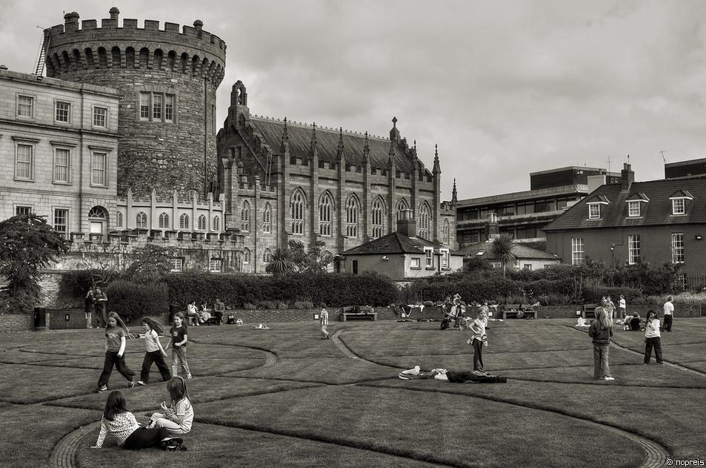
Norman Tower

Slide 44
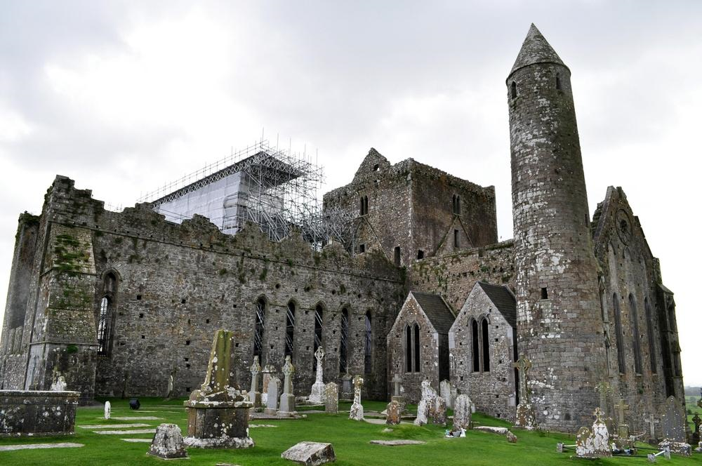
Rock-of-Cashel

Slide 45
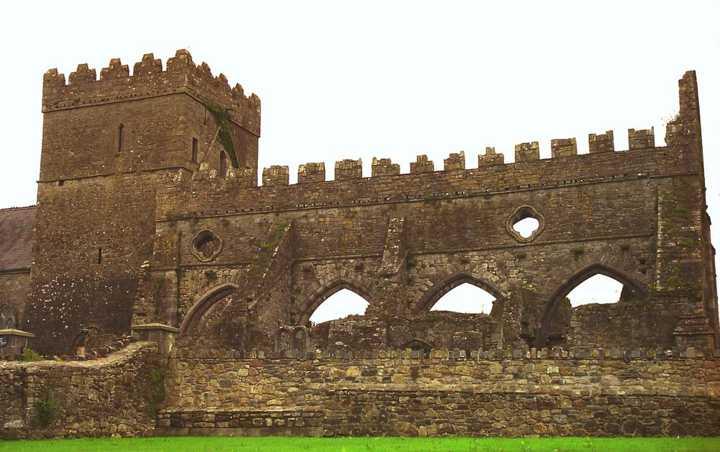
The Church of the Assumption of the Blessed Virgin Mary

Slide 46
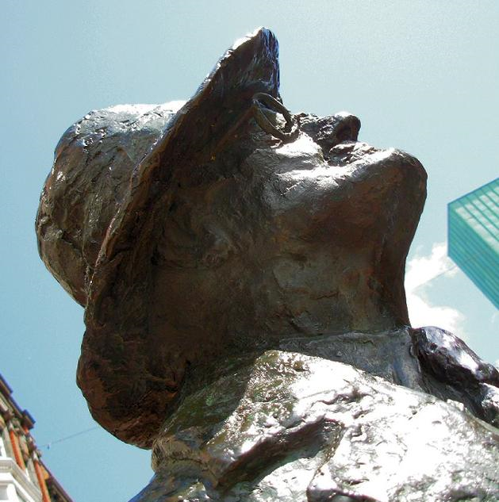
James Joyce-Irish novelist and poet

Slide 47
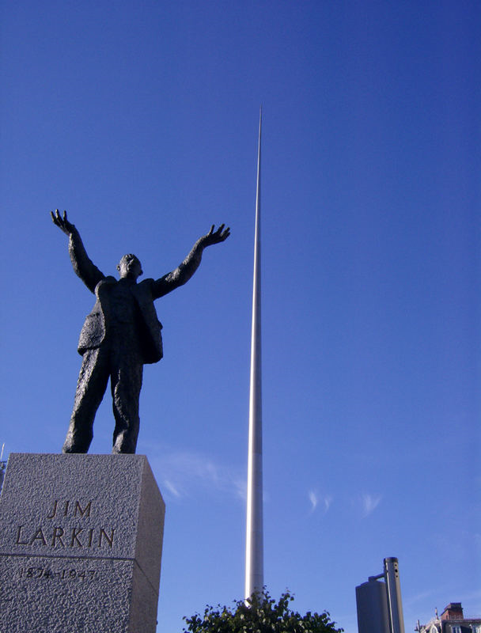
James (Big Jim) Larkin-Irish trade union leader and socialist activist.

Slide 48
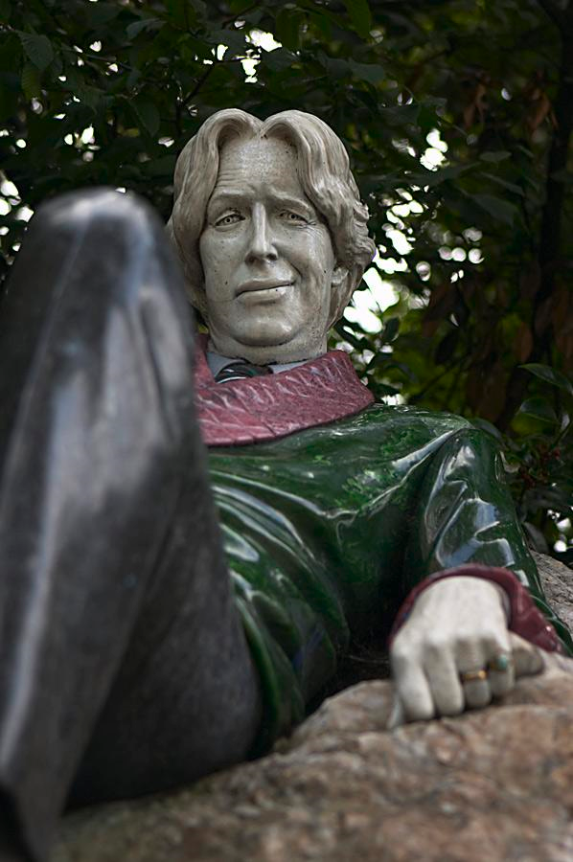
Oscar Wilde-Irish writer, poet, and prominent aesthete.

Slide 49
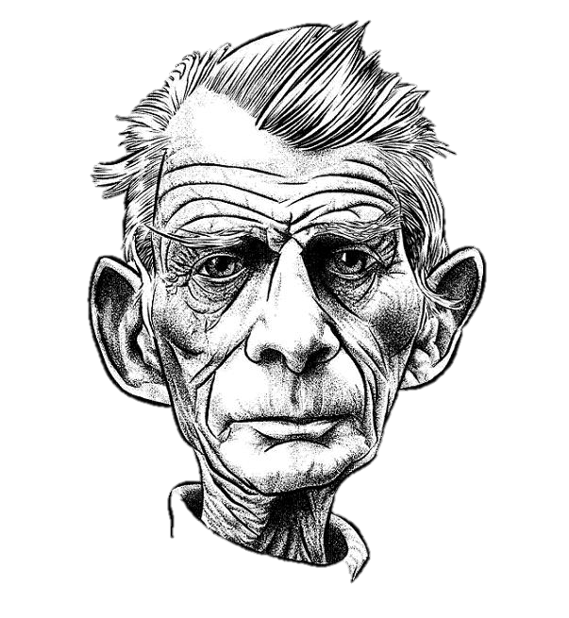
Samuel Beckett-Irish avant-garde writer, dramatist and poet, writing in English and French.

Slide 50
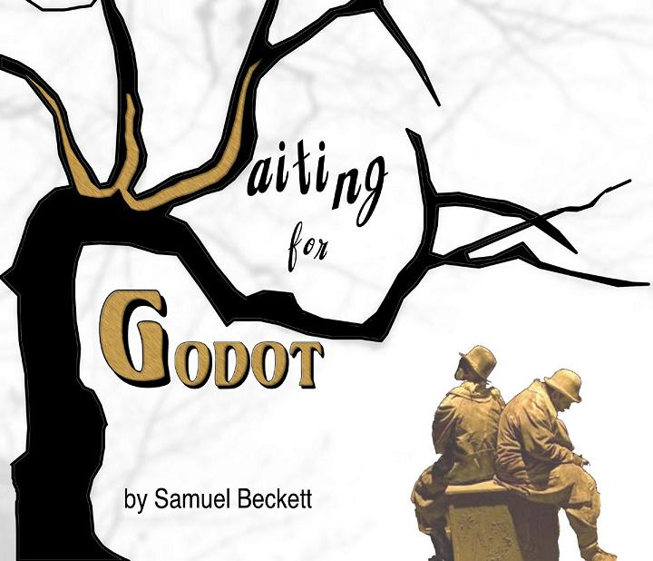

Slide 51
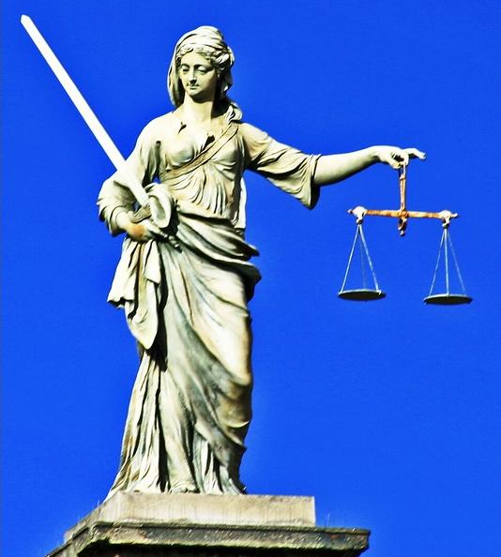
Justice at Dublin Castle

Slide 52
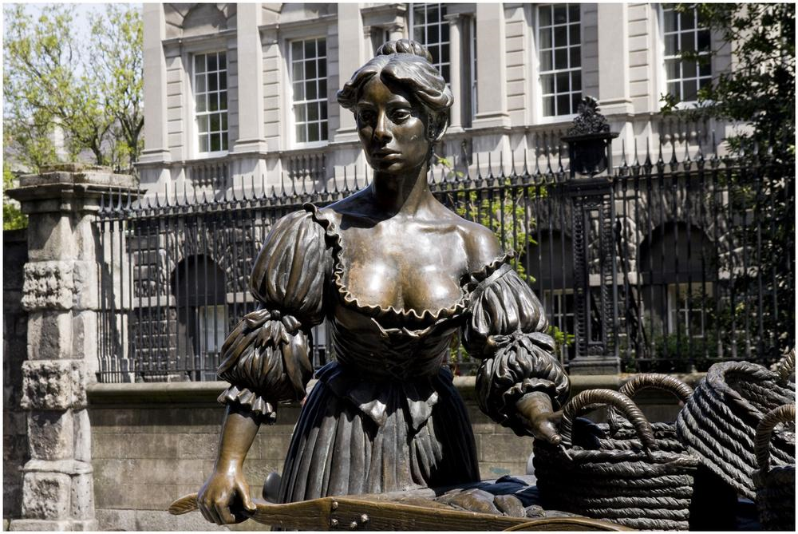
Molly Malone statue in Grafton Street, Dublin.

Slide 53


Slide 54

The Linesman

Slide 55

The Famine Memorial on Custom House Quay.

Slide 56

George Salmon-mathematician and Anglican theologian in Trinity College

