Slide 1
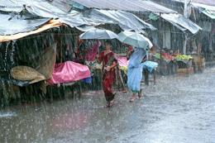
India – The Wet Monsoon in Assam

Slide 2
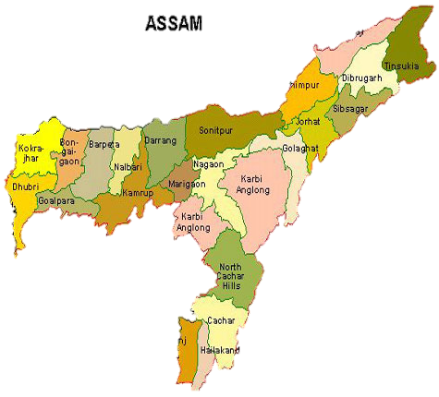
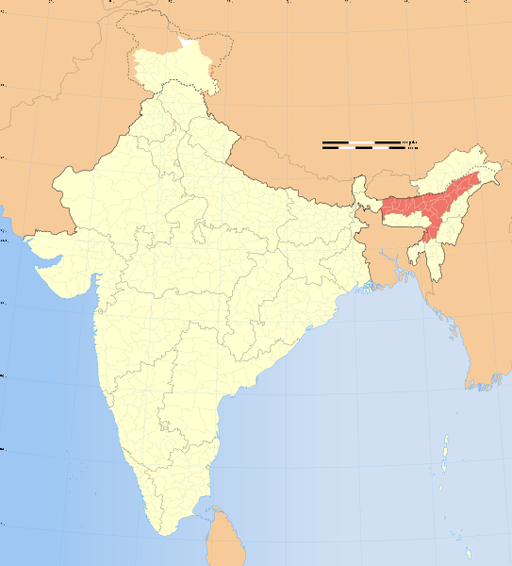
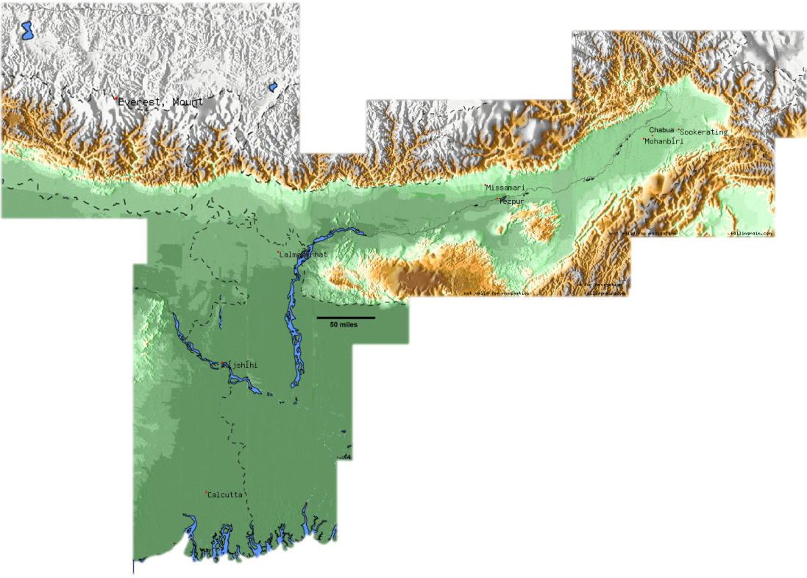

Slide 3
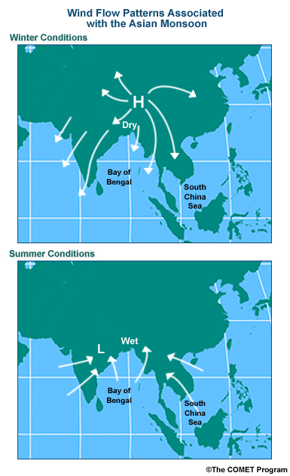
Wind: the horizontal movement of air from a high pressure area to a low pressure area.

Slide 4
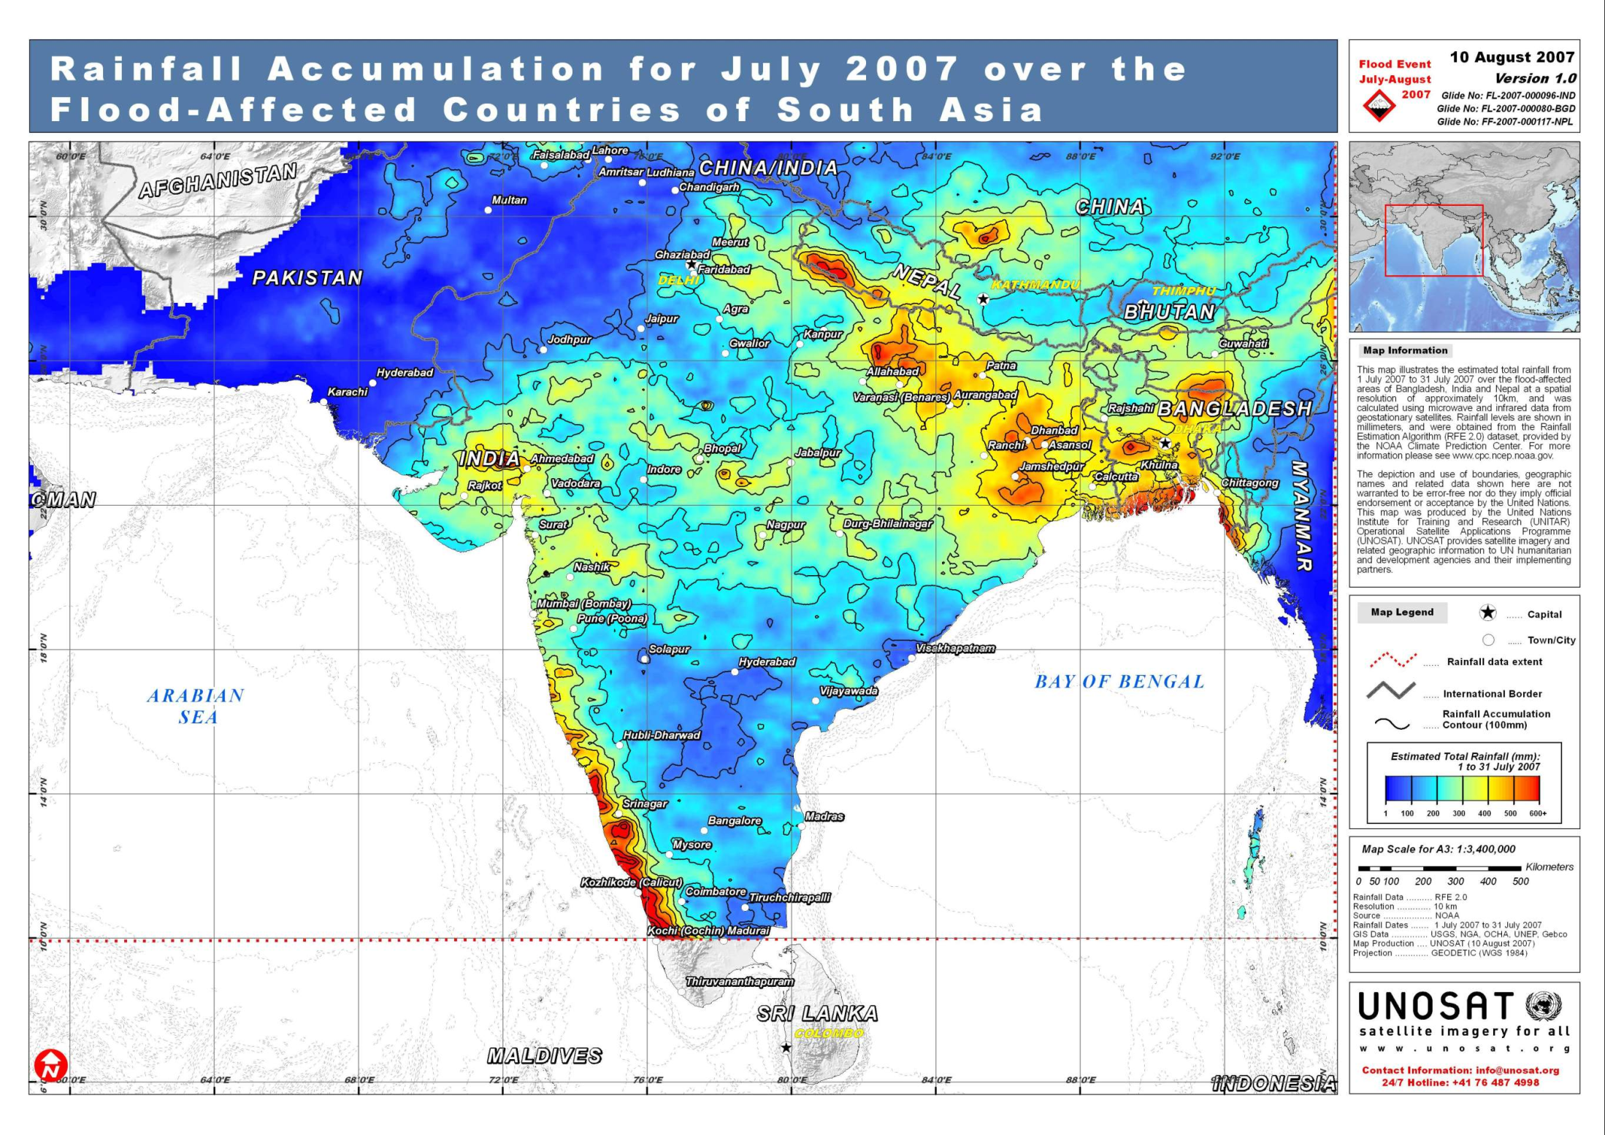

Slide 5
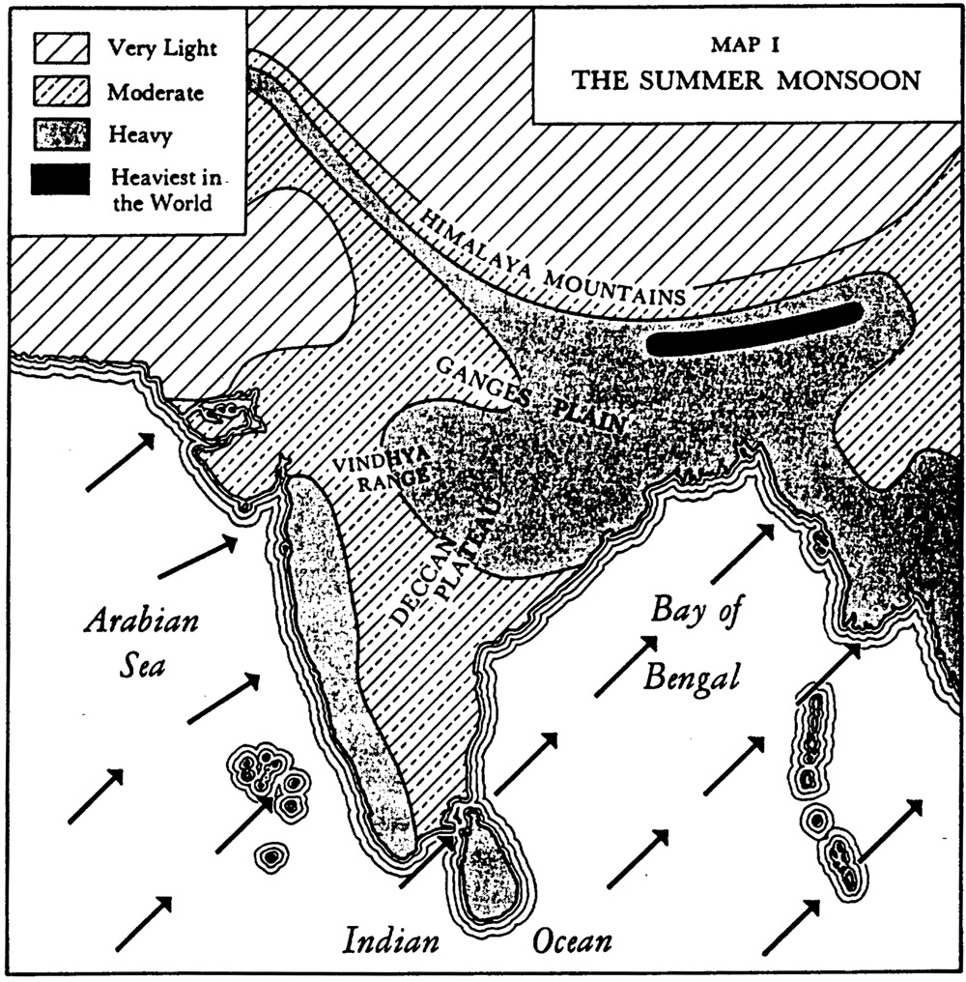

Slide 6
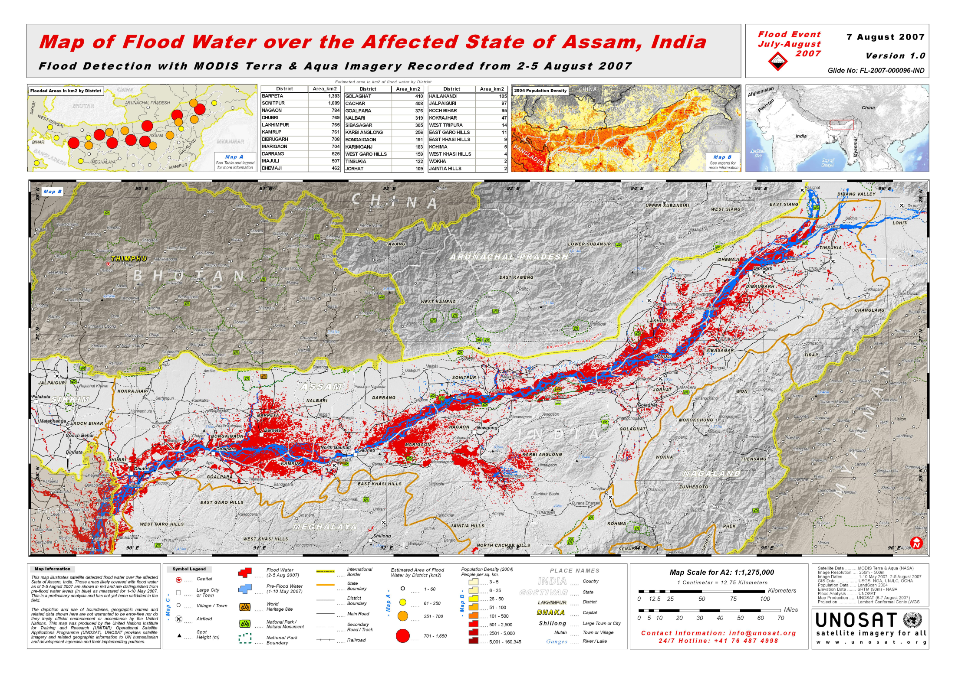

Slide 7
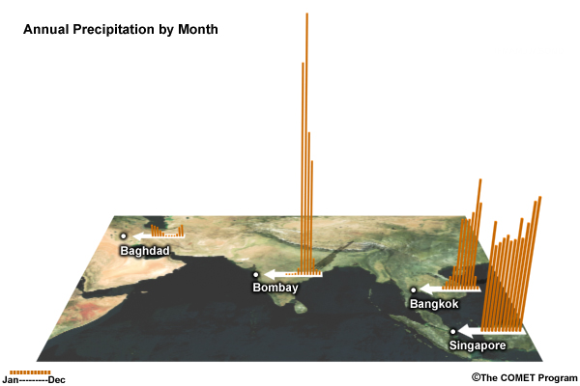
Monsoon Precipitation Patterns

Slide 8
Monsoon –
Shifting of the Wind Direction
During the warm months, the winds come from the sea, bringing precipitation (often quite heavy – this is the wet season, the Wet Monsoon)
During the cooler months, dry winds come from the interior of the subcontinent and go out to the sea. This is the dry season (the Dry Monsoon)
The monsoon floods have submerged parts of Assam's Pobitora Wildlife Sanctuary, forcing the rare one-horned Rhinoceros and local residents take shelter on higher land. Photos courtesy: AP

Slide 9
The timing of the wet monsoon can determine whether agriculturalists have a good year or a bad year. The quality of life is very dependent on the wet monsoon’s timing and intensity.
When the wet monsoon is very intense, it can result in great loss of homes, washing out of bridges and roads, and increased insect-borne diseases.
Much of South Asia and Southeast Asia is affected by the seasonal monsoons.

Slide 10
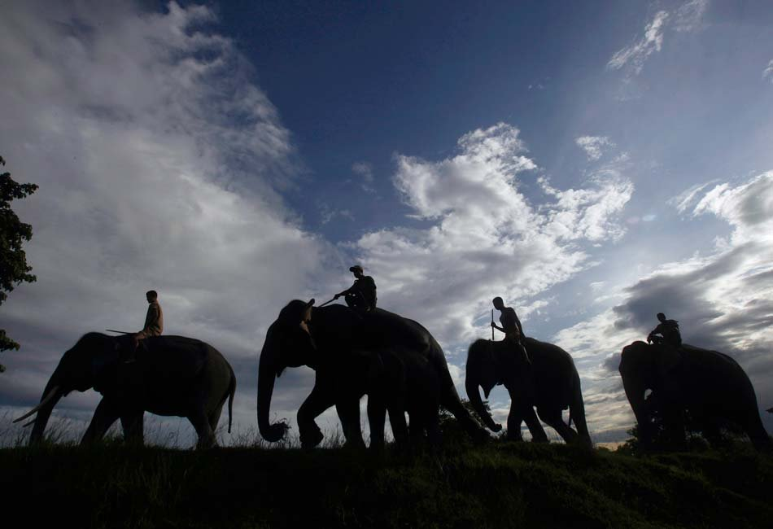

Slide 11
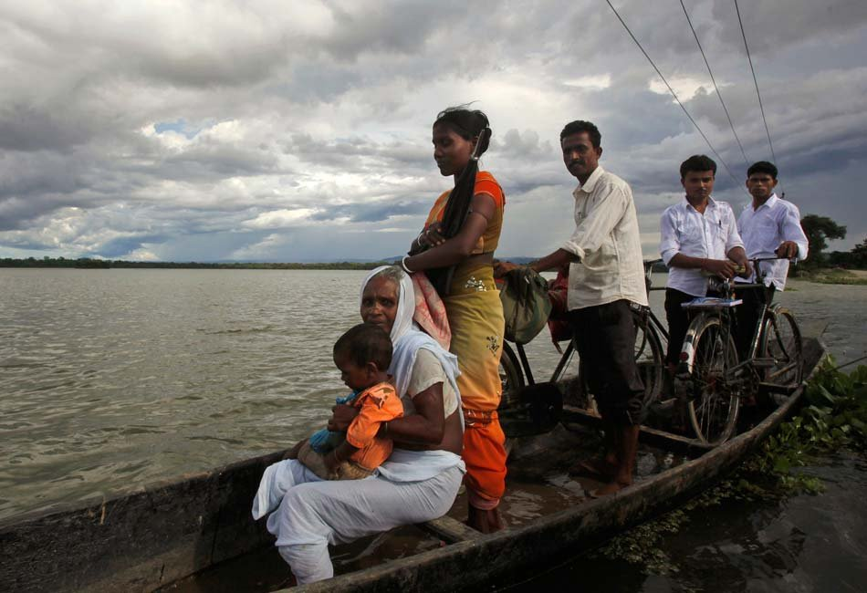

Slide 12
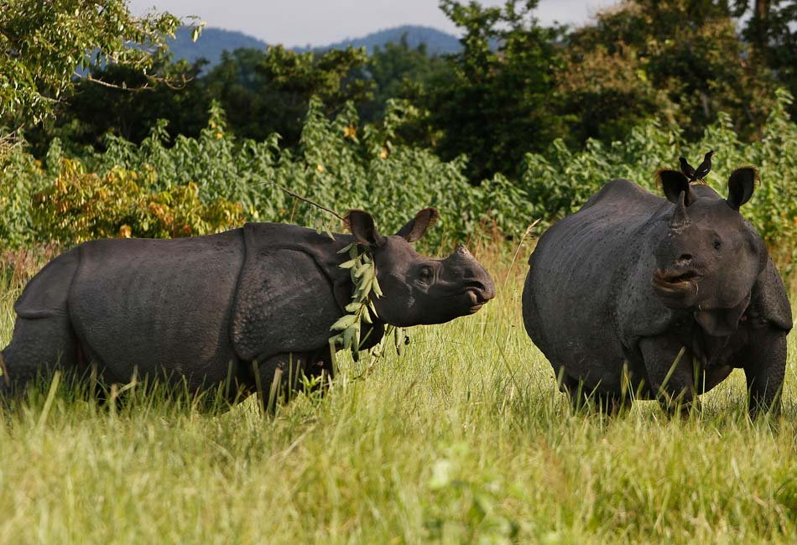

Slide 13


Slide 14
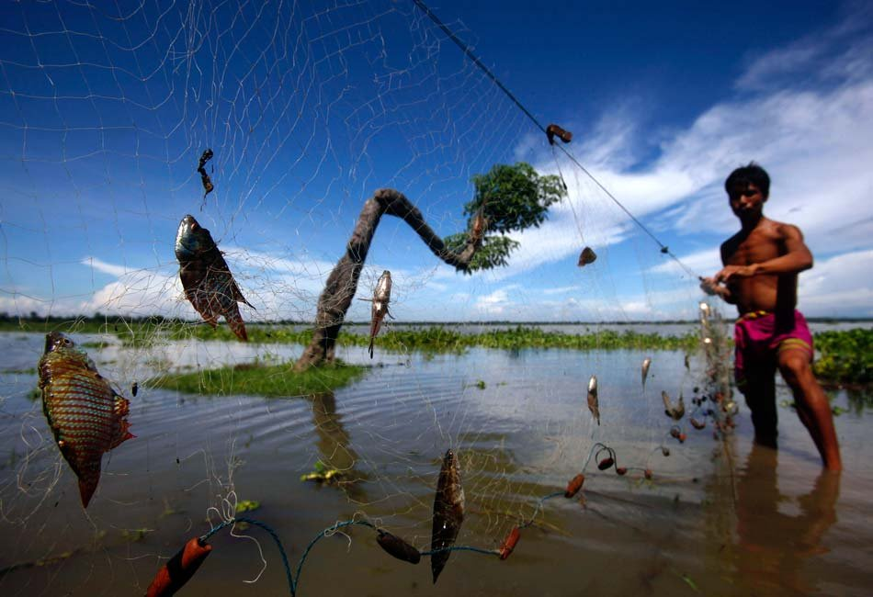

Slide 15
