Slide 1
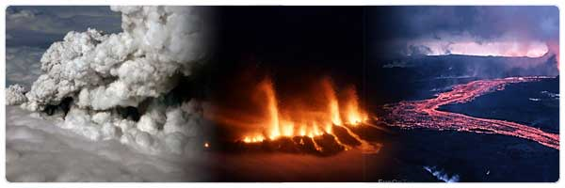
Iceland – the Mid-Atlantic Sea Ridge above sea level.

Slide 2
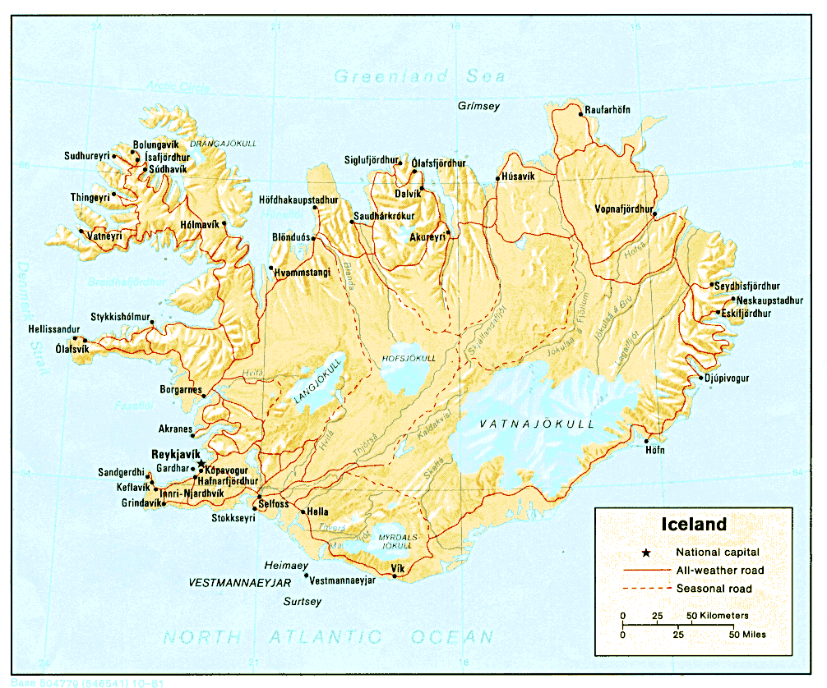

Slide 3
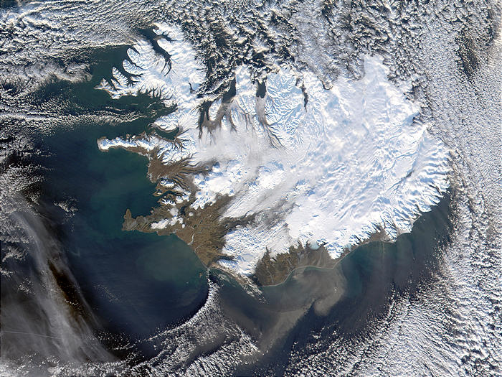
Satellite View in Winter

Slide 4
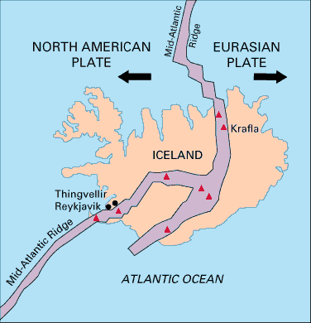

Slide 5
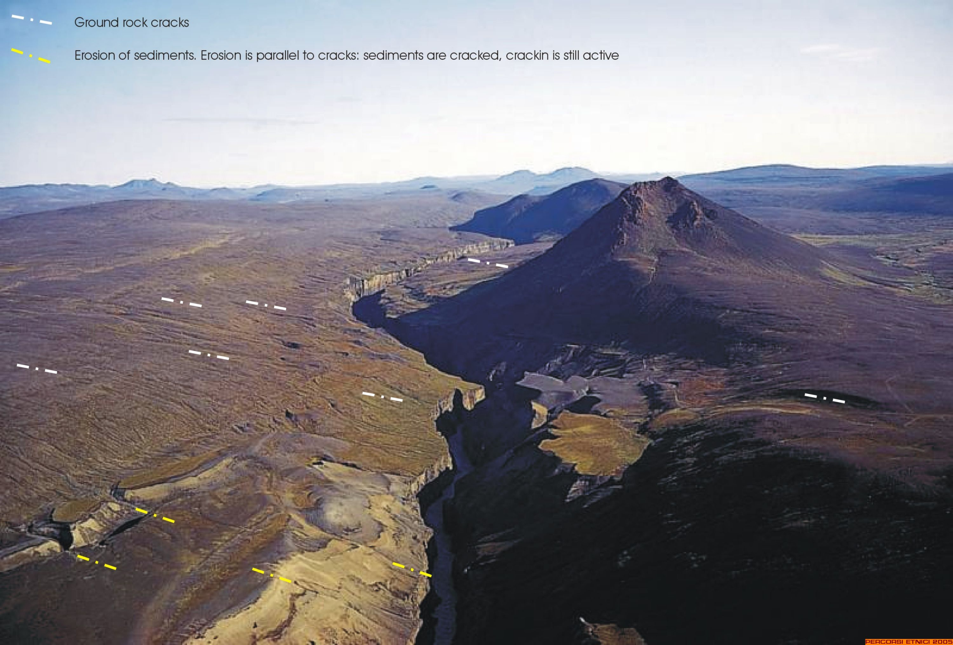

Slide 6
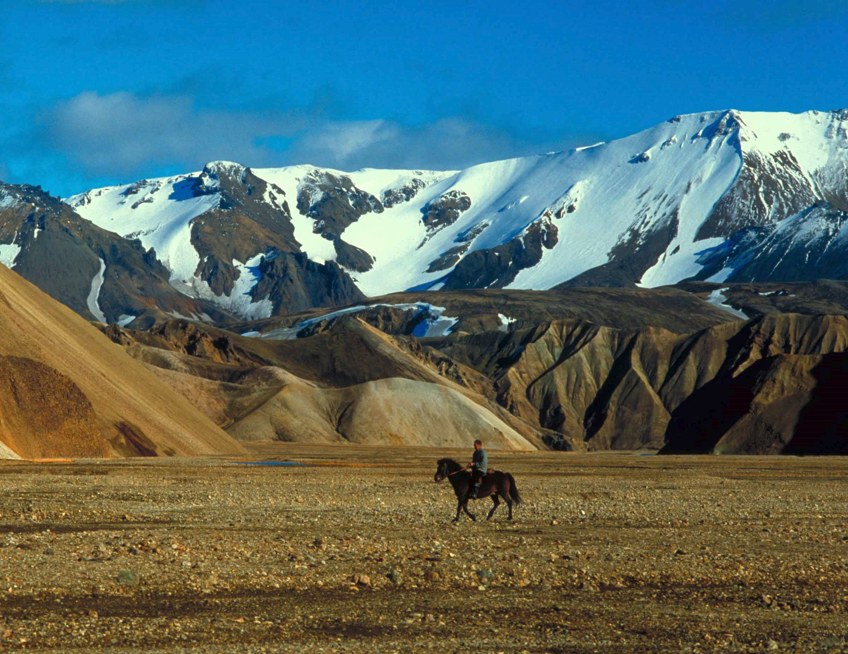

Slide 7
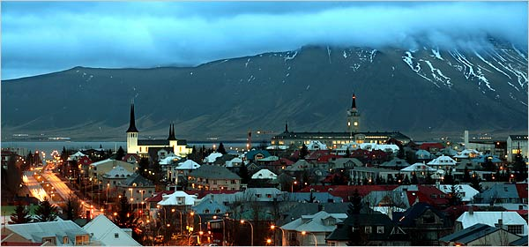

Slide 8
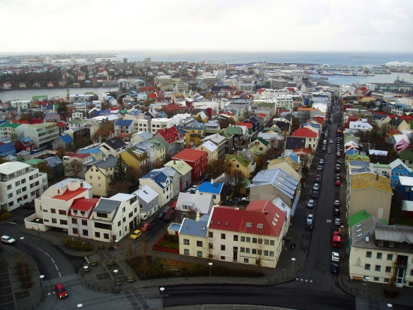

Slide 9
An Icelandic volcano, dormant for 200 years, has erupted, ripping a 1km-long fissure in a field of ice. The volcanic ash has forced the cancellation of many flights and disrupted air traffic across northern Europe, stranding thousands of passengers. Collected here are photos of the most recent eruptions.

Slide 10
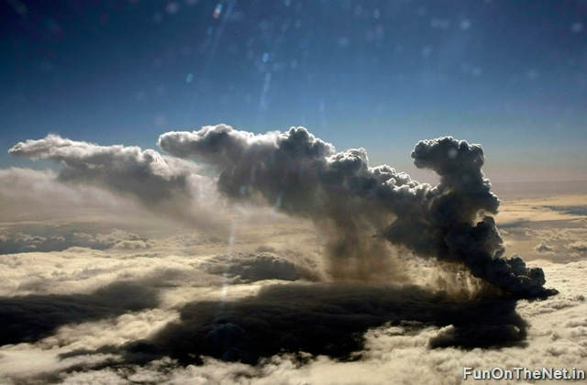
The volcano has erupted for the second time in less than a month, melting ice, shooting smoke and steam into the air and forcing hundreds of people to flee rising floodwaters.

Slide 11
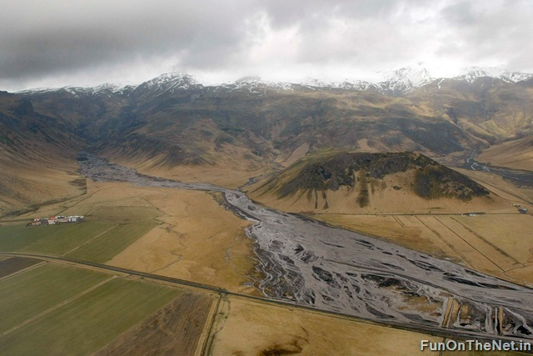

Slide 12
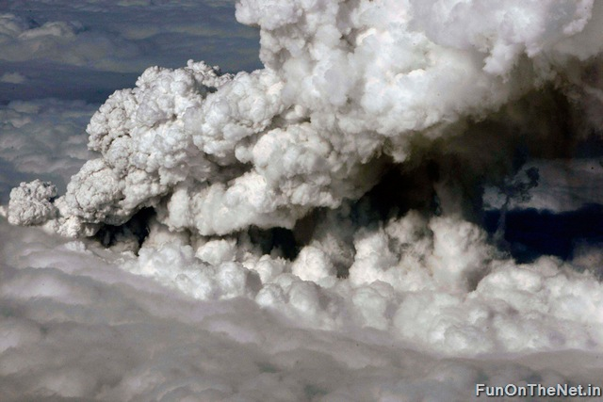

Slide 13
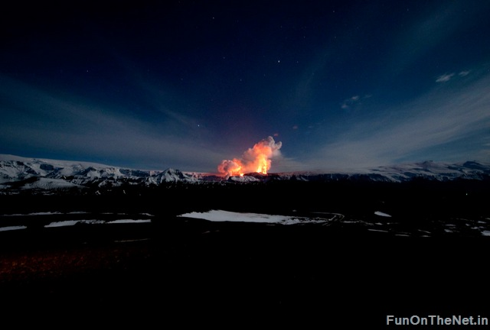

Slide 14
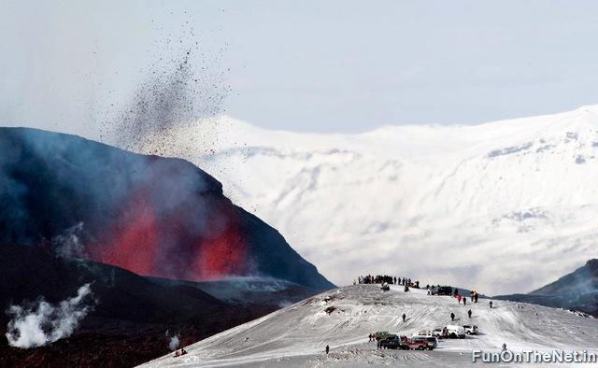

Slide 15
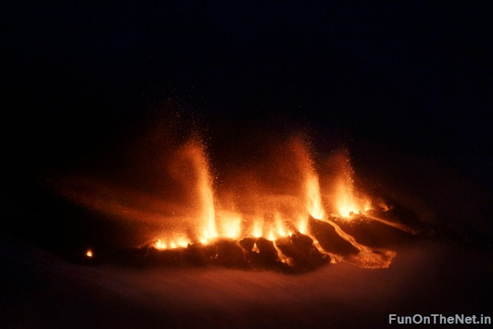

Slide 16
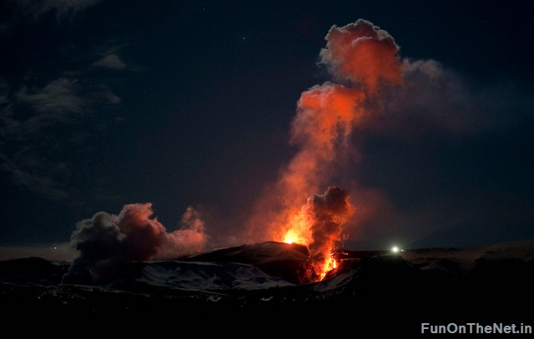

Slide 17
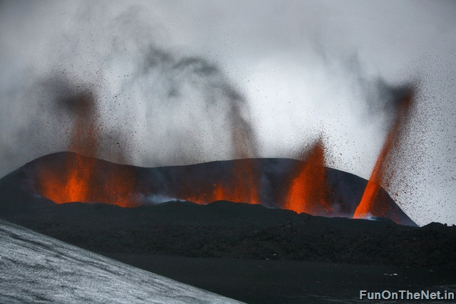

Slide 18
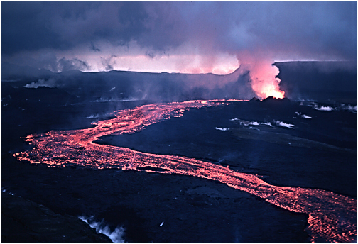

Slide 19
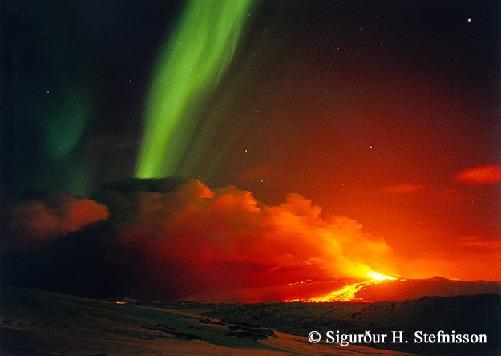

Slide 20
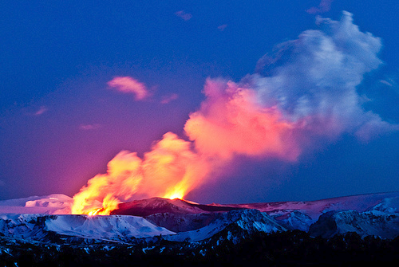

Slide 21
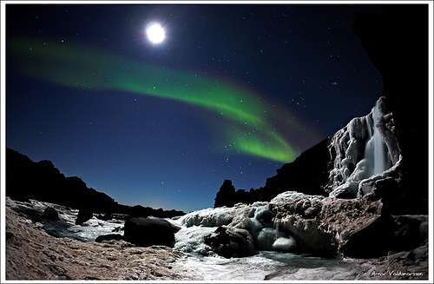

Slide 22
