Slide 1
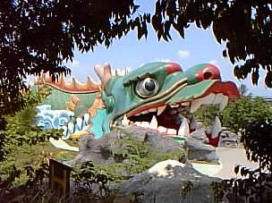
Haw Par Villa - Amazing Park, Singapore
Haw Par Villa, also known as the Tiger Balm Gardens has to be one of the weirdest tourist spots you can find in Southeast Asia, and the weirdest in Singapore.

Slide 2
Background
Aw Boob Haw and Aw Boon Par, the two brothers behind the famous Tiger Balm, built the Haw Par Villa in 1937. It featured over 1,000 statues and 150 dioramas inspired from Chinese folklore, history and mythology, and quickly became an attraction for people who appreciated Chinese culture. Although it was a huge place, Haw Par Villa was always full of people taking pictures of its weird-looking exhibits and kids running around holding balloons. That was 20 years ago, because now Singapore’s weird theme park is almost deserted.

Slide 3
But just because this place lost its glow doesn’t mean it’s not worth a visit, especially if you’re into offbeat attractions. I mean this place will really blow your mind, with statues like a woman breastfeeding her father in law, armed monkeys, or the human faced giant crab. Now these apparently do make some sense if you’ve read up on Chinese mythology, but to an uneducated guy like me they just look freaky.

Slide 4
Not to mention the Ten Stages of Hell exhibit, a place that will creep the hell out of a grownup, let alone a child. According to Chinese mythology, a soul must pass through ten courts of judgment, before being allowed into heaven, and Haw Par Villa has very detailed representations of these trials. As you’re about to see, they are not pretty.
All in all, Haw Par Villa is still considered a must-see attraction for people fond of Chinese culture, and efforts are being made to restore it to its former glory.
Posted in “Lights of India” by FARDEEN

Slide 5
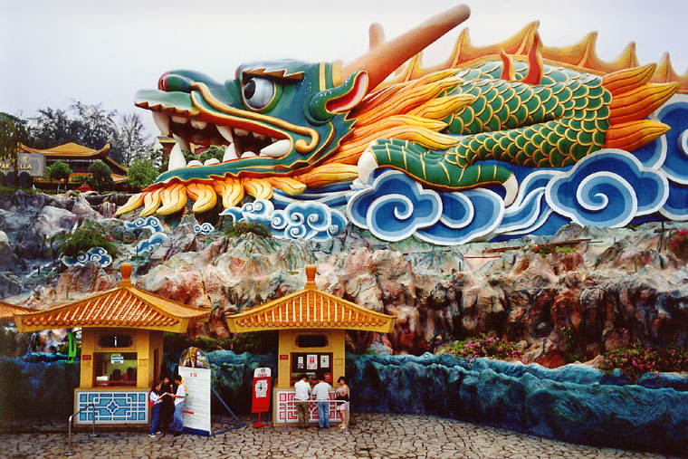

Slide 6
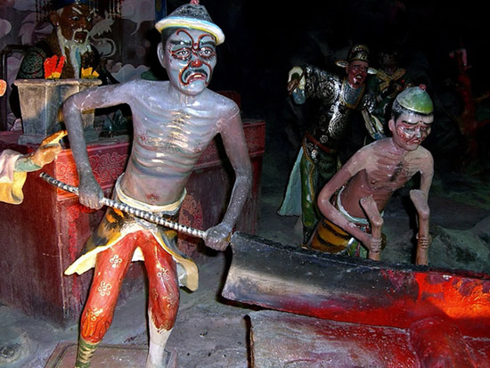

Slide 7
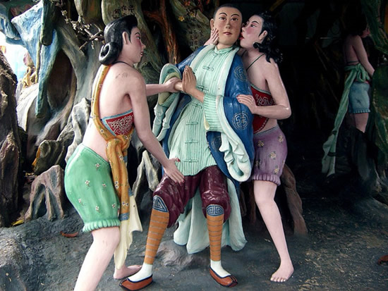

Slide 8
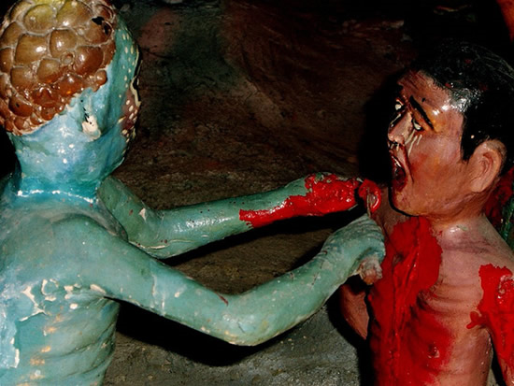

Slide 9
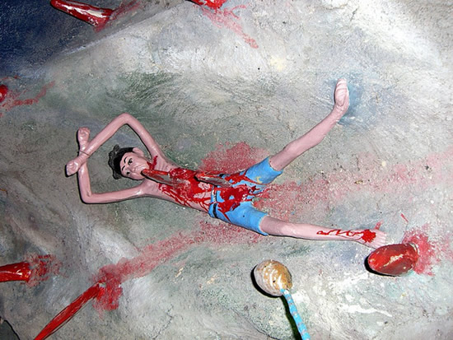

Slide 10
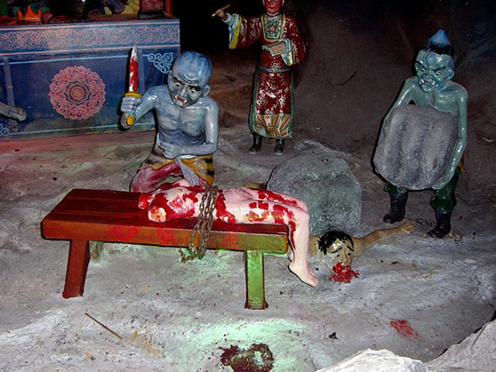

Slide 11
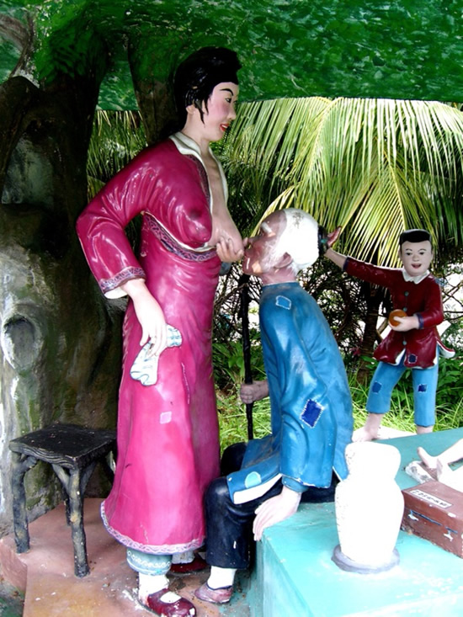

Slide 12
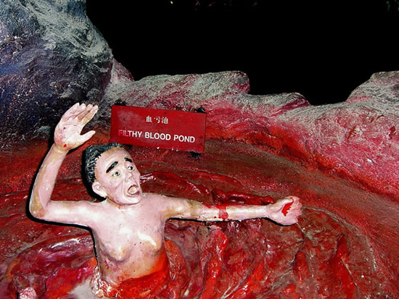

Slide 13
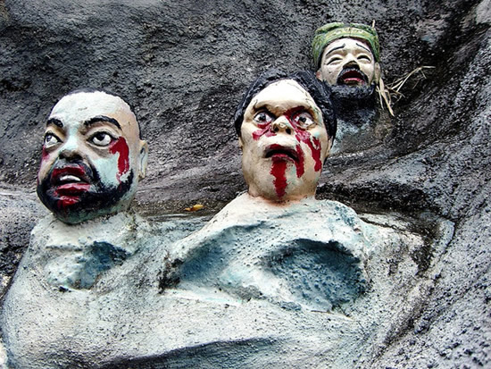

Slide 14
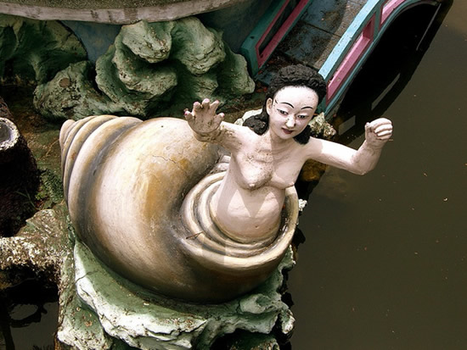

Slide 15
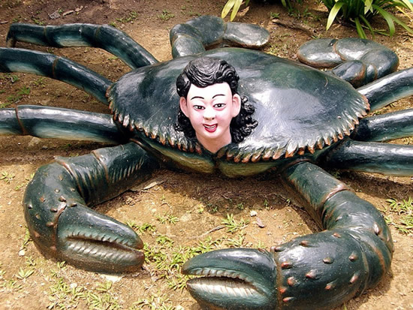

Slide 16
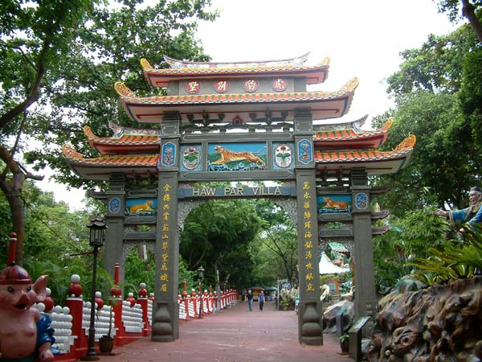

Slide 17
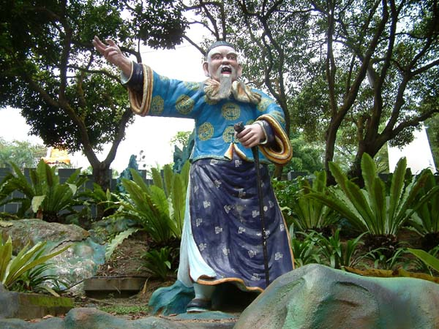

Slide 18
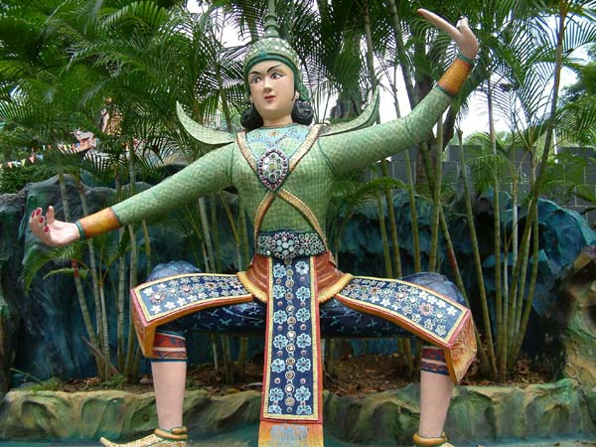

Slide 19
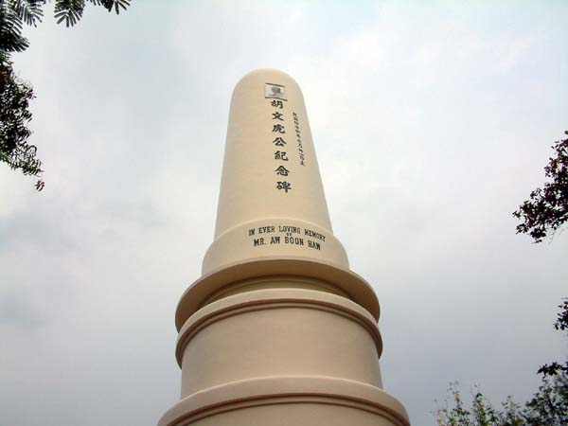

Slide 20
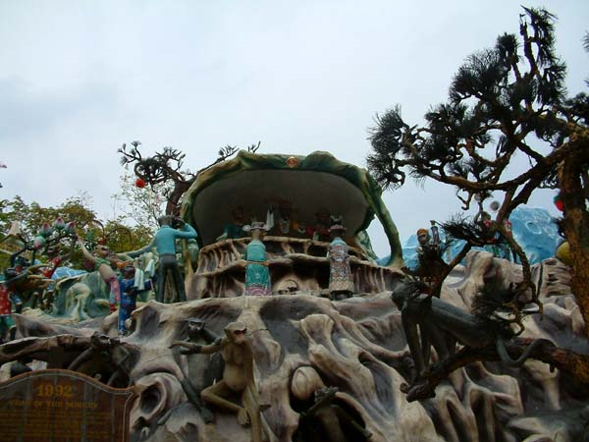

Slide 21
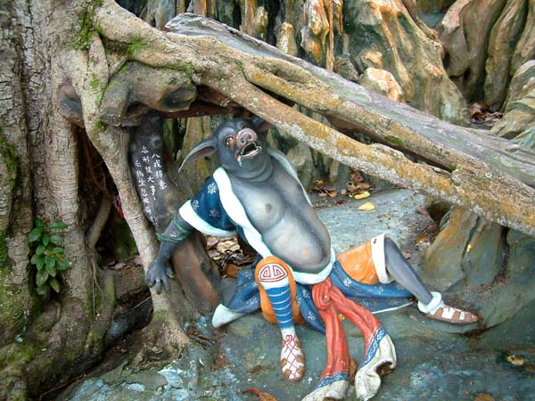

Slide 22
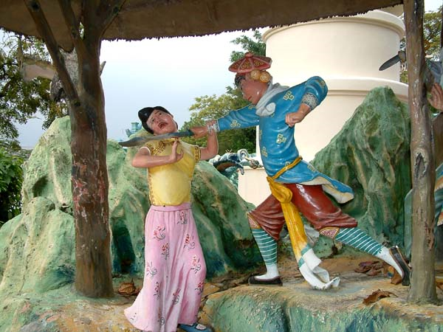

Slide 23
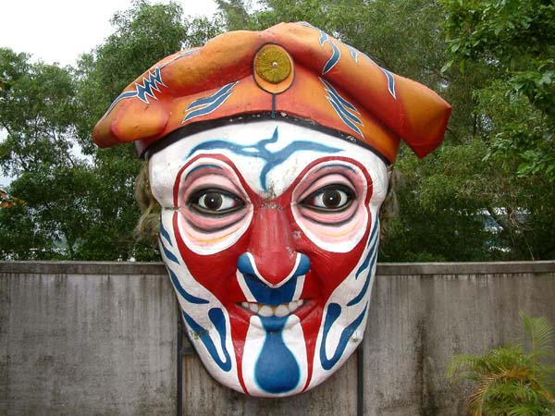

Slide 24
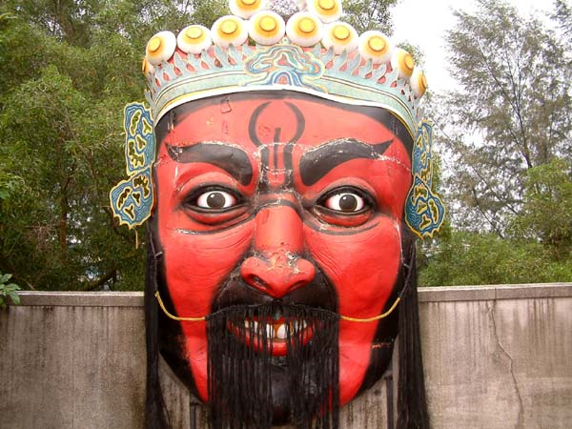

Slide 25
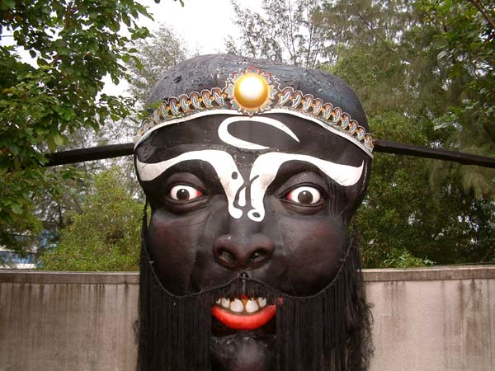

Slide 26
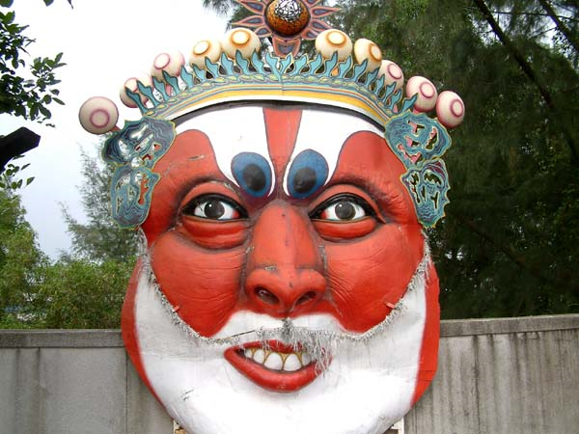

Slide 27
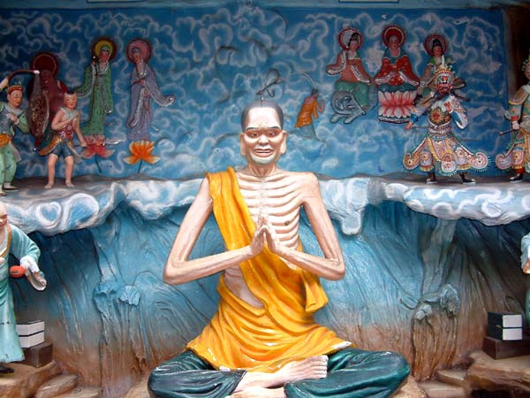

Slide 28
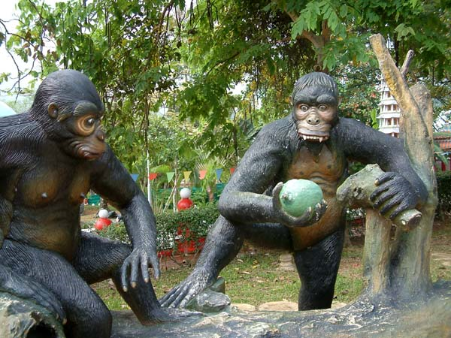

Slide 29
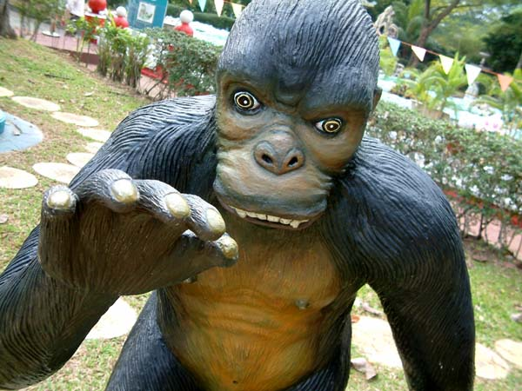

Slide 30
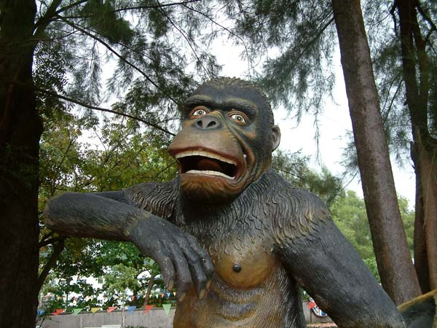

Slide 31
