Slide 1
Dog Fighting In Afghanistan
An Unsavory Culture Trait

Slide 2
From a posting by K. Samin
So, these are the people that wage Jihad and punish the infidels…Well if they’re so pure how come they enjoy such display of unnecessary violence, eh? Don’t get me wrong, I respect their faith, their religion but they are clearly not as righteous as they claim. Look at that crowd, I wouldn’t be surprised if they made dog-fights a national sport. it’s legal, that much I know (still illegal according to Wikipedia).
K. Samin

Slide 3
From Wikipedia
Dog fighting is a blood sport in which game dogs are made to fight, sometimes to the death. Dog fighting is used for entertainment and may also create a revenue stream from stud fees, admission fees, and gambling. Dog fighting has been popular in many countries throughout history and continues to be practiced both legally and illegally around the world. In Afghanistan, the breeds are usually live stock guardian mixtures.^{[citation needed]} While still illegal, it appears that dog fighting is gaining popularity in Afghanistan.

Slide 4
Pictures posted by k. samin in “lights of india”

Slide 5
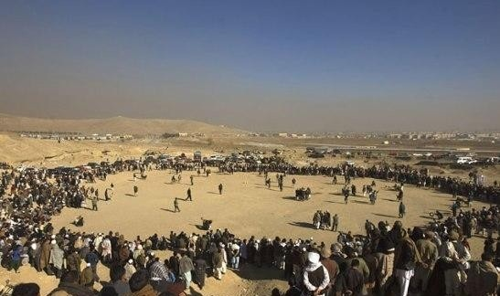

Slide 6
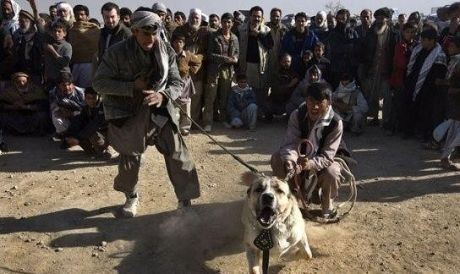

Slide 7
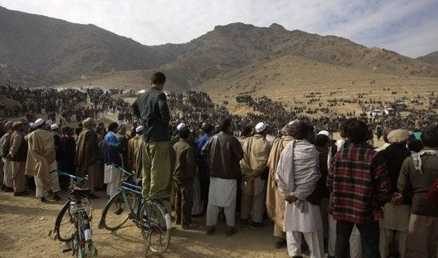

Slide 8
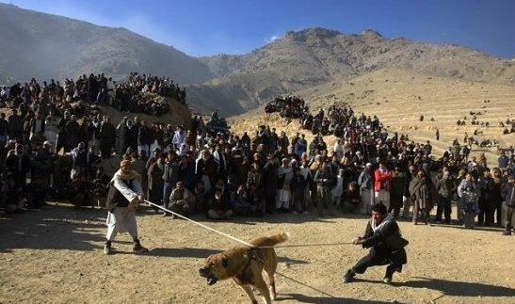

Slide 9
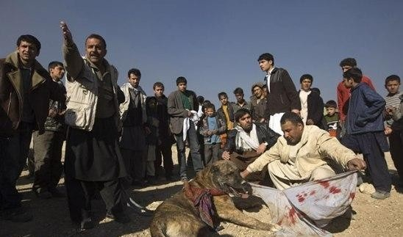

Slide 10
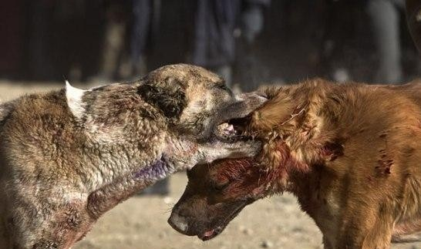

Slide 11
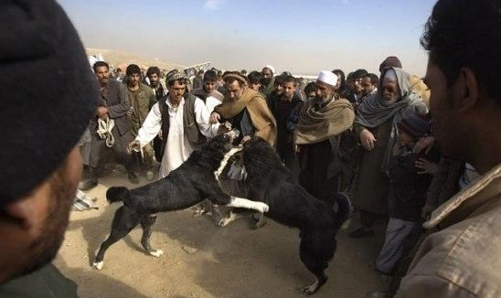

Slide 12
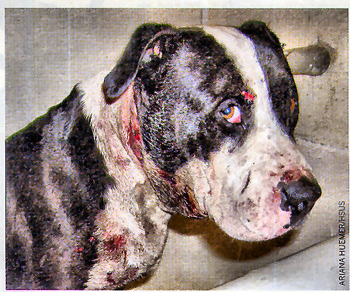

Additional photos from the internet
Other animal contests too

Slide 13
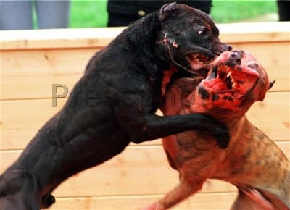

Slide 14
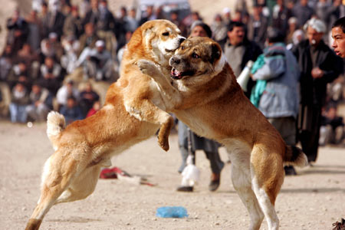

Slide 15
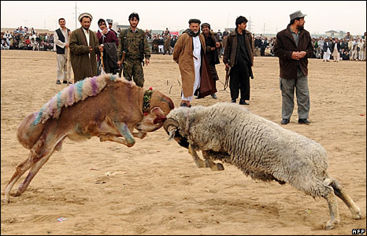
Spectators look on during a ram fight on the outskirts of Mazar-i-Sharif, Afghanistan. The contest, alongside dog and camel fighting, was held as part of new year festivities that began on Saturday.

Slide 16
