Slide 1
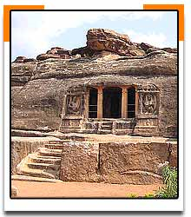
Badami - India

Slide 2
Badami
Set in beautiful countryside at the foot of a red sandstone ridge, the charming village of Badami was once the capital of the Calukya empire, which covered much of central Deccan between the 4th and 8th centuries. The sculptural legacy left by its artisans includes some of the earliest and finest examples of Dravidian temples and rock-cut caves. Aihole was a sort of trial ground for new temple architecture, which was further developed at Pattadakal, now a World Heritage site. The forms and sculptural work at these sites inspired later South Indian Hindu empires that rose and fell before the arrival of the Muslims. In the three centers there are over 150 temples!

Slide 3
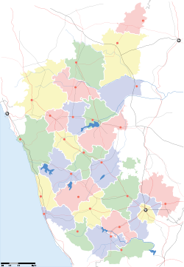
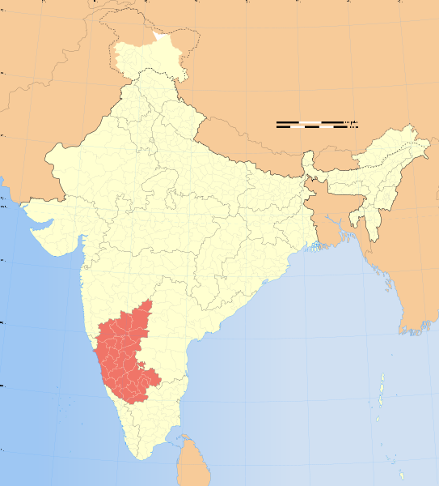
Location
Badami

Slide 4
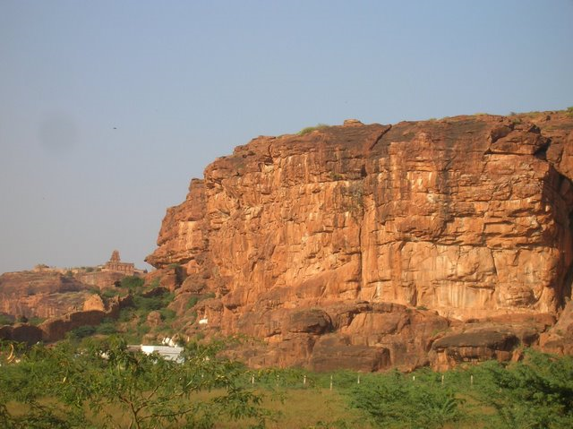
Badami Cliffs

Slide 5
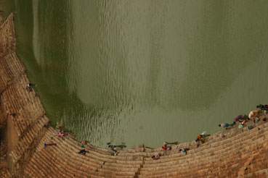
The water tank beneath cave temples

Slide 6
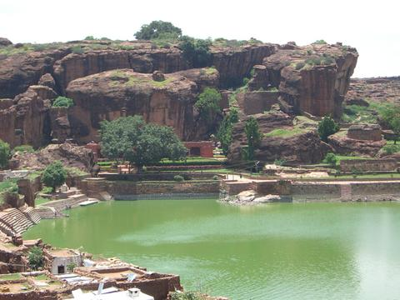
Badami tank at mouth of gorge

Slide 7
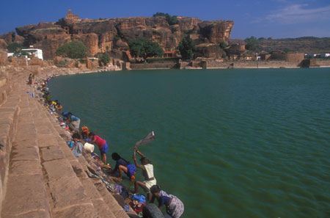
Doing the wash at the Badami tank

Slide 8
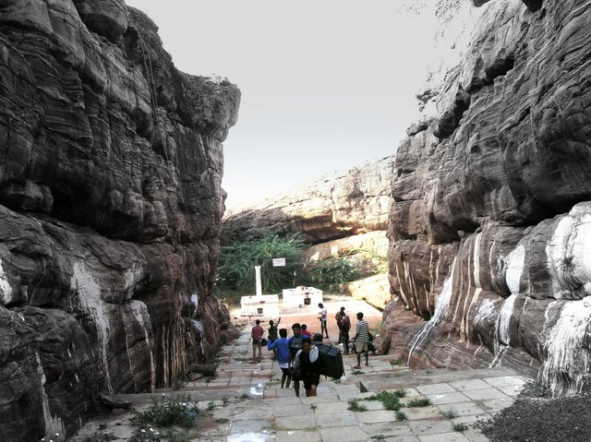
Bolted climbs, Temple Area, Badami, Karnataka, India

Slide 9
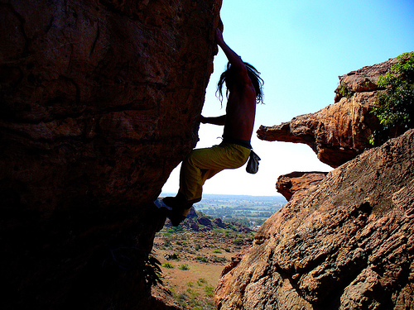

Slide 10
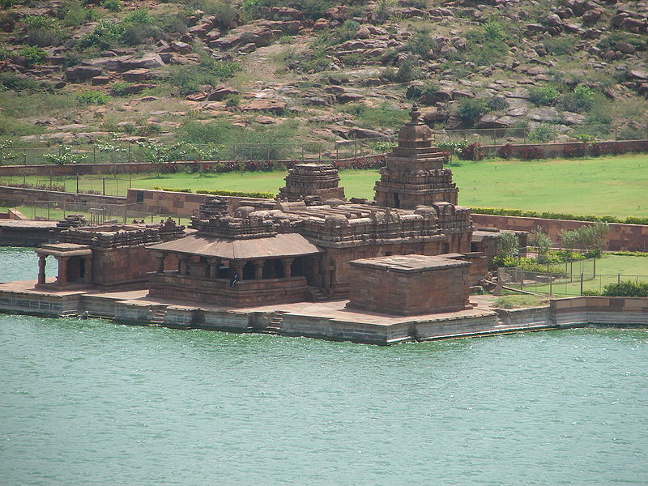
Bhutanatha temple complex in Badami

Slide 11
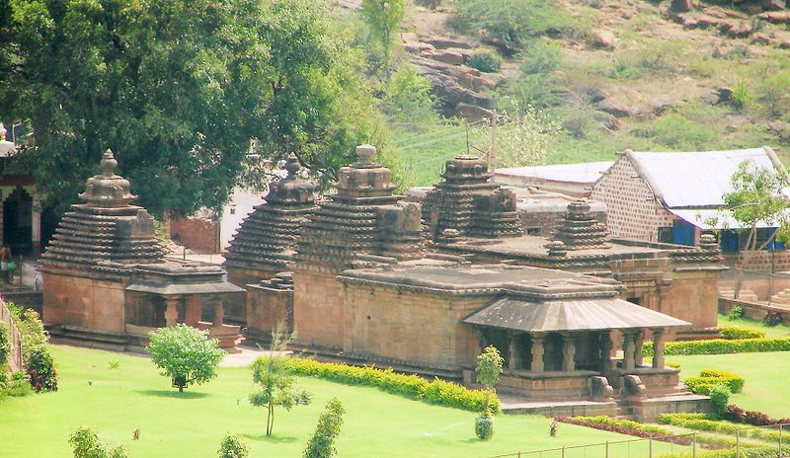
Mallikarjuna group of temples at Badami

Slide 12
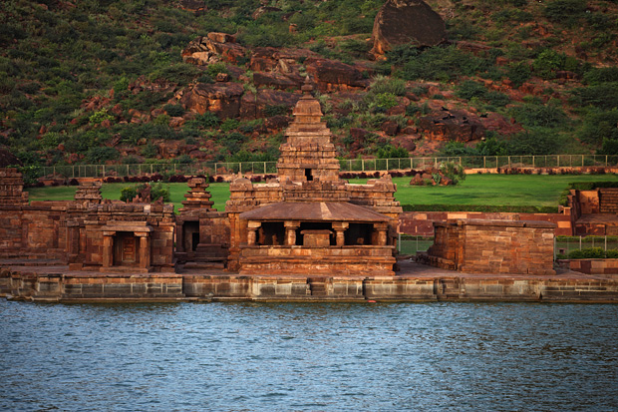
Bhoothanatha Temple, Badami

Slide 13
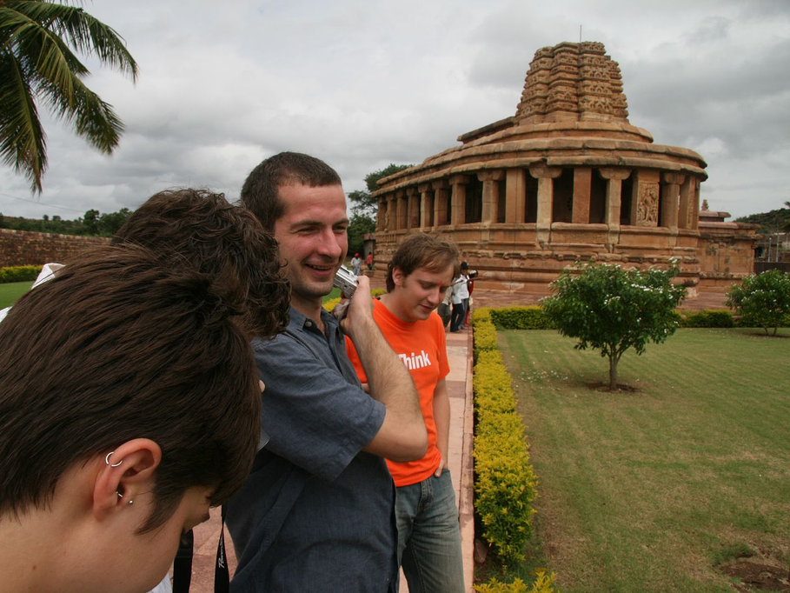

Slide 14
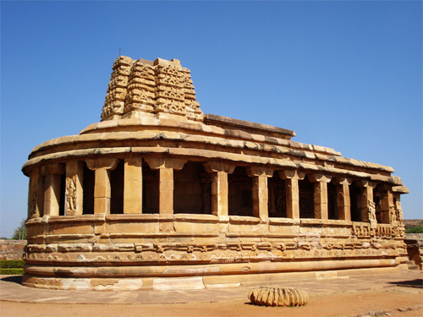

Slide 15
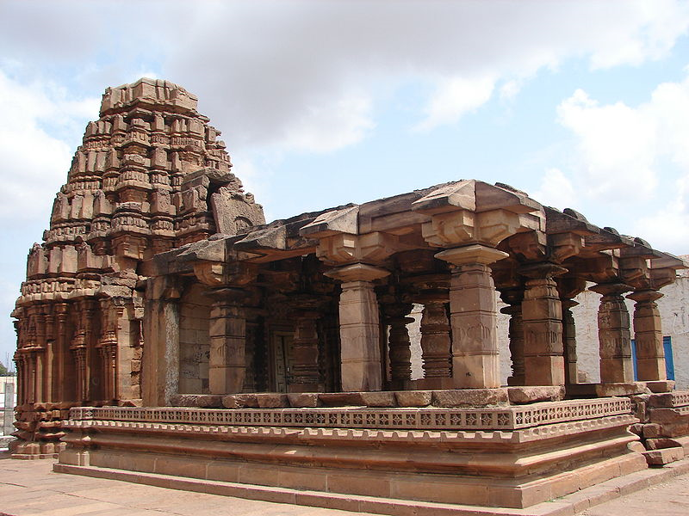
Yellamma temple at Badami, early phase construction, 11th century

Slide 16
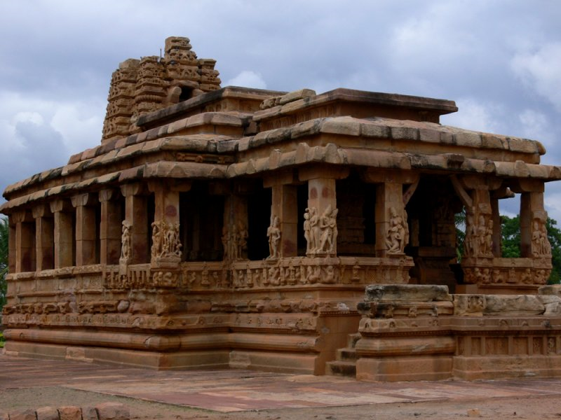

Slide 17
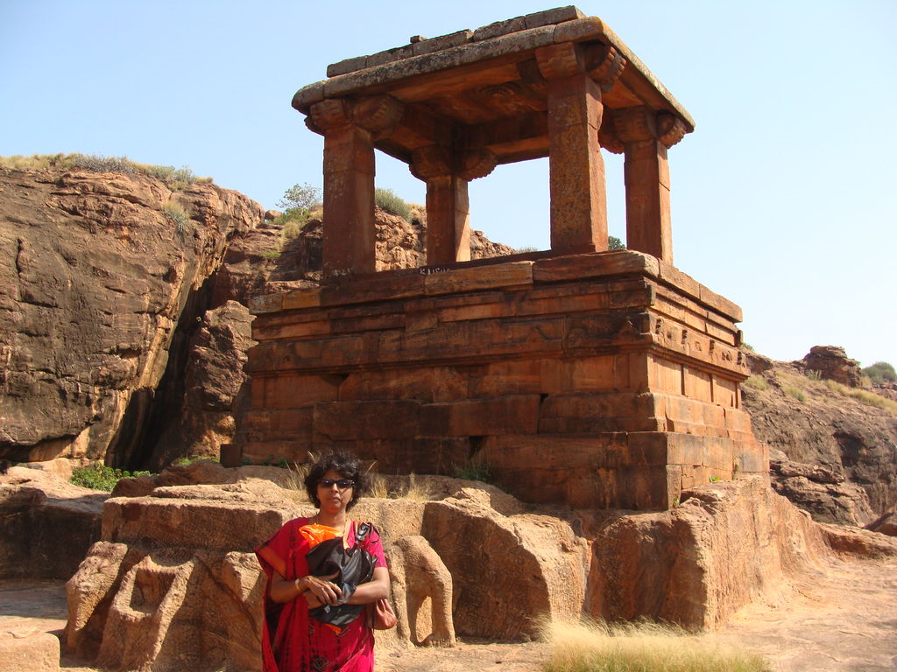

Slide 18
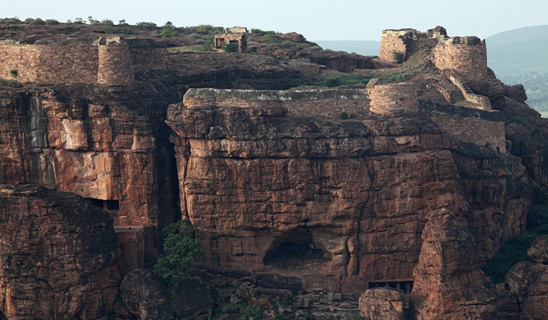

Slide 19
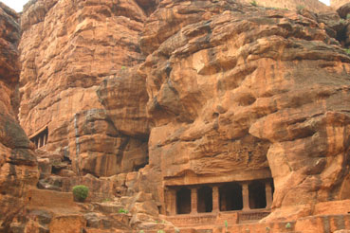
Cave Temple Entrances

Slide 20
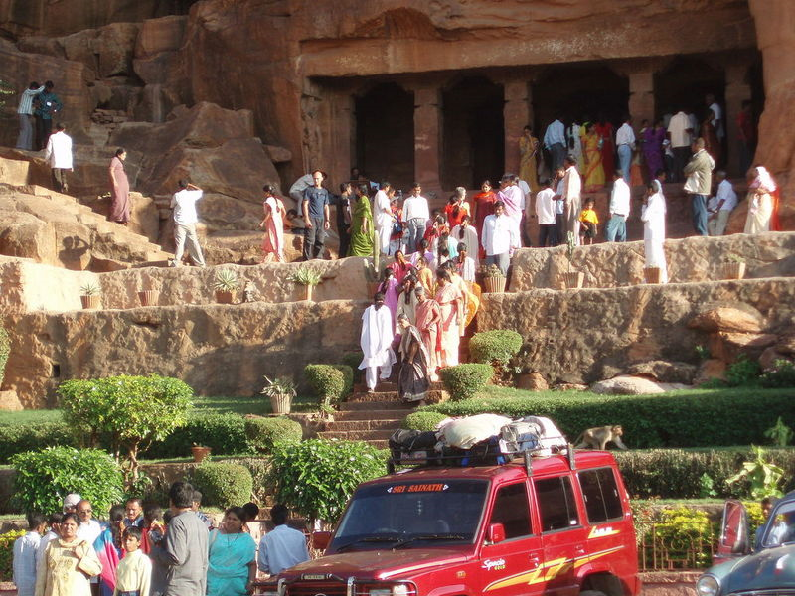

Slide 21
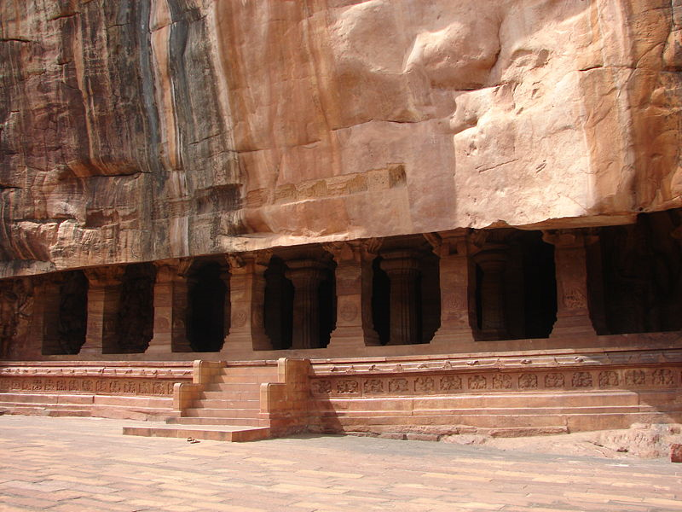
Vaishnava Cave temple No. 3 at Badami, 578 CE

Slide 22
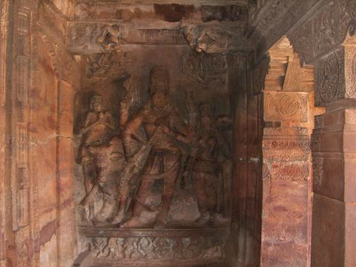
Sanctum sanctorum inside Cave No.1

Slide 23
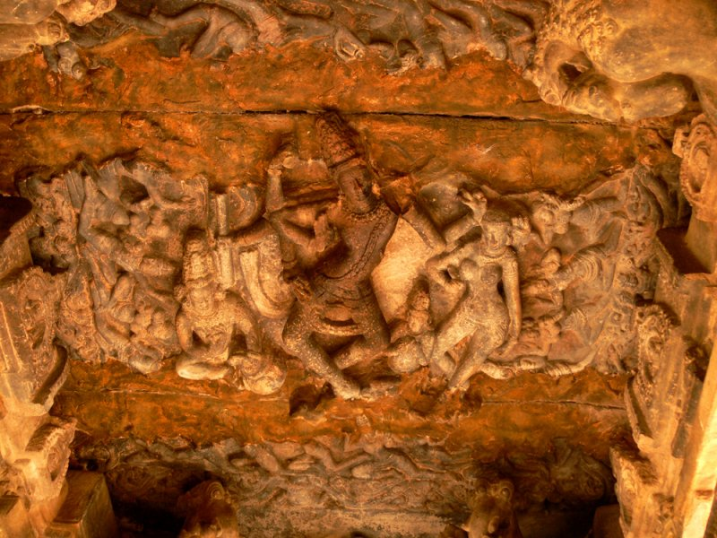
Dancing Shiva

Slide 24
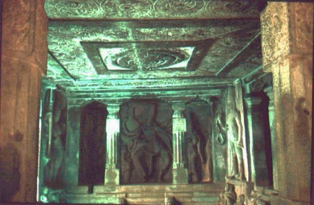
Dancing Shiva

Slide 25
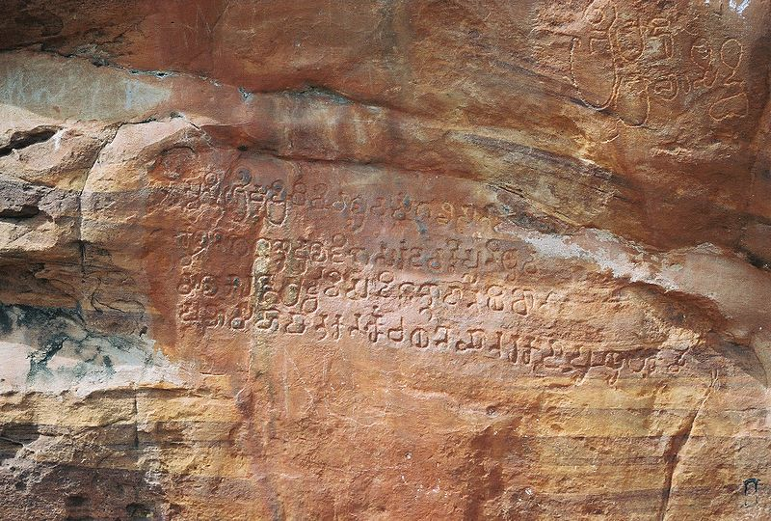
6th century Kannada inscription in cave temple number 3 at Badami

Slide 26
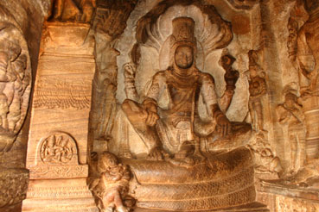
Statue of Vishnu in a Cave Temple

Slide 27
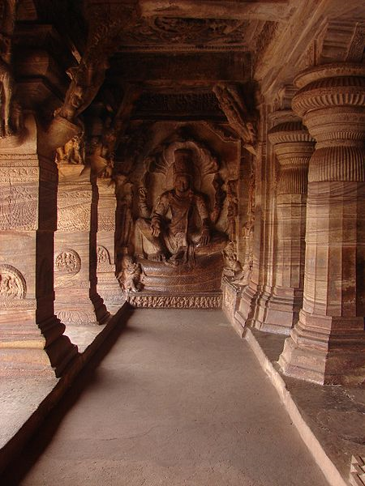
Vishnu in Cave Temple No. 3

Slide 28
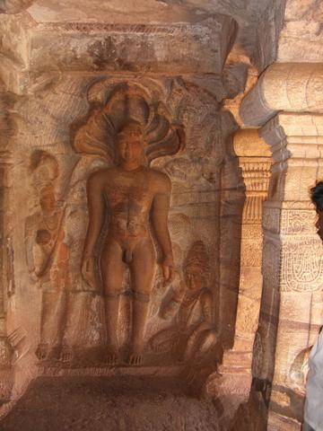
Parshvanath (the earliest Jain leader ) in cave 4

Slide 29
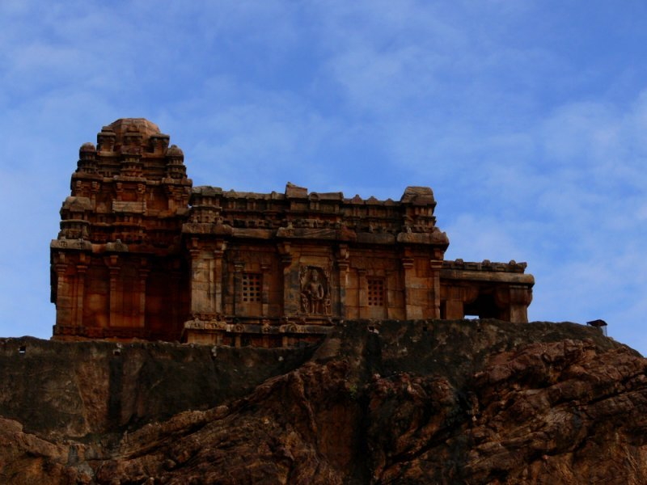

Slide 30
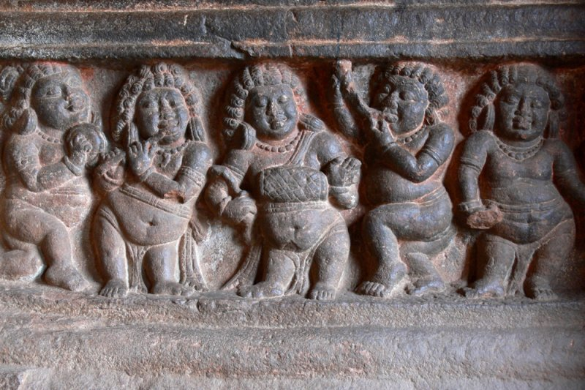

Slide 31
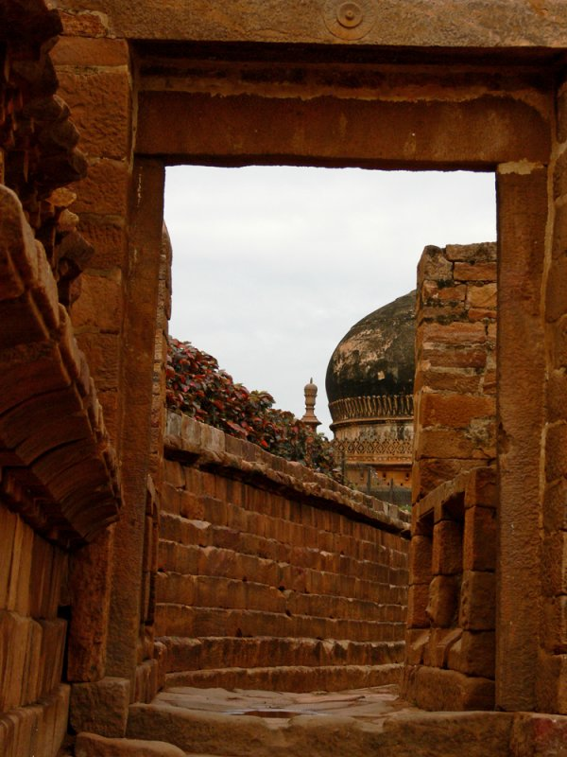

Slide 32
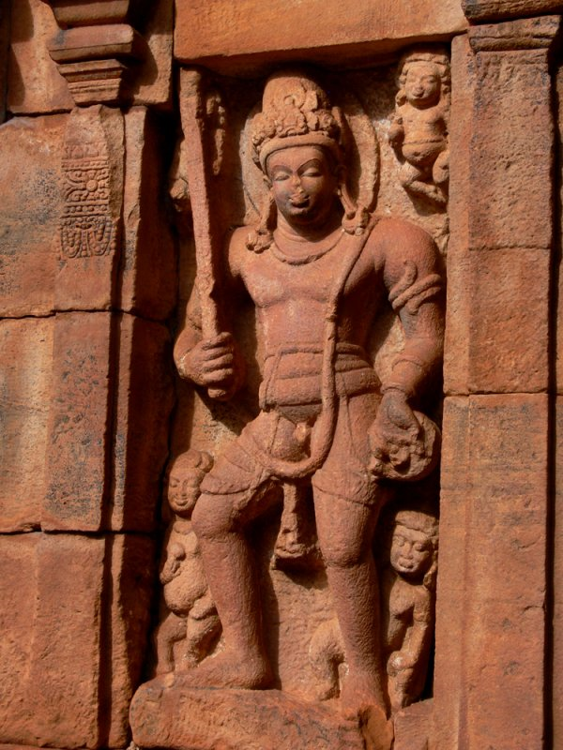

Slide 33
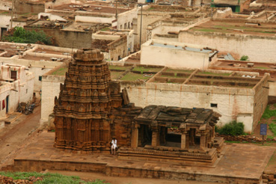
View of the town

Slide 34
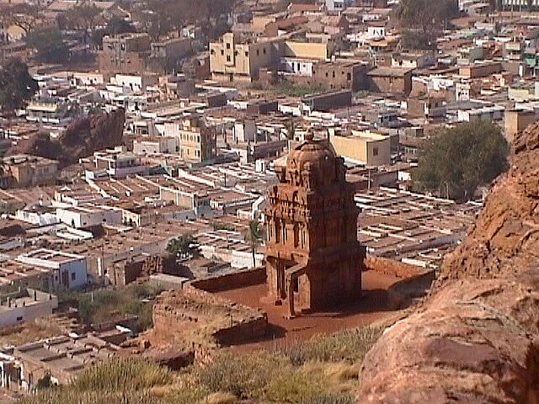
View of the Town

Slide 35
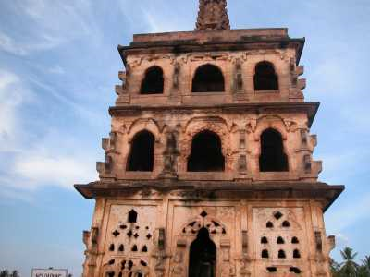

Slide 36
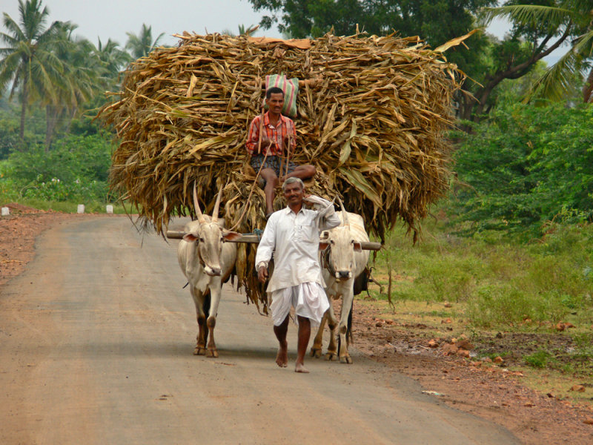

Slide 37
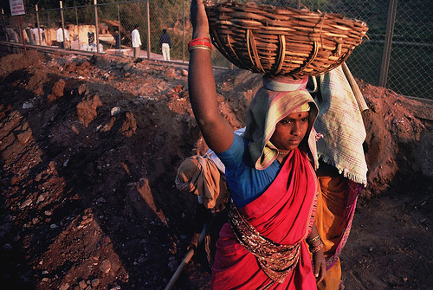

Slide 38


Slide 39
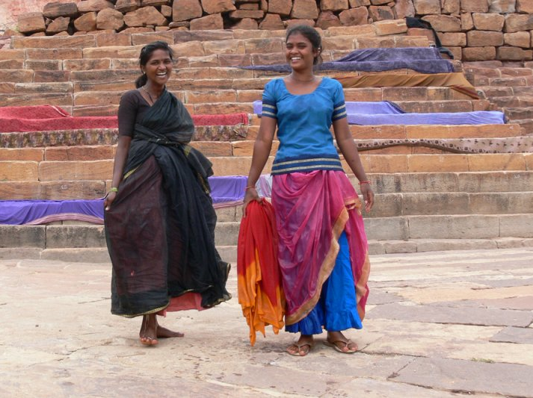

Slide 40
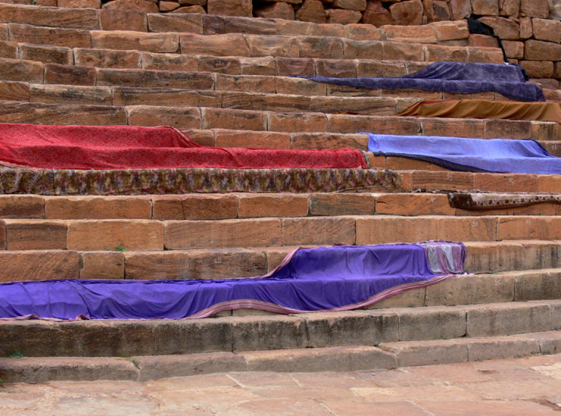

Slide 41
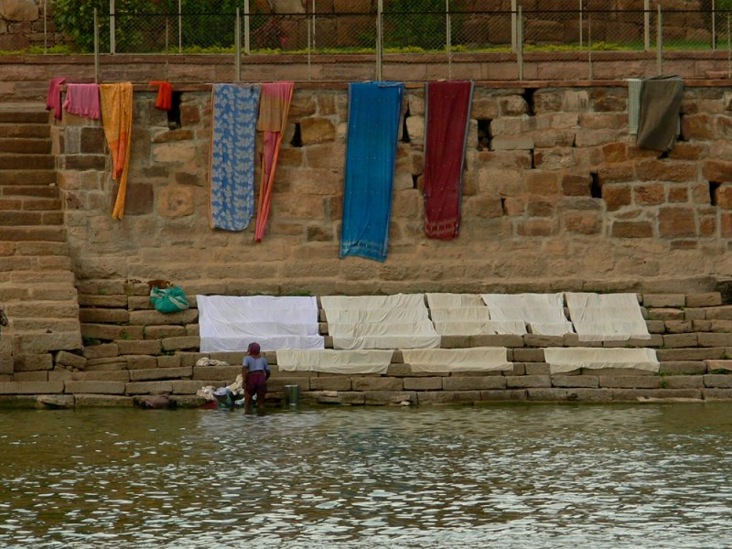

Slide 42
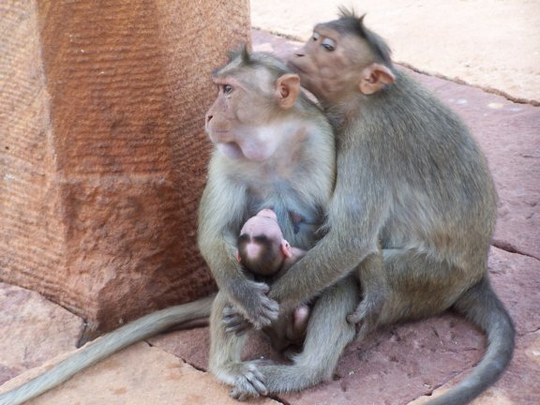
Primate Family

Slide 43
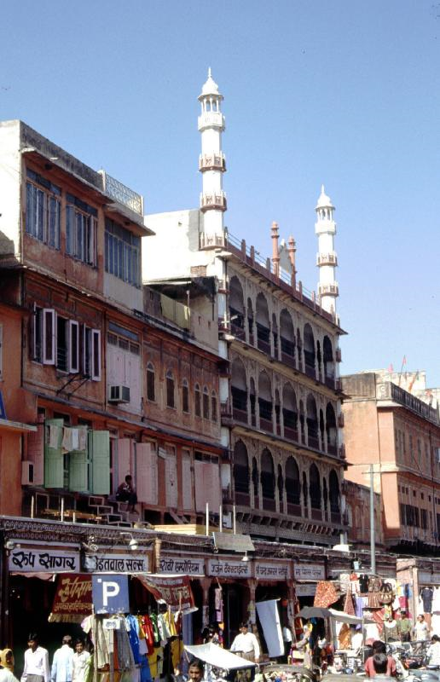
Mosque in Bamai

Slide 44
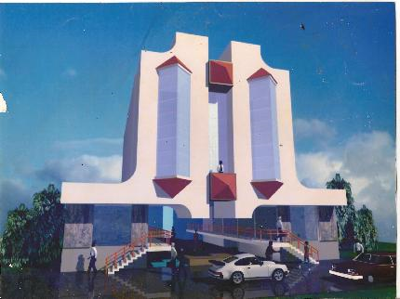
Hotel Rajsangam

