Slide 1
Five ways climate change could affect Africa

Slide 2
Africa is expected to be one of the continents hardest hit by climate change, with an increase in severe droughts, floods and storms expected to threaten the health of populations and economies alike.
Part of that vulnerability is simply down to geography - already the hottest continent, Africa is expected to warm up to 1.5 times faster than the global average, according to the UN's Intergovernmental Panel on Climate Change (IPCC) - the recognised global authority on climate science.

Slide 3
FOCUS ON AFRICA

Slide 4
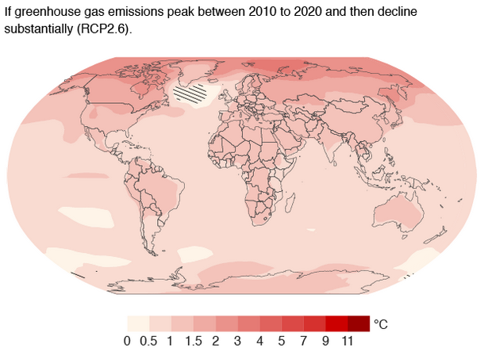

Slide 5
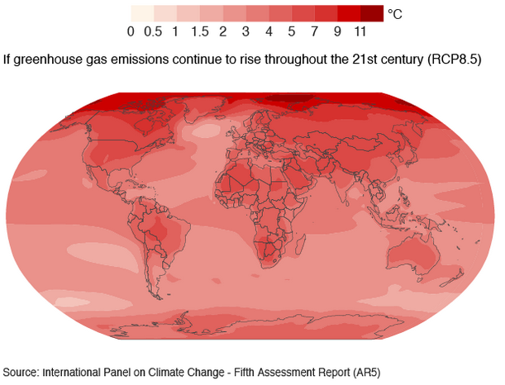

Slide 6
1. Farming will mostly become harder
The IPCC says it has "high confidence" that rising temperatures and unpredictable rains will make it harder for farmers to grow certain key crops like wheat, rice and maize (corn).
For example, it predicts that by 2050, yields for maize in Zimbabwe and South Africa could decrease by more than 30%.

Slide 7
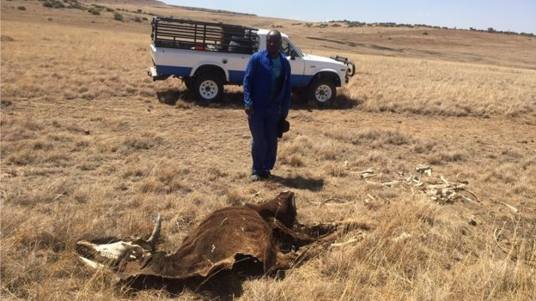
Cattle are already dying from the drought currently ravaging southern Africa

Slide 8
SA grapples with worst drought in 30 years
Namibia on frontline of drought battle
Can Ethiopia cope with worst drought in decades?
One prominent climate scientist has used IPCC data to predict that by 2100, Chad, Niger and Zambia could lose practically their entire farming sector due to climate change.
This scenario is especially worrying when you consider that, according to the World Bank, agriculture employs two in three people in sub-Saharan Africa and accounts for a third of GDP.

Slide 9
2. But there will be some new farming opportunities
When it comes to farming, climate change may take with one hand and give with the other.
So, as it becomes harder to grow maize in southern Africa, it could become easier to grow it in the highland areas of East Africa in countries like Ethiopia, Kenya and Tanzania, though the overall picture for cereal crops in Africa is still a pessimistic one, the latest IPCC report says.

Slide 10
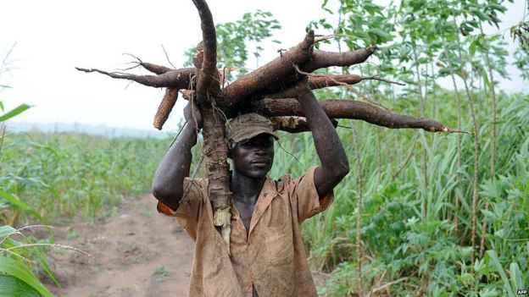
Cassava has been described as the "Rambo of the food crops"

Slide 11
The challenge to agriculture may also force farmers to be more savvy with their choice of crops.
If climate change means it no longer makes sense to grow maize in certain regions, another staple, cassava, a root vegetable which has a "hardiness to higher temperatures and sporadic rainfall" and is already widely consumed on the continent, could provide a viable alternative, it says.

Slide 12
Temperature rises

Slide 13
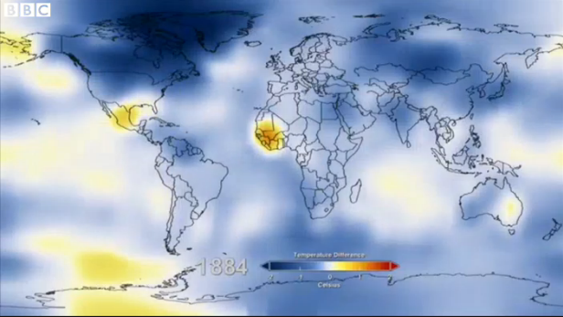

Slide 14
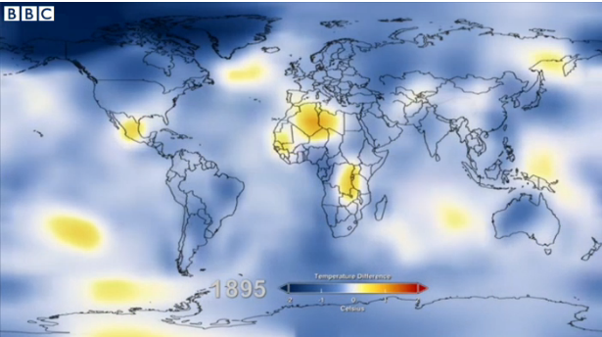

Slide 15
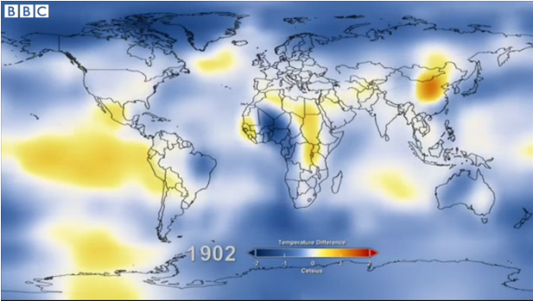

Slide 16
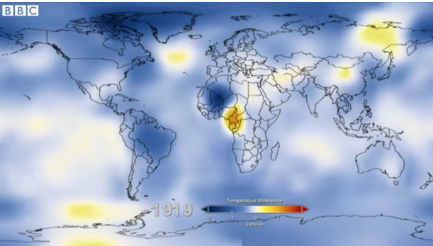

Slide 17
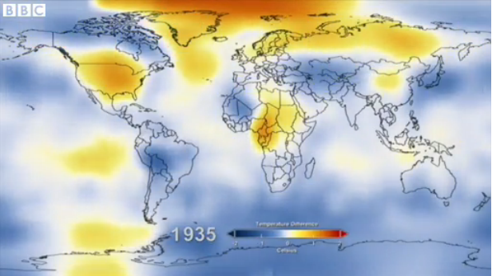

Slide 18
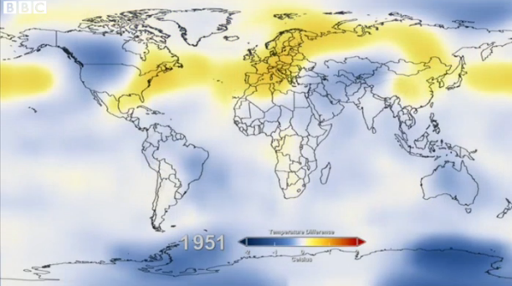

Slide 19
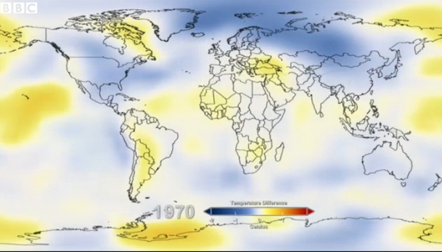

Slide 20
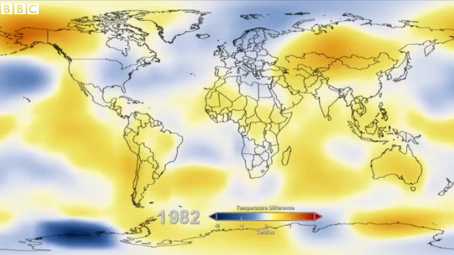

Slide 21
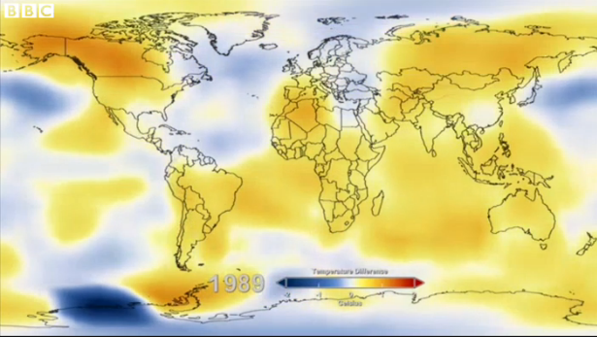

Slide 22
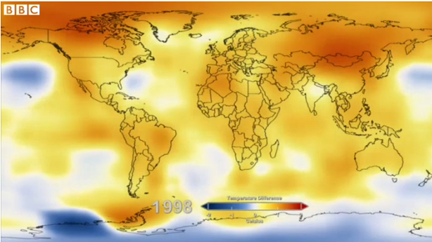

Slide 23
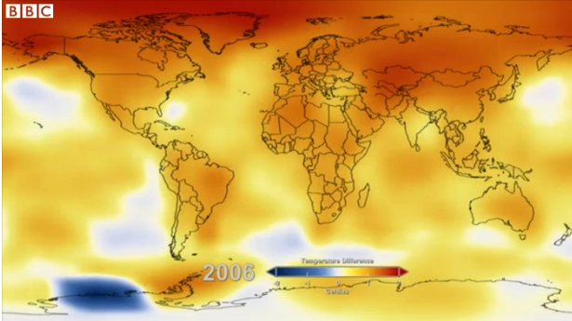

Slide 24
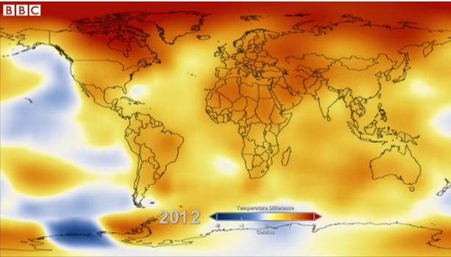

Slide 25
3. Malnutrition
Food insecurity, one of the key threats from climate change, will necessarily have a knock-on impact on people's health.

Slide 26
The IPCC reports that in Mali by 2025, 250,000 children are expected to suffer stunting, or chronic malnutrition, and that "climate change will cause a statistically significant proportion" of these cases.
Although the rate of under-nourishment in sub-Saharan Africa is coming down (it now stands at just under 1 in 4 people), the overall numbers have increased because of the rapid birth rate in recent decades.
By 2050, the population of sub-Saharan Africa is expected to more than double to 1.9 billion. That means even more mouths to feed at a time when the agricultural sector could well be struggling.

Slide 27
4. Malaria
The IPCC admits that "the complexity of disease transmission" makes it incredibly difficult to say which diseases may become more or less prevalent as a result of climate change.
But it does offer one confident prediction for the highland areas of East Africa, which are among the most densely populated on the continent.
According to the reports' authors, it is not only maize crops which are likely to benefit from the warmer temperatures, but malarial mosquitoes, causing increased epidemics of Africa's biggest killer, and introducing the disease to altitudes above 2,000 metres, which have so far been considered out of harm's way.

Slide 28
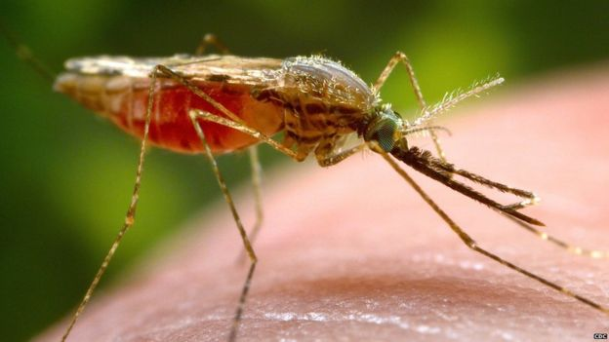
More than half a million people in Africa are estimated to have died from malaria in 2013
This new threat looms even though Africa has managed to reduce its malaria mortality rate by more than a third since the turn of the century.

Slide 29
5. Water shortages
One of the biggest threats facing the continent is also one of the hardest for scientists to definitively pin on climate change.
Water scarcity is driven by so many other factors, such as population growth, rapid urbanisation and changes to the way land is being used, that it has not yet been possible to figure out exactly how climate change will add to the mix.
Added to this, many African countries are already under high levels of "water stress", and 95% of farmed land in sub-Saharan Africa is estimated to be rain-fed.

Slide 30
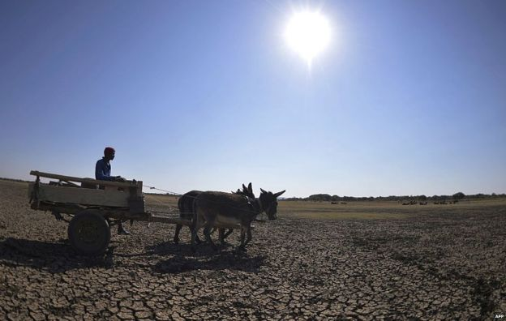
The worst drought in 30 years has left one in three people in Botswana without enough water

Slide 31
"Water is life - with no water, Africa will be a dead continent," Opha Pauline Dube, Associate Professor at the University of Botswana and review author of the latest IPCC Africa report, told the BBC.
"Further water scarcity will negatively affect food production, trigger several diseases and worsen energy shortages which are already constraining development in many African countries," she adds.
Unreliable rainfall in the future will also play a big part in any crisis over water resources, but frustratingly again for scientists, it is much harder to make confident predictions about rain than it is about temperature.
The IPCC has predicted that rainfall is expected to decrease in northern Africa and parts of southern Africa.
Despite this uncertainty, three contributing authors to the Africa report told the BBC that changes in rainfall were the single impact of climate change on the continent which they were most worried about.
Africa will need to act to reduce man-made climate change as well as putting in place strategies to deal with those which cannot be avoided, but it is not going to be cheap.

Slide 32
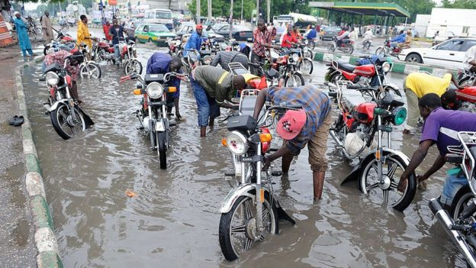
Flooding may become more frequent and severe as a result of climate change

Slide 33
The continent will need $20-30bn every year for the next two decades, according to the African Development Bank (AfDB), and African negotiators will be looking to developed nations in Paris to make firm financial commitments as well as agreeing to curb emissions.
In the words of AfDB president Akinwumi Adesina last week at the summit in Paris:
"Africa has been short-changed by climate change. Africa must not be short-changed by climate finance."

