Slide 1
Colorado under a heavy blanket of spring snow -- 40 inches in some spots 4/17/2016

Slide 2


Slide 3
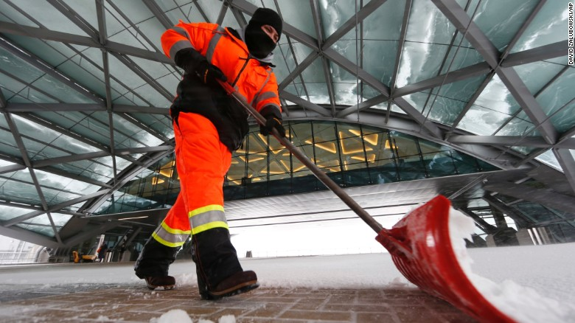

Slide 4

Naptime – A stranded traveler sleeps in the main terminal at Denver International Airport on April 16.

Slide 5
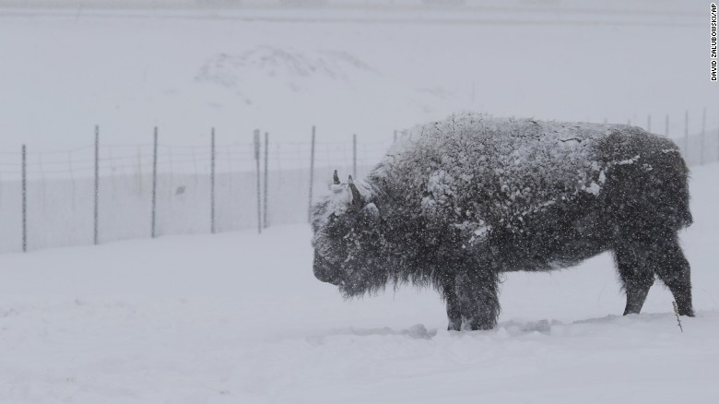

Slide 6
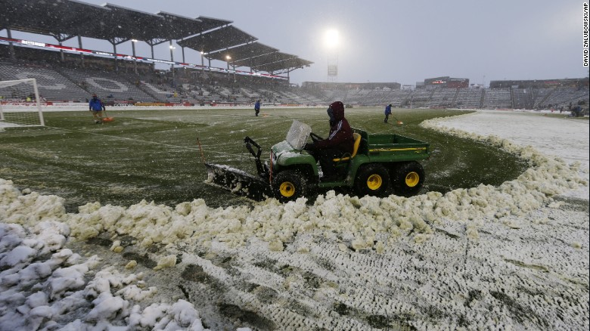
Maintenance workers use tractors to plow the pitch before the Colorado Rapids were to host the New York Red Bulls in an MLS soccer match on April 16 in Commerce City, Colorado.

Slide 7
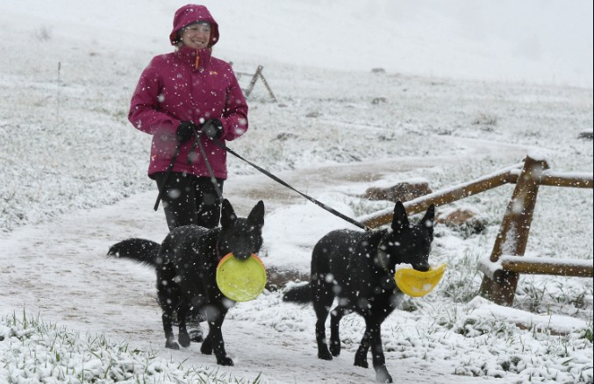

Slide 8
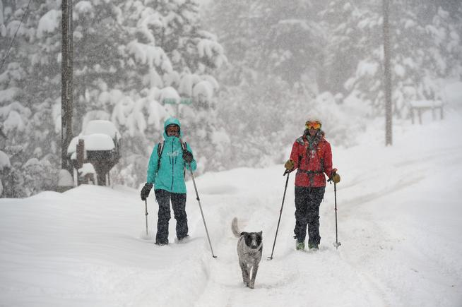

Slide 9
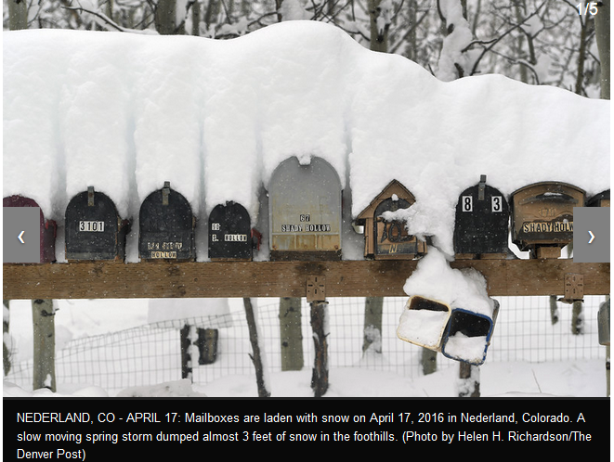

Slide 10
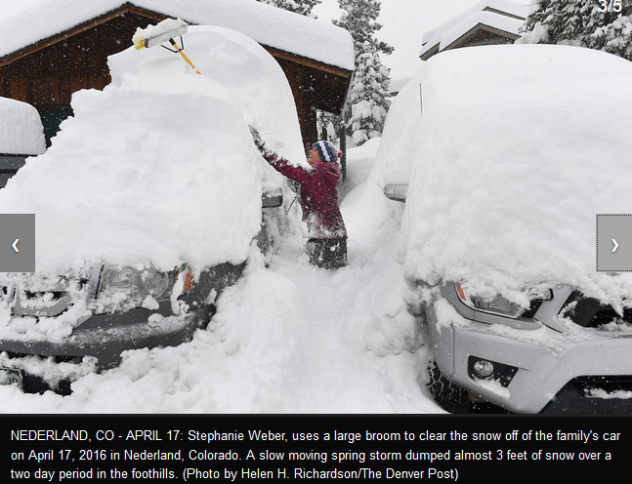

Slide 11
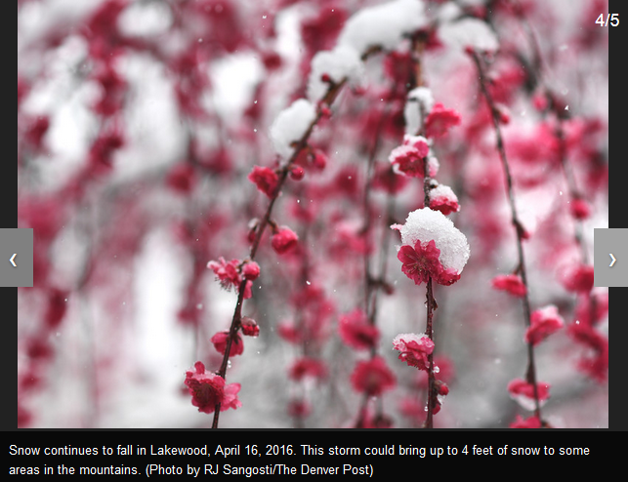

Slide 12
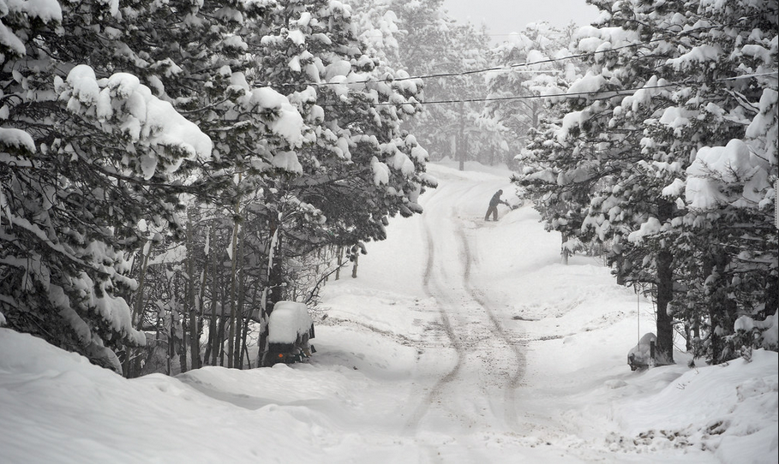

Slide 13
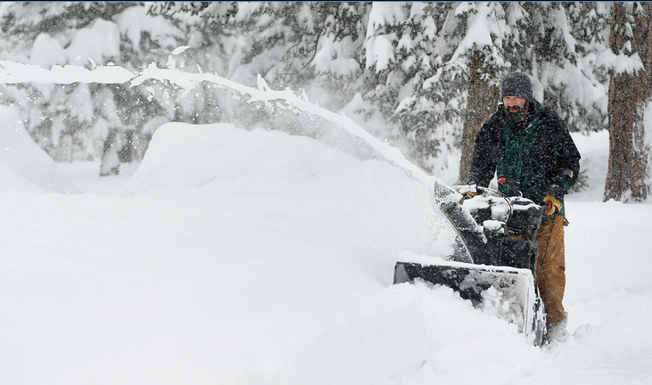

Slide 14
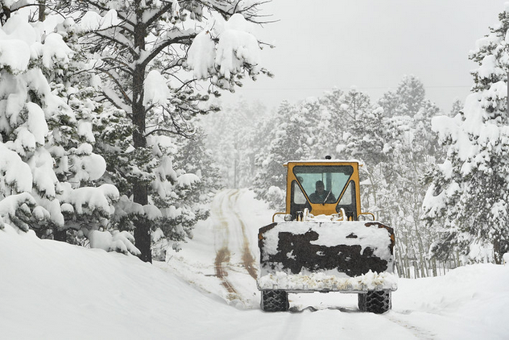

Slide 15
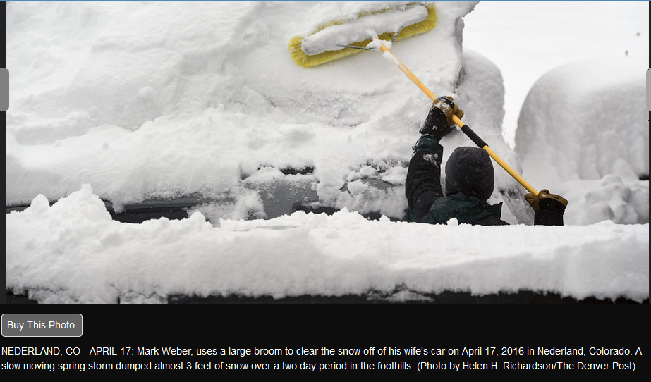

Slide 16


Slide 17


Slide 18
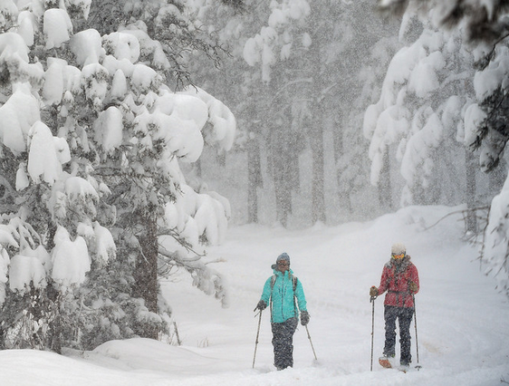

Slide 19
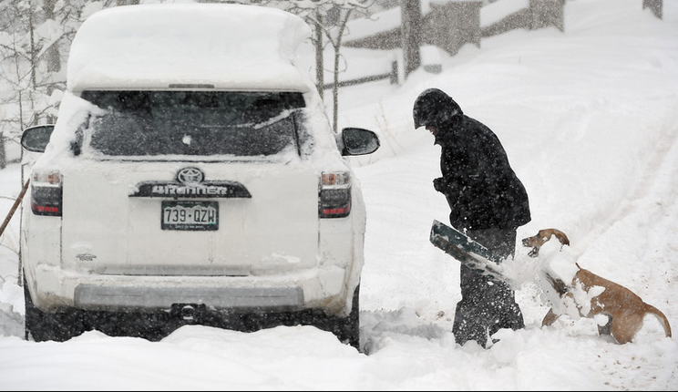

Slide 20


