Slide 1
Giant holes are bursting open in Siberia, and you can hear the explosions from 60 miles away
From Tech Insider

Slide 2
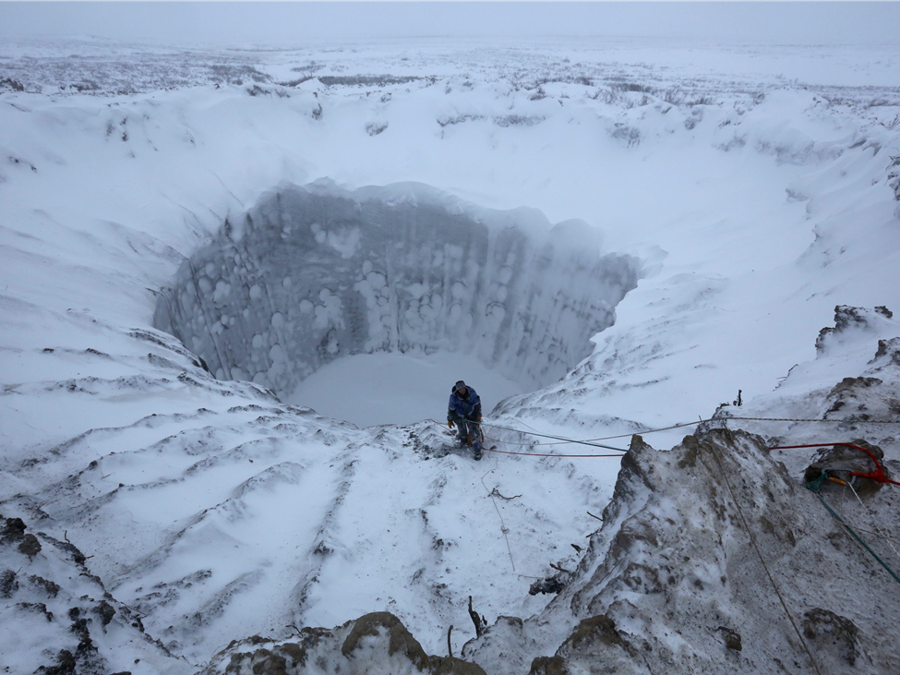
Scientists may have discovered what caused these mysterious giant holes in Siberia

Slide 3
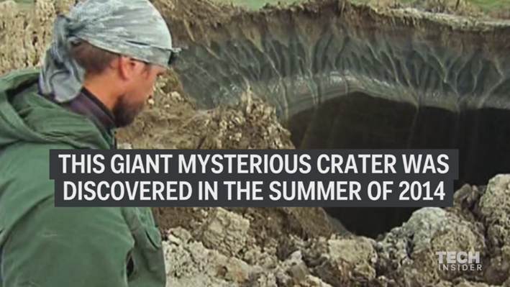

Slide 4
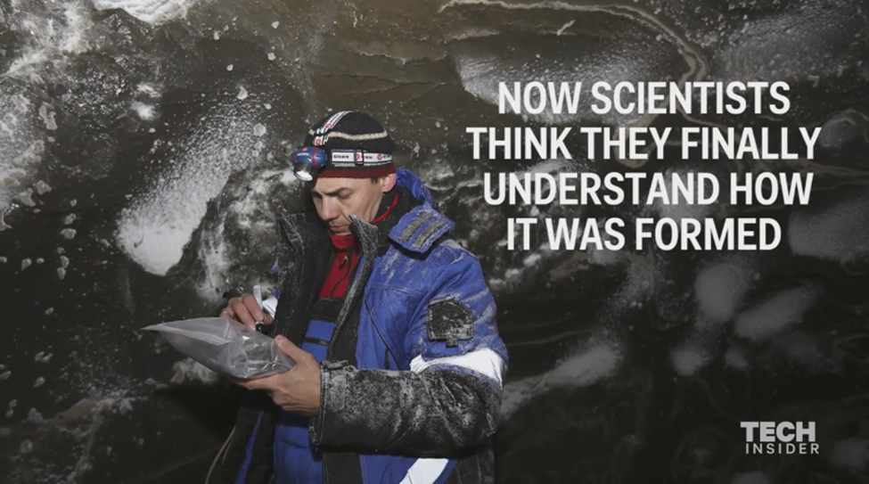

Slide 5
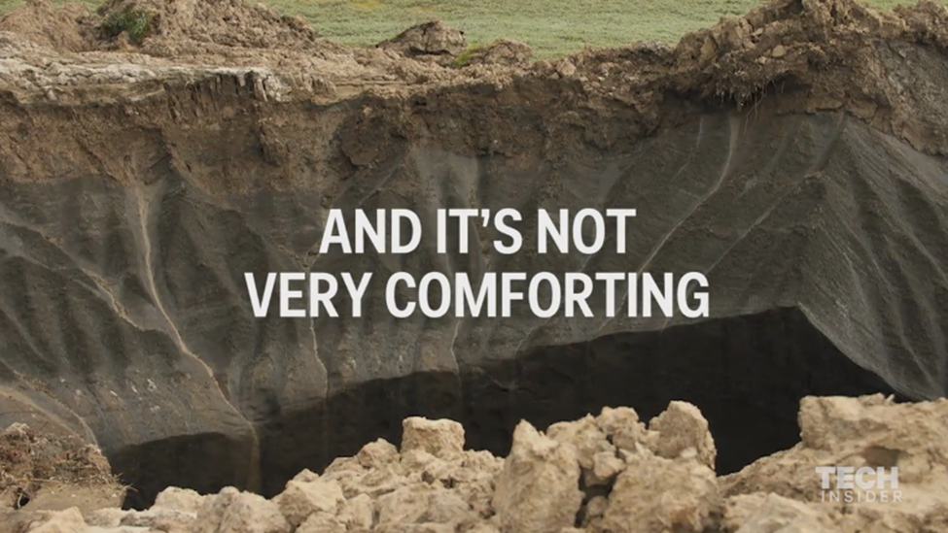

Slide 6
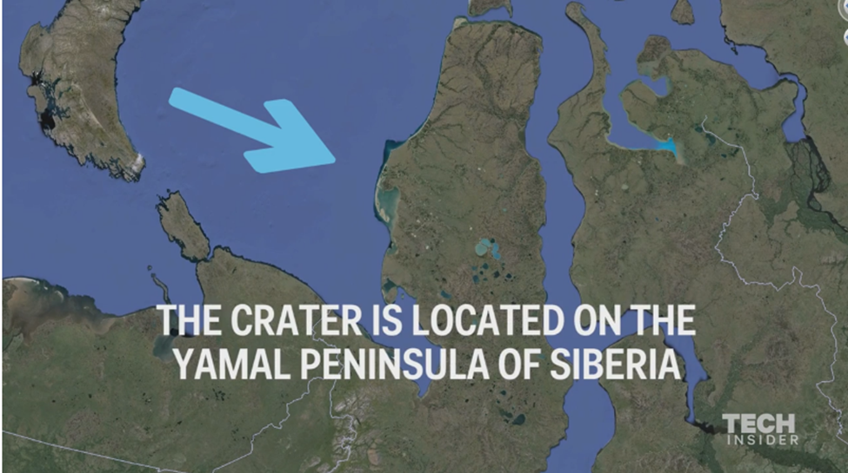

Slide 7
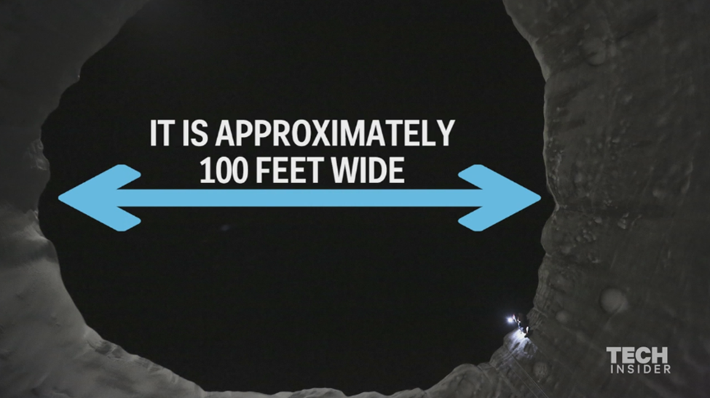

Slide 8
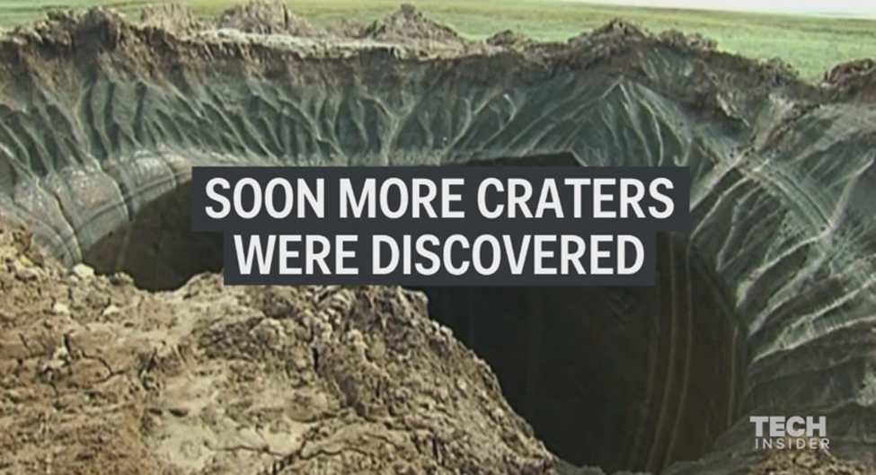

Slide 9
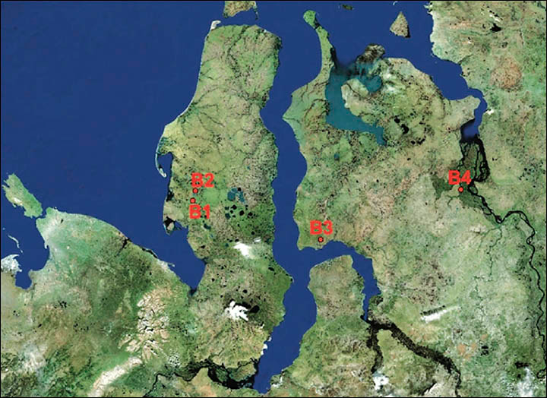

Slide 10
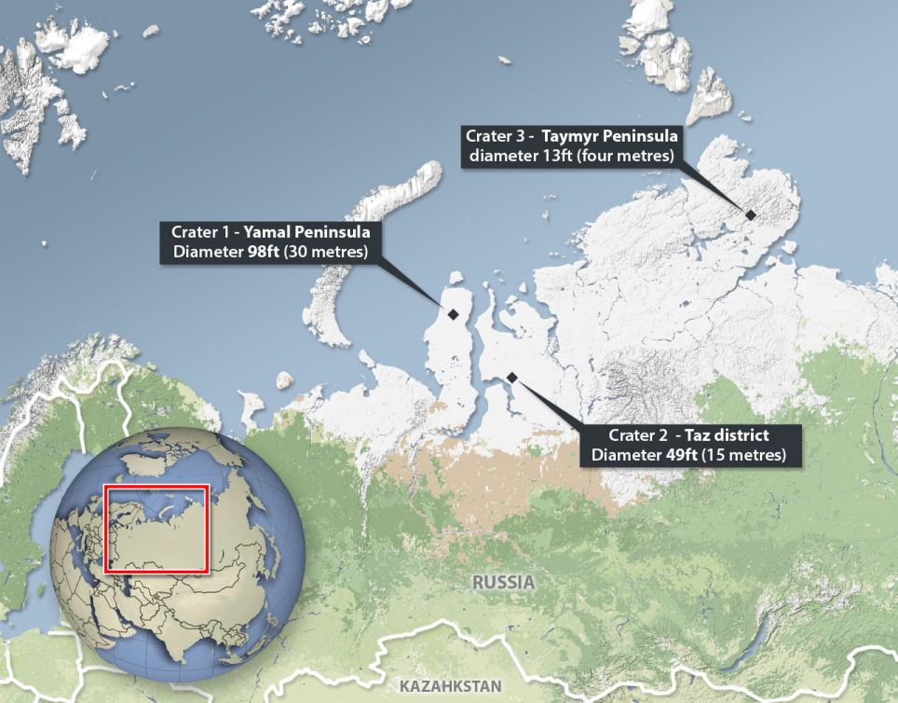

Slide 11
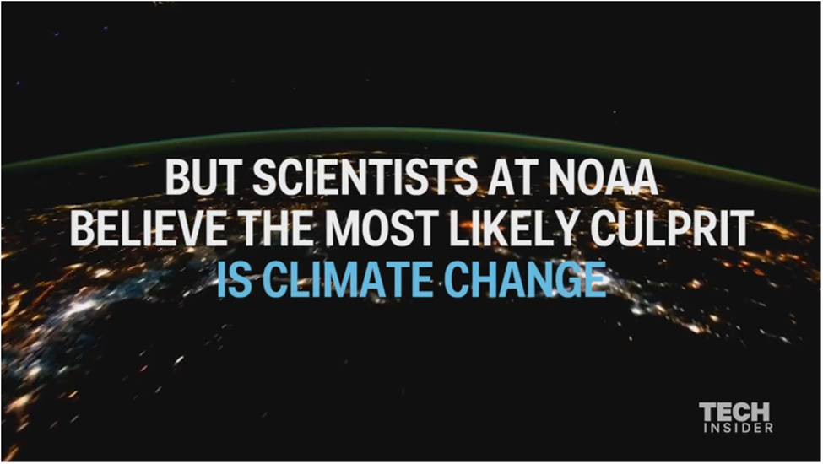

Slide 12
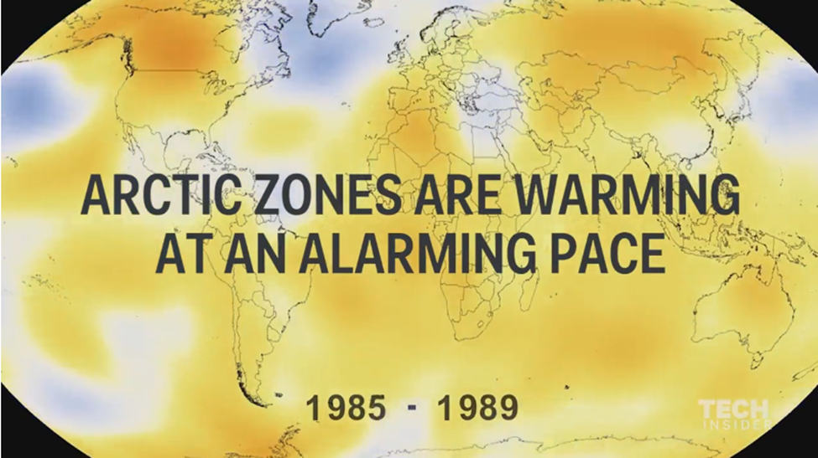

Slide 13
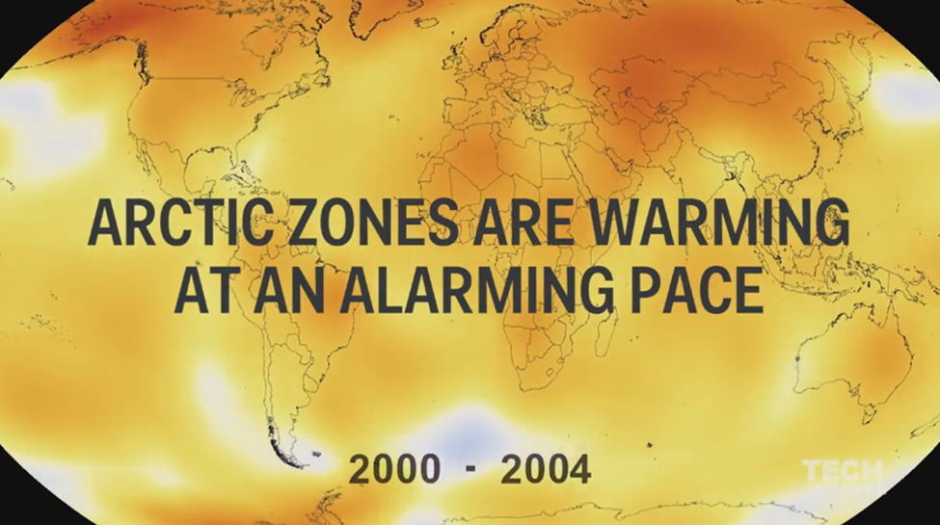

Slide 14
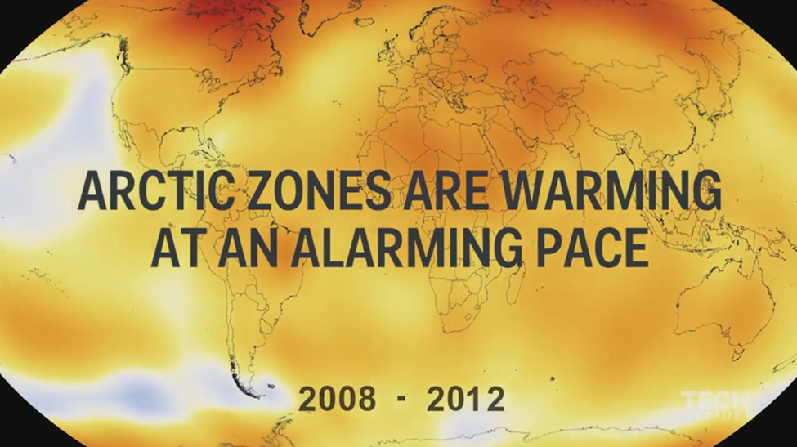

Slide 15
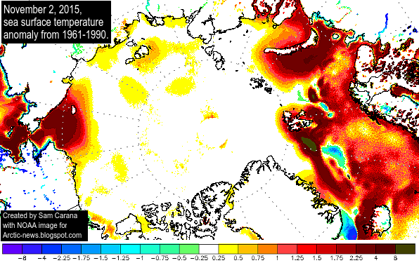

Slide 16
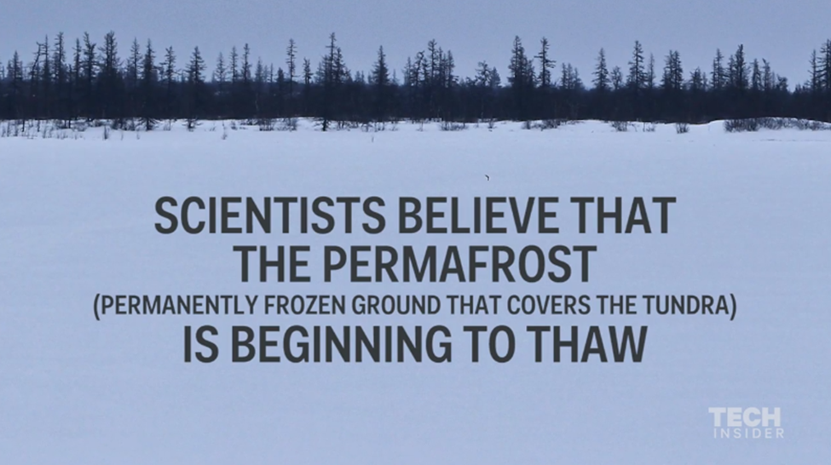

Slide 17
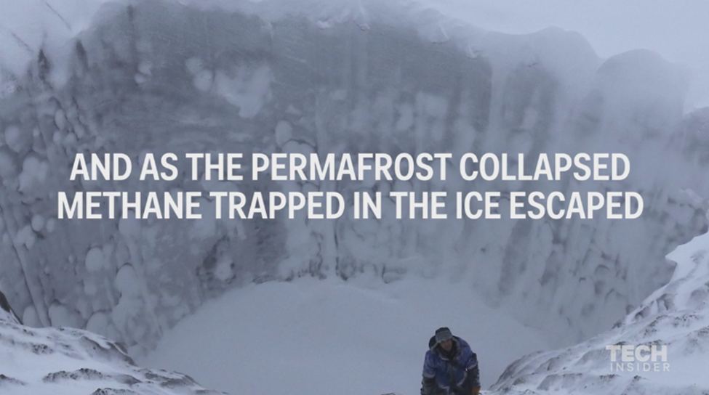

Slide 18
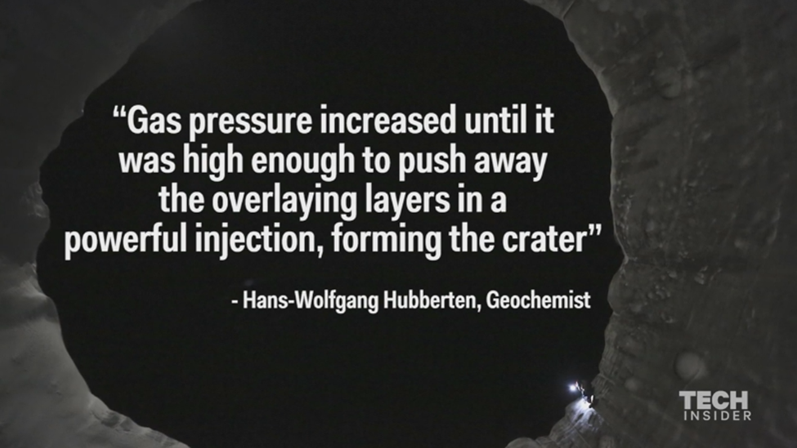

Slide 19
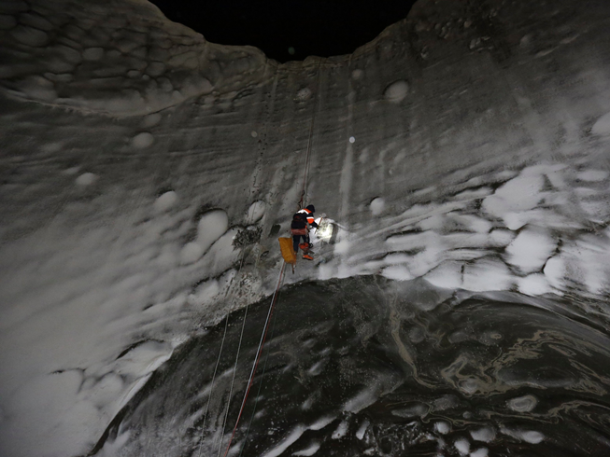
climber scales down a permafrost crater.

Slide 20
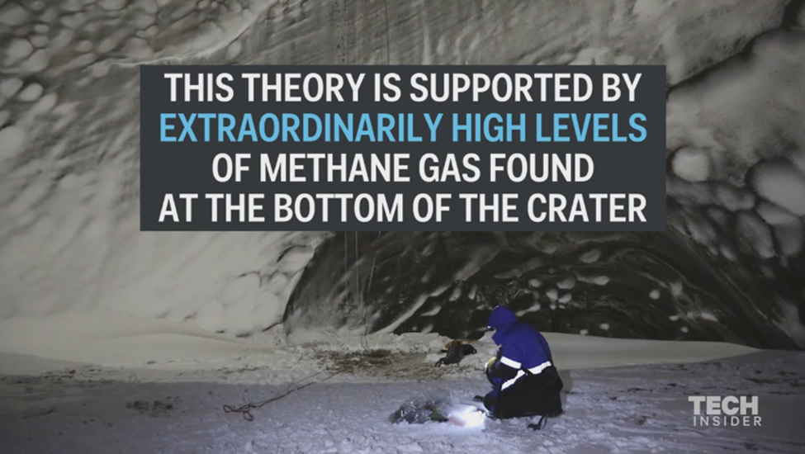

Slide 21
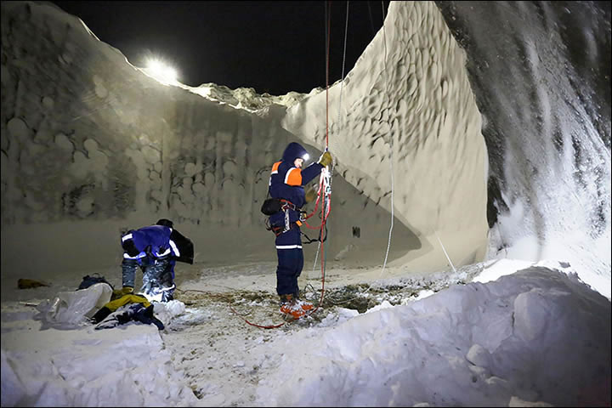

Slide 22
It's not just explosions and melting permafrost we should worry about, either. The EPA states that methane is a greenhouse gas that could have 25 times the impact of carbon dioxide over the next century. A significant addition to methane emissions would likely have a disastrous impact on our already troubling atmospheric warming, since it's 21 times better at trapping heat, according to Live Science

Slide 23
If the explosion theory is correct . . .
One of the craters is just 6 miles from a natural gas field. The Siberian Times reported the combination of the two flammable materials in such close proximity is a huge safety concern for the area. (At least two of the craters have since turned into lakes.)

Slide 24
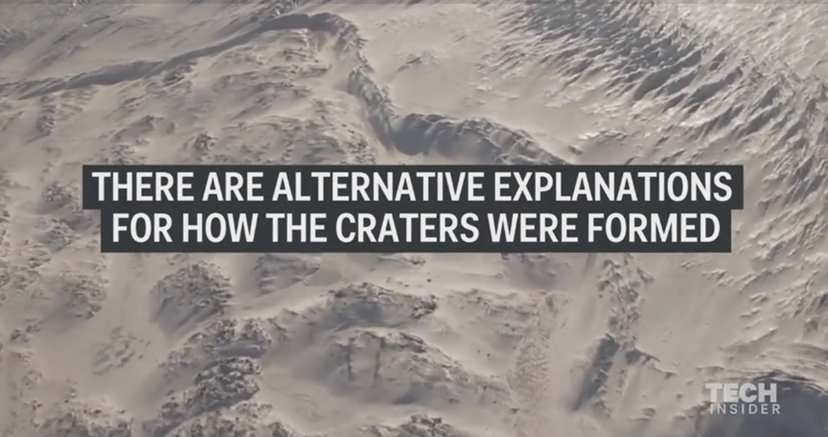

Slide 25
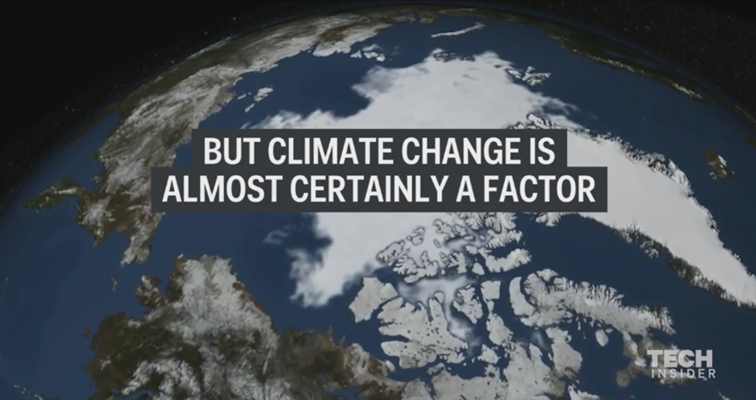

Slide 26
There may be an alternate explanation, though. Land can collapse without a burst of methane in something called a pingo, which form when ice is trapped between layers of earth and distorts the top layer into a sort of mound. Thawing can make those mounds suddenly collapse. Even if the craters are the result of collapsing pingos, they're still likely the result of climate change (and still dangerous).

Slide 27
Pingo or exploding crater, it's clear that climate change is impacting the Arctic more rapidly than any other place on Earth, but researchers are only beginning to grasp how unprecedented warming will effect northern ecosystems.

Slide 28
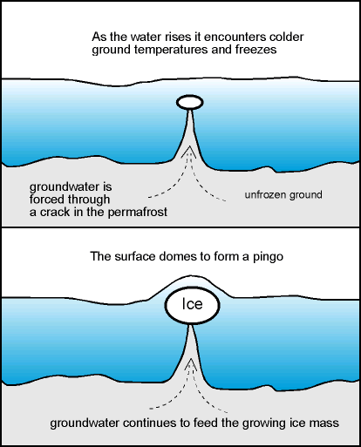
How a pingo forms

Slide 29
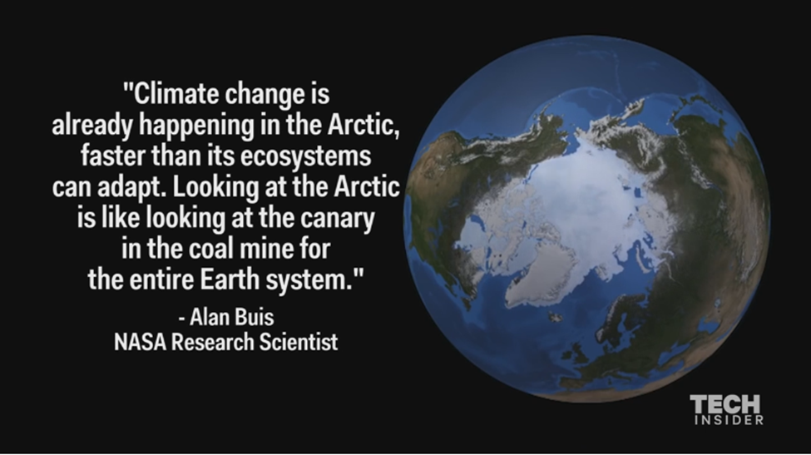

Slide 30
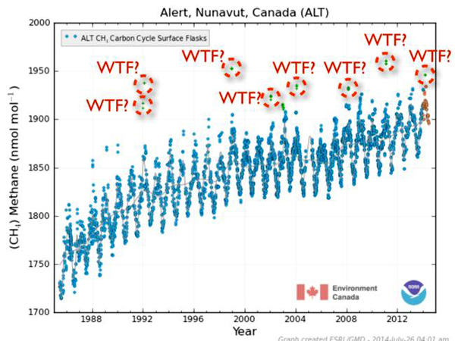
And so I (Joe Naumann) ask – shouldn’t this be happening in northern Canada and Alaska too?
Methane spikes recorded in Canada

