Slide 1
Facts About Lake Mead and the Long Drought

Slide 2
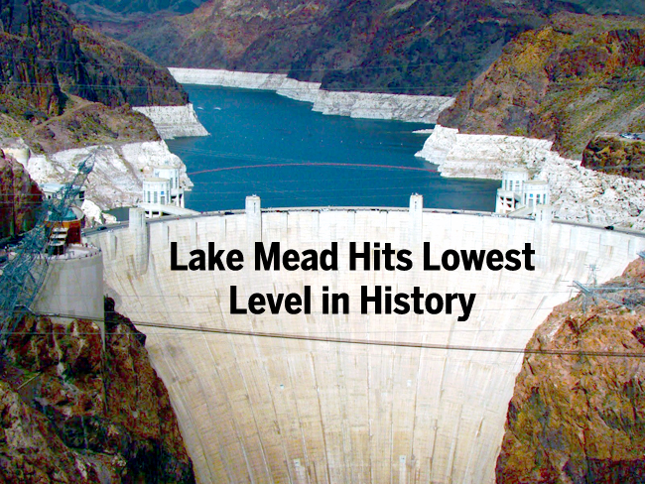

Slide 3
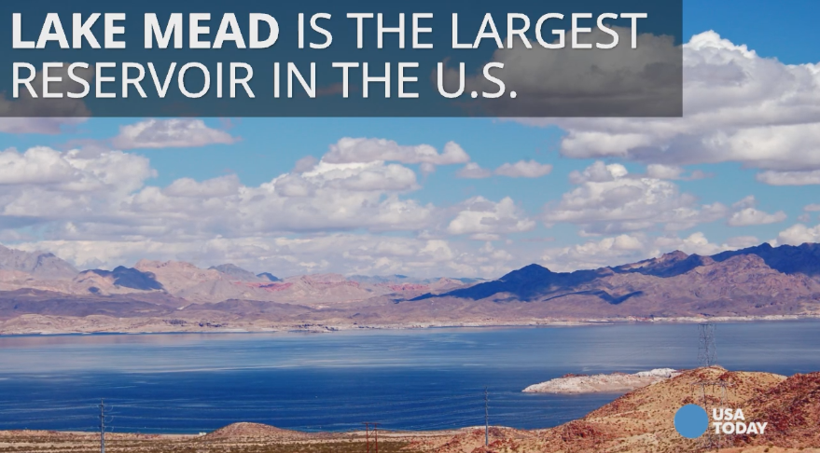

Slide 4
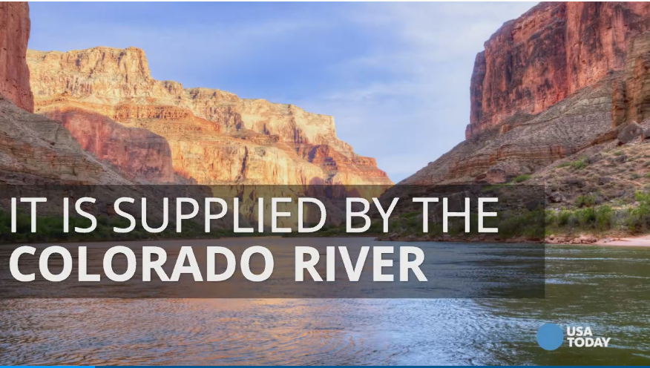

Slide 5
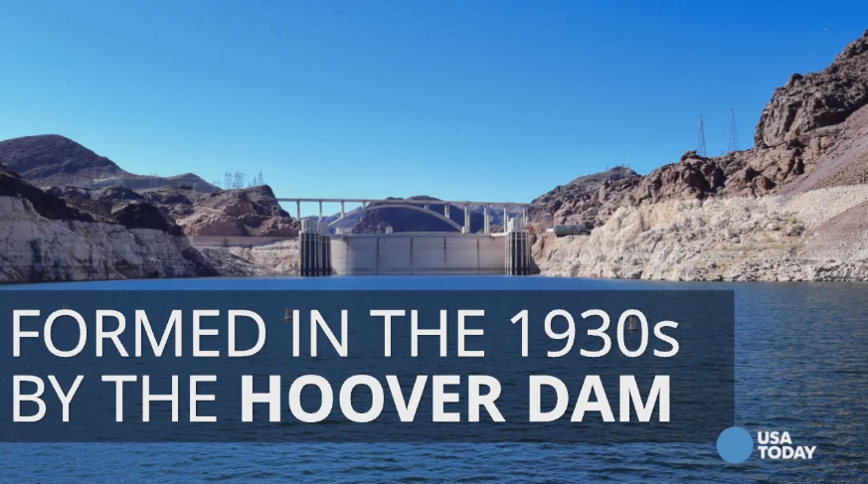

Slide 6
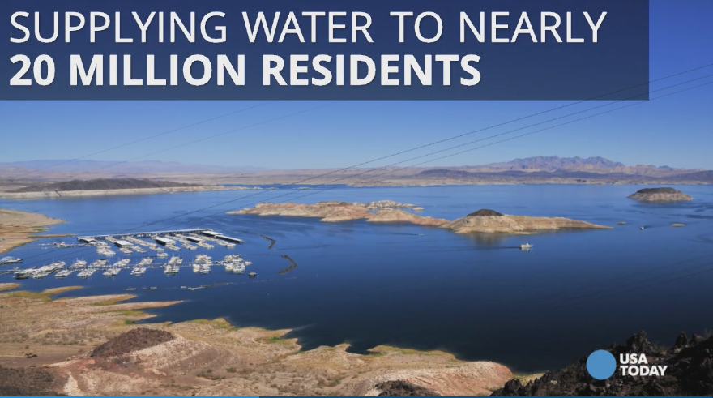

Slide 7
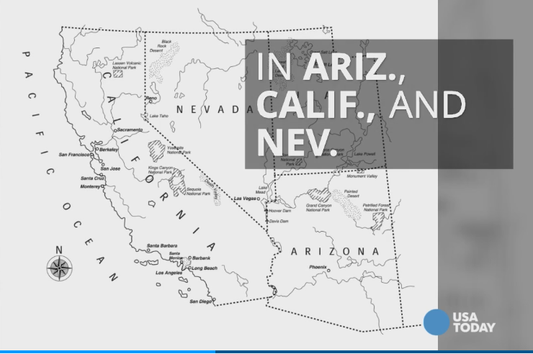

Slide 8
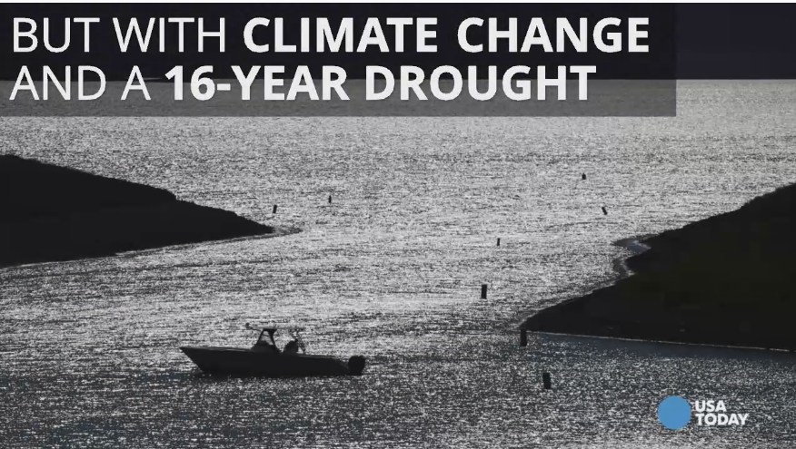

Slide 9
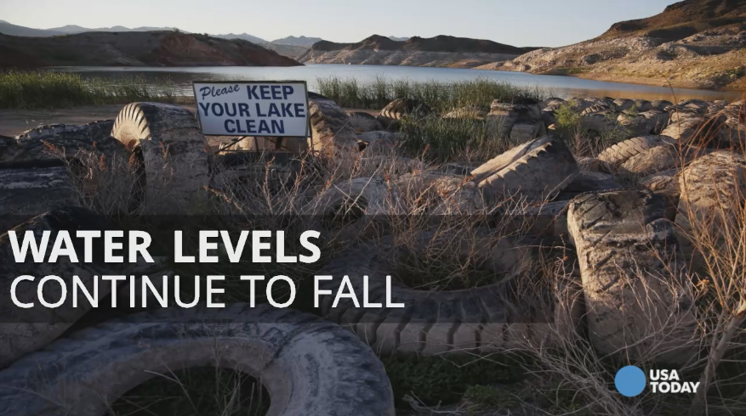

Slide 10
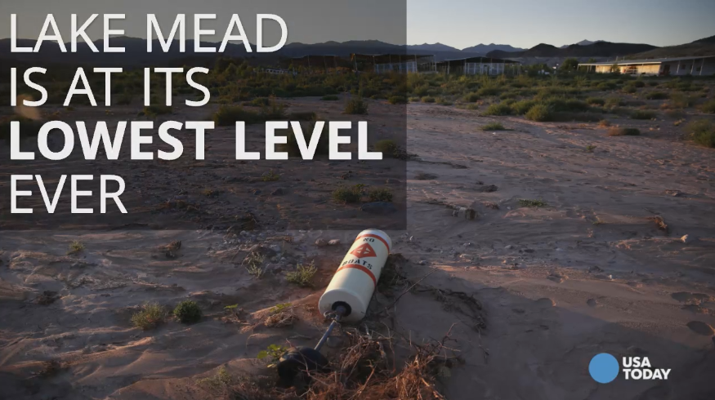

Slide 11
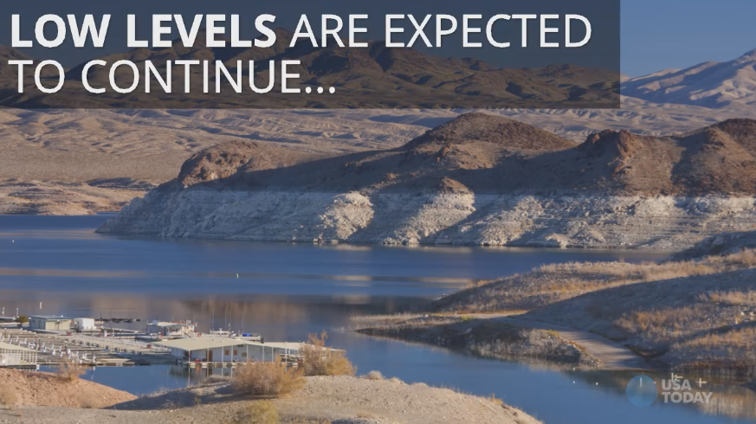

Slide 12
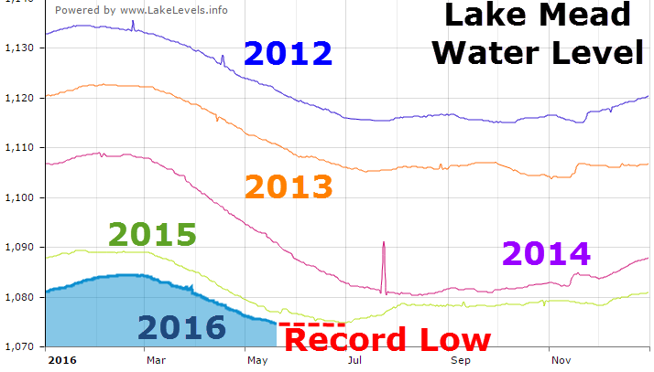

Slide 13
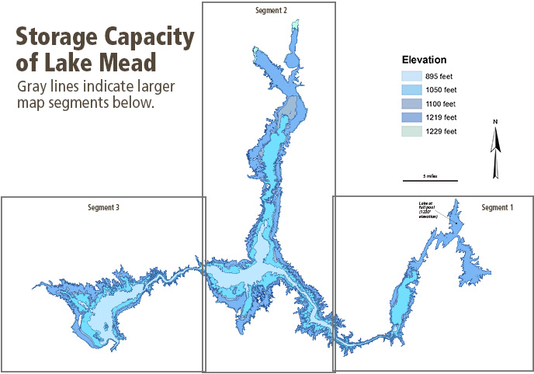

Slide 14
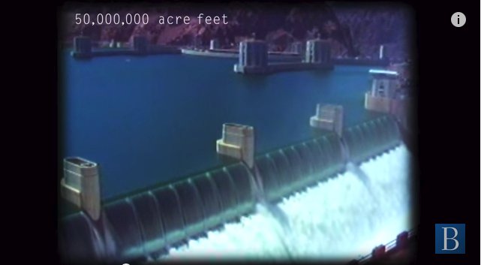
At full volume, Lake Mead and Lake Powell had 50 million acres feet of water in storage at a height of 1220 feet above sea level.
This image shows the Hoover Dam at full capacity in 1983.

Slide 15
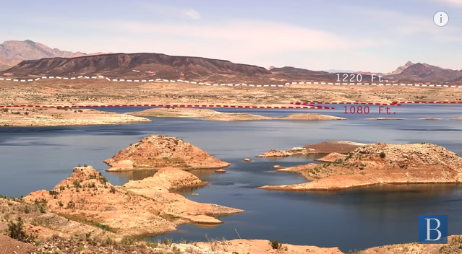
Now Lake Mead is at record low levels and getting lower, causing consequences for the entire region.
140 feet below the full level
This week, the water level dropped below 1080 feet and the National Weather Service predicts it will drop further this summer. She argues that Lake Mead and Lake Powell “going down to quarter capacity is a pretty scary proposition.

Slide 16
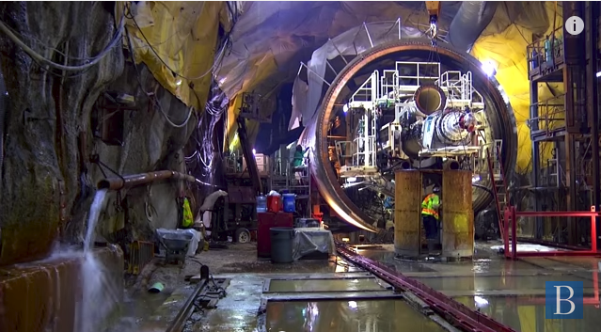
The Southern Nevada Water Authority built an underground tunnel to prepare for this scenario.
“We built this huge tunnel underneath Lake Mead so we can access even the last drop should the worst of all possible scenarios happen,”

Slide 17
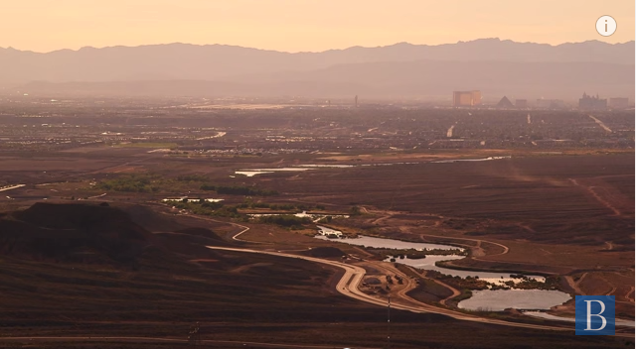
They took measures to prevent water use in residential areas and made changes to water usage in Las Vegas.
they “began to implement a whole series of measures aimed at driving down residential use. [They] banned grass in the front yards, [they] put in water waste ordinances, [they] put the community on a watering schedule,

Slide 18
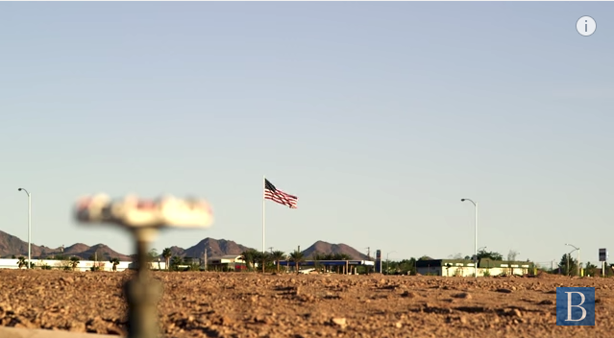
Investing in infrastructure can lessen the consequences, but we need to first identify ourselves as citizens of the watershed.

Slide 19
Mulroy, who served as general manager of the Southern Nevada Water Authority (SNWA), believes that “water is a basic human right because you need it in order to live. But what you don’t have a basic human right to is that that water is pumped from great depths in Lake Mead, treated to a very safe standard, and then pumped 2500 feet to your front door to where all you have to do is turn on the tap. That infrastructure costs money.” However, Mulroy argues that “we need to identify ourselves as citizens of the watershed,” and argues that “if you want it treated and delivered at your house on a guaranteed 24/7 basis, then you have an obligation to help defray those infrastructure and operating costs.”

Slide 20
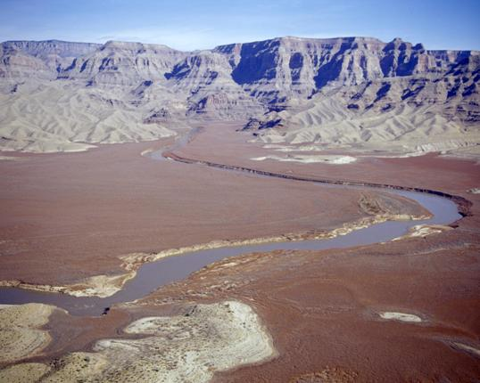
Aerial view of the (historic) easternmost end of Lake Mead
If Lake Mead were full, the brown and light grey areas would be under water

Slide 21
Receding Lake Mead poses challenges to Hoover Dam's power output
For more than 77 years, the iconic Hoover Dam has been producing dependable and cheap electricity for millions of customers in the Southwest. In today's climate, the fact that hydropower is both renewable and carbon-free makes the federal dam and others like it across the West that much more integral to any national policy to control CO2 emissions. But the water level of Lake Mead behind the dam that straddles Arizona and Nevada has been in a steady decline and is already affecting electricity production at the man-made wonder,

Slide 22
As a result, each of the power plant's 17 generating units with a nameplate capacity of 2,074 megawatts was derated in June; the current capacity is 1,592 MW and is projected to decline later this year. So the dam mostly provides power only during periods of peak demand, according to Mark Cook, engineering group supervisor at the Hoover Dam. "We pretty much shut down at night."

Slide 23
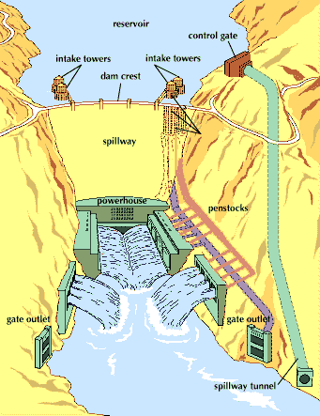
How it all works

Slide 24
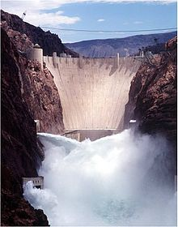
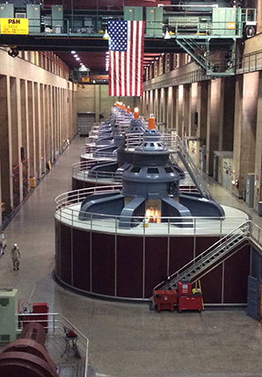
Making electricity the generators

Slide 25
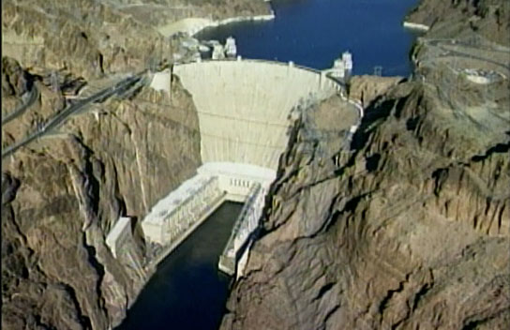
No water spray means the generators are not producing electricity

Slide 26
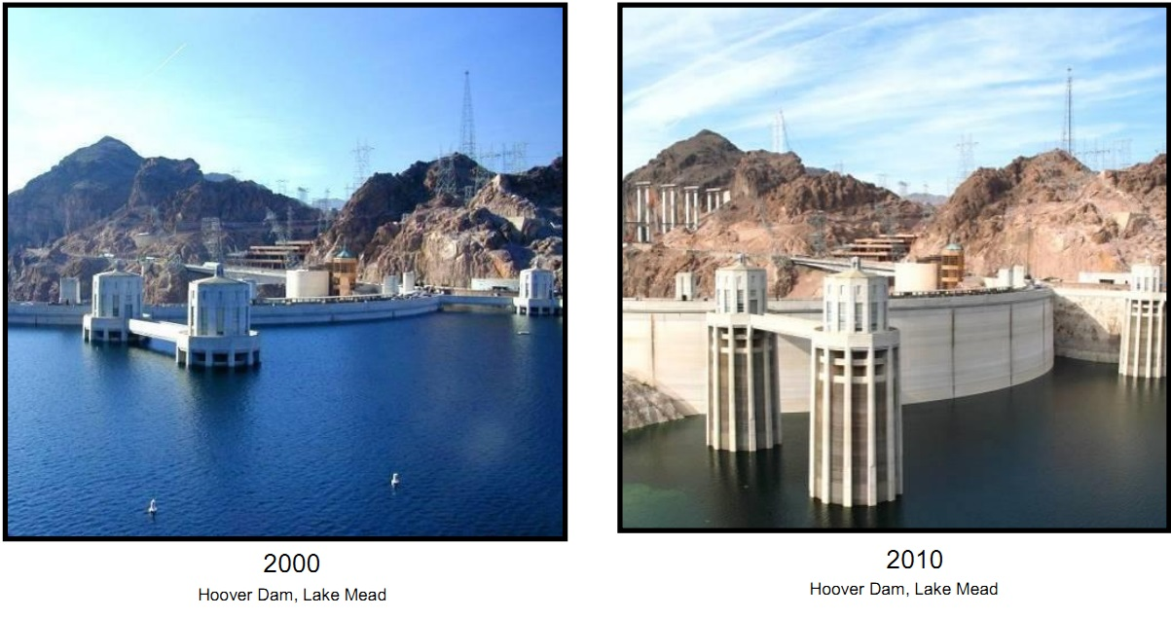
Level of the lake against the water intake towers – 2016 (the lowest so far) the difference is greater.

