Slide 1
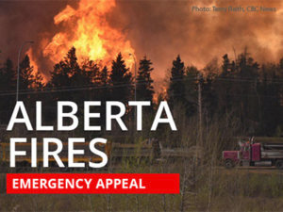
FIRE GIANT IN CANADA

Slide 2
Evacuate more than 80,000 people in Canada because of huge fire
The city of Fort McMurray, Alberta, is on high alert due to a major fire that threatens to raze thousands of homes

Slide 3
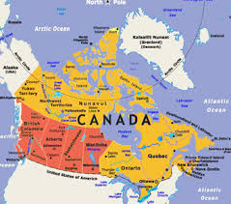
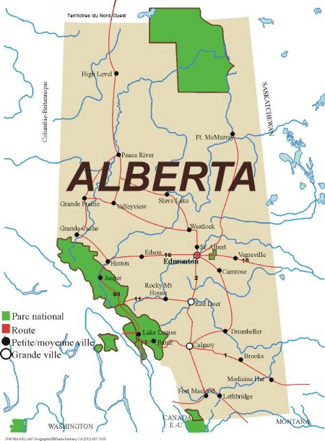

Slide 4


Slide 5
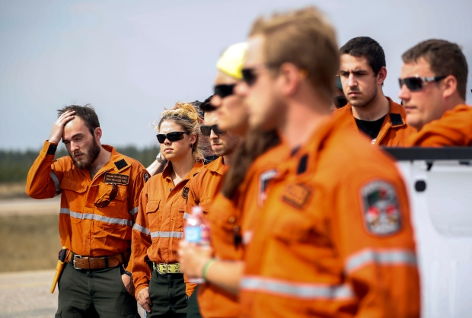
Firefighters prepare to be deployed

Slide 6
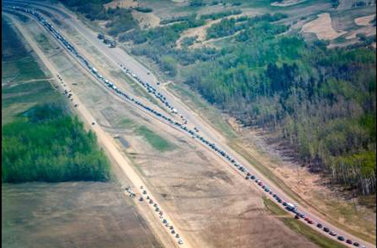
Evacuation traffic

Slide 7
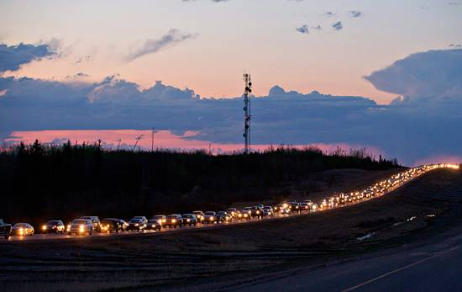

Slide 8
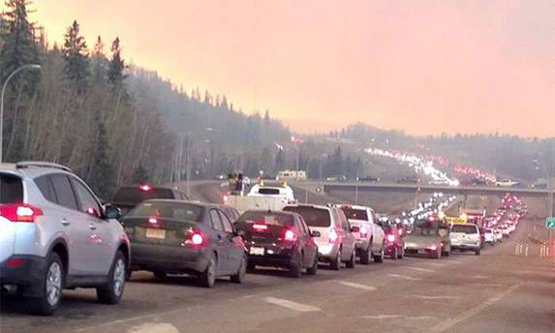

Slide 9
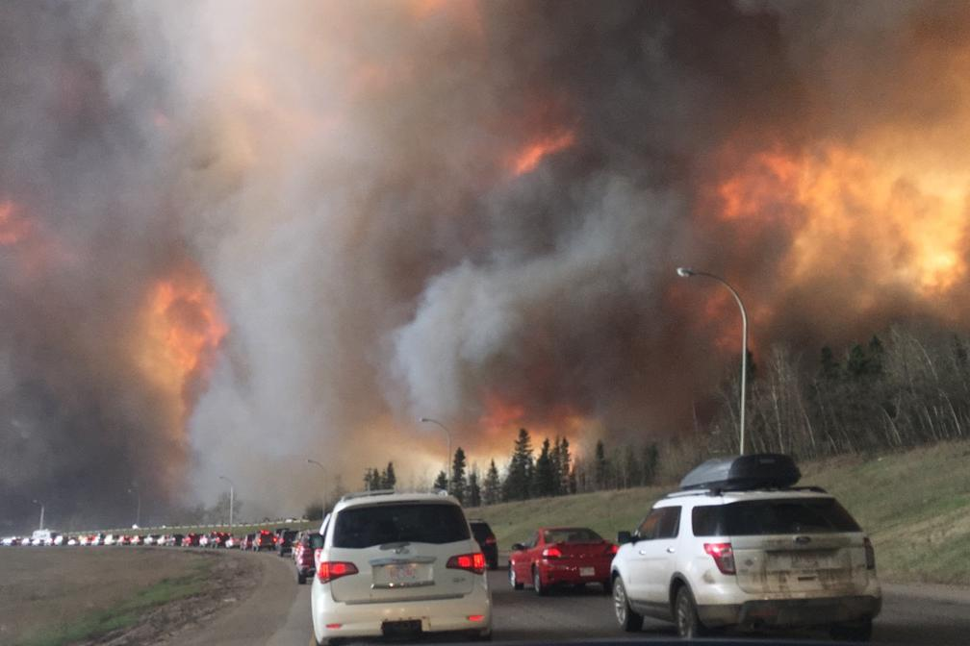

Slide 10
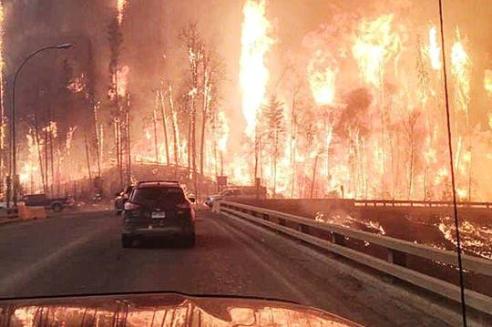
Talk about scary!

Slide 11
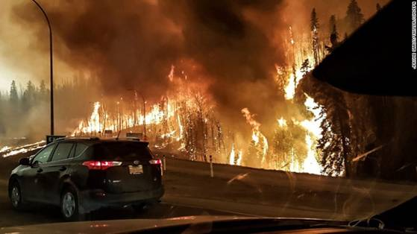
Many homes were destroyed

Slide 12
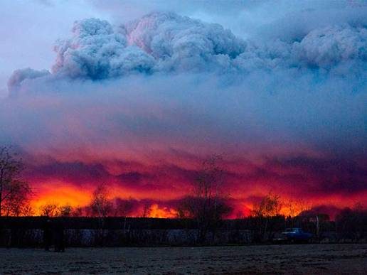
As far as the eye could see . . .

Slide 13
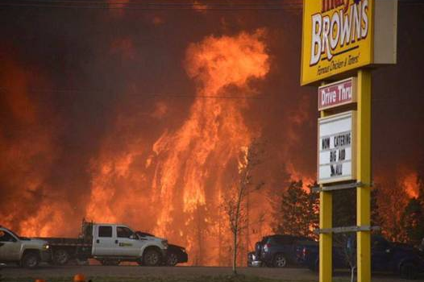

Slide 14
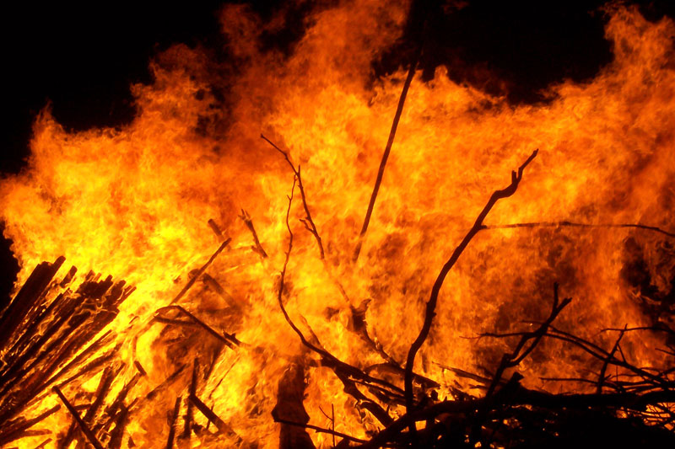

Slide 15
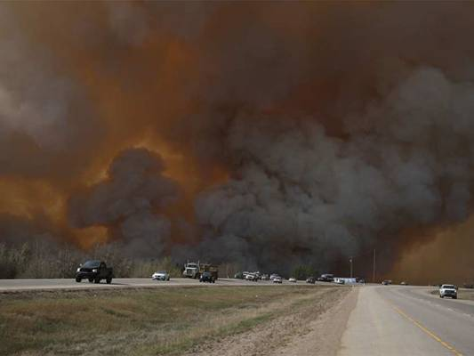

Slide 16
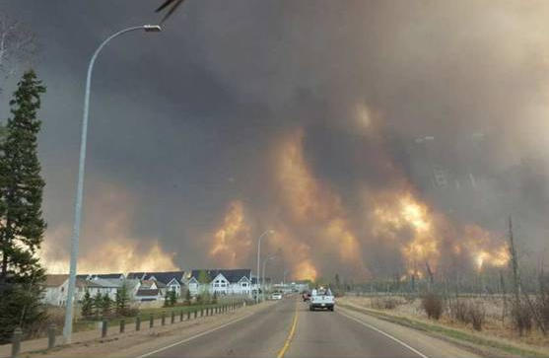

Slide 17
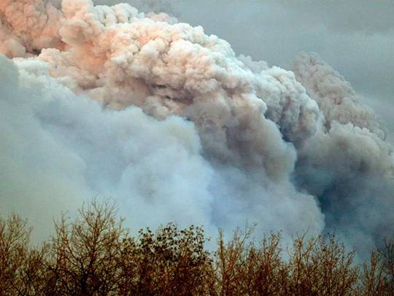

Slide 18
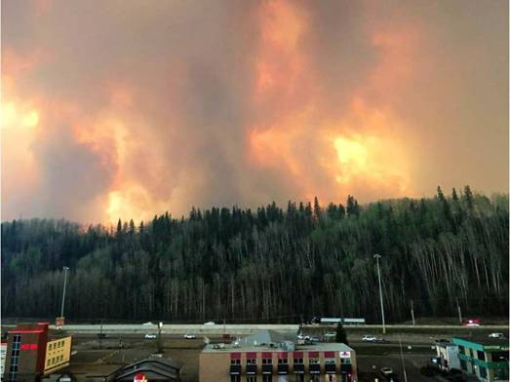

Slide 19
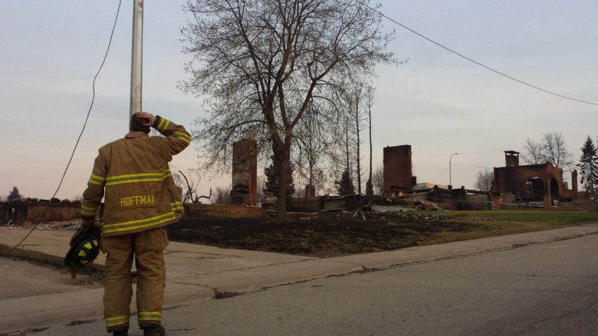
Fire fighter Hoffman stands among the ruins of his childhood home at 433 Beacon Hill Drive.

Slide 20
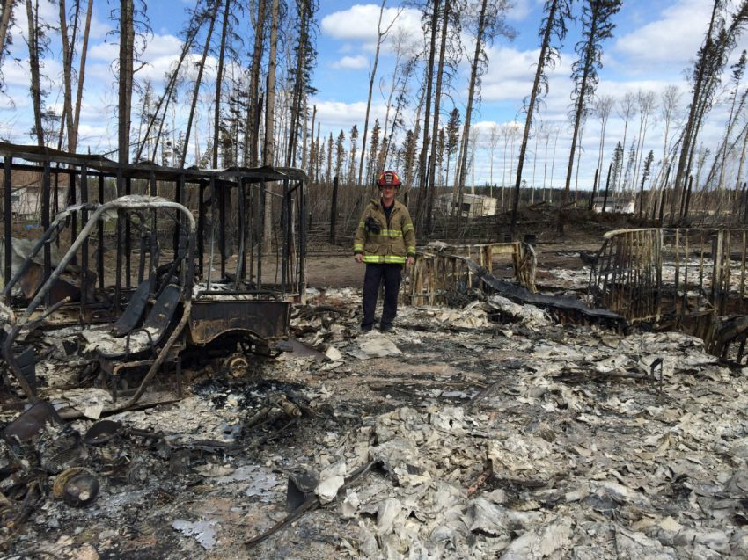
Fire Department captain Damian Asher stands among the remains of his 3700-square foot bungalow that he built himself over the past four years

Slide 21
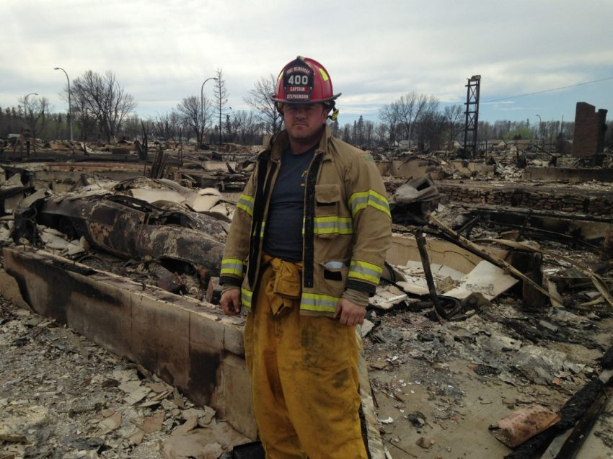

Slide 22
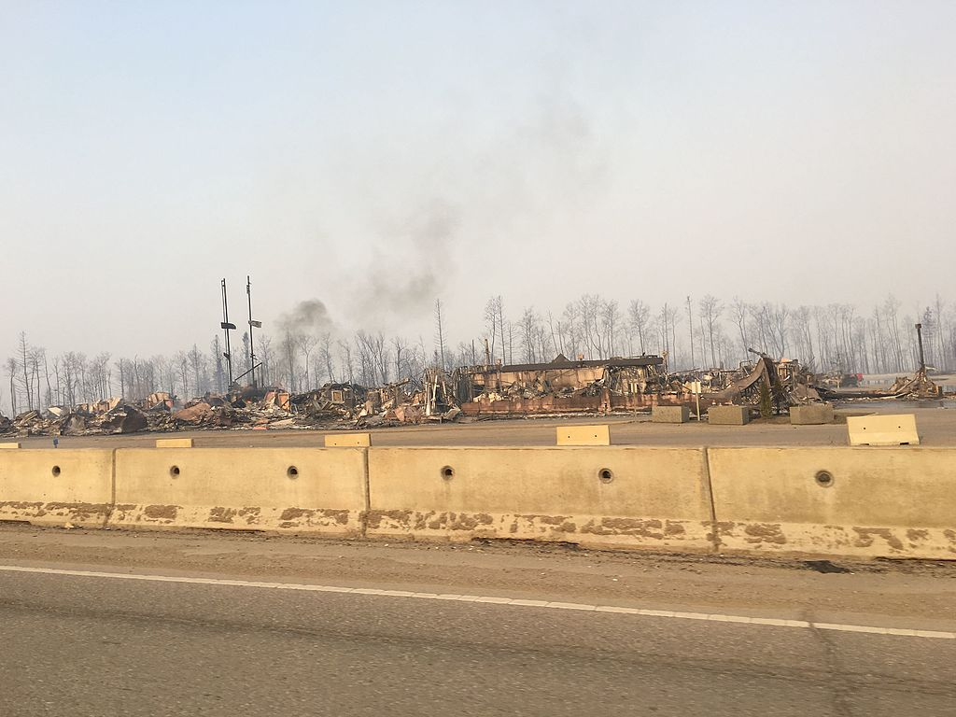

Slide 23
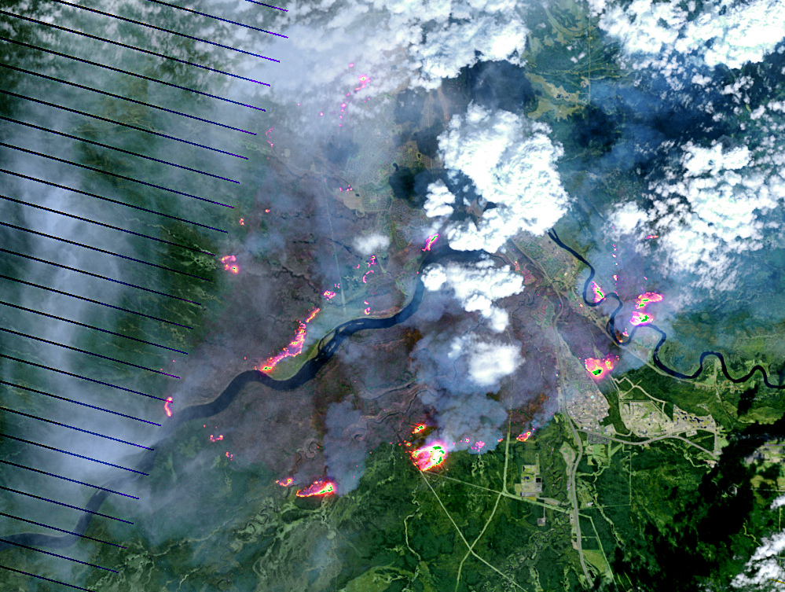

Slide 24
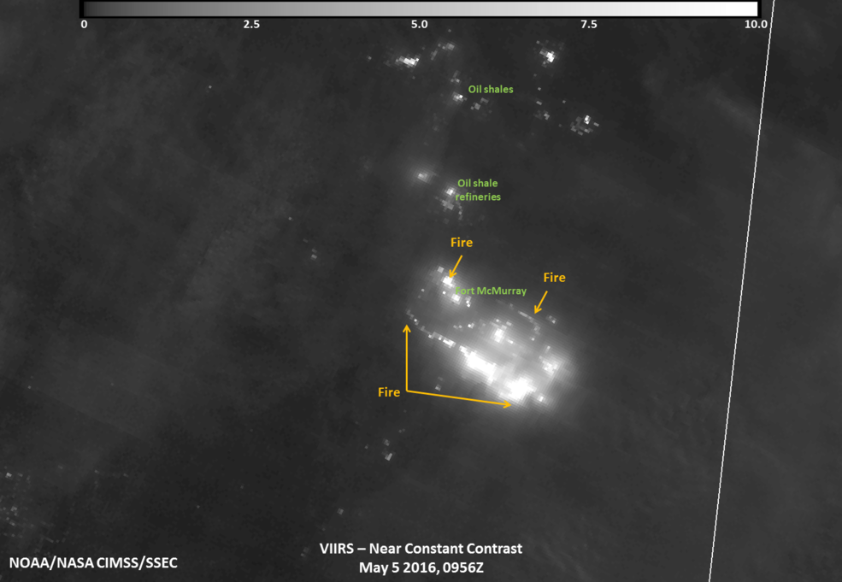

Slide 25
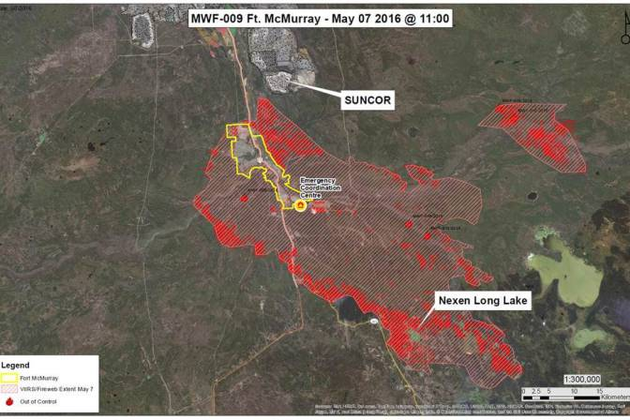

Slide 26
