Slide 1

Climate change charts & Maps
They support only one conclusion

Slide 2


Slide 3
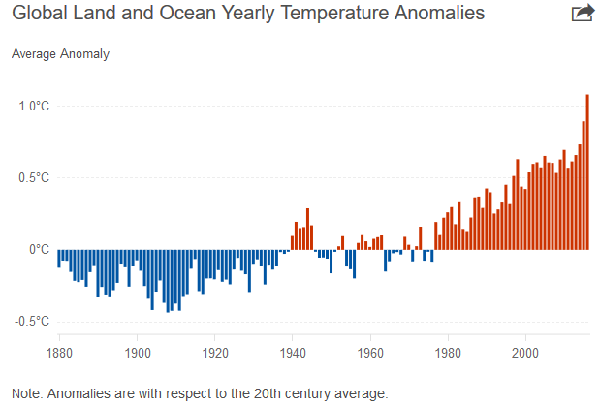

Slide 4
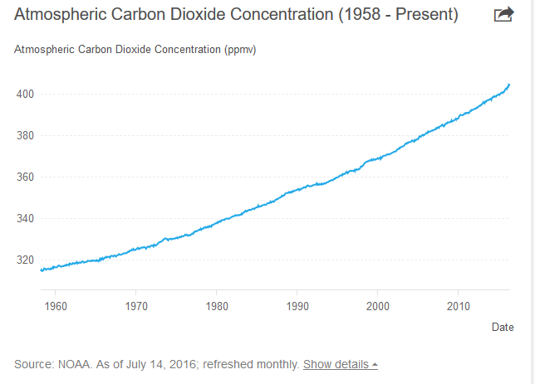

Slide 5
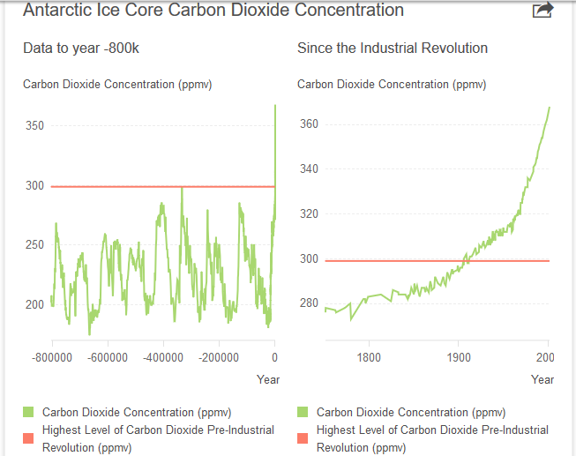

Slide 6
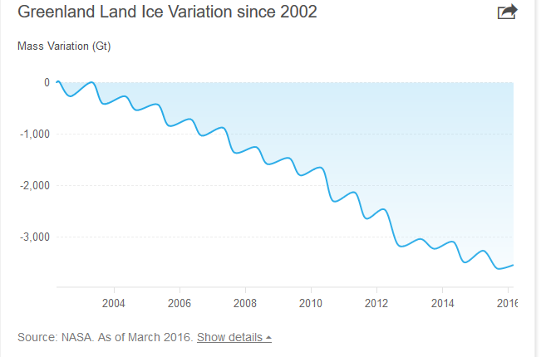

Slide 7
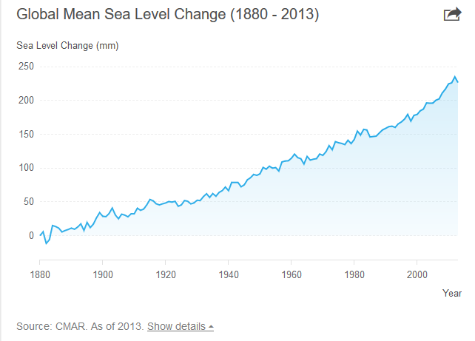

Slide 8
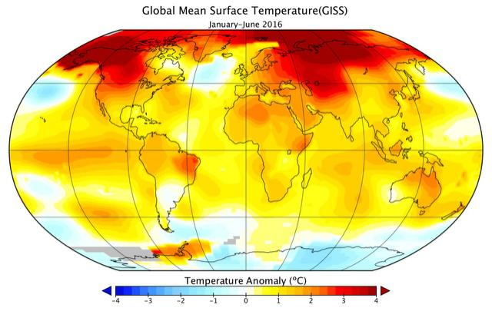
on track to be the hottest year ever on record,

Slide 9
This year may be only half over, but 2016 is already on track to be the hottest year ever on record, with each of the first six months, from January to June, setting new temperature records, NASA officials announced this week.
For the first time, NASA shared a midyear climate analysis, doing so because temperature averages this year have been so in excess of previous data, agency officials said. NASA's data showed that each month in 2016 was the warmest respective month globally in the modern temperature record, which dates to 1880. This trend suggests 2016 will surpass 2015 as the hottest year on record, NASA said.

Slide 10
On Tuesday, two government science agencies announced that the first six months of 2016 were the warmest first half of any year on record. The data confirms what climate scientists have been startled to see during the past several years — the Earth's climate has made a step jump into a new, hotter era with more intense and frequent extreme events.

Slide 11
NASA Says 2016 Hottest On Record So Far, Arctic Sea Ice Cover May Reach New Lows

Slide 12
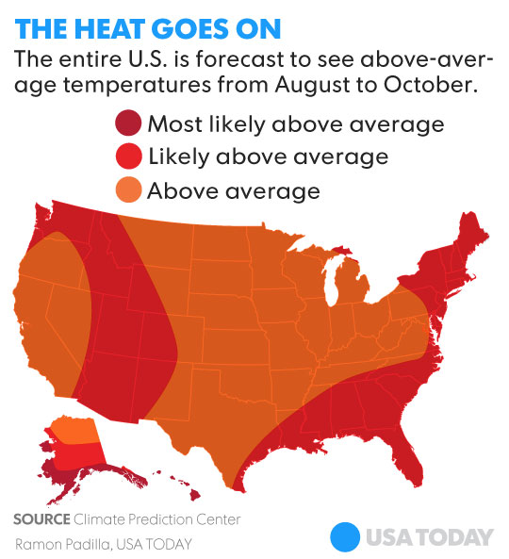
For the first time, forecast predicts hotter than normal in every square inch of the USA

Slide 13

It’s not a myth; it’s reality!
The climate that most of us grew up with is gone for good

Slide 14


Slide 15


Slide 16
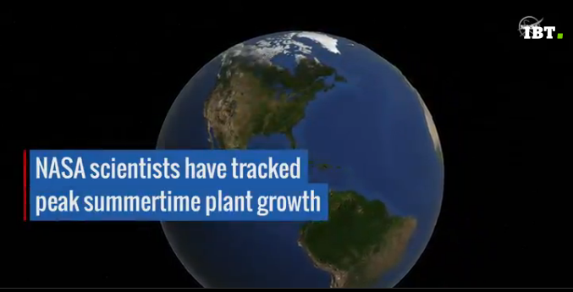

Slide 17
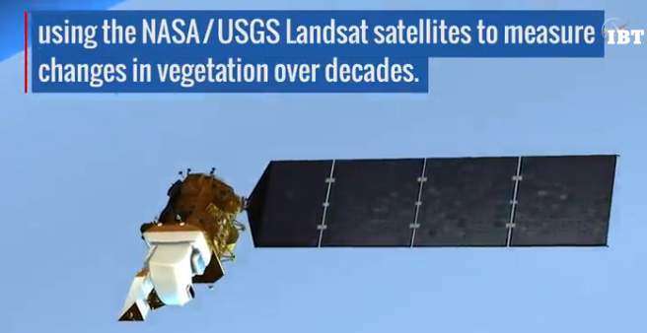

Slide 18
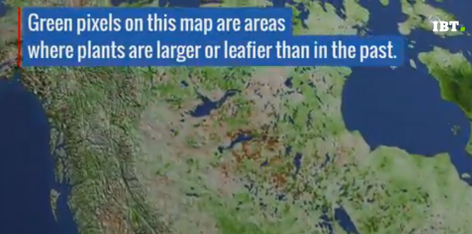

Slide 19
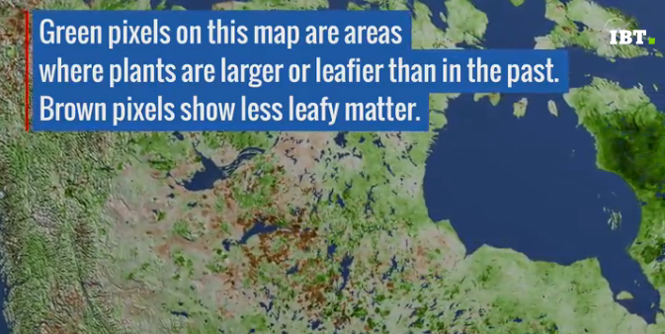

Slide 20


Slide 21
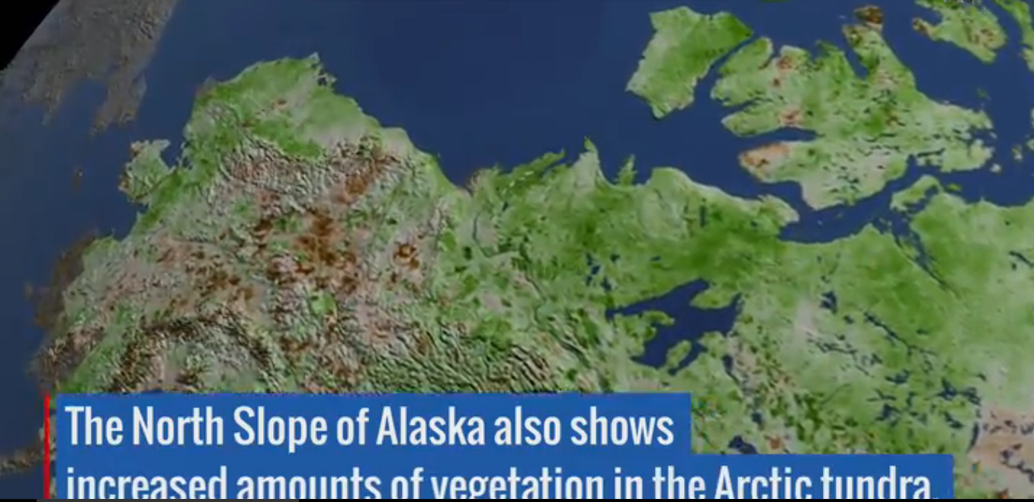

Slide 22
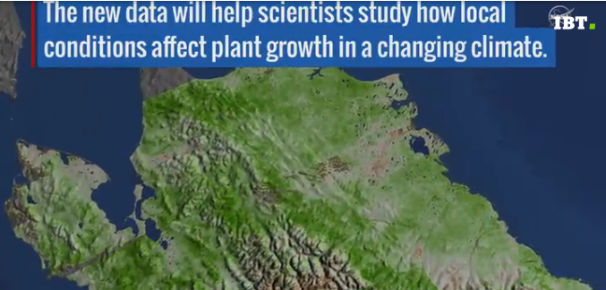

Slide 23
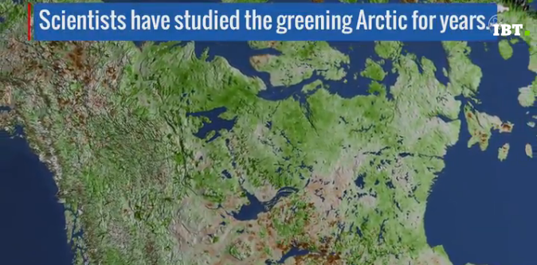

Slide 24
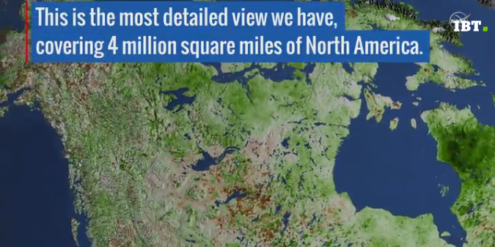

Slide 25
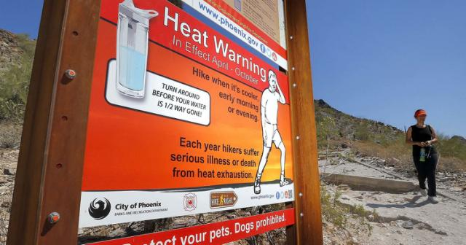
Pay attention!

Slide 26
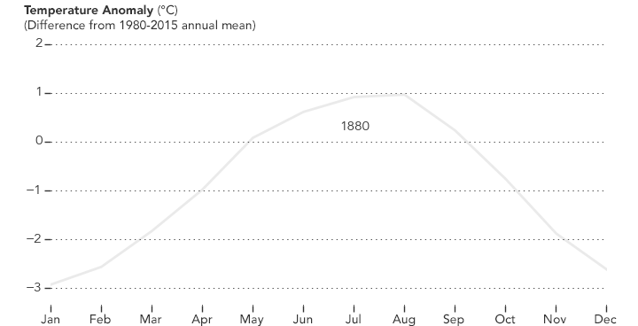
2016 becoming the hottest year in the history of weather records

Slide 27


