Slide 1
Cities with the World's Highest Temperatures

Slide 2
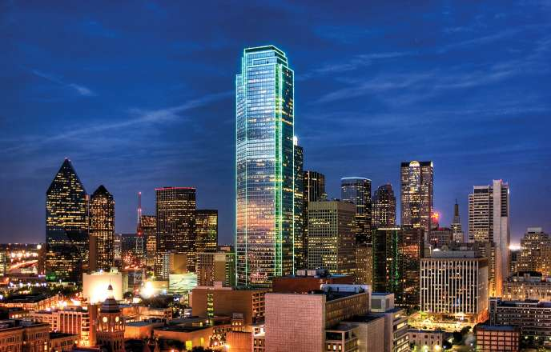
Dallas,Texas

Slide 3
When people think of the Lone Star state, they think of cowboys and deserts; a general Wild West theme. With that kind of climate, it's natural for heat to accompany it, even if Texas isn't really home to gunslingers. In particular, Dallas sees heat in July with an average of 96 degrees. Luckily, like in most of America, air conditioners keep the citizens cool, as do the different water-related activities available at water parks and swimming pools.

Slide 4
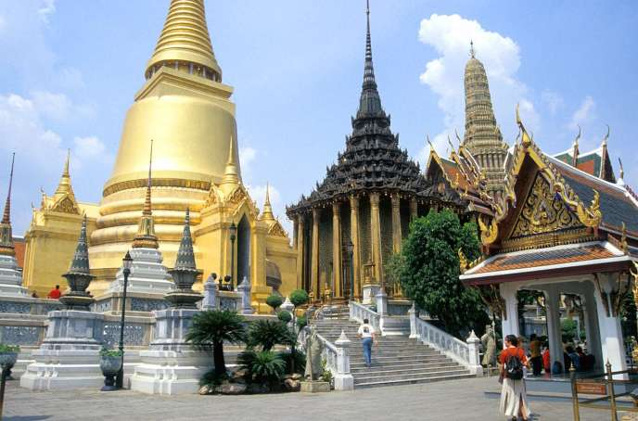
Bangkok, Thailand

Slide 5
This Asian city is used to the heat, as the temperature stays high all year round. However, in April temperatures stay at a 96-degrees average. Citizens take to the water, throwing many community-wide pool parties to ride out the heat in fun.

Slide 6
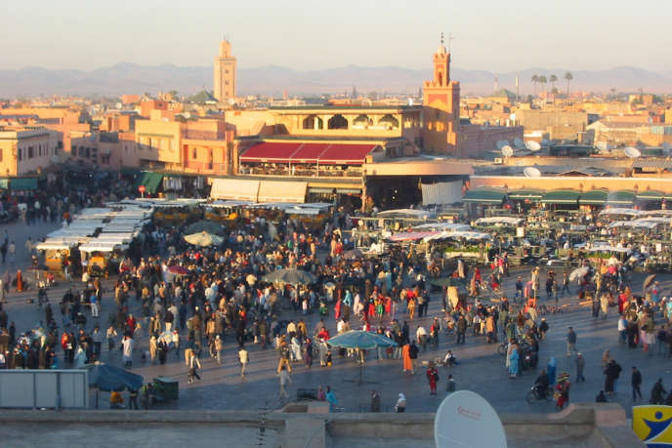
Marrakech, Morocco

Slide 7
This epicenter of trade and economy is heavily populated and walled in. This doesn't help the fact that temperatures get up to an average of 99 degrees in July, and stay there. Luckily for the citizens and hoards of visitors, local beaches offer refuge from the heat.

Slide 8
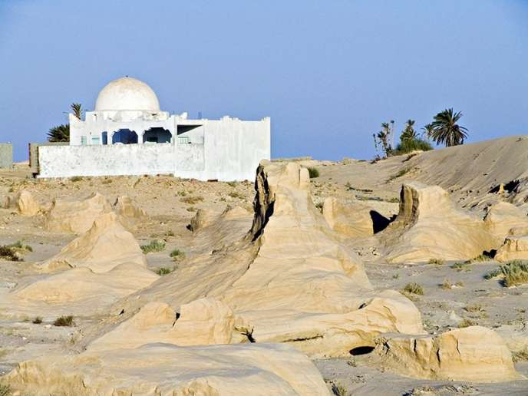
Kebili, Tunisia

Slide 9
This desert oasis sees some of the hottest weather around, averaging out at temperatures of 100 degrees in July. However, it remains a popular place to escape the North African heat. People surround their houses with canopies and stay in springs to beat the waves of heat.

Slide 10
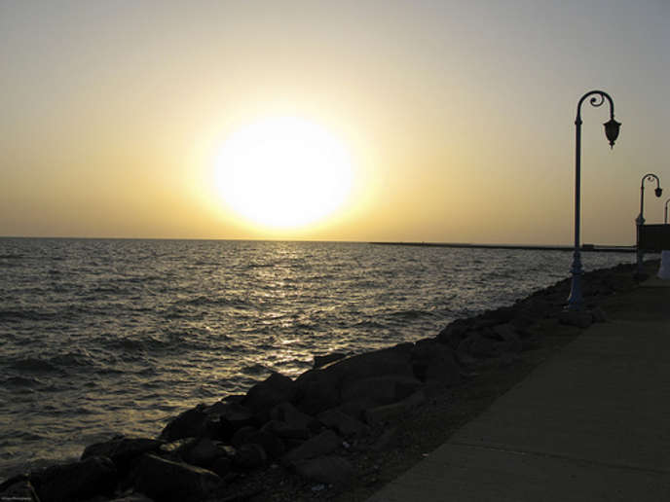
Jizan, Saudi Arabia

Slide 11
This bustling city sees an average heat of 101 degrees in the scorching month of July. The city of Jizan is a port town, though, so citizens can always take a dip in the water to refresh and cool down.

Slide 12
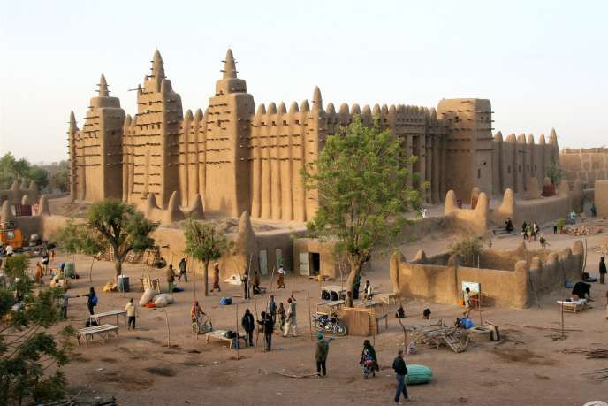
Timbukyu, Mali

Slide 13
Timbukyu boarders the Sahara Desert, so temperatures average out at a horrible 104 degrees even in May. The humid, scorching air is relentless, but citizens stay cool by going for dips in the bordering Niger River.

Slide 14
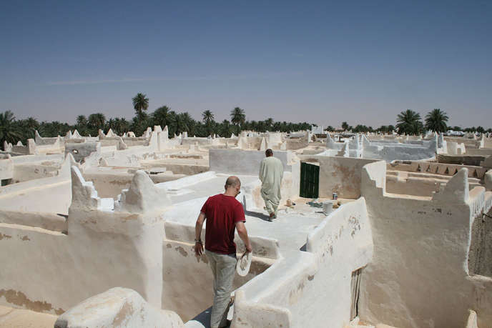
Ghadames, Libya

Slide 15
This little oasis sees temperatures on average of 105 degrees in July, as it is virtually rain free through out the year. The Berber oasis allows for cool water, but citizens mostly spend time in doors and heavily covered to escape the burning sun.

Slide 16
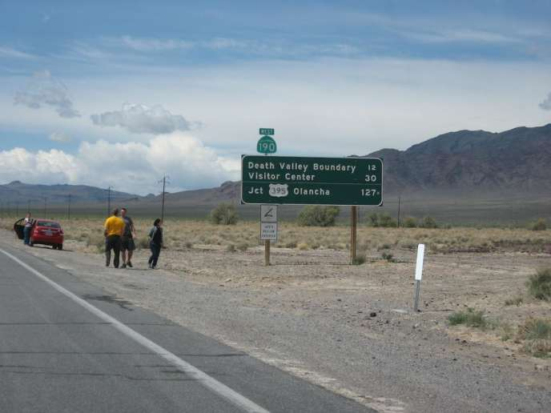
Death Valley Junction, California

Slide 17
The sunny state of California is known for its warm weather, but Death Valley is downright fierce. The tiny Mojave Desert community sees temperatures of 105 degrees in July daily. Visitors tend to stay towards pools or indoor activities such as visiting the Opera House to beat the heat.

Slide 18

Las Vegas, Nevada

Slide 19
Nevada is famous for its desert climate, and Las Vegas sees it with its average of 105 degrees in July. Lucky for the citizens and tourists, most of the attractions are indoors in the air conditioning or happening at poolside.

Slide 20
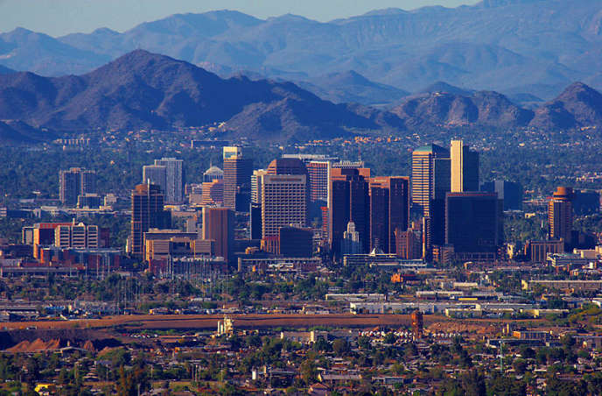
Phoenix, Arizona

Slide 21
Phoenix is a heavily populated city in Arizona that sees an average temperature of 107 degrees in July. The citizens spend their days at the many pools and water-related activities, or just simply adapting to the heat. Several local water parks make beating the heat fun for the family.

Slide 22
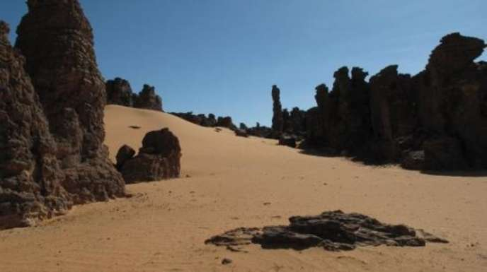
Illizi, Algeria

Slide 23
Like a lot of cities in Africa, Illizi sees heat like no other. With an average July temperature of 107 degrees, the heat is scorching. Seeing as the area is mostly rocky desert, the best bet is to make the outdoors your last resort.

Slide 24
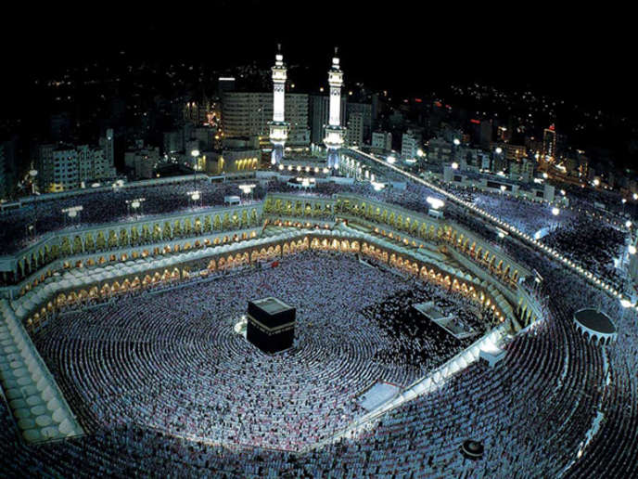
Mecca, Saudi Arabia

Slide 25
This religious destination sees lots of travelers, which is amazing as the summer heat averages out at 109 degrees. As most visitors come for the churches and religious artifacts, staying indoors is a popular pastime.

Slide 26
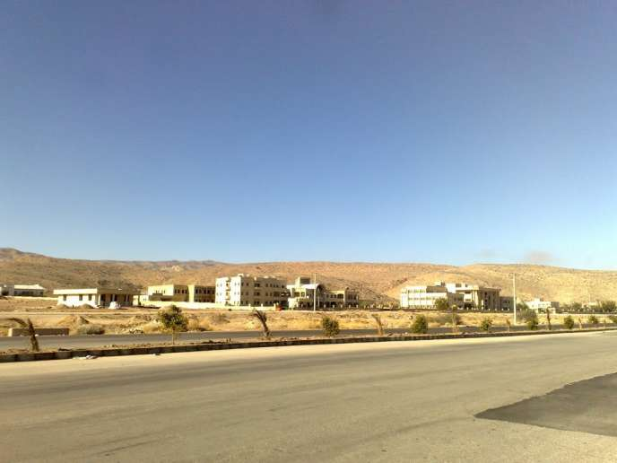
Evaz, Iran

Slide 27
In Evaz, summers are hot and dry, and rain is rare. The temperatures max out at an average of a scorching 115 degrees, making the heat killer. As water is precious here, the best way to beat the heat is to find ways to spend time indoors and to cover up to avoid burning.

