Slide 1
Freezing Rain
Great Potential For Damage

Slide 2
The Process
Freezing rain is the name given to rain that falls when surface temperatures are below freezing. The raindrops become supercooled while passing through a sub-freezing layer of air, many hundred feet (or meters), just above the surface, and then freeze upon impact with any object they encounter. The resulting ice, called glaze, can accumulate to a thickness of several centimetres.

Slide 3
Results
This process adds greatly to the the objects that are coated with ice and can cause collapse and breakage.
  Trees topple or large parts break off
  Power lines break from the weight or pull moorings from buildings.
Consequences
  Roads blocked by fallen trees
  Power loss to thousands of homes & businesses
  Damage and loss to commercial plants and ornamental plants

Slide 4
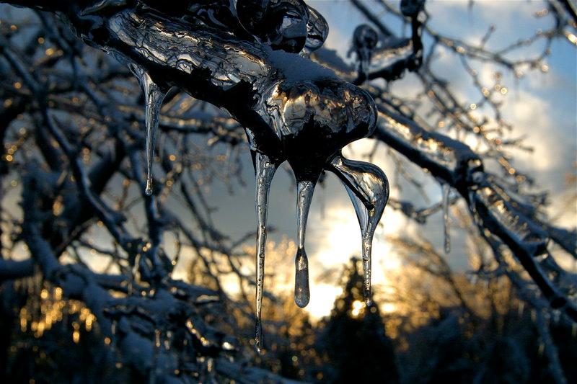

Slide 5
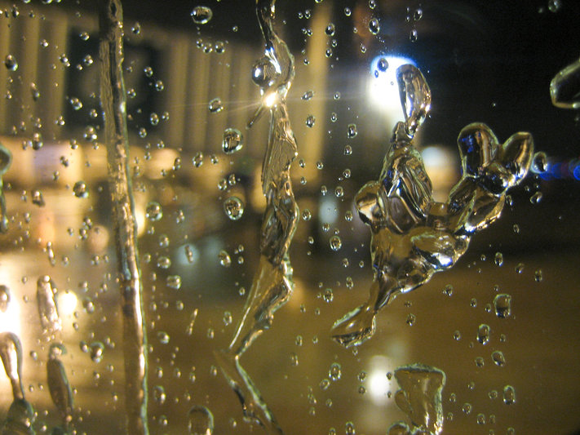

Slide 6
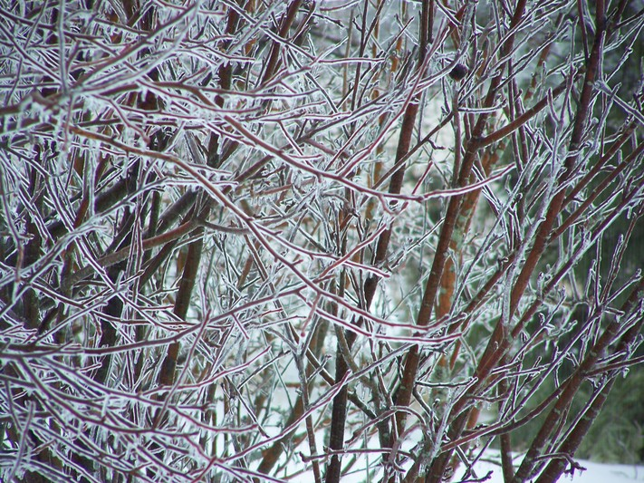

Slide 7
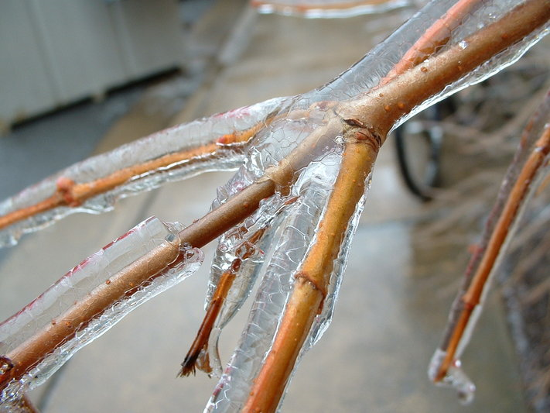

Slide 8
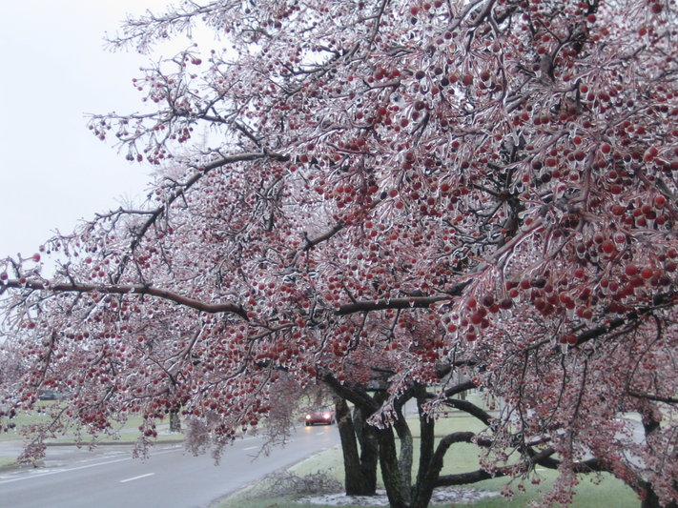

Slide 9
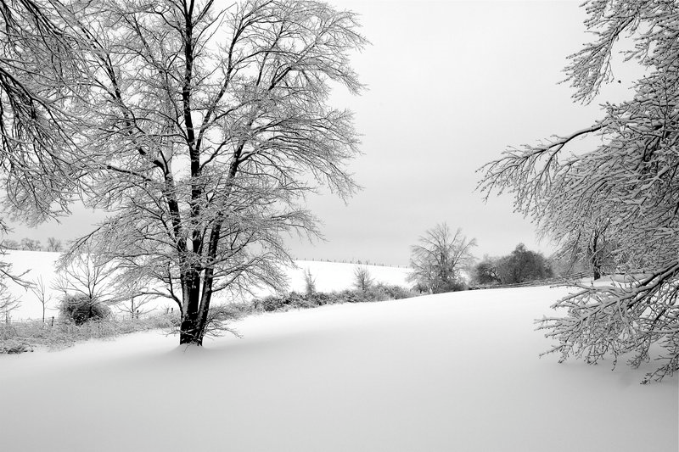

Slide 10
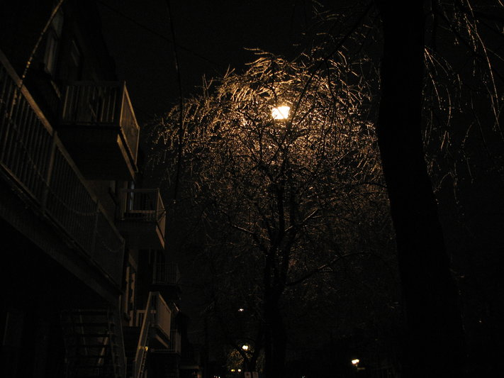

Slide 11
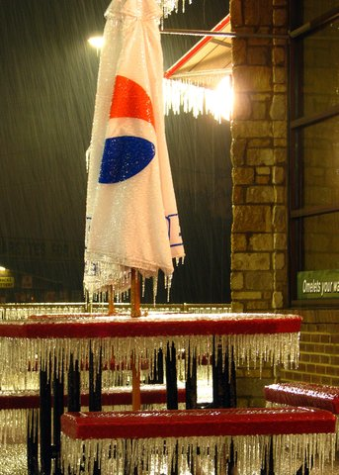

Slide 12
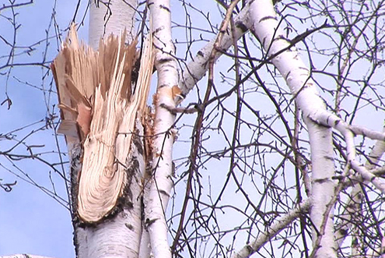
The Down side

Slide 13
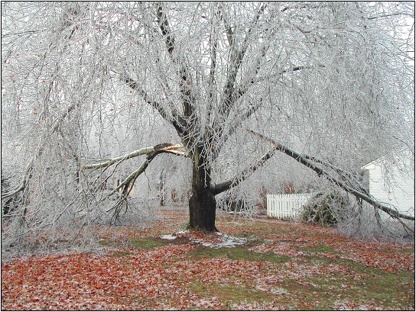

Slide 14
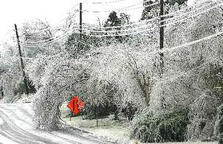
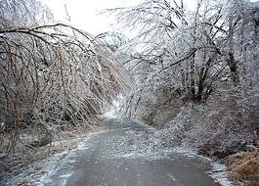

Slide 15
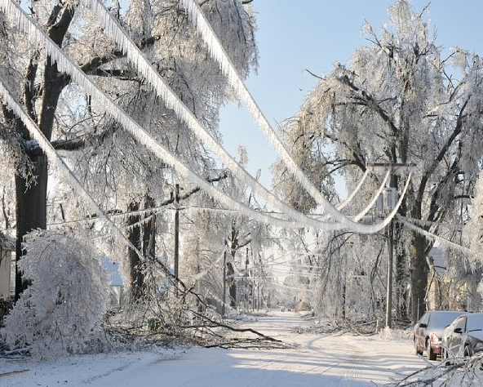

Slide 16
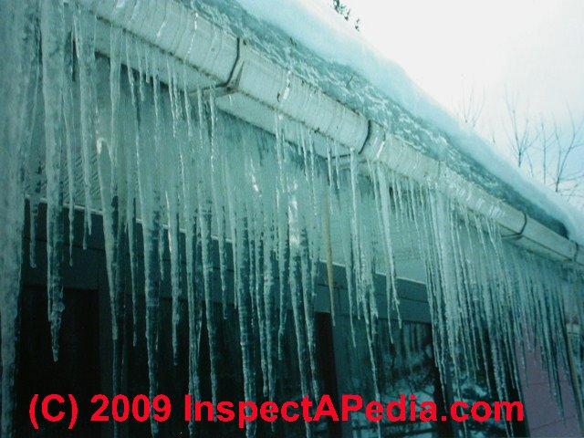

Slide 17
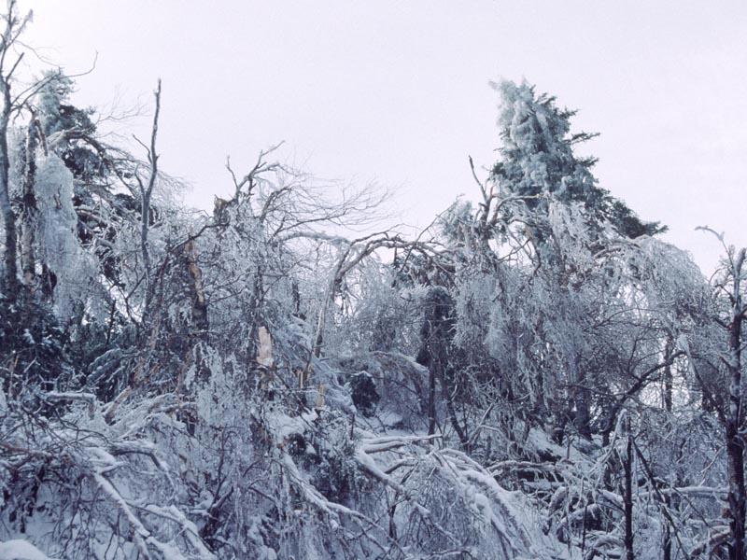

Slide 18
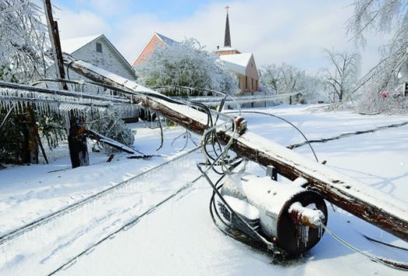

Slide 19
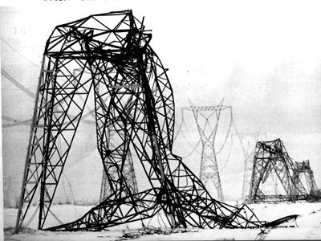

Slide 20
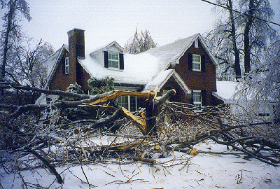

Slide 21
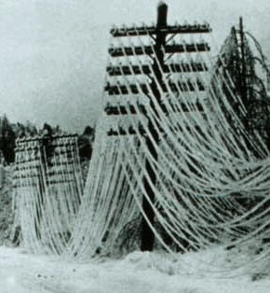

Slide 22
