Slide 1
Cities and Special Places Threatened by Sea Level Rising
Victims of Global Warming – Climate Change

Slide 2
Vulnerable Cities
Coastal cities with canals
Coastal cities on estuaries
Cities (towns) on coral islands with very little elevation

Slide 3
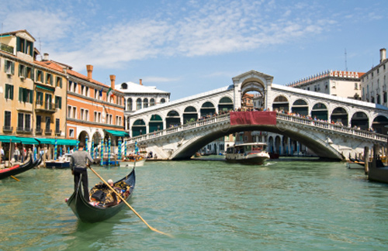
Venice, Italy

Slide 4
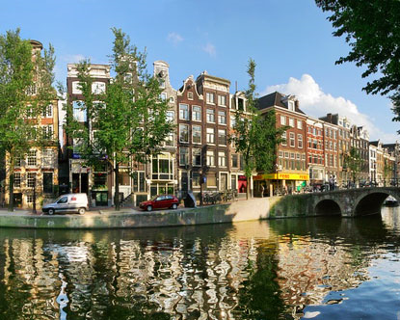
Amsterdam, the Netherlands

Slide 5
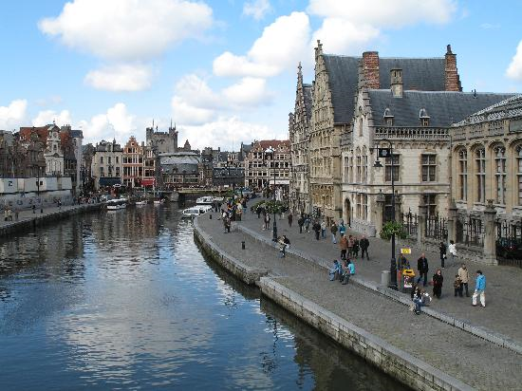
Brugge, Belgium

Slide 6
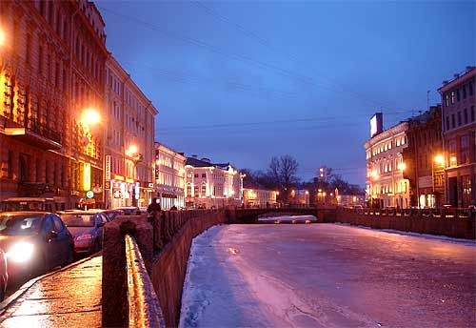
St. Petersburg, Russia

Slide 7
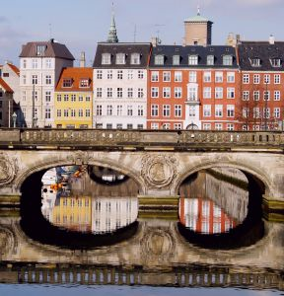
Copenhagen, Denmark

Slide 8
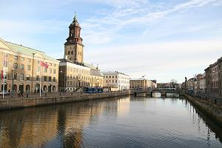
Gothenburg, Sweden

Slide 9
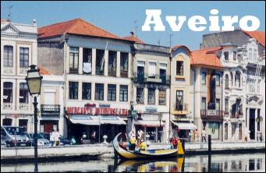
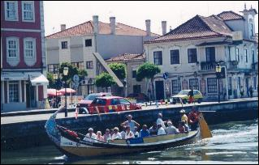
Aveiro, Portugal

Slide 10
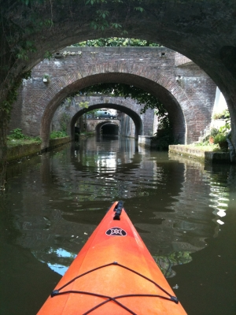
Utrecht, the Netherlands

Slide 11
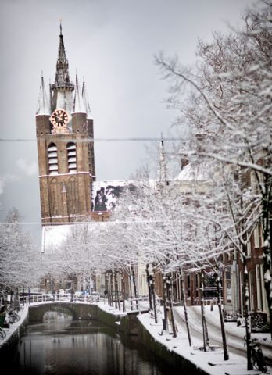
The Hague, the Netherlands

Slide 12
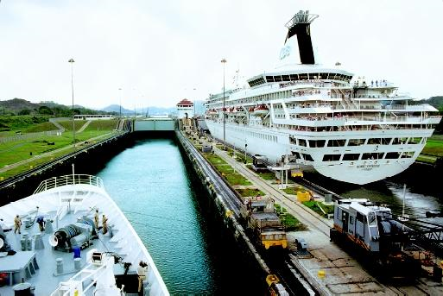
Hamburg, Germany

Slide 13
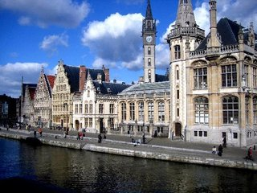
Ghent, Belgium

Slide 14
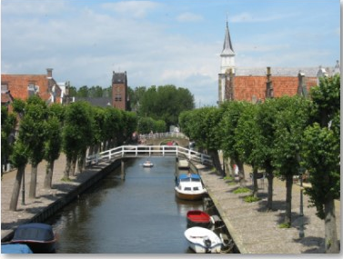
Sloten, the Netherlands

Slide 15
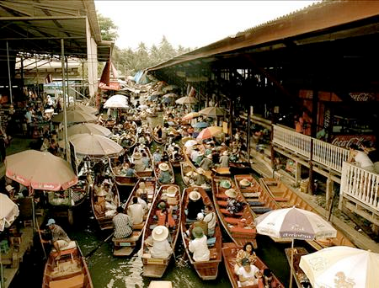
Bangkok, Thailand

Slide 16
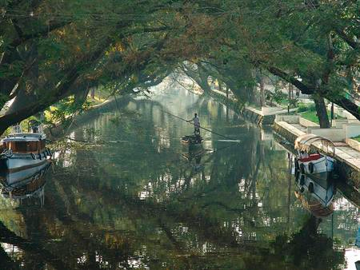
Alappuzha, India

Slide 17
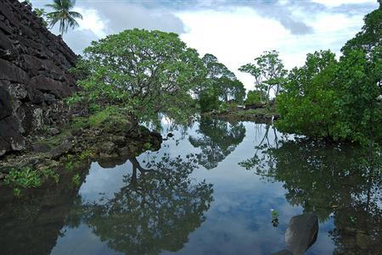
Nan Madol, the island of Pohnpei in Micronesia

Slide 18
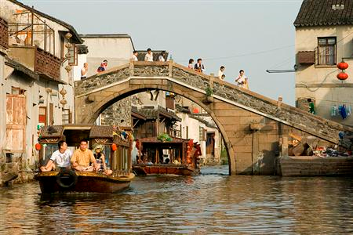
Suzhou, China

Slide 19
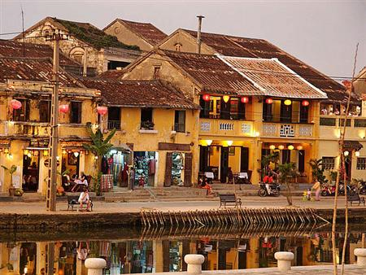
Hoi An, Vietnam

Slide 20
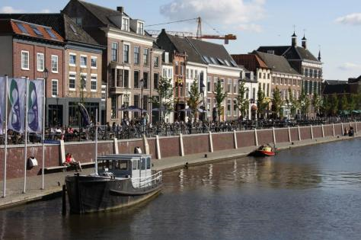
Den Bosch, the Netherlands

Slide 21
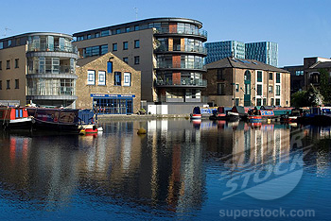
London, UK

Slide 22
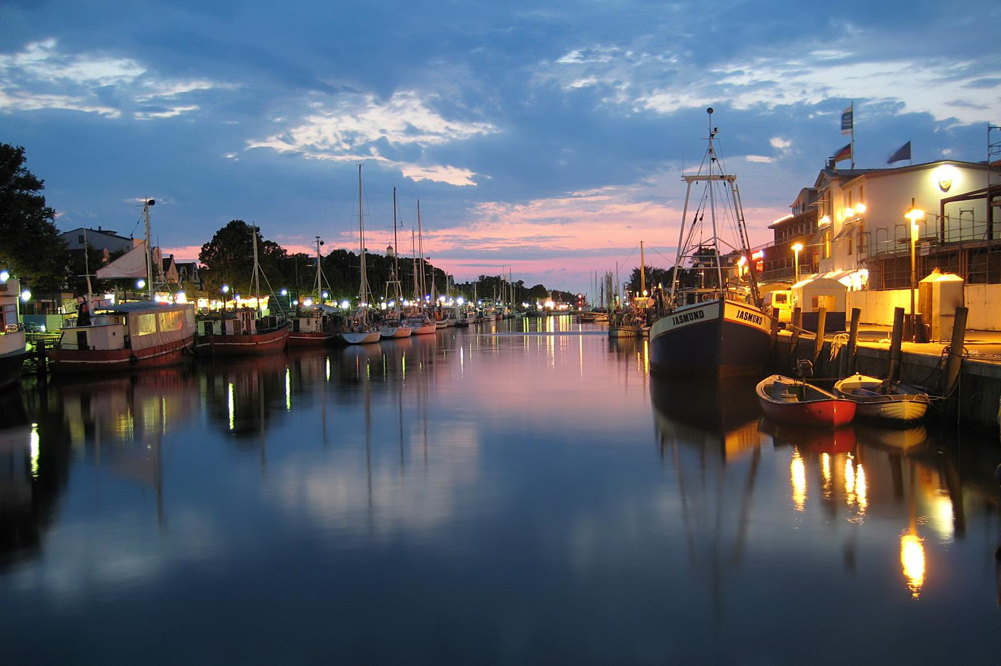
Warnemunde, Germany

Slide 23
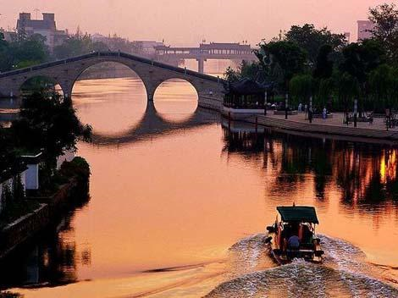
Shanghai, China

Slide 24
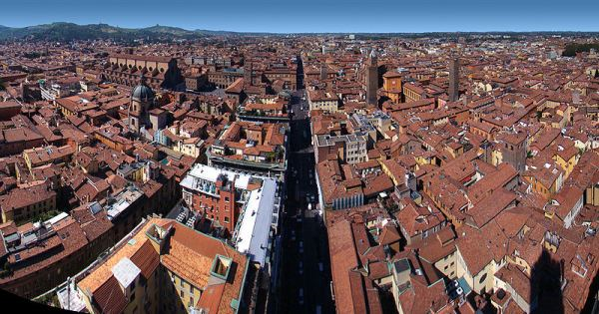
Bologna, Italy

Slide 25
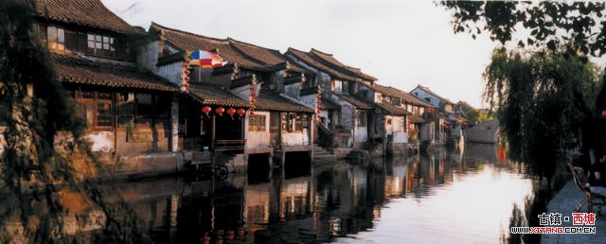
Zitang, china

Slide 26
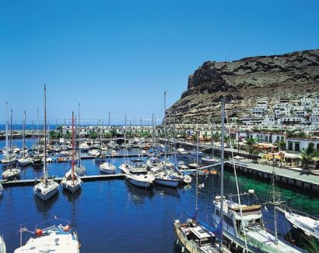
Mogan Gran Canaria, Canary Islands.

Slide 27
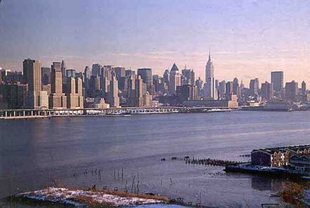
Of the 32 largest cities in the world 22 are located on Estuaries.

Slide 28
Threatened Cities of the World
The report also listed cities most likely to be impacted in terms of population and cost, focusing on 136 port cities around the world.
Calcutta, India, heads the list of the top 10 cities at risk in 2070 in terms of population exposure, with India's Mumbai, or Bombay, second. Miami, Fla., in ninth place, was the only city in a developed country on the report's list of the 10 top cities at risk due to population exposure.

Slide 29
The other cities on that list are Dhaka (Bangladesh), Guangzhou (China), Ho Chi Minh City (Vietnam), Shanghai (China), Bangkok (Thailand), Rangoon (Myanmar) and Hai Phong (Vietnam), respectively.
For present-day conditions, the top 10 cities in terms of exposed population are estimated to be Mumbai, Guangzhou, Shanghai, Miami, Ho Chi Minh City, Calcutta, Greater New York, Osaka-Kobe (Japan), Alexandria (Egypt) and New Orleans, respectively.

Slide 30
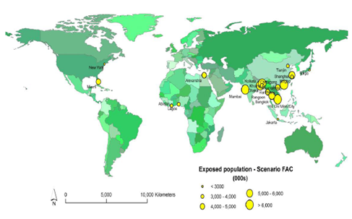
Top 20 Port Cities for Exposed Population
Future climate, subsidence and socio-economic scenario, 2070s

Slide 31
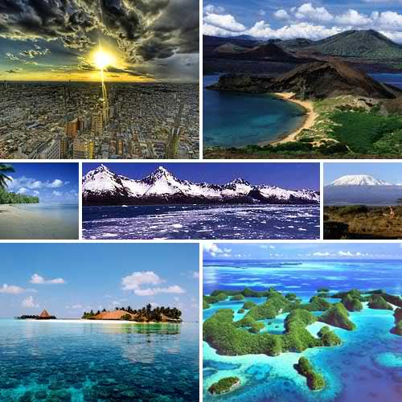
20 Places Threatened By Global Warming

Slide 32
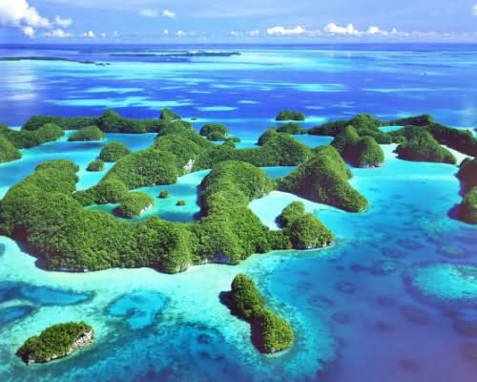
Palau, Micronesia

Slide 33
Palau: This tiny Pacific Island nation is a place that has gained a lot of attention in recent years since being named one of the Seven Underwater Wonders of the World. These are areas that marine researchers have deemed worthy of protection because of their rich underwater life. As a result, Palau has gained a lot of attention as a great place for divers interested in seeing one of the most beautiful spots in the world. Despite the efforts made to protect the area, Palau may end up changing significantly or disappearing altogether as a direct result of global warming.

Slide 34
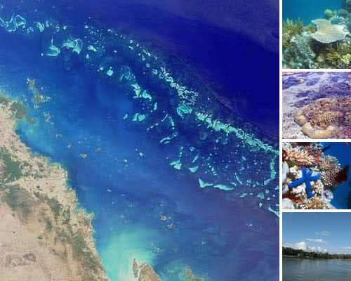
Great Barrier Reef, Australia

Slide 35
Great Barrier Reef: This well-known diving spot is another of the Seven Wonders of the Underwater World and another place that is threatened by global warming. Global warming causes the temperature of the water to rise and can change acidity levels in the area which has a direct negative impact on the coral reefs that make up this magnificent coral reef. Australia has traditionally been slower than other parts of the world to reduce greenhouse gas emissions, a fact which has already resulted in damage to the Great Barrier Reef.

Slide 36
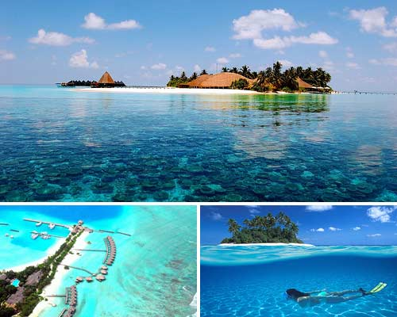
Maldives, Indian Ocean

Slide 37
Maldives: Off of the coast of India is this island nation which is seeing the same devastating effects as the rest of the area. Because of its small size, it is in particular danger of being wiped out by the global warming problems of the region. Scientists give it only about one hundred years before it completely disappears into the ocean surrounding it.

Slide 38

Virgin Islands, Caribbean

Slide 39
Virgin Islands: People travel to the Virgin Islands to enjoy the warm water and beaches as well as to see the unique wildlife that thrives in this part of the world. With damage to the natural landscape and animal life already occurring, this tourist destination is coming under threat.

Slide 40
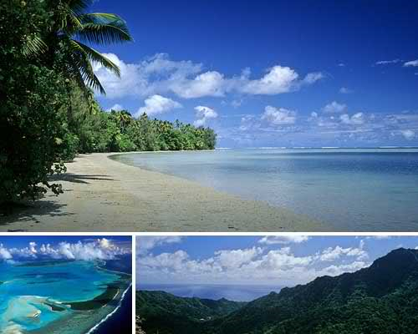
Cook Islands, Pacific Ocean

Slide 41
Cook Islands: The problem that the Virgin Islands are facing also apply to the Cook Islands, which are located just off of the coast of New Zealand. This area derives its primary economic support from tourism, support which is likely to drop off if the area doesn’t get its global warming problem under control. As with other oceanic islands, this chain are low-lying and face being swamped by rising sea levels.

Slide 42
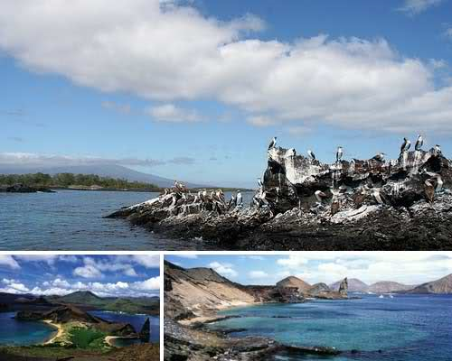
Galapagos Islands, Pacific Ocean

Slide 43
Galapagos Islands: This Pacific Ocean archipelago is not only a place which is beautiful but also one of historical importance. This is where Darwin came to do the studies which ultimately led him to his theory of evolution. Tourists come here each year to enjoy the beautiful weather and water as well as to learn about the history of the area. They might stop coming soon, though, if efforts to prevent damage from global warming are unsuccessful.

Slide 44
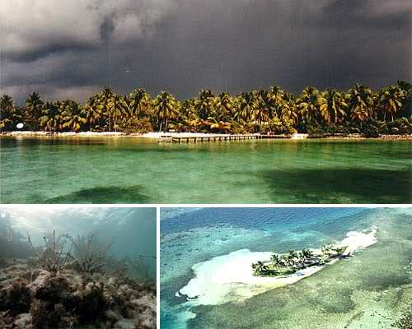
Belize Barrier Reef, Belize

Slide 45
Belize Barrier Reef: The Belize Barrier Reef is the largest in the Caribbean and one of the largest coral reefs in the world (second only to the Great Barrier Reef) and is the biggest tourist attraction bringing an economic boost to Belize. That boost is poised to fizzle out as damage to the reef occurs from global warming. That damage is already taking place despite protections put in place to prevent it.

Slide 46
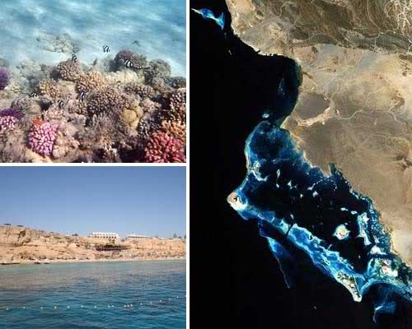
Red Sea Reefs, Egypt

Slide 47
Red Sea Reefs: Yet another popular area for coral reef diving is in the Red Sea, specifically the renowned reefs that lie off the coast of Sharm el Sheikh . However, this region of the world may be on the path towards protecting itself from full damage by global warming through a unique experiment which would grow an artificial reef to replace the natural one. This would allow divers to continue coming to the area for at least a short while after global warming ruins the existing reefs and could protect the economy of the area which is highly dependent on tourism.

Slide 48
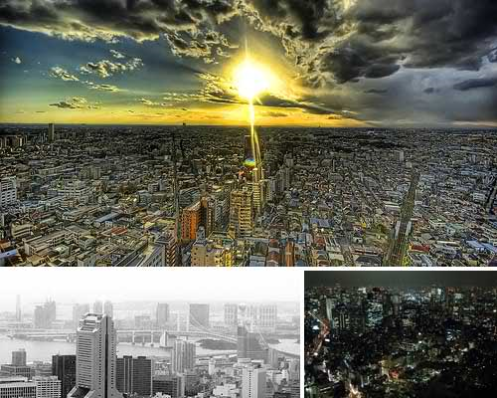
Tokyo, Japan

Slide 49
Tokyo: This major international city is in some serious danger; it’s temperatures have been rising five times faster than the average global warming rate around the world. The entire climate of that part of the world is undergoing rapid change and it is impossible to accurately predict what this will mean for the many people living there today.

Slide 50
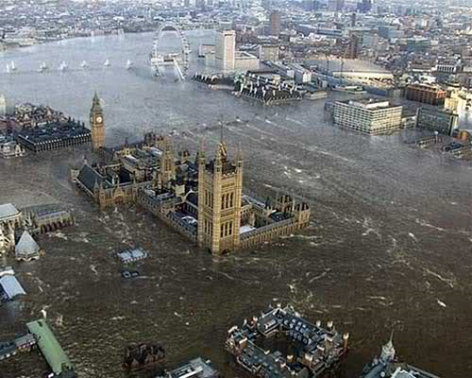
London, United Kingdom

Slide 51
London: It isn’t only reefs and low-lying islands that are under threat from global warming. In fact, a major threat is for those large urban areas which are at risk of eventually being submerged underwater. This is caused by a change in sea levels that occurs when global warming takes place, resulting in coastal cities being destroyed by flooding. London is one of the major world capitals at high risk of this type of flooding, as depicted in this shot from the 2007 movie Flood. Scientists say that the city could be under water as early as within the next one hundred years.

Slide 52
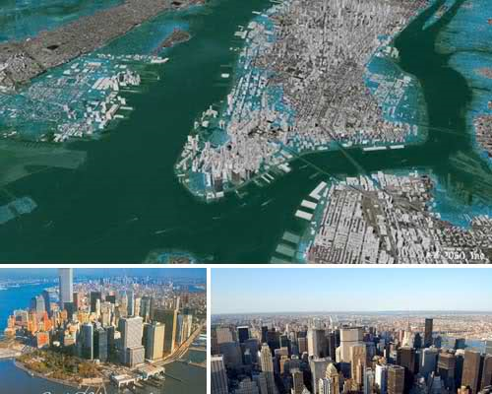
New York City, USA

Slide 53
New York City: Across the ocean is another coastal city which plays a major role in the international landscape and which is also threatened by the flooding that could occur as a result of global warming. New York City is working hard to limit these risks but only time is going to tell whether the city can survive the rise in temperatures that is plaguing the globe.

Slide 54
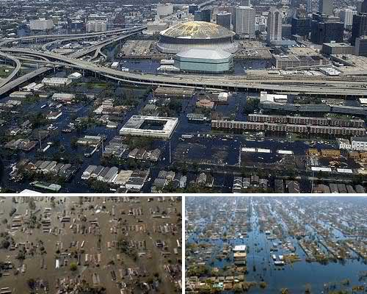
New Orleans, USA

Slide 55
New Orleans This city in Louisiana, United States already got a glimpse of the dangers of climate change when it was devastate by Hurricane Katrina in 2005. The city is still in the process of rebuilding and remains at risk from additional damage due to future hurricanes in the area. As global warming causes the temperatures in the Atlantic and Caribbean to rise, this city finds itself to be a major target which serves as an example of the human cost of global warming.

Slide 56
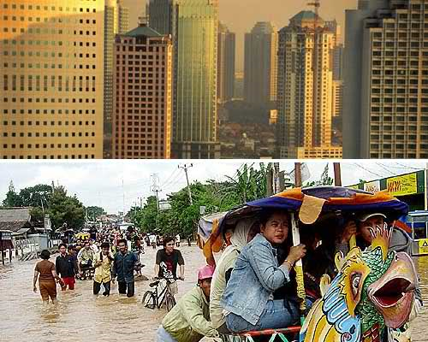
Jakarta, Indonesia

Slide 57
Jakarta: The capital city of Indonesia has already experienced serious flooding last year, which many believe was a direct result of the climate change affecting the world. With more than twenty million people living in its metropolitan area, Jakarta is a city that has a lot to lose if the global warming issue continues unabated.

Slide 58
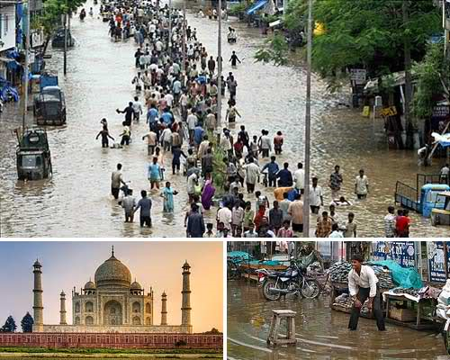
India

Slide 59
India: Losing a massive city like London or New York to global warming would be devastating but think of the impact of losing an entire country, especially one as highly populated as India. This part of the world is seeing some of the worst impact of global warming with problems ranging from extremely high (even fatal) temperatures to increased cyclone activity. The main problem is due to changes in the water patterns which are reducing the flow of water throughout the country. Mumbai is particularly at risk but the entire country is in danger from extreme weather phenomena.

Slide 60
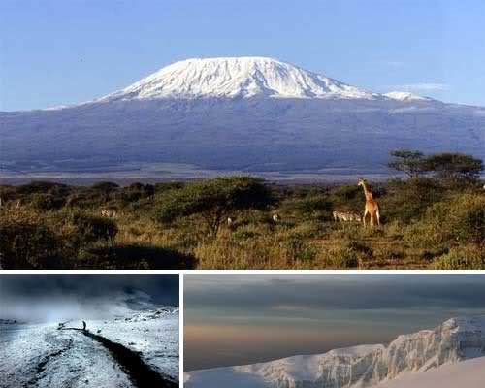
Mount Kilimanjaro, Tanzania

Slide 61
Mount Kilimanjaro: Another icy area that is threatened by global warming is Tanzania’s Mount Kilimanjaro. This is a highly popular destination for rock climbers who enjoy challenging themselves with extreme weather conditions. At the top of this mountain are glaciers which are rapidly melting and could disappear as early as 2020. That changes conditions in the area for climbers and may affect the value of this African mountaintop as a tourist destination.

Slide 62
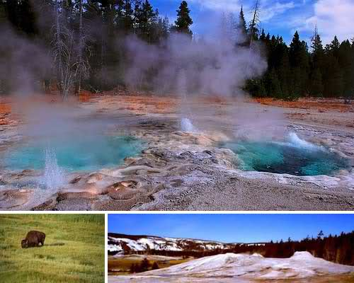
Yellowstone National Park, USA

Slide 63
Yellowstone National Park: This national park is a place of historical importance to the United States because it’s the oldest national park in the country. It is a place that truly takes you back in time, preserving nature and wildlife (such as American bison) that don’t exist in most places throughout the country. With unique geological formations such as geysers, it’s a park that draws in visitors from all around the world. And it’s a park that is under serious threat as climate change impacts the nature and wildlife that are living here today.

Slide 64
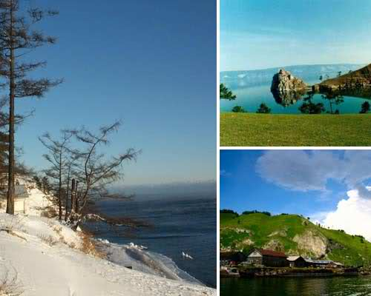
Lake Baikal, Siberia

Slide 65
Lake Baikal: This Siberian lake is the deepest lake in the entire world and the largest freshwater lake in existence. Scientists originally hoped that its sheer size would protect it from damage due to global warming but evidence suggests that they were mistaken. The water’s temperature has already begun to rise which could ultimately cause significant damage to the islands that have only recently started to gain the attention of tourists from around the world.

Slide 66
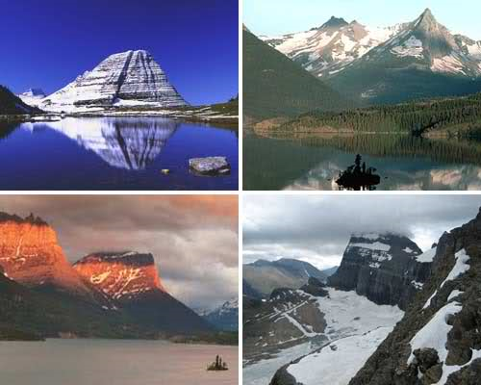
Glacier National Park, USA

Slide 67
Glacier National Park: This national park located in Montana is an amazing place popular with tourists from throughout America. This astounding historic wonder is on the brink of being destroyed by global warming. In fact the number of glaciers at the park has decreased from 150 to just 26 in the last century-and-a-half due primarily to climate changes in the area.

Slide 68
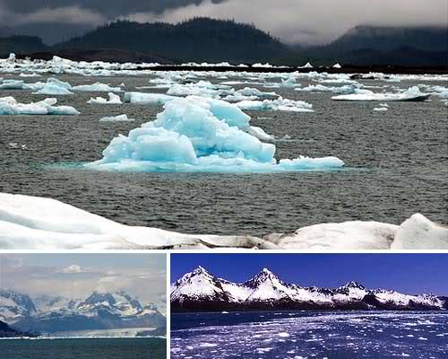
Columbia Glacier, Alaska

Slide 69
Columbia Glacier: Speaking of glaciers, the largest one in Alaska is rapidly disappearing as the result of global warming. It is currently a favourite tourist attraction for Alaska’s visitors but taking those tours is getting increasingly difficult since the glacier is moving at an astonishingly rapid rate. This is likely to have a continued effect on the area and potentially the rest of the world – over time.

Slide 70
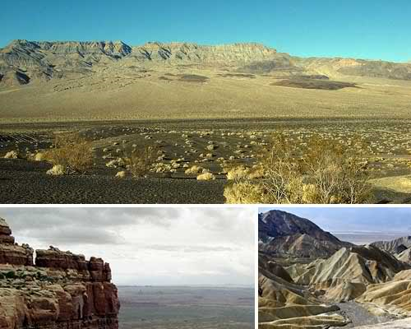
Death Valley, USA

Slide 71
Death Valley: Most of the places that are threatened by global warming are at risk because climate change causes flooding in the area. In contrast, Death Valley is at risk because it’s already a hot place that doesn’t have much access to water. This United States National Park area takes up a big chunk of Southern California, a chunk that could become almost impossible to cross if global warming heats it up even more. ProTraveller

