Slide 1

Sticker Shock: What Extreme Weather Costs the U.S.
Posted by Tara Thean Monday, June 27, 2011
Ecocentric – a Blog
Powerpoint Templates

Slide 2
It's not hard to imagine the damage weird weather inflicts on our planet. Hurricane Katrina, for example, obliterated coastal communities, wiped out businesses and left hundreds of dead bodies in its wake. Quantifying the cost of such a one-off (we hope) event is pretty easy too: Katrina left us with a bill of $81 billion, according to the National Hurricane Center. But what about the year-in, year-out price tag of our increasingly volatile weather?

Slide 3
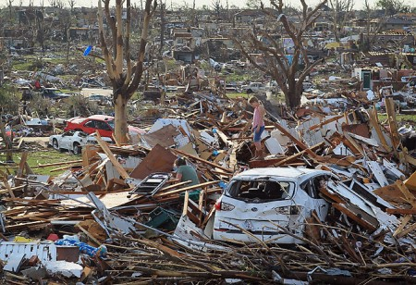
Joplin, MO – worst tornado damage in U.S. recorded weather history – 5/24/11

Slide 4
It's a whole lot harder to calculate the cost of a chronic condition like that — or at least it was. Now a study by the National Center for Atmospheric Research estimates that the bottom-line cost of all the meteorological craziness is a staggering $485 billion per year in the U.S. alone, as much as 3.4% of the country's GDP. "It's clear that our economy isn't weatherproof," Jeffrey Lazo, the study's lead author, said in a statement. "Even routine changes in the weather can add up to substantial impacts on the U.S. economy."

Slide 5
The fact that it took until now for someone to calculate a hard figure shows just how daunting the number crunching can be. When it comes to the weather yo-yo, a debit to one industry can be a credit to another. Take what happens in a snowstorm: air travel is disrupted and heating costs go up, but ski resorts hit the jackpot. In a dry spell: crop supplies dwindle, but construction projects are able to stay on schedule. (continued after the following photos)

Slide 6
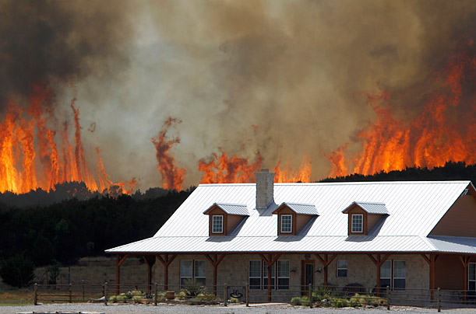
Possum Kingdom, Texas, April 19, 2011

Slide 7
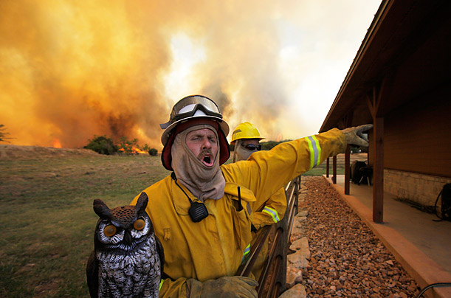

Slide 8
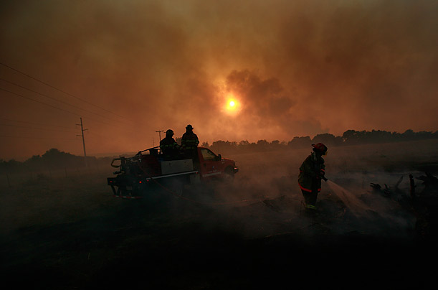

Slide 9
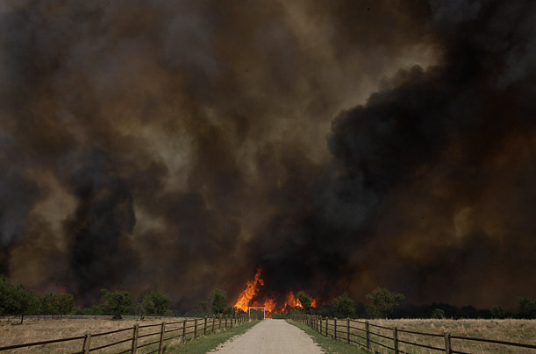

Slide 10
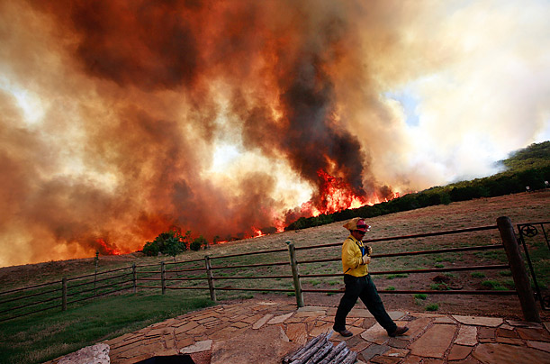

Slide 11
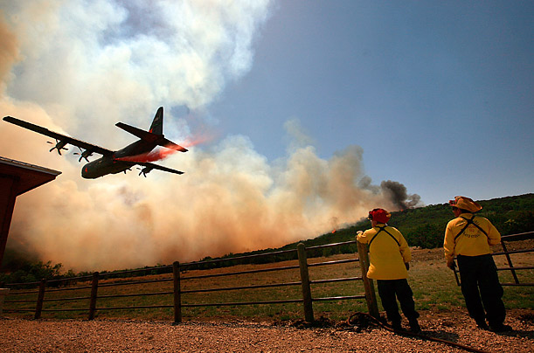
Dropping fire retardant

Slide 12
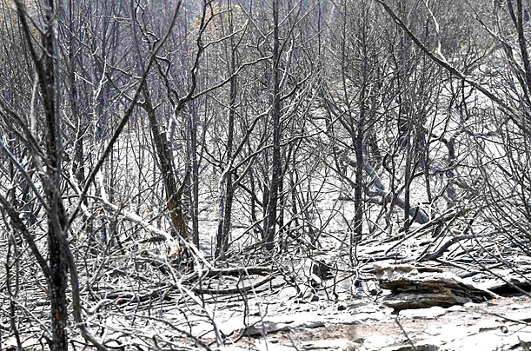
The Aftermath
There were more than 24 other fire locations in Texas, and by July 2011, fires in California, Arizona, & New Mexico.

Slide 13
Other industries are affected in many ways. In mining, you absolutely hate weird weather events, which eat up 14% of the mining economy each year, probably through several avenues: price fluctuations as demand for oil, gas and coal changes in tandem with the weather; threats to the security of mine water supply; and damage to mines and associated transport infrastructure. Agriculture cuts a close second at 12%; crops deal with torrential rain and unreliable temperatures even worse than we do.

Slide 14
The manufacturing, finance, insurance, retail and utilities sectors are also sensitive: people don't buy as many bikinis and bikes in rainy summers, and weather-induced power outages are a huge blow to electric-utility operations. But, wholesale trade, retail trade or services are barely touched by the weather, partly because manufacturers can’t function without wholesalers no matter what the climate; and America still needs its health care and financial advice even when it's raining. (continued after the following photos)

Slide 15
The Aftermath of 240 Tornadoes

Slide 16
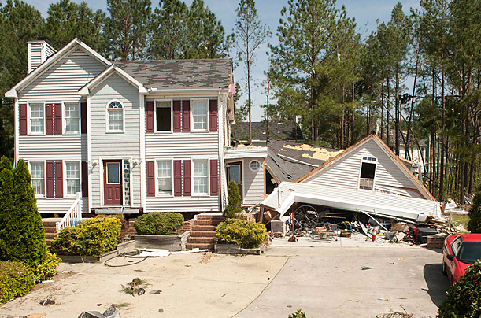
Raleigh, North Carolina, April 18, 2011

Slide 17
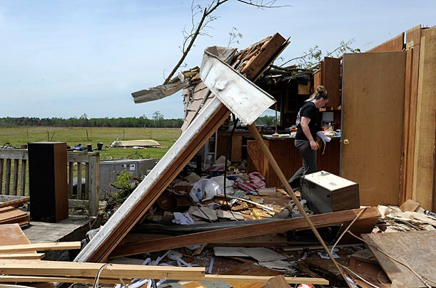
Askewville, North Carolina April 18, 2011

Slide 18
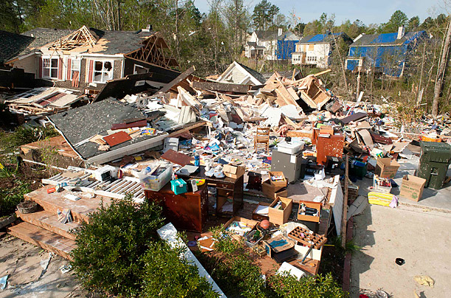
Raleigh, North Carolina, April 18, 2011

Slide 19
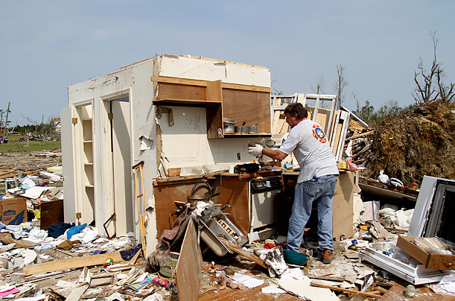
Colerain, North Carolina, April 18, 2011

Slide 20
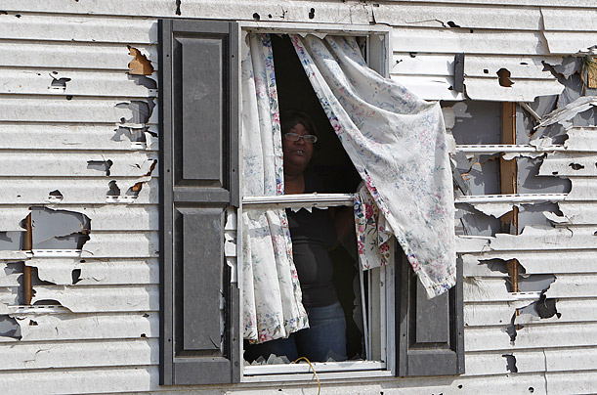
Ammon, North Carolina April 18, 2011

Slide 21
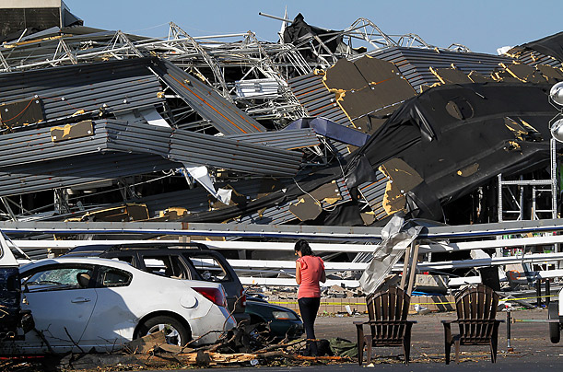
Sanford, North Carolina, April 17, 2011

Slide 22
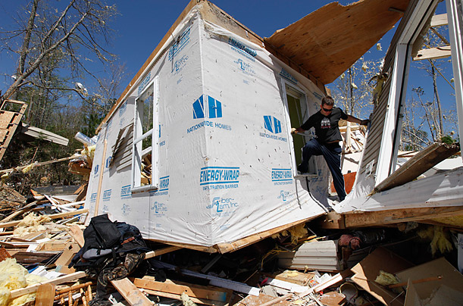
Gloucester, Virginia, April 17, 2011

Slide 23
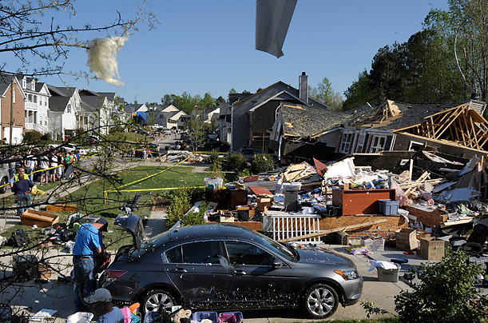
Raleigh, North Carolina, April 17, 2011

Slide 24
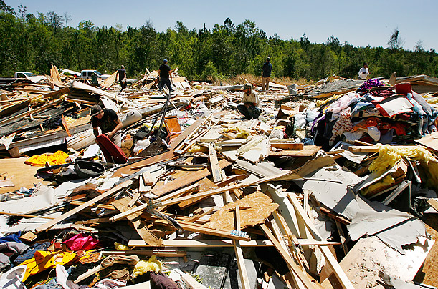
Deer Park, Alabama, April 16, 2011.

Slide 25
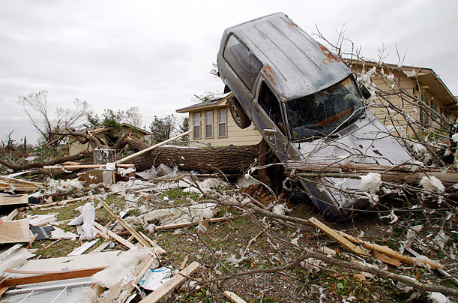
Tushka, Oklahoma, April 15, 2011

Slide 26
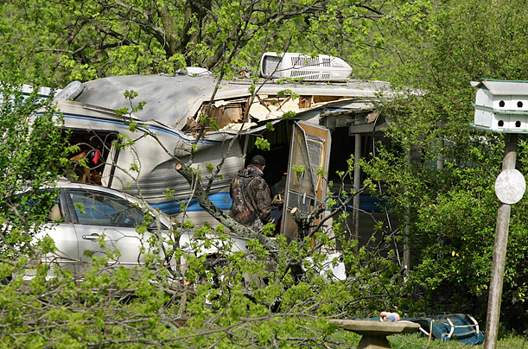
Scott, Ark., April 15, 2011

Slide 27
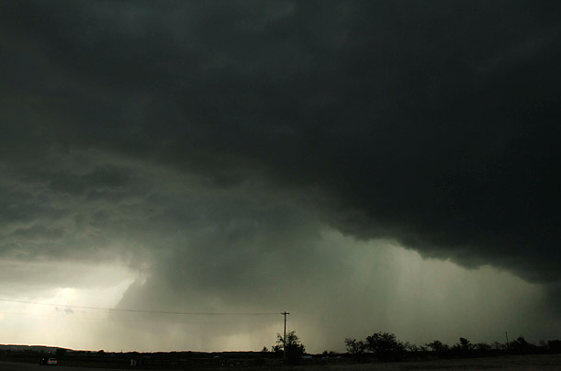
Kiwefer, Oklahoma, April 14, 2011.

Slide 28
Lazo found that states have different vulnerabilities to wild weather. New York was the most sensitive, with weather having a 13.5% impact on its gross state product, and Tennessee fared best, with only a 2.5% impact. While the researchers didn’t provide a concrete explanation for all the state-to-state differences, they noted that states with a larger gross state product, or larger economic outputs, were more weather-sensitive in absolute terms. (A 10% loss of economic activity in a big-revenue state is simply a lot more money than the same 10% in a smaller state.)

Slide 29
Differences may also arise from the fact that coastal regions are hit hardest by tropical storms, while other areas are more susceptible to drought and severe winters. But the study noted that no one part of the country seemed radically more weather sensitive than any other part. (Continued after the following photos)

Slide 30
Historic floods in north dakota
There was also flooding along the Mississippi from Missouri to the Gulf of Mexico.

Slide 31
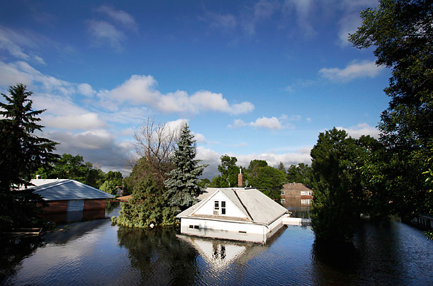
Minot, North Dakota, June 27, 2011

Slide 32
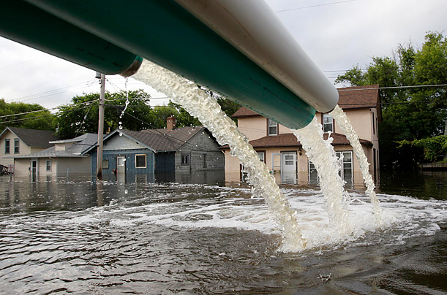
Floodwater is pumped out of the basement of a Minot State University building

Slide 33
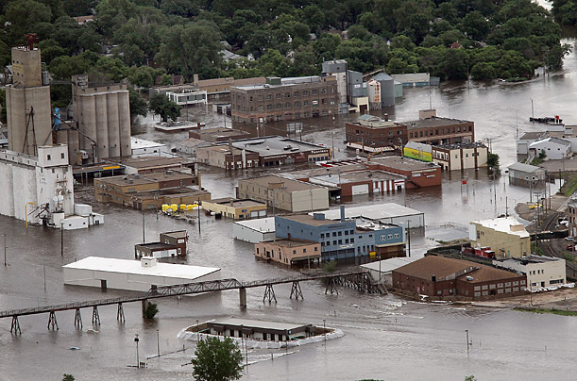
Minot, North Dakota, June 26, 2011

Slide 34
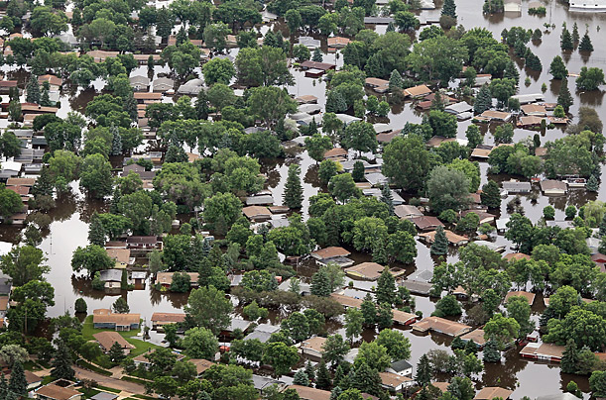

Slide 35
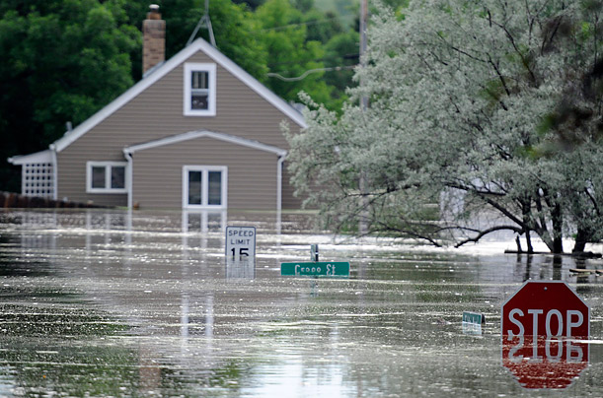
Burlington, North Dakota, June 24, 2011

Slide 36
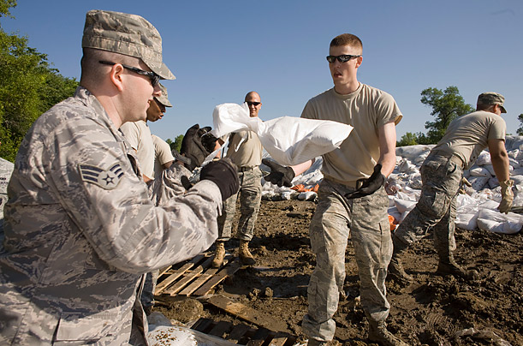
Burlington, North Dakota, June 23, 2011

Slide 37
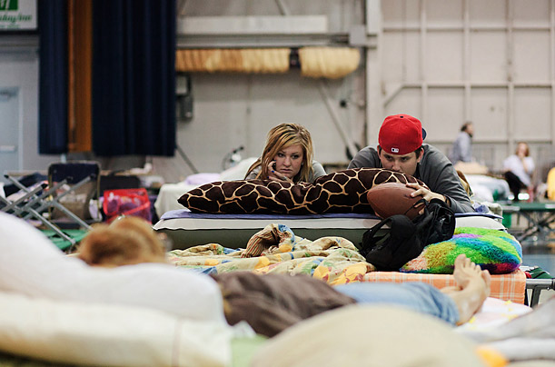

Slide 38
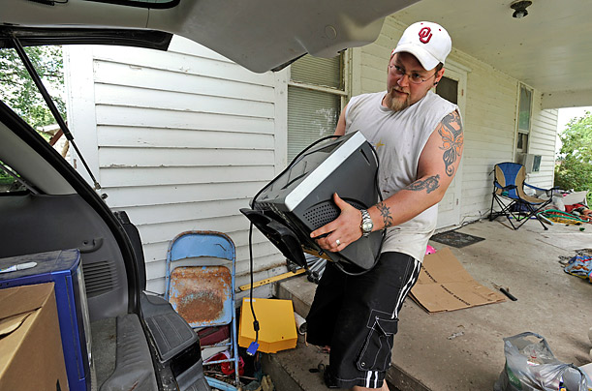
Craig, Missouri, June 21, 2011

Slide 39
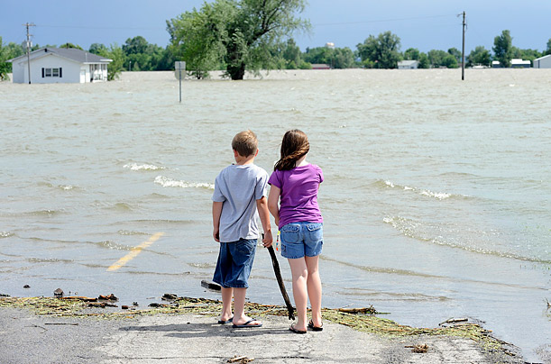
Corning, Missouri on June 21, 2011.

Slide 40
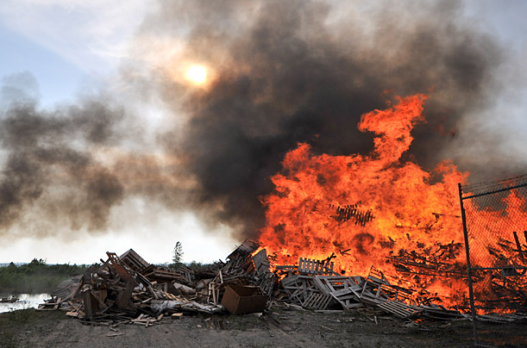
Piles of pallets are set on fire to keep them from becoming debris near Rock Port, Missouri on June 19, 2011.

Slide 41
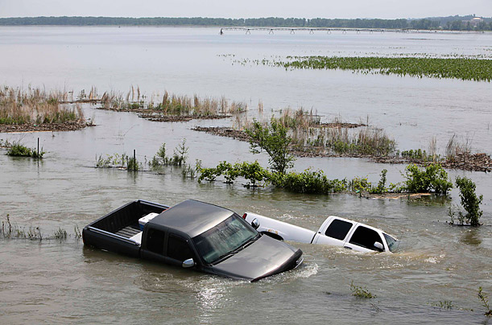
Rural Missouri Valley, Iowa on June 17, 2011

Slide 42
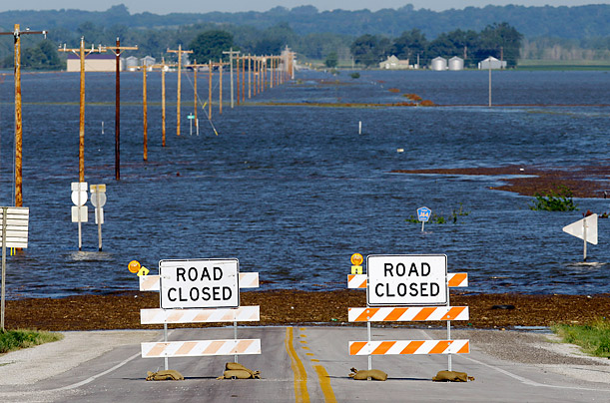
June 15, 2011, Hamburg, Iowa

Slide 43
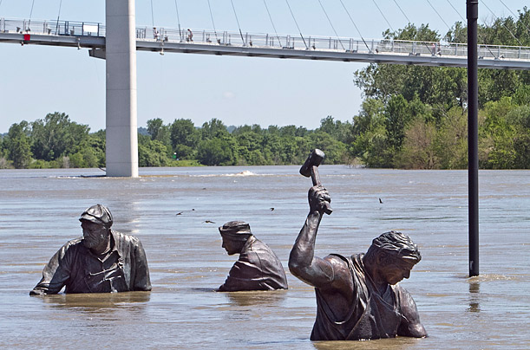
Missouri River in Omaha, Nebraska on June 15

Slide 44
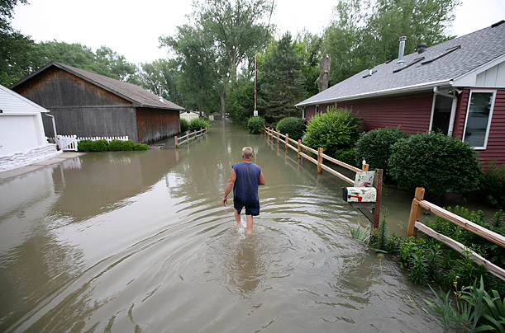
Cottonwood Marina, Nebraska, June 14, 2011

Slide 45
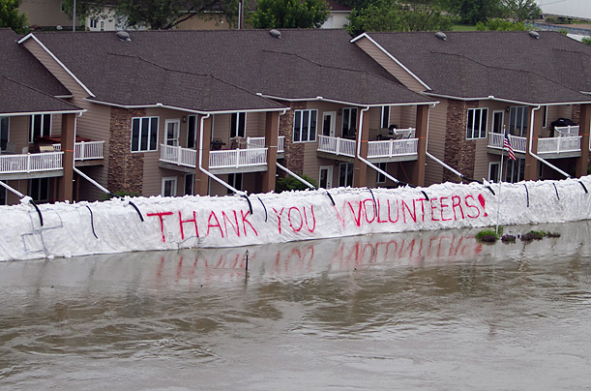
South Sioux City, Nebraska on June 14, 2011

Slide 46
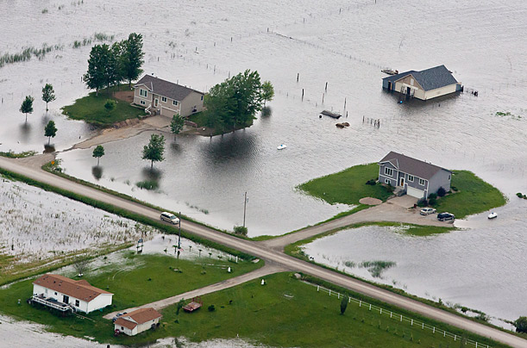
Bartlett, Iowa, June 13, 2011

Slide 47
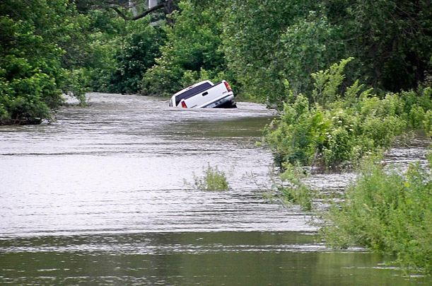
Blair, Nebraska on June 12,

Slide 48
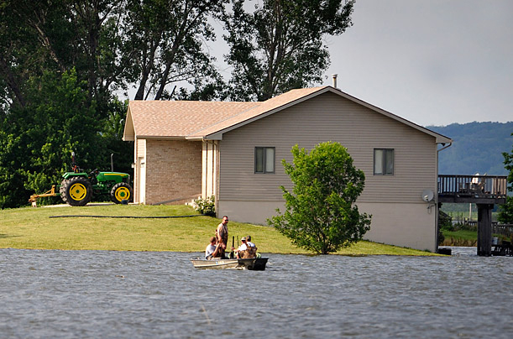
Crescent, Iowa on June 12, 2011

Slide 49
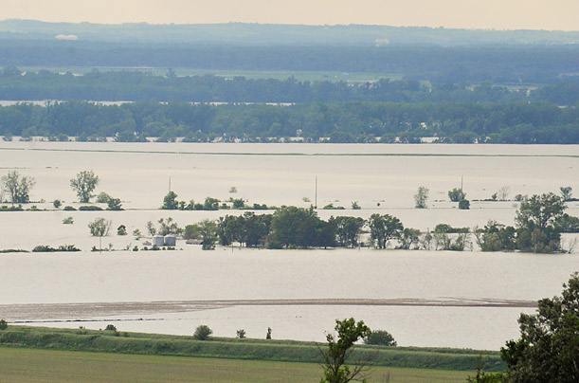
Loveland, Iowa, on June 12, 2011

Slide 50
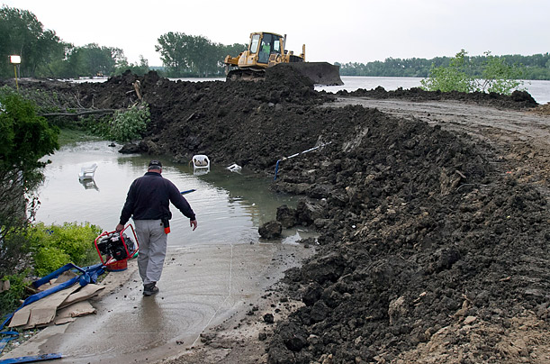
Dakota Dunes, S.D., June 3, 2011

Slide 51
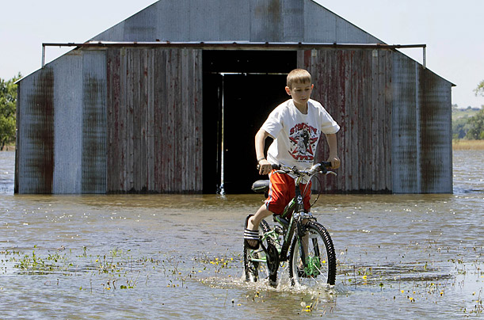
Fort Calhoun, Neb., May 31, 2011

Slide 52
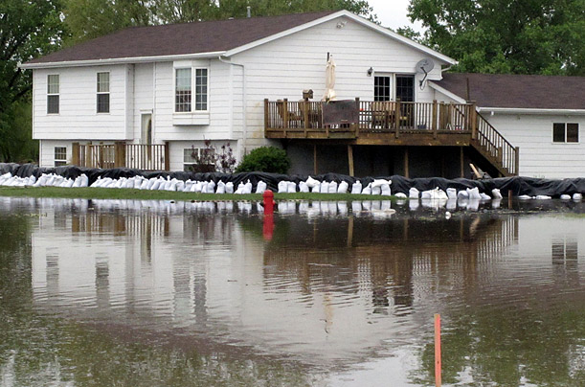
Fort Pierre, S.D., on May 29, 2011

Slide 53
No matter the regional differences, $485 billion is a lot of money, and it remains to be seen how effectively Americans will respond to the threat. If a recent survey by the HNTB Corp., an infrastructure contracting group, is any indication, we have a lot of work to do. More than two-thirds of Americans don't realize that flooding is the biggest natural threat to their home, for example; fewer than 1 in 10 have prepared their homes for flooding, and 63% refuse to pay more taxes for flood-protective measures in their neighborhoods.

Slide 54
Floods are only one part of the weird weather picture, but HNTB flood management practice leader Rob Vining says the survey's findings are a perfect example of how we do a much better job of reacting to disasters than preparing for them. That may be human nature, but it's a part of our nature that we have to learn to fight. If a broken planet isn't enough to mobilize us, a flat-broke country ought to be.

Slide 55
Inside the Flood Zone

Slide 56
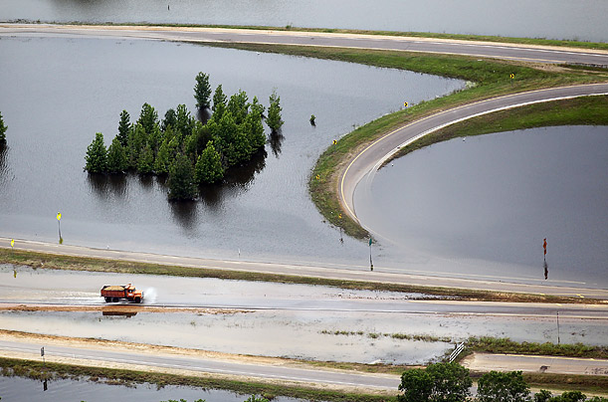
Vicksburg, Mississippi, May 23, 2011

Slide 57
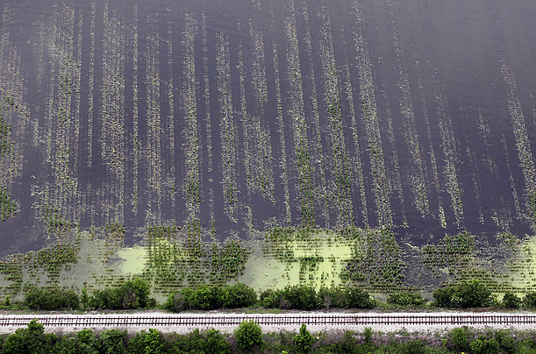
Yazoo County, Mississippi, May 23, 2011

Slide 58
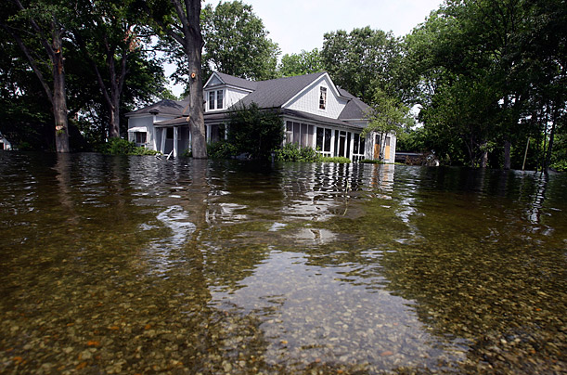
Satartia, Mississippi, May 23, 2011

Slide 59
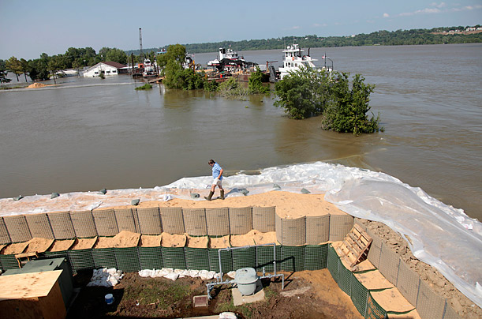
Vidalia, Louisiana, May 22, 2011

Slide 60
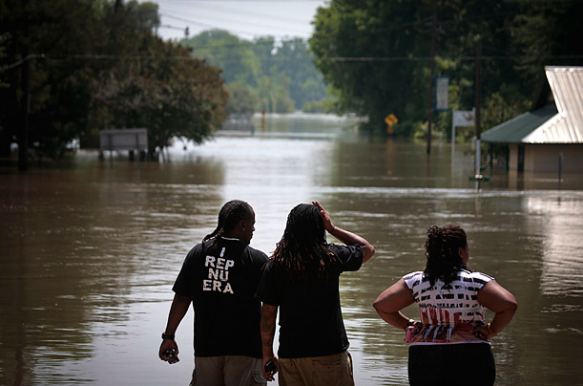
St. Francisville, Louisiana, May 21, 2011

Slide 61
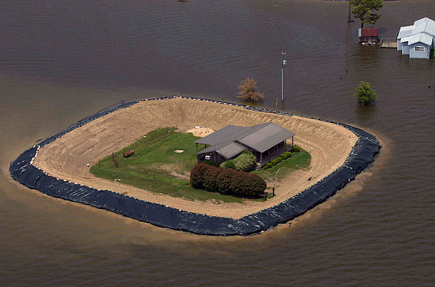
Yazoo City, Mississippi, May 21, 2011

Slide 62
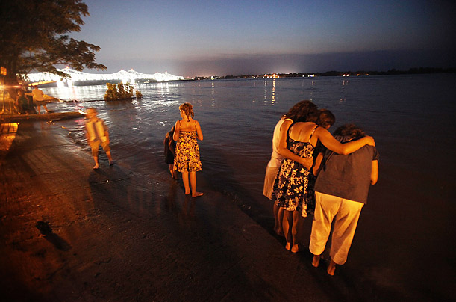
Natchez, Mississippi, May 20, 2011

Slide 63
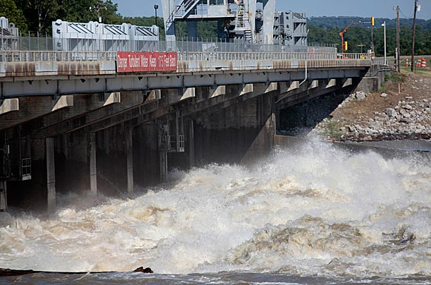
Concordia Parish, Louisiana, May 17, 2011

Slide 64

Highway 61, north of Natchez, Mississippi

Slide 65

Deer Park, Louisiana, May 16, 2011

Slide 66

Simmesport, La., on May 16, 2011.

Slide 67

Melville, La., May 15, 2011

Slide 68

Stephensville, La., on May 15, 2011

Slide 69

Water diverted from the Mississippi River rushes through a bay in the Morganza Spillway in Lousiana on May 14, 2011.

Slide 70

A secondary levee protecting 10,000 acres (about 4,000 hectares) of farmland at Bunches Bend in East Carroll Parish, La., fails on May 13, 2011

Slide 71

New Orleans, May 13, 2011

Slide 72

Greenville, Miss., May 11, 2011

Slide 73
Tornado Rips Through Western Massachusetts

Slide 74

Monson, Massachusetts on June 2, 2011.

Slide 75

Springfield, Massachusetts.

Slide 76


Slide 77


Slide 78


Slide 79


Slide 80


Slide 81


Slide 82


Slide 83


Slide 84
Only Half Way There
The events mentioned in the preceding material occurred in the first half of 2011. We still have most of hurricane season to go through as well as the driest months of the year (greater forest fire threat is to come).

