Slide 1
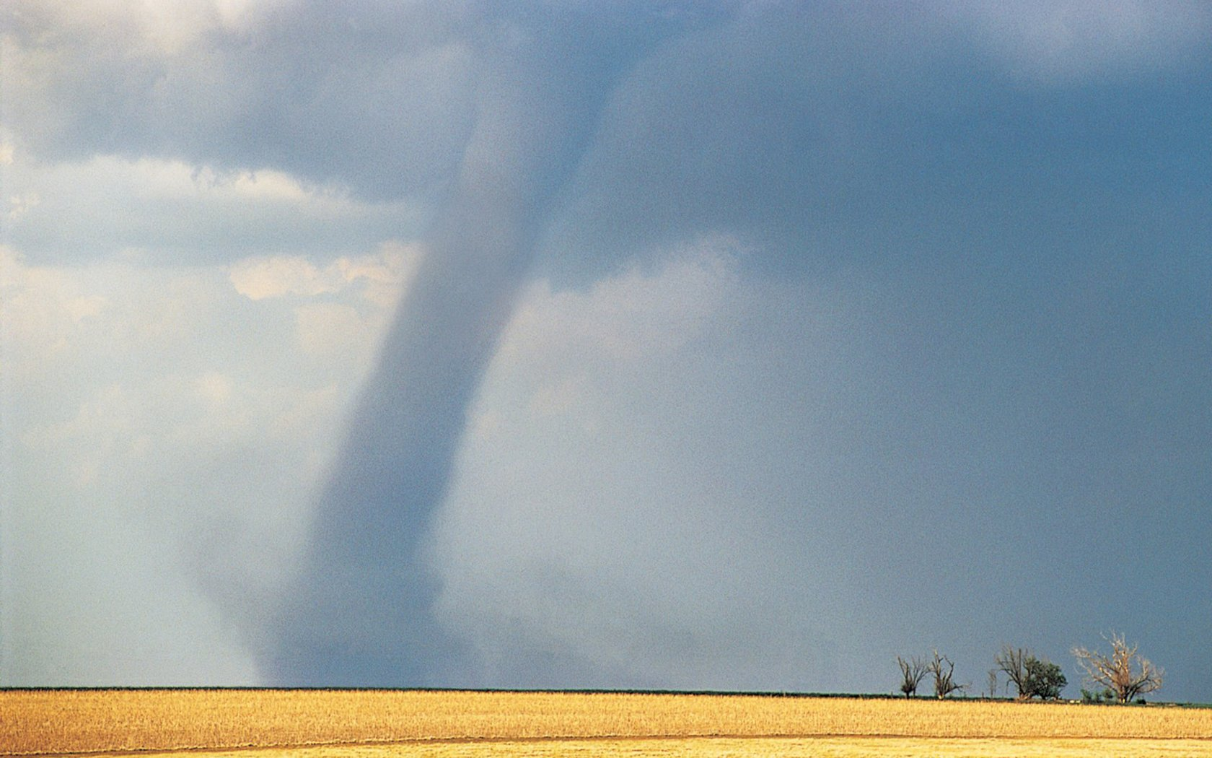
Tornado: Devastation in Joplin, Mo on May 22, 2011

Slide 2
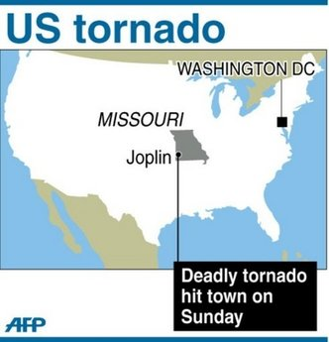

Slide 3
Disaster
Residents of Joplin, Missouri, had about 20 minutes of warning before a tornado strike Sunday. But this spring, early warnings have not been enough to prevent high death tolls from tornadoes.
Traffic lights, street and miscellaneous signs were leveled with numerous houses and buildings by a tornado that struck Joplin, Mo, on Sunday, May 22. The tornado cut a swath 6 miles long and one half of a mile wide through the heart of Joplin, Missouri. On May 29, they had counted at least 139 dead with 100 unaccounted for.

Slide 4
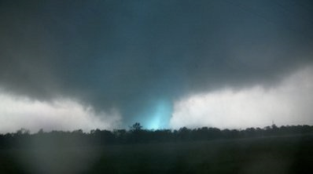

Slide 5

A covered body is seen in a tornado ravaged car while emergency workers wait for a medical team to arrive in Joplin, Missouri, Monday, May 23, 2011.

Slide 6
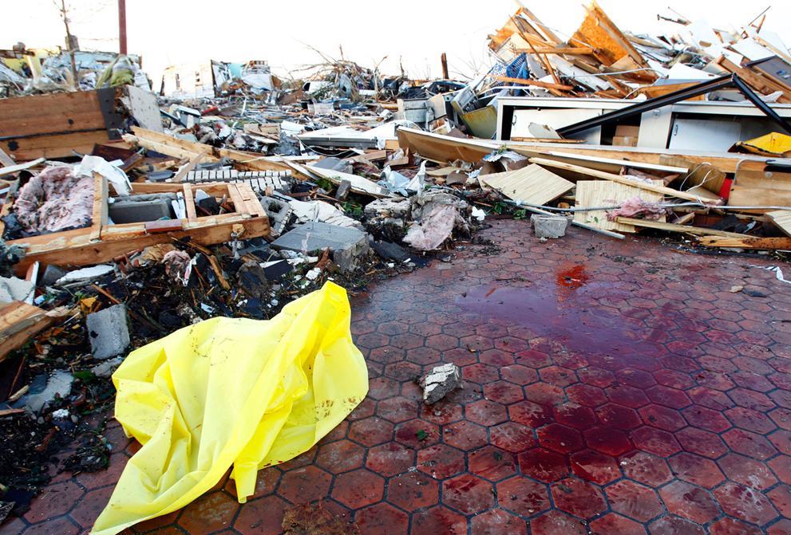
Pool of blood in a destroyed business

Slide 7
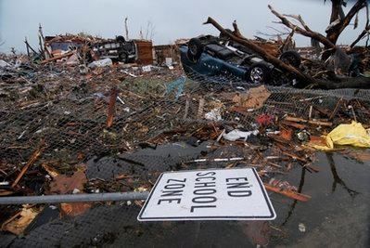

Slide 8
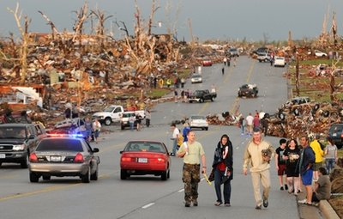

Slide 9
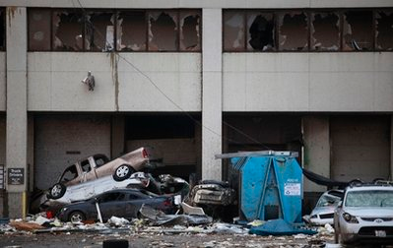

Slide 10
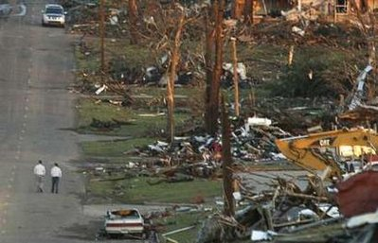

Slide 11
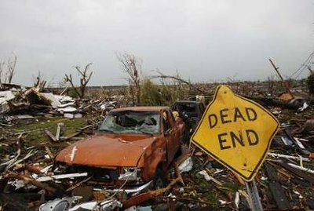

Slide 12
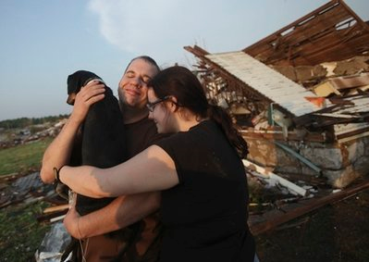

Slide 13
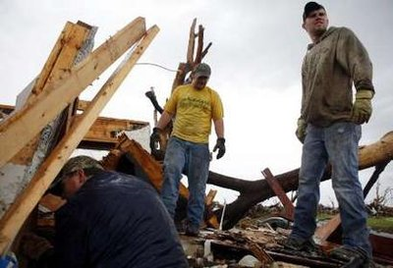
Searching for survivors

Slide 14
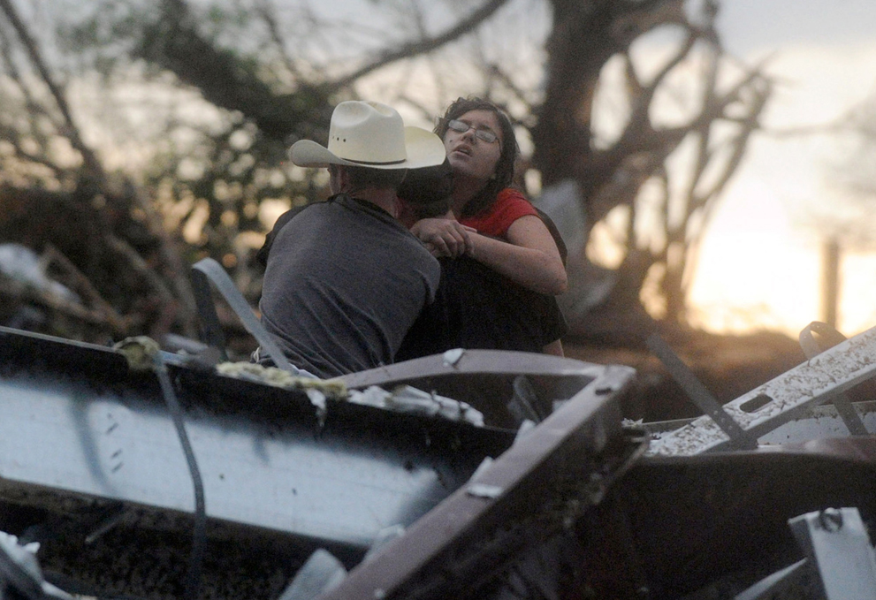
Pulling a woman from the wreckage

Slide 15
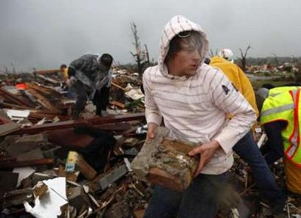

Slide 16
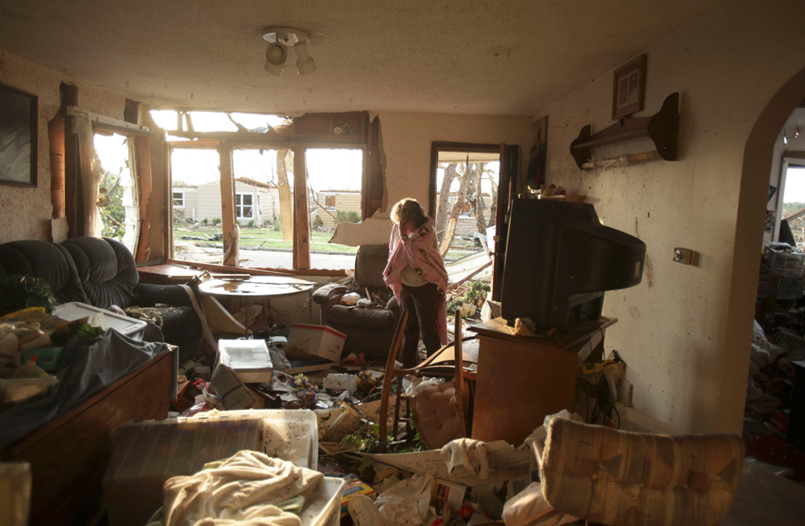

Slide 17
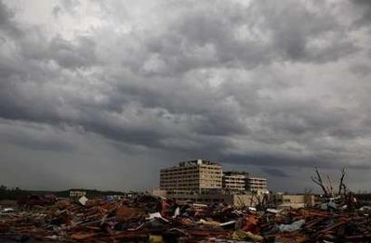
A view of the devastation after a tornado blew the roof off the St. John's Regional Medical Center, where about 180 patients cowered as the fierce winds blew, in Joplin.

Slide 18
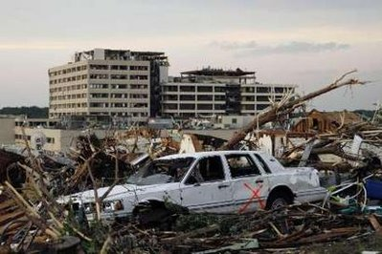

Slide 19
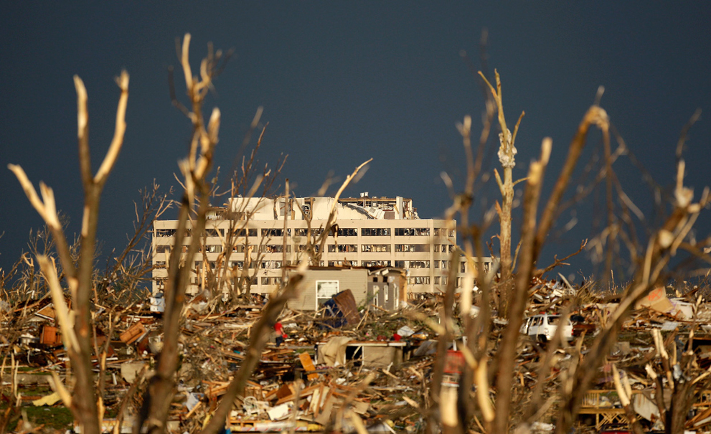

Slide 20
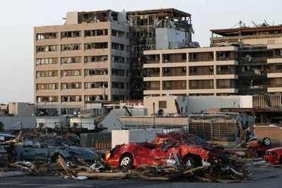

Slide 21
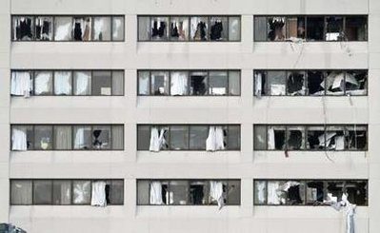

Slide 22
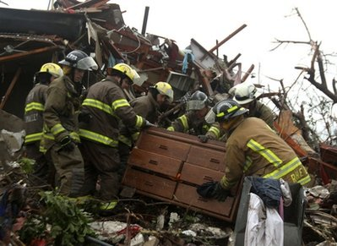
Searching for victims

Slide 23
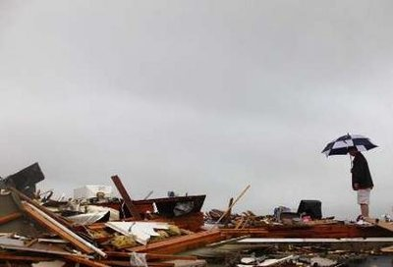

Slide 24
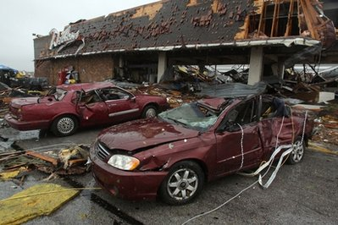

Slide 25
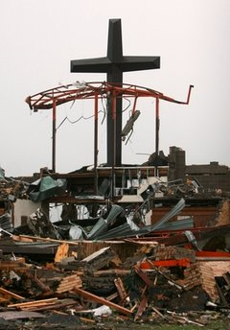
All that is left of St. Mary’s Catholic Church

Slide 26
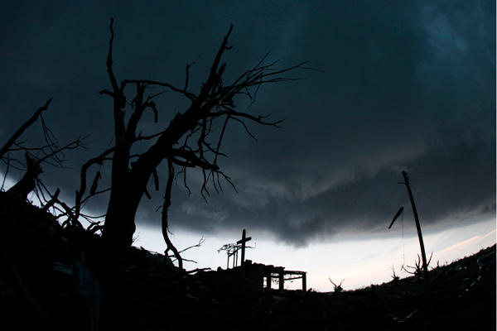

Slide 27
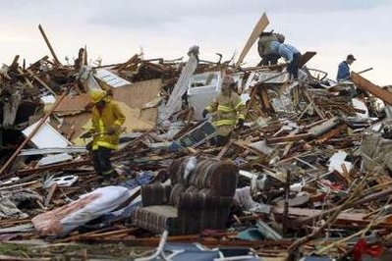

Slide 28
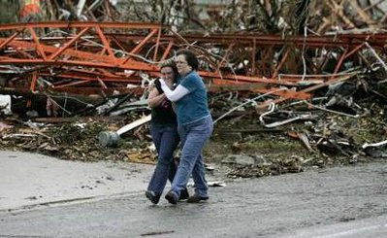

Slide 29
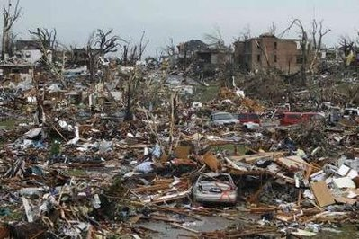

Slide 30
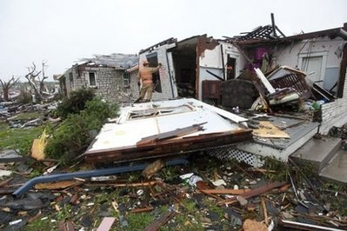

Slide 31
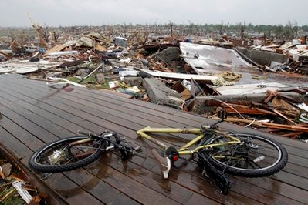

Slide 32
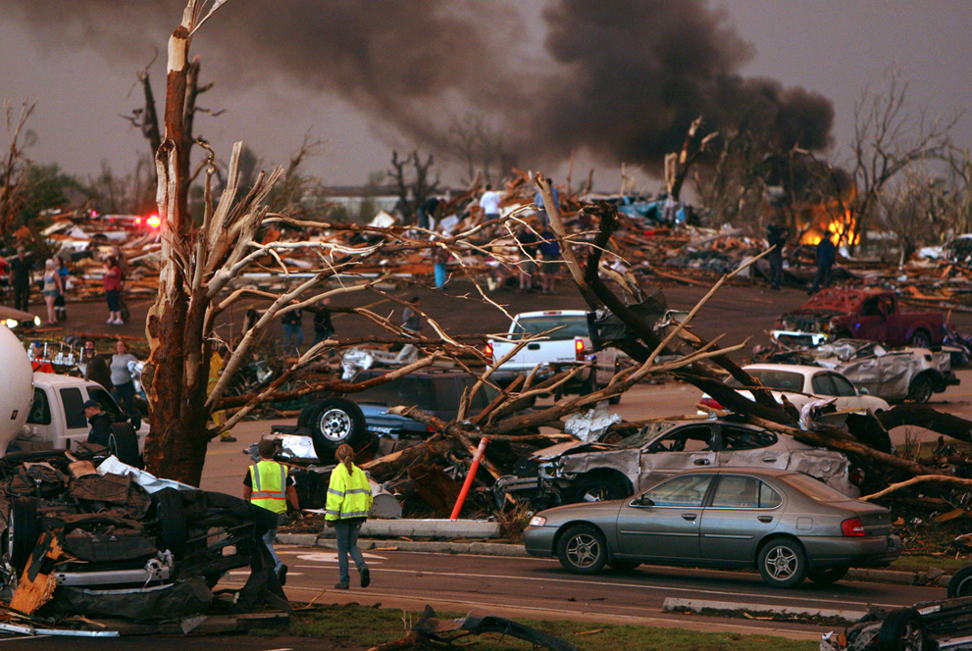
Fire from ruptured gas line.

Slide 33
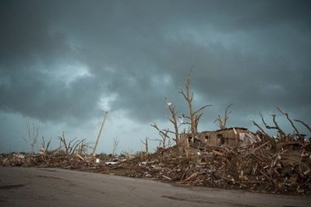

Slide 34
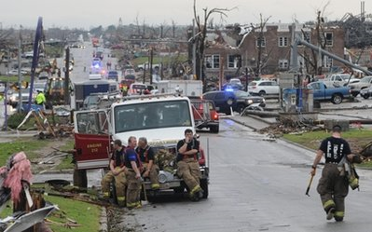

Slide 35
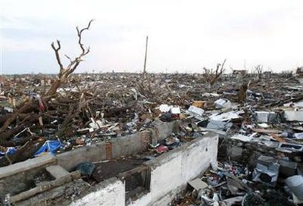
This had been a residential area

Slide 36
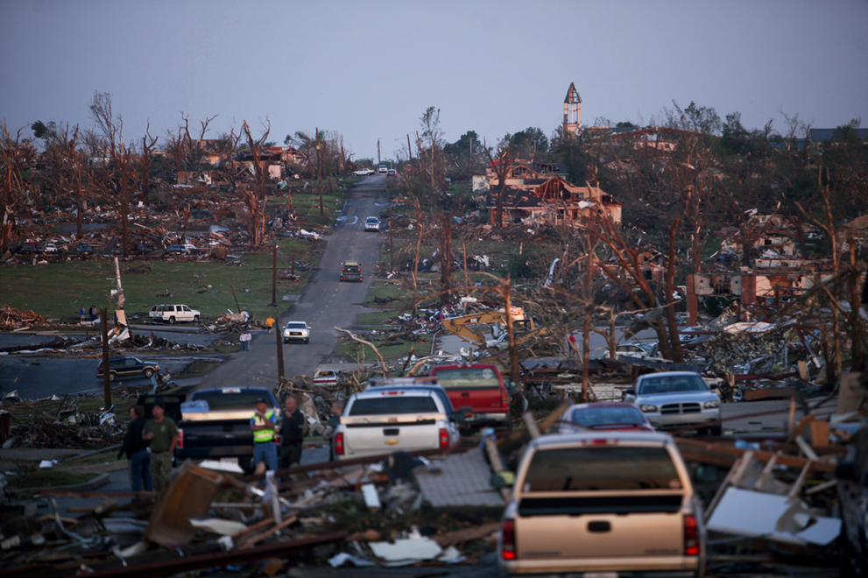

Slide 37
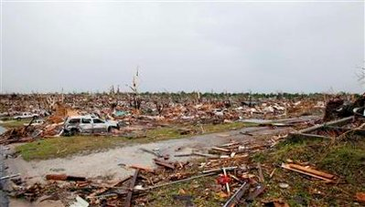

Slide 38
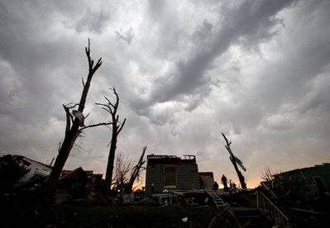

Slide 39
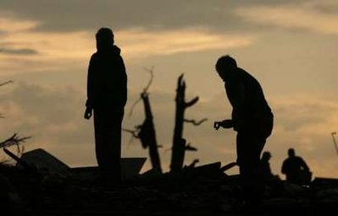

Slide 40


Slide 41

Friends check up on friends and offer help

Slide 42
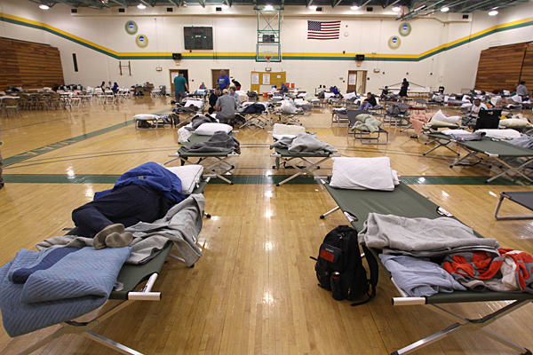
Shelter for evacuees

Slide 43
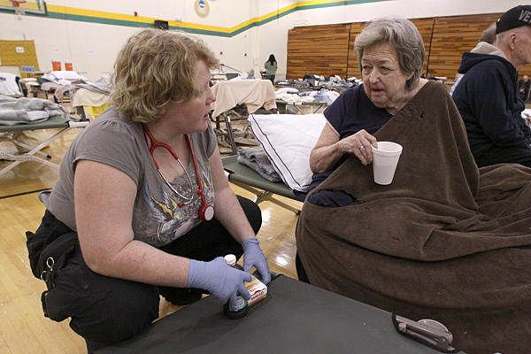

Slide 44

Sunset on May 22 (after the tornado)

Slide 45
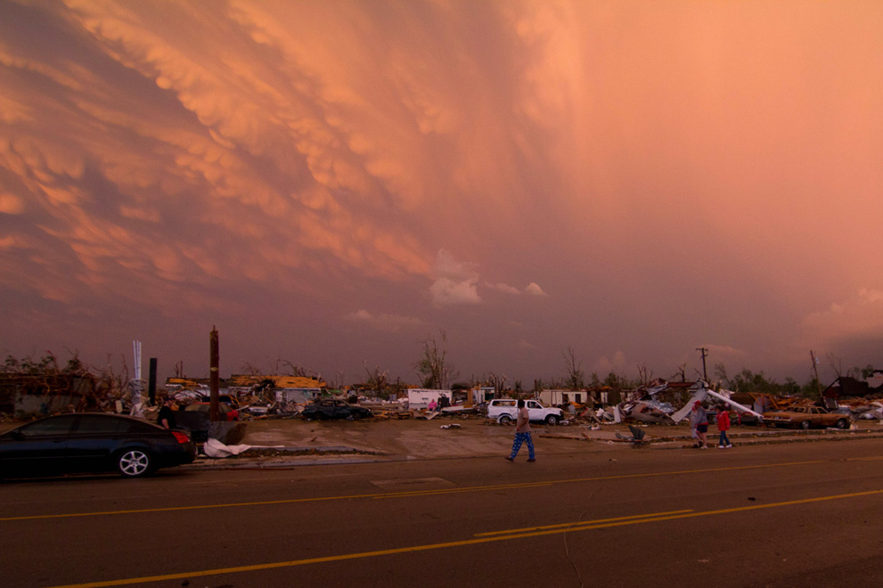

Slide 46
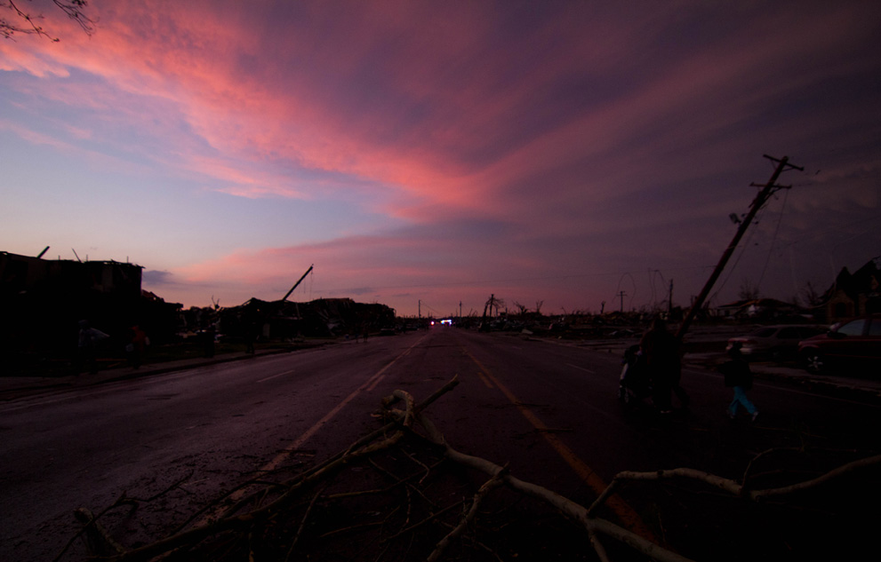

Slide 47
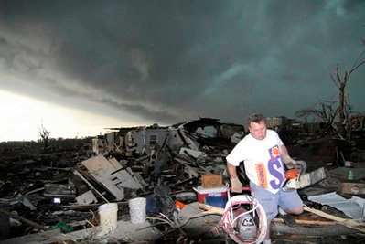
More storms hit Joplin on Monday

Slide 48
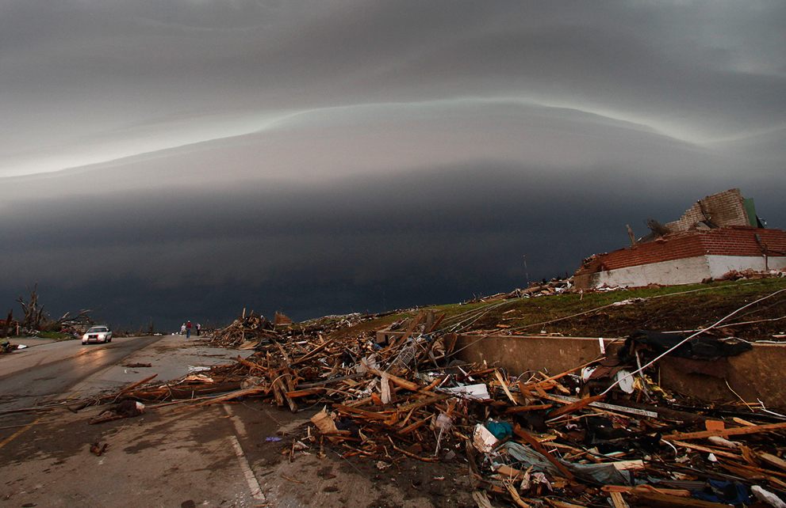
A shelf cloud containing a thunderstorm approaches a tornado-ravaged neighborhood on Monday, May 23, 2011

