Slide 1
Cyclone (hurricane –typhoon) sailing
Very Dangerous . . .

Slide 2
Tropical cyclone Phet
Wed Jun 2, 2010 9:45am EDT
MUSCAT (Reuters) - Tropical cyclone Phet barreled toward the coast of the Gulf Arab state of Oman on Wednesday, strengthening quickly on its way to becoming a powerful category five storm.
Phet was a Category 3 storm on Wednesday, with sustained winds of over 130 mph. It was expected to become a Category 5 storm, the most powerful with winds of over 156 mph,

Slide 3
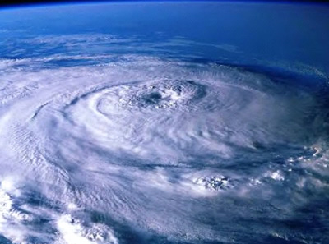

Slide 4
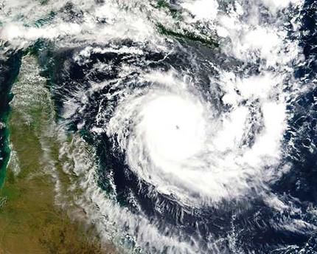

Slide 5
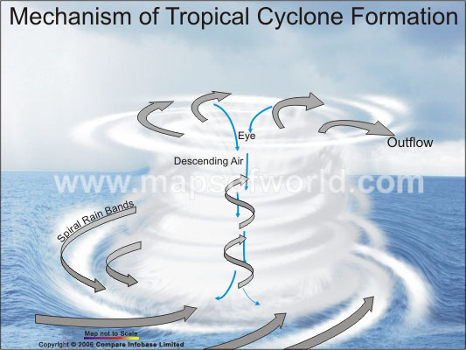

Slide 6
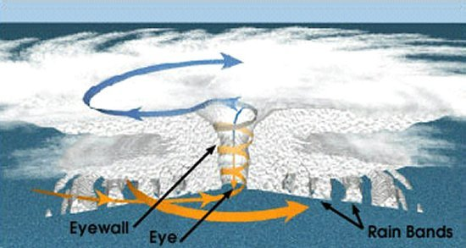

Slide 7
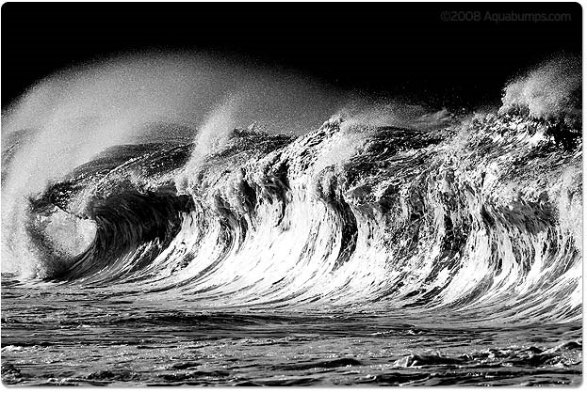
Cyclones Produce Huge Waves

Slide 8
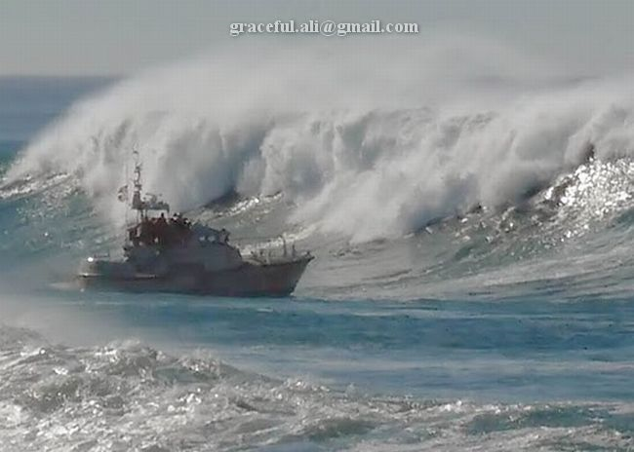
Ship dealing with waves caused by Cyclone Phet

Slide 9
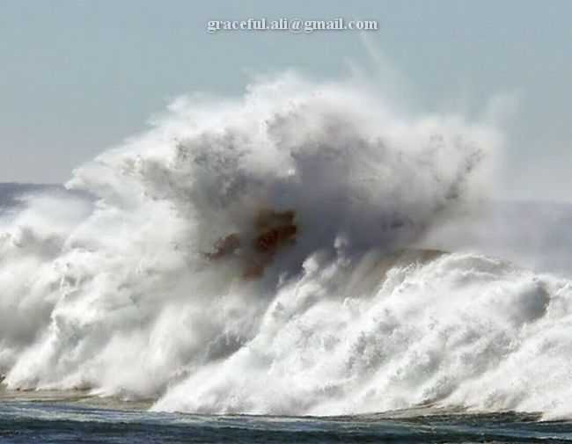

Slide 11
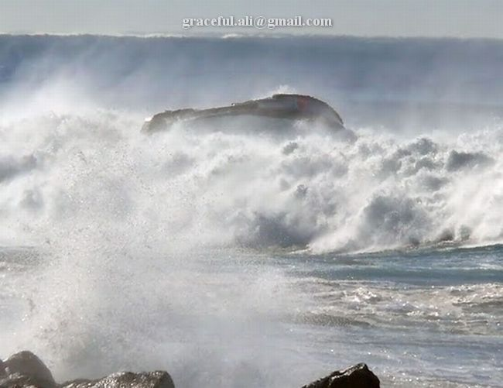

Slide 12
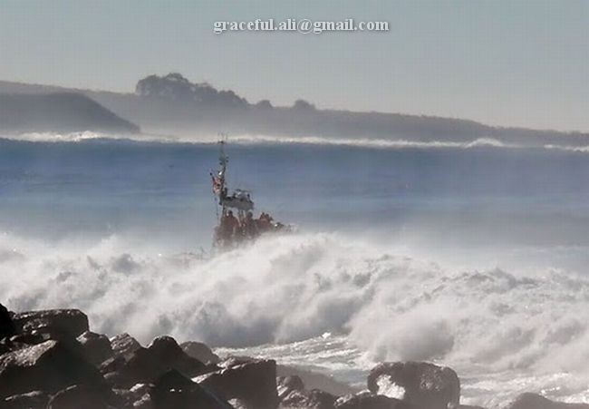

Slide 13
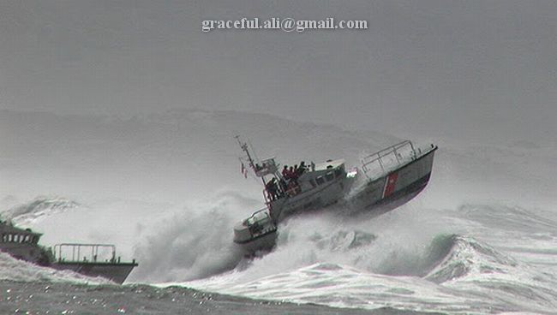
Phew!!!!

Slide 14
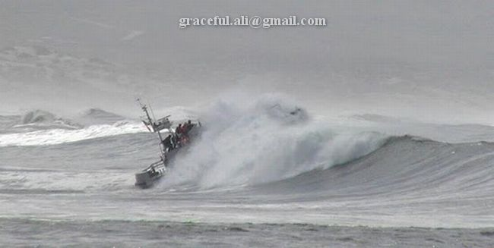

Slide 15
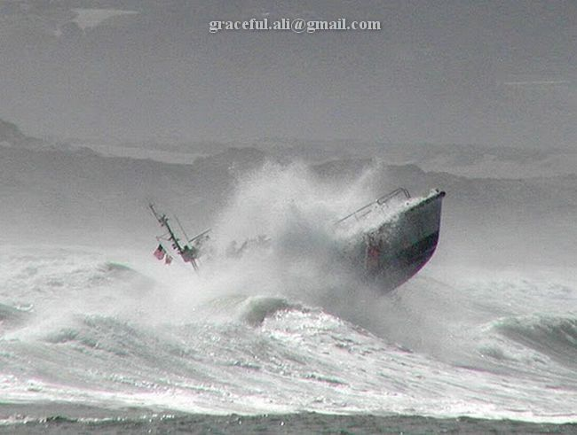

Slide 16
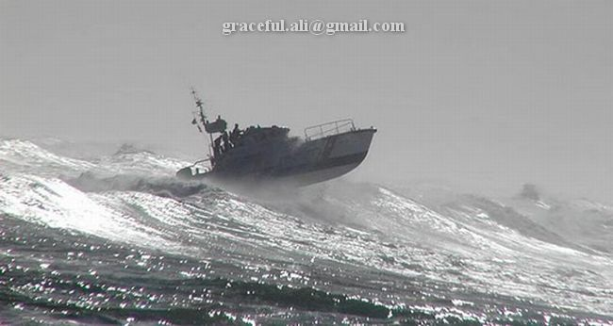
Double Phew!

Slide 17
Cyclone Ratings

Slide 18

One
One 74-95 mph No real damage to building structures. Damage primarily to unanchored mobile homes, shrubbery, and trees. Also, some coastal road flooding and minor pier damage

Slide 19
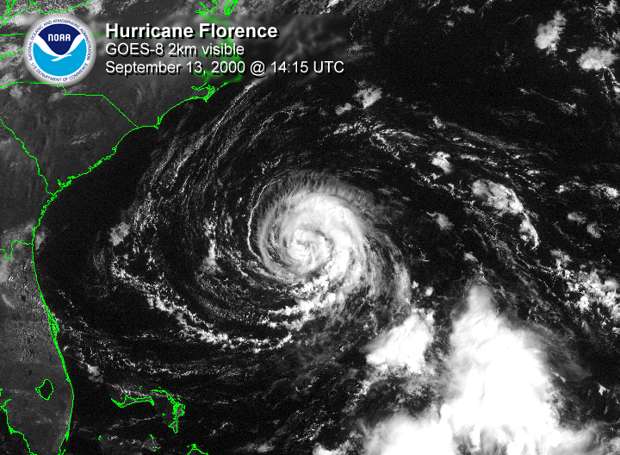

Slide 20
Two
Two 96-110 mph Some roofing material, door, and window damage to buildings. Considerable damage to vegetation, mobile homes, and piers. Coastal and low-lying escape routes flood 2-4 hours before arrival of center. Small craft in unprotected anchorages break moorings.

Slide 21
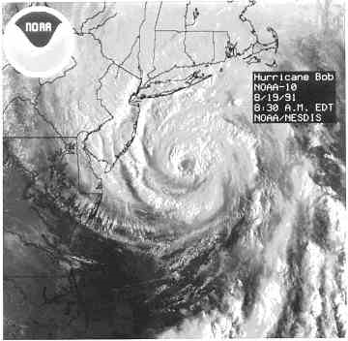

Slide 22
Three
Three 111-130 mph Some structural damage to small residences and utility buildings with a minor amount of curtain wall failures. Mobile homes are destroyed. Flooding near the coast destroys smaller structures with larger structures damaged by floating debris. Terrain continuously lower than 5 feet Above Sea Level (ASL) may be flooded inland 8 miles or more.

Slide 23
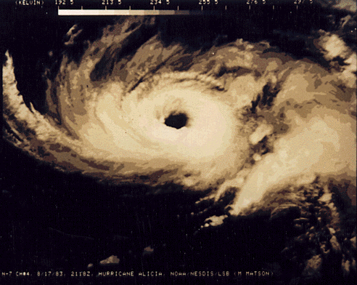

Slide 24
Four
Four 131-155 mph More extensive curtain wall failures with some complete roof structure failure on small residences. Major erosion of beach. Major damage to lower floors of structures near the shore. Terrain continuously lower than 10 feet ASL may be flooded requiring massive evacuation of residential areas inland as far as 6 miles

Slide 25
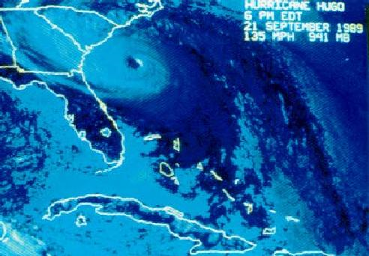

Slide 26
Five
Five greater than 155 mph Complete roof failure on many residences and industrial buildings. Some complete building failures with small utility buildings blown over or away. Major damage to lower floors of all structures located less than 15 feet ASL and within 500 yards of the shoreline. Massive evacuation of residential areas on low ground within 5 to 10 miles of the shoreline may be required.

Slide 27
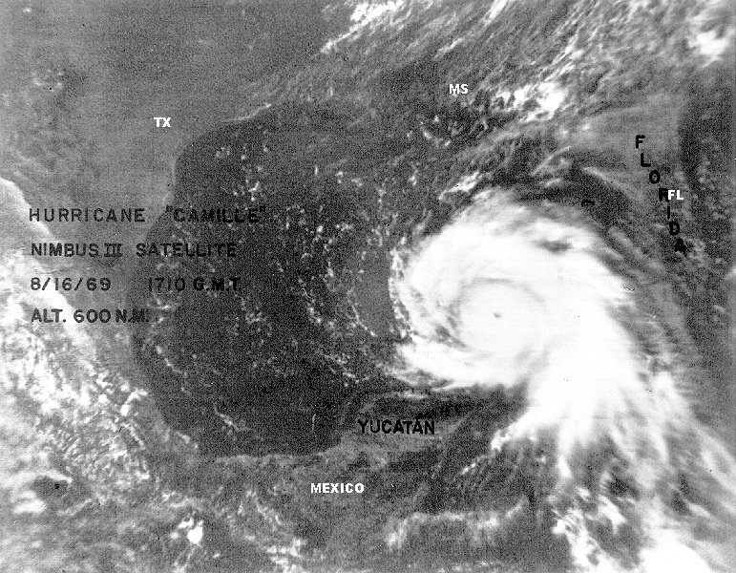

Slide 28
Storm Surge
Though people remember hurricanes for their tempestuous winds and heavy rainfall, the most deadly aspect of these storms is what is known as Storm Surge. As these hurricanes move about in the ocean, their deep pressure core churns up the ocean and actually plows the water ahead of it. Normally in open water this resembles terribly rough seas, but it becomes an entirely different scenario when faced with a fixed land mass.

Slide 29
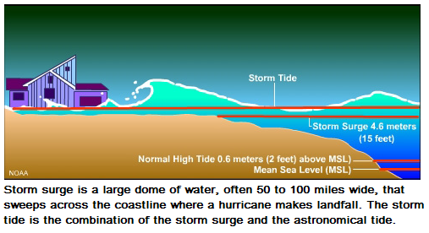

Slide 30
