Slide 1
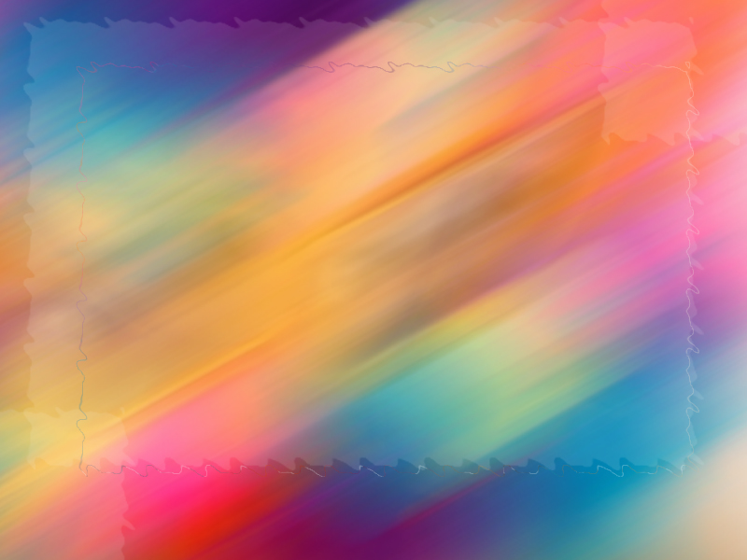
Atmospheric Color – Atmospheric Moisture Plus Light
The rainbow plus other atmospheric wonders

Slide 2
Everyone is familiar with rainbows!
Raindrops act like prisms, revealing the colorful components of “white” light.
They often occur after a daytime thunderstorm – the clouds move and allow the sunlight to interact with moisture laden air.

Slide 3
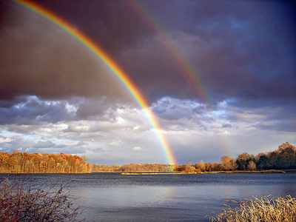

Slide 4
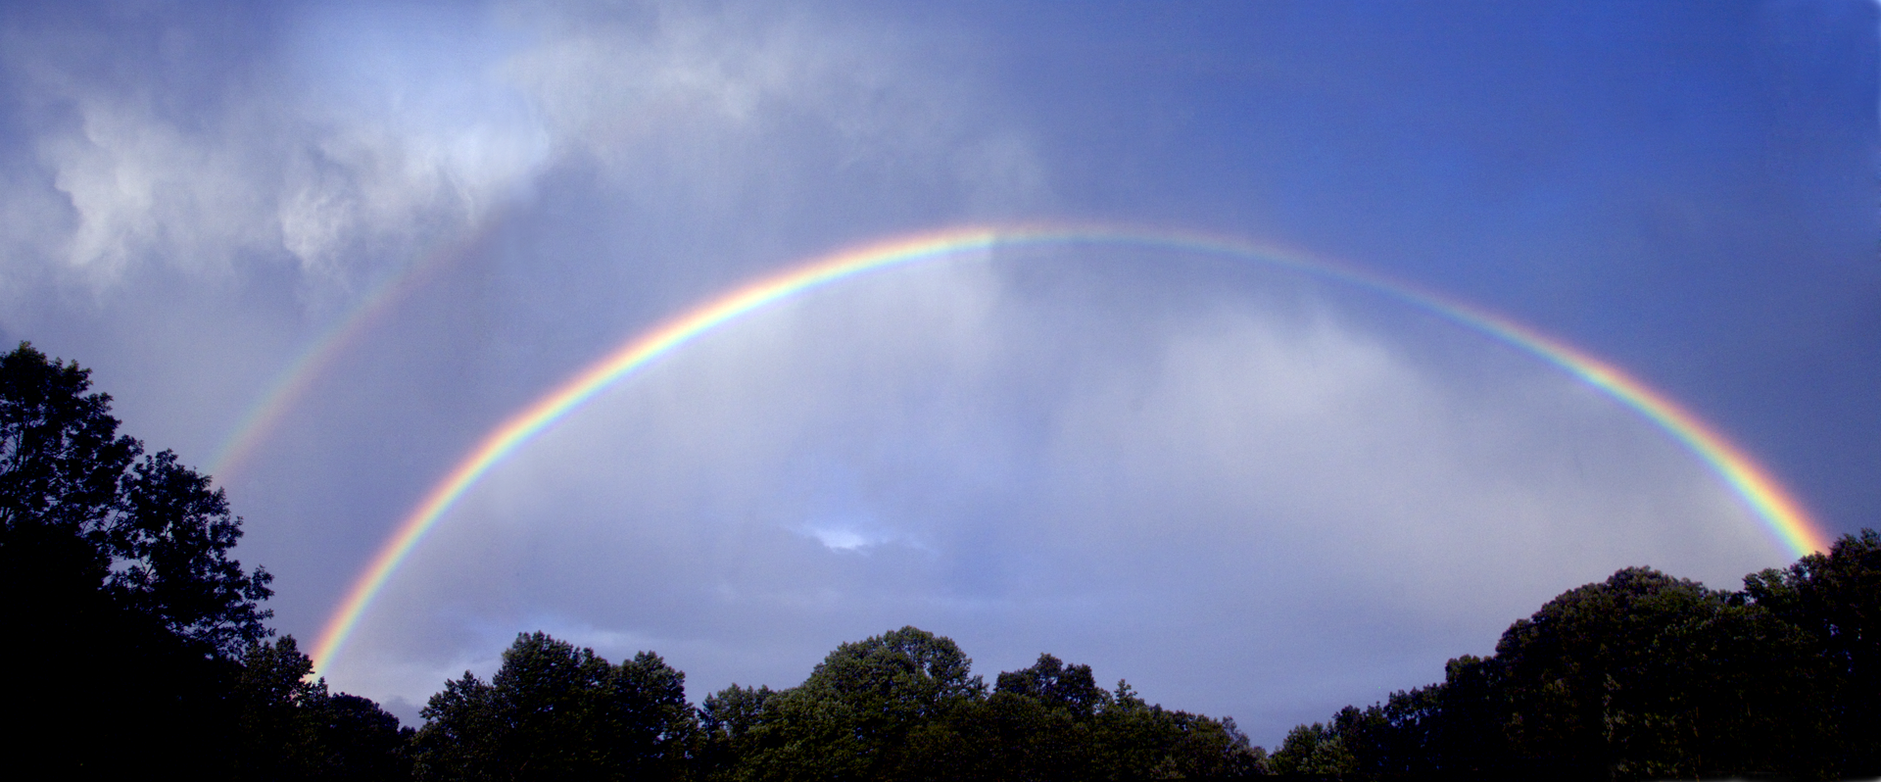

Slide 5
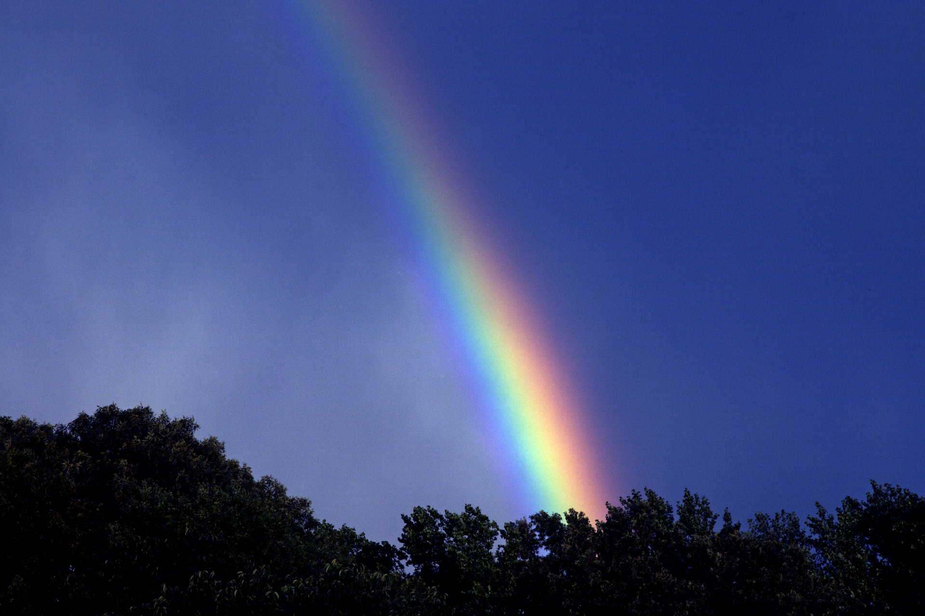

Slide 6
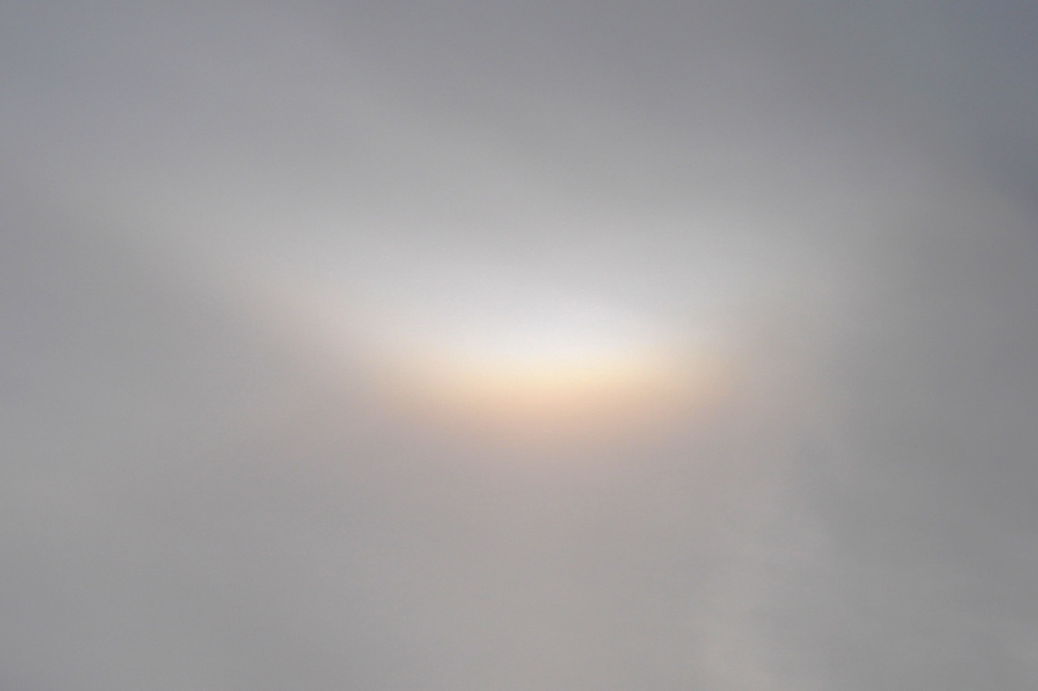
Inverse Rainbow - Circumzenithal arc

Slide 7
Circumzenithal arc
is an optical phenomenon similar in appearance to a rainbow; but it arises from refraction of sunlight through horizontally-oriented ice crystals, generally in cirrus clouds, rather than from raindrops. It forms no more than one-quarter of a circle centered on the zenith and on the same side as the sun. Its colors are from blue on the inside to red on the outside of the arc. It is one of the brightest and most colorful halos. Its colors are purer than those of the rainbow because there is much less color overlap in its formation. The first impression is that of an upside-down rainbow

Slide 8
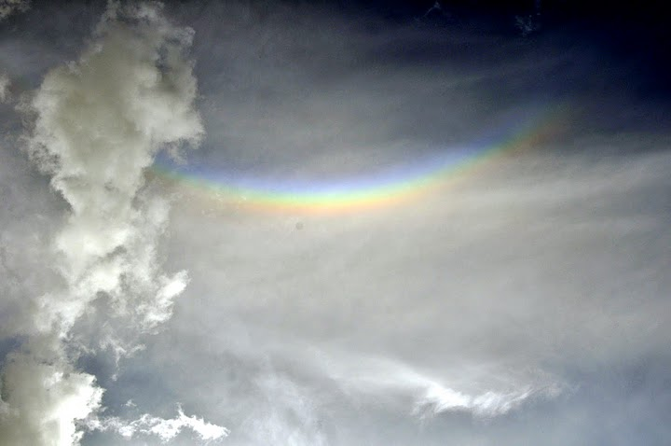

Slide 9
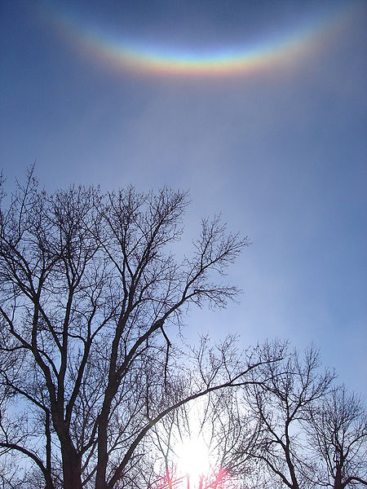

Slide 10
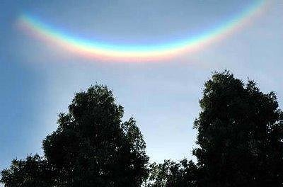

Slide 11
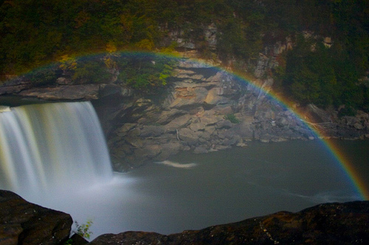
Somewhere over the... moonbow: Dazzling arc of colour lights up night sky at Yosemite National Park and cumberland Falls.

Slide 12
Moonbow
This dazzling arc of colour soaring across the night sky looks unreal.
But this is no fantasy or trick of the light, it is known as a moonbow, the rainbow of the night.
These rare lunar rainbows can only be seen in a few places on earth.

Slide 13
The Yosemite National Park in California is one of the best places to catch a glimpse of the phenomenon.
Sunlight reflects off the moon and hits the droplets spraying off the park's spectacular waterfalls.
'A lot of people don't realize that we even get rainbows at night in Yosemite,' said Steve Bumgardner who took these images as part of a new video of the spectacle.

Slide 14
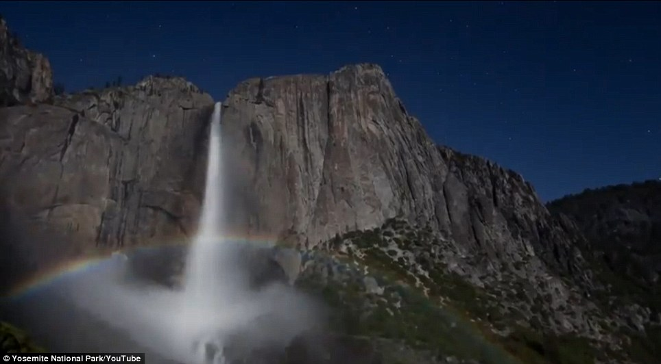
Spectacular: Sunlight is reflected off the moon to create this dazzling arc of colour in the Yosemite National Park

Slide 15
'If there's a full moon and the sky is clear, the moon, which is just reflected sunlight, is actually enough light to generate a rainbow at a place like Yosemite Falls.'
The remarkable spectrums of lights are best seen at the park during the spring and summer seasons.
'Yosemite is a 24-hour park and its well-illustrated by the numbers of people who are going to go out all night long to take pictures of moonbows,' said park ranger Bob Roney.

Slide 16
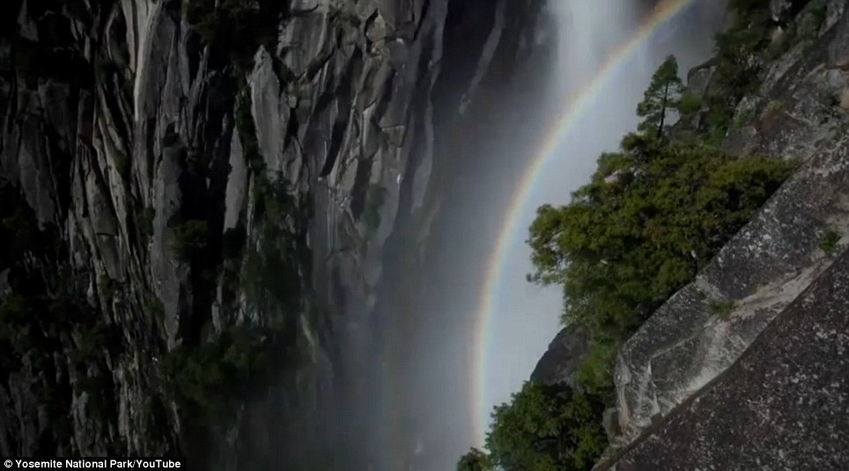

Slide 17
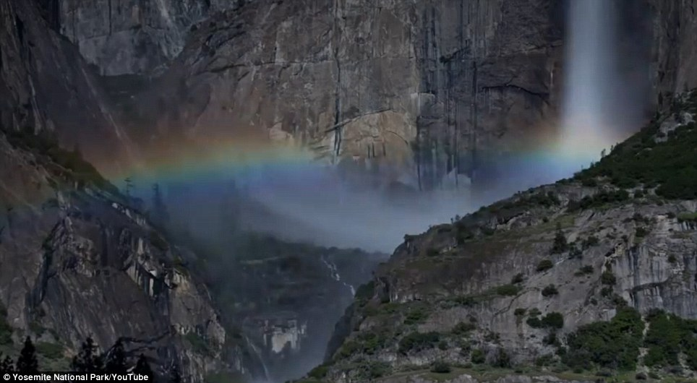

Slide 18
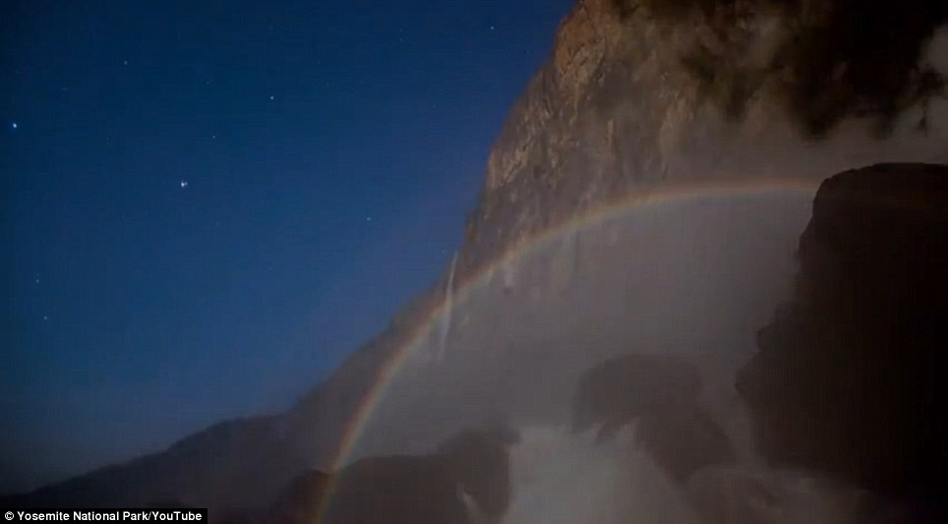

Slide 19
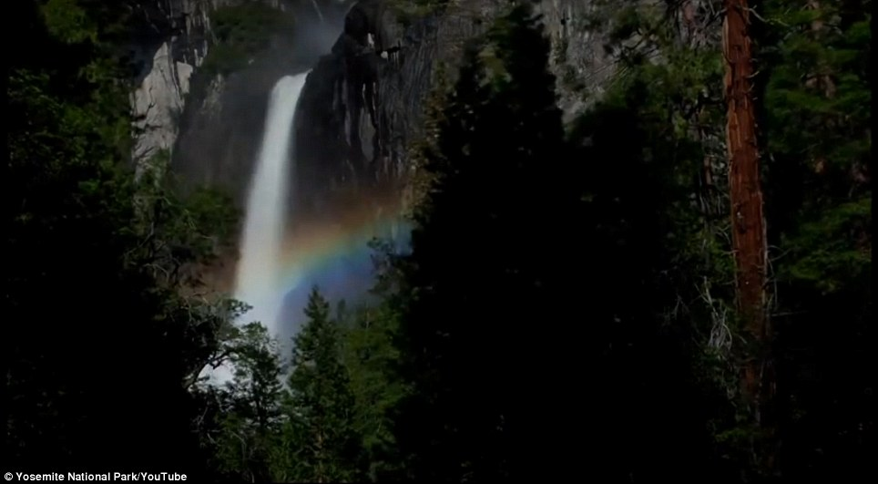

Slide 20
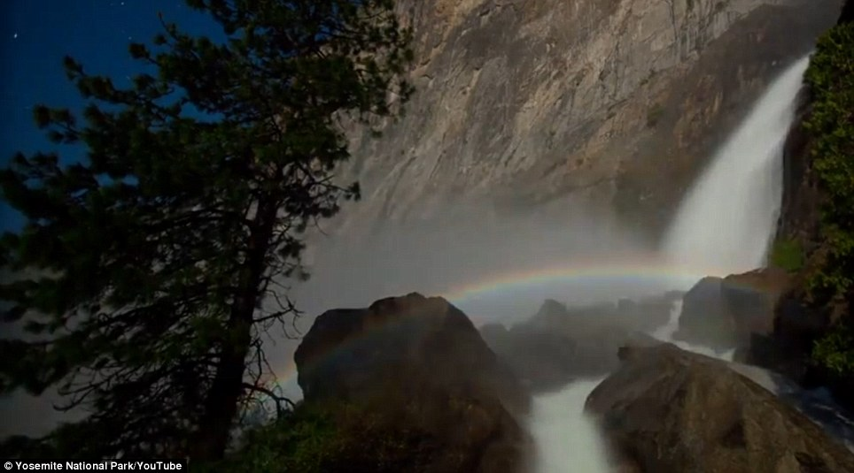

Slide 21
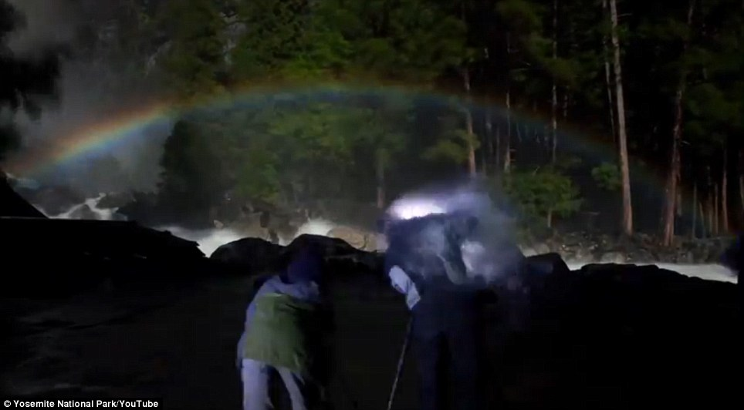

Slide 22
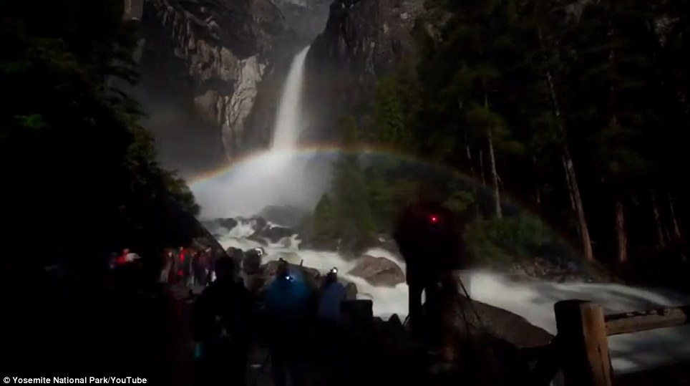

Slide 23
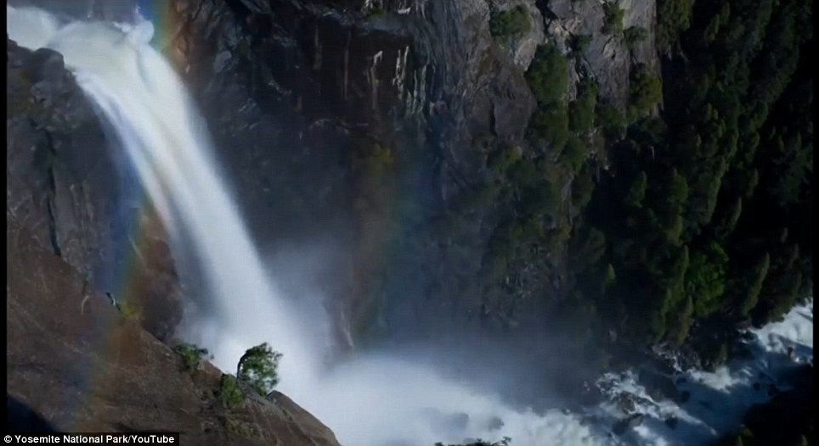

Slide 24
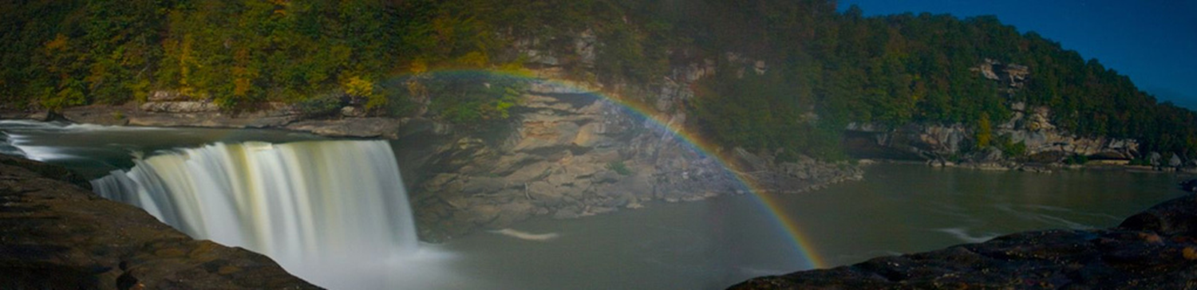
Cumberland Falls

Slide 25


Slide 26
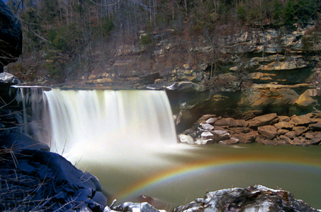

Slide 27
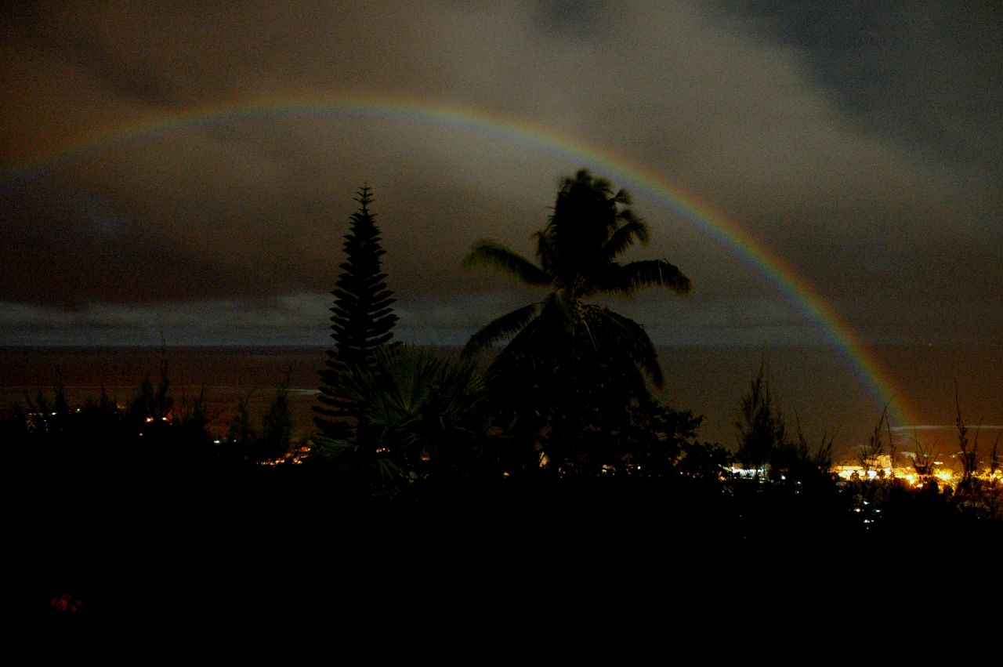
Moonbow Over Tahiti

Slide 28
Circumhorizontal Arc

Slide 29
Yosemite
'From the night skies and Milky Way to the full moon rising to create these lunar rainbows, the beauty here doesn't end when the sun goes down,' Mr Bumgardner said.
'You can have a unique experience 24 hours a day in Yosemite.'
'It has its own romantic sense to it,' he said. 'It's ethereal.'

Slide 30
Circumhorizontal Arc
Known in the weather world as a circumhorizontal arc, this rare sight was caught on film. The arc isn't a rainbow in the traditional sense—it is caused by light passing through wispy, high-altitude cirrus clouds. The sight occurs only when the sun is very high in the sky (more than 58° above the horizon). What's more, the hexagonal ice crystals that make up cirrus clouds must be shaped like thick plates with their faces parallel to the ground.

Slide 31
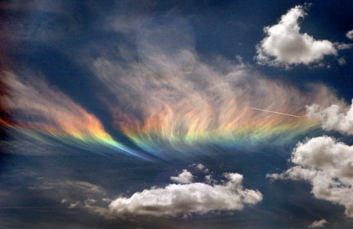

Slide 32
In Addition . . . .
When light enters through a vertical side face of such an ice crystal and leaves from the bottom face, it refracts, or bends, in the same way that light passes through a prism. If a cirrus's crystals are aligned just right, the whole cloud lights up in a spectrum of colors.This particular arc spanned several hundred square miles of sky and lasted for about an hour, according to the London Daily Mail.

Slide 33
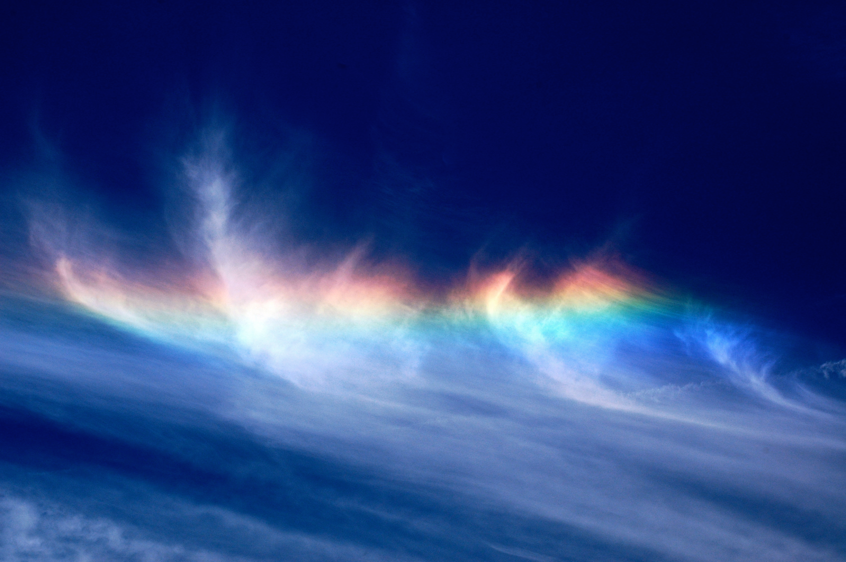

Slide 34
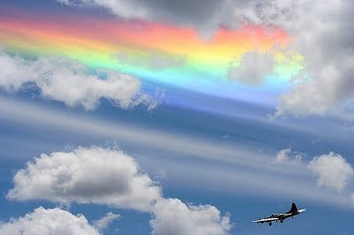

Slide 35
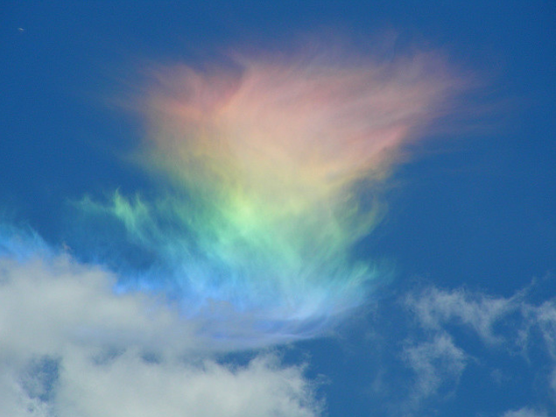

Slide 36
Rare occurrence at Mount Everest.

Slide 37
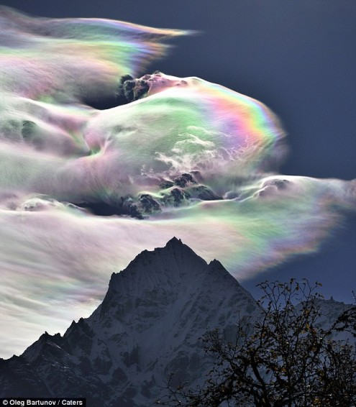

Slide 38
